Slide 1
Comparing Freight Transport GHG Emission Reductions through Emerging Technologies
Dr. Avi Mersky (Amersky@aceee.org)
American Council for an Energy Efficient Economy (ACEEE)
Conference on Sustainability and Emerging Transportation Technology, 6/2/2022

Slide 2
The American Council for an Energy-Efficient Economy is a nonprofit 501(c)(3) founded in 1980. We act as a catalyst to advance energy efficiency policies, programs, technologies, investments, & behaviors.
Our research explores economic impacts, financing options, behavior changes, program design, and utility planning, as well as US national, state, & local policy.
Our work is made possible by foundation funding, contracts, government grants, and conference revenue.
aceee.org @ACEEEdc

Slide 3
amerksy@aceee.org
ACEEE UPCOMING EVENTS
SUMMER STUDY ON ENERGY EFFICIENCY IN BUILDINGS | August 20-26, 2022 | Pacific Grove, CA
BEHAVIOR, ENERGY, AND CLIMATE CHANGE CONFERENCE | November 13-16, 2022 | Washington, DC
ENERGY EFFICIENCY POLICY FORUM | December 8, 2022 | Washington, DC
HOT WATER FORUM | March 6-8, 2023 | Mission Valley, CA
SUMMER STUDY ON ENERGY EFFICIENCY IN INDUSTRY | July 11-13, 2023 | Detroit, MI
NATIONAL CONFERENCE ON ENERGY EFFICIENCY AS A RESOURCE | October 16-18, 2023 | Philadelphia, PA
The top convener in energy efficiency.
aceee.org/events

Slide 4
3 Large Trends in Trucking Efficiency through 2050
Fuel Source Changes
  Petroleum being replaced by Electricity, Hydrogen and other alt-fuels
Automation
  The introduction of autonomous and connected vehicles to the trucking market
Logistical Improvements
  Information and Communications Technology will allow for more efficient utilization of existing trucking stock

Slide 5
Electrification
Plans to rapidly electrify the trucking fleet are underway and have support from the federal and many state governments
CA Plans to have 100% new EV sales by 2040 and all on road vehicles by 2045
  6 states have adopted the slightly less ambitious ACT Rule
Private sector investments in HD EVs are also significant, both from fleets and manufactures
  Volvo has pledged 50% HD EVs by 2030
What would the emissions effect be if we were on track to achieve this nationwide

Slide 6
Automation
Connected and autonomous vehicles are already being developed and introduced to the market
Both are expected to have fuel efficiency impacts
Two Techniques are of particular interest
Cooperative Adaptative Cruise Control (I.e. Platooning)
  Improved traffic stability, reduced headway
Slope Predictive Cruise Control
  Optimize velocity in response to the routes height map
What would it look like if these technologies were rapidly adopted

Slide 7
Logistical Improvements
ICT can allow finer fleet operator control and deployment of assets
ICT can also allow collaboration among purchases of freight service
Examples:
  Trailer Pairing
  Co-loading
  Shipping Container (Cube) Optimization
  Empty Backhaul Minimization
  Mode Shifting

Slide 8
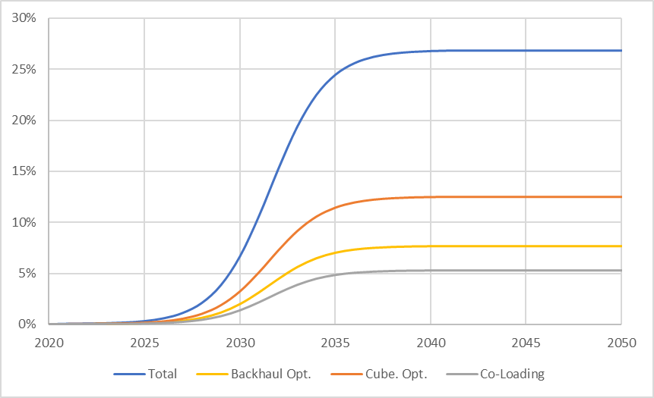
Increase in ton-mi Delivered per mi Traveled

Slide 9
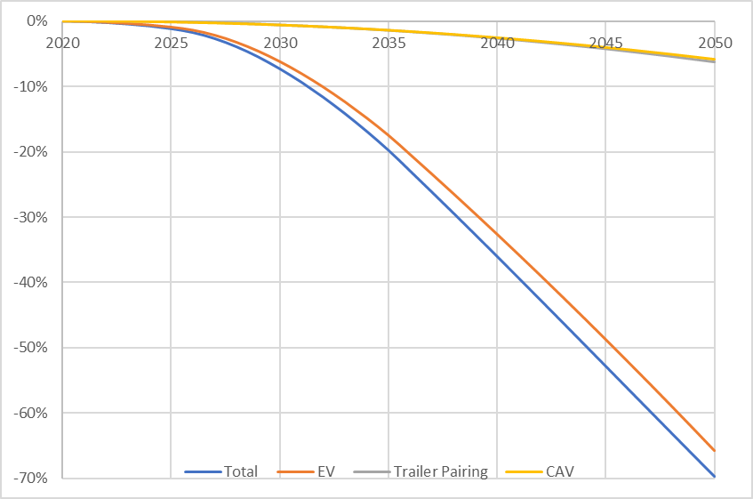
Decrease in Emissions per Mile

Slide 10
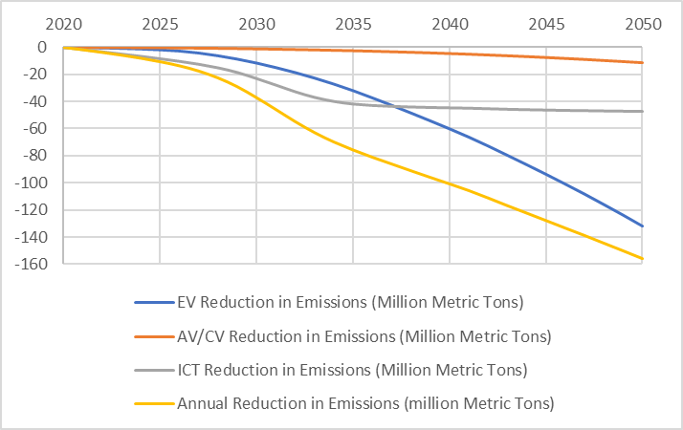
Comparing the Effects: Annual Emission Reduction

Slide 11
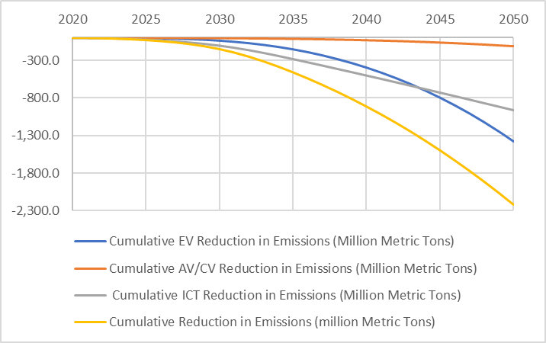
Comparing the Effects: Culminative Reduction

Slide 12
Observations
New Vehicle Technologies, CAVs and EVs, Have the joint potential to reduce emissions immensely
  But these reductions will take decades to realize, while the fleet replenishes itself
Logistical Improvements can often be applied to existing vehicles
  The potential GHG reductions for logistical improvements are found to be greater than those from vehicle improvements on a yearly basis through 2036 and on a cumulative basis through 2042

Slide 13
Questions
Contact: AMersky@aceee.org

Slide 14
Appendix

Slide 15
Assumptions
 | Assumptions (see text for more detail and sources)
Reduced empty miles | Trips are either full or empty Target market share is 100% of the total freight market Reduction in empty miles of 23% is possible
Cube optimization | Target market share is 90% of freight market Cube optimization increases fullness by 13%
Co-loading | Target market is 10% of freight market Co-loading increases fullness by 86%, climbing from LTL rate to TL rate
Tractor-trailer pairing | Sales of pairable systems increase by 2.7% per year Share of trips for which pairable trailers are paired starts at 25% and increases by 2% per year
Truck-to-rail shift | Ton-mile demand from truck to rail increases linearly by 1% per year until 2030, then 0.5% per year Rail packing can benefit from cube optimization equivalent to that of trucks. Rail vehicle performance and fuel source remain constant.
Electrification | National power grid shifts linearly from 20% coal, 38% natural gas, and 41% zero direct emissions to 5% coal, 39% natural gas, and 57% zero direct emissions by 2050
CAV technologies | CACC platoons consist of 3 trucks Sales grow linearly to 40% by 2040

Slide 16
Electrification Considerations
The GHG effects are highly dependent on the source of power (I.e. “the Grid”
ACEEE estimates that the national average grid can reduce emissions by roughly 1.2% per year, 2020-2050
This will vary regionally
This will vary by time of day
Additional draws of power generally emit more than average grid emissions

Slide 17
Automation Considerations
CACC
  How large can these platoons be
  Will they have their own lanes and regulations
  Will we allow headway to go down and velocities to go up
  What are the system-wide affects
Slope Predicative Cruise Control
  How many roads will be pre-mapped
Both
  How will these techniques interact
  How will they interact with electrification

Slide 18
Logistics Considerations
How often can these techniques actually be used
Can all of these techniques be used co-currently, what are the limits
What shares of industry are eligible for these techniques
    Independently or Co-currently
What shares of the industry already use these techniques or will not be open to sharing
What will the pricing effects be
  If trucks become cheaper will they siphon off rail demand

Slide 19
Intermodal Issues
Will rail electrify or switch to less emitting fuels
If not the long-term effects of switching to rail would be increases in emissions, as trucking industry rapidly de-carbonizes

Slide 20
Intermodal Issues: Stagnant Rail Emission Improvements

