Slide 1


Conference on Sustainability and Emerging Transportation Technology-2022
Organized By Transportation Research Board
Date: June 02, 2022
Paper Title: Machine Learning Approach to Estimate Daily Bike Traffic (DBT) Using Emerging Data Source STRAVA (# 4735)
Presented By-
Stephen P. Mattingly
Professor, Department of Civil Engineering
University of Texas at Arlington
Email: mattingly@uta.edu
Co-authors:
Md Mintu Miah, PhD Candidate, CE, UTA
Dr. Kate Kyung Hyun, Associate Professor, CE, UTA

Slide 2
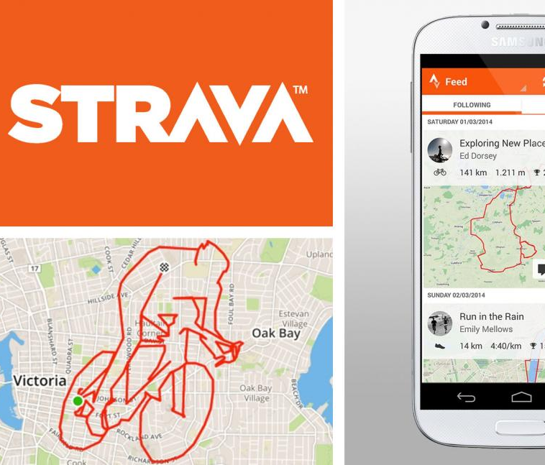

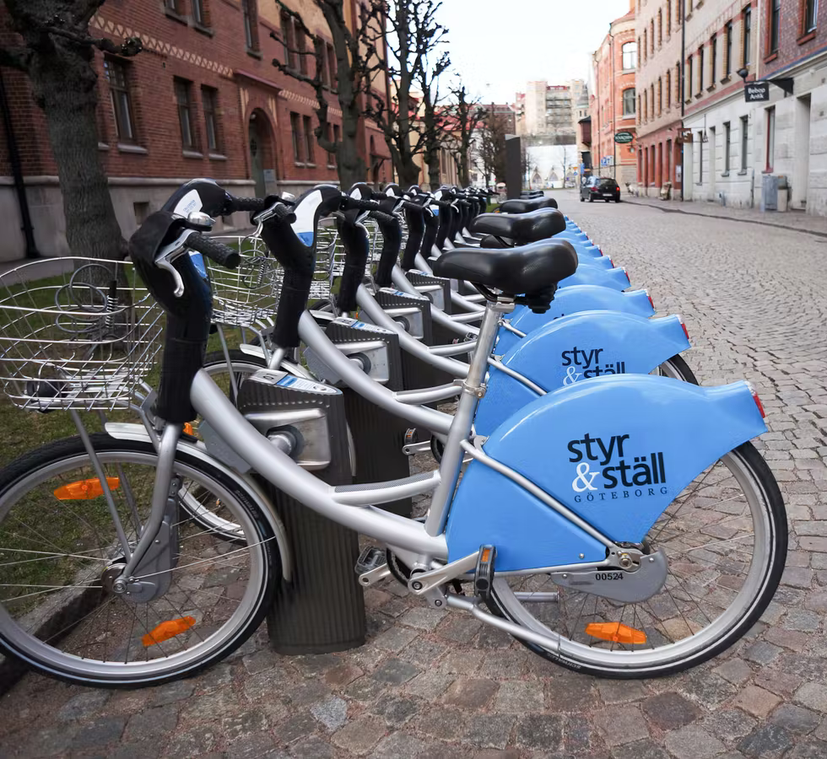
Presentation Outline
Introduction
Research Objectives
Methodology
Study Area and Data
Strava Pattern
Strava User Links Clustering
Machine Learning Modeling Techniques
Analysis and Results
Backward Model (2019-----2017)
Forward Model (2017-------------2019)
Findings

Slide 3
Introduction
Increase in bicycling popularity nationwide has led to:
  Efforts to better measure riding activity
  Improve the interpretation of available data
  Assess the impacts associated with bicycling
    Safety
    Physical activity – public health
Emerging sources of mobile location data such as Strava and other phone-based apps may provide useful information for each link of a network
  Potential to complement traditional bike count programs
  Representativeness and the suitability of these emerging sources for producing bicycle volume estimates require further exploration

Slide 4
Objectives
This research investigates using third-party mobile location data for network-wide DBT (daily bike traffic) estimation.
  This study employed machine learning models alongside more traditional count models to understand whether these estimation techniques improve modeling performance in non-motorized applications.
  This study fuses Strava data with short-term and permanent conventional count program data to investigate its feasibility to produce bicycle volume estimations that could be expanded to entire networks

Slide 5
Methodology
  Characterize data and demand patterns
  Evaluate model performance
  Investigate error sources
  Assess benefit of STRAVA data
  Assess benefit of advanced modeling

Slide 6
Study Area

Slide 7
Traditional Data:
This study uses 12 PCs (permanent counters) in Portland, Oregon.
  Five PC sites use inductive loop detectors to collect counts
  7 PC sites use pneumatic tubes
    Pneumatic tube normally used for short term data collection
    Portland uses these pneumatic tubes for permanent data collection and short- term data collection.
  Not all of the permanent counters report 365 days of data
Study uses 166 short-term count (SC) sites in Portland. The SC daily counts range from 10 to 1956
  Bike counts occurred on weekdays from Monday to Friday at intersections
  Considers different facility types and land use contexts

Slide 8
Strava Data
This study used 4,975 miles of Strava links in Portland, Oregon.
The Strava data represented directional hourly counts of user trips on OpenStreetMap (OSM) network links.
  Strava masked hourly counts of less than three to protect user privacy, and the study treated these masked counts as zero.
  The analysis omitted links with no (unmasked) Strava activity over the entire period.
The data fusion process
  Matches Strava OSM segments to sensor locations (permanent and short-term count stations) manually within a GIS environment
  Automated matching produced errors due to the OSM network detail and the accuracy of counter coordinates
The basic Strava user demographics for the region correspond with previous studies
  70% of Portland users are male
  Majority between 25 and 54 years old

Slide 9
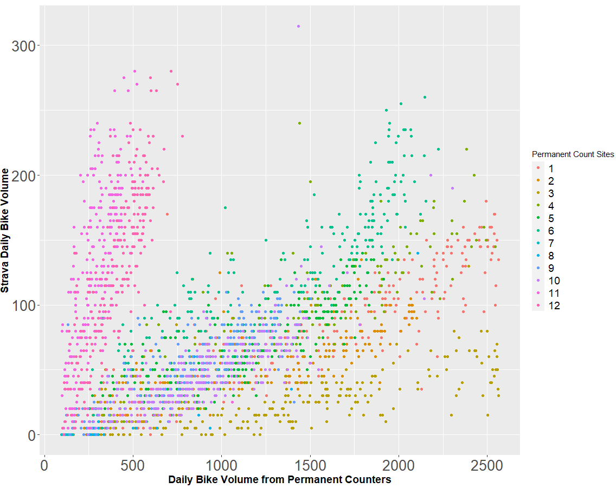
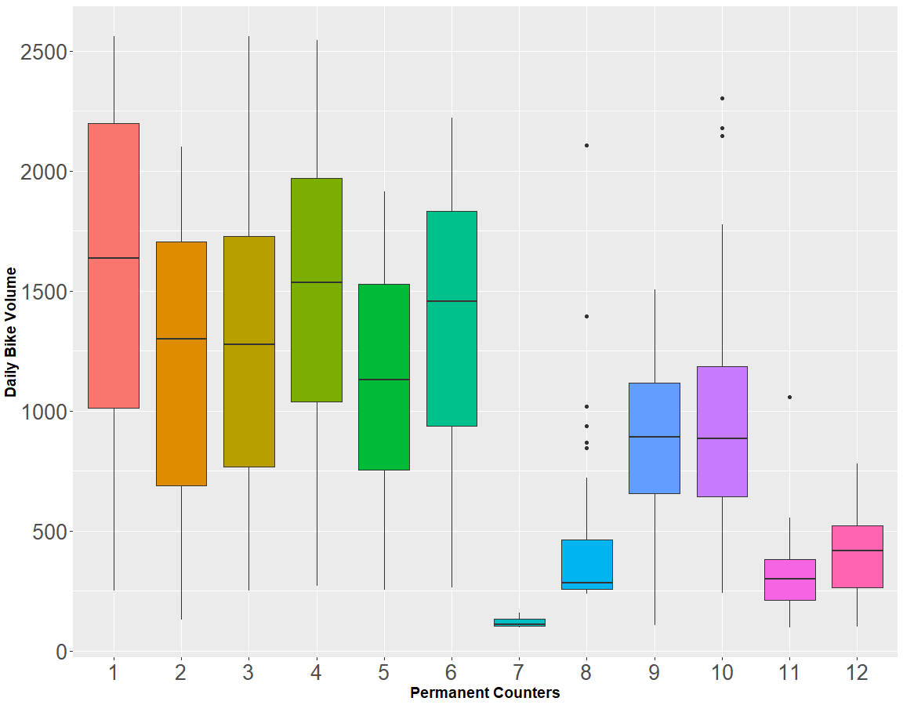
  Ground Truth and Strava Pattern
Funnel shape relationship between daily bicycle volume and Strava count confirms non-linearity
Ground truth bike volume is biased as majority of the count sites (8 out of 12) have median Volume greater than 750, 2 sites ranges 300-750 and 2 sites below 300
Notes:
Two distinct funnel patterns between Strava and PC counts indicate a non-linearity between two datasets.
The long wide shape of the funnels in the bottom also indicates that a linear factor of Strava to PC may not accurately capture bicycle activities within a funnel
Most of the sites (8 out of 12) observe high volumes (sites 1-6, 9, and 10 ) while very few sites 7,8 and 11 represent low volumes (< 300 bicycles/day) and site 12 as of mid-volume (300-750).
These two plots clearly show the limitation of using a linear modeling structure for Strava data to estimate network-wide bike counts.
The non-linearity and sampling bias suggest that a non-parametric model with careful allocations of the training and testing data may better utilize Strava datasets in network-wide volume estimations and compensate for the limited low and mid-volume sites available for the PC locations.

Slide 10
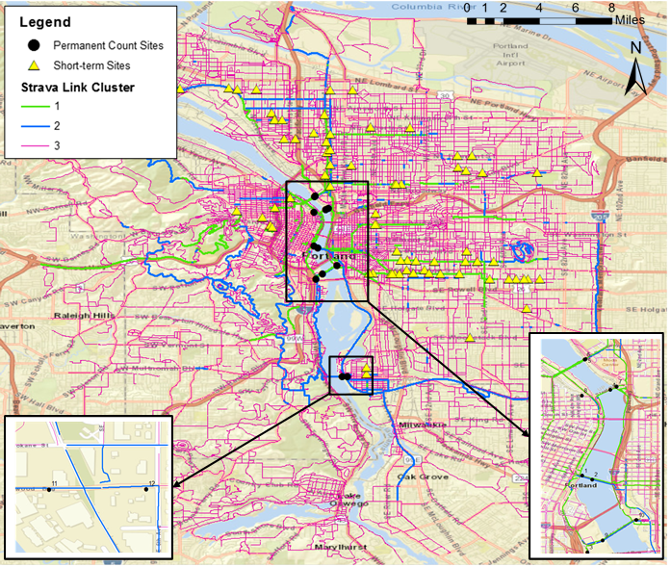
Clustering of Strava User Links
Cluster Type |  | Cluster Variables |  |  | # of Data Points in Clusters
Cluster Group | Description | AM Peak (7 to 8 am) | Weekend Ratio | Utilitarian Ratio | # of PC | # of Short-Term | # of Strava link (length)
1 | Daily Recreational | 0.86 | 1.38 | 0.32 | 7 | 27 | 813(40.73 miles)
2 | Mixed Utilitarian | 1.86 | 0.69 | 0.61 | 5 | 44 | 1004(67.92 miles)
3 | Weekend Recreational | 0.72 | 3.79 | 0.11 | 0 | 2 | 21,803 (1108.76 miles)
Notes:
1. k means cluster was used to group the Strava links based on activities using three indices (am peak, weekend ratio, utilitarian ratio)
2. Overall, seven and five PC sites, and 27 and 44 short-term locations belong to clusters 1 and 2, respectively
3. Weekend recreational represents 92.31% of the network, but a model cannot be developed for it because insufficient permanent counters and short-term counters represent these locations.

Slide 11
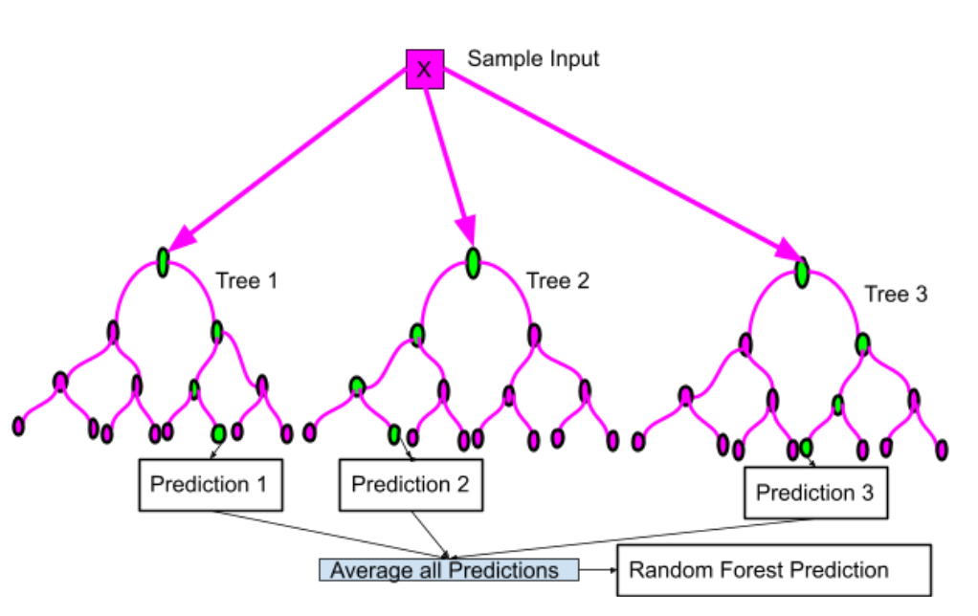
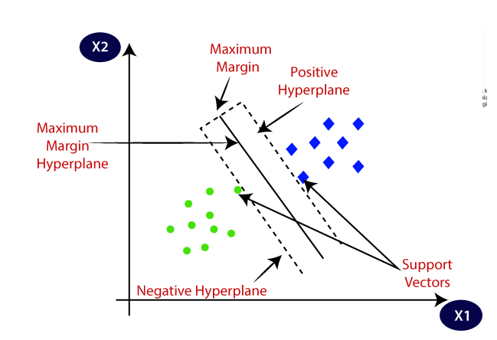
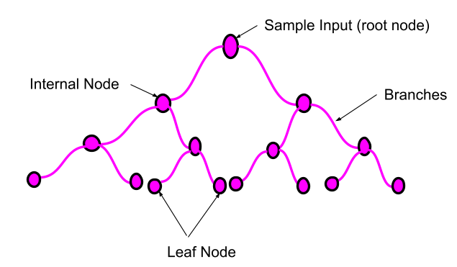
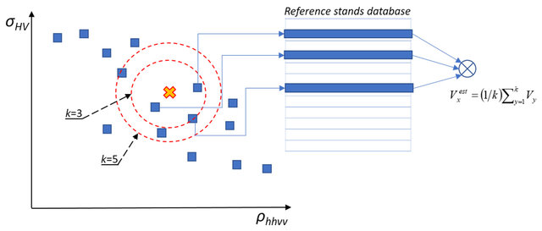
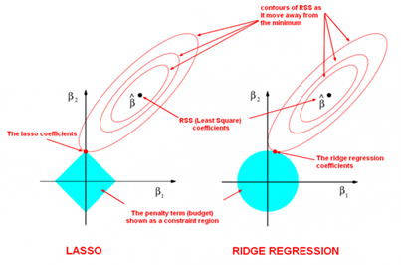
Modeling Techniques
Linear -Negative Binomial
More advanced – Decision tree, KNN regression, Random Forest, Regularized Linear Regression (Ridge, Lasso and Elastic Net)
Decision Tree (DT)
Random Forest (RF)
Support Vector Machine (SVM)
KNN Regression
Ridge Regression Cost Function, L_{ridge} =${argmin}_{\hat{β} }$|| Y- β*X ||² + λ *||β${||}_{2}^{2}$
Lasso Regression Cost Function, L_{lasso} =${argmin}_{\hat{β} }$|| Y- β*X ||² + λ *||β${||}_{1}$
Elastic Net Cost Function, L_{Elastic Net} $= {argmin}_{\hat{β} }$|| Y- β*X ||² + λ₁ *||β${||}_{2}^{2}$+ λ₁ *||β${||}_{1}$
Lasso and Ridge Regression
* only Ridge Regression model was considered finally due to its stronger performance

Slide 12
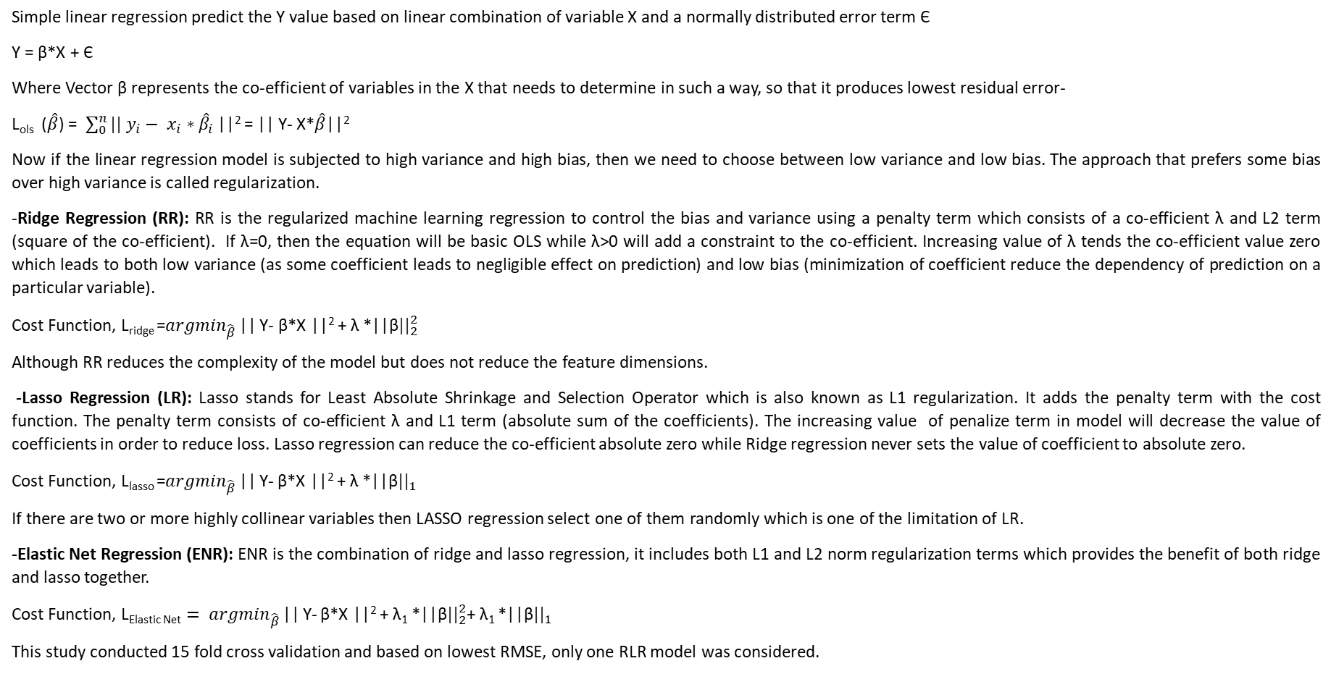
Regularized Linear Regression (RLR)
Simple linear regression predict the Y value based on linear combination of variable X and a normally distributed error term Є
Y = β*X + Є
Where Vector β represents the co-efficient of variables in the X that needs to determine in such a way, so that it produces lowest residual error-
L_{ols} ($\hat{β}$) = $\sum_{0}^{n}{|| y_{i}− x_{i}∗{\hat{β}}_{i }}$||² = || Y- X*$\hat{β}$||²
Now if the linear regression model is subjected to high variance and high bias, then we need to choose between low variance and low bias. The approach that prefers some bias over high variance is called regularization.
-Ridge Regression (RR): RR is the regularized machine learning regression to control the bias and variance using a penalty term which consists of a co-efficient λ and L2 term (square of the co-efficient). If λ=0, then the equation will be basic OLS while λ>0 will add a constraint to the co-efficient. Increasing value of λ tends the co-efficient value zero which leads to both low variance (as some coefficient leads to negligible effect on prediction) and low bias (minimization of coefficient reduce the dependency of prediction on a particular variable).
Cost Function, L_{ridge} =${argmin}_{\hat{β} }$|| Y- β*X ||² + λ *||β${||}_{2}^{2}$
Although RR reduces the complexity of the model but does not reduce the feature dimensions.
-Lasso Regression (LR): Lasso stands for Least Absolute Shrinkage and Selection Operator which is also known as L1 regularization. It adds the penalty term with the cost function. The penalty term consists of co-efficient λ and L1 term (absolute sum of the coefficients). The increasing value of penalize term in model will decrease the value of coefficients in order to reduce loss. Lasso regression can reduce the co-efficient absolute zero while Ridge regression never sets the value of coefficient to absolute zero.
Cost Function, L_{lasso} =${argmin}_{\hat{β} }$|| Y- β*X ||² + λ *||β${||}_{1}$
If there are two or more highly collinear variables then LASSO regression select one of them randomly which is one of the limitation of LR.
-Elastic Net Regression (ENR): ENR is the combination of ridge and lasso regression, it includes both L1 and L2 norm regularization terms which provides the benefit of both ridge and lasso together.
Cost Function, L_{Elastic Net} $= {argmin}_{\hat{β} }$|| Y- β*X ||² + λ₁ *||β${||}_{2}^{2}$+ λ₁ *||β${||}_{1}$
This study conducted 15 fold cross validation and based on lowest RMSE, only one RLR model was considered.

Slide 13
Modeling Direction
Forward Model: Model developed with 2017 data and applied for 2018 and 2019 data
2017-Model
Applied on
2018 & 2019 Data
Backward Model: Model developed with 2019 data and applied for 2018 and 2017 data to check the temporal and spatial (short term site locations vary from year to year) transferability of the model.
2018 & 2017 Data
Applied on
2019-Model

Slide 14
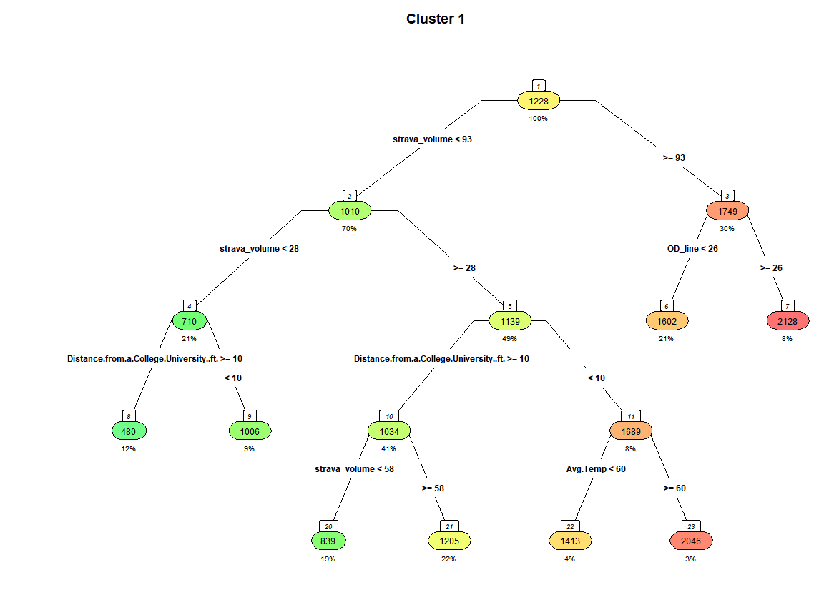
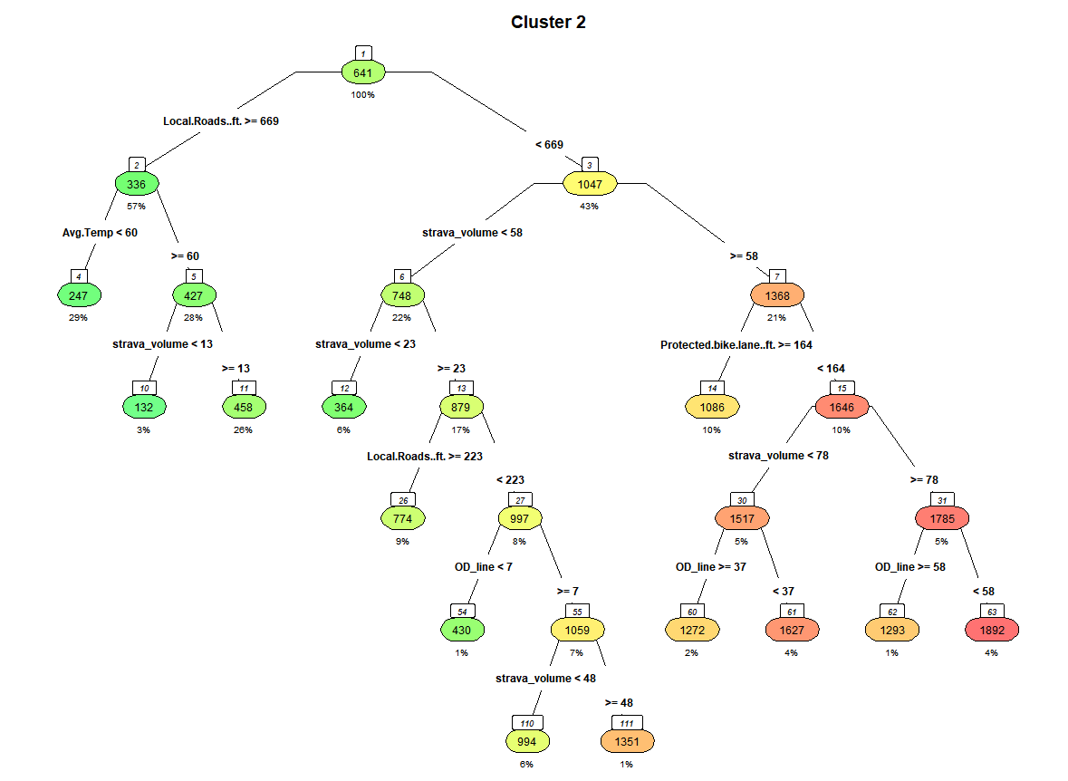
Backward (2019 Model) Decision Tree Model for cluster 1 and 2
DT1 uses Strava volume, bike share, distance from college or University and average temperature to form the tree where Strava volume and bike share was the most important variables.
Strava is most significant variable and appears several times and helping to estimate low volumes
Notes:
Each node indicates the average bicycle volume and the percentage of the dataset belonging to each branch.
The first branch of cluster 1 tree uses the Strava volume, which indicates it has the greatest importance in explaining the dataset, to split the data at a Strava volume of 93.
The Strava counts reappear on left sides of the tree in lower branches
The cluster 2 tree contains 13 terminal leaves using distance from college, Strava volume, average temperature, local roads, protected bike lane and bike share OD Line.
Strava volume regularly appears throughout the cluster 2 tree, but local roads or Average temperature represents the most significant factor.

Slide 15
Backward Model Results
Decision Tree (DT) model performs best in terms of estimation-year and transferability accuracy with a maximum error of 34%
Negative Binomial (NB) and Ridge models show a higher risk of transferability for other years
Although the ensemble of trees, RF and KNN work better in the estimation-year their transferability error is higher than the decision tree.

Slide 16
Backward DT Modeling Results Breakdown Data Fusion
Emerging (Strava) data reduces the APE when fused with Static data
Bike share data does not appear to improve the modeling outcomes
Comparatively more APE produced from short term sites for both clusters
  Short-term sites usually have low volumes (<300)
  Small errors represent larger percentage errors

Slide 17
Forward Model Results
RF performs better than any other model for estimation-year and for transferability with a maximum APE of 22%
Forward RF worked better than backward RF due to more data points and data patterns in 2017
After RF, DT model has the second-highest performance with APE less than around 30%.
Although KNN and Regularized linear regression perform better within the estimation-year, a high risk of transferability occurs
RF key variables:
  Strava volume, bike share
  Average temperature, humidity, precipitation, weekend
  Median household income, speed limit, local roads, distance from CBD and distance from college or university

Slide 18
Forward DT Modeling Results Breakdown Data Fusion
Adding Strava data improves the static modeling results with a 10-12% reduction in APE
Adding bike share data improves the static models with a 3 – 9% reduction in APE
Combining bike share, Strava and static data does not improve on the static and Strava models

Slide 19
Findings
Study investigated the importance of fusing emerging data with current sensor and static data to estimate bike volume with:
  Traditional models
  Advanced machine learning algorithms: k-means clustering, NB, DT, RF, SVM, KNN, Lasso, Ridge, and Elastic Net regression.
Strava link clustering helps to identify the trip pattern by link level
Traditional data collection requires weekend data for recreational links for better network wide estimation
Model performance and temporal transferability of the different algorithms in terms of APE
  Forward ensemble model (RF) performs best with a maximum error of 22%
  For the backward case, DT works best with a maximum 34% error
  All other models have temporal transferability risks when estimating daily bike volume outside the estimation-year.

Slide 20
Findings
Strava data, bike share and other traditional data have significant importance in reducing bike volume estimation error.
  Emerging volume data: Strava volume, bike share
  Temporal/weather: weekend, average temperature, humidity, precipitation
  Static: local roads, protected bike lane, median household income, speed limit, distance from CBD and distance from college or university
The research team also found that lower bike volume (<300) has higher error than the mid-range (300 to 750) and high range (>750) bike volume.
Read our Recent Publications for more info:
Miah, M.M., Hyun, K.K., Mattingly, S.P. et al. Estimation of daily bicycle traffic using machine and deep learning techniques. Transportation, Springer Nature (2022). https://doi.org/10.1007/s11116-022-10290-z
Miah, M. M., Hyun, K. K., Mattingly, S. P., Broach, J., McNeil, N., & Kothuri, S. (2022). Challenges and Opportunities of Emerging Data Sources to Estimate Network-Wide Bike Counts. Journal of Transportation Engineering, Part A: Systems, 148(3), 04021122. https://ascelibrary.org/doi/full/10.1061/JTEPBS.0000634

Slide 21

Q & A
For More information:
Please contract : mattingly@uta.edu

