Slide 1

A methodology to develop a geospatial transportation typology
Mona Asudegi, Ph.D., FHWA
Natalie Popovich, Ph.D., LBNL
Anna Spurlock, Ph.D., LBNL
June 1, 2022
Office of Transportation Policy Studies
Lawrence Berkeley National Laboratory

Slide 2
Disclaimer
This presentation was created and is being co-presented by FHWA and LBNL. The views and opinions expressed in this presentation are the presenters’ and do not necessarily reflect those of FHWA or the U.S. Department of Transportation (USDOT). The contents do not necessarily reflect the official policy of the USDOT.
The U.S. Government does not endorse products or manufacturers. Trademarks or manufacturers’ names appear in this presentation only because they are considered essential to the objective of the presentation. They are included for informational purposes only and are not intended to reflect a preference, approval, or endorsement of any one product or entity. Unless otherwise noted, FHWA is the source of photos, graphics, and maps.
Lawrence Berkeley National Laboratory

Slide 3
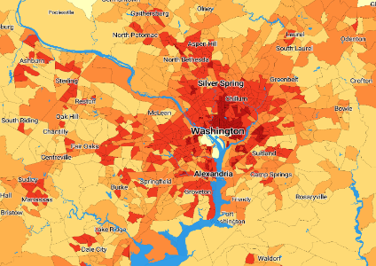
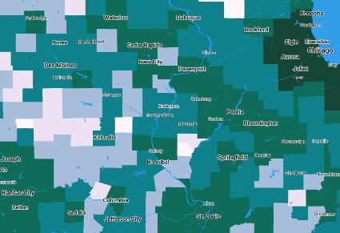
Background & Motivation
Purpose: Group regions all over the country into clusters that exhibit similar geo-economic drivers of relationship between geographic attributes and transportation demand and travel costs
Outcome: Set of geotypes (region level types) and microtypes (neighborhood level types) that represent common geographic and system combinations across the US
Lawrence Berkeley National Laboratory

Slide 4
Methodology
Popovich, N., Spurlock, C. A., Needell, Z., Jin, L., Wenzel, T., Sheppard, C., & Asudegi, M. (2021). A methodology to develop a geospatial transportation typology. Journal of Transport Geography, 93, 103061.
Lawrence Berkeley National Laboratory

Slide 5
Typology Methods: Sequential Clustering
Inputs (neighborhood)
Dimension-ality reduction
Clustering
Street network, geographic and socio-economic characteristics for 72,776 census tracts
Exploratory Factor Analysis (EFA)
CLARA partitioning algorithm
6 Microtypes
Inputs (regional)
Dimension-ality reduction
Clustering
Geography and travel structure characteristics for 2,250 Counties or CBSAs
Factor Analysis
Partitioning around medoid (PAM) partitioning algorithm
Process microtypes to create metrics used as inputs to geotype phase
6 Geotypes
Methodology Published in Popovich et al. (2021)
Lawrence Berkeley National Laboratory

Slide 6
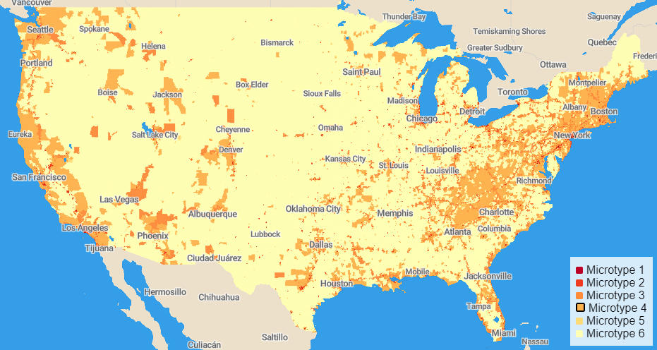
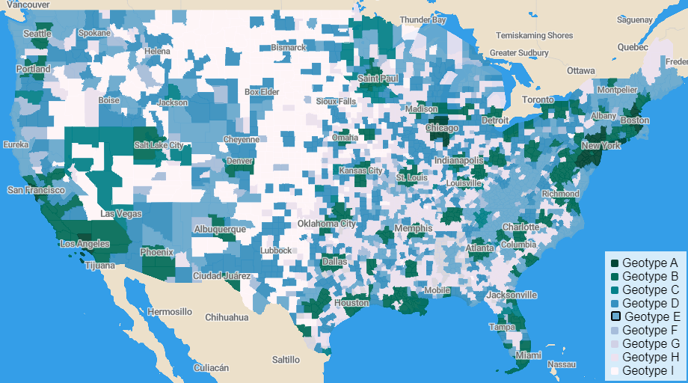
Signature Typology
First typology to accommodate every location in the US in terms beyond population density.
A tool for transportation experts to identify other locations that share similar environments.
Captures more diversity at subregional and regional levels than alternatives.
Sequential clustering method captures two levels of spatial variation.
Lawrence Berkeley National Laboratory

Slide 7

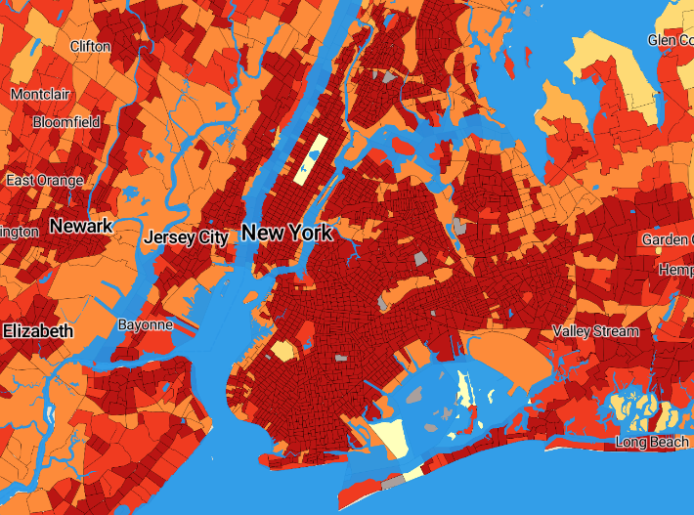
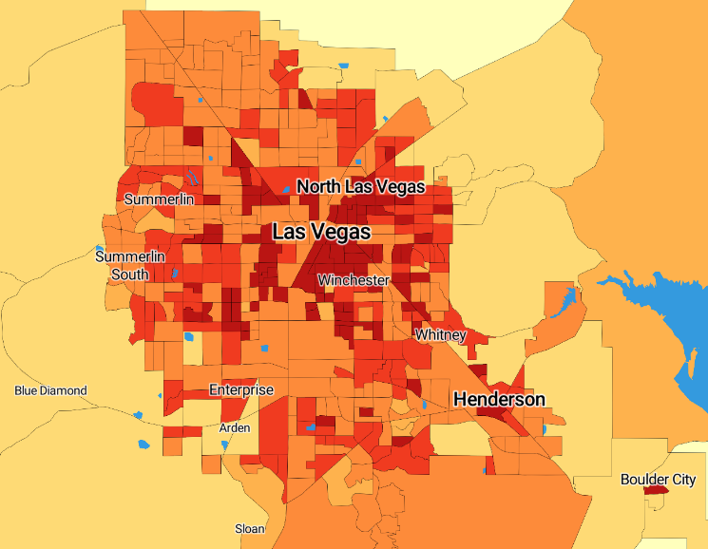
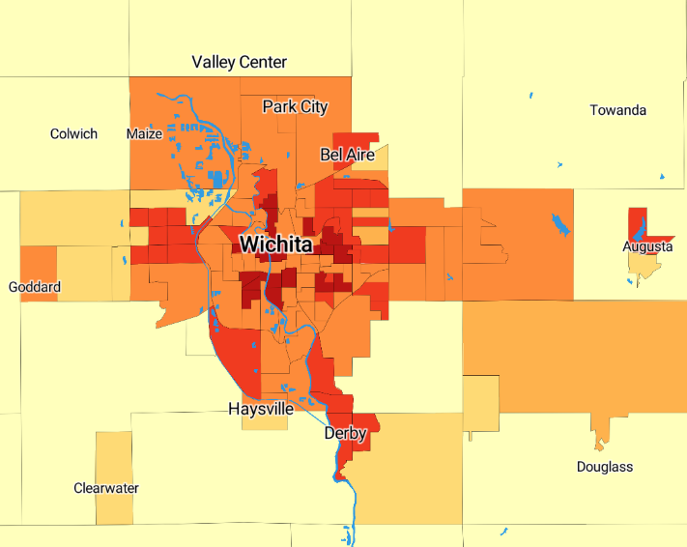
Neighborhood Types (Microtypes): Results
Microtype 1: Multi-modal job hubs Densest job centers Densest populations Worst pavement quality Typically poor air quality Highest intersection density shortest block lengths Most “grid-like” streets typical “urban core” | Microtype 2: Dense residential Adjacent to Type 1 Second highest population density Lowest agriculture Low relative freight travel
Microtype 3: Freight corridors Highest proportion of highways Heavy freight travel Lower job and residential density Co-located on outskirts of urban centers | Microtype 4: Steep loops and lollipops Hilly / mountainous dead-ends Lowest freight travel
Microtype 5: Hilly, ex-urban Highest proportion of local roads steeper terrain Few jobs Low population density Some agriculture, but relatively low | Microtype 6: Agricultural centers Highest jobs per capita Lowest jobs per land area Highest ag. economy Lowest broadband access Heavy freight travel Relatively flatter land Long blocks
Lawrence Berkeley National Laboratory

Slide 8
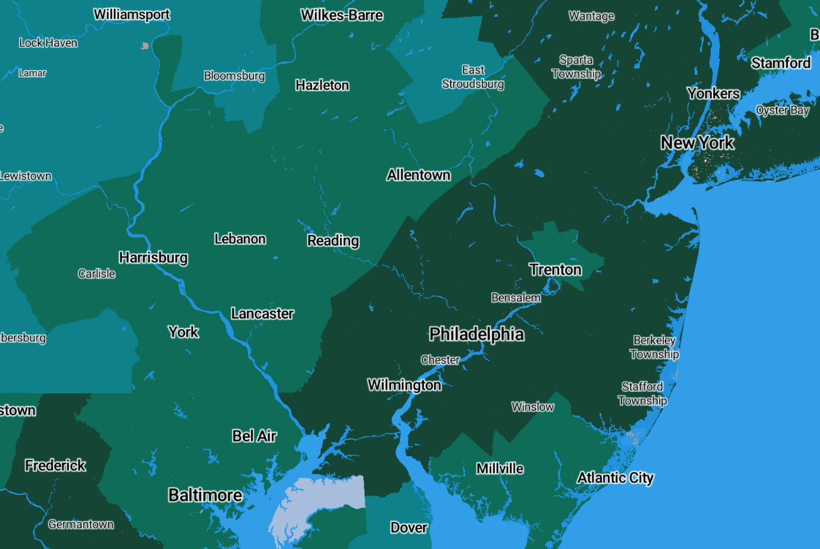
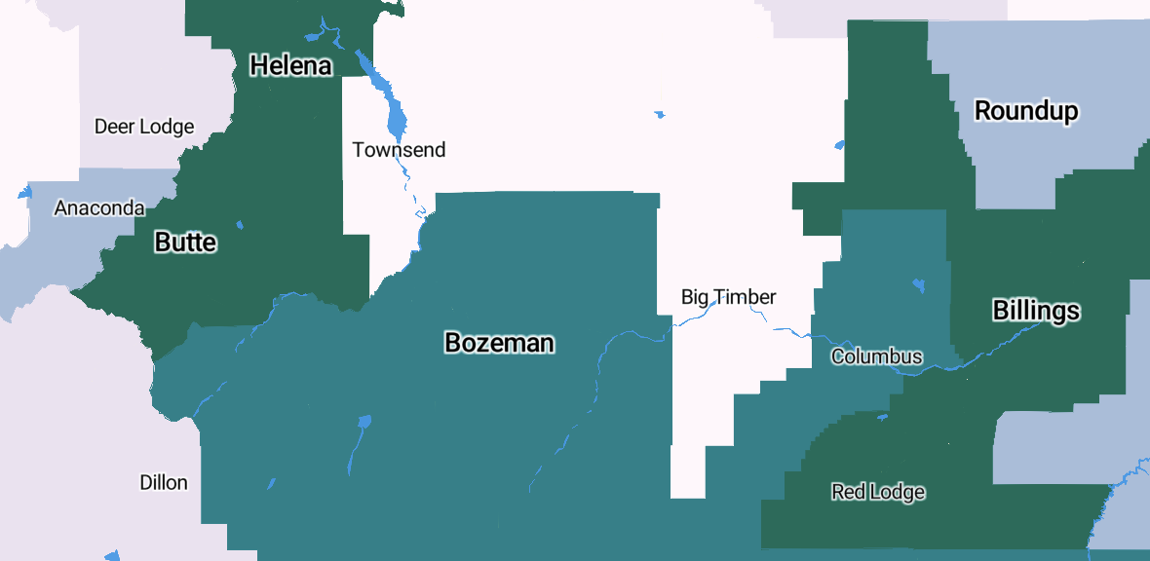
Region Types (Geotypes): Results
Geotype A: Polycentric urban areas with dispersed commute patterns with highest representation of the “multi-modal job hub” microtype 1. Geotype A regions on average have the highest population and job density. Geotype A is comprised of the 19 largest, densest CBSAs, with no non-CBSA counties represented.
Geotype B: Urban areas with highly dispersed commute patterns and moderately polycentric structure. The region has a relatively high proportion of “multi-modal job hub” microtype 1. Geotype B includes many of the smaller CBSAs, and on average has the second highest population and job density.
Geotype C: Of the monocentric regions, this has the highest degree of dispersed commute patterns. Geotype C is largely rural, with the lowest population and job density on average of all the geotypes. | Monocentric regions with very low proportion of “multi-modal job hub” microtype 1.
Geotype D: Of the monocentric regions, this has the second highest degree of dispersed commute patterns. Geotype D has the third lowest population and job density on average. | Monocentric regions with very low proportion of “multi-modal job hub” microtype 1.
Geotype E: Of the monocentric regions, this has the second highest degree of concentrated commute patterns. Geotype E is the second lowest job and population density, making it the second most rural geotype. | Monocentric regions with very low proportion of “multi-modal job hub” microtype 1.
Geotype F: Of the monocentric regions, this has the highest degree of concentrated commute patterns. On average regions in Geotype F have the third highest population and job density and the highest share of census tracts in Microtype 5 (Hilly, ex-urban). While this geotype has a low proportion of Microtype 1, it still includes a large number of urban areas, but because of the monocentric structure and concentrated commute patterns, Geotype F regions are distinct from the other more urban Geotypes (A and B). | Monocentric regions with very low proportion of “multi-modal job hub” microtype 1.
Lawrence Berkeley National Laboratory

Slide 9
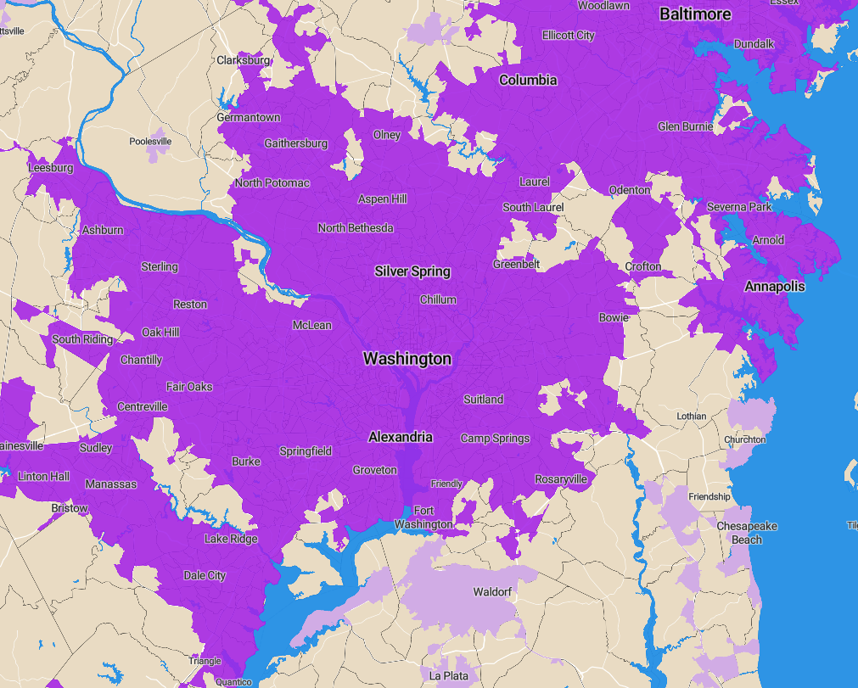
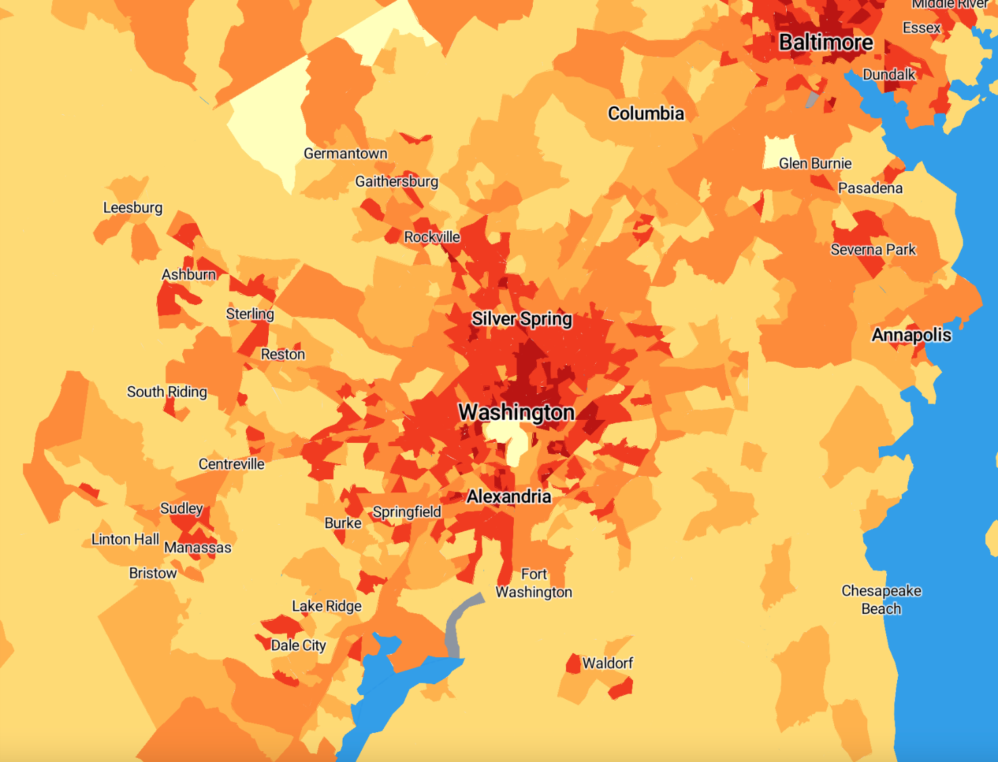

Capturing greater diversity of subregional types
Microtype
FTA classification
Multi-modal job hubs
Dense residential
Freight corridors
Steep loops and lollipops
Hilly, ex-urban
Agricultural centers
Urban
Rural eligible
Rural
Lawrence Berkeley National Laboratory

Slide 10
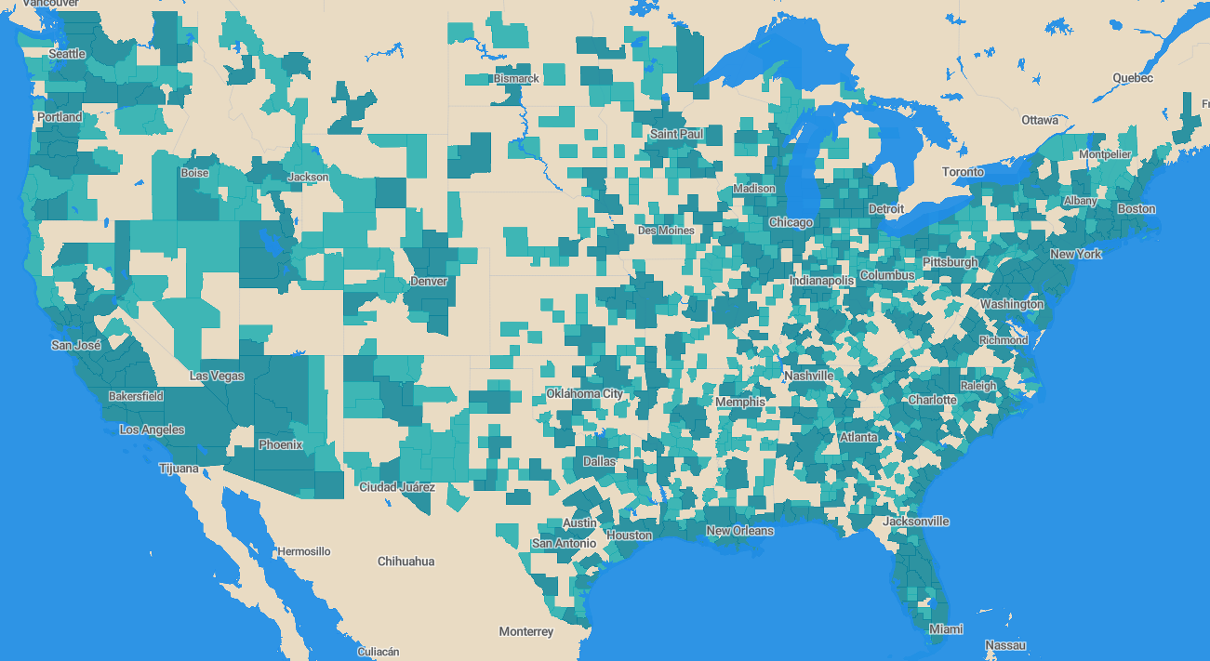
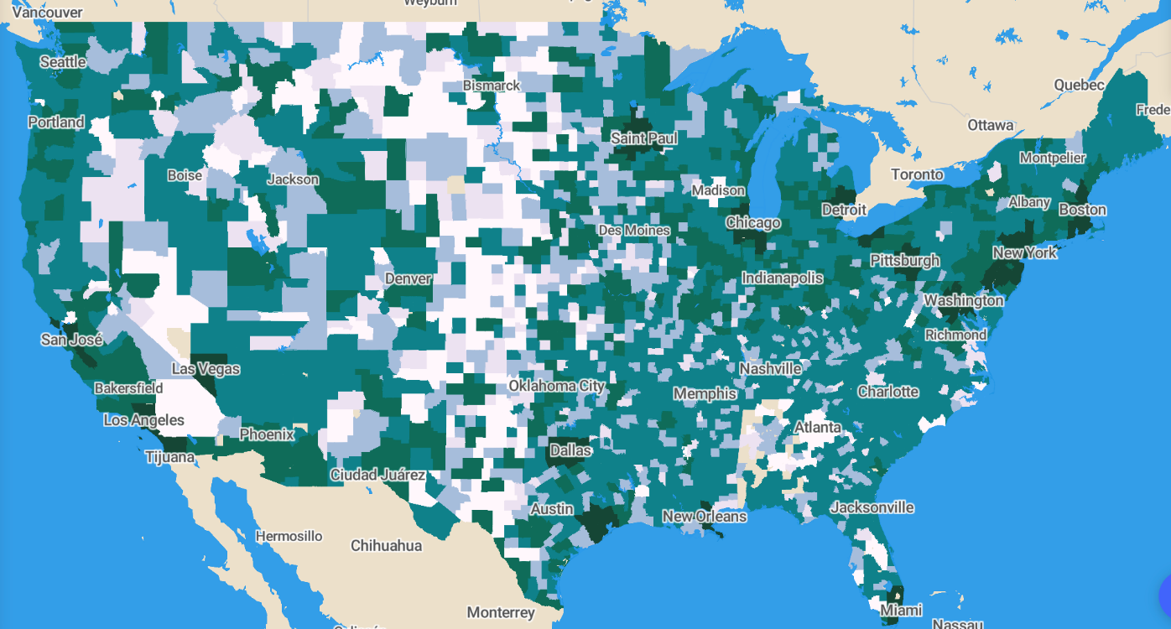
Capturing greater diversity of regional types
Existing Classification: CBSAs
Geotypes
CBSAs
Metropolitan Statistical Areas
Micropolitan Statistical Areas
Geotypes
A | D
B | E
C | F
Lawrence Berkeley National Laboratory
Lawrence Berkeley National Laboratory
Notes:
Updated to transp geo results

Slide 11
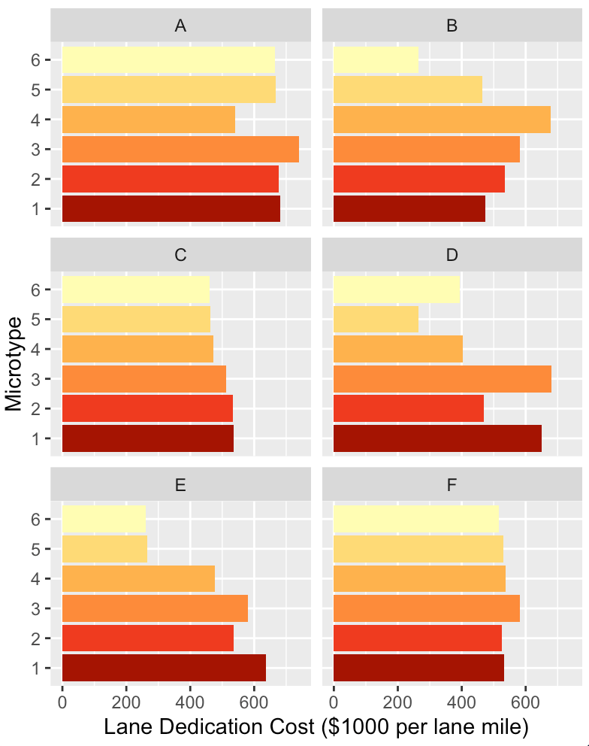
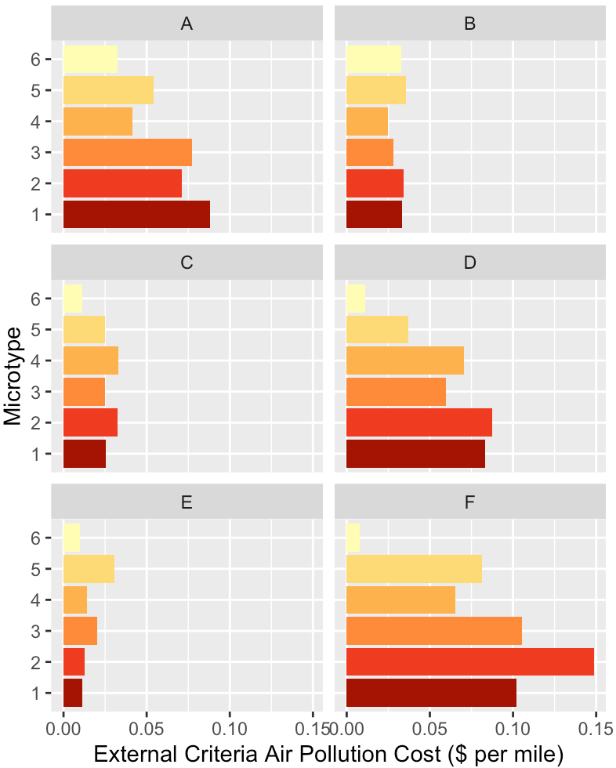
Examples
Lane dedication costs by micro-geotype
Criteria air pollutants by micro-geotype
Lawrence Berkeley National Laboratory

Slide 12
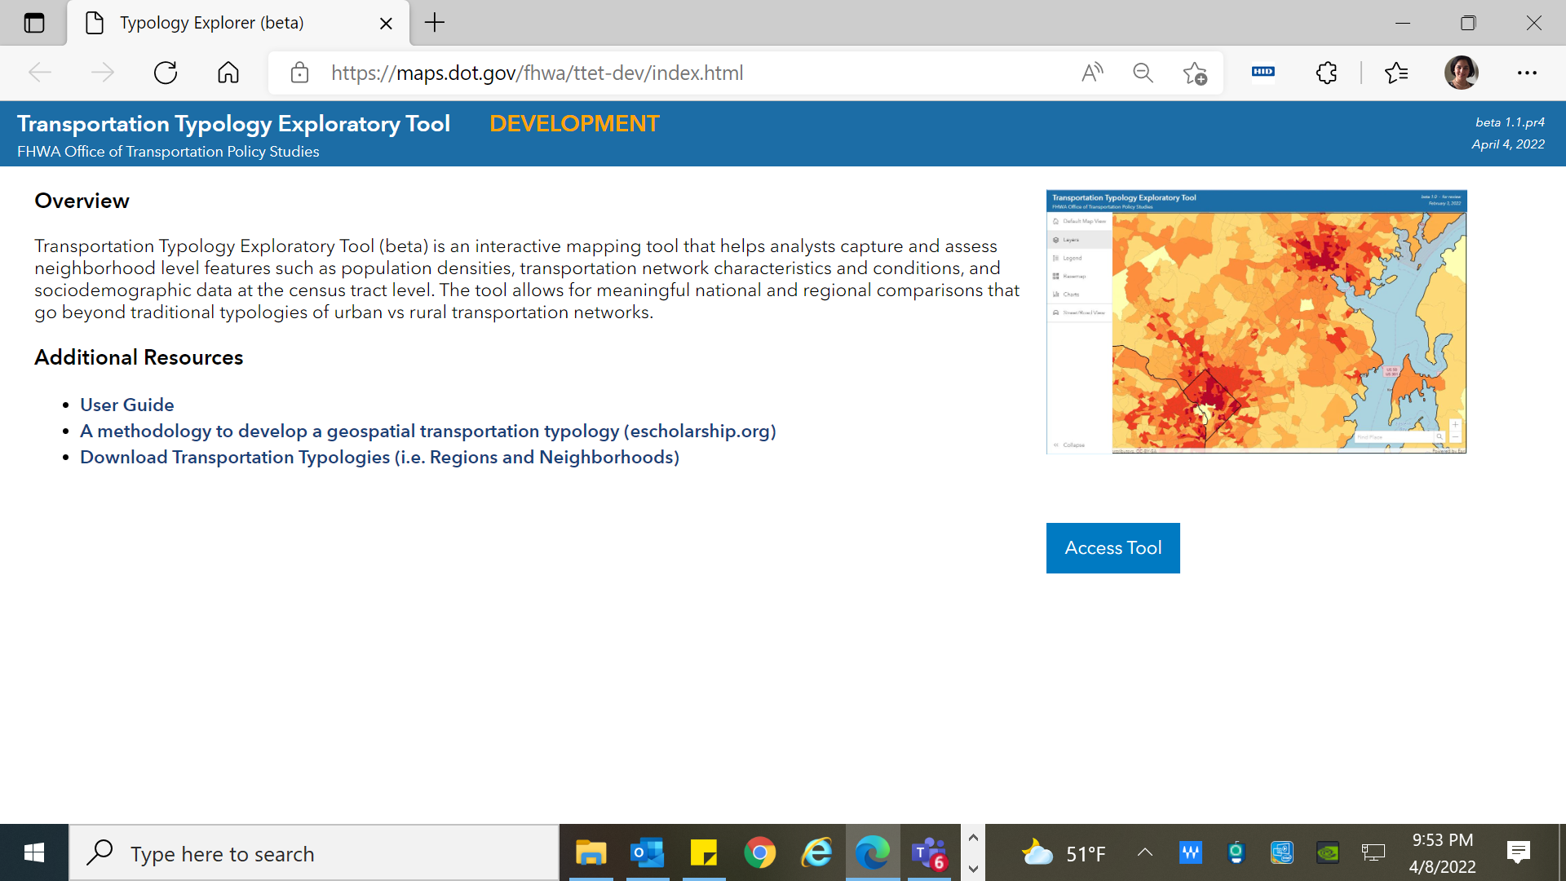
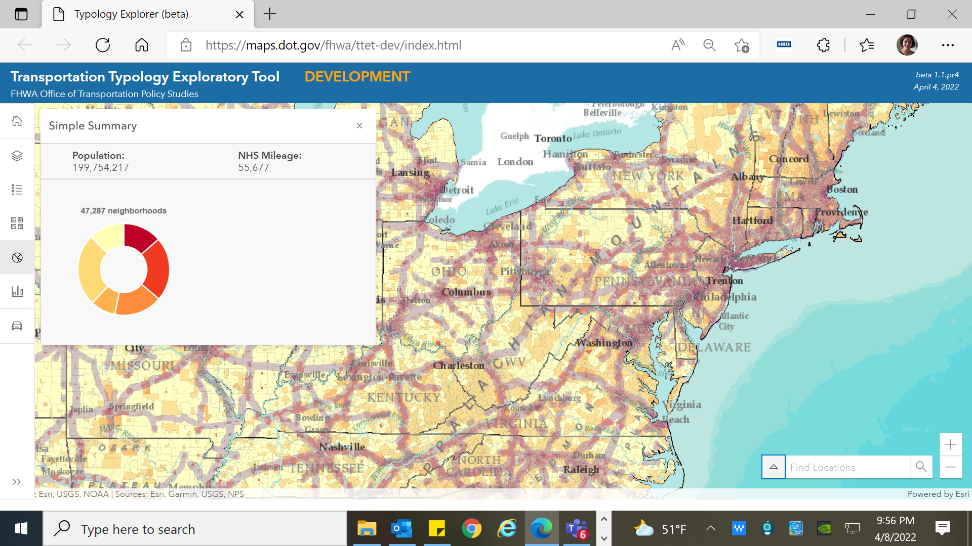
Transportation Typology Exploratory Tool (TTET)
TTET (BETA VERSION):
Typology Explorer (beta) (dot.gov)

Slide 13
Potential applications
Use microtypes to jointly estimate macroscopic fundamental diagrams (MFDs) for a range of locations simultaneously
Use the micro-geotype combinations to model changes in travel costs by mode as a result of different transportation strategies
Provide insights on what locational studies results can be expanded to other locations in the country such as micro-simulation results
Provide insights on potential similar databases to use in case of lack of data in certain areas
Provide insights on choosing location for case studies such as AV, new, and emerging modes
Lawrence Berkeley National Laboratory

Slide 14
Thank you!
Questions?
Mona Asudegi, Ph.D.
Federal Highway Administration
mona.asudegi@dot.gov
Lawrence Berkeley National Laboratory

Slide 15
Backup Slides
Lawrence Berkeley National Laboratory

Slide 16
Microtypes: Inputs
Trip Generation
Lawrence Berkeley National Laboratory
Notes:
These are updated

Slide 17
Microtypes: Inputs Transportation Supply Constraints
Lawrence Berkeley National Laboratory
Notes:
These are updated

Slide 18
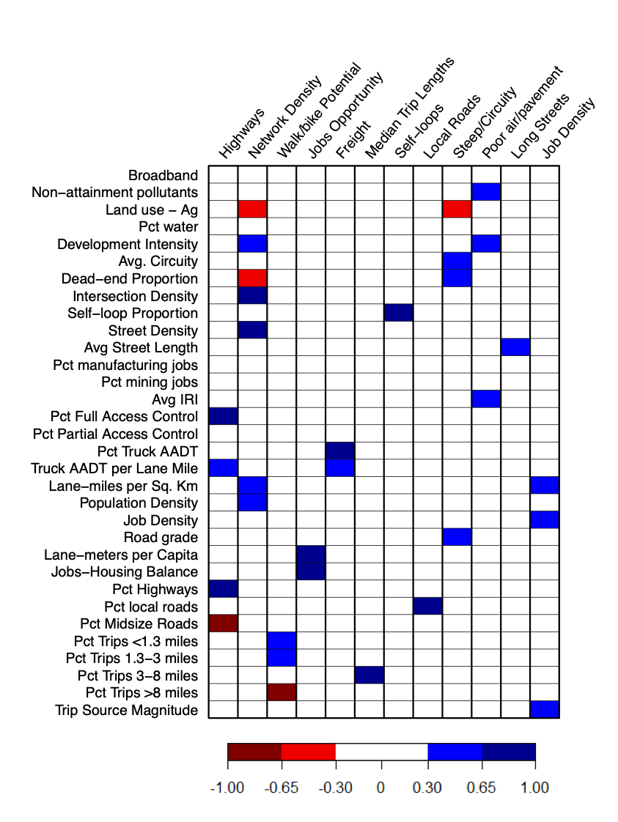
Microtypes: Factors Uncovered
Factors related to travel costs
Highways | functional system 1 and 2 high freight volumes
Network density | shorter blocks high proportion of land dedicated to ROW dense populations
Self-loops | self-loop streets
Local roads | high proportion of functional systems 6 and 7
Steep/circuity | steep roads high proportion of cul-de-sacs/dead ends
Poor air / pavement | rough pavement low air quality
Long streets | Long blocks, low intersection density
Factors related to travel demand
Freight | high ratio of freight to overall travel volumes high freight demand per lane mile of ROW
Job density | dense employment and populations high proportion of ROW per unit of land area
Job opportunity | high ratios of jobs per capita high level of ROW per capita
Walk/Bike potential | High share of commutes under 3 miles
Median Trip Lengths | High share of commutes 3-8 miles
Factor loading
Lawrence Berkeley National Laboratory
Notes:
Note: these have been updated to match Transp Geo results

Slide 19
Geotype: Inputs
Lawrence Berkeley National Laboratory
Notes:
These are updated

Slide 20
Geotype Characteristics
Median value
“Distributed”
“Dispersed”
A | Dispersed polycentric employment hubs (metropolitan)
B | Dispersed polycentric micropolitan
C | Dispersed monocentric
D | Distributed monocentric
E | Concentrated monocentric rural
F | Monocentric rural
Lawrence Berkeley National Laboratory

Slide 21
References
Geroliminis, N., & Daganzo, C. F. (2007). Macroscopic modeling of traffic in cities. TRB 86th Annual Meeting, (January), 07–0413.
Geroliminis, N., & Daganzo, C. F. (2008). Existence of urban-scale macroscopic fundamental diagrams: Some experimental findings. Transportation Research Part B: Methodological, 42(9), 759-770.
Gonzales, E., Chavis, C., Li, Y., & Daganzo, C. F. (2011). Multimodal Transport in Nairobi, Kenya: Insights and Recommendations with a Macroscopic Evidence-Based Model. Transportation Research Board 90th Annual Meeting, 11–3045.
Popovich, N., Spurlock, C. A., Needell, Z., Jin, L., Wenzel, T., Sheppard, C., & Asudegi, M. (2021). A methodology to develop a geospatial transportation typology. Journal of Transport Geography, 93, 103061.
Lawrence Berkeley National Laboratory

