Slide 1
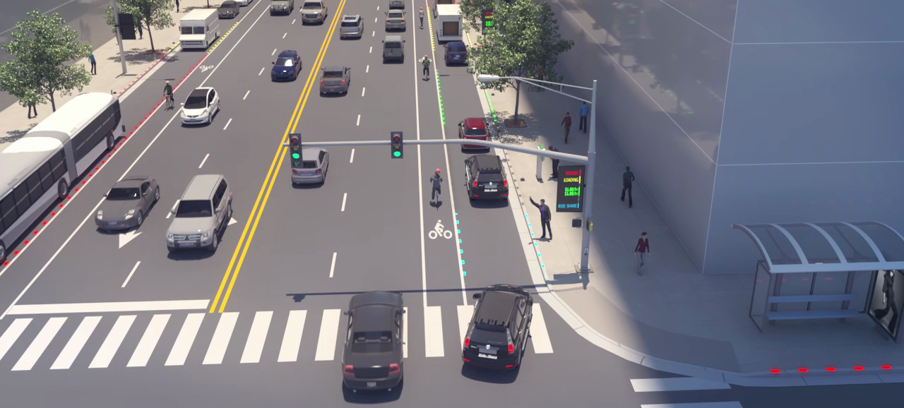
Addressing Traffic Congestion: Dynamic Curb Management
TRB Sustainability and Emerging Transportation Technology (SETT) – June 2, 2022
Presenter: Ryan Winn (AECOM)
1

Slide 2
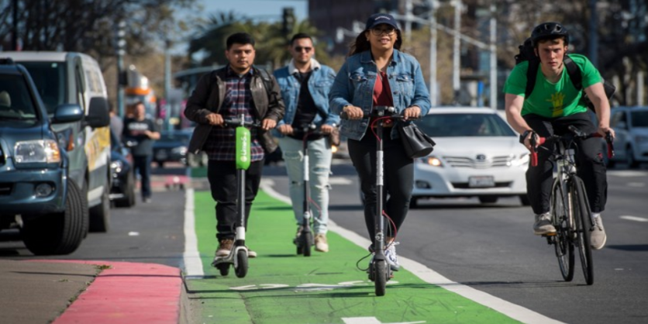
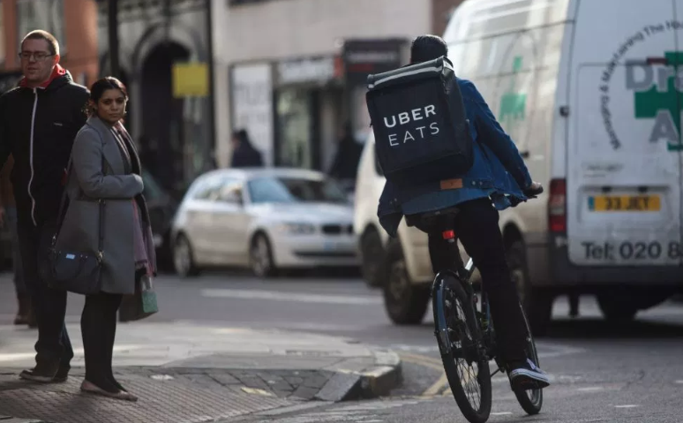
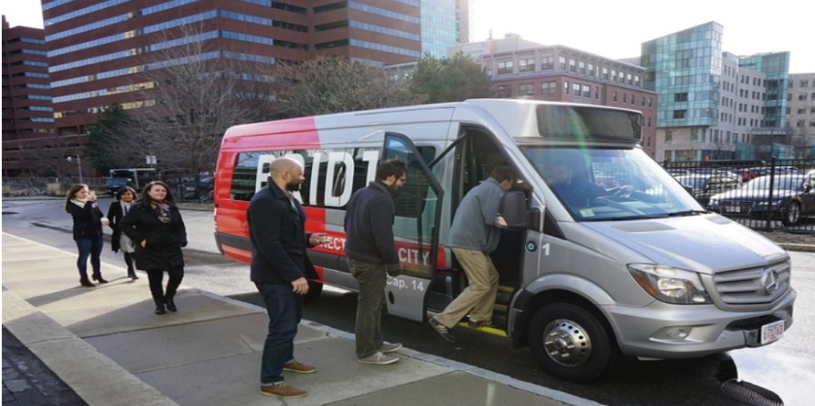
Changing Mobility Patterns
Growing mobility options are shifting how travelers get around their cities.
Increased TNC/ride-hailing use
Expansion of mobility options, including e-scooters
On-demand services shifting trip generation patterns
Lower prices incentivized shared-uses (Microtransit)

Slide 3
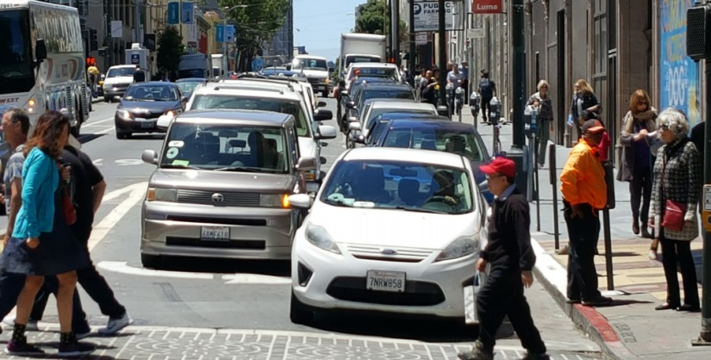
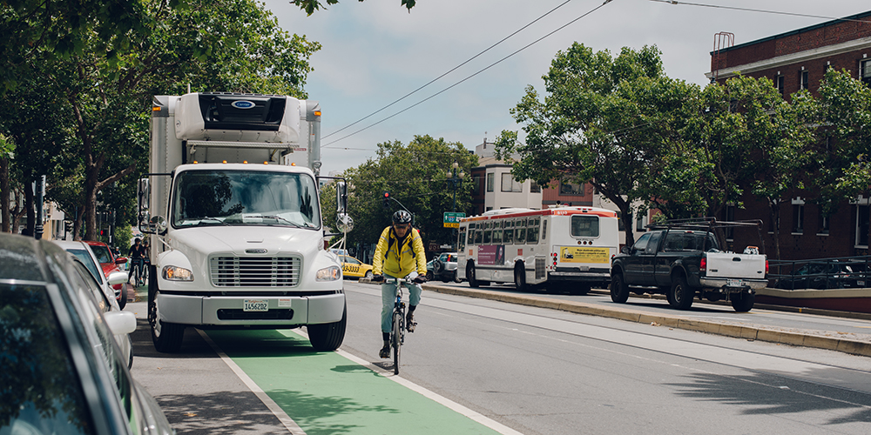
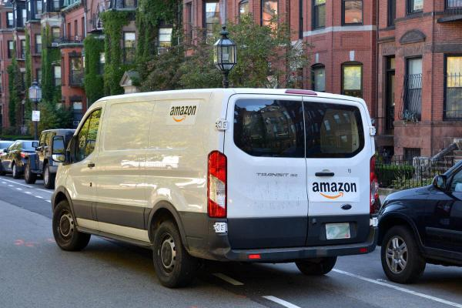
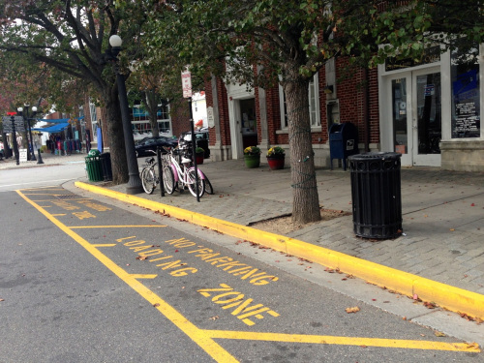
Challenges in Curbside Management
Curb owners are facing increasing competition and congestion for curb space in the public right-of-way.
TNCs creating greater congestion in urban core
Safety risks and inefficiencies for alternative transportation
E-commerce increasing delivery volumes
Fixed uses leave revenue on the table during off-peak hours

Slide 4
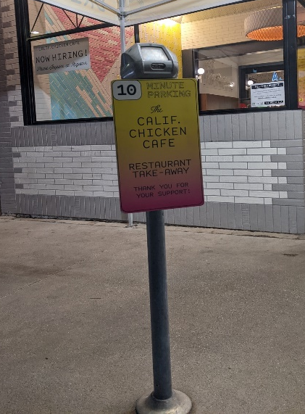
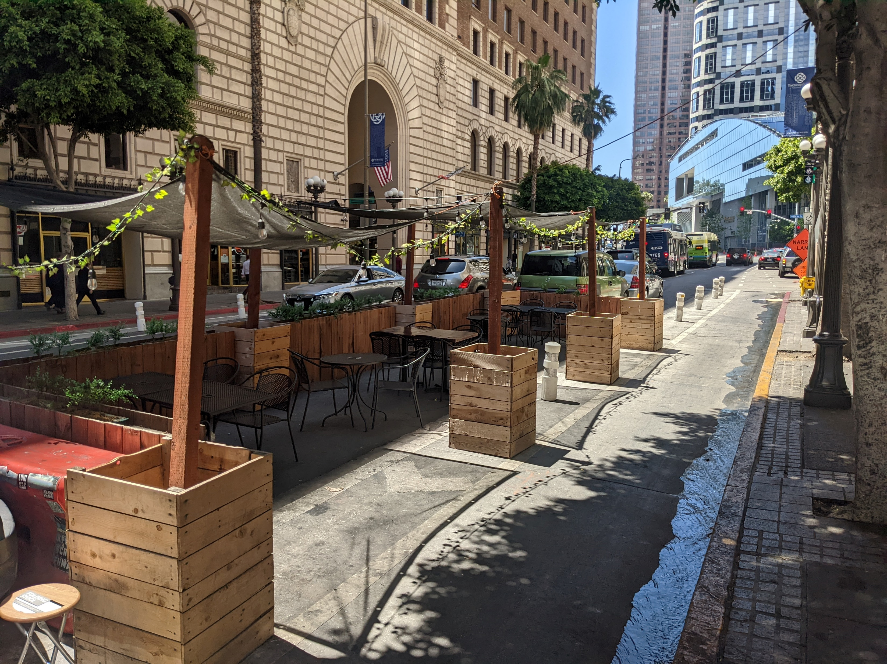
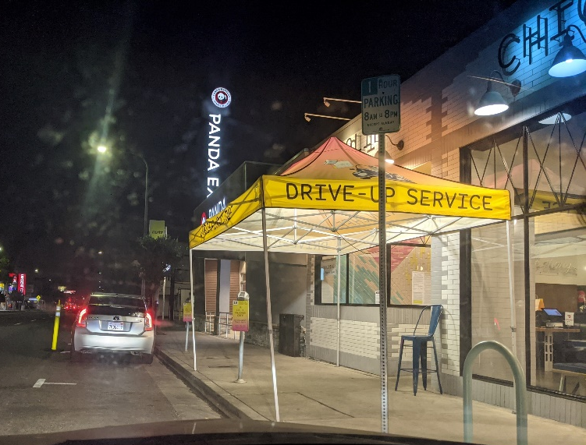
How COVID-19 has impacted Curbside Management
COVID-19 has had temporary changes to the way people interact with the curb, but what is here to stay?
Replace parking with
short-term loading
Capturing parking spaces for additional seating
In-vehicle waiting lines for contact-less service

Slide 5
Rethinking Curb Space & Potential Policy Considerations
Planning for the “highest and best use”
Flexible spaces that varies throughout the day based on real-time demand
Rethink pricing policies such as a “curb access fee”
Incentivize businesses and delivery companies to shift to off-peak
Data sharing is a must

Slide 6
Curb Management Project Roadmap
Digital curb management is evolving with expected near- & long-term projects that help cities better understand what assets they have and how they can be adapted to CV/AVs and smart city infrastructure.
Digital inventory & data collection
Best Practices
Policy Changes
Near-term solutions
Smart loading zones
Last mile zero emission zones
Full-scale tech solution(s)
Leads to CV/AV & Smart City Infrastructure
1 (Now)
2 (Near-term)
3 (Long-term)

Slide 7
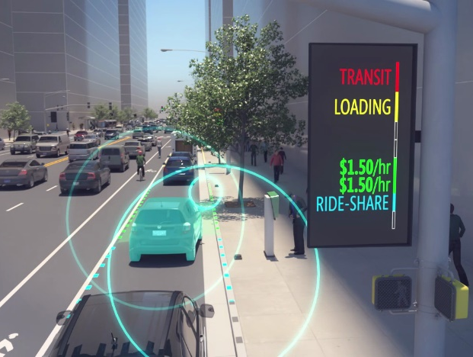
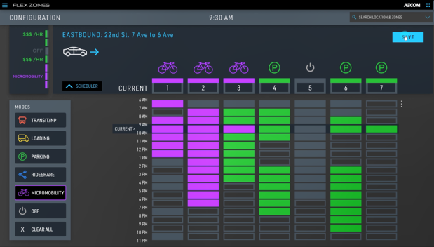
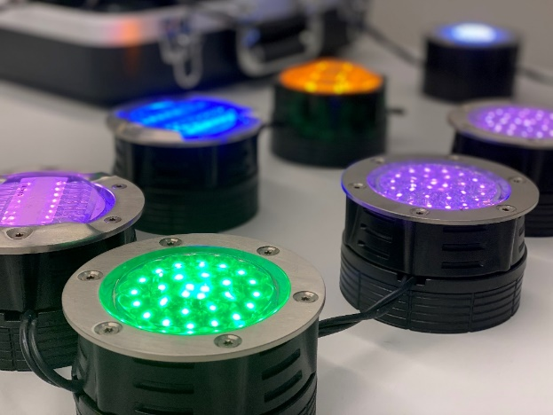
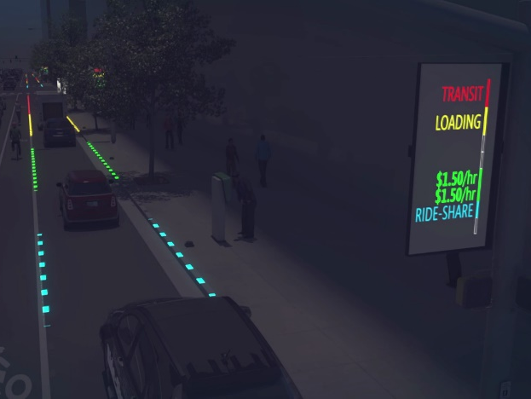
Flex Zones Overview
Flex Zones is a dynamic curbside management solution using an integrated software and hardware system that enables operates control of the price and use of their most in-demand curb space.
Curb space is optimized through:
Embedded lights and sensors to detect and display occupancy
Changing digital signage and lights based on availability
Operating web-based portal to remotely manage a Flex Zones system
Portal (or integration) for end-users (e.g., drivers) to view availability, reserve space, and/or pay for curb usage
Sensors and digital signage visualization
Dashboard
Lights
Embedded lights and digital signage visualization

Slide 8
Thank You!
Contact: Ryan.Winn@aecom.com
8

