Slide 1
A Driving Simulator Interface for Micromobility
Micro-AV.com
Tyler Folsom
University of Washington
Bothell, WA
Tfolsom@uw.edu
TRB 2022 Sustainability and Emerging Transportation Technology
TRB 2022 Sustainability and Emerging Transportation Technology

Slide 2
Change people’s behavior or change the bike?
Micro-AV.com
In Amsterdam, 35% of trips are by bike and 22% by car
In the US, commuting numbers are 1% by bike and 85% by car
People are unlikely to flock to micromobility until it becomes the fastest, most convenient and safest way to get around the city
Today’s presentation focuses on the bigger issues that produced a simulator interface for micromobility
TRB 2022 Sustainability and Emerging Transportation Technology

Slide 3
Problem 1:
Global Warming
Micro-AV.com
TRB 2022 Sustainability and Emerging Transportation Technology

Slide 4
Electrification and Sustainability
Micro-AV.com
It is feasible to electrify all land transportation
R. Gilbert & A. Perl, Transportation Revolutions: Moving People and Freight without Oil, New Society Publishers, 2010
Is it possible to generate enough electricity sustainably?
A 4000 lb. (1500 kg) car carrying a 200 pound (80 kg) person is not sustainable.
Neither is a 38,000 pound (17,300 kg), 4 mpg (56 l/100 km) bus carrying 9 people.
Light, automated vehicles are a solution
TRB 2022 Sustainability and Emerging Transportation Technology

Slide 5
Problem 1:
Global Warming
Solution 1: PRT / ATN
Micro-AV.com
e
TRB 2022 Sustainability and Emerging Transportation Technology

Slide 6
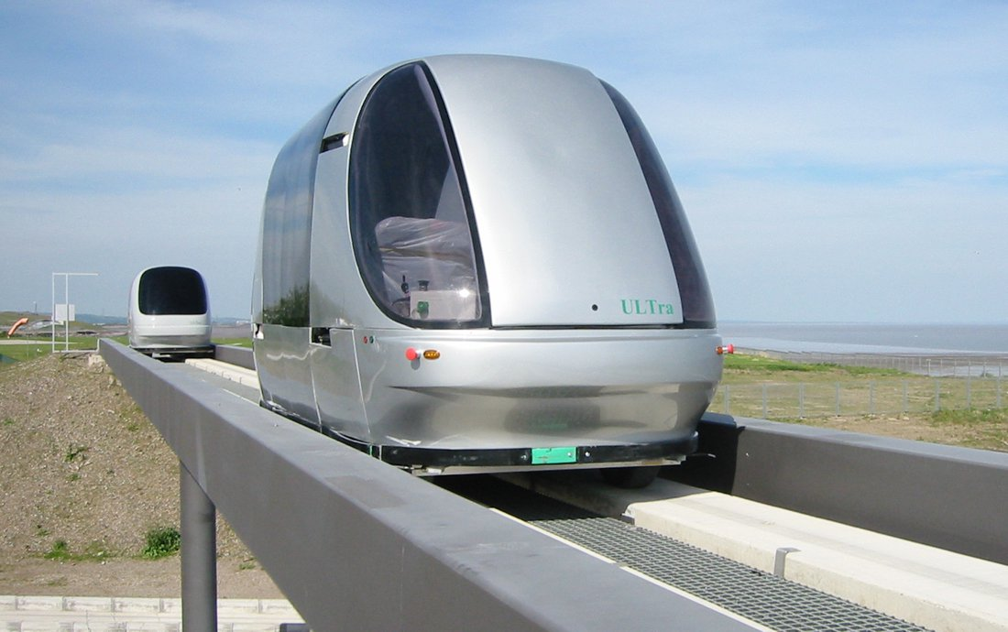
Personal Rapid Transit / Automated Transit Networks
Micro-AV.com
Operational for 40 years
Deployed on three continents
4 to 6 riders / vehicle
Runs on either rails or pavement
Stops are off the main line and do not slow other riders
Runs on its own guideway
No unpredictable vehicles, etc.
TRB 2022 Sustainability and Emerging Transportation Technology

Slide 7
Problem 2: Unproven technology Needs new infrastructure
Problem 1:
Global Warming
Solution 1: PRT / ATN
Micro-AV.com
TRB 2022 Sustainability and Emerging Transportation Technology

Slide 8
PRT / ATN has not caught on
Micro-AV.com
Needs a whole new infrastructure
Earlier versions pushed available technology, causing cost overruns
Transportation planners are reluctant to use a technology not proven elsewhere at scale
Little public awareness
TRB 2022 Sustainability and Emerging Transportation Technology

Slide 9
Problem 2: Unproven technology Needs new infrastructure
Problem 1:
Global Warming
Solution 1: PRT / ATN
Micro-AV.com
Solution 2: Automated Electric Vehicles
TRB 2022 Sustainability and Emerging Transportation Technology

Slide 10
Automated Electric Vehicles
Micro-AV.com
No tailpipe emissions for electric vehicles
Falling prices makes it feasible to electrify all US vehicles by 2035
Drivers would save trillions in fuel costs over 15 years
Partial or full automation improves safety and convenience
Could implement PRT concepts without new infrastructure
Sensors are on vehicles; not infrastructure
TRB 2022 Sustainability and Emerging Transportation Technology

Slide 11
Problem 2: Unproven technology Needs new infrastructure
Problem 1:
Global Warming
Solution 1: PRT / ATN
Micro-AV.com
Problem 3: Need lots of electricity
Solution 2: Automated Electric Vehicles
TRB 2022 Sustainability and Emerging Transportation Technology

Slide 12
How much electricity is needed?
Micro-AV.com
The US electric grid may already have enough capacity
Vehicles can be charged off-peak or at night when there is typically little electric demand
Most vehicles would be charged at home on existing circuits
But running electric generators close to full capacity 24/7 will bring in the least efficient plants such as coal
A vehicle weighing 20 times more than the passenger wastes energy
TRB 2022 Sustainability and Emerging Transportation Technology

Slide 13
Problem 2: Unproven technology Needs new infrastructure
Problem 1:
Global Warming
Solution 1: PRT / ATN
Micro-AV.com
Problem 3: Need lots of electricity
Solution 2: Automated Electric Vehicles
Solution 3: Automated Electric Micro-Vehicles
TRB 2022 Sustainability and Emerging Transportation Technology

Slide 14
Vehicles weighing less than the rider
Micro-AV.com
A commuting streamlined bicycle or tricycle uses 155 times less energy than a car
Wilson, D. G., Bicycling Science, 3rd ed, MIT Press, 2004, pp 140, 166
Total Energy Consumption at 50 km/h (30 mph) in kW per person
TRB 2022 Sustainability and Emerging Transportation Technology

Slide 15
Problem 2: Unproven technology Needs new infrastructure
Problem 1:
Global Warming
Solution 1: PRT / ATN
Micro-AV.com
Problem 3: Need lots of electricity
Solution 2: Automated Electric Vehicles
Solution 3: Automated Electric Micro-Vehicles
Problem 4: Expensive to educate students
TRB 2022 Sustainability and Emerging Transportation Technology

Slide 16
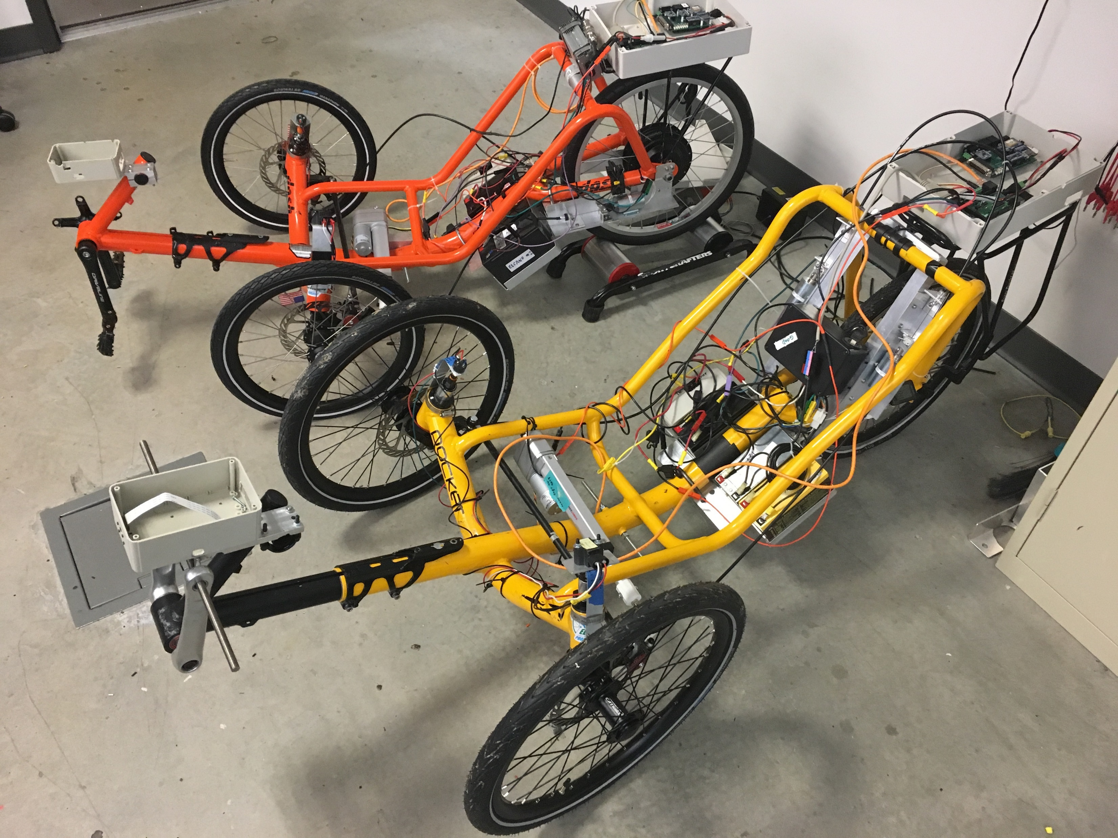
$ for student lab?
Micro-AV.com
Buy cars? Find garage space? Get insurance?
Base trike costs $1350 to $2150
Sensors, actuators, electronics, etc. adds another $2500
Even cheaper starting with a used bike with training wheels
TRB 2022 Sustainability and Emerging Transportation Technology

Slide 17
Problem 2: Unproven technology Needs new infrastructure
Problem 1:
Global Warming
Solution 1: PRT / ATN
Micro-AV.com
Problem 3: Need lots of electricity
Solution 2: Automated Electric Vehicles
Solution 3: Automated Electric Micro-Vehicles
Problem 4: Expensive to educate students
Problem 5: Trike conversion needs labor & $
TRB 2022 Sustainability and Emerging Transportation Technology

Slide 18
Converting a trike is labor intensive
Micro-AV.com
Remove chain, rear wheel, pedals, handle bars and brake levers
Install hub-motor rear wheel, e-bike controller and battery
Build battery mount
Buy and mount an actuator for steering
Install sensor to get feedback on wheel turn angle
Mount speedometer for motion feedback
Build solenoid mounts for brakes
Fabricate printed circuit boards for vehicle control
Make 3D printed case for camera, sonars and lidar
Wire it all together
Program and test all the software
TRB 2022 Sustainability and Emerging Transportation Technology

Slide 19
Problem 2: Unproven technology Needs new infrastructure
Problem 1:
Global Warming
Solution 1: PRT / ATN
Micro-AV.com
Problem 3: Need lots of electricity
Solution 2: Automated Electric Vehicles
Solution 3: Automated Electric Micro-Vehicles
Problem 4: Expensive to educate students
Problem 5: Trike conversion needs labor & $
Solution 4:
Simulator Bridge
TRB 2022 Sustainability and Emerging Transportation Technology

Slide 20
Simulator Bridge attaches trike HW & SW to CARLA simulator
Micro-AV.com
Two key trike Arduino boards plug into Bridge
A third Bridge Arduino routes simulator to virtual vehicle
Actuators control simulated vehicle
Sensors are fed from simulator
Can develop software without needing a real vehicle
Described in detail in 2020 TRB SETT
https://cdn.filestackcontent.com/xiPTYLtcTCyHOPdqs2N8?A%20driving%20simulator%20for%20micromobility.pdf
TRB 2022 Sustainability and Emerging Transportation Technology

Slide 21
Problem 2: Unproven technology Needs new infrastructure
Problem 1:
Global Warming
Solution 1: PRT / ATN
Micro-AV.com
Problem 3: Need lots of electricity
Solution 2: Automated Electric Vehicles
Solution 3: Automated Electric Micro-Vehicles
Problem 4: Expensive to educate students
Problem 5: Trike conversion needs labor & $
Solution 4:
Simulator Bridge
Problem 6: Simulation is good enough
TRB 2022 Sustainability and Emerging Transportation Technology

Slide 22
Most students just want AV on their resumés
Micro-AV.com
Solving a real-world problem takes too much time
Simulated AV software looks fine on the resumé
Few are interested in actually deploying the solution
No sales for the simulator bridge
Racing 1/10 scale autonomous cars indoors pads the resumé.
TRB 2022 Sustainability and Emerging Transportation Technology

Slide 23
Problem 2: Unproven technology Needs new infrastructure
Problem 1:
Global Warming
Solution 1: PRT / ATN
Micro-AV.com
Problem 3: Need lots of electricity
Solution 2: Automated Electric Vehicles
Solution 3: Automated Electric Micro-Vehicles
Problem 4: Expensive to educate students
Problem 5: Trike conversion needs labor & $
Solution 5: Manufacture automation ready eTrike
Solution 4:
Simulator Bridge
Problem 6: Simulation is good enough
TRB 2022 Sustainability and Emerging Transportation Technology

Slide 24
Partner with an organization to build an advanced e-trike
Micro-AV.com
Similar to Tesla: build a (micro)vehicle that will be fully automated when software is ready
Initial model is an e-trike with power steering and power brakes
Suitable for shared mobility with empty trike repositioning itself
Suitable for package delivery
Can add ADAS systems for level 1 & 2 automation
Eventually achieve level 4 automation
TRB 2022 Sustainability and Emerging Transportation Technology

Slide 25
Automation removes chaos from micromobility
Micro-AV.com
Two-wheeled users tend to be undisciplined
Level 4 vehicles can be externally controlled and synchronized
With high automation, bike lanes can form dynamically
A well-run microvehicle system can be faster than car, bus or light rail
Microvehicles can tightly platoon and stay in narrow lanes
Doing so requires trusted communication between vehicles
TRB 2022 Sustainability and Emerging Transportation Technology

Slide 26
Problem 2: Unproven technology Needs new infrastructure
Problem 1:
Global Warming
Solution 1: PRT / ATN
Micro-AV.com
Problem 3: Need lots of electricity
Solution 2: Automated Electric Vehicles
Solution 3: Automated Electric Micro-Vehicles
Problem 4: Expensive to educate students
Problem 5: Trike conversion needs labor & $
Problem 7: Security
Solution 5: Manufacture automation ready eTrike
Solution 4:
Simulator Bridge
Problem 6: Simulation is good enough
TRB 2022 Sustainability and Emerging Transportation Technology

Slide 27
How easy is it to hack your vehicle?
Micro-AV.com
Internal vehicle control networks have little or no security
Anything connected to the Internet can be hacked
Sensors can be spoofed
A nation’s transportation system could be taken down in cyberwarfare
Blockchain verification or keyed encryption may be too slow
TRB 2022 Sustainability and Emerging Transportation Technology

Slide 28
Problem 2: Unproven technology Needs new infrastructure
Problem 1:
Global Warming
Solution 1: PRT / ATN
Micro-AV.com
Problem 3: Need lots of electricity
Solution 2: Automated Electric Vehicles
Solution 3: Automated Electric Micro-Vehicles
Problem 4: Expensive to educate students
Problem 5: Trike conversion needs labor & $
Problem 7: Security
Solution 5: Manufacture automation ready eTrike
Solution 6: Physically connected platoons
Solution 4:
Simulator Bridge
Problem 6: Simulation is good enough
TRB 2022 Sustainability and Emerging Transportation Technology

Slide 29
A physically wired system has better security
Micro-AV.com
Shrink the gap between vehicles to zero, equip them with bumpers and dynamic coupling
Once vehicles are physically connected, communication is wired
Wireless messages are critical in the docking stage
Messages can be authenticated by visual signaling
Micro-AV has a pending patent on the technology and is looking for partners.
TRB 2022 Sustainability and Emerging Transportation Technology

Slide 30
Robot taxis may be overgrown bicycles
Legally a bicycle in the US
Has fewer than 4 wheels
Includes pedals
Electric helper motor ≤ 750W
No electric help > 20 mph (32 km/h)
Even though empty vehicle weighs 160 pounds (72 kg).
TRB 2022 Sustainability and Emerging Transportation Technology

Slide 31
Appendix
Highlights from 2020 TRB SETT Driving simulator for micromobility

Slide 32
Less energy = less battery
Micro-AV.com
Automated micromobility can move people in the city
With a light-weight shell, an e-trike becomes a practical urban vehicle
A 10 kg battery suffices; cars need about 500 kg.
A light battery can be swapped
No need for EV charging stations
Batteries enable renewable energy
TRB 2022 Sustainability and Emerging Transportation Technology

Slide 33
Micromobility fits the city
Micro-AV.com
65% of the 3.25 trillion vehicle miles (5.24 T km) traveled in the US are urban
The average urban trip is 12 miles (19 km)
Micromobility can handle the 1T annual VMT under 12 miles
Doing so is the carbon equivalent of 54 coal trains daily
TRB 2022 Sustainability and Emerging Transportation Technology

Slide 34
Elcano project
Micro-AV.com
Open source software and hardware for automated micromobility
https://www.elcanoproject.org
https://github.com/elcano
Automated Vehicle < $5000
TRB 2022 Sustainability and Emerging Transportation Technology

Slide 35
Other systems
Micro-AV.com
MIT Media Lab
Cornell University
Indian Institute of Technology
Mälardalen University - Hampus Baez
Intelligent Ground Vehicle Competition
Delivery robots
Segway Ninebot
TRB 2022 Sustainability and Emerging Transportation Technology

Slide 36
Elcano Architecture
Micro-AV.com
TRB 2022 Sustainability and Emerging Transportation Technology

Slide 37
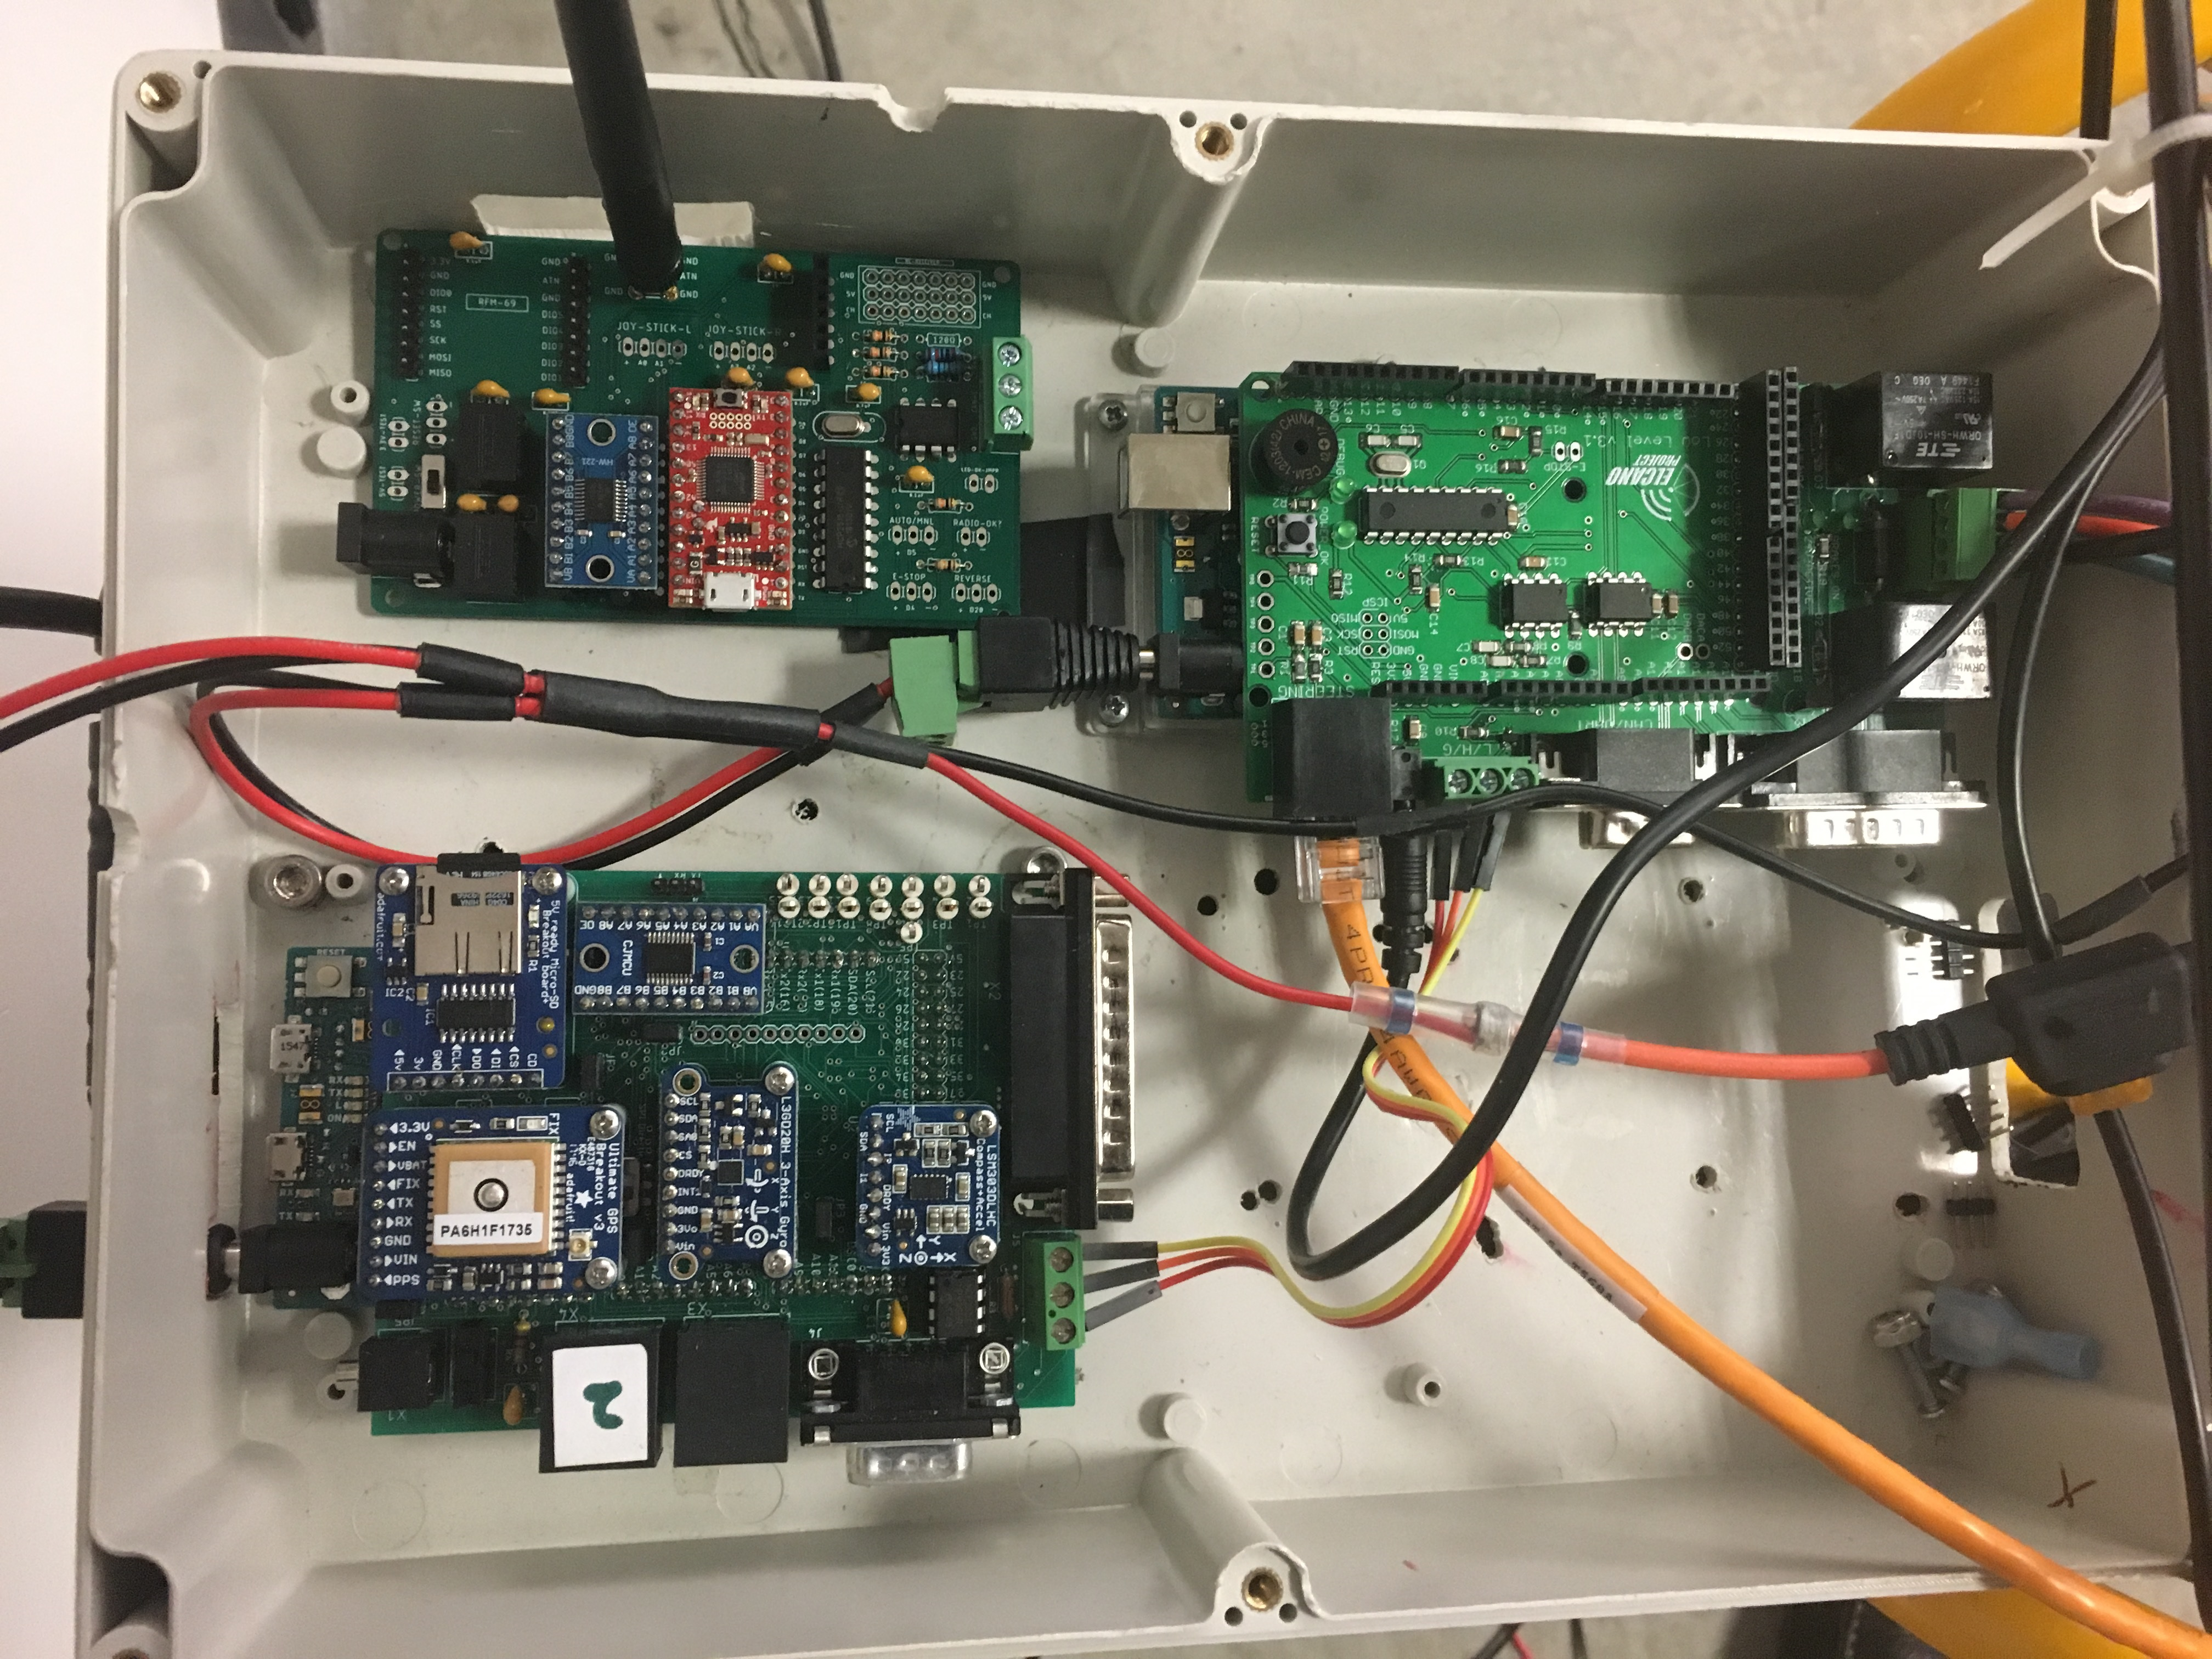
Trike circuit boards
Micro-AV.com
Upper Left: Receiver
Right: Drive-by-wire
Lower Left: Sensor hub
All boards are Arduino shields
TRB 2022 Sustainability and Emerging Transportation Technology

Slide 38
Problems
Micro-AV.com
No vehicle
Batteries not charged
Loose wire
Missing component
Weather
Test grounds unavailable
TRB 2022 Sustainability and Emerging Transportation Technology

Slide 39
CARLA driving simulator scene
Micro-AV.com
TRB 2022 Sustainability and Emerging Transportation Technology

Slide 40
Simulator Interface Architecture
Micro-AV.com
TRB 2022 Sustainability and Emerging Transportation Technology

Slide 41
Simulator interface circuit board
Micro-AV.com
Left bottom: Arduino running Drive-by-wire
Top middle: Arduino router to CARLA simulator on PC
Right bottom: Arduino running Sensor Hub
TRB 2022 Sustainability and Emerging Transportation Technology

Slide 42
Micromobility as public transit
Micro-AV.com
T. C. Folsom, Improved Bus Service on Ten Times Less Energy, 5th EAI International Conference on Intelligent Transport Systems; Lisbon, Portugal; November 2021
https://www.researchgate.net/publication/356194082_Improved_Bus_Service_on_Ten_Times_Less_Energy
TRB 2022 Sustainability and Emerging Transportation Technology

