Slide 1
The Effect of Price and Time on Private and Shared Transportation Network Company Trips
Transportation Research Board
Conference on Sustainability and Emerging Transportation Technology
June 1st, 2022
Office of Operations
Federal Highway Administration
1200 New Jersey Avenue SE
Washington, DC 20590

Slide 2
Shared Rides Options
Transit
Traditional carpooling
App-based carpooling
Transportation Network Companies (TNC) shared ride options

Slide 3
Why Sharing?
Vehicle occupancy impacts the number of vehicles on the road.
By reducing vehicle miles traveled (VMT), sharing may:
Alleviate congestion
Improve travel time and travel time reliability for all road users
Reduce vehicle emissions
Support economic growth
Purpose of study
Understand motivations behind the choice to use specific shared options versus private options
Notes:
Note that ridehailing isn't necessarily equivalent to SOV. Although it isn't Pool, it may still have high occupancy if it is a group of 2+ people. It could also be worse than SOV if drivers are deadheading between passengers.

Slide 4
Ridehailing vs. Ridesharing
Private Rides
UberX
Standard Lyft
Taxi
Shared Rides
UberPool
Shared Lyft
Via
Notice
The United States Government does not endorse products or manufacturers. Trademarks or manufacturers’ names appear herein only because they are considered essential to the object of this document.

Slide 5
TNC Methodology and Data
Survey Questions to TNC Users:
Trip purpose
Personal characteristics
Travel behavior
Appended Data:
Trip cost and travel time
Built environment characteristics
City-specific data
Notes:
PRE COVID SURVEY from Fall 2018
Had a lot of population data from the provider to weight our sample accordingly

Slide 6
National Survey Results Usage Summary
4,365 TNC Users
71.9%
28.1%
Last Trip was Private
Last Trip was Shared
Source: FHWA
Notes:
PRE COVID

Slide 7
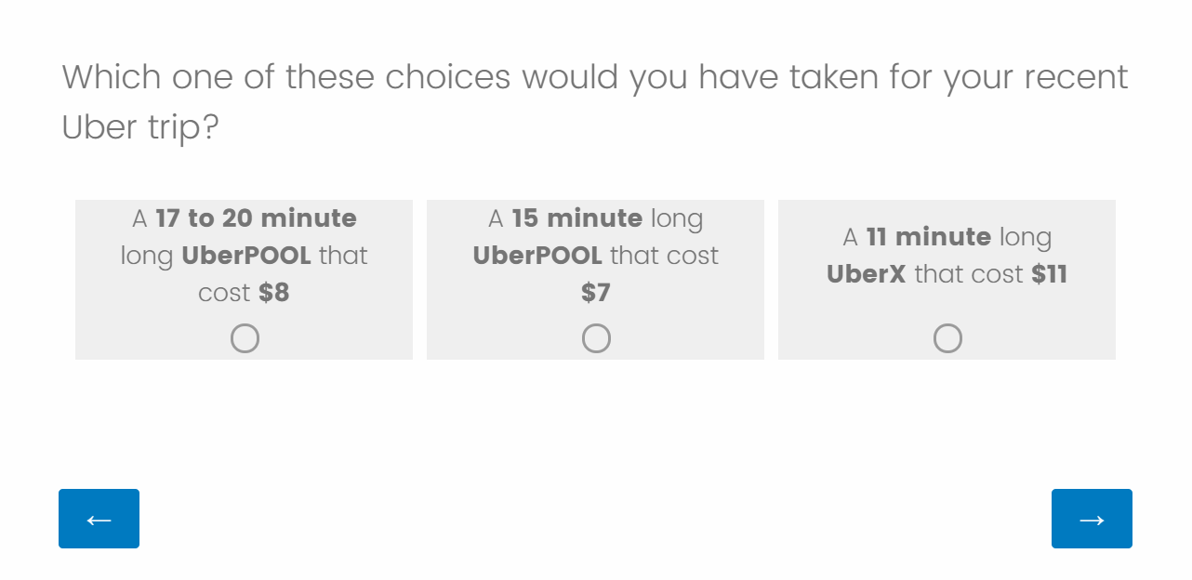
TNC Methodology and Data: Sample Survey Question
Which one of these choices would you have taken for your recent trip by TNC?
A 17 to 20-minute shared trip that cost $8
A 15 to 17-minute shared trip that cost
$7
An 11-minute private trip that cost
$11

Slide 8
Results: Descriptive Price Analysis
Survey asked how TNC users would respond to hypothetical options generalized from their observed trip, if they were made available.
Holding travel time constant, higher discounts for shared rides correspond to greater portions of the population willing to use sharing, indicating some amount of price sensitivity.
This relationship presents a roughly linear pattern.
Source: FHWA

Slide 9
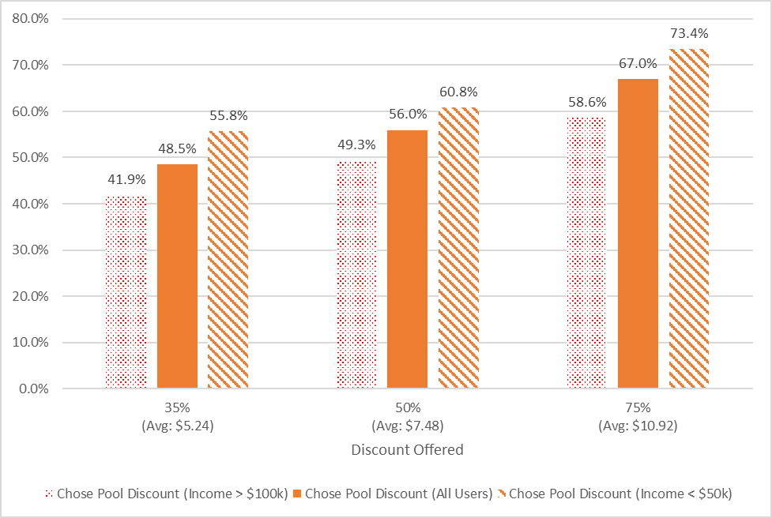
Results: Descriptive Price Analysis
Share of Private TNC Users Switching to Shared (Holding Travel Time Constant)
Source: FHWA
Notes:
Graph is showing % of private rides that would have used shared according to survey under this % discount offered
BARS ARE INCOME CATEGORIES
X AXIS IS % DISCOUNT FOR SHARING THE RIDE
Lower income – more price sensitive. Difference between discount %s not dramatic. Not continuous results, which may have impacted model.

Slide 10
Results: Descriptive Analysis of Time (Combined with Price)
Lower travel time penalties for shared rides correspond to greater portions of the population willing to use sharing, holding price constant.
As noted earlier, the willingness to share increases along with discount, due to price sensitivity.
Over 30% of users rejected a shared trip with no time penalty at the maximum discount (75% less expensive than the observed private trip).
At the lowest tested amount of travel time penalty (a 15-30% increase), 50% of respondents were unwilling to share at a 75% discount.
Source: FHWA
Notes:
Tested differences in travel time for hypothetical rides. Reliability/variability not captured. There are some group of riders who will not use shared ride no matter how appealing the circumstances (no time penalty, max discount). Business riders who may be getting reimbursed

Slide 11
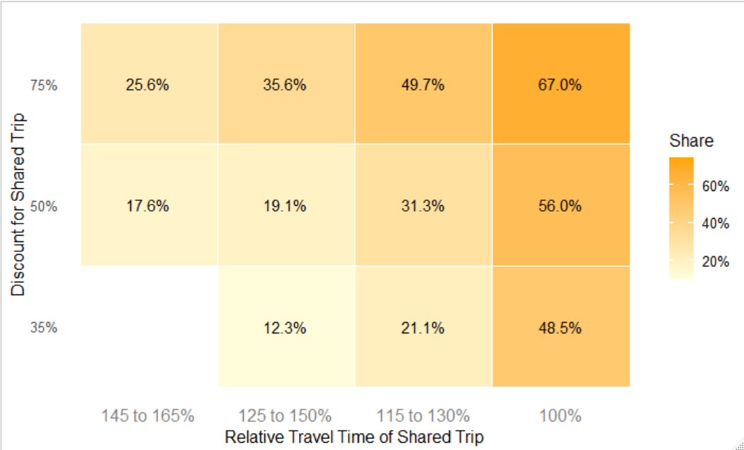
Results: Descriptive Analysis of Time (Combined with Price)
Portion of private TNC users that switched from private to shared travel at each level of travel time difference and price difference offered (n = 3,142).
Source: FHWA
Notes:
Didn’t test bottom cell – but its not the comparison point. Reference value is taking a private trip.

Slide 12
Results: Variables that Predict Sharing
A discrete choice model analyzed the effect of several predictor variables on the choice to share a TNC ride.
Exponentiated coefficients (next slide) greater than 1 indicate that a unit change in that variable would increase the probability of sharing; the opposite is the case for coefficients below 1.
Dividing data into market segments, it is possible to examine the effect of an increase in the price differential between shared and private TNC travel on an individual’s probability of selecting shared travel.
Source: FHWA

Slide 13
Results: Variables that Predict Sharing
Source: FHWA

Slide 14
Results: Variables that Predict Sharing
Source: FHWA
Notes:
Car ownership – if you want to travel privately you’d just drive yourself. TNC when you don’t want to drive yourself.
Transit use makes sense – may use shared rides to fill in transit network gaps.
Having good transit at the location you start makes sharing less likely. Destination having good transit doesn’t matter as much because if you didn’t have the option at the origin, irrelevant.
Dense office location – 90th percentile density
Competitive transit – percentile based, ratio of access to population for transit vs auto
More likely to share in the evening vs the morning, fewer schedule concerns
Home based commute – point of comparison is non home based.

Slide 15
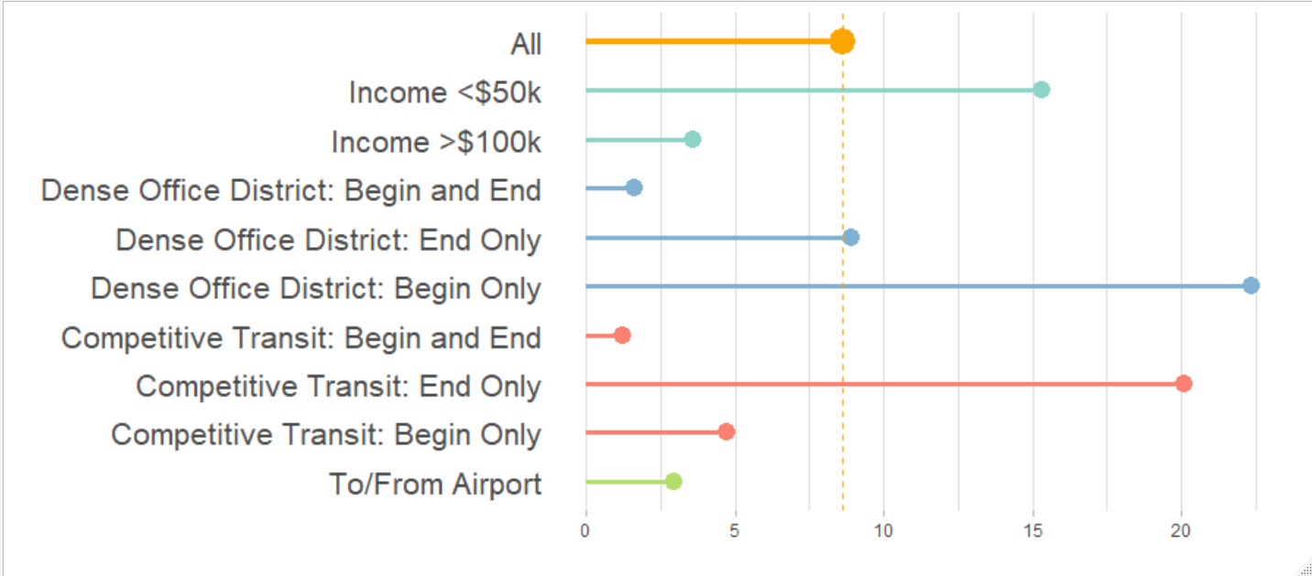
Results: Effect of Price on Sharing
For each additional $/mile price difference between private and shared rides, there is an 8.6 percentage point increase in the probability of sharing
Effect of $1/mile price difference on a user’s percent probability of sharing
Source: FHWA
Notes:
Elasticities for different categories of riders or trips

Slide 16
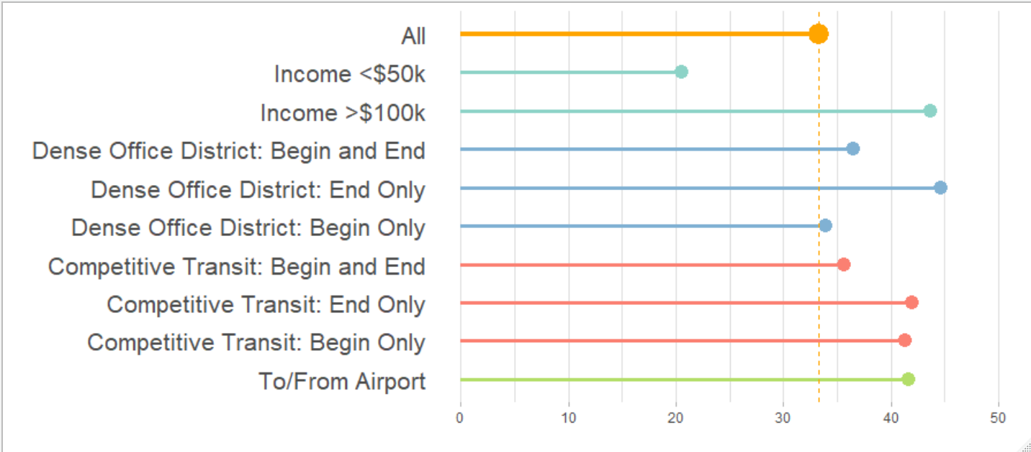
Results: Effect of Time on Sharing
For each reduction of 1 minute/mile between a shared and private ride, there is a 33.3 percentage point increase in the probability of sharing.
Effect of 1 minute/mile travel time difference on a user’s percent probability of sharing
Source: FHWA
Notes:
Travel time elasticities – not a lot of variability
20mph – 3 minutes to go a mile
30 mph – 2 minutes
Example – speed of 20mph vs 30mph
Not surprised that value of time is lower for lower income hhs

Slide 17
Results: Effect of Price and Time
The price difference between private and shared rides that would increase the probability of sharing for general trips by 25% (i.e., from ~30% of trips to ~37.5%):
$0.87 per mile (at average trip length of 6.4 miles and starting price/mile of $3.30) or
The time difference between shared ride and private rides that would increase the probability of sharing for general trips by 25% (i.e., from ~30% of trips to ~37.5%):
14 seconds per mile (at average trip length of 6.4 miles and starting speed of 23.8 mph)
The implied value of time to increase general trips by 25% with either a $0.87 per mile price differential or 14 seconds per mile time differential:
$3.86 per minute or $231.47 per hour
Differences that would increase the probability of sharing for trips starting in office districts by 25%:
$0.33 per mile, or
13 seconds per mile

Slide 18
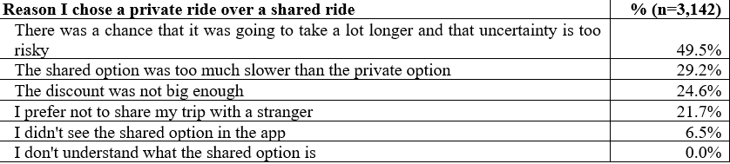
Results: Effect of Price and Time
Riders appear to place a very high value on their travel time showing the same travel response when offered to save either $3.86 or 1 minute (for $231 or 1 hour).
Over 30% of riders whose last trip was private never selected a hypothetical shared option.
Source: FHWA
Notes:
The value $231 compares the effect of price differential and travel time penalties
This value represents the amount that respondents were willing to pay to reach their destinations more quickly (and privately).
Because all price and time differentials were presented relative to the private trip as part of a shared product option, the desire for privacy (which might also have a per-mile rate) is not separable from the desire for faster arrival.
Because shared choices were presented with fixed uncertainty bands at the different travel time penalty levels, the effect of uncertainty and delay can also not be separated in the choice survey. These limitations are discussed more in the sub-section Limitations of Approach.”

Slide 19
Results: Effect of Price and Time (Among Only Shared Options)
Looking at preferences among shared options, the ratio of savings a user accepted to the delay that they also accepted represents a ceiling on the user’s willingness to pay to avoid additional travel time in a shared ride.
For users whose last trip was private:
A small share of respondents have values of time below a ceiling of $14.24 (18.9%) and most have ceilings below $139.19 (70.1%).
For users whose last trip was shared:
More than half of respondents (55.7%) have an implied value of time under $10.62 and nearly all (91.8%) implying a value of time under $57.82.
These findings are consistent with the notion that a higher value of time is expected for customers whose last TNC trip was private.

Slide 20
Conclusions
Research used a novel stated preference study anchored off real TNC trips to simulate real decisions between taking private and shared TNC trips.
Users may be influenced by time-based ridesharing incentives or price-based incentives, but some users appear unmoved by price.

Slide 21
Conclusions (Continued)
Users taking certain types of trips are more inclined than other users to select a shared option if relatively small changes in cost and time are made in the direction that favors sharing.
Exploration of this data could help guide service offerings and encourage more customers to make a shared ride choice (e.g., offering service-standard guarantees for shared ride products).
Notes:
Generally: not a cost-effective solution to subsidize shared rides, lots of that subsidy goes to riders more likely to share anyways, doesn’t move the needle that much

Slide 22
Contact Information
Allen Greenberg
U.S. Department of Transportation
Federal Highway Administration
Office of Operations
Allen.Greenberg@dot.gov
(202) 366-2425
Kyle Schroeckenthaler
kyle.schroeckenthaler@ebp-us.com
Notes:
Allens focus: time penalties on non-shared trips

