Slide 1

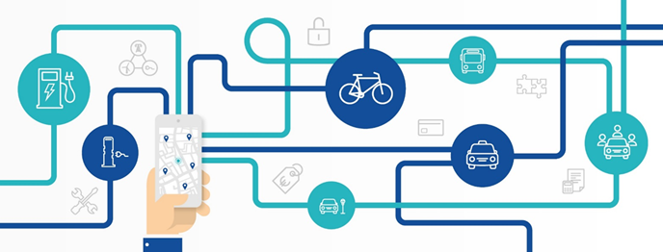

How Mobility on Demand (MoD) Concepts are Re-Shaping Mobility for Rural and Elderly/Disabled Customers in the US: Lessons Learned from the Field
May 31, 2022

Slide 2
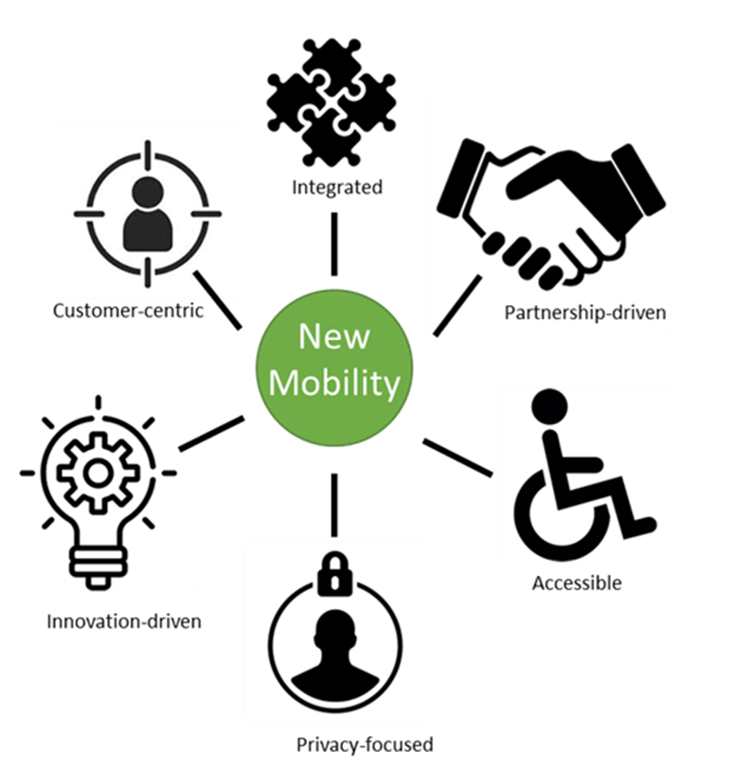
  Discussion Overview – Mobility On Demand (MoD)
What is MoD
1
2
Mobility Industry Trends
(& Issues/Challenges)
3
IBI Experience: Paratransit & Rural
What’s Next?
4
2

Slide 3

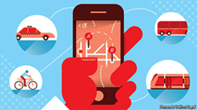
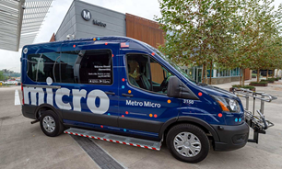
  Mobility on Demand
Number of new concepts and ideas brewing in the Transitverse, often with overlapping definitions and blurred categorizations, creating confusion. Today we look at the emerging concept of Mobility on Demand (MoD).
MoD combines traditional public transportation with private enterprise options into a single mobility service.
  Traveler-focused - personal choice, trip satisfaction, efficient service delivery
Valuable in addressing transportation challenges: reduce congestion/reduce VMTs, transit deserts, and as a replacement for fixed route during off-peak hours.
Bridge gaps in first mile/last mile, corporate transportation, paratransit/dial-a-ride, and university shuttle services
MoD digital platform - responds to changing customer expectations: single platform, trip planning/discovery, spontaneity of travel, e-hailing, real-time information, mobile payment
3

Slide 4












Mobility Context (cont’d.)
Rural
Suburban
Hub
Hub
Hub
Urban
Hub
Hub
Hub
Hub
Hub
Hub
Anaheim
Hub
4
Notes:
Definition of Mobility-on-Demand depends on where people live, their destinations and their needs for a trip

Slide 5




Services and Modes (FTA Perspective)
Fixed
Bus
BRT
Light Rail
Heavy Rail
Fixed-equivalent
ADA Paratransit
Demand Response
Taxi/TNC
Carpool, Vanpool
Ridesourcing
Ridesharing | Microtransit
Micromobility + Shared vehicles
Oct 6, 2021
5
Notes:
https://www.transit.dot.gov/are-micro-transit-services-eligible
https://www.transit.dot.gov/regulations-and-guidance/shared-mobility-definitions
https://www.transit.dot.gov/regulations-and-guidance/civil-rights-ada/part-37-transportation-services-individuals-disabilities
https://www.transit.dot.gov/regulations-and-guidance/civil-rights-ada/part-37-transportation-services-individuals-disabilities#subpartF

Slide 6
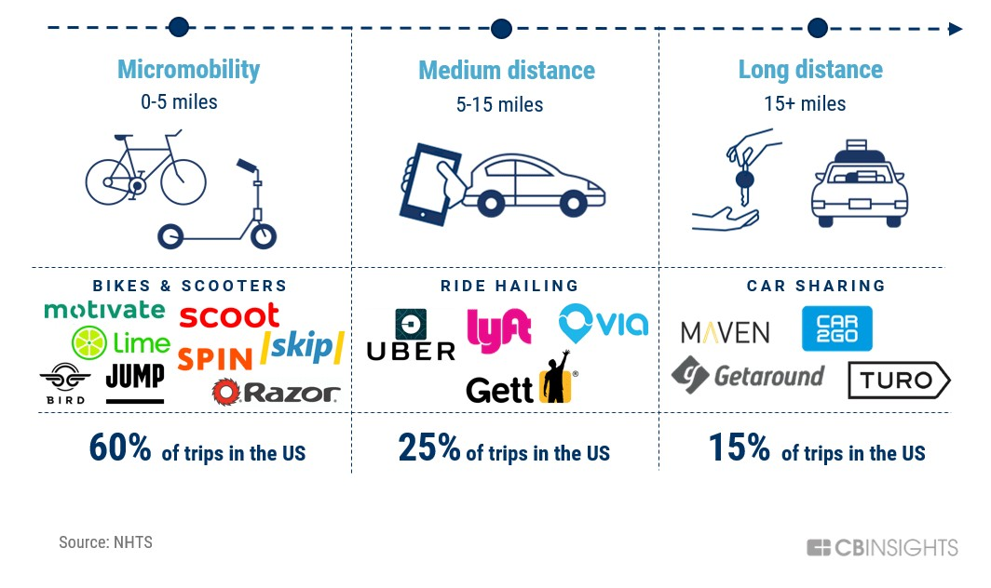
Modes
6

Slide 7
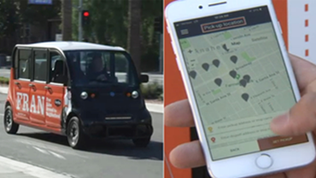
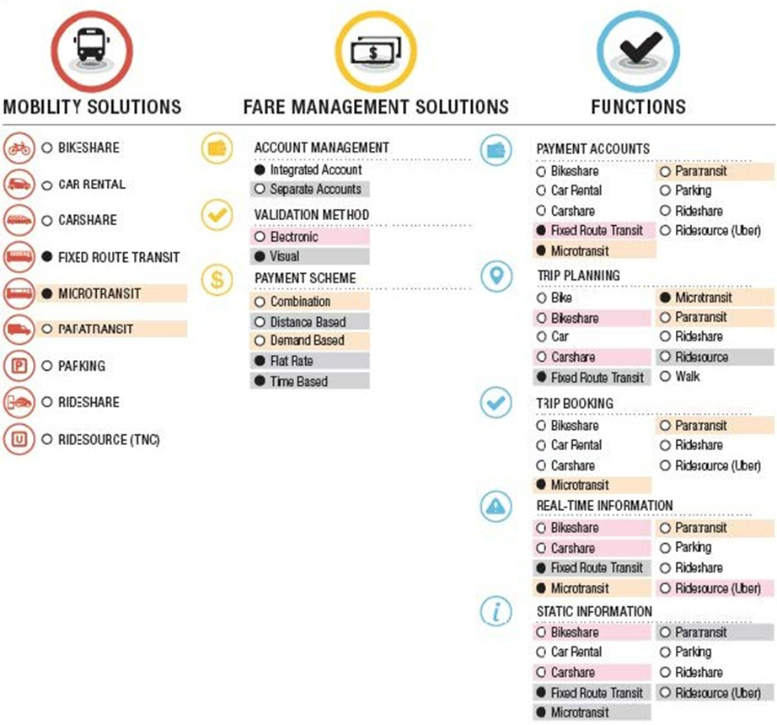
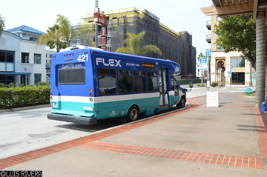
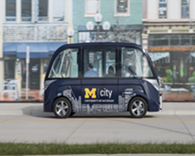
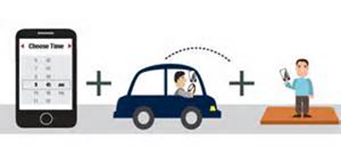

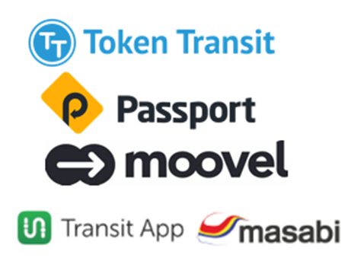
  MoD Potential Partners – Delivery & Technology Platforms
7

Slide 8
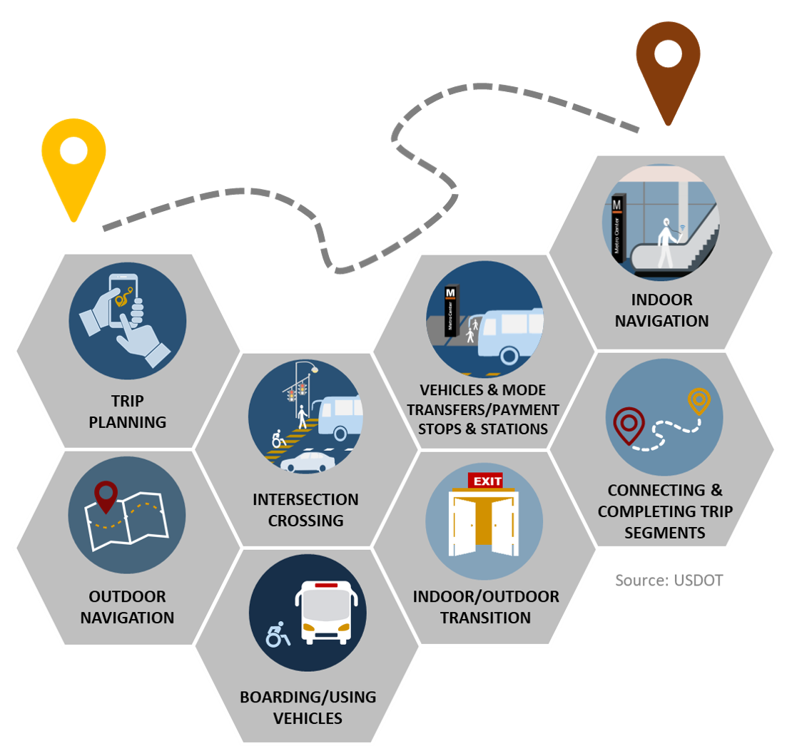
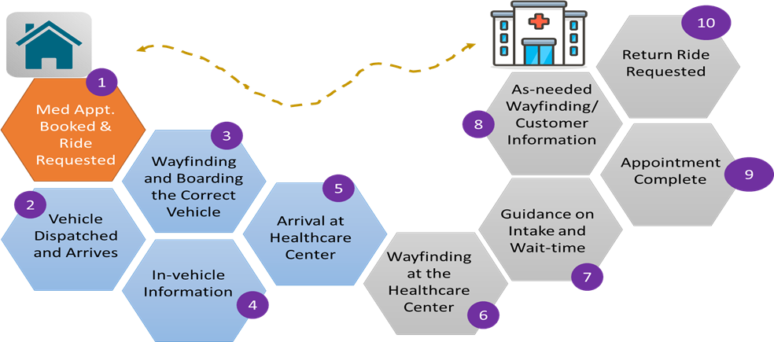
  Complete Trip – Deployment Program
Vision
Innovative and integrated complete trip deployments to support seamless travel for all users across all modes, regardless of location, income, or disability
COMPLETE TRIP:
Mode
Trip planning/discovery
E-hailing
Payment
Information
Wayfinding
Data Sharing
Health Connector Complete Trip Overview
8

Slide 9
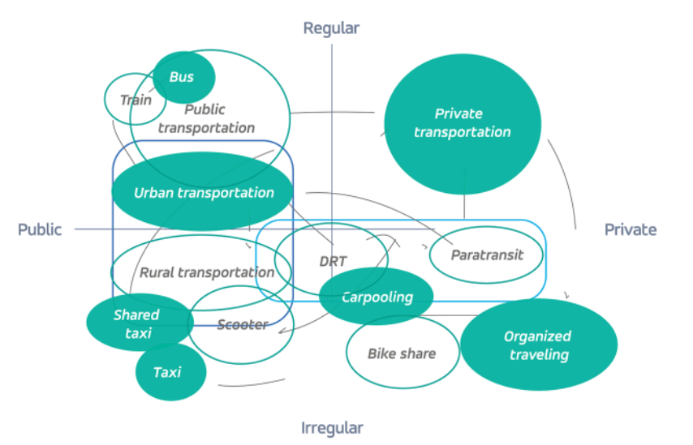

Issues with Industry Solutions
Limited open ecosystem
  Lack of transactional data standards
  Walled garden approach
  Fragmented experience for Travelers
“One size fits all” Approach
Focused on urban mobility
Limited multimodal solutions
Limited focus on agency operations management
Limited tools for regulatory compliance
Unsustainable business models
9
Notes:
Customer experience

Slide 10
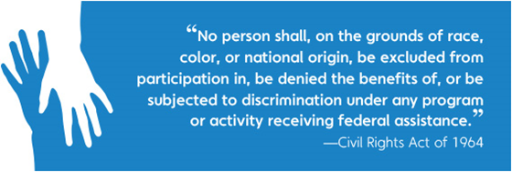
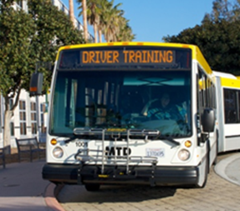
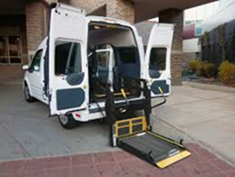







  Challenges & Considerations
Labor Relations/Collective Bargaining
Local Laws/Ordinance - TNCs & AVs
Equity (ADA & Title VI) - compliance concerning service availability; fares; technology access
Driver Training/Screening/Hours of Service
Vehicle Standards
Private Sector Competition/Charter Regulations (& Taxi Exemption rules)
10

Slide 11
Addressing Challenges
Efficiencies in eligibility management
Vendor partnerships for added capacity (e.g., TNCs, taxis, TaaS)
Multimodal trips & connectivity (e.g., fixed route feeder/first-last mile solutions)
Volunteer driver network
Creative agency partnerships for cost sharing (e.g., NEORide consortium)
NEORide One-Call Mobility Center Technology Plan (consortium of 18 agencies in the State of Ohio, Michigan and Northern Kentucky): regional mobility center to serve as the single point of contract for agencies for reservation, scheduling and management of demand response trips.
11
Notes:
Customer experience

Slide 12

  Chicago - RTA/Pace Paratransit - Potential Innovations
Advanced for more detail analysis
Mobility on Demand (MoD)/Emerging Technology
Conditional Eligibility
Integration with Fixed Route Transit/ADA as a Feeder
Same Day Service/TAP/TNCs
Pricing Policy
Subscription Trips
Integrated Trip Planning
Communications
Contract Structure | maybe
Not Advanced
Trip Brokering/E-Commerce | X
Electrification of Fleets | X
Autonomous Vehicles | X
Wearable Technology/Advanced Wayfinding | X
Segmentation of Pace Service Area into Zones | X
Delivery of Dialysis Trips | X
An opportunity for a fresh look at Pace ADA Paratransit services in context of delivery innovations / Next-Gen Mobility made possible by advanced technologies.
12

Slide 13

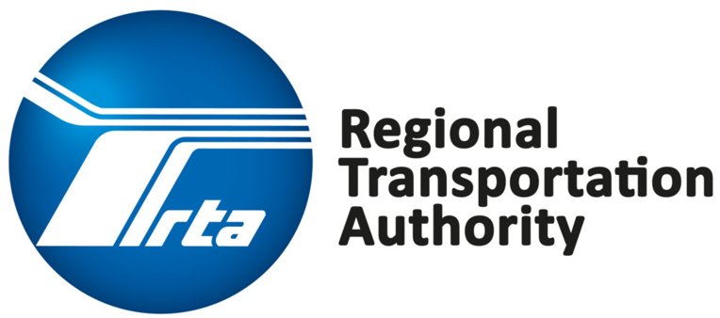
  RTA/Pace Paratransit - Potential Innovations
Guiding Principles:
Preserve the integrity of Pace paratransit services for those with no alternative
Maximize benefits from investments made in accessible fixed route transit (bus and rail) and provide flexible mobility options
Ensure compliance with Americans with Disabilities Act (ADA) & Title VI
Be fiscally responsible and accountable
Goals: Cost – Service Quality – Innovation (RTA’s Strategic Plan)
Deliver Value on Investment (including cost/efficiency considerations);
Build on the Strengths of Network (service delivery); and
Remain Competitive (innovate, deploy new technologies).
Driving Innovation
13

Slide 14
  RTA/Pace Paratransit – Evaluation Framework
14

Slide 15
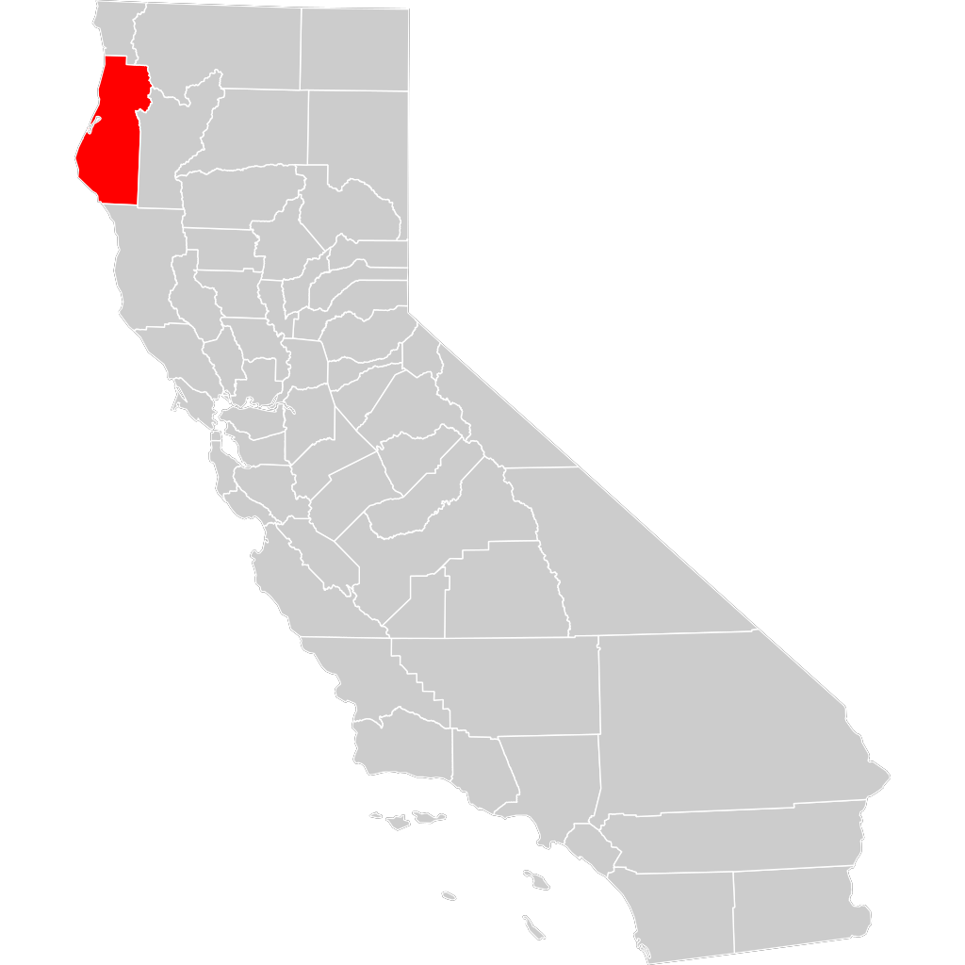


  Rural – MoD Strategic Plan
Humboldt County, California
4,000 square miles
270 miles north of San Francisco
Population of 140,000
Largest City – Eureka – population 27,000
THE NEED: Expand mobility options where gaps exist in the transit network and to locations not easily served by fixed-route transit (First-Last Mile solutions).
  Absence of transit/mobility options
  Lack of awareness on transportation options
  Lack of integrated booking and trip management experience
  Limited capabilities in current modes to meet the needs of underserved
  Limited wayfinding capabilities
  Limitations – day of week, time of day
  Limited data sharing and reporting for performance measurement
15

Slide 16
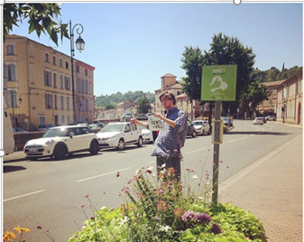
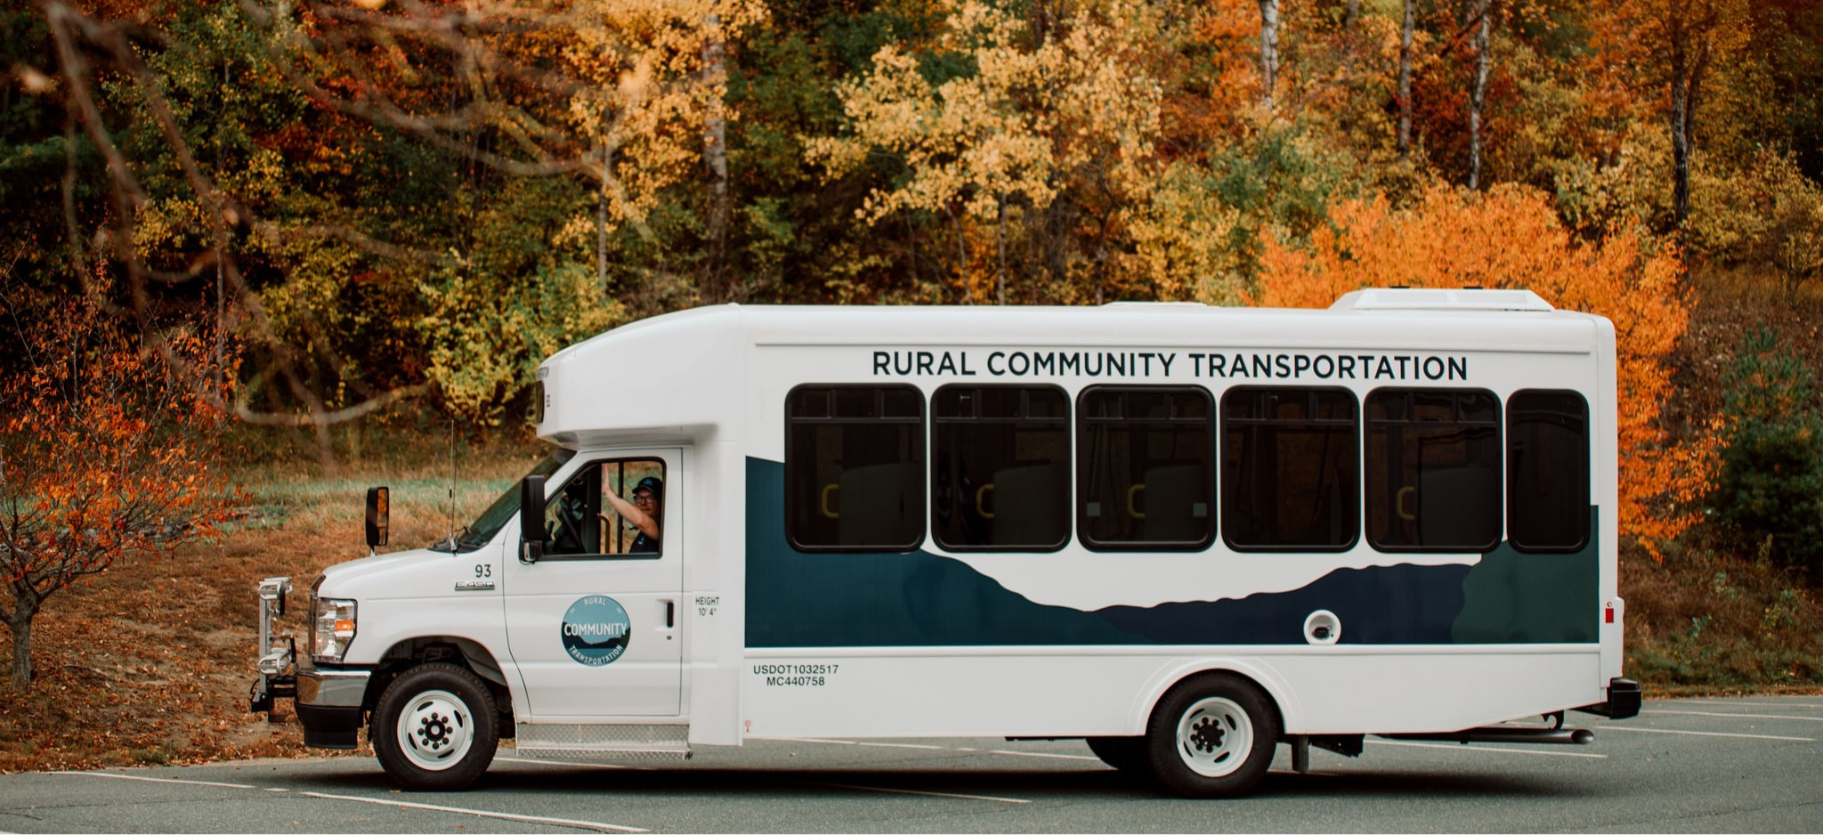
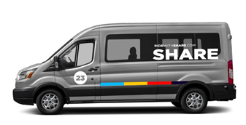
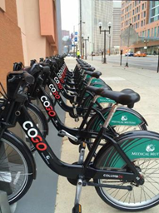

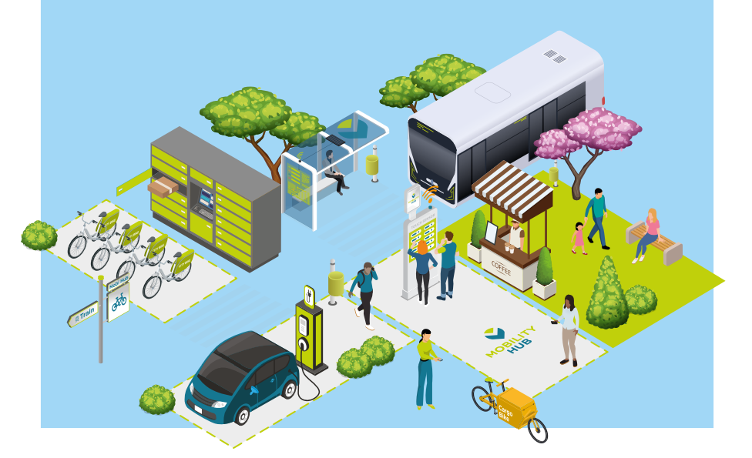
  MoD Strategies – Rural Areas Imagine Possibilities
Range of Delivery Schemes & Types
Volunteer Driver Programs
Organized Hitch-Hiking
Fixed-Route/Fixed Schedule, Flex, Hybrid
Lifeline Services
Car Share
Shared Micromobility/On-Demand Transit
Community Ridesharing/Carpooling
Use of Taxis/TNCs (payment model: ‘service consumed’)
Facilitating Multimodality (& making it more straightforward)
Promoting Low-Carbon Vehicles – electric charging stations
Implementing Mobility Hubs in rural areas
Regional/Statewide Platforms
16

Slide 17
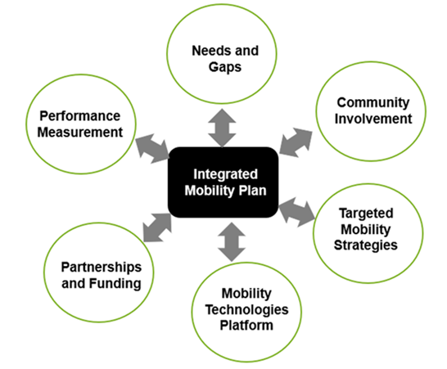
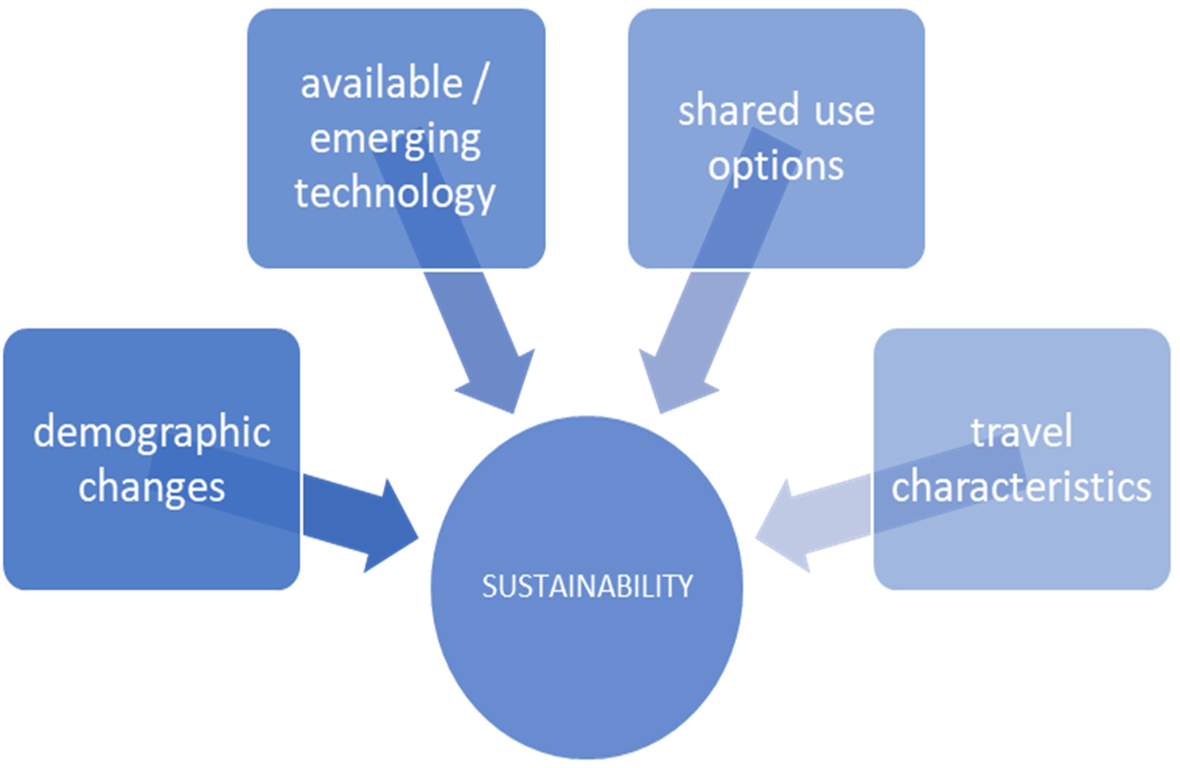
  Integrated Mobility Plan
Sustainability Challenges
17

Slide 18
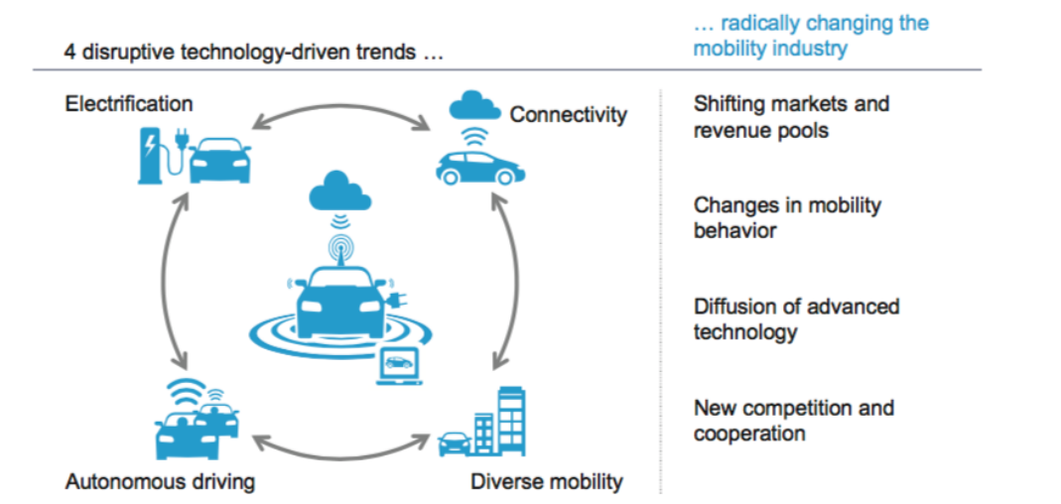
  What’s Next?
Traveler-centric
Technology-driven
Focused on sustainability
Multi-disciplinary & Multimodal
Open ecosystem
Full lifecycle
18

Slide 19
How Mobility on Demand (MOD) Concepts are Re-Shaping Mobility for Rural and Elderly/Disabled Customers in the US: Lessons Learned from the Field
THANK YOU
Steve Wilks: swilks@ibigroup.com
Santosh Mishra: santosh.mishra@ibigroup.com
May 31, 2022
19

