Slide 1
Emerging mobility services, car ownership, and urban transport sustainability in the U.S.
Deborah Salon and Matt W. Bhagat-Conway
School of Geographical Sciences and Urban Planning
TOMNET University Transportation Center

Slide 2
The widespread use of cars in cities is unsustainable.

Slide 3
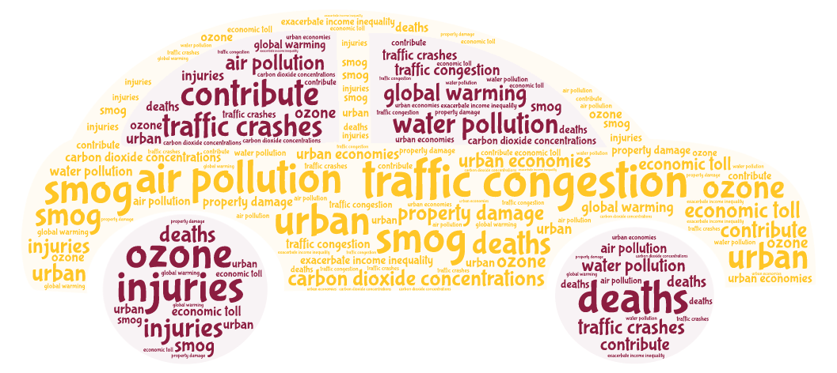

Slide 4
And cars are expensive
(and dangerous)…

Slide 5
…except when compared with other transport options.
This is the main finding of our study.

Slide 6
But, emerging alternatives now provide convenient car access without ownership.

Slide 7
And new ways of accessing bikes and
e-scooters.

Slide 8
Some are saying that car ownership may soon become a choice rather than a necessity for many U.S. households.

Slide 9
And that by ditching their cars, people could save money and the environment, too!

Slide 10
For example:
“Could mobility services, new business models and the sharing economy spell the end of the private car?”
-Automotive World, Feb 2018

Slide 11
Research Question #1:
How much are people in the US actually paying to own and operate their cars?

Slide 12
Research Question #2:
Will emerging mobility options soon make it economical for many Americans to “shed” cars?
People won’t necessarily give up car ownership just because it saves them money, but this study presents a rough upper bound to car shedding, based on money alone.

Slide 13
Our research merged 2017 National Household Travel Survey data with information from multiple other places to estimate detailed car ownership and use costs for more than 230,000 vehicles in the survey.

Slide 14
Included Cost Components
Depreciation
Insurance
Fuel
Maintenance + repair
Vehicle registration fees
Financing

Slide 15
Depreciation
Estimated the 2017 value of each car by matching make, model, and model year to a large sample of 2017 used vehicle listings from TrueCar.com
Depreciation estimated as a percentage of each car’s 2017 value based on a piecewise-linear log-linear regression of car values and their ages
SMALL PRINT:
If more than one TrueCar.com record matched an NHTS car, we used a weighted average of those TrueCar.com listing values
If the NHTS record included an odometer reading $o_{n}$,the weight for matched vehicle $i$ was $w_{i}={(\left|o_{n}−o_{i}\right|+1)}^{−1}$; otherwise, all $w_{i}$s were set to 1

Slide 16
Insurance
We used average insurance costs by driver age, state of residence, and amount of insurance purchased from carinsurance.com.
SMALL PRINT:
Cars with values above $10,000 required comprehensive and collision coverage
Higher-income households selected more liability coverage (presumably, they have more to lose)
Households with more than one car got a 25% multiple-vehicle discount

Slide 17
Fuel
$$Fuel {Cost}_{i}=p_{g}∗{VMT}_{i}/{mpg}_{i}$$
where: $i$ indexes cars,
$p_{g}$ is the price of gasoline in the geographic region where $i$ lives, inclusive of taxes,
${VMT}_{i}$ is the vehicle miles traveled by $i$ in 2017, and
${mpg}_{i}$ is $i$’s miles per gallon fuel economy

Slide 18
Maintenance and Repair
We used 2016 Consumer Expenditure Survey data on car maintenance and repair costs by age and luxury/non-luxury make to estimate per-mile maintenance and repair costs.
SMALL PRINT:
A simple regression estimated annual per-vehicle maintenance and repair costs from the CES by vehicle age category (CES data is by household, not vehicle)
We divided these numbers by annual VMT averages by vehicle age category from the NHTS to obtain average per-mile maintenance costs
We applied these per-mile costs to each vehicle according to the miles it actually traveled.

Slide 19
Registration Fees
The National Conference of State Legislatures published a complete guide to vehicle registration fees and other annual vehicle taxes by state. We used this to estimate fees for each car in our database.
SMALL PRINT:
This was somewhat complicated because some states charge fees based on vehicle weight, others charge based on vehicle age, others charge based on vehicle type, etc. We did our best.

Slide 20
Financing
Financing both new and used car purchases is common in the U.S., but we do not know which of the cars in our sample were financed.
We took a conservative approach, and assume that all cars were financed if they are less than 16 years old.
Interest on car loans is assumed to be 2.4% of the car’s value, calculated based on a 5.15% interest rate car loan with 12% down payment (the average down payment made in 2016), and standard amortization schedule

Slide 21
Note that parking costs are not included in our national estimates.
We do run scenarios that include parking costs in dense urban areas.

Slide 22
This is because most Americans do not pay to park their cars.
Due to widespread implementation of zoning with minimum parking requirements, the vast majority of U.S. car owners do not pay separately to garage their cars at home or park them when they go out.

Slide 23
Distribution of Per-Car Ownership Costs
Car ownership costs are highly variable

Slide 24
To get an idea of who might be able to save money by ditching their car, we created a “demand curve” for vehicle shedding
This is not a true demand curve because it only takes relative money prices into account – it is not based on preferences.

Slide 25
"Demand Curve" for Cost-Effective Car Shedding in the US
Notes:
For each average price point for alternative transport modes, we illustrate:
% of households could save money by shedding at least one vehicle
% of vehicles that could be economically shed
% of VMT that these vehicles currently travel

Slide 26
If the average cost per mile for alternatives were $1.00…

Slide 27
10% of owned cars in the U.S. could be cost-effectively shed

Slide 28
but these cars represent only 2.4% of the miles traveled in owned cars today

Slide 29
The average price per mile for owned car alternatives is the average price for the bundle of alternatives that a household would use if they shed a car.
For every household, this will be a different mix of alternatives, depending on what is available and meets their needs.

Slide 30
As cars are shed, some trips currently taken in owned cars would likely be shortened or simply not taken.
For these miles, the cost would be zero.

Slide 31
Research Question #2:
Will emerging mobility options soon make it economical for many Americans to give up car ownership?

Slide 32
Traditional sustainablemobility options cost less than owned cars on a per-mile basis.

Slide 33
For most Americans,emerging mobility options cost far more than owned cars on a per-mile basis.

Slide 34
On a per-mile basis, median operating (i.e. variable) costs for owned cars are shockingly low.

Slide 35
Our findings suggest that emerging mobility services are unlikely to induce widespread shedding of owned cars, enabling a sustainable urban transport future

Slide 36
Sensitivity analyses:
How do these findings change when we look at different types of cars, households, and cities?
Answer: Not much.

Slide 37
Scenario analysis:
How do these findings change when we add parking costs in medium and high density neighborhoods?
Answer: Quite a bit.

Slide 38
Our parking cost scenario:
$100/month per car in medium density block groups (7000-16999 people/sq. mile)
$300/month per car in high density block groups (17000 or more people/sq.mile)

Slide 39
Adding parking costs in medium and high density neighborhoods moves the national car shedding curve.
Walk
($0.10)
Car
Rental
($0.75)
Bike
($0.17)
Shared
Bicycle
($0.98)
Ridehailing or
Carsharing
Shared
E-scooter
($1.40)
Owned
Car
($0.17)
Public
Transit
($0.27)

Slide 40
Adding parking costs in medium and high density neighborhoods moves the car shedding curve in these neighborhoods even more.
Car
Rental
($0.75)
Walk
($0.10)
Shared
Bicycle
($0.98)
Bike
($0.17)
Ridehailing or
Carsharing
Shared
E-scooter
($1.40)
Public
Transit
($0.27)

Slide 41
Focusing on only high density neighborhoods shows how parking costs can shift this curve toward cost effective car shedding.
Car
Rental
($0.75)
Shared
Bicycle
($0.98)
Walk
($0.10)
Bike
($0.17)
Ridehailing or
Carsharing
Shared
E-scooter
($1.40)
Public
Transit
($0.27)

Slide 42
In a world of technology-enhanced mobility options, traditional solutions for sustainable urban transport still apply.

Slide 43
Make cars more expensive
Local governments have the most control over parking: prices and supply.

Slide 44
Invest in sustainable alternatives
Walking, biking, and transit: They are already cheap – make them safe and convenient!

Slide 45
Thanks for your attention!
deborah.salon@asu.edu
TOMNET University Transportation Center

Slide 46
Next Steps …
Add external costs of car use, and redo analysis
Look more carefully at variation across cities and households in both car costs and alternative costs
Other suggestions?

Slide 47
Insurance
Car insurance premiums depend on a wide variety of factors:
characteristics of the car itself
the primary driver’s individual safety record, demographic characteristics, and credit score
the address where the car is insured
how far the car is driven
whether there are multiple cars in the household
the household’s choice of how much insurance to buy

Slide 48
Insurance
Car insurance premiums depend on a wide variety of factors:
characteristics of the car itself
the primary driver’s individual safety record, demographic characteristics, and credit score
the address where the car is insured
how far the car is driven
whether there are multiple cars in the household
the household’s choice of how much insurance to buy

Slide 49
Regression: Annual HH Maintenance and Repair Expenditures
 | Coef. | S.E.
# Proletarian:
1994 and older | 255 | 46
1995-1999 | 489 | 48
2000-2004 | 653 | 32
2005-2009 | 619 | 28
2010-2014 | 602 | 28
2015-2019 | 327 | 58
N = 11,763
 | Coef. | S.E.
# Luxury:
1994 and older | 581 | 266
1995-1999 | 1087 | 191
2000-2004 | 1002 | 107
2005-2009 | 1237 | 100
2010-2014 | 1060 | 102
2015-2019 | 831 | 241
R² = 0.24

Slide 50
Distribution of Average Car Ownership Cost Per Mile
Median cost per mile for owned cars is only $0.39

Slide 51
Distribution of the Variable Cost of Car Ownership
Overall, 56% of per-mile costs are fixed: paid regardless of how much the car is actually driven

Slide 52
Distribution of Average Variable Car Cost Per Mile
Median variable cost per mile for owned cars is only $0.17

Slide 53
Vehicle type?

Slide 54
Pickups and SUVs are the most likely to be economically shed, while passenger cars and vans are the least.

Slide 55
Luxury (i.e. expensive) make?

Slide 56
The difference between the luxury and “regular” vehicle makes is about the same as between the most and least economical car type.

Slide 57
Car age?

Slide 58
Newer cars cost more per mile because their depreciation cost is so high.

Slide 59
Driver-Car Ratio in the Household?

Slide 60
Households with more cars than drivers (23% of US households!) are more likely to have a car they can economically shed.

Slide 61
Regression: Household Average Cost per Mile
 | Coef
HH Size | -0.01***
# Workers | -0.03***
# Vehicles | -0.02***
Home Owner | 0.03***
Adults, No Kids | -
Adults with Kids | NS
Retired | 0.08***
Income <$25K | -
Income $25-50K | NS
 | Coef.
Income $50-100K | NS
Income >$100K | 0.04***
Low Density | -
Mid Density | 0.03***
High Density | 0.04***
Low Density NYC | 0.04*
Mid Density NYC | 0.03**
High Density NYC | 0.06***
N = 114,185 R² = 0.07

