Slide 1
Automated Vehicle Policy Strategies for California
Mollie Cohen D’Agostino
Co-Director, Automated Vehicle Technology and Policy Center, Institute of Transportation Studies at UC Davis
Policy Director, UC Davis Policy Institute for Energy, Environment, & the Economy
Policy Lead, Emerging Technologies, Public Transit and Shared Mobility, University of California – Institute of Transportation Studies
Presentation at TRB SETT Conference
June 3, 2022
mdagostino@ucdavis.edu

Slide 2
AV Innovation timeline
Takeaway:
We’re just getting started doing something about Automation.
(after many years of hype)

Slide 3
White Paper Research Question:
What AV-related policies can fill gaps in existing California state policy to advance state goals?
Safety, Equity, Accessibility, Sustainability

Slide 4
Methodology
Potential problems
Near Term Actions
Long-term outcomes
Mixed-methods approach:
State of the Industry Scan
Legal Policy Gap Analysis
Policy Options Assembled
using policy backmapping exercise
Interviews with key stakeholders in all sectors to refine policy strategies
(incorporated into the Policy Option)
Policy Back mapping example
Notes:
“Will Robotic Trucks Be ‘Sweatshops on Wheels?’

Slide 5
1. State of the Industry in California
California DMV AV Testing Program 2020 mileage reporting vs. vehicle fleet
CA DMV Deployment Permits Issued
Nuro
Cruise
Waymo
CPUC Passenger
Service Operation
Notes:
Certainly Cruise and Waymo traveled the most miles in 2020, and it’s paid off.
They are

Slide 6
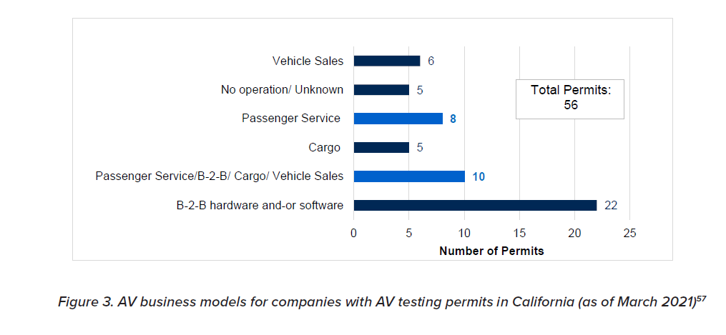
AV Business Models
Notes:
Blended business models will likely dominate the AV space, and several of those categorized as passenger service, have recently announced they are likely moving towards some goods movement, including Zoox who will be here today to expand on that.

Slide 7
2. Legal Policy Gap Analysis State and Federal AV Policy and Regulation

Slide 8
Timeline: California Automated Vehicle Policy
DMV AV Policy Established (SB 1298)
3 permits est. (testing w/ driver, w/o driver, and commercial deployment).
Est. safety self-certifications
Set annual reporting requirements, e.g. Vehicle counts, Mileage Reporting)
DMV Policy Updated
Added Light-duty delivery vehicles added (limit of 10,001 lbs)
.
DMV Deployment Permits Issued
Nuro (licensed to operate commercially)
Cruise (not yet charging fares)
Waymo
DMV: Current Status
> 4 million miles reported
~49 active permits
EV exemption 8,500 lbs
Weight limit 10,0001 lbs
NHTSA
Issues Final Rule to Update FMVSS
2019
2021
2018
2020
2022
CPUC AV Passenger Service Pilot Est.
(and held workshop)
Restricted fares, ride pooling, airport access,
CPUC - Moves AV Pilot to Full Deployment
Removed fare and pooling restrictions
Approval of Safety Plans Required
San Francisco makes CEQA argument for “Phased Approach”
SB 500 Passed
Requires all AVs (under 8,501 lbs) electrify by 2030
CPUC: Current Status
Cruise – draft approval for Deployment Program Published
19 support letters
SF and Disability Rights Council submitted protest letters.
Notes:
Safety Self-certification (e.g. AVs were tested in circumstances that simulate public roads, AVs have a remote operator, and AVs meet insurance requirements)

Slide 9
Federal AV Policy
Prior to a recent ruling four high-level guidance documents issued.
March 2022 – New Rule issued that updates the Federal Motor Vehicle Safety Standards (FMVSS)
Goals include minimizing changes and providing regulatory certainty
Rule only applies to row seating (additional research needed for campfire or rear facing seating)
Rule will “eliminate the need for ADS-equipped -vehicle manufacturers to equip vehicles with redundant manual driving controls in vehicles that do not have manual driving capabilities.”
Require that the left front seating position equivalent to the right front seating position
Made accommodations for vehicles intended for people with wheelchairs (no seats- still requires occupant safety standards)
Still coming a possible new “Safety Framework” for the Automated Driving System (ADS) - Draft Proposed by Trump Admin – stalled
CalSTA public Comment: Consider ADS Competency Evaluation
(Important Note: these actions are distinct from NHTSA activities associated with semi-autonomous vehicles- include investigation of crashes involving semi-autonomous vehicles, and is considering ADAS related updates to its New Car Assessment.)
Notes:
NHTSA is tasked with administering the National Traffic and Motor Vehicle Safety Act (Safety Act)

Slide 10
3. Policy Options Assembled Top 10 AV Policy Areas (not ordered)
Safety
Emissions
Occupancy
Transit and Interoperability
Rural and Suburban Issues
Disability access
Workforce
Booking and Payment Standards
Data collection
Insurance and liability
Notes:
“Will Robotic Trucks Be ‘Sweatshops on Wheels?’

Slide 11
AVs and Safety
Q: Can/should the state do more to ensure that AVs will be safe enough for passengers onboard and for pedestrians, bicyclists, and all people who will interact with AVs?
Potential Policy Mechanisms investigated:
Set Safety Performance Measures: Update (DMV regulations) for two tracks: freight and passenger AVs, aligning to data collection for both safety and security outcomes.
Collect more Safety data: Update AV safety reporting requirements - to CA DMV to encourage public accountability for AV-related safety incidents (ensure there is no disparity in safety outcomes by race, income, or mode).
*New Research pending further research:
Develop clear standards for remote operation: Recognizing the technological limitations surrounding latency of remote operation.
Develop new permit classifications: Recognizing
Notes:
CA statute goes one step further than federal regulators, in requiring a self-certification from companies asserting that their vehicles are safe for public roads....This is still a self-certification. A set of performance measures would go a step further.
- ADS competency evaluation would be extremely hard to administer at the state level, and may require FAA level regulatory efforts.
CalSTA (in comments to the federal government) asked for the feds to consider a “ADS competency test”, which could be developed federally. Worth considering whether an external test should validate the safety assertions of the companies.

Slide 12
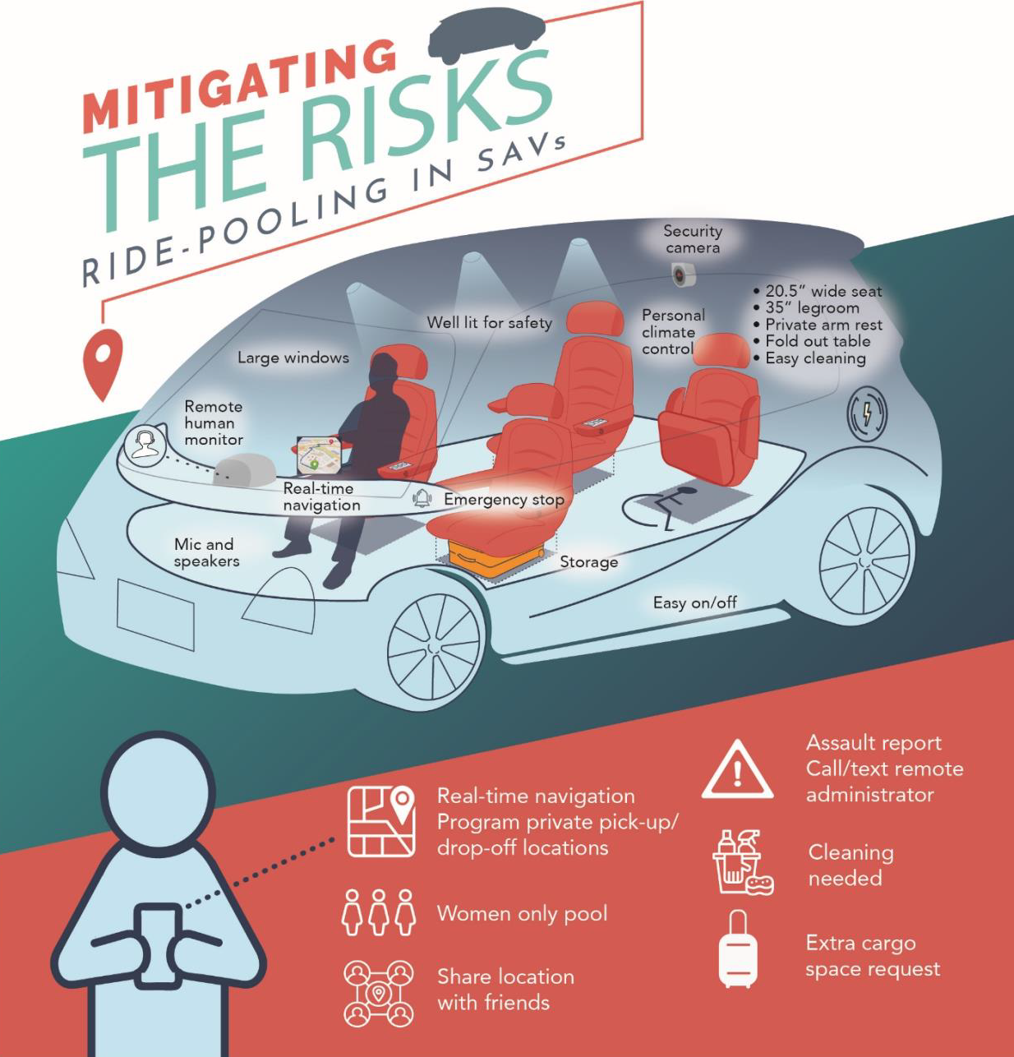
Safety & Security Definitions
Safety is protection from accidental harms.
Security is protection from intentional harms.
Regulatory Requirements:
CPUC is responsible for working with industry to ensure safety and security outcomes
Sanguinetti, Kurani, Ferguson (2019)
Notes:
AV-TNCs will submit a plan outlining how they intend to orient consumers to the technology, minimize risks, and respond to harassment or hostile individuals aboard. While these design questions fall out of scope for state regulators they are addressing some basic vehicle design issues with the passage of SB 570 which modernized the vehicle code. I think our guest respondents can speak to that more later.

Slide 13
AV Electrification
Q: How can California encourage AVs to be deployed as ZEVs?
Potential policy mechanisms
State Law Now Requires AV electrification
(SB500 requires that all light duty AVs be ZEVs by 2030, omitting AVs over 8,500 lbs)
Invest in public charging infrastructure that meets the needs of AVs

Slide 14
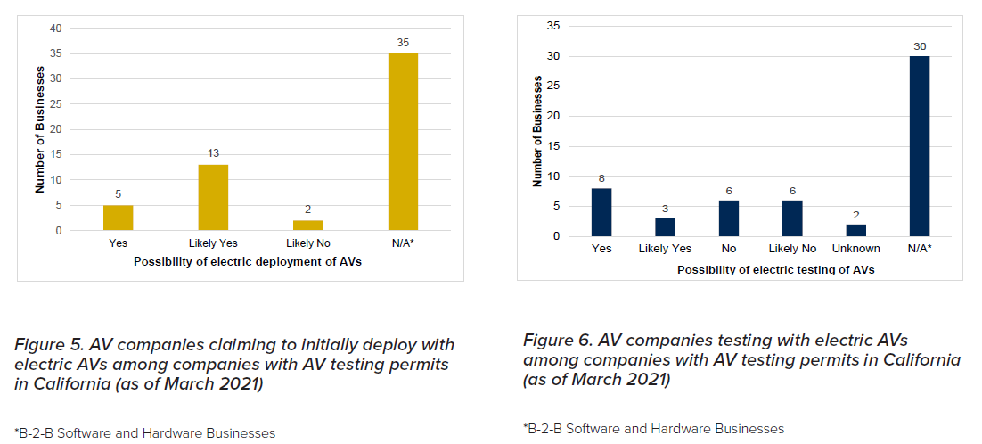
AV Electrification Plans

Slide 15
AVs and Pooling
Q: How can the state discourage personal ownership of AVs and zero mile trips?
Potential Policy Mechanisms:
Registration fees for personally owned AVs.
Road user fees that charges privately owned AVs on a GHG-per-mile basis (with additional charges for empty miles) while ensuring user privacy.
Feebates to support more efficient modes of travel (e.g., public transit, biking, and walking), equitable access, and maintenance of public infrastructure. (Targeted reinvestment of fee revenues listed above.)
Notes:
The research points to the fact that AVs may be high mileage vehicles

Slide 16
Transit and Interoperability
Q: How can the state support AVs that are complementary to public transit?
Potential Policy Mechanisms:
New grant opportunities - transit-complementary service
Spending flexibility for current funds
Guidelines for equitable AV service as a prerequisite for credits or permits
Guidelines for AV booking and payment (for open-loop and open-API) and alternatives for cash and app-based service ensure universal accessibility and transit integration.

Slide 17
Rural and Suburban AV Service
Q: Should the state encourage AV mobility service providers to provide service to rural and suburban areas?
Potential Policy Mechanisms
Provide guidance for community needs assessment to ensure AV service can improve on status quo options and achieve equitable and sustainable long-term outcomes.
Rewards, credits, or subsidies for operating where density may not demand service? (especially disadvantaged communities)
Notes:
There are some concerns that less-dense rural and suburban communities (where costs of AV passenger services are likely to be more expensive) will be left out of the tide of innovation coming to the transportation sector. It remains an open question whether there is a public responsibility to help ensure SAEV service reaches rural communities in an equitable and sustainable manner.

Slide 18
AVs and Workforce
Q: Should the state establish workforce impact mitigation strategies for AVs?
Potential policy Mechanisms:
Target retraining programs to future proof skills for drivers.
Investigate how partial automation that can yield safety benefits for workers and community members.
Target data collection strategies toward monitoring workforce safety and effects.
Ensure a robust stakeholder engagement process includes drivers, so they can contribute their knowledge and expertise toward the transportation innovation sector.

Slide 20
AVs and Disability Access
Q: Should the state hasten adoption of AV passenger services for people with disabilities?
Possible policy mechanisms:
Define key terminology as it relates to AVs, including the terms “accessibility,” “accessible AV service,” and “equivalent AV passenger service”
Set guidelines to directly connect (AV and WAV-TNC) regulatory efforts
Support community-owned enterprises or nonprofit organizations that can increase the availability of WAV service.
Notes:
b. Will there need to be a separate AV-TNC classification and new metrics applied for the access for all fund? Right now TNCs

Slide 21
AV Data Collection and Insurance
Q: Should the state align data collection across agencies to achieve public objectives?
Streamline data that collected by DMV and CPUC
Establish or participate in a data clearinghouse
Q: Should the state reevaluate options for covering risks and assigning liability?
Evaluate AV insurance minimums to match liability risks with different risk profiles (e.g. size of fleets, cybersecurity preparedness, infrastructure connectivity).
Identify liability insurance requirements for those who operate and use AVs (e.g., individual owners, fleet owners, TNCs).

Slide 22
Thank you
Huge thanks to co-authors and contributors:
Jerel Francisco, Graduate Student Research, UC Davis, Transportation, Technology, and Policy
Benjamin Baek, Law Student, UC Davis Law
Susan Shaheen, PhD, Director, California RIMI, UC ITS, Professor, CEE, UC Berkeley
Dan Sperling, Founding Director, Institute for Transportation Studies; Professor, CEE, UC Davis

