Slide 1
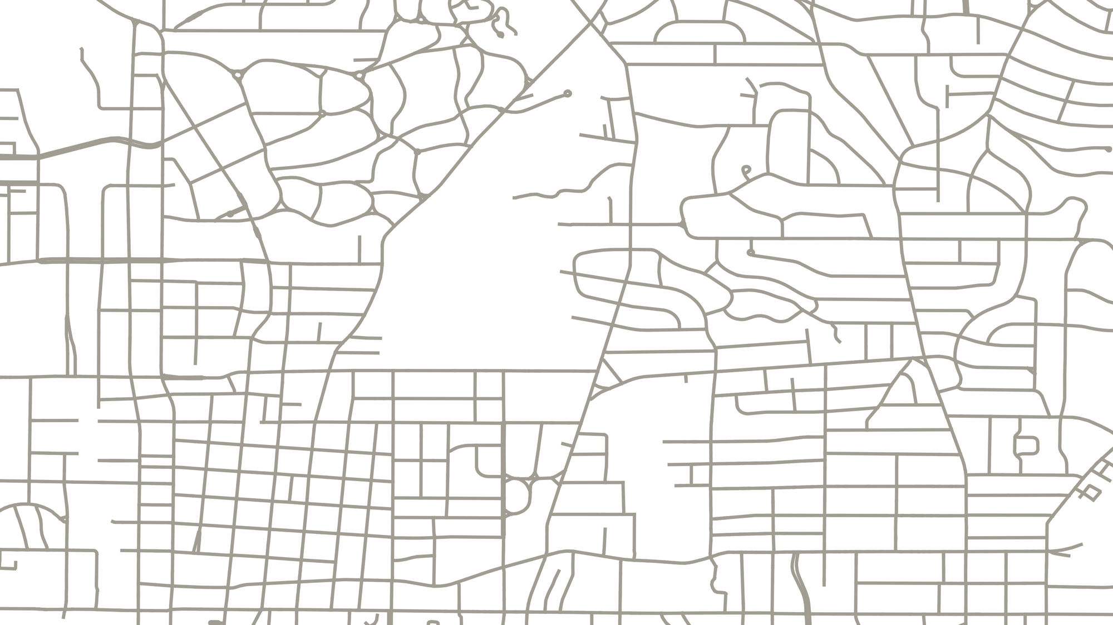
BikewaySim: Using impedance to estimate improvement in perceived safety from new cycling infrastructure
Reid Passmore, Dr. Kari E. Watkins, Dr. Randall Guensler
SETT Conference
June, 2nd, 2022

Slide 2
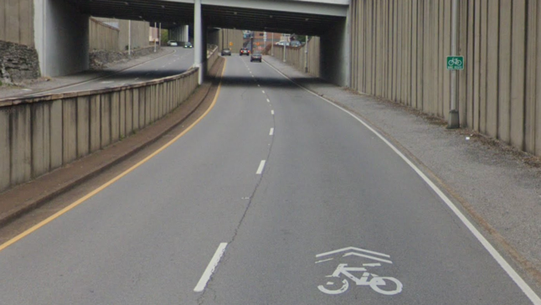
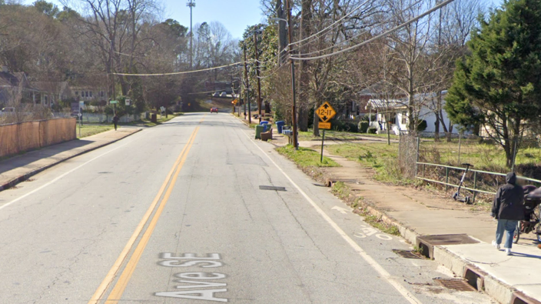
Need for better cycling infrastructure in the U.S.
Real and perceived danger imposed on cyclists by cars when sharing the same space is a major deterrent to cycling in the U.S.
Street view images from Google Maps

Slide 3
We already have good bike design guidelines
But where and what kind of infrastructure to place to best increase the perceived safety of cycling?

Slide 4
Introducing BikewaySim
What:
Python based shortest path calculator
Finds least impedance path for cycling trips for any origin/destination pair
How:
Uses Dijkstra's algorithm to find shortest path using impedance
Uses link impedance to model cyclist’s preferences for road attributes
Why:
To evaluate how new cycling facilities change aggregate impedance
To prioritize infrastructure that increases perceived safety
To provide suggested routes
Notes:
Animate?

Slide 5
Link Impedance
Typically represented by travel time, not sufficient for cycling
Cyclists’ show preferences for certain road attributes:
Bike infrastructure, slow speed streets, traffic signals
And avoidance of other attributes:
Turns, hills, busy roads, distance
Hood, J., E. Sall, and B. Charlton. A GPS-based bicycle route choice model for San Francisco. Transportation Letters, 2013.
Fitch, D. T., and S. L. Handy. Road environments and bicyclist route choice: The cases of Davis and San Francisco, CA. Journal of Transport Geography, 2020.
Menghini, G., N. Carrasco, Schüssler, and K. Axhausen. Route choice of cyclists in Zurich. Transportation Research Part A, 2010.

Slide 6
Desired impedance function form
$$C_{i}={\frac{l_{i}}{v}\sum_{k∈K}{β_{k,i}}x}_{k,i}$$
Where:
$C_{i}$: the impedance to traverse link i in units of time
$l_{i}$: length of link i
$v$: assumed average cyclist speed
$β_{k,i}$: attribute specific impedance coefficient, k, for link i
$x_{k,i}$: link attribute, k, for link i
Path/route impedance = sum of link impedances

Slide 7
Desired impedance function form
$$C_{i}={\frac{l_{i}}{v}\sum_{k∈K}{β_{k,i}}x}_{k,i}$$
Where:
$C_{i}$: the impedance to traverse link i in units of time
$l_{i}$: length of link i
$v$: assumed average cyclist speed
$β_{k,i}$: attribute specific impedance coefficient, k, for link i
$x_{k,i}$: link attribute, k, for link i
Path/route impedance = sum of link impedances

Slide 8
How to calibrate impedance functions?
Cycling Data
Observed Cyclists:
Bicycle Volume Counts
GPS Trajectory Data
Potential Cyclists:
Stated Preferences for Cycling Facilities
Calibration Process
Impedance Functions
Network Data with Attribute Data

Slide 9
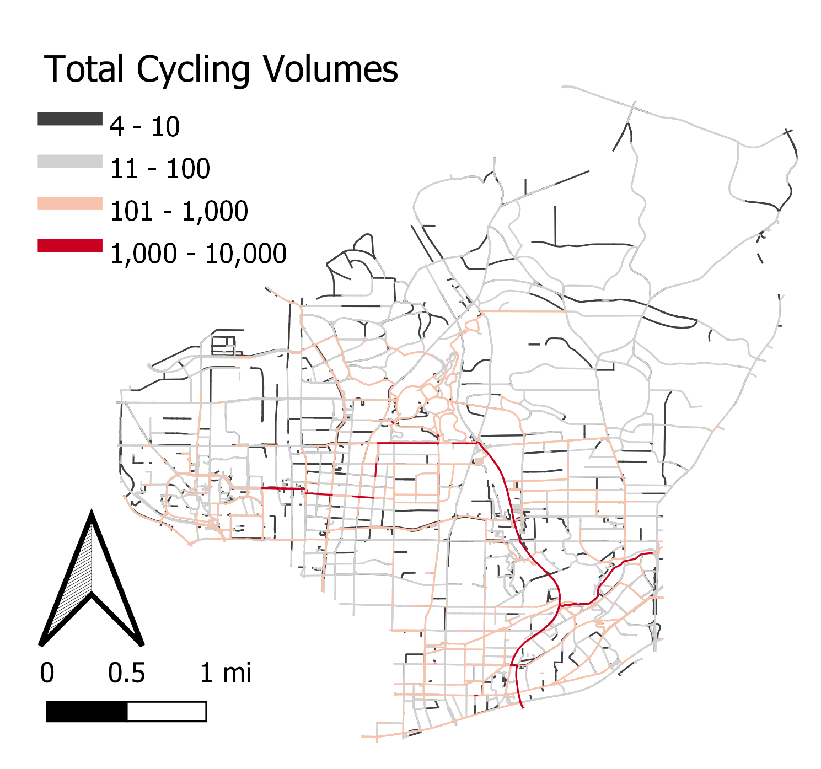
How to calibrate impedance functions?
Cycling Data
Observed Cyclists:
Bicycle Volume Counts
GPS Trajectory Data
Potential Cyclists:
Stated Preferences for Cycling Facilities
Network Data with Attribute Data

Slide 10
How to calibrate impedance functions?
Cycling Data
Observed Cyclists:
Bicycle Volume Counts
GPS Trajectory Data
Potential Cyclists:
Stated Preferences for Cycling Facilities
Network Data with Attribute Data
Basemap from CartoDB

Slide 11
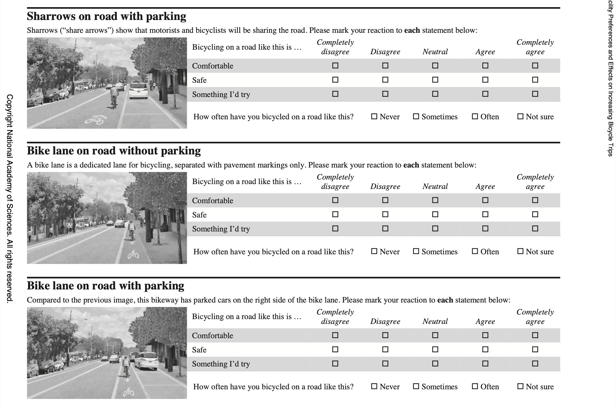
How to calibrate impedance functions?
Cycling Data
Observed Cyclists:
Bicycle Volume Counts
GPS Trajectory Data
Potential Cyclists:
Stated Preferences for Cycling Facilities
Network Data with Attribute Data
Survey from National Academies of Sciences, Engineering, and Medicine 2020. Bicyclist Facility Preferences and Effects on Increasing Bicycle Trips. Washington, DC: The National Academies Press. https://doi.org/10.17226/25792

Slide 12
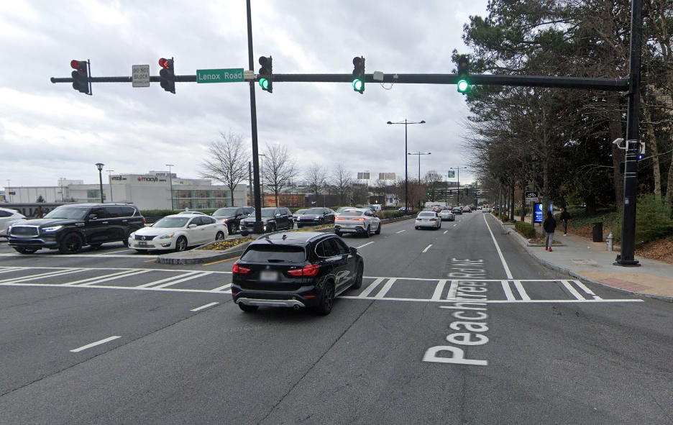
How to calibrate impedance functions?
Cycling Data
Observed Cyclists:
Bicycle Volume Counts
GPS Trajectory Data
Potential Cyclists:
Stated Preferences for Cycling Facilities
Signalization
# of traffic lanes, speed limit, traffic volume
Network Data with Attribute Data
Street view images from Google Maps
Bike facility type

Slide 13
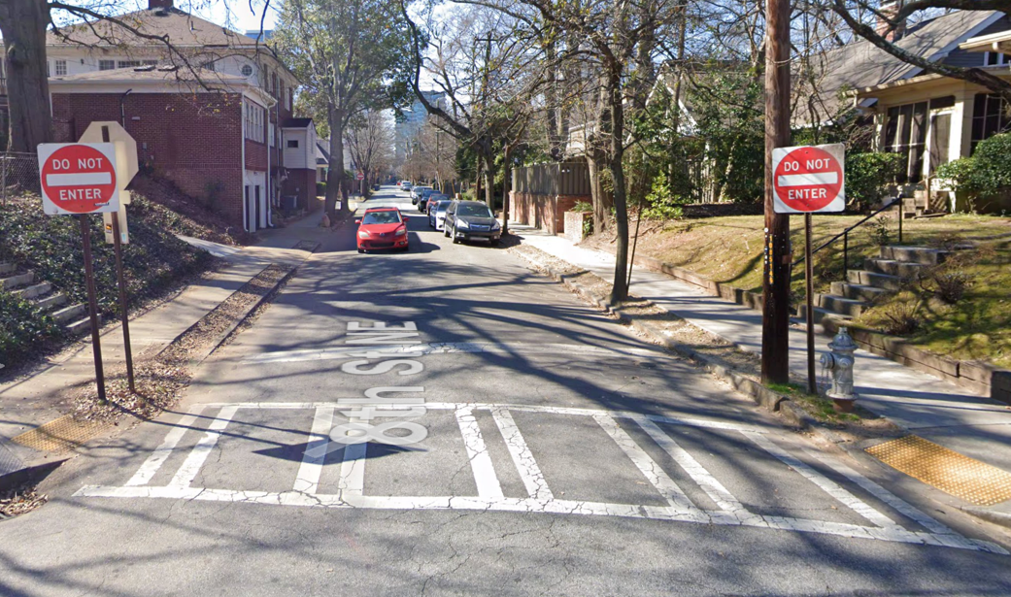
How to calibrate impedance functions?
Cycling Data
Observed Cyclists:
Bicycle Volume Counts
GPS Trajectory Data
Potential Cyclists:
Stated Preferences for Cycling Facilities
One way restriction
Network Data with Attribute Data
Street view images from Google Maps
On-street parking

Slide 14
How to calibrate impedance functions?
Cycling Data
Observed Cyclists:
Bicycle Volume Counts
GPS Trajectory Data
Potential Cyclists:
Stated Preferences for Cycling Facilities
Hills
Network Data with Attribute Data

Slide 15
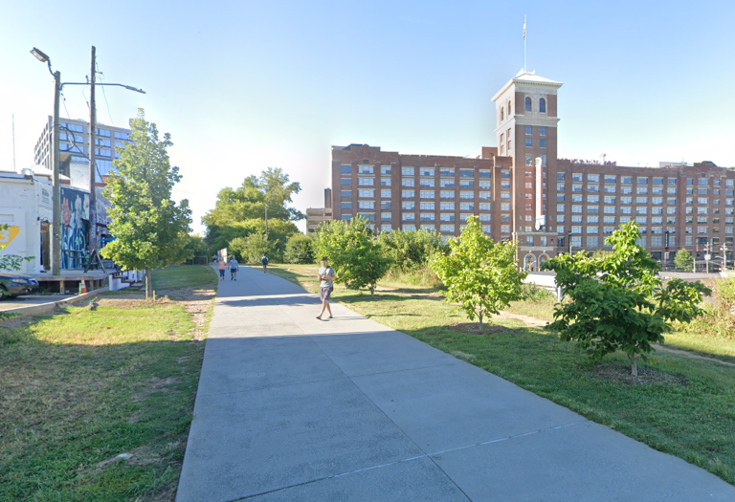
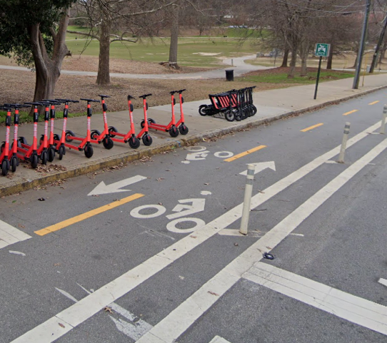
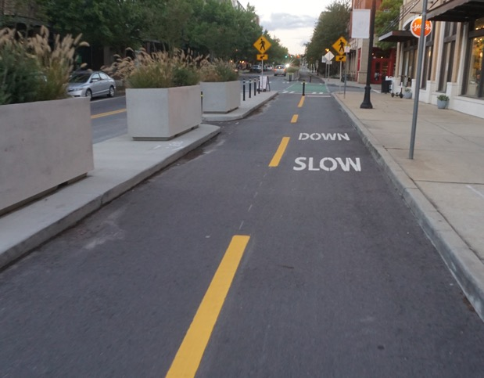
How to calibrate impedance functions?
Cycling Data
Observed Cyclists:
Bicycle Volume Counts
GPS Trajectory Data
Potential Cyclists:
Stated Preferences for Cycling Facilities
Network Data with Attribute Data
Multi-use paths
Cycletracks

Slide 16
How to calibrate impedance functions?
Cycling Data
Need network data with attributes
Municipal data is limited for our study area
For this project we looked at three sources:
ABM: Our MPOs activity based model network
HERE: Licensed data on roads from HERE
OSM: OpenStreetMap
Observed Cyclists:
Bicycle Volume Counts
GPS Trajectory Data
Potential Cyclists:
Stated Preferences for Cycling Facilities
Network Data with Attribute Data

Slide 17
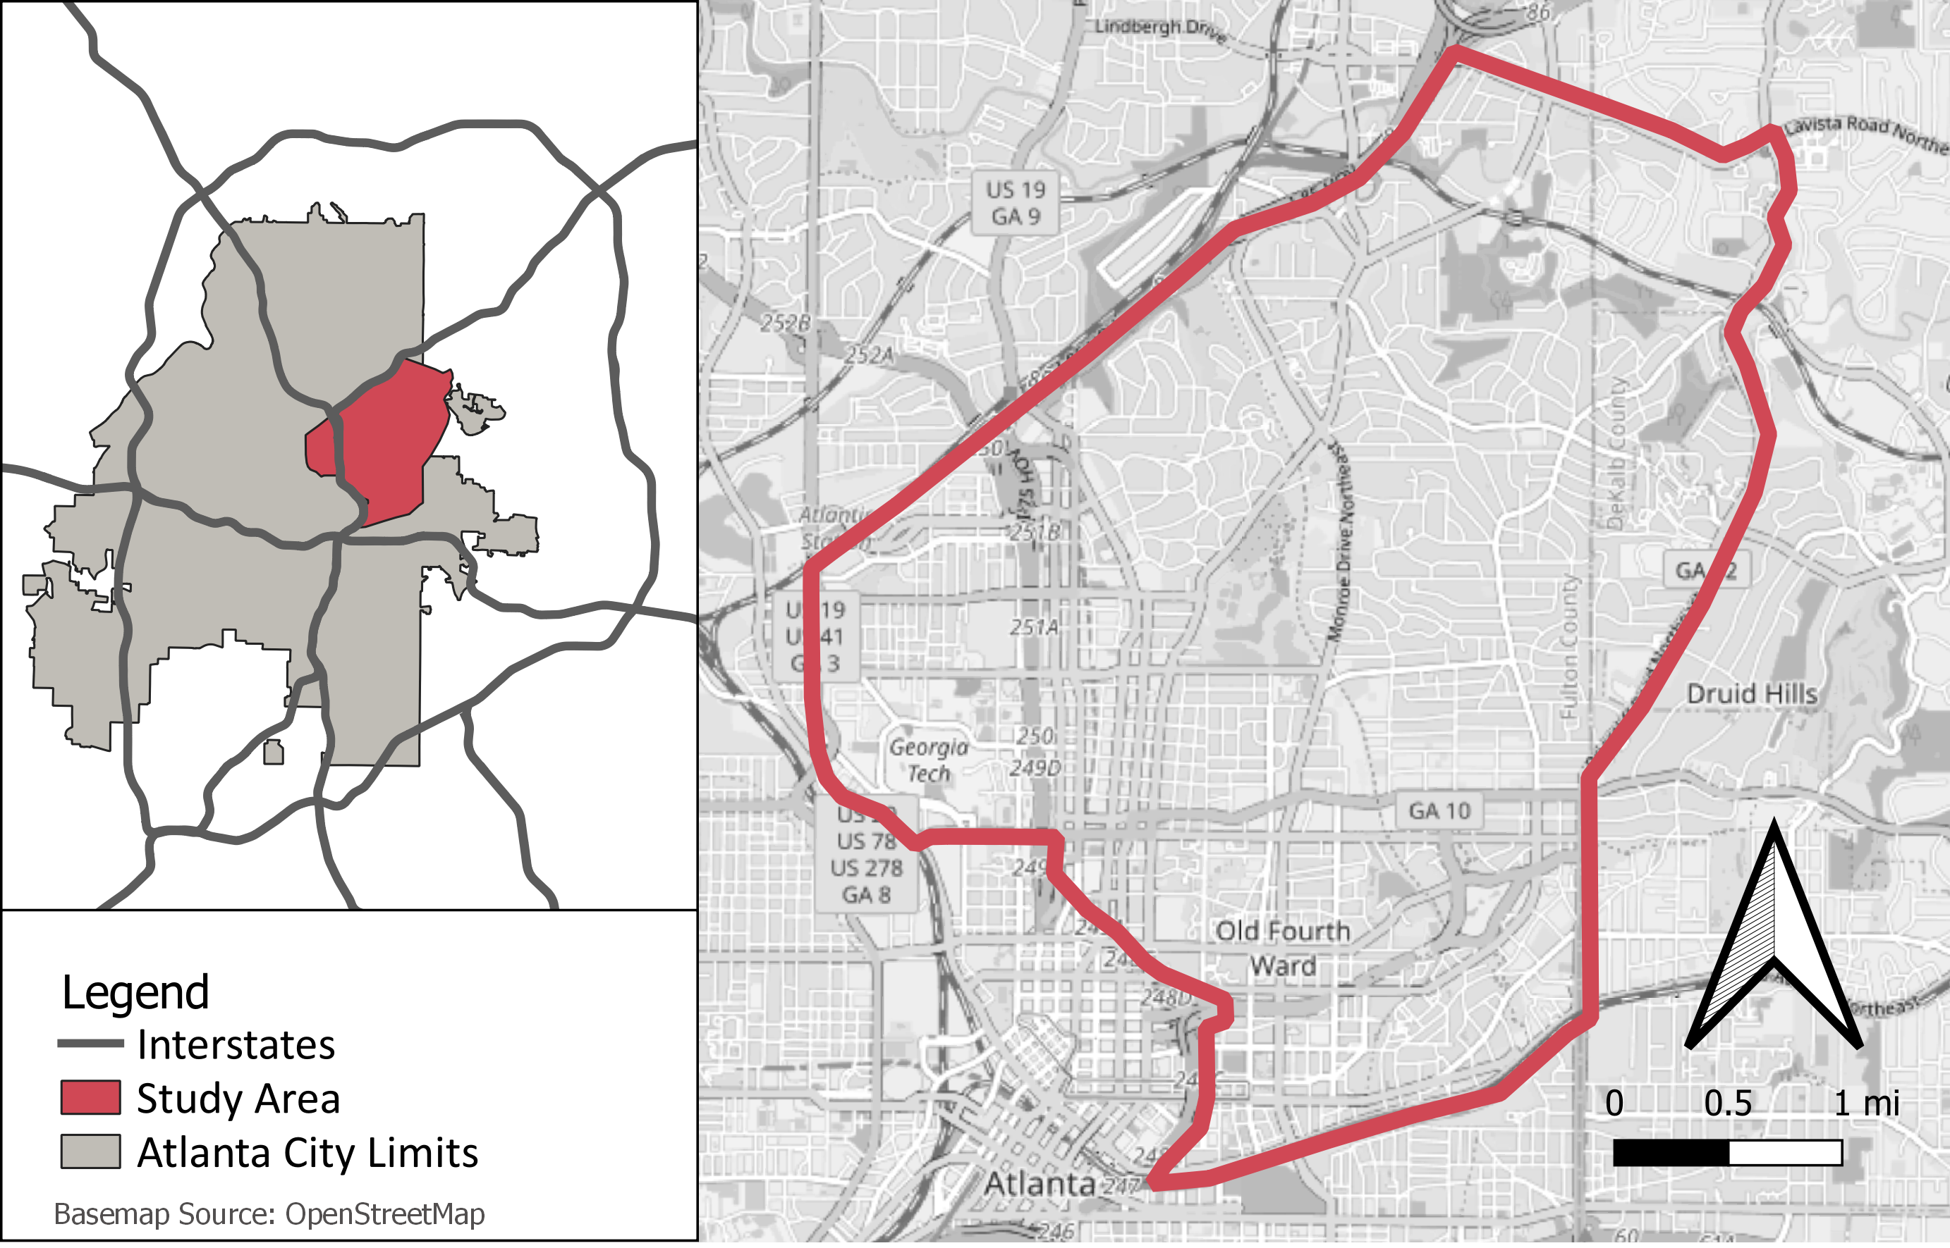
How to calibrate impedance functions?
Cycling Data
Observed Cyclists:
Bicycle Volume Counts
GPS Trajectory Data
Potential Cyclists:
Stated Preferences for Cycling Facilities
Network Data with Attribute Data
Notes:
Pull off greater atlanta map to the side to fill in white space

Slide 18
How to calibrate impedance functions?
Cycling Data
Network Type | Network Name | Number of Links | Number of Nodes | Total Length (mi.)
Total | ABM | 2,542 | 2,065 | 182
 | HERE | 12,286 | 9,535 | 401
 | OSM | 24,198 | 17,029 | 627
Observed Cyclists:
Bicycle Volume Counts
GPS Trajectory Data
Potential Cyclists:
Stated Preferences for Cycling Facilities
Network Data with Attribute Data
ABM
HERE
OSM
Notes:
Going to just have maps of the network and the overall counts because they say pretty much the same thing.

Slide 19
How to calibrate impedance functions?
Attribute | ABM | HERE | OSM
Bicycle Facilities | - | - | ◑
Bicycle Facility Width | - | - | -
Bicycle Facility Blockage | - | - | -
Bicycle Traffic Volume | - | - | -
Sidewalks | - | - | ◑
Sidewalk Width | - | - | -
Number of Lanes | ● | ● | ◑
Travel Lane Width | - | - | -
Shoulder Width | - | - | -
Traffic Volume | ● | - | -
Directions Allowed | ● | ● | ◑
Road Classification | ● | ● | ●
Speed Limit | ● | ● | ◑
Observed Speed Limit | ● | - | -
Median Presence | ● | ● | -
On Street Parking | - | - | ○
Road Grade/Slope | - | - | -
Bridge/Tunnel | - | ● | ○
Cycling Data
Observed Cyclists:
Bicycle Volume Counts
GPS Trajectory Data
Potential Cyclists:
Stated Preferences for Cycling Facilities
Network Data with Attribute Data
Legend:
‘-‘: Attribute not available
‘○’: Less than 1% data available
‘◑’: 1%-50% data available
‘●’: > 50% of data available
Notes:
Maybe take out one of these and make sure to streamline

Slide 20
How to calibrate impedance functions?
Attribute | ABM | HERE | OSM
Bicycle Facilities | - | - | ◑
Bicycle Facility Width | - | - | -
Bicycle Facility Blockage | - | - | -
Bicycle Traffic Volume | - | - | -
Sidewalks | - | - | ◑
Sidewalk Width | - | - | -
Number of Lanes | ● | ● | ◑
Travel Lane Width | - | - | -
Shoulder Width | - | - | -
Traffic Volume | ● | - | -
Directions Allowed | ● | ● | ◑
Road Classification | ● | ● | ●
Speed Limit | ● | ● | ◑
Observed Speed Limit | ● | - | -
Median Presence | ● | ● | -
On Street Parking | - | - | ○
Road Grade/Slope | - | - | -
Bridge/Tunnel | - | ● | ○
Cycling Data
Observed Cyclists:
Bicycle Volume Counts
GPS Trajectory Data
Potential Cyclists:
Stated Preferences for Cycling Facilities
Network Data with Attribute Data
Legend:
‘-‘: Attribute not available
‘○’: Less than 1% data available
‘◑’: 1%-50% data available
‘●’: > 50% of data available
Notes:
Need to fix circle sizes; rephrase osm completion

Slide 21
How to calibrate impedance functions?
Attribute | ABM | HERE | OSM
Bicycle Facilities | - | - | ◑
Bicycle Facility Width | - | - | -
Bicycle Facility Blockage | - | - | -
Bicycle Traffic Volume | - | - | -
Sidewalks | - | - | ◑
Sidewalk Width | - | - | -
Number of Lanes | ● | ● | ◑
Travel Lane Width | - | - | -
Shoulder Width | - | - | -
Traffic Volume | ● | - | -
Directions Allowed | ● | ● | ◑
Road Classification | ● | ● | ●
Speed Limit | ● | ● | ◑
Observed Speed Limit | ● | - | -
Median Presence | ● | ● | -
On Street Parking | - | - | ○
Road Grade/Slope | - | - | -
Bridge/Tunnel | - | ● | ○
Cycling Data
Observed Cyclists:
Bicycle Volume Counts
GPS Trajectory Data
Potential Cyclists:
Stated Preferences for Cycling Facilities
Network Data with Attribute Data
Legend:
‘-‘: Attribute not available
‘○’: Less than 1% data available
‘◑’: 1%-50% data available
‘●’: > 50% of data available
Notes:
Need to fix circle sizes; rephrase osm completion

Slide 22
How to calibrate impedance functions?
Attribute | ABM | HERE | OSM
Bicycle Facilities | - | - | ◑
Bicycle Facility Width | - | - | -
Bicycle Facility Blockage | - | - | -
Bicycle Traffic Volume | - | - | -
Sidewalks | - | - | ◑
Sidewalk Width | - | - | -
Number of Lanes | ● | ● | ◑
Travel Lane Width | - | - | -
Shoulder Width | - | - | -
Traffic Volume | ● | - | -
Directions Allowed | ● | ● | ◑
Road Classification | ● | ● | ●
Speed Limit | ● | ● | ◑
Observed Speed Limit | ● | - | -
Median Presence | ● | ● | -
On Street Parking | - | - | ○
Road Grade/Slope | - | - | -
Bridge/Tunnel | - | ● | ○
Cycling Data
Observed Cyclists:
Bicycle Volume Counts
GPS Trajectory Data
Potential Cyclists:
Stated Preferences for Cycling Facilities
Network Data with Attribute Data
Legend:
‘-‘: Attribute not available
‘○’: Less than 1% data available
‘◑’: 1%-50% data available
‘●’: > 50% of data available
Notes:
Need to fix circle sizes; rephrase osm completion

Slide 23
How to calibrate impedance functions?
Cycling Data
ABM network has traffic volume and observed speed attributes
HERE has good overall attribute completion
OSM has more bike facility data and most link mileage
Need to combine networks
Observed Cyclists:
Bicycle Volume Counts
GPS Trajectory Data
Potential Cyclists:
Stated Preferences for Cycling Facilities
Network Data with Attribute Data
Notes:
Change to plus plus equal

Slide 24
How to calibrate impedance functions?
Cycling Data
Three potential approaches:
Marginal rates of substitution (MRS) or equivalent %∆ distance from existing route choice models
Recursive logit models
Route choice set generation with random coefficients
Observed Cyclists:
Bicycle Volume Counts
GPS Trajectory Data
Potential Cyclists:
Stated Preferences for Cycling Facilities
Calibration Process
Network Data with Attribute Data
1) Broach J, J Dill, J Gliebe. Where do cyclists ride? A route choice model developed with revealed preference data. Transportation Research Part A: Policy and Practice. 2012; 46(10):1730-1740. doi:10.1016/j.tra.2012.07.005
2) Zimmermann M, T Mai, E Frejinger. Bike route choice modeling using GPS data without choice sets of paths. Transportation Research Part C: Emerging Technologies. 2017;75:183-196. doi:10.1016/j.trc.2016.12.009
3) Nassir N, Ziebarth J, Sall E, Zorn L. Choice Set Generation Algorithm Suitable for Measuring Route Choice Accessibility. Transportation Research Record. 2014;2430(1):170-181. doi:10.3141/2430-18
Notes:
If anyone has experience with these I’d love to talk afterwards

Slide 25
How to calibrate impedance functions?
Cycling Data
Different approaches needed for these data
Trajectory not known
For stated preferences, there’s no spatial connection
Observed Cyclists:
Bicycle Volume Counts
GPS Trajectory Data
Potential Cyclists:
Stated Preferences for Cycling Facilities
Calibration Process
Network Data with Attribute Data

Slide 26
How to calibrate impedance functions?
Cycling Data
Observed Cyclists:
Bicycle Volume Counts
GPS Trajectory Data
Potential Cyclists:
Stated Preferences for Cycling Facilities
Calibration Process
Impedance Functions
Network Data with Attribute Data

Slide 27
How to calibrate impedance functions?
Cycling Data
Observed Cyclists:
Bicycle Volume Counts
GPS Trajectory Data
Potential Cyclists:
Stated Preferences for Cycling Facilities
Calibration Process
Impedance Functions
Network Data with Attribute Data
More than one impedance function depending on user type

Slide 28
Three uses of impedance functions
Bikeshed visualization
Preference based individual routing
Measuring change in aggregate impedance from network improvements
Notes:
Do something with this slide

Slide 29
Example impedance function
High stress streets are perceived as 4x the distance
Links with bike lanes viewed as 0.25x the distance
$$C_{i}=\frac{l_{i}}{v}(0.25∗x_{bike lane, i}+4∗x_{high stress, i})$$

Slide 30
Three uses of impedance functions
So if we have a 0.1 mile low-stress road with a bike lane:
$$C_{i}=\frac{0.1 miles}{8\frac{miles}{hour}}\left(0.25∗1+4∗0\right)$$
$$C_{i}=0.003 mi.$$
Link is effectively shorter, less impedance to travel

Slide 31
Study Area:
Atlanta, GA
Notes:
Turn these back to miles

Slide 32
Study Area:
Atlanta, GA
Virginia Highlands Neighborhood
(low-density, primarily single-family zoning)
Midtown (dense, urban)
Georgia Tech
BeltLine Multi-Use Path
Piedmont Park

Slide 33
169 TAZs

Slide 34
Street Network

Slide 35
15 Minute Bikeshed

Slide 36
15 Minute
Impedance Bikeshed
*regular 15 minute bikeshed not shown

Slide 37
15 Minute Bikeshed

Slide 38
Removed links

Slide 39
New links

Slide 40
15 Minute
Impedance Bikeshed
*regular 15 minute bikeshed not shown
BeltLine Multi-Use Path

Slide 41
Individual Routing

Slide 42
Individual Routing
Time

Slide 43
Individual Routing
Impedance

Slide 44
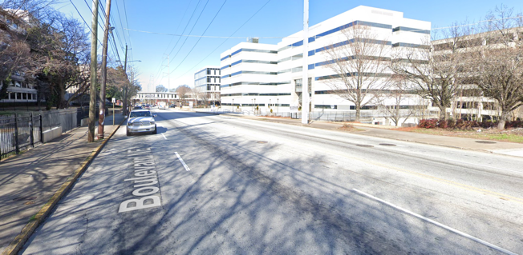
Least travel time path is not always the preferred path
Street view images from Google Maps

Slide 45
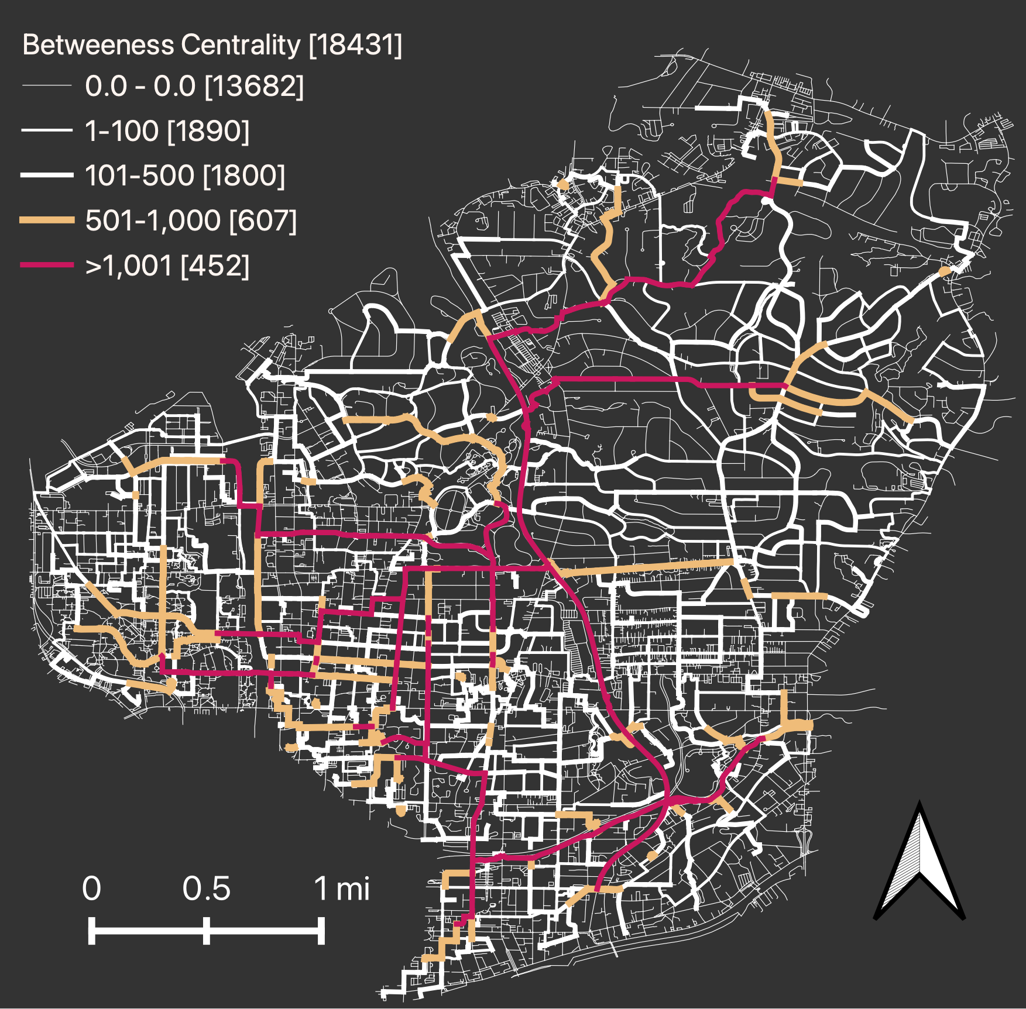
Aggregated results using impedance
From all TAZs to all TAZs:
28,392 OD pairs
Betweenness centrality
# of trips using link for shortest path
Average impedance:
15.2 minutes
Notes:
Placeholder images until I redo these; convert text to table

Slide 46
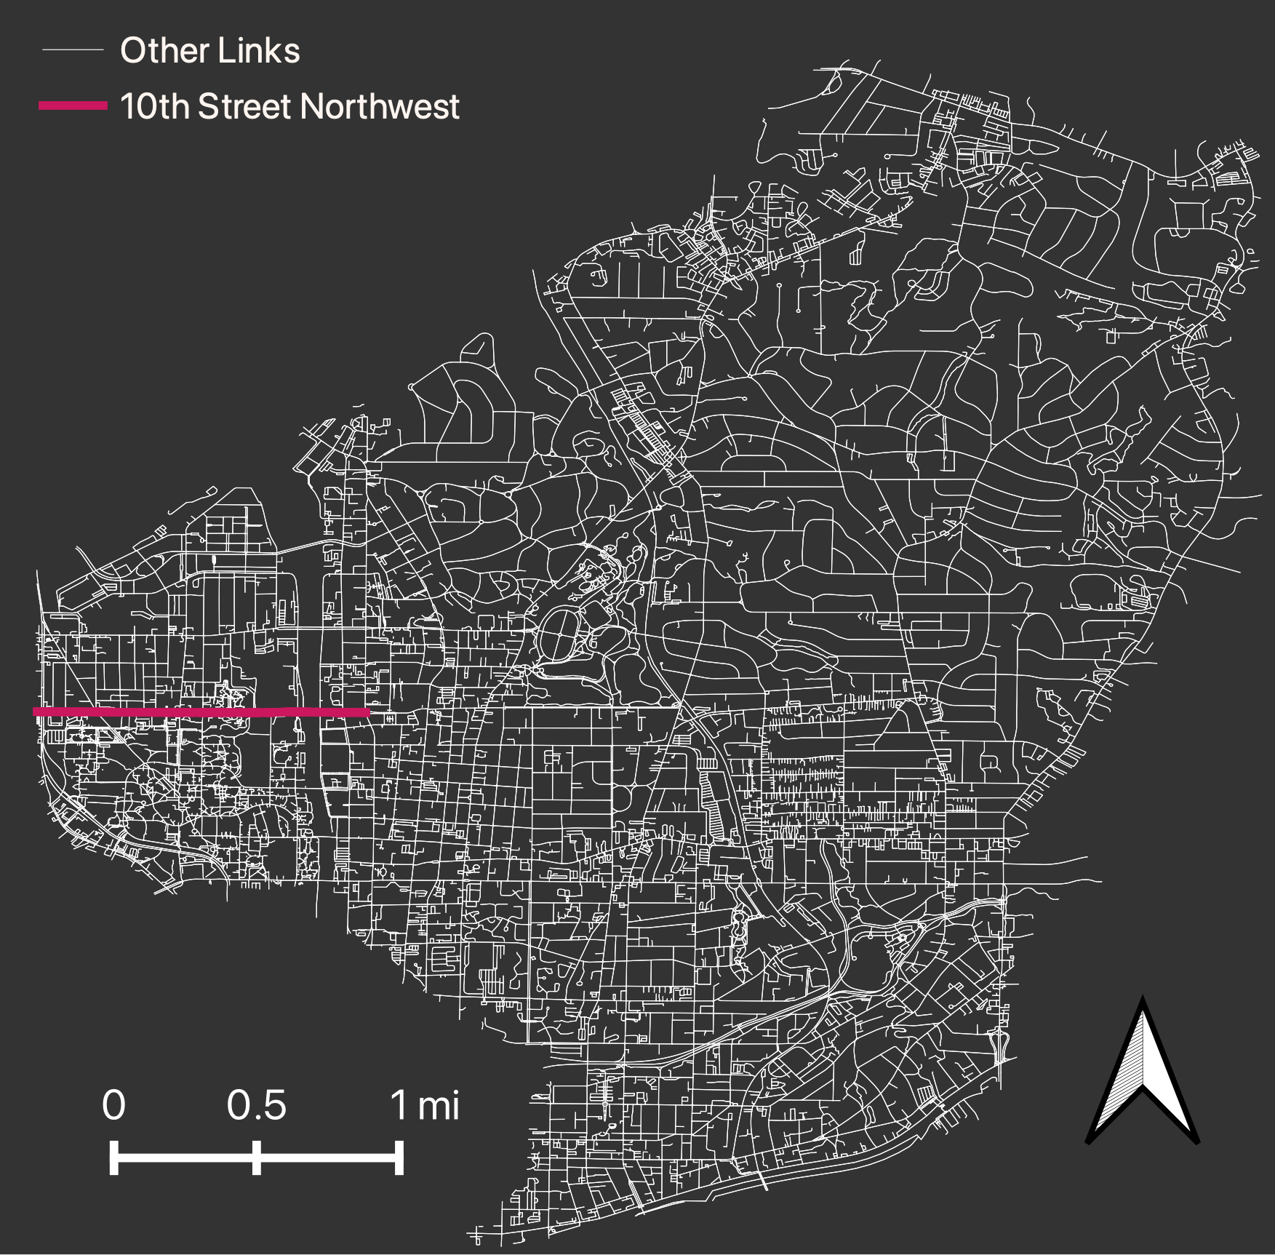
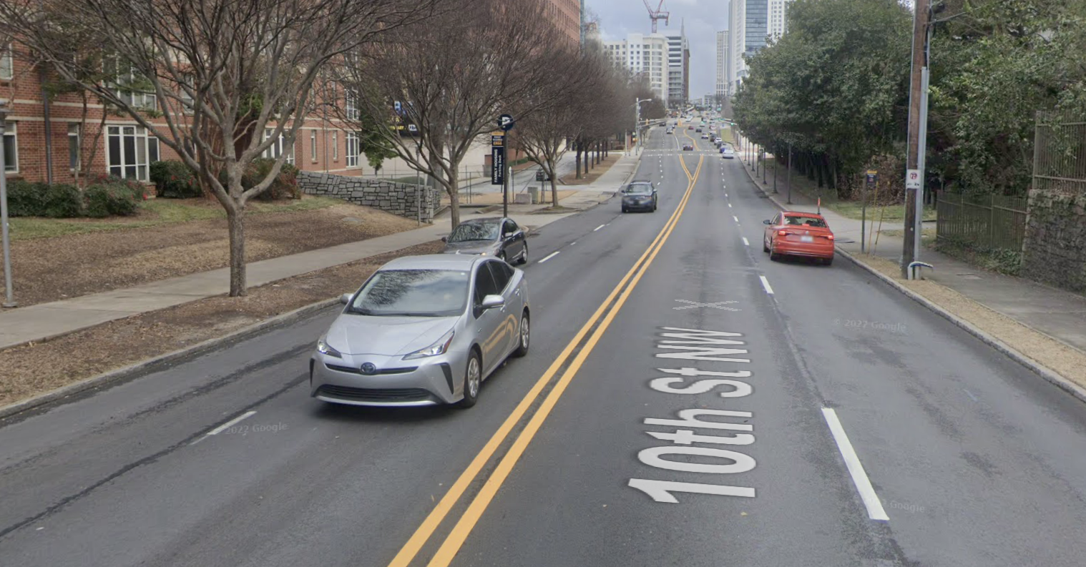
Network Improvement
Cycletrack added to 10th Street Northwest
10th Street is one of the few roads that cross I-75/85 interstate
Current Conditions:
Notes:
Add streetview of current conditions

Slide 47
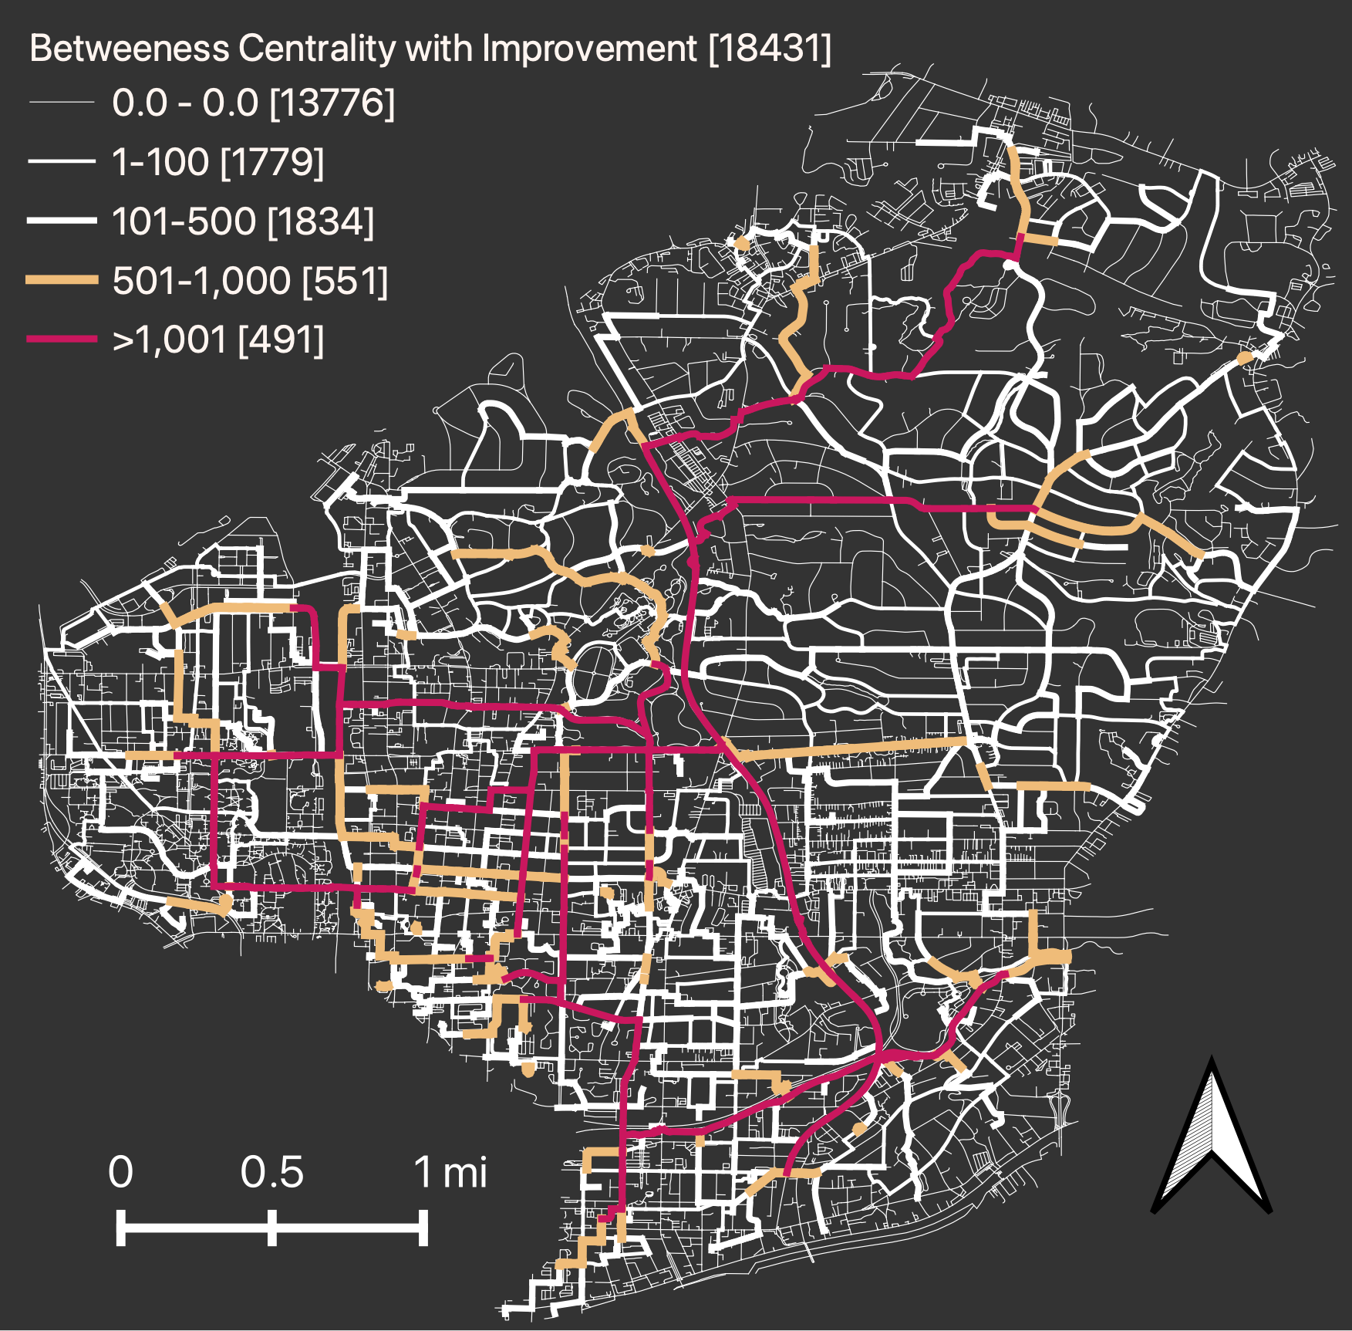
Aggregated results after improvement
New average impedance
15.1 minutes
Difference in impedance
0.1 minutes
Can compare to other improvements and rank accordingly
Notes:
Placeholder images until I redo these; convert text to table

Slide 48
Aggregated results using impedance
Notes:
Placeholder images until I redo these; convert text to table

Slide 49
Conclusion
BikewaySim is an opensource shortest path calculator for cycling
BikewaySim can measure change in impedance from new infrastructure
Planners and engineers can rank projects
Need calibration methods for:
Trajectory data
Aggregated data
Stated preferences
BikewaySim Code Link:
Notes:
This is my dissertation project, make sure to see feedback

Slide 50
Questions/Suggestions?

