Slide 1
Congestion Pricing Policy – Factoring Shared Mobility and Autonomous Vehicles
Matthew W. Daus, Esq.
Technical Session C5: Policy Impacts on Emerging Mobility Services
Session Track: New Mobility Services
6/2/2022, 10:30 AM - 12:00 PM

Slide 2
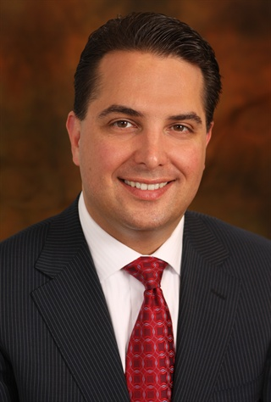
Matthew W. Daus, Esq.
Former Commissioner/Chair/CEO & General Counsel, New York City Taxi & Limousine Commission
President, IATR
International Association of Transportation Regulators www.iatr.global
Transportation Technology Chair, CUNY-UTRC, CCNY
University Transportation Research Center, City University of New York at The City College of NY www.utrc2.org
Partner & Chairman, Transportation Practice
Windels Marx Lane & Mittendorf, LLP www.windelsmarx.com
Contact: mdaus@iatr.global 646-261-1590

Slide 3
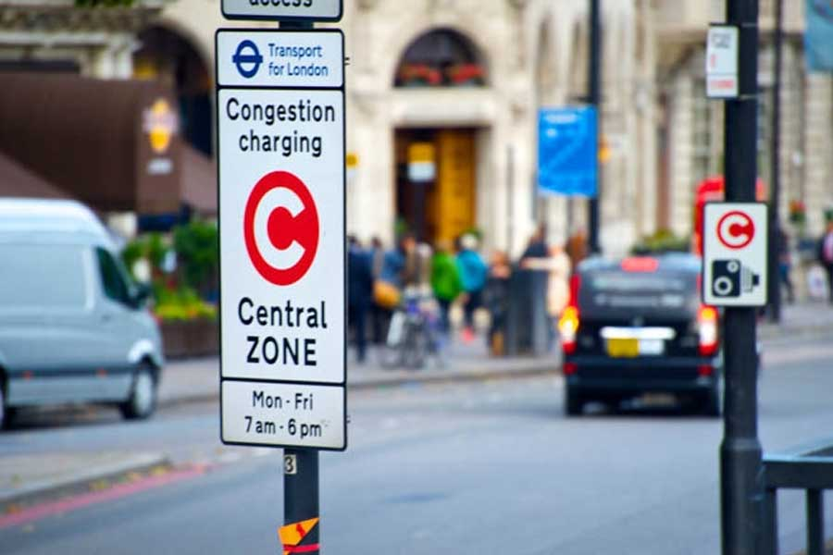
Lessons Learned from London
Since 2003, London has had a congestion pricing scheme, which initially exempted all for-hire vehicles (private-hire vehicles and black cabs) from the fees.
As TNCs became increasingly popular, they diminished the pricing scheme’s effectiveness, leading London to remove the exemption for private-hire vehicles in 2019. London’s black cabs remain exempt.
Key lessons from TfL (as noted from the IATR workshop):
Charging scheme should be accompanied by measures to make public transport (and other alternatives to car travel) cheaper, faster and more reliable.
There must be political will and commitment to deliver solutions related to equity and accessibility.
TfL is looking into mileage-based user fee (MBUF) due to the anticipated reduction in gas tax revenue as a result of increasing EVs on the road.

Slide 4
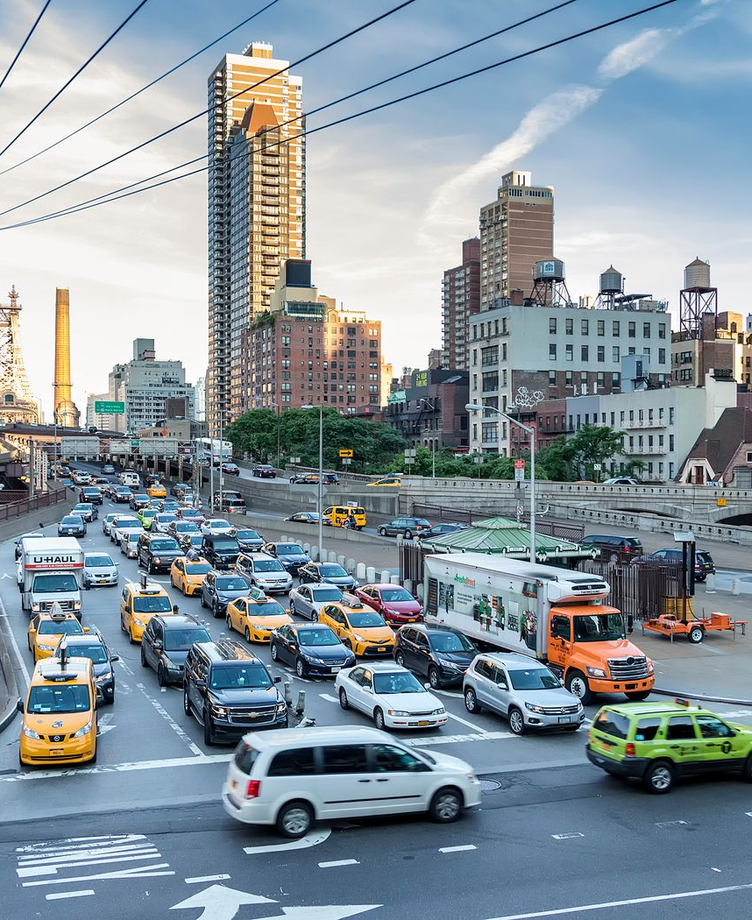
New York: Congestion Surcharge
The congestion surcharge was implemented in February 2019 with the stated hope of reducing dependence on for-hire services – and to encourage New Yorkers to use more public transit or pooled rides.
The Congestion Zone is south of 96th Street in Manhattan.
The surcharge amount is $2.75 for each for-hire vehicle trip, $2.50 per trip in a medallion taxicab, and $0.75 per passenger for rides in a pool vehicle.
All revenue from the surcharge goes to the MTA.
o Total revenue in 2019: $376 Million
o Total revenue in 2020: $177 Million (↓53% compared to 2019)
o Total revenue in 2021: $256 Million (↓32% compared to 2019)
o Total revenue in 2022: ???
Congestion never really abated in 2019, while traffic reduction in the subsequent years is strictly attributed to COVID-19, so this surcharge plan is nothing more than an MTA tax.

Slide 5
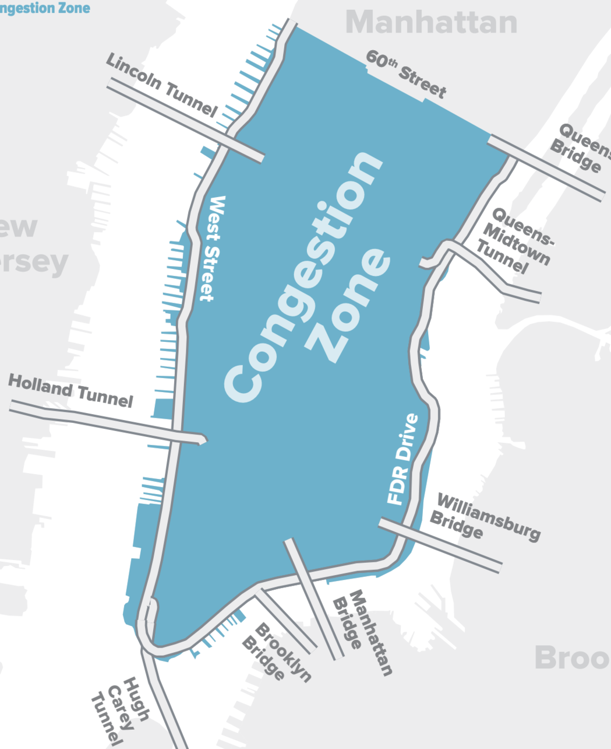
New York: The Central Business District Tolling Program
In April 2019, New York passed a first-in-the-nation congestion pricing law to reduce traffic in the Central Business District (CBD) of Manhattan.
A Traffic Mobility Review Board (TMRB) will recommend toll rates.
Under the law, the Tolling Program must:
Charge passenger vehicles only once each day for entering or remaining in the CBD.
Change the toll rates at set times or days (variable tolling).
Allow CBD residents making less than $60,000 to get a NYS tax credit for CBD tolls paid.
Not toll qualifying authorized emergency vehicles and qualifying vehicles transporting people with disabilities.
Recommend a plan for credits, discounts, and/or exemptions for tolls paid the same day on bridges

Slide 6
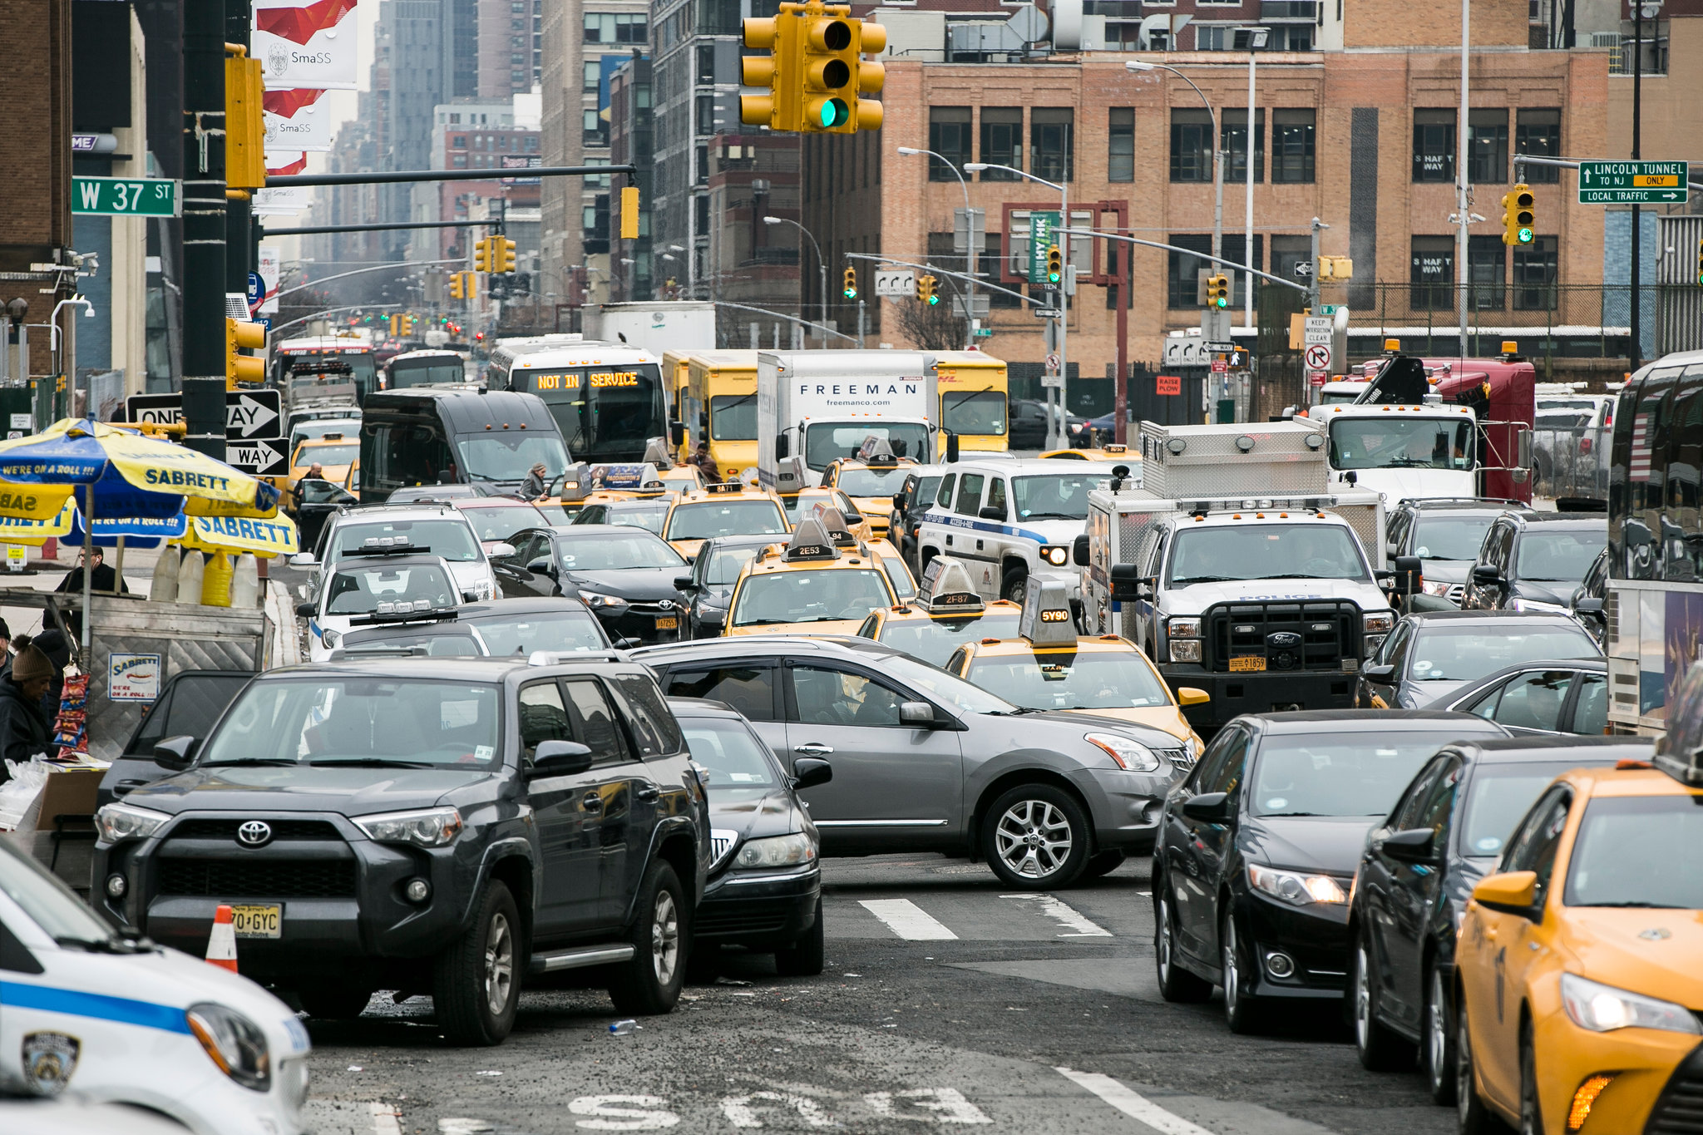
The Central Business District Tolling Program (cont.)
At this time, the modeling is not complete. However, it has been reported that officials are planning on a congestion pricing amount somewhere between $9 and $23.
Status:
The Environmental Assessment process began at the end of August 2021, setting in motion a 16-month process to obtain federal approval for the project.
Once the review is complete, FHWA will need to give it permission to proceed.
Then, the vendor installing the infrastructure (Transcore) will have up to another 310 days to get the tolls underway.
Transit officials expect the tolls to be up and running in 2023—conveniently after the next gubernatorial election in November 2022.

Slide 7
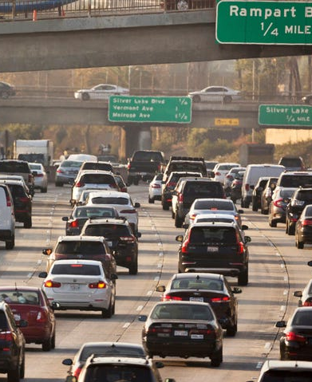
Post-Pandemic Carmageddon and Work From Home Trends
Car registrations continue to increase in NYC amid pandemic.
In June 2020, about 34,000 cars were registered, up 2,000 from 2019.
In July 2020, nearly 40,000 cars were registered, an increase of more than 9,000 from the prior year.
By the end of 2021, NYC tops the list of most congested cities in the country, with 102 lost hours in traffic (versus an average of 36 hours nationwide).
On a worldwide scale, New York City places fifth among the most congested cities, with London (148 hours) leading the ranking, followed by Paris (140 hours), Brussels (134 hours), and Moscow (108 hours).
Currently, NYC bridges and tunnels are witnessing traffic comparable to (if not worse than) before the pandemic. According to the Port Authority, in April 2022, daily traffic across the Port Authority's bridges and tunnels increased by 4% over March 2022, while April 2022 traffic levels were the same as those of April 2019.

Slide 8
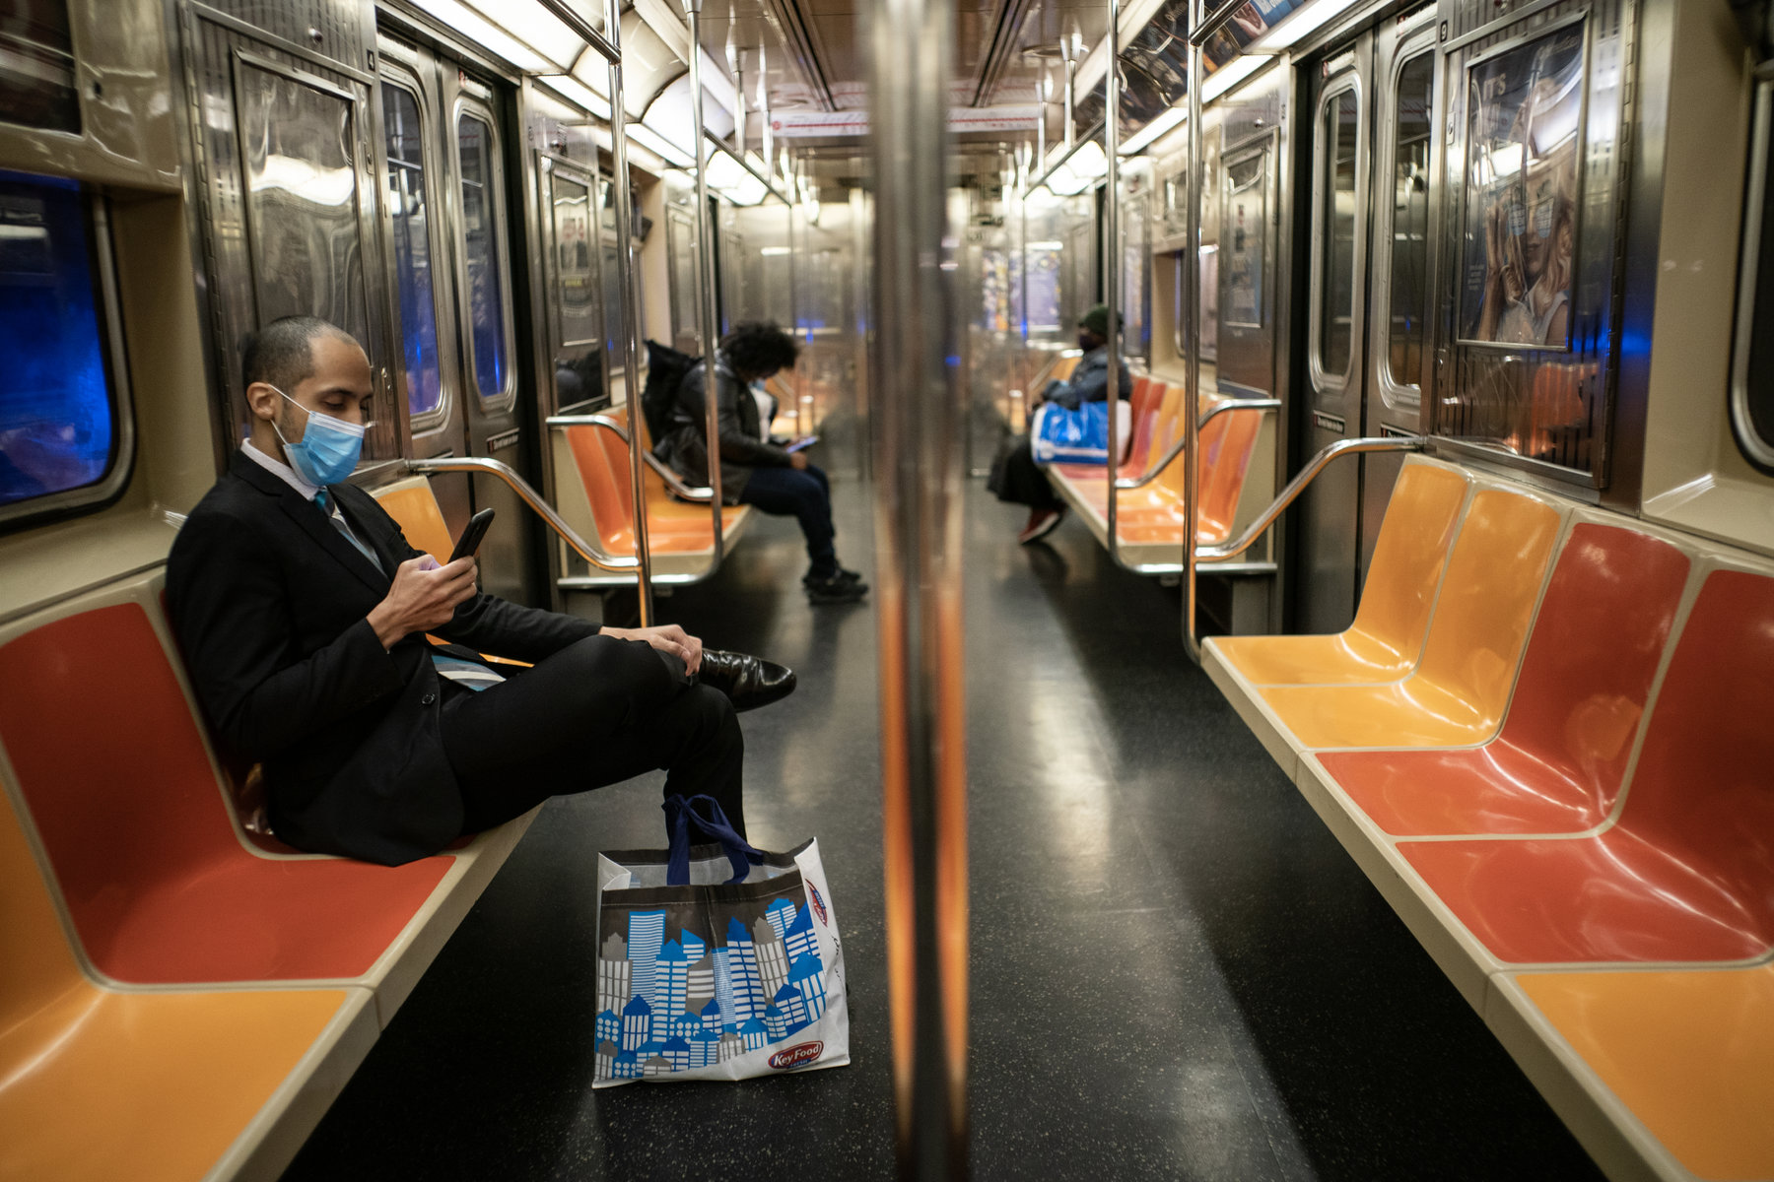
Post-Pandemic Carmageddon and Work From Home Trends (Cont.)
On the other hand, trains are negatively affected. Subway ridership remains at less than 70% of pre-pandemic levels, and this is due in part to WFH and rising crime.
The office occupancy rate in NYC was 38.8% in the week that ended May 11, below the 43.4% occupancy rate nationwide.
Crime in the subway is up 58% compared to last year. Fifteen people have been shot in the transit system so far this year, compared to two last year. Criminal complaints on the subway system in April were up 24.7% compared to last year.
Congestion pricing faces more delays as MTA officials struggle to answer hundreds of questions from the feds on the plan to toll motorists driving south of 60th St. in Manhattan.
MTA Chairman Janno Lieber recently lamented on the lengthy approval process required by the Federal Highway Administration, which must give the program the green light because streets in Manhattan receive federal funding.

Slide 9
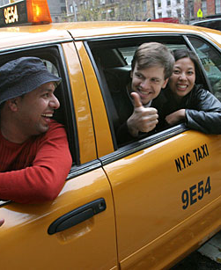
Shared Rides
One issue with how taxis, TNCs and other for hire vehicles operate which contributes to congestion is “deadheading,” which refers to miles traveled without passengers.
TNCs spend 42% of their time deadheading without passengers.
Conceptually, some deadheading could be offset by shared rides, but the percentage of shared trips remains stubbornly low for TNCs.
Prior to the pandemic, it was hovering around 6% of all trips for Uber and 22% for Lyft in New York City.
The TLC and the NYC Council could have promoted sharing rides and put a plan in place to reduce the number of vehicle permits, not simply cap them and preserve the status quo. Examples of policy interventions include:
Exempt shared rides from congestion surcharge
Ban surge (or demand) pricing in the CBD unless rides are shared
Introduce first & last mile collaborations between ride-hailing and public transit (with cost reductions)

Slide 10
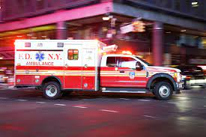
Congestion Pricing Exemptions and Discounts
MTA is under a mandate to use the congestion tolls to produce $15 billion in transit funding by 2024.
Every carve-out and exemption may make the price of commuting more expensive for everyone else.
There are only two exemptions in NY’s law: emergency vehicles and vehicles transporting a person with a disability.

Slide 11
Congestion Pricing Exemptions and Discounts: Taxis & FHVs
TMRB must come up with a plan to address credits, discounts, and/or exemptions for taxi and FHV trips already subject to the “Congestion Surcharge.”
Since February 2, 2019, taxi and FHV trips that begin, end, or pass through Manhattan below 96th Street have been subject to a congestion surcharge. The surcharge fees are $2.50 for taxis, $2.75 for for-hire vehicles, and 75 cents for app-based pooled rides of multiple passengers.
Taxis and FHVs should be exempt as they are an alternative to PMV car usage.
Opponents of this exemption argue that these vehicles accounted for over half of all vehicle miles travelled in the CBD before the pandemic, and it is possible that giving them an exemption would negatively impact the pricing scheme’s effectiveness, like it did in London.
The TMRB could recommend other credits, discounts, and exemptions, including an exemption for shared rides and electric vehicles.

Slide 12
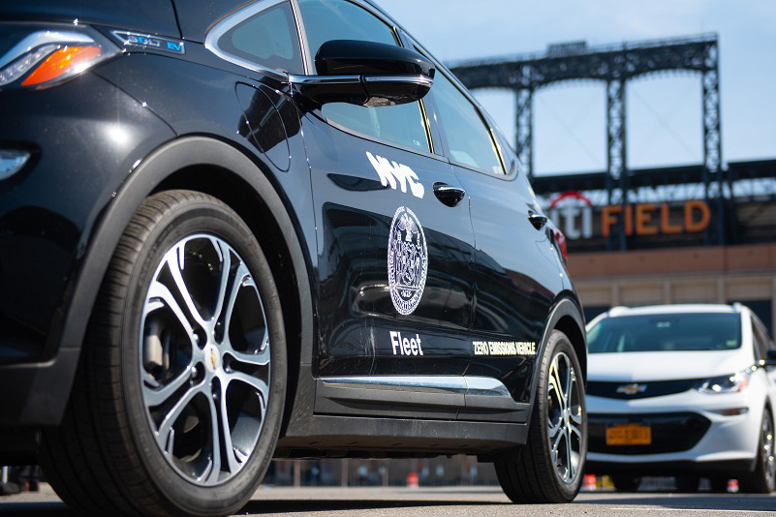
Other Initiatives to Work in Conjunction with Congestion Pricing
Municipal Fleet Reduction
New York City’s fleet currently consists of 24,526 owned and leased on-road vehicles, the largest municipal fleet in the United States.
In April 2022, Mayor Eric Adams announced a resolution aiming to reduce the city’s vehicle fleet by at least 855 (4% of the fleet) by September 1, 2022, in an effort to reduce carbon emissions. The reduction will focus on general use cars (non-emergency) and will reduce agency vehicle acquisition budgets by an estimated $13.7 million.
Municipal Fleetshare: NYC has a fleet share program, where technology enables agencies to share and optimize City owned fleet units and to reserve City owned fleet units online.

Slide 13
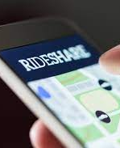
Other Initiatives to Work in Conjunction with Congestion Pricing
Carshare:
Municipal Carshare: In the last four years, NYC has reduced its light duty (non-emergency) fleet size by 1,000 units in part through a contract with Zipcar to provide carshare for City employees on official business.
Dedicated Parking Spaces: NYC provides “carshare parking only” spaces at the curb that are open to the public and in its municipal parking facilities through a permit system, which it is in the process of making permanent.
Rideshare: In April 2020, the U.S. General Services Administration (GSA) awarded Uber and Lyft with contracts to provide government-wide rideshare services for official travel or local travel. The five-year contracts are worth up to $810 million and are expected to reduce travel expenses and the related burdensome back-office functions, such as reports, analytics, and business improvement processes.

Slide 14
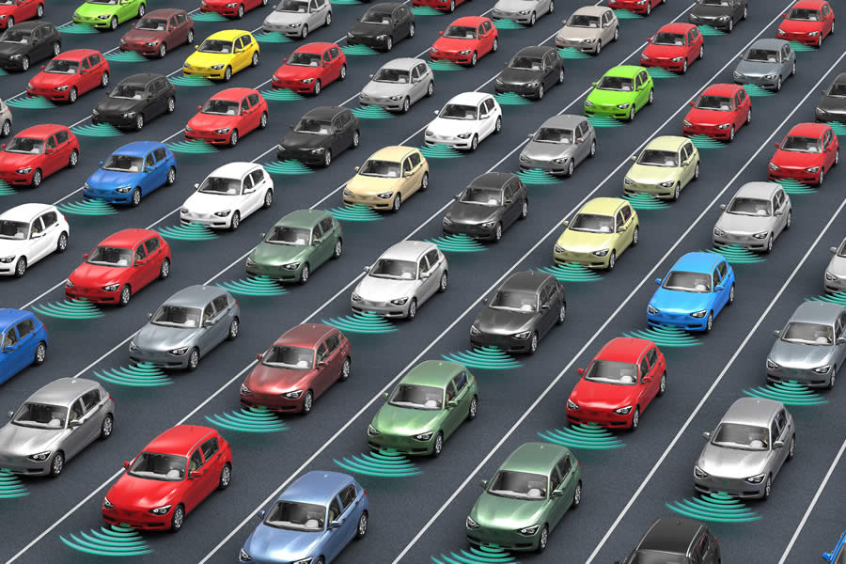
Santa Cruz Study on AVs
In 2019, a UC Santa Cruz study makes a convincing case that AVs will exacerbate traffic congestion.
Using a traffic microsimulation model and data from downtown San Francisco, the study suggests that AVs could more than double vehicle travel to, from and within dense, urban cores.
New vehicle trips are generated by a 90% reduction in effective parking costs, while existing trips become longer because of driving to more distant parking spaces and cruising.
The study argues that the rise of AVs provides the opportunity and the imperative to implement congestion pricing in urban centers.

Slide 15
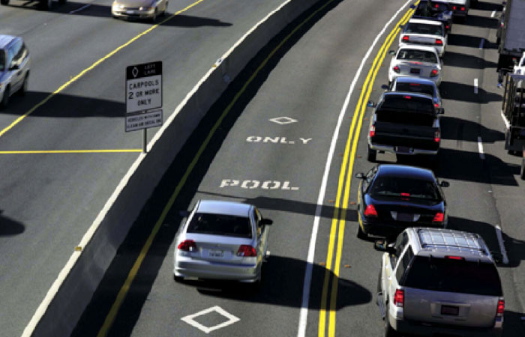
What The Future Should Look Like: Short-Term Plans
Let’s start by at least exempting: corporate shuttles and private buses in general; FHVs and taxis coming into the CBD to work without a passenger; and group rides or full vehicles (like an HOV 3 lane).
It makes no sense from a congestion mitigation standpoint to charge private buses, or shared ride services like Via for that matter.
We should encourage shared mobility at all levels as an alternative to PMV usage.
Sustainable Policies to Solve the First Mile/Last Mile Problem:
During the night, some bus routes do not operate or operate very limited services, and many neighborhoods are considered transit deserts, where residents have at least a 15-minute walk to the nearest subway or rail station.

Slide 16
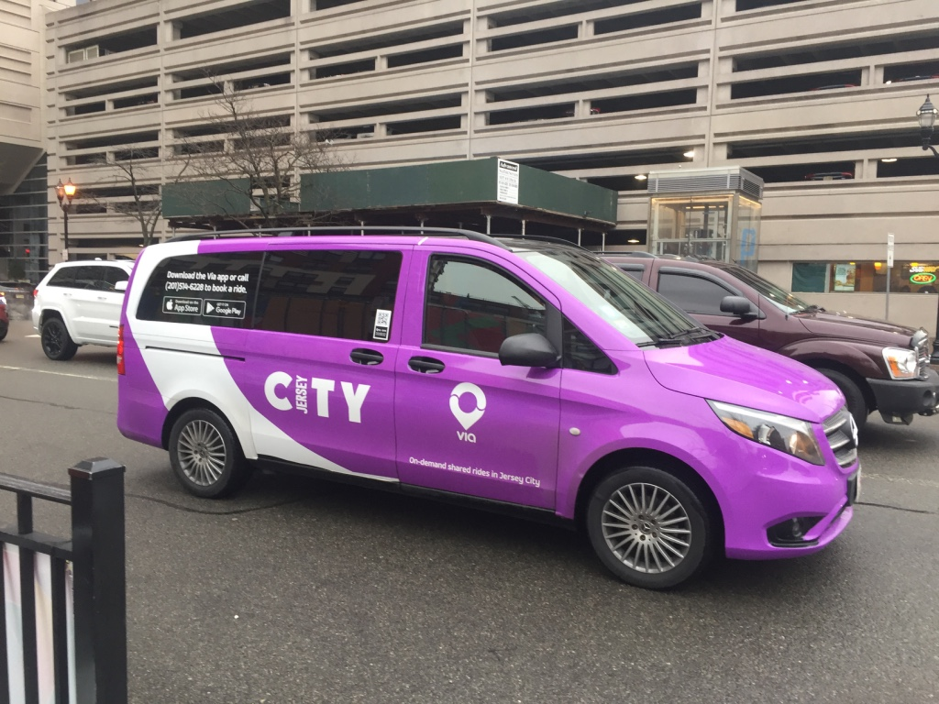
What The Future Should Look Like: Short-Term Plans (cont.)
Possible Solutions:
Divert taxis and FHVs to the outer boroughs to provide first/last mile transportation to transit hubs. Now is the time to use subsidized taxis and liveries for first and last mile service in transit deserts.
Microtransit/Commuter Vans: Shared-Mobility pilot programs to provide cost-effective on-demand, shared, dynamically-routed mobility service in New York City’s outer borough areas where bus service is less frequent than subway service or is unavailable.

Slide 17
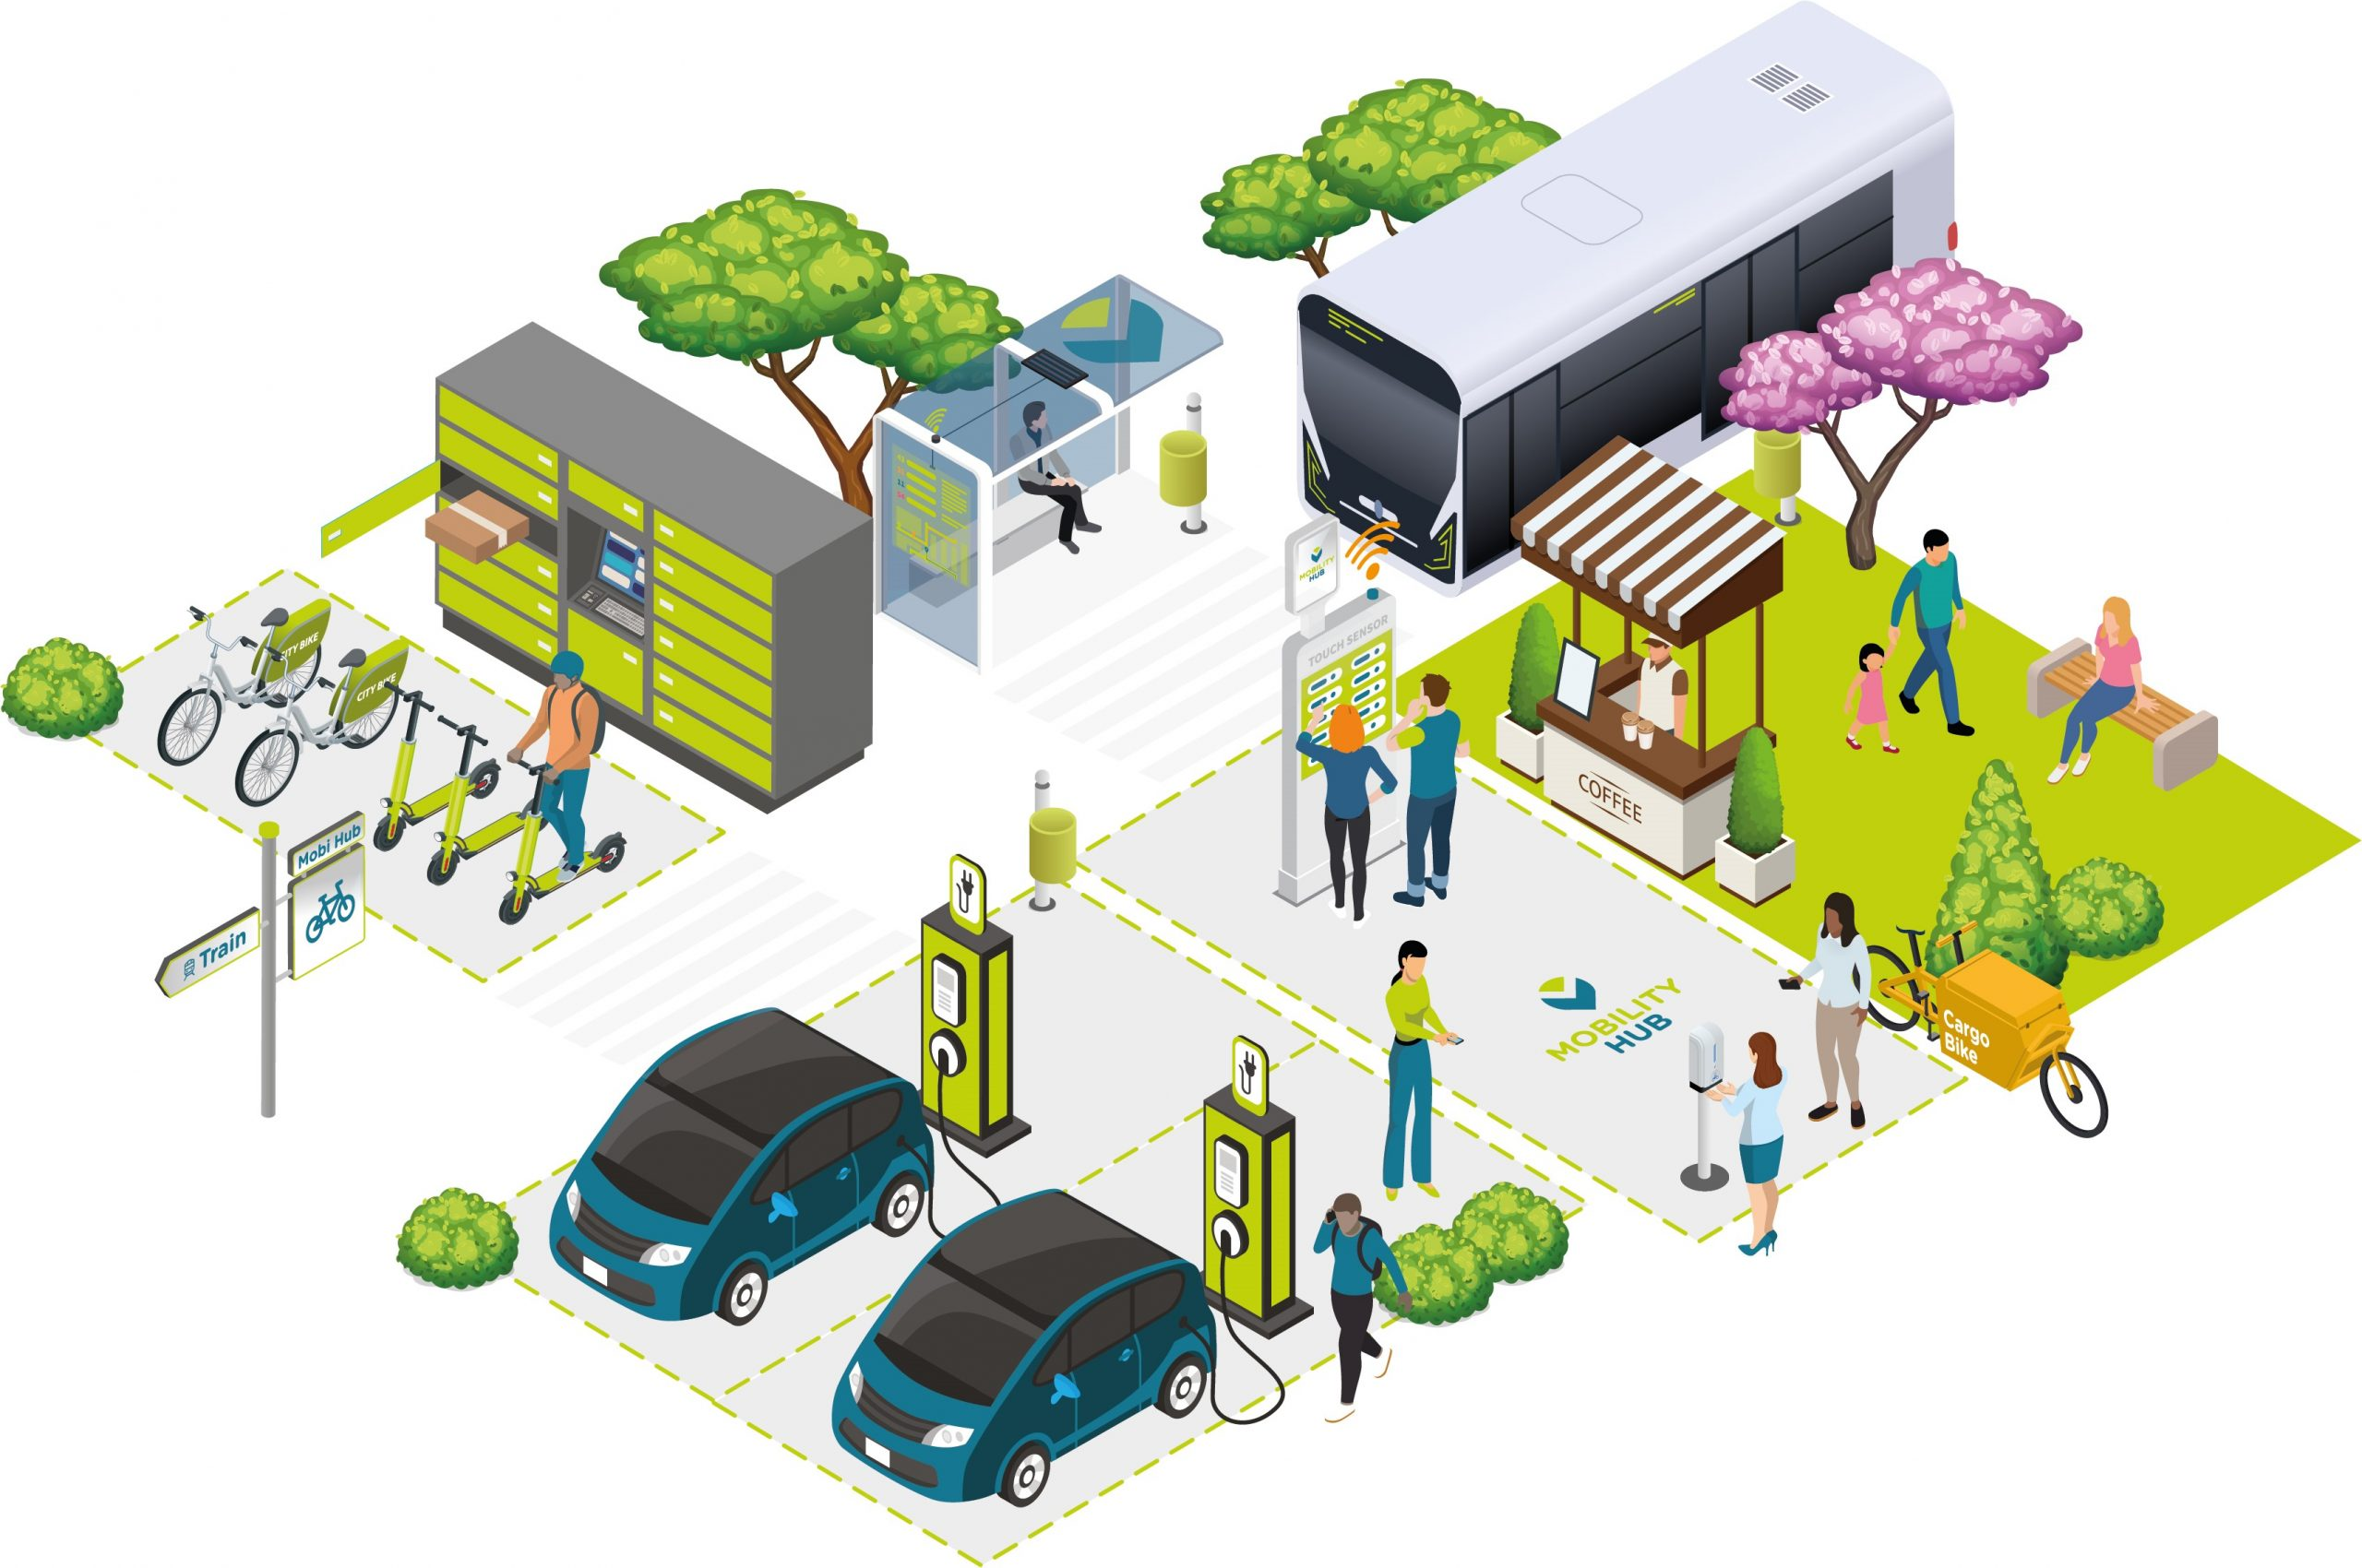
What The Future Should Look Like: Mid-Term Plans
Complete Subsidization of Paratransit with Apps
First and Last Mile Stands with EV Charging and Multi-Modal Mobility Hubs

Slide 18
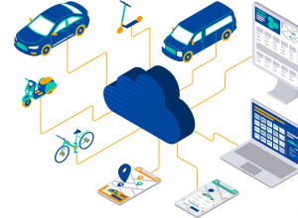
What The Future Should Look Like: Long-Term Plans
MaaS platform and AVs will be used to fit into this paradigm.

Slide 19
Further Reading
NYC Congestion Pricing Primer: Plans, Policies, Pandemic Impacts & Ideas to Make It Work Better!. Black Car News, et al. (Oct. 2021). https://www.blackcarnews.com/article/nyc-congestion-pricing-primer-plans-policies-pandemic-impacts-ideas-to-make-it-work-better
Report Card on New NYC Transportation Policies: FHV Vehicle Cap, Driver Pay & Congestion Pricing, Black Car News, et al. (Aug, 2019). https://www.blackcarnews.com/article/report-card-on-new-nyc-transportation-policies-fhv-vehicle-cap-driver-pay-congestion-pricing
First Report Card on Congestion Surcharge Black Car News, et al. (May, 2019). https://www.blackcarnews.com/article/first-report-card-on-congestion-surcharge

Slide 20
Questions for the Audience
What exemptions and/or incentives should be part of CP – if any?
What should be the role of public and private transit in the CP/AV ecosystem to promote shared multi-mobility and to discourage PMV use?

