Slide 1
Ride-Hailing’s Climate Risks
Steering a Growing Industry Toward a Clean Transportation Future

Slide 2
Notes:
At the Union of Concerned Scientists, we put rigorous science to work to build a healthier planet and a safer world. In today’s polarized political environment, UCS leads with solutions: helping regular people and elected officials find the best ways to respond to the consequences of climate change, cut our oil use in half, ramp up renewable energy, reduce the threat from nuclear weapons, build a healthier food system, and much more. We believe that scientific analysis—not political calculations or corporate hype—should guide government policies.
Our staff includes scientists, engineers, economists, and analysts. To address some of today’s most pressing problems, we augment our substantial in-house resources with our proven ability to mobilize some of the nation’s top scientists as well as our network of more than 500,000 members and supporters. We also strategically deploy the unique asset of our UCS Science Network, which can mobilize some 20,000 scientists and technical experts across the country to take action.

Slide 3
Electricity
Transportation
Industrial
Residential
Commercial
Notes:
Transportation emissions are growing, because even though our vehicles are getting cleaner, we are driving more miles

Slide 4
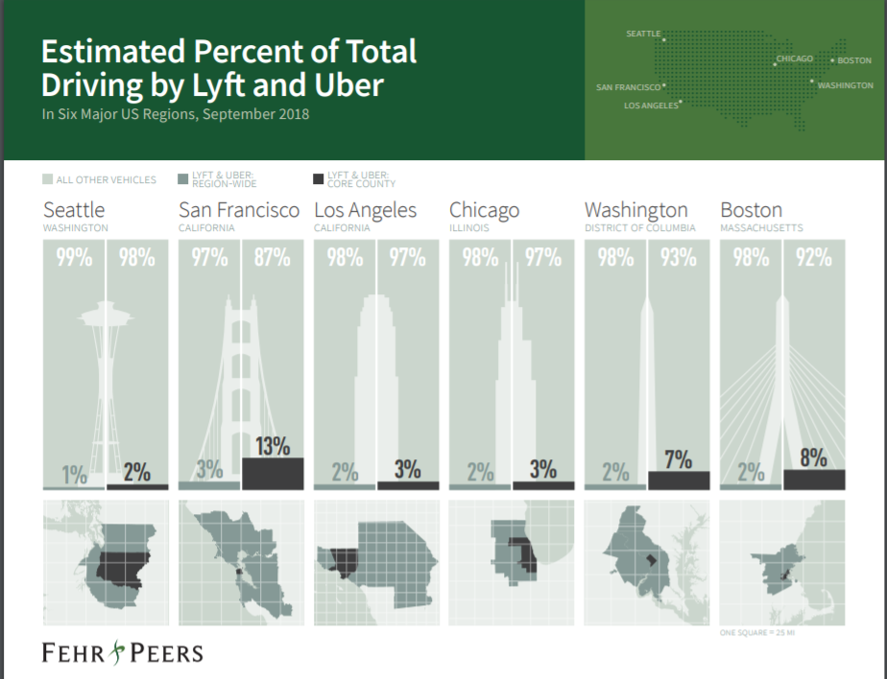
Title Here
Notes:
Ride-hailing is an increasing percentage of miles, particularly in urban cores, with impacts on congestion and ridership on other modes
Potentially add new report on impact of ridehailing on transit (either here or later)

Slide 5
Notes:
When we were working on this report ridehailing was in the middle of tremendous growth– obviously the last couple of years have been different, but it’s still a ridehailing as the test case for other types of emerging technology we don’t have good data on yet (AVs, delivery)

Slide 6
Notes:
Ridehailing can be part of the solution. But is it yet?

Slide 7
What is the emission impact of ride-hailing trips?
What can we do to reduce emissions?
Notes:
Lots of research has been done on congestion impacts of ride hailing, but we were focused on two key questions

Slide 8
What is the emissions impact of ride-hailing trips?

Slide 9
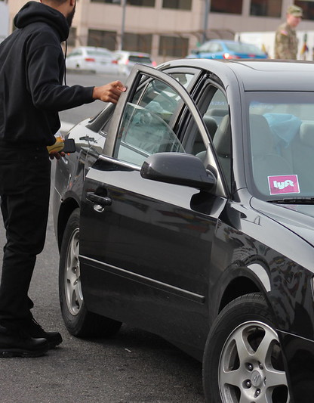
Notes:
Let’s start with a fundamental question– is hailing a ride better or worse than driving yourself the same distance? (can make this audience participation, depending on the audience and available time)

Slide 10
A non-pooled ride-hailing trip emits 47% more than a comparable private vehicle trip

Slide 11
^{Deadheading}
Notes:
Explain what deadheading is (this is a screengrab from Google at the end of the CTA red line near where I live. Use Don’s stat about deadheading here.

Slide 12
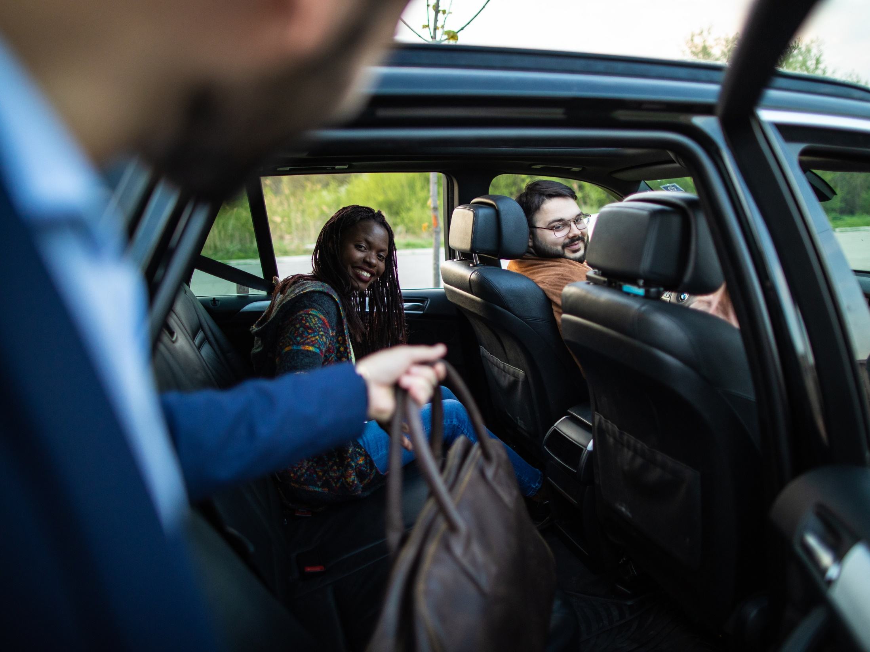
Notes:
How about pooling? (explain what pooling is)

Slide 13
Pooling essentially eliminates climate disadvantage of ride-hailing compared to private vehicles

Slide 14
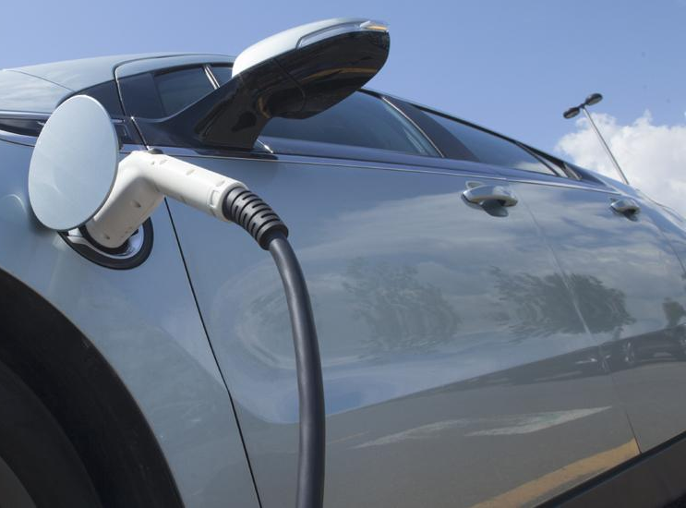
Notes:
How about electrification?

Slide 15
An electric, pooled ride-hailing trip can cut emissions by 68% compared with a private vehicle trip

Slide 16
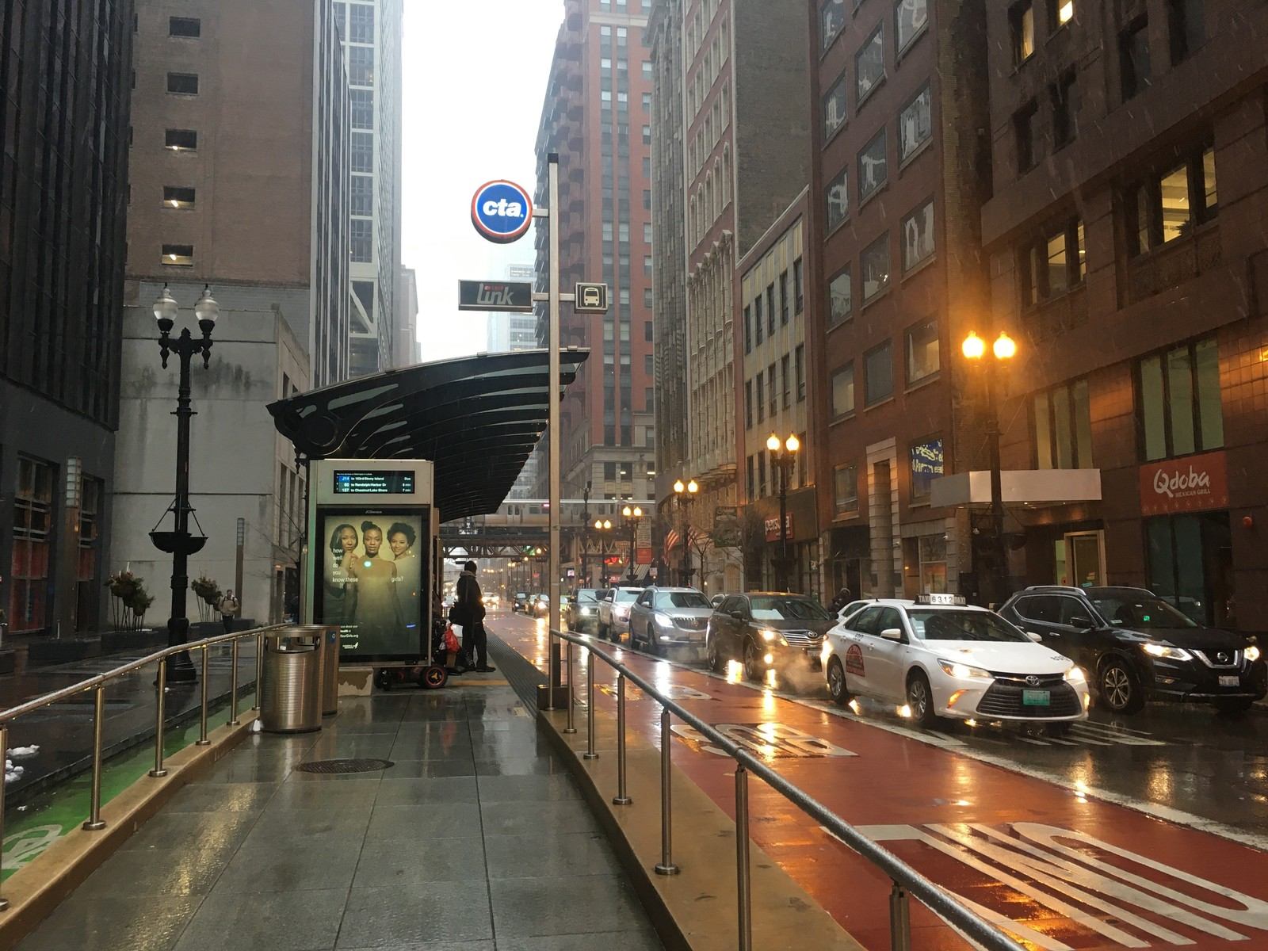
Notes:
But the choice isn’t just between hailing a lyft and driving your own car. In a lot of the places where ridehailing is most popular, people don’t own cars and use lots of other ways to get around

Slide 17
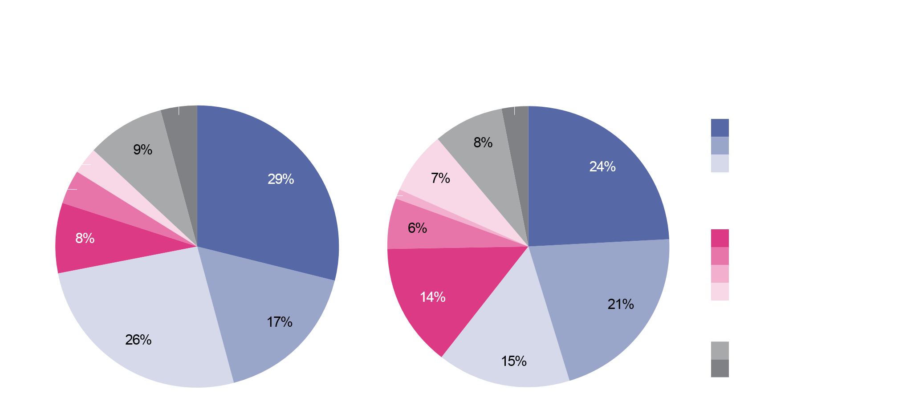
Ride-hailing users often would have used lower-carbon modes rather than cars
Circella, Giovanni, G Matson, Farzad Alemi, and S Handy. 2019. “Panel Study of Emerging Transportation Technologies and Trends in California: Phase 2 Data Collection”

Slide 19
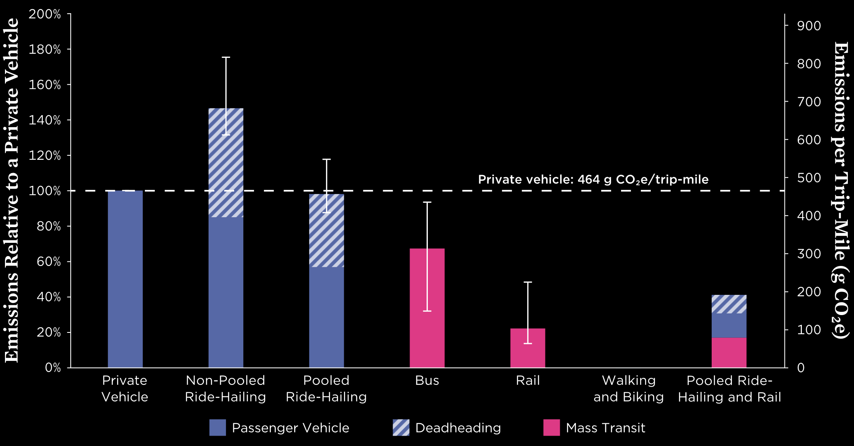
Combining pooled ride-hailing with other low carbon modes can further cut emissions

Slide 20
What can we do to reduce emissions from ride-hailing?

Slide 21
Electrify ride-hailing vehicles
Increase rates of pooling
Reduce deadheading
Complement transit, biking and walking
Notes:
Our research points to some key ways to reduce emissions. Lots of policy options to achieve this, want to focus on one policy that has been in the process of implementation since this report was released in 2020– California’s Clean Miles Standard

Slide 22
Notes:
Bill passed in 2018

Slide 23
Notes:
We’re a little behind this timeline, because pandemic.

Slide 24
Notes:
Mention the stat here about the percent of vehicles CARB estimates need to be electrified

Slide 25
Key concern: Impacts to drivers
UCS estimate: it would cost less than 4 cents per mile for Uber and Lyft to cover:
increased vehicle costs,
home charger installation
insurance costs
And allow drivers to save on maintenance and fuel costs

Slide 26
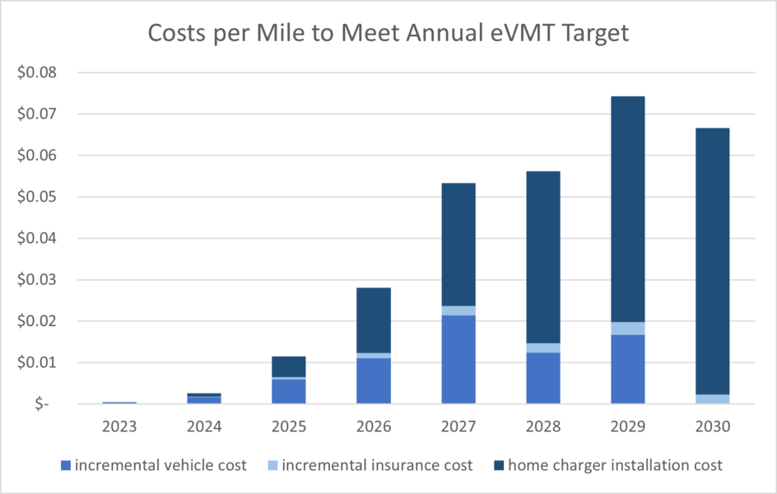
Notes:
Maybe cut

Slide 27
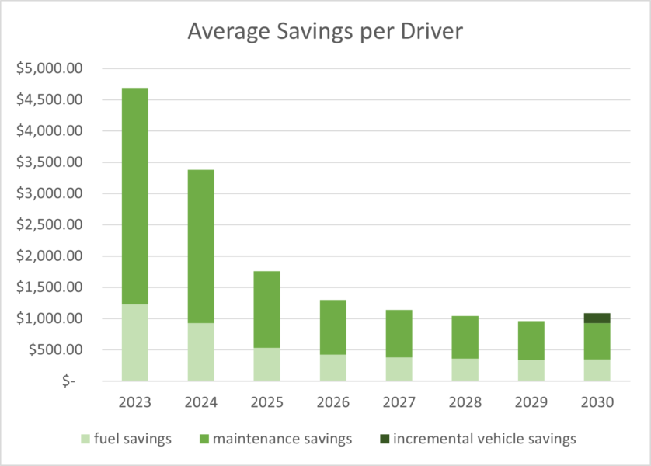
Notes:
Maybe cut

Slide 28
^{Lessons Learned}
Clean Miles Standard will make a big impact on electrification and GHG emissions, but other policies needed
Company commitments helped set a strong standard
It was critical to engage drivers in implementation
Getting good data on emissions and other aspects of TNC operations is important for both setting targets and enforcement
The industry has changed since 2018- CMS doesn’t cover on-demand delivery fleets
Notes:
Lessons learned

Slide 29
@SciNetUCS
ScienceNetwork@ucsusa.org
linkedin.com/groups/8540478

Slide 30
Thank You
Elizabeth Irvin
Senior Transportation Analyst
eirvin@ucsusa.org

