Slide 1
On-Demand Transit in Belleville: the impacts on activity participation
June 2, 2022
Yixue Zhang, Steven Farber, MISCHA YOUNG

Slide 2
Background
New mobility technologies create new opportunities for improving the lives and wellbeing of socially disadvantaged groups
Municipalities and transit authorities are inundated by new opportunities to partner with companies to pilot new mobility services
How should we be evaluating the “return on investment” for transport interventions targeted at disadvantaged groups?

Slide 4
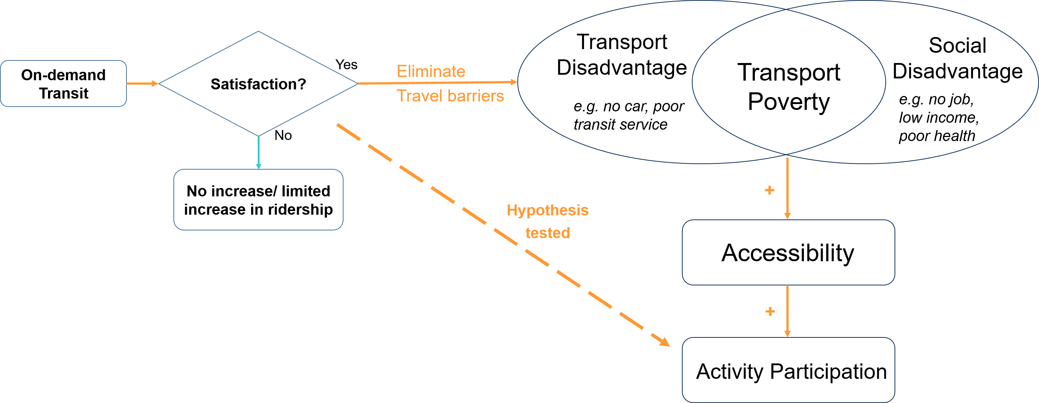
Adapted from: Lucas, K. (2012). Transport and social exclusion: Where are we now?. Transport policy, 20, 105-113.

Slide 5
On-Demand Transit (ODT) In Belleville, Ontario
The Pilot
ODT Pilot for night bus service (9pm-midnight)
Web+App bookings in near real-time
Phone bookings accepted during office hours
Operations
Uses existing transit busses (full size)
Uses existing, unionized bus drivers
Began operation in September 2018
300% increase in ridership (small base)

Slide 6
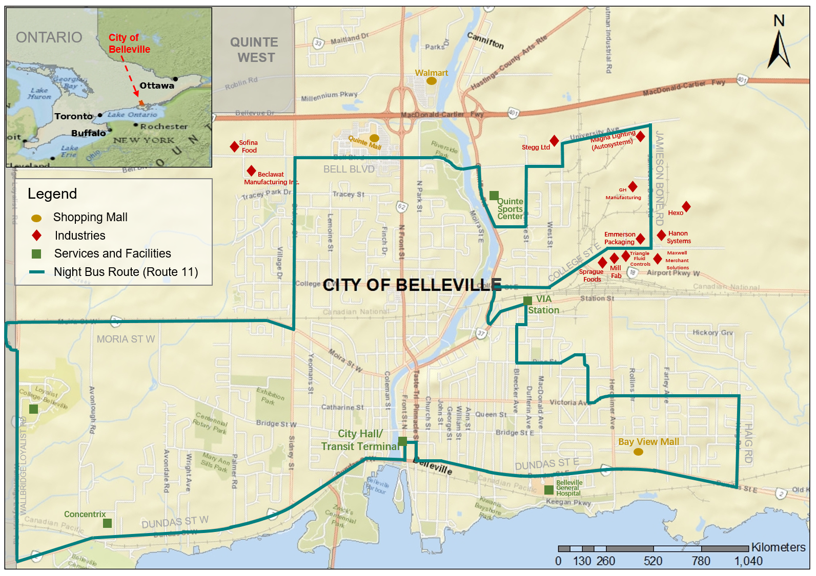

Slide 7
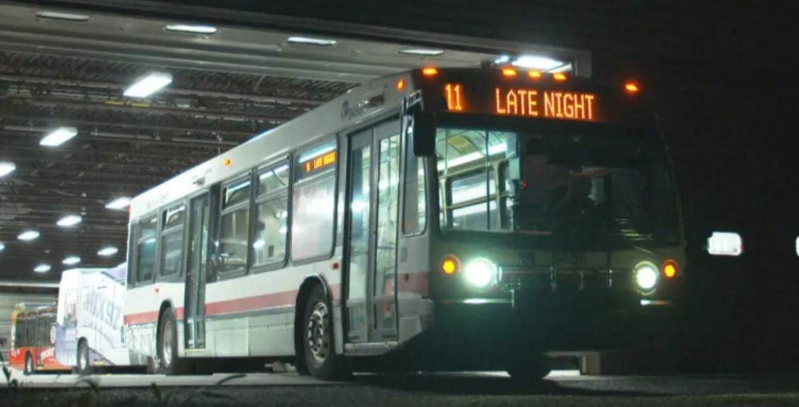
SURVEY Data Collection
November 12 – December 21, 2019
1,342 of them have used the service for at least once.
Recruitment via email and fliers
263 responses. 19.60% response rate.

Slide 8
Research Questions
Who are the users?
Travel frequency and purpose?
What are their satisfaction levels with the service?
What are the impacts on activity participation?

Slide 9
Part 1
Who are the users?

Slide 10
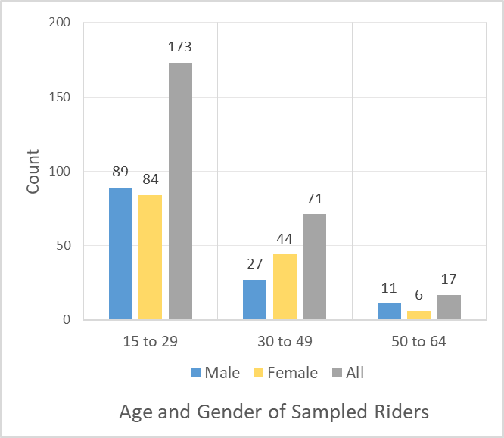
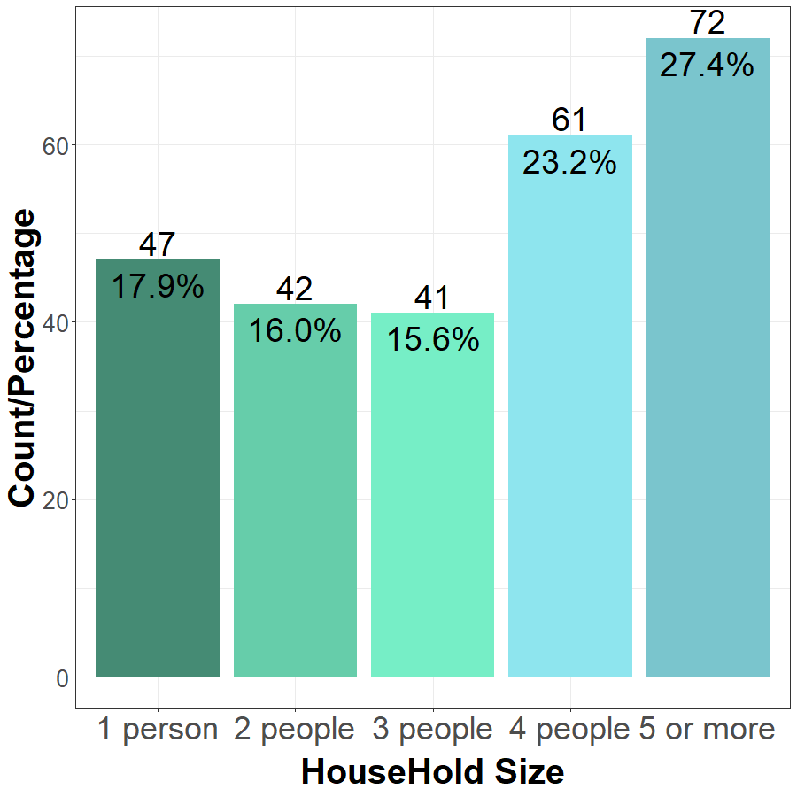
Age, Gender, household size
Note: We only collect responses from riders who are over 15 years old.
The minimum age in our sample is 16, and the maximum is 63.

Slide 11
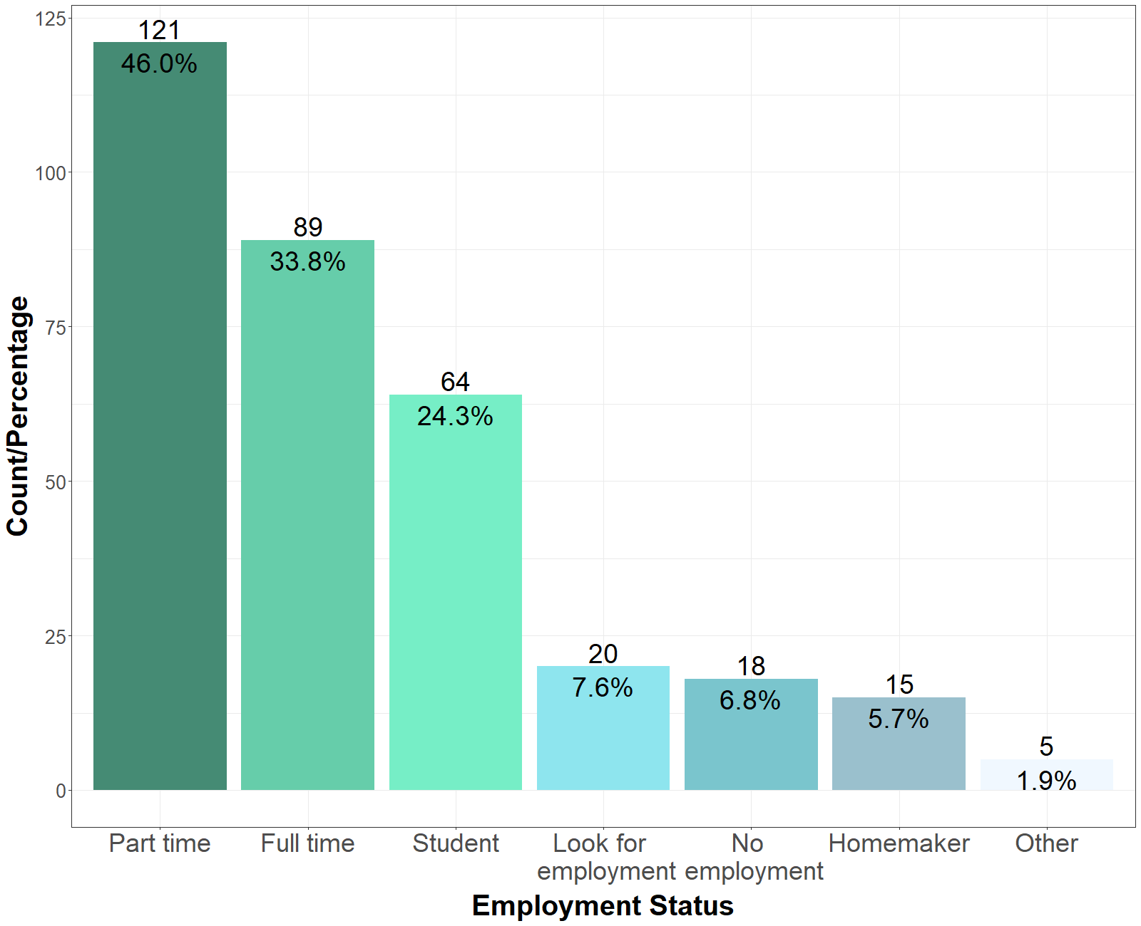
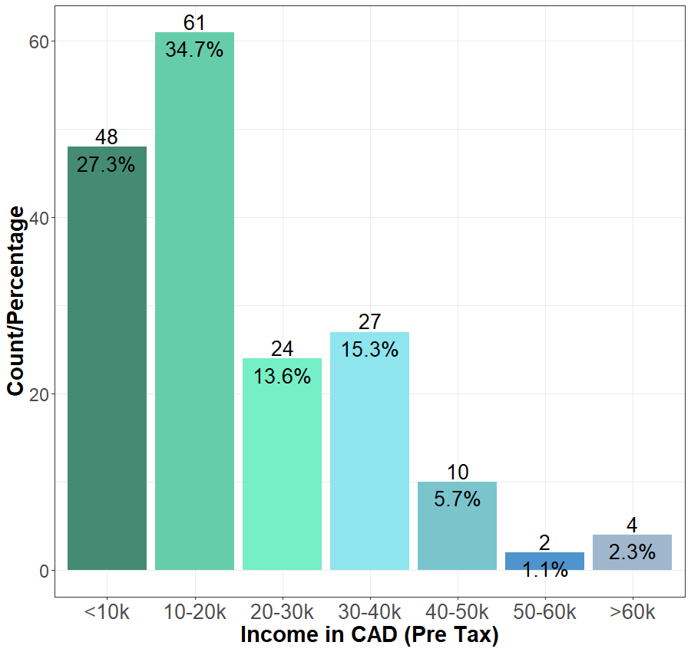
Employment Status and Income
75% International, mostly India

Slide 12
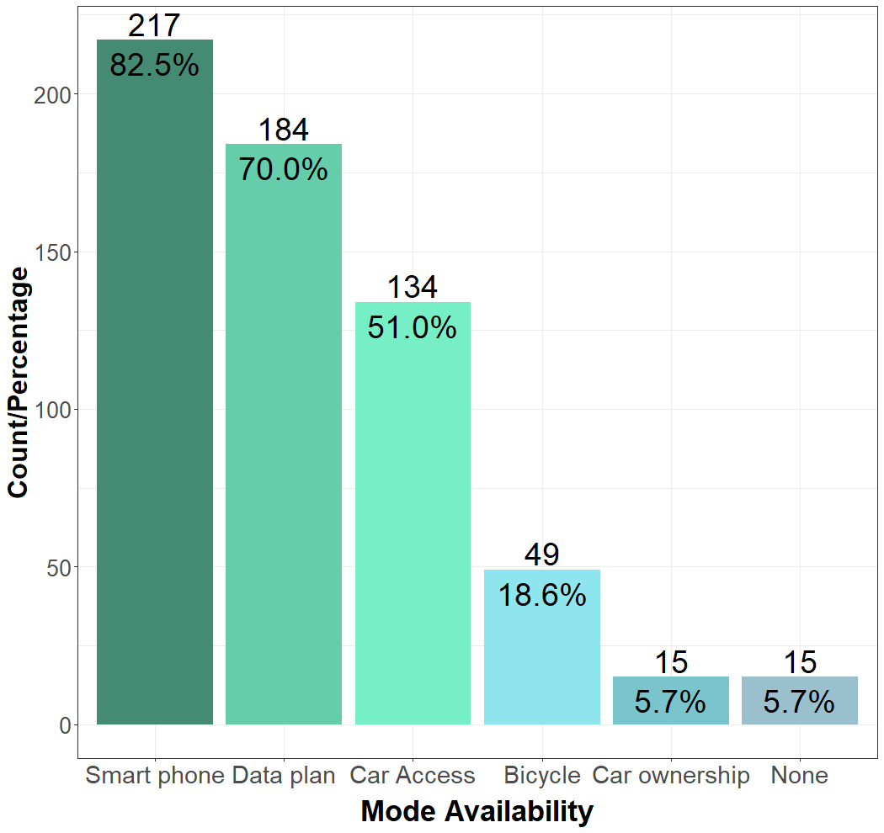
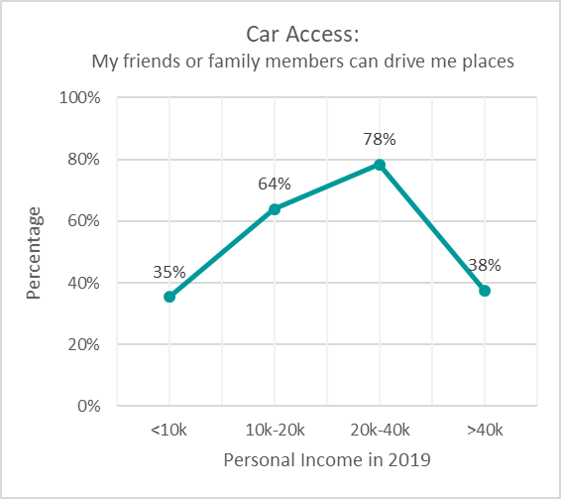
Vehicle ownership and access

Slide 13
Part 2
Use Frequency and Purpose?

Slide 14
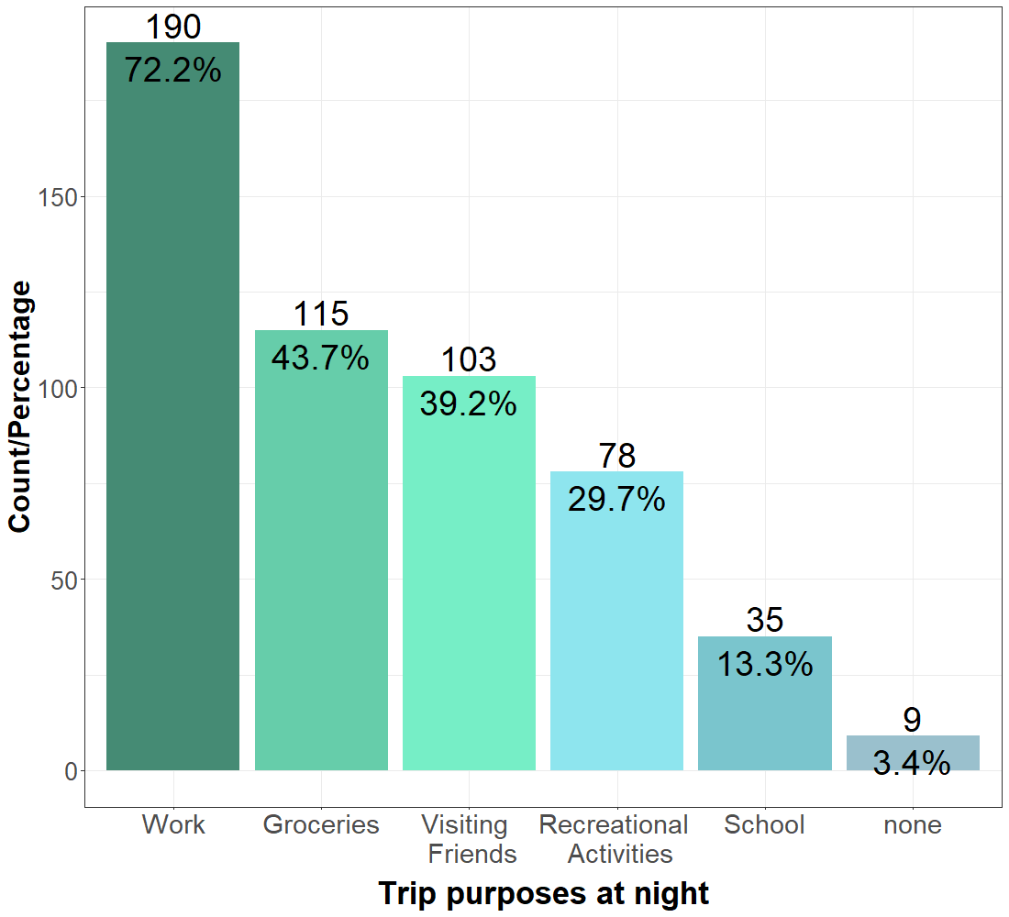
ODT Trip Purposes

Slide 15
Frequency and Mode Switching
Notes:
Get rid of other groups, and only show group 1.
Change time period 1, 2, 3 to: Before Night Bus, During fixed route, During ODT
Only keep 2 of 4 plots.

Slide 16
Part 3
ODT User Satisfaction

Slide 17
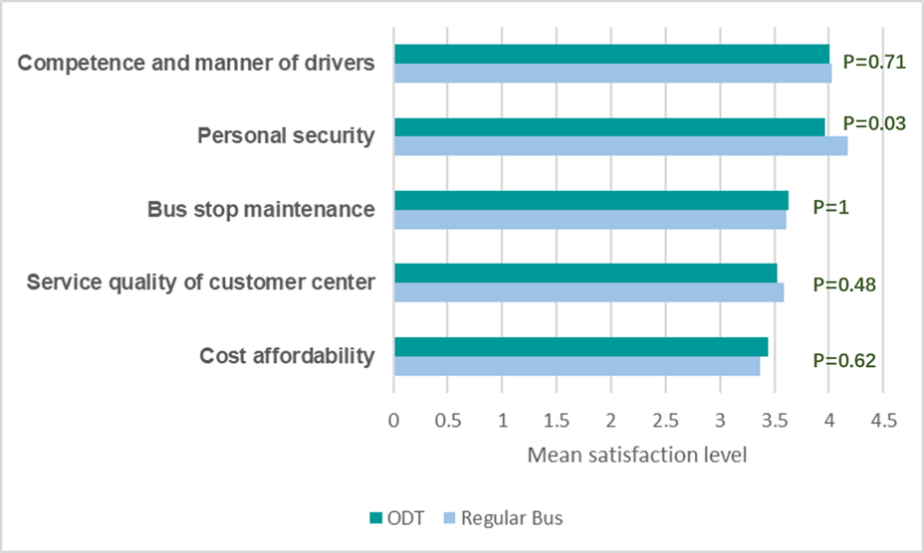
Service Quality

Slide 18
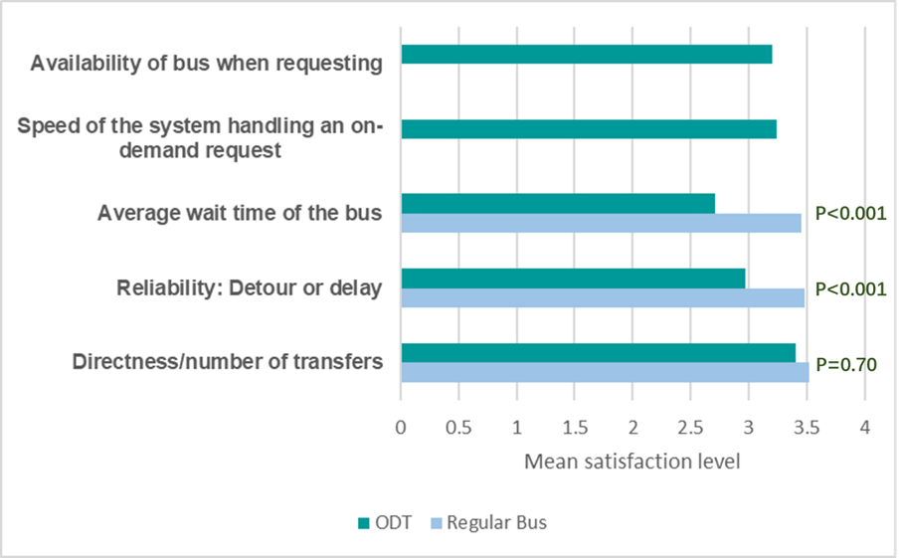
Performance

Slide 19
Part 4
The impacts on activity participation

Slide 20
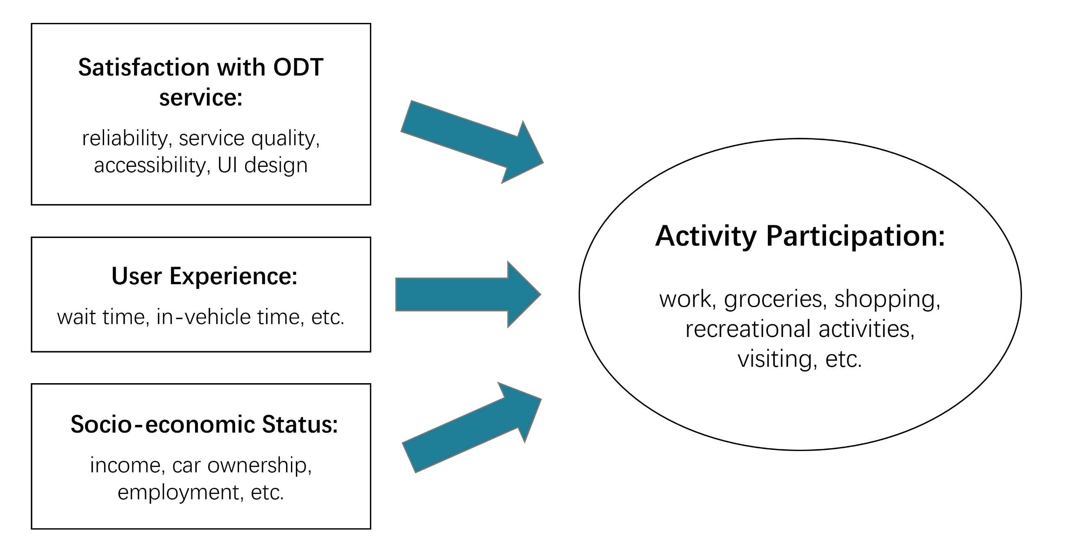
MODEL FRAMEWORK

Slide 21
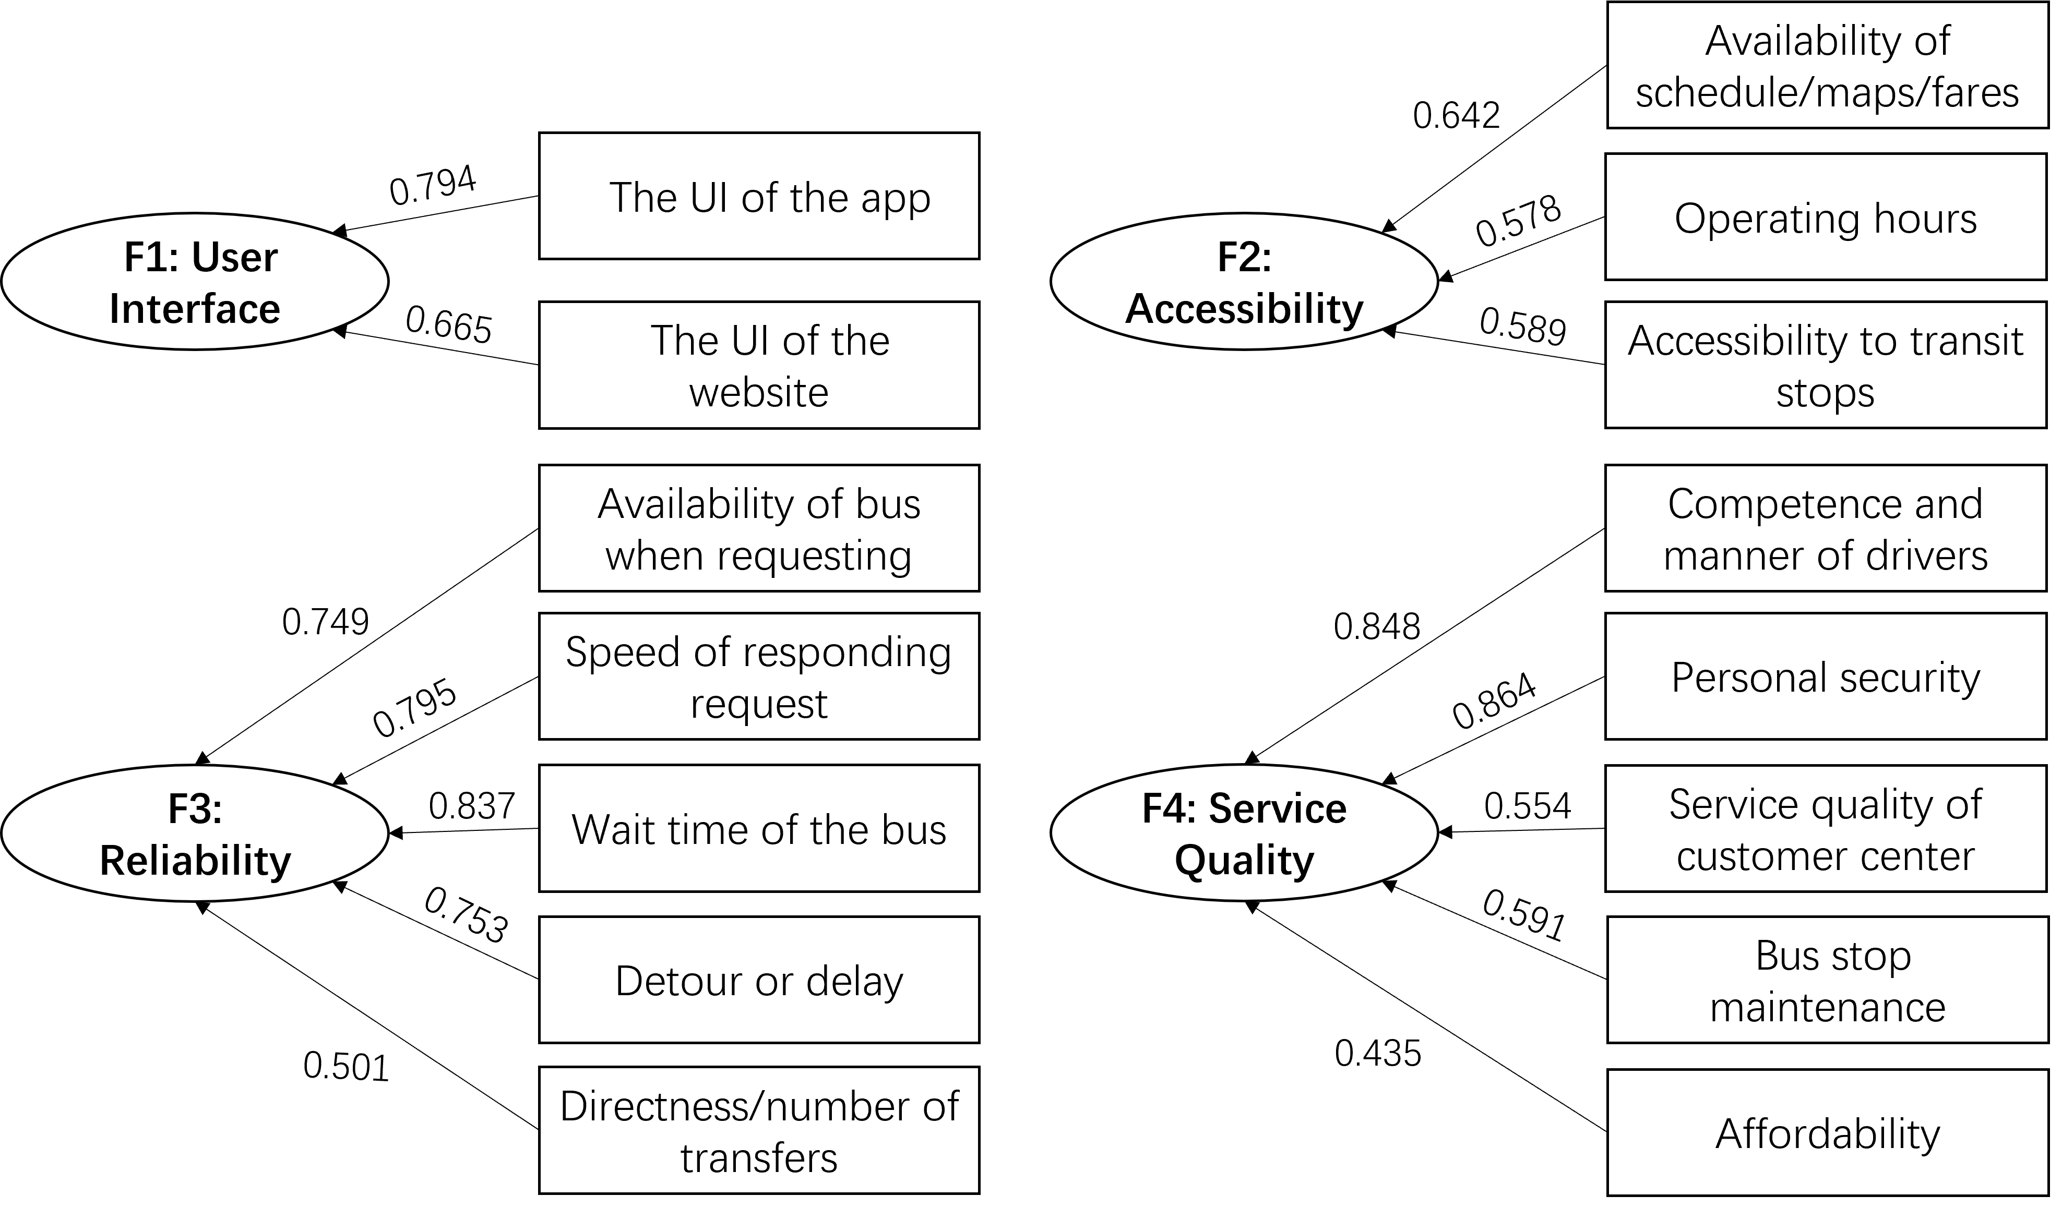
Exploratory Factor Analysis

Slide 22
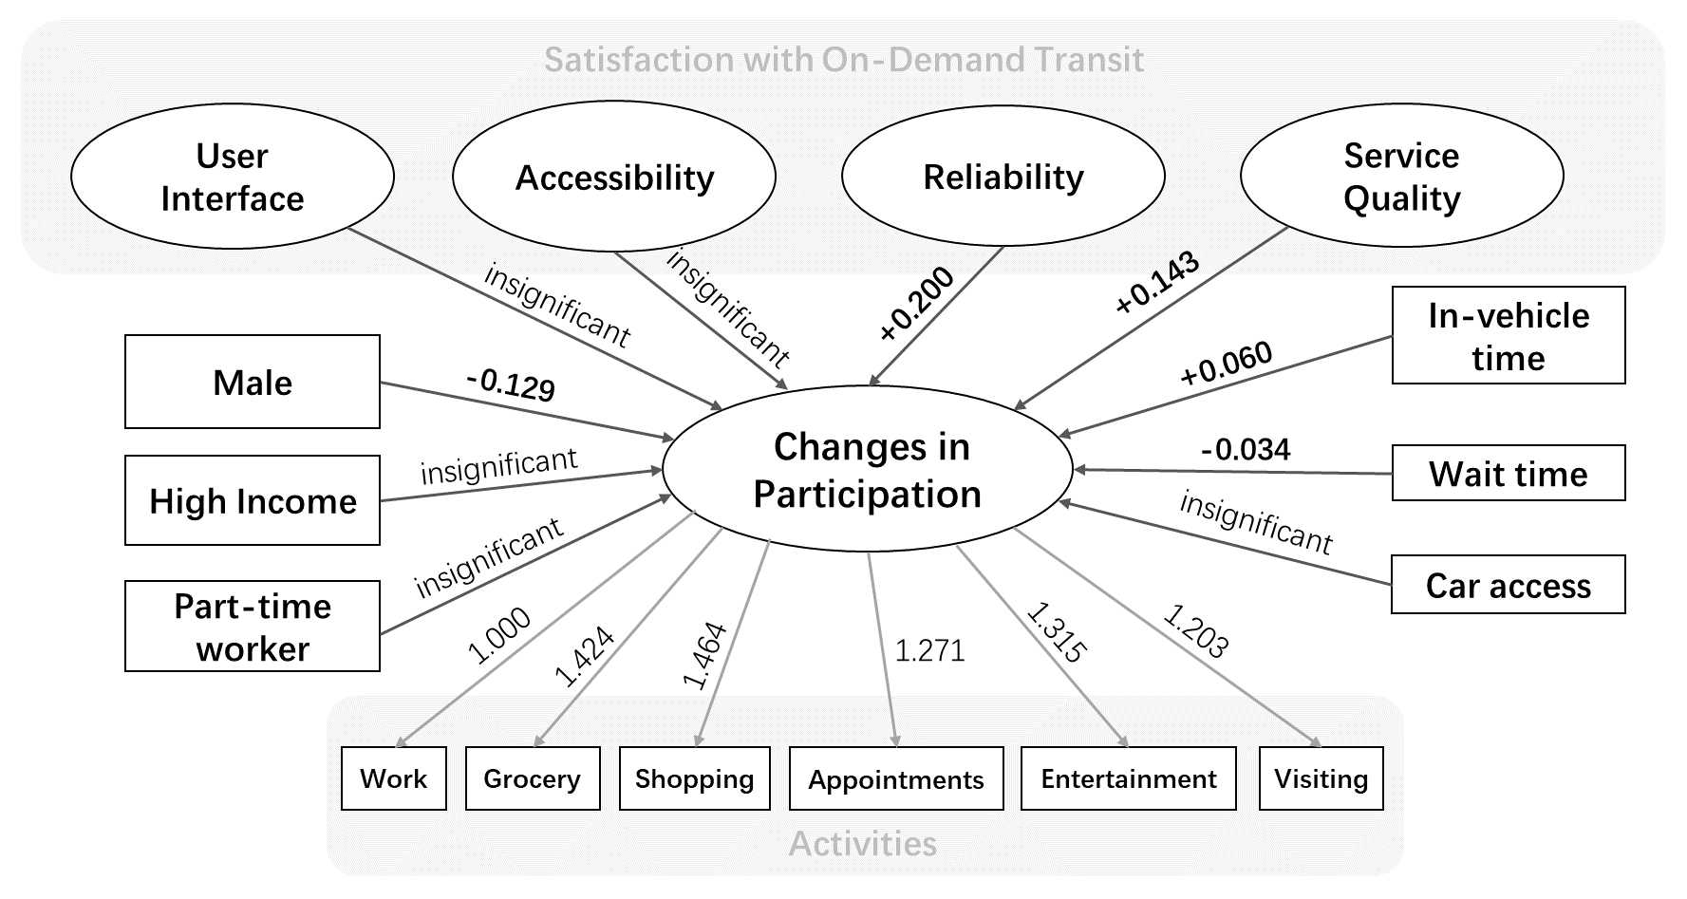
STRUCTURAL EQUATION MODEL
Note: Exogenous variables are in the square boxes; latent exogenous variables are in the oval boxes.
The diagram presents the SEM parameter means

Slide 23
Conclusions
On-demand transit can be a new solution to combat social exclusion.
Transit performance improvements need to be incorporated within equity considerations.
Satisfaction with reliability and service quality are significantly associated with activity participation.

Slide 24
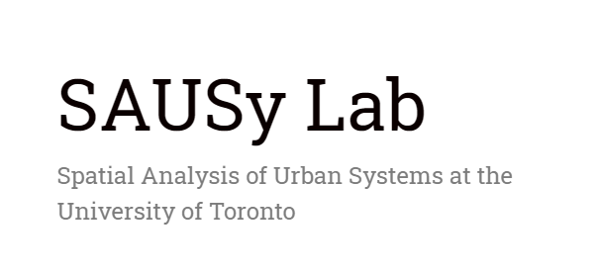
Acknowledgements
Zhang Y, Farber S, Young M. Eliminating barriers to nighttime activity participation: the case of on-demand transit in Belleville, Canada. Transportation. 2021 Jul 26:1-24.
Funders: Social Sciences and Humanities Research Council of Canada, CUTRIC
Partners: Pantonium Inc., Belleville Transit
Notes:
ADD a logo from CUTRIC

Slide 25
THANK YOU!
Contact: yixue.zhang@mail.utoronto.ca

