Slide 1
Ridesharing a new traffic risk? The introduction of Moto-Uber in the Dominican Republic.
José Ignacio Nazif-Munoz, Université de Sherbrooke and Harvard University
Brice Batomen, University of Toronto
Arijit Nandi, McGill University

Slide 2
Uber, in less than ten years, has spread to at least 900 cities in 84 countries, and provided over 14 million journeys per day globally in 2018 (Uber, 2020).
“Effects” of Uber have focused on:
(Weber, 2019, Dills and Mulholland, 2016, Park et al., 2017, Zhou, 2020)
(Erhardt et al., 2019)
(Brazil and Kirk, 2016, Greenwood and Wattal, 2017, Peck, 2017, Huang et al., 2019, Nazif-Munoz et al., 2020)
2

Slide 3
“Effects” of Uber have been studied mostly on

Slide 4
And studies have focused on four-wheel based vehicle
Source: https://wehavekids.com/parenting/26-ways-your-kids-can-help-protect-the-environment

Slide 5
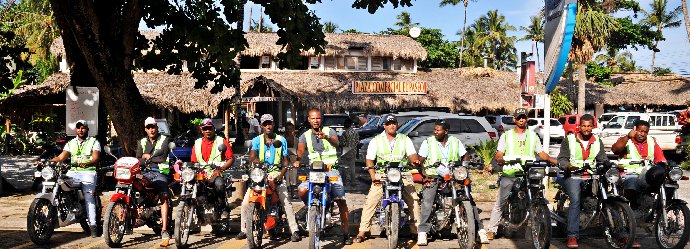
Source: https://todorepublicadominicana.com/listado/asociacion-de-moto-taxi-publico-de-las-terrenas/
https://www.hosteltur.com/lat/149000_uber-se-diversifica-dominicana-servicio-moto-taxi.html
What about countries where motorcycle ridesharing exists? Has this service affected traffic fatalities, particularly among motorcycle users?

Slide 6
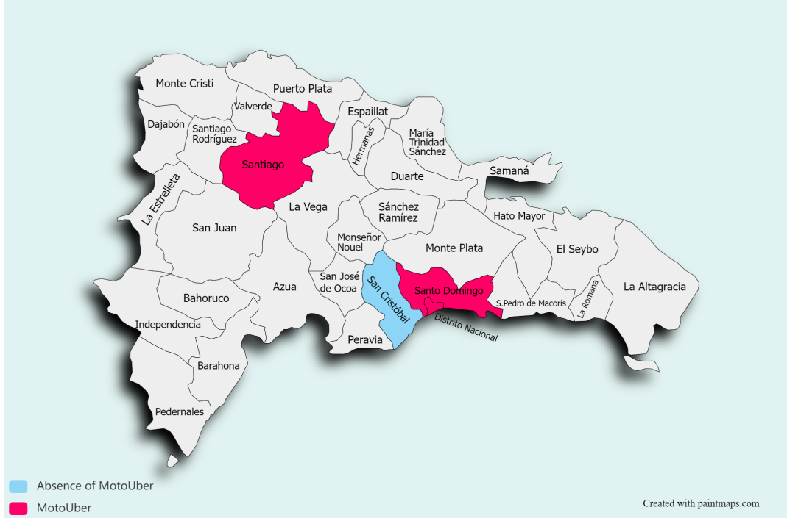
In this study, we turn the lens to the Dominican Republic, and ask whether the introduction of Uber’s motorcycle ridesharing services(UberMOTO) in two cities, Santo Domingo and Santiago, has been associated with a change in the number of motorcycle occupant (drivers and passengers) fatalities

Slide 7
Implications:
MotoUber has the potential to transform road safety in various regions of the world, such as South Asia or the Western Pacific, where, for instance, ridesharing has been associated with increases in motorcycle ownership (Wadud, 2020)
If motorcycle ridesharing reduces motorcycle fatalities in these Dominican cities, it may be advantageous for cities to partner with ridesharing companies to promote its use.
Conversely, if this service increases the risk of road fatalities, additional regulation of the industry might be needed.

Slide 8
Methods
We evaluated the impact of UberMOTO in the Dominican Republic using an interrupted time–series design
We focused our analyses on two urban conglomerates, Santo Domingo and Santiago, which introduced UberMOTO and UberCAR.
Our analytic sample included all crash fatalities between January 1, 2012 and December 31, 2018.

Slide 9
Data
Traffic fatalities from the Ministry of Public Health
Population from National Office of Statistics
Intervention
March 15th, 2017 (Uber, 2017, Santelises and del Cid, 2017) MotoUber was launched in both cities simultaneously.

Slide 10
Figure 1: Cumulative frequency of five different UberMOTO terms searched in Google (January 2016 – December 2018)
Note: source www.google.trends.com

Slide 11
Equation
${ Y}_{t}= β_{0}+β_{1}time+β_{2}UberCAR+ β_{3}UberMOTO + β_{4}{Time }_{afterUberMOTO}+\sum_{m=1}^{11}{β_{m}∗(I\left[{Month}_{m}=m\right])}+R_{m}$, with $R_{t}$= $Φ_{1}R_{t−1}+ Φ_{p}R_{t−p}+ ℇ_{t} (1)$.
Poisson with offset of population (analyses with vehicle fleet were also carried out)

Slide 12
Sensitivity
Attention to San Cristobal where MotoUber is inexistent

Slide 13
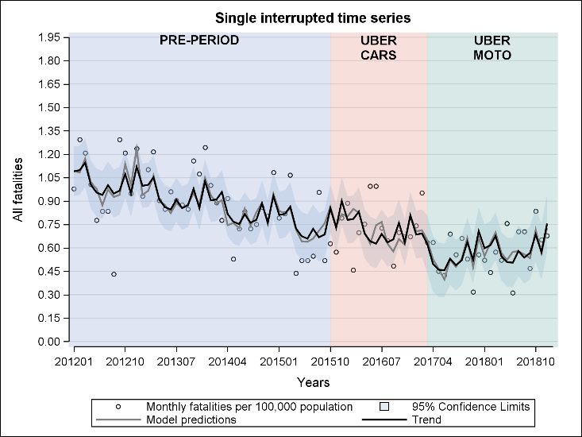
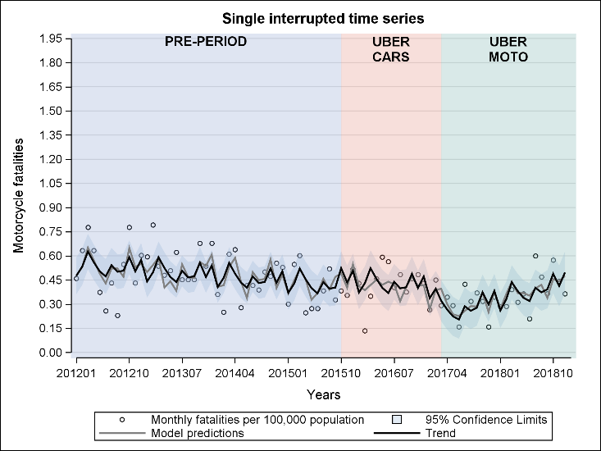
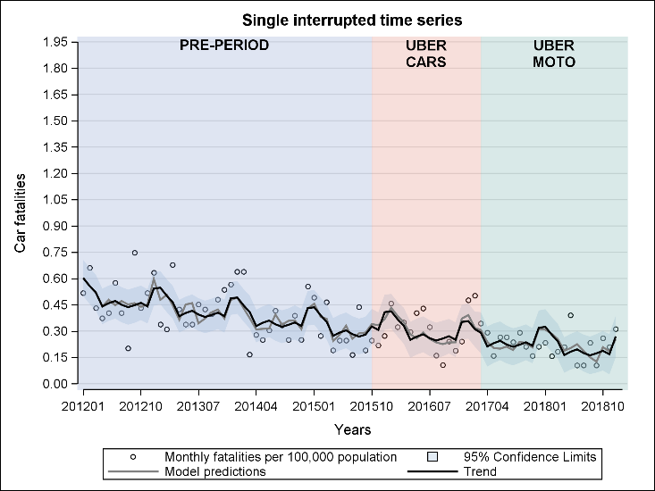
Results
Figure 2 Monthly time–series plot for all traffic fatality, motorcycle fatalities and car occupant fatalities per 100 000 population in Santo Domingo, Dominican Republic (January 2012–December 2018)
Note: Monthly time–series plot for traffic fatality for all fatalities, motorcycle fatalities and car occupant fatalities (in round dots). Trend (black solid line). Model predictions and confidence intervals (grey shade). The pre period is indicated by the purple box, the UberCAR period by the light coral box, and the UberMOTO period by the green box.

Slide 14
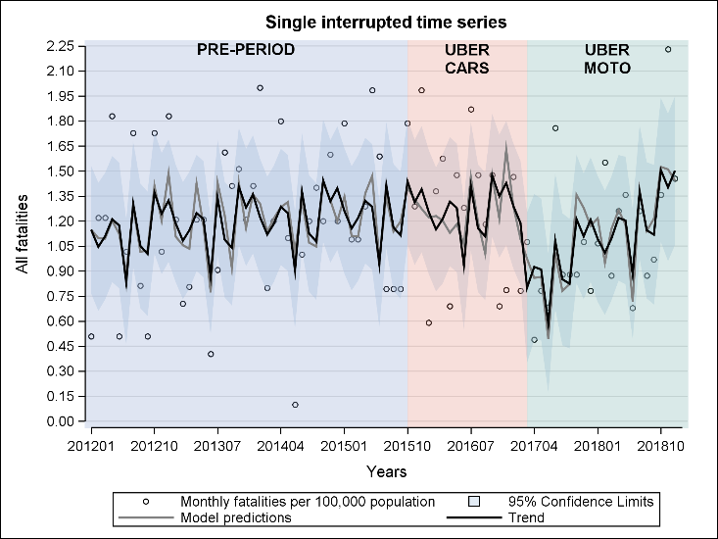
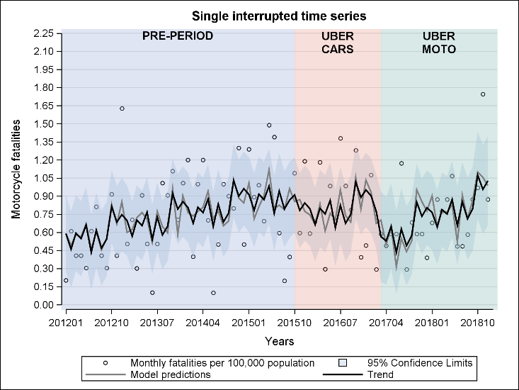
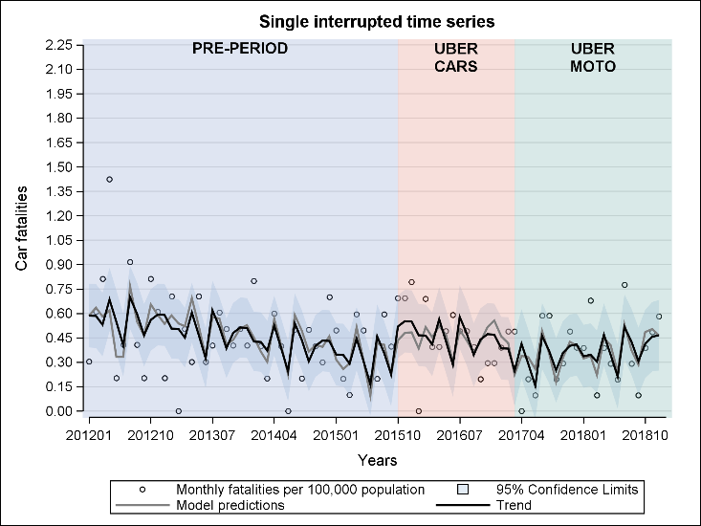
Results
Figure 3 Monthly time–series plot for all traffic fatality, motorcycle fatalities and car occupant fatalities per 100 000 population in Santiago, Dominican Republic (January 2012–December 2018)
Note: Monthly time–series plot for traffic fatality for all fatalities, motorcycle fatalities and car occupant fatalities (in round dots). Trend (black solid line). Model predictions and confidence intervals (grey shade). The pre period is indicated by the purple box, the UberCAR period by the light coral box, and the UberMOTO period by the green box.

Slide 15
Results
Table 1 Segmented regression with AR errors for the monthly traffic fatality rates for all fatalities, motorcyclist, and car occupant in Santo Domingo, Santiago and San Cristóbal, Dominican Republic 2012–18
All outcomes are fatalities per 100,000 population; β = estimate; LCL= lower confidence interval limits; UCL= upper confidence intervals limits.
 |  | All fatalities | All fatalities |  | Motorcyclist fatalities | Motorcyclist fatalities |  | Car occupant fatalities | Car occupant fatalities
City | Variables | β | LCL | UCL | β | LCL | UCL | β | LCL | UCL
Santo Domingo | UberCAR | 0.06 | -0.09 | 0.21 | 0.04 | -0.08 | 0.15 | 0.03 | -0.06 | 0.13
 | UberMOTO Arbupt change (level) | -0.11 | -0.28 | 0.06 | -0.17 | -0.29 | -0.05 | 0.02 | -0.09 | 0.12
 | UberMOTO Gradual change (trend) | 0.01 | 0.00 | 0.02 | 0.01 | 0.00 | 0.02 | 0.00 | -0.01 | 0.01
Santiago | UberCAR | -0.04 | -0.39 | 0.31 | -0.23 | -0.52 | 0.07 | 0.20 | 0.05 | 0.35
 | UberMOTO Arbupt change (level) | -0.45 | -0.86 | -0.04 | -0.34 | -0.68 | 0.00 | -0.08 | -0.25 | 0.08
 | UberMOTO Gradual change (trend) | 0.02 | -0.01 | 0.05 | 0.01 | -0.02 | 0.04 | 0.01 | 0.00 | 0.02
San Cristóbal | UberCAR | 0.11 | -0.36 | 0.59 | 0.14 | -0.14 | 0.41 | -0.01 | -0.37 | 0.35
 | UberMOTO Arbupt change (level) | 0.03 | -0.51 | 0.56 | 0.05 | -0.25 | 0.36 | -0.07 | -0.46 | 0.33
 | UberMOTO Gradual change (trend) | 0.02 | -0.02 | 0.06 | 0.01 | -0.02 | 0.03 | 0.01 | -0.02 | 0.04

Slide 16
Discussion
Findings suggest that the introduction of UberMOTO with a modest a short-term decline in rates of motorcyclist fatalities in Santo Domingo, and Santiago.
In these two cities trends seemed to revert in the longer-term to 2015 pre-intervention levels.
There was also modest evidence that the introduction of UberCAR with a minor increase in rates of car occupant fatalities in Santiago
The placebo city found no effects when UberCar or MotoUber were simulated to be introduced

Slide 17
Discussion
Why these results?
UberMOTO in Santo Domingo may have gradually increased the purchase of motorcycles, which in turn increased the risk exposure of motorcyclists to pre-UberMOTO term levels.
While in 2017, in Santo Domingo there were approximately a total of 642000 registered motorcycles, by the end of 2018 this number grew by 50%, reaching a total of 960000.
The introduction of UberMOTO is not necessarily associated with negative traffic safety changes per se, but rather how this service could trigger results depending on the transport context where it is embedded.
The null effect on car occupants maybe explained by transport preferences as function of socioeconomic status: mototaxi clients in the Dominican Republic are mostly from lower socioeconomic background (Alonso et al. 2020) and therefore the new offer did not bring a change in the demand of transport.

Slide 18
Discussion
Why these results?
UberCar is associated with increases in car occupant fatalities only in Santiago. This maybe because Uber arrived to zones in which public transport is less developed--the increase of trips associated with the arrival of a new service could lead to more crashes in these zones due to greater vehicle density. Santo Domingo on the other hand has a better public transport connectivity.
Maybe results are explained by differences on how police officers collect information in each city. Misclassification practices may be more prominent in one city over the other
Tempering the interpretation
Police misclassification
Unknown if the road victims were or not ridesharing users
Absence of other time-varying exposures
Spatial distribution of crashes

Slide 19
Thank you
jose.ignacio.nazif-munoz@usherbrooke.ca
@nachonazif

