Slide 1
Electrification of Shared Mobility – Challenges and Opportunities Ahead
Matthew W. Daus, Esq.
Technical Session B1: Electrification – A Path to Decarbonization?
Session Track: Automated, Connected and Digital Technologies
5/31/2022, 3:30 PM - 5:00 PM

Slide 2
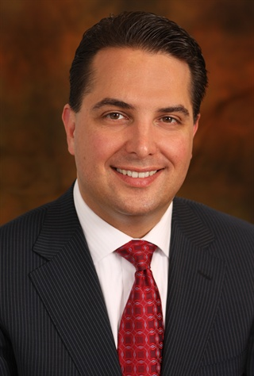
Matthew W. Daus, Esq.
Former Commissioner/Chair/CEO & General Counsel, New York City Taxi & Limousine Commission
President, IATR
International Association of Transportation Regulators www.iatr.global
Transportation Technology Chair, CUNY-UTRC, CCNY
University Transportation Research Center, City University of New York at The City College of NY www.utrc2.org
Partner & Chairman, Transportation Practice
Windels Marx Lane & Mittendorf, LLP www.windelsmarx.com
Contact: mdaus@iatr.global 646-261-1590

Slide 3
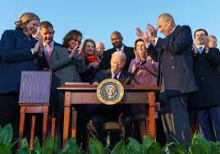
Bipartisan Infrastructure Law (BIL)
On November 15, 2021, President Biden signed the $1.2 trillion Infrastructure Investment and Jobs Act (H.R. 3684).
$283.8 billion in funds are dedicated to categories related to transportation: roads, bridges & major projects; airports; low-carbon and zero-emission school buses and ferries; passenger and freight rail; ports and waterways; electric vehicle charging; public transit; safety and research; and community reconnections.
The legislation provides $15 billion in funding for the electrification of “everyday” transportation. These funds will be divided equally with $7.5 billion each for electric vehicle supply equipment (EVSE) charger expansion and low-to-zero emission school buses.
Funding for the National Electric Vehicle Infrastructure Formula Program (NEVI) under the Bipartisan Infrastructure Law will be disbursed over the course of 5 years.
States must submit their EV infrastructure deployment plans to the Joint Office of Energy and Transportation by August 1, 2022.
The Federal Highway Administration will approve eligible plans by September 30, 2022.

Slide 4
Promising Sectors for EVs
Shared Mobility
Will shared mobility (taxis, TNCs, and car sharing) accelerate EV adoption?
Today, shared mobility services account for less than 5% of total distance traveled by passenger vehicles.
By 2040, this contribution could rise to 19% as demand for private vehicle ownership is reduced.
The average mileage of TNCs is estimated to be three to four times that of private vehicles. Higher mileage improves the economics of EV charging.
Today, EVs account for 1.8% of the shared mobility fleet (below 1% for major TNC platforms). By 2040, they could account for up to 80%.

Slide 5
Promising Sectors for EVs

Slide 6
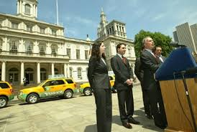
E-Taxis
The Movement Started in the 2000s, in NYC with Hybrid Taxis

Slide 7
NYC Alternate Fuel Lawsuit
In the mid-2000s, as part of PlaNYC, former New York City Mayor Michael Bloomberg and the Taxi and Limousine Commission announced the hybrid-electric vehicle miles per gallon fuel-efficiency mandate for taxicabs, and then added for-hire vehicles – with other cities following suit.
The taxi industry brought a successful lawsuit against the Mayor and the TLC to strike down the fuel mandate.

Slide 8
NYC Alternate Fuel Lawsuit
By 2020, 59% of all Yellow taxis, 42% of Green taxis, and 20% of FHVs have hybrid engines.
Meanwhile, only 0.24% of Yellow taxis and 0.65% of FHVs are BEVs today.

Slide 9
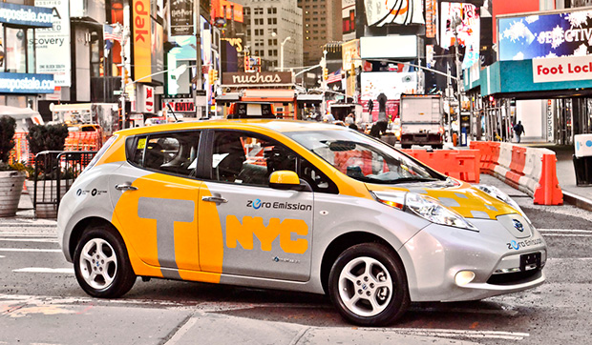
NYC: Nissan LEAF Pilot
In April 2013, NYC and the TLC launched a pilot program for all-electric taxis with a fleet of six first-generation Nissan LEAF vehicles, with the goal of electrifying one-third of the TLC taxi fleet by 2020.
NYC pilot program was decommissioned by 2015 due to two primary issues:
Range anxiety: Battery range was not enough to sustain the required 114 miles per shift (vs. Nissan LEAF’s 84-mile range). Taxi drivers spend a significant amount of time cruising for fares, which drives up the number of miles per shift. In addition, it was found that the usage of the HVAC system decreased vehicle range significantly.
Charging infrastructure: An average gas station visit lasted only 6.25 minutes, while L2 charging takes approximately 8 hours. Even on a DC Fast Charger, a LEAF takes 30 minutes to charge from 0% to 80%. A vast majority of taxis operated two shifts per day, which limited charging time. There was also a lack of tech support in the aftermath of several malfunctioning chargers.

Slide 10
BEV Taxi Pilot Program
The TLC approved a BEV Taxi Pilot Program on May 4, 2021 – the pilot would operate for 12 months after the first BEV taxi enrolled.
The first BEV taxi was certified for use under the pilot in August 2021.
This pilot increases the number of BEV options available to use as taxis beyond the already-approved Tesla Model 3.
Pursuant to the pilot, taxi medallion vehicle specifications regarding horsepower and acceleration have been modified for several BEVs that meet the TLC's interior volume standards.
While the pilot is set to run for 12 months, new BEVs will remain licensed as long as they comply with TLC rules.
There are 9 BEVs in the pilot, including the following models: Tesla Model Y, VW E-Golf, VW ID.4/5, Hyundai Ioniq, Audi E-Tron, Kia Niro and Ford Mach-E.

Slide 11
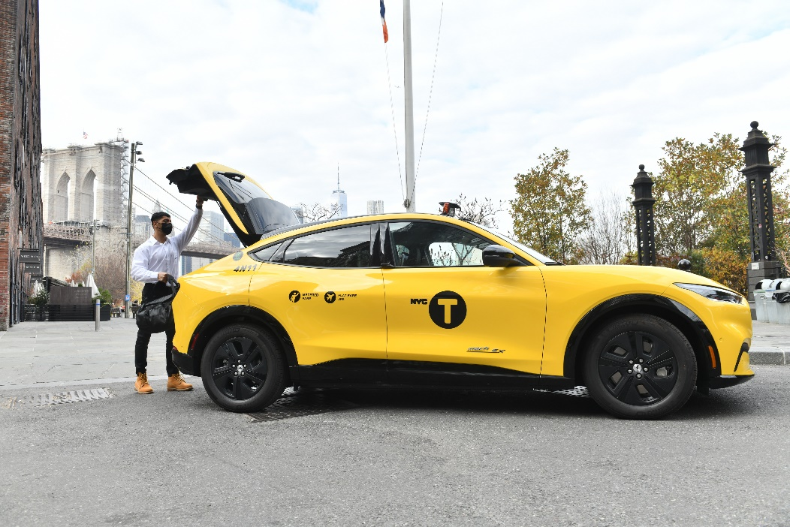
Gravity, Inc.
Gravity launched its all EV taxi fleet in December 2021.
Gravity began with the first Ford Mustang Mach-E Crossover enrolled in the BEV Taxi Pilot Program.
The company has since begun adding the Tesla Model Y to the pilot.

Slide 12
FHV Cap
In August 2018, New York City enacted Local Law 147, imposing a one-year cap on the issuance of new FHV licenses with limited exceptions for wheelchair accessible vehicles (“WAVs”) and certain lease-to-own situations.
L.L. 147 also gave the TLC the authority to limit the number of licenses after the first year. The TLC has maintained the FHV cap since it was first implemented – a decision it now reviews every February and August.
In August 2019, the TLC continued the existing exemptions and added an exemption for battery electric vehicles (BEVs).
In June 2021, the TLC removed the exemption for BEVs, citing the agency’s fear that the number of applications under the BEV exemption would increase.
During the webinar Transportation Talk with Matt Daus in March 2020 with candidate Eric Adams, he said that, if elected mayor, he would expand charging infrastructure to further incentivize drivers to go electric.

Slide 13
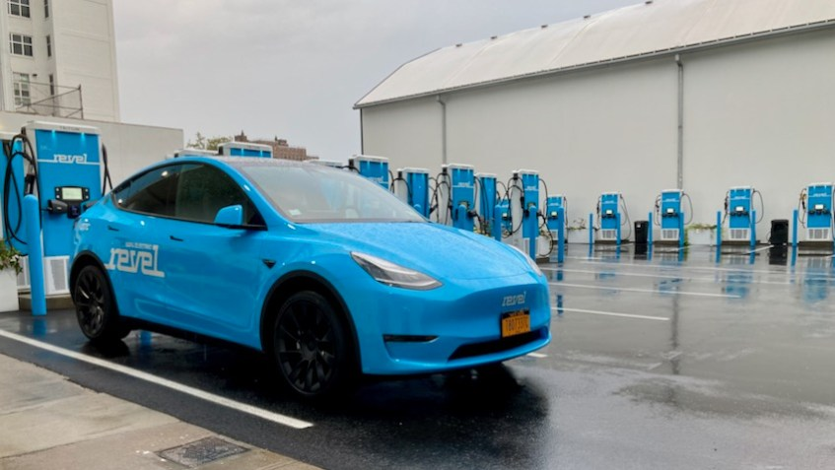
Revel
Revel entered the NYC FHV market in May 2022 – after already launching it e-scooter program in NYC in August 2020.
Due to the EV exemption in the FHV cap, Revel was able to launch with nearly 50 Tesla Model Ys with its black car base.
Revel owns its fleet and employs the drivers – with full benefits – to maximize efficiency.
Revel invested in an EV charging station at the old Pfizer Factory in Brooklyn.
In June 2021, the TLC (during the de Blasio administration) abruptly ended the EV exemption to the FHV cap.
Even so, on June 29, 2021, U.S. Energy Secretary Jennifer Granholm attended the Revel EV charging station ribbon cutting and expressed her support for an all-electric fleet.
With this limited fleet of EVs, Revel is only operating in Manhattan at this time.

Slide 14
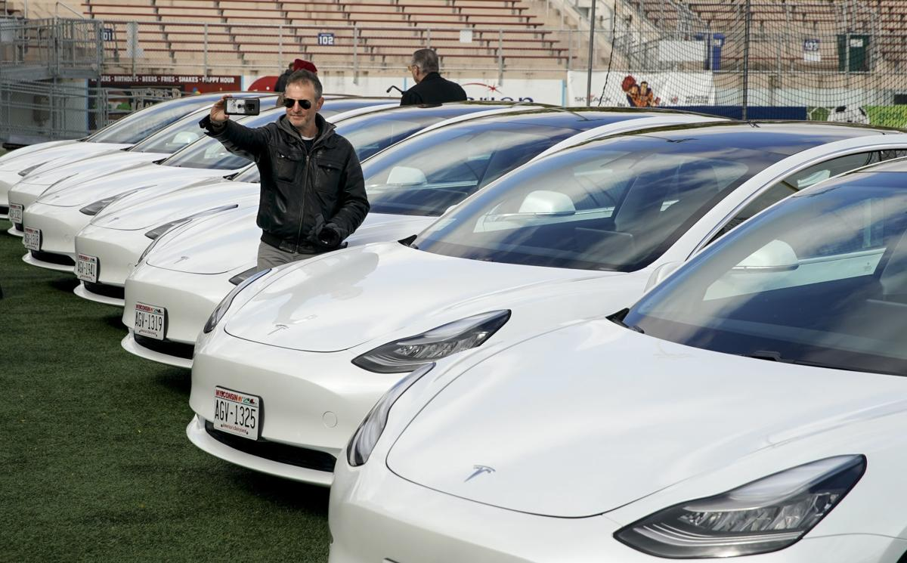
Madison, WI: Tesla Model 3 Taxi
Madison-based Green Cab converted its entire fleet to Tesla Model 3s in 2021, becoming the first all-electric taxi service in the US.

Slide 15
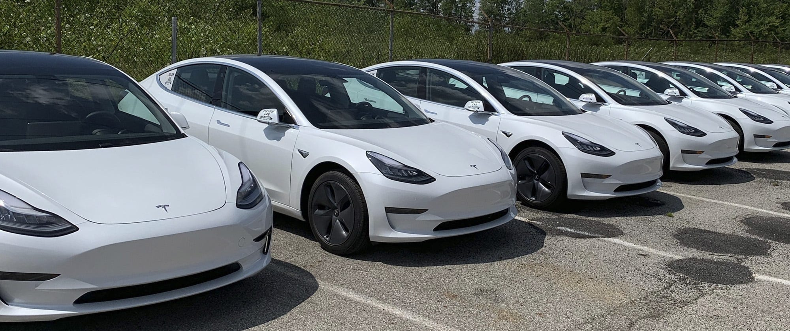
Columbus Yellow Cab
Columbus Yellow Cab is working on the electrification of their fleet of ~200 taxis.
The company’s approach to EV purchasing is a test-as-you-go methodology, in which the more advanced and efficient models are introduced into the fleet as they become available in the market.
For the first 10 EVs, the company started with the 2018 Chevy Bolt.
In 2020, the company added 10 Tesla Model 3 vehicles to its fleet.

Slide 16
Uber Pledges to Shift to ‘100%’ EVs by 2030
Under the Zero Emissions incentive, BEV drivers are eligible for an extra $1 on every Uber trip.
Uber is also working with Hertz to offer Tesla and Hyundai rental cars for drivers. The offer includes basic maintenance and unlimited mileage.

Slide 17
Lyft (also) Pledges to Shift to ‘100%’ EVs by 2030
Through Express Drive, Lyft’s vehicle rental program, drivers will be able to rent EVs from Flexdrive and Hertz.
Lyft is also negotiating with auto manufacturers to reduce EV prices and aggregating demand to help drive down costs across the supply chain.

Slide 18
Drivers of EV Adoption
State/City Initiatives
Goals & Incentives
Private Sector Innovation
Public-Private Partnerships (P3)

Slide 19
Electrification Goals in Cities
Los Angeles aims to eliminate tailpipe emissions by 2028.
New York City aims to have 20% of new vehicle registrations be EVs by 2025.
Seattle aims to have 100% of shared mobility to be emissions-free by 2030.
Denver aims to have 15% of new vehicle registrations be EVs by 2025, with that share doubling by 2030.

Slide 20
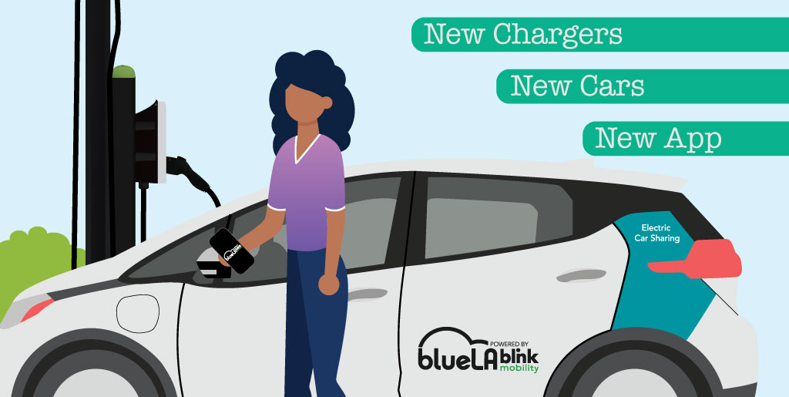
Electric Carsharing
BlueLA (currently owned by Blink Mobility) has more than 300 EVs and 500 charging stations in L.A.

Slide 21
Electric Autonomous Vehicles
Companies pursuing autonomous vehicles such as Waymo and GM Cruise are considering utilizing EVs largely due to lower operating costs for high-mileage autonomous vehicles.
In California, still by far the largest AV test bed in the world, roughly 81% of the AVs operating in 2021 were either fully electric or plug-in hybrid.
AEVs run 24/7, use fuel at the equivalent of 130 mpg, and operate with a fraction of the labor costs. The cost of running a fully-developed fleet of AEVs would likely be lower than light rail or conventional buses.

Slide 22
State and Local Government Incentives

Slide 23
State and Local Government Incentives
The economics of charging infrastructure and installation remains unfavorable or weak.
The lack of standardization could lead to operational challenges, reduced public access, decreased utilization of charging infrastructure, and overall higher costs for electric transportation.

Slide 24
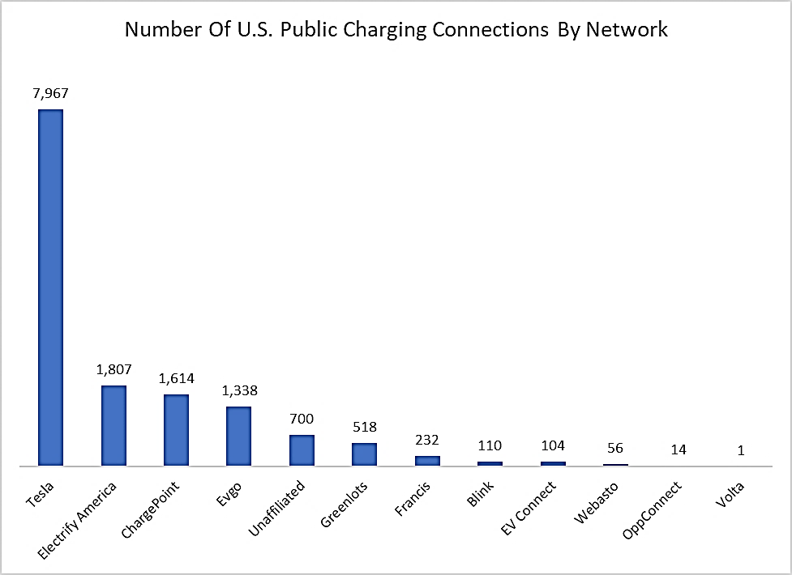
Private Sector Innovation
The proliferation of charging infrastructure would not be possible without players such as Tesla and Electrify America.
Tesla currently has the nation's largest charging network.
Like Tesla, Electrify America has concentrated on highway network but is now turning to urban areas.

Slide 25
Public-Private Partnerships (P3s)
The EV Shared Mobility project is led by the City of Seattle and Atlas Public Policy, and it brings together the U.S Department of Energy’s Energy Efficient Mobility Systems program and major industry stakeholders with the cities of Seattle, New York, Denver, and Portland to test different electric shared mobility interventions.

Slide 26
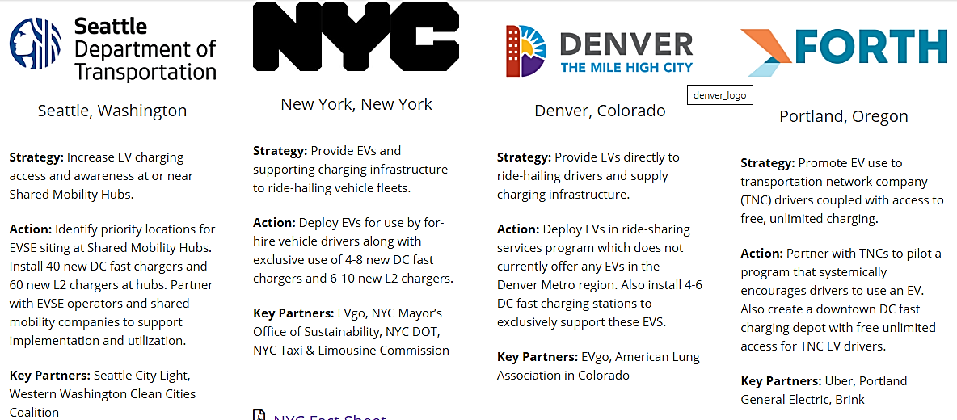
Public-Private Partnerships (P3s)

Slide 27
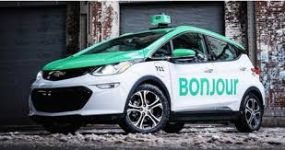
International Exemplars
Quebec, Canada Téo Taxi was re-launched in Montreal and Gatineau with a fleet of 55 Kia Soul EVs. The company aims to make available 120 new EVs per year to thus become the largest fleet of electric taxis in Canada. | Oslo, Norway The City of Oslo is joining forces with taxi operator Cabonline, Jaguar Land Rover, Fortum Recharge, and Momentum Dynamics to build wireless, high-powered charging infrastructure for electric taxis by Q1 2024.
Shenzhen, China In 2009, the city initiated its New Energy Vehicles Plan, which converted all of the city’s 21,000 taxicabs to EVs within a decade. | Singapore In 2017, the Land Transport Authority launched a trial fleet of 50 electric taxis that has since been issued a full-service operator license and is expected to grow to 800 electric taxis by July 2022.

Slide 28
Thank You!/ Questions?
Contact: mdaus@iatr.global
646-261-1590

