Slide 1
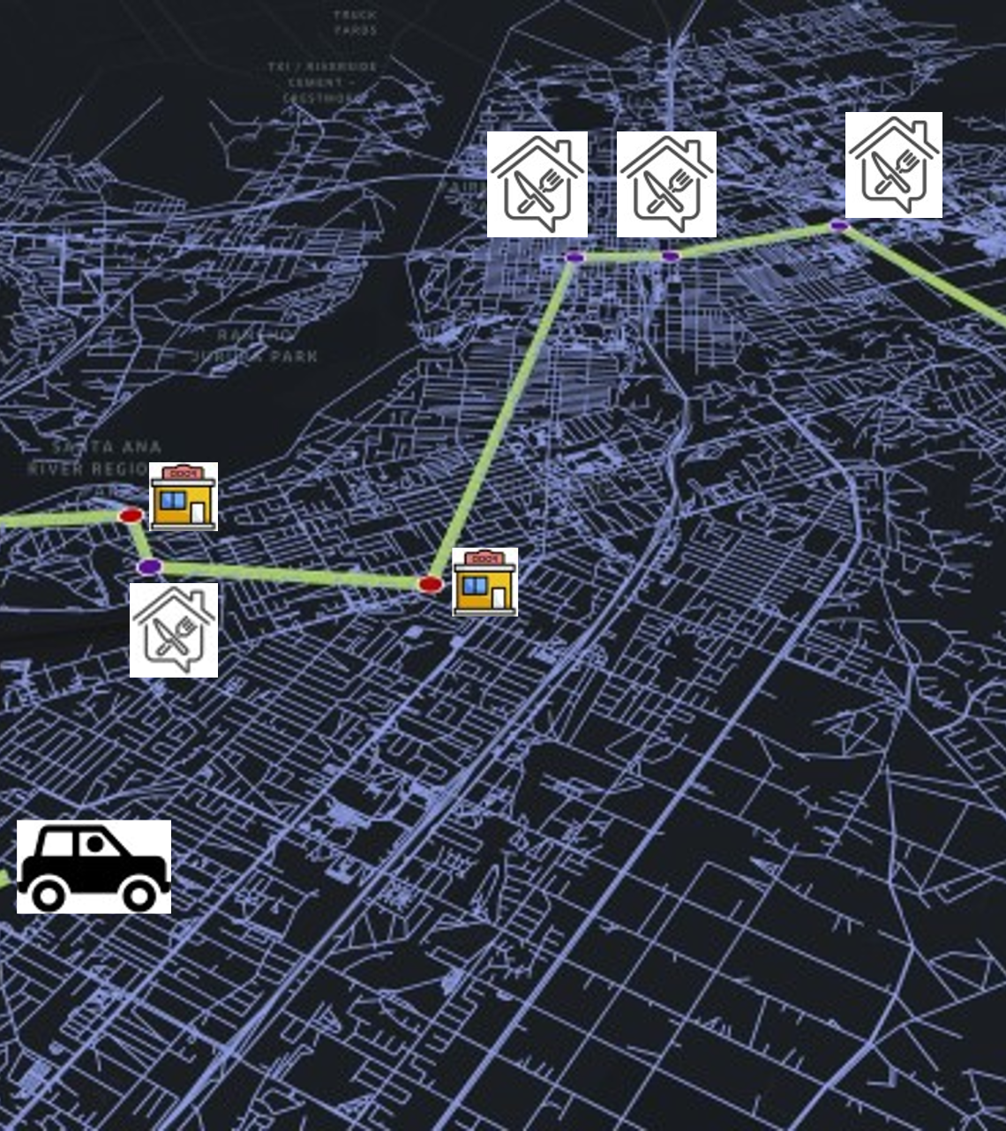
How On-demand Food Delivery Impacts Traffic Network During Pandemic?
Peng Hao, Haishan Liu, Yejia Liao, Kanok Boriboonsomsin, Matthew Barth
Center for Environmental Research & Technology, University of California, Riverside
Conference on Sustainability and Emerging Transportation Technology

Slide 2
Background
On-demand delivery services, also known as shared delivery, third party delivery, door-to-door delivery or peer-to-peer (P2P) delivery, is a service that any qualified driver registered in the delivery platform can deliver groceries, cooked food or other goods with their private vehicles.
On-demand food delivery (ODFD) platforms have gained prevalence around the world because they benefit both consumers and restaurants by providing contactless, efficient, and handy services, especially during the COVID-19 pandemic.
There is great uncertainty regarding how the fast-growing ODFD services reshape the traffic network and urban environment, considering the short-term and long-term impact of the pandemic.
Lack of public data on the operation of ODFD companies makes it challenging to quantify the impact on the real-world transportation network.

Slide 3
Objectives
Develop the on-demand food delivery model
1
Calibrate the eat-out demand in a traffic network
2
Evaluate the traffic and environment impact of ODFD services.
3
Study the VMT and emission change related to ODFD in the pandemic
4

Slide 4
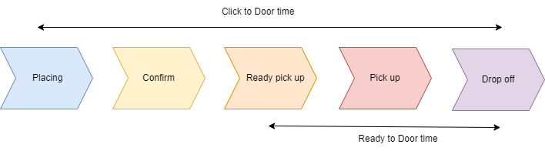
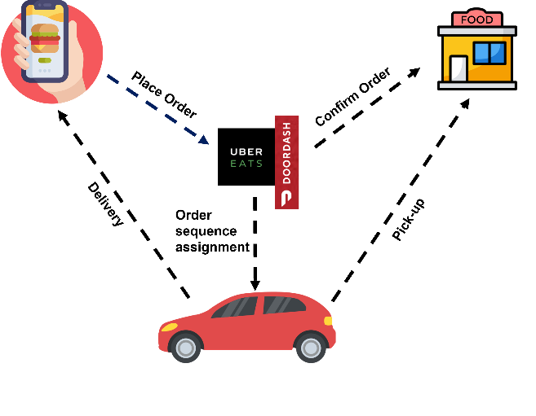
Basics of On-Demand Food Delivery

Slide 5
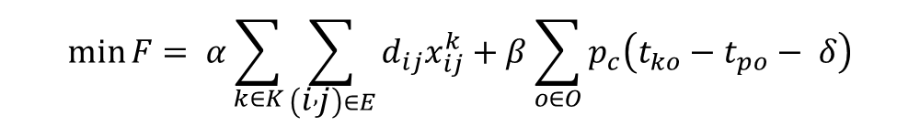
Optimization Problem
The objective function aims to minimize the weighted sum of total travel distance of the all on-demand delivery drivers and the penalty of potential Click-to-door time (CtD) overage occurs to orders. α and β are weight factors designed to balance the distance cost and late delivery penalty.
Constraints include:
  The driver’s working schedule requirement
  Flow conservation to ensure the route feasibility
  Capacity and delivery requirement for drivers
  Time consistence of all phases in the delivery
Two modes for order sharing: one restaurant in one trip, multiple restaurants in one trip
$$\min{F}= α\sum_{k∈K}{\sum_{\left(i , j\right)∈E}{d_{ij}x_{ij}^{k}}}+β\sum_{o∈O}{p_{c}\left(t_{ko}−t_{po}− δ\right)}$$

Slide 6
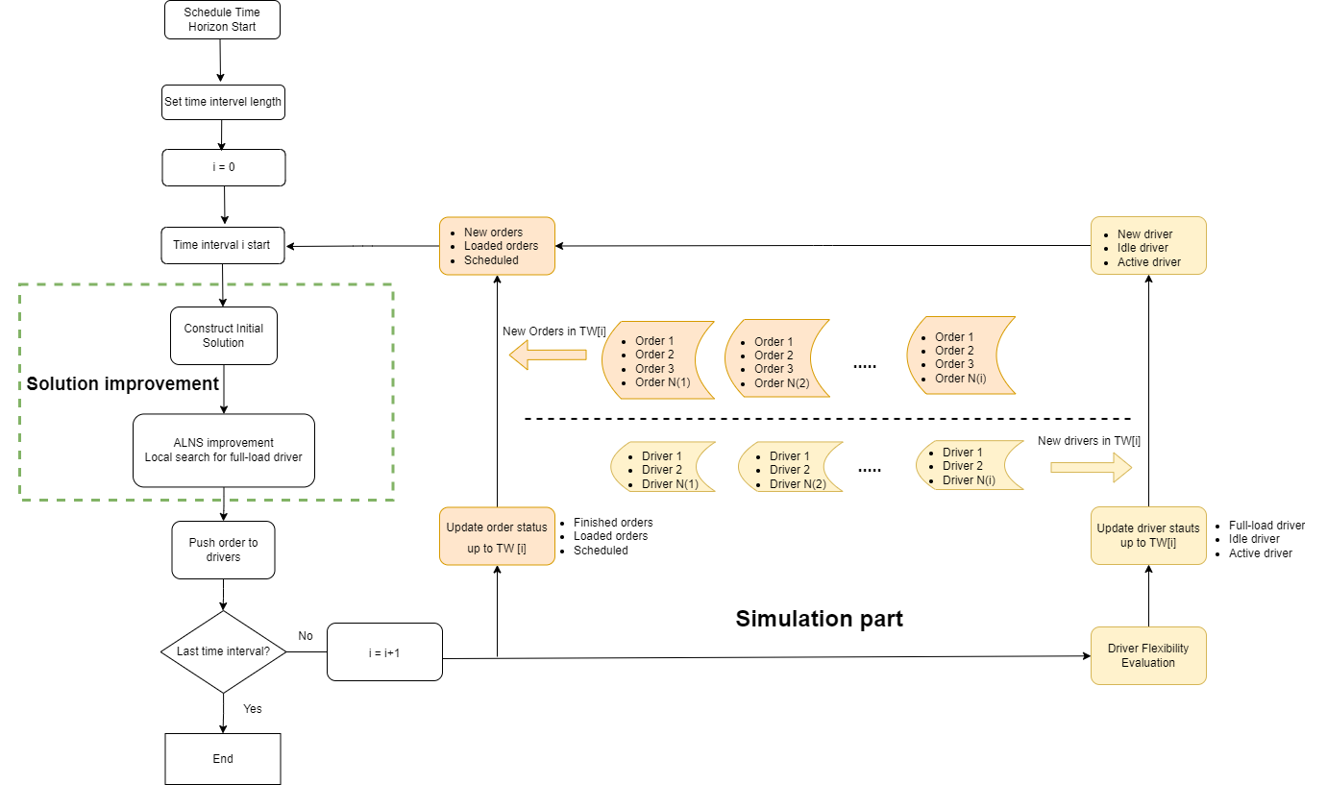
A Rolling Horizon Algorithm with ALNS Framework

Slide 7
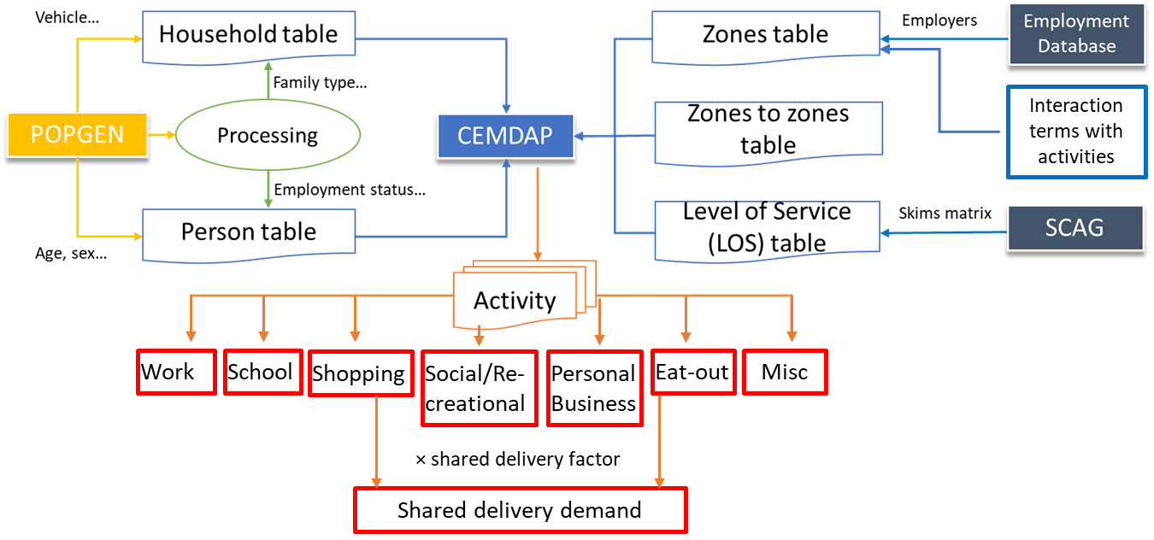
Delivery Demand Generation
On-demand delivery

Slide 8
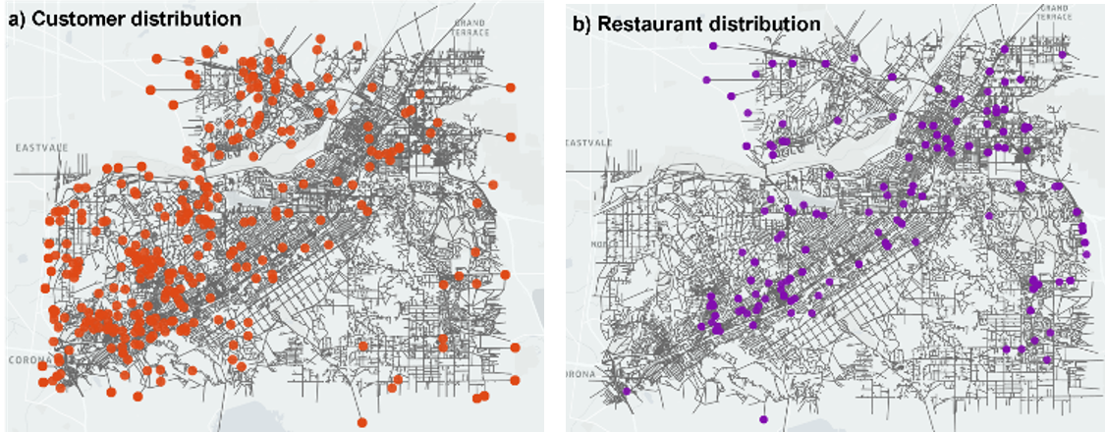
Delivery Demand in Riverside, CA

Slide 9
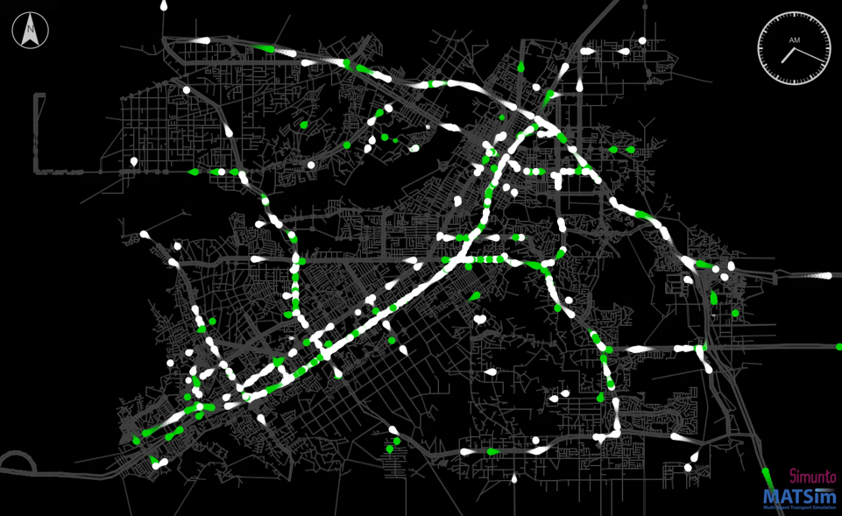
Background Traffic Generation in BEAM

Slide 10
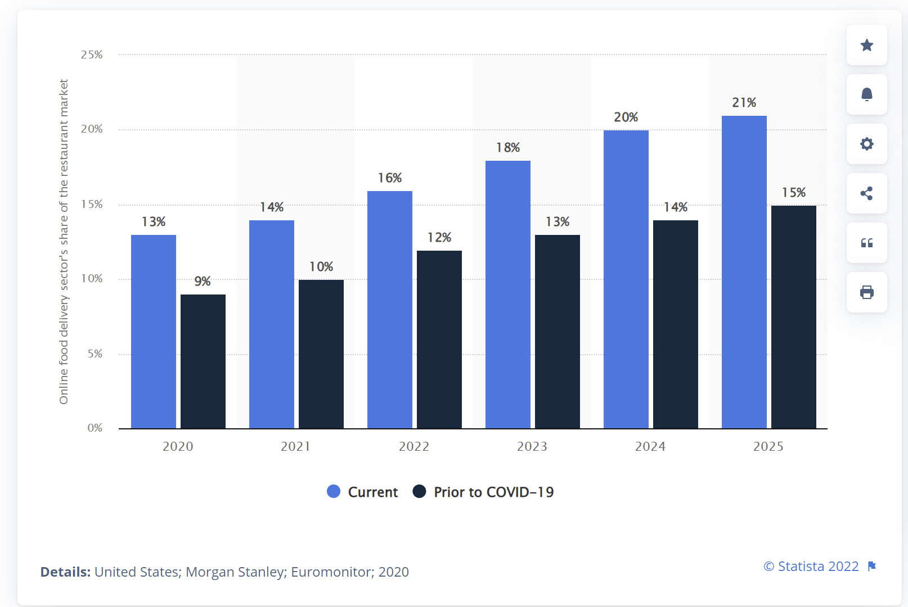
Change of ODFD Penetration due to Pandemic
Meanwhile. the total eat-out demand decreases by 34% in the pandemic

Slide 11
Results (Pre-Covid)
One restaurant in one trip Multiple restaurants in one trip

Slide 12
Results (During-Covid)

Slide 13
Results (Pre-Covid Vs. During-Covid Vs. Future)
45.10%
45.00%
45.00%
45.05%
45.02%
45.08%
42.88%
42.88%
42.88%
42.89%
42.89%
42.89%

Slide 14
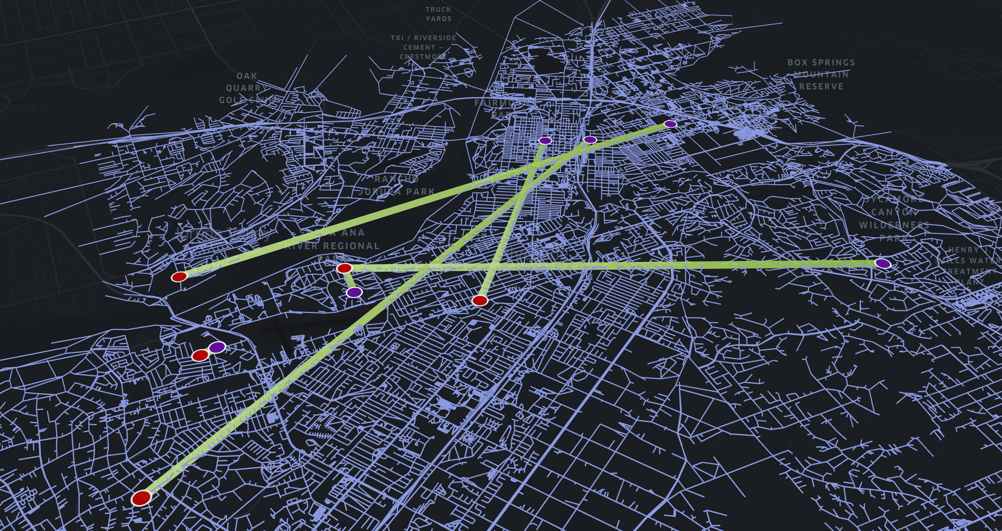


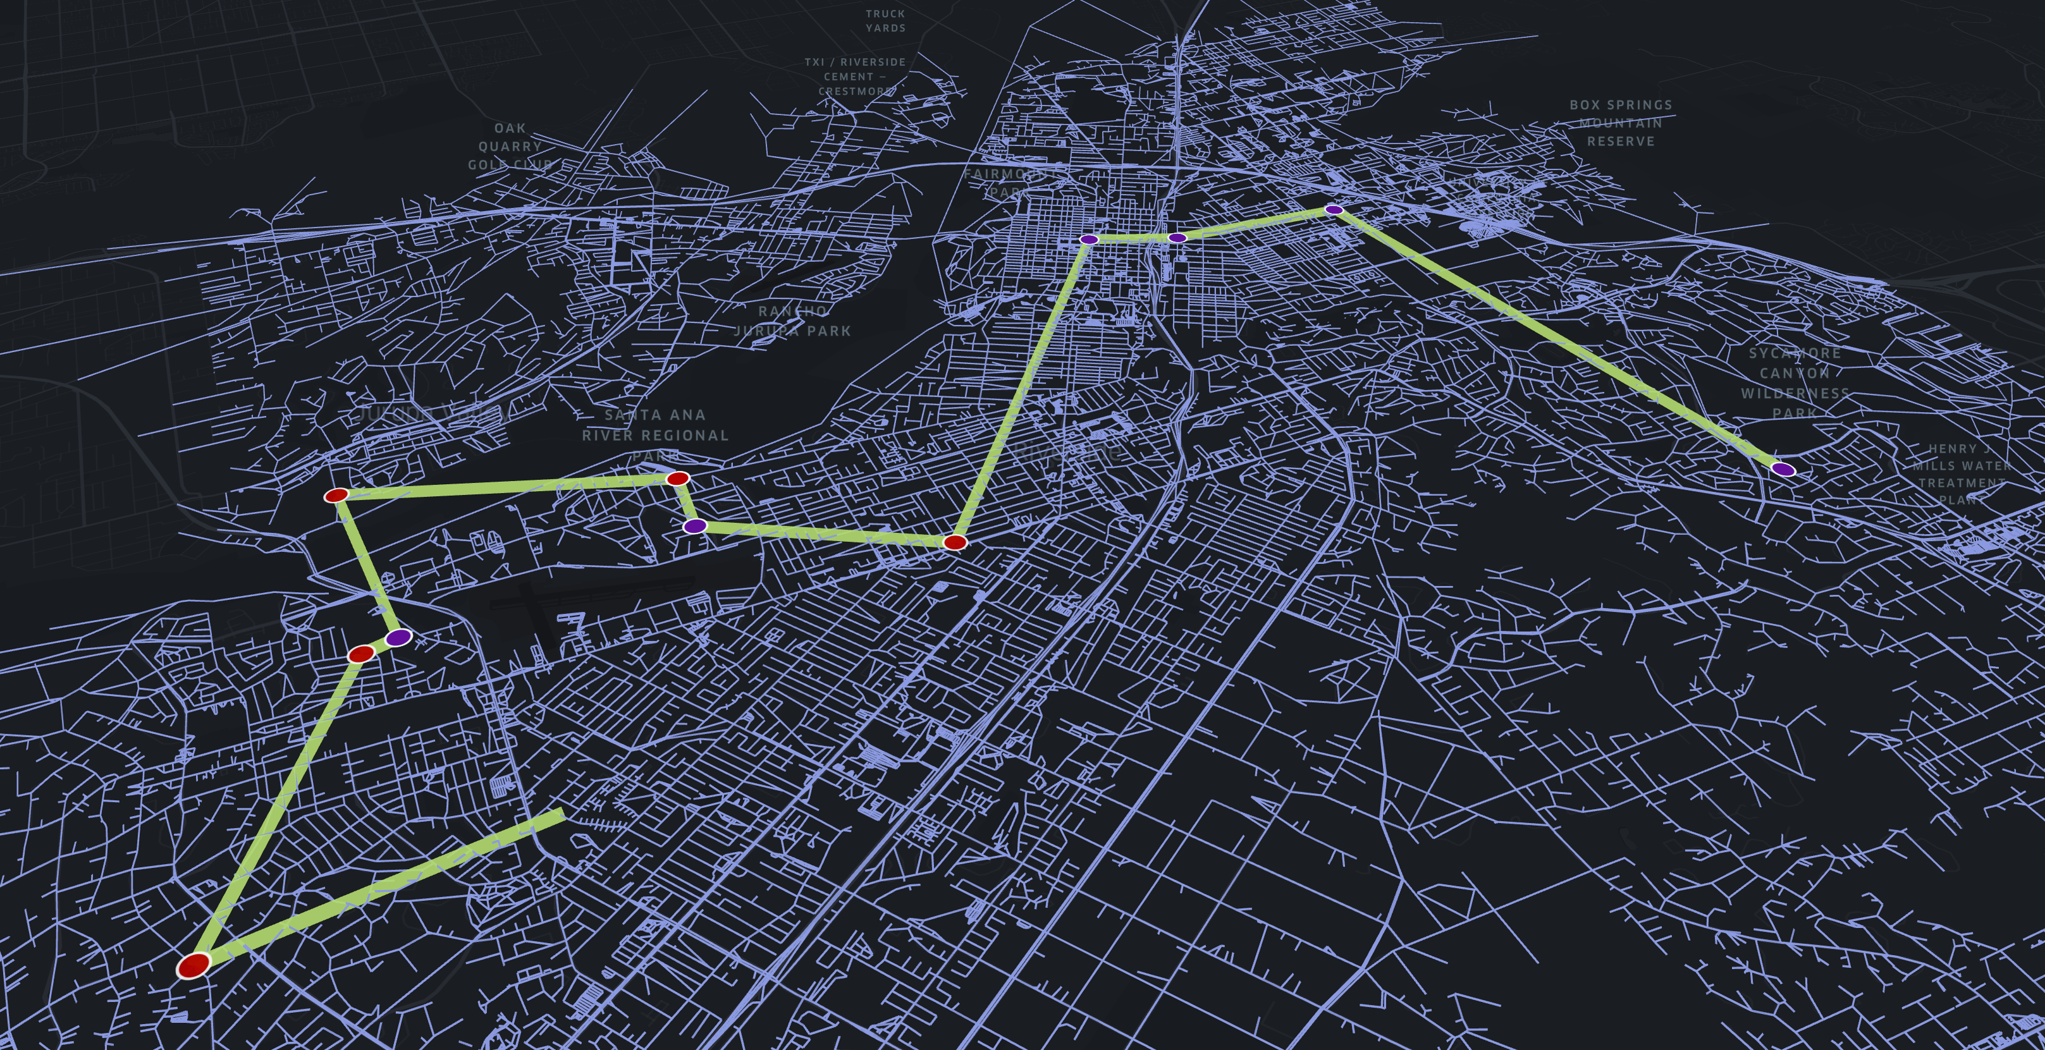

An Example on the VMT Saving from ODFD

Slide 15
Conclusions
A PDPTW model was constructed to formulate the on-demand food delivery problem and the ALNS algorithm was used to solve the problem efficiently.
A well-calibrated CEMDAP model was used to generate realistic ODFD demand.
Multiple scenarios were simulated to evaluate the urban traffic and environmental impact of on-demand food delivery services before and during COVID.
ODFD is a more efficient way to decrease the VMT and emissions.
During pandemic, the total travel distance incurred by eat out demand decreased by 34% compared with the pre-COVID period, but the penetration of ODFD increased by 4%.

Slide 16
Thank you
Questions or Comments ?
  Peng Hao
  Center for Environmental Research & Technology
  University of California, Riverside
  haop@cert.ucr.edu

