Slide 1
Mobility Data for Safer Streets Initiative: UC Davis Evaluation
PRESENTED BY ASHLEY N. DEPEW
UC DAVIS INSTITUTE OF TRANSPORTATION STUDIES
Notes:
Hi everyone, my name is Ashley DePew and I’m a Graduate Student Researcher at UC Davis. Thanks for having me here today, to talk about the Mobility Data for Safer Streets Initiative, or MDSS. I’m excited to share some findings from the evaluation of the pilot, conducted by my team at UC Davis Institute of Transportation Studies.

Slide 2
Research Team
ELI ALSTON-STEPNITZ, M.A.
Graduate Research Assistant
CINDY ROSS, B.A.
Undergraduate Research Assistant
ANGELA SANGUINETTI, PH.D.
Director of cEnergi
NERMIN DESSOUKY, M.A.
Graduate Research Assistant
Notes:
Speaking of which, I’d like to acknowledge to my very talented team team who have contributed immensely to this project.

Slide 3
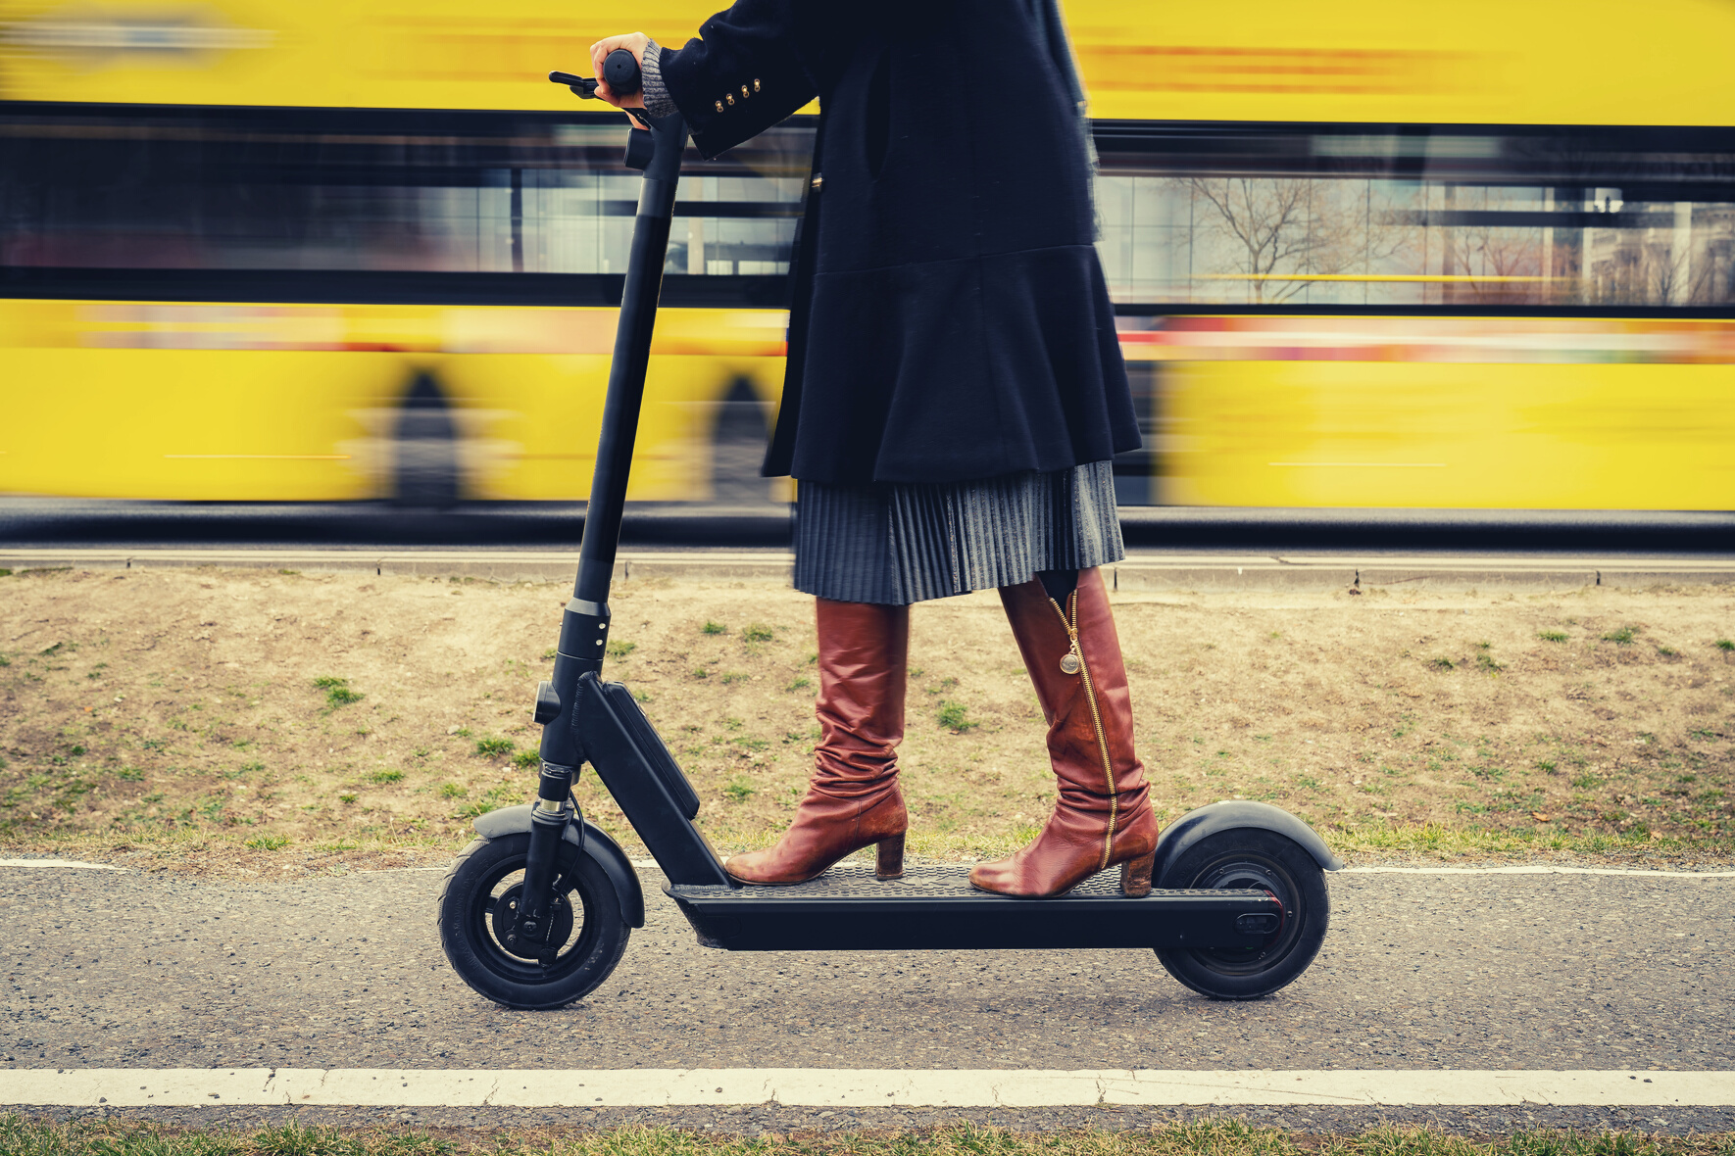
PREVALENCE & POTENTIAL
Shared Micromobility
Rapid proliferation
Investments by big mobility companies
COVID impact
Notes:
Advances in light electric vehicle technology along with the phenomenon of shared mobility have led to the recent emergence of shared micromobility services, which include on-demand, docked or dockless electric or traditional human-powered bikes, scooters, and mopeds.

Slide 4
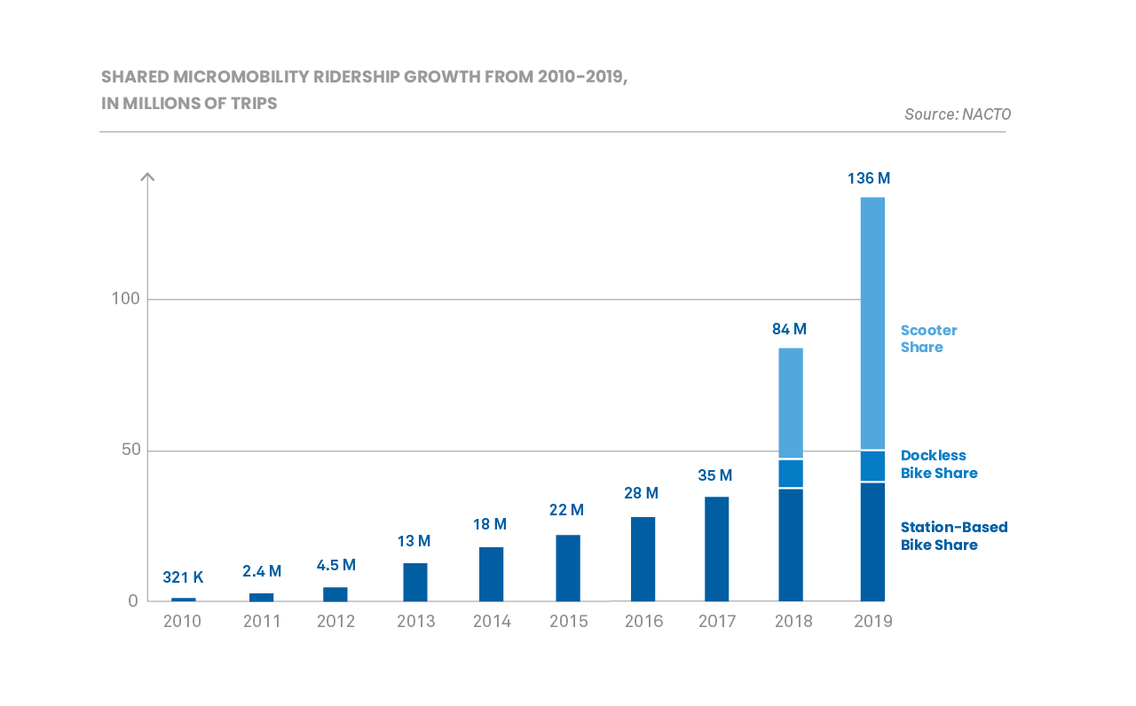
Source: https://nacto.org/shared-micromobility-2019/#:~:text=Big%20Increases%20in%20Shared%20Micromobility,on%20shared%20bikes%20and%20scooters
Notes:
Though shared micromobility still constitutes a small share of overall travel in the US, the market has really been evolving, with many startups emerging and then investments by big mobility companies, like Ford’s acquisition of Spin.

Slide 5
The Benefits
Increased mobility (first/last-mile, filling gaps in underserved communities)
Reduced fuel use and greenhouse gas emissions
Economic development
Health benefits (extending benefits of active transportation to more people)
Smith, C. S., and J. P. Schwieterman. E-scooter Scenarios: Evaluating the Potential Mobility Benefits of Shared Dockless Scooters in Chicago, 2018.
Shaheen, S., and A. Cohen. Shared Micromoblity Policy Toolkit: Docked and Dockless Bike and Scooter Sharing, 2019.
Portland Bureau of Transportation. (2018). 2018 E-Scooter Findings Report. Portland: Portland Bureau of Transportation.
Notes:
In addition to its rapid growth, shared micromobility is also being widely promoted for its societal and environmental benefits. There is limited research but so far it validates a variety of benefits, like increased mobility, including by providing options for first and last mile connections with public transit or other shared modes. And it can fill mobility access gaps in underserved communities. Active transportation in general, including walking and traditional bicycling, has long been recognized for its associated environmental health benefits. Shared micromobiliy modes, to varying degrees, are still more environmentally friendly and more active than personal car travel. Shared micromobility is accessible to more people who would not be able to bike or walk to their destinations, thus offering more mobility options and expanding the health benefits of active travel to more people.

Slide 6
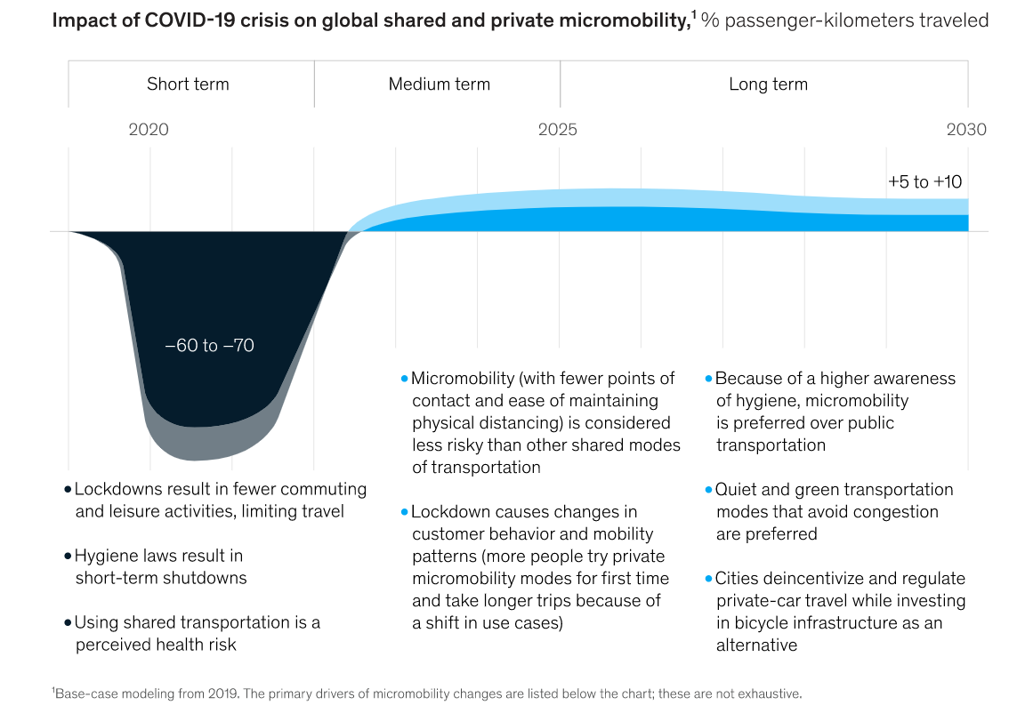
Source: www.mckinsey.com/industries/automotive-and-assembly/our-insights/the-future-of-micromobility-ridership-and-revenue-after-a-crisis#
Notes:
Shared micromobility is recovering relatively quickly since the start of the global pandemic, compared to other shared and pooled modes. It offers a safer alternative to sharing a vehicle with others outside one’s household, in terms of risk of COVID transmission. Some are predicting usage will increase as much as 10 or 12% after the pandemic, compared to pre-pandemic levels.

Slide 7
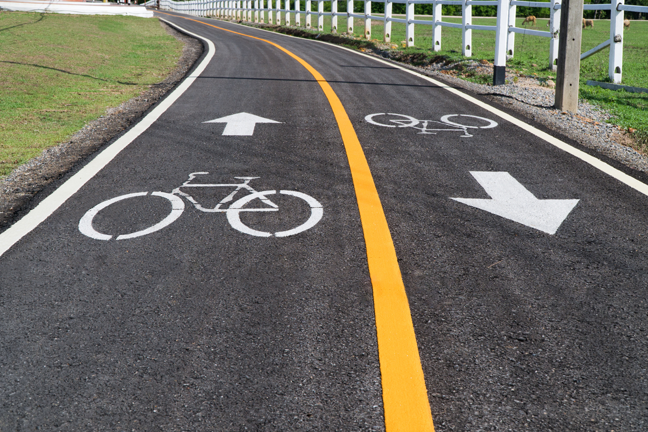
Safer Streets
Insufficient infrastructure
Safety issues
Equitable access
Notes:
So we know the overall promise of micromobility is quite positive, but there are of course some barriers. In particular, safer streets are a precursor to fulfill potential adoption and benefits of micromobility. The emergence of shared micromobility and uptick in active modes generally during the pandemic has drawn attention to a general deficit of safe and appropriate infrastructure for all types of active transportation. Appropriate street facilities for any mode that is being used ultimately contributes to enhanced safety for all modes, including cars. Many cities lack bike lanes or sidewalks, or need improvements because bike lanes are unprotected or unconnected, leaving users with partially unsafe routes or longer routes than necessary. When shared micromobility started showing up in cities, there were both real and perceived safety issues related to increased users of bike facilities and sidewalks, traveling at different speeds. There was often a lack of clear regulation or safe facilities to ride and park the vehicles, and lack of equitable access to these new services.

Slide 8
Restrictions
Banned from greenways
Banned from sidewalks
Harsh restrictions on speed and operating hours
Taxes (e.g., extra cost to ride in certain area)
People really only saw scooters downtown and that’s where the problems happened... people were riding them and leaving them on the sidewalk… a lot of people viewed them as “toys for tourists”
MDSS AWARDEE RE: SCOOTERS
Notes:
And sometimes minor or uncommon incidents received more attention and micromobility got a bit of a bad rap. Cities learned and started to regulate operators more, limiting vehicle fleets sizes, speeds, and boundaries. While much of this was an improvement, some restrictions may be unnecessarily limiting. For example, some cities ban shared micromobility vehicles from greenways for walking and biking, or ban them from sidewalks even where they are underutilized and street facilities are unsafe or nonexistent. Cities or law enforcement have also restricted speeds and operating hours quite stringently in some places, for example so they can only be used between 7am and 7pm. It is important that these policies and street design be informed by rigorous data, so that they can facilitate shared micromobility while optimizing safety for all modes.

Slide 9
Big Mobility Data
Quantification of
Modeshare
Speeds
Volumes
Routes
Notes:
This is where mobility data comes in. Alongside the emergence of shared mobility, in general, is a growing wealth of mobility data generated by the operators providing these services, and travel-related data generated from smartphones. These data, which include mode use volumes, origins and destinations, and routes, can support public agencies in regulating mobility companies and planning for changing transportation patterns. However, analyzing the data requires sophisticated technical skills. This has created a market for software platforms that help process and evaluate the data, often using map-based interfaces.

Slide 10
Access to Mobility Data Tools
Primarily private sector market
Prohibitively expensive for public sector
Even more beyond reach for micromobility advocacy organizations
Local government doesn’t always have resources to put towards getting the right tools or data.
MDSS AWARDEE RE: ACCESS TO MOBILITY DATA TOOLS
Notes:
These advanced planning tools can be prohibitively expensive for the public sector. They are not always affordable for cities, let alone for not-for-profit advocacy groups that are often the strongest voice for progressive micromobility infrastructure and policy. Historically, transportation planning is a slow-changing institution with top-down processes that tend to replicate and maintain the status quo, which includes relatively low prioritization and inequitable distribution of active transportation facilities. This is not true for every city. Advocacy orgs fight for safer streets for micromobility, but, lacking the resources to gather rigorous data, they typically rely on anecdotal data which doesn’t alone tend to carry the weight needed to drive government decision-making.

Slide 11
MDSS Initiative Pilot
Jan 2020-Mar 2021
Mobility Data for Safer Streets
Six advocacy organizations
Suite of mobility data tools
Use to identify and/or garner support for street redesign projects for safer streets
Notes:
Enter MDSS. Realizing the value of mobility data tools in the hands of those working hardest to make streets safer for micromobility, Spin launched a program called Mobility Data for Safer Streets. The inaugural, or pilot phase of the project awarded six advocates around the country with access to a suite of data tools to leverage in their advocacy for safer streets.

Slide 12
MDSS Awardees
Notes:
The awardees were...

Slide 13
Tools: Software
Notes:
The tool package included 5 software-based tools

Slide 14
Tool | Modes Identified | Key Data Metrics / Layers | Data Visualization Options
 | Shared mobility | Trip count, duration, volume | Origin-destination route analytics, live map, curb activity
 | Bike, Ped | Trip count, volume, tourism volume | Heatmaps, graphs, charts, corridor use, top routes
 | Bike, Ped, Car, Truck, Bus, Rail | Trip speed, duration, distance, annual average daily traffic count, demographics | Origin-destination route analytics, heatmaps, graphs
 | N/A | Land, energy, water use, community resilience, climate & hazard risk, demographics, walkability, transit accessibility | Mapping, scenario building
Notes:
These tools are diverse, providing data on various modes and a rich array of travel data metrics and data visualization options. For example, StreetLight Data uses smartphone data to capture travel behavior, including different travel modes (auto, bike, ped), traffic volumes, speeds, origins and destinations, and routes, displayed on a map interface or graphs. It stores historical data that can be used for temporal analyses. Populus has some similar features but it is focused on shared mobility, has real-time data, and gets its data from service providers. So for the pilot awardees were granted access to Spin data on this platform. Strava Metro is a crowdsourcing platform where users sign up to have their travel logged, it is typically used by avid bikers. It can show common routes and traffic volumes. And Urban Footprint is an urban planning mapping tool that doesn’t include travel behavior data but layers can be added it, and it includes a variety of contextual geography-based data related to land use and demographics.

Slide 15
Physical Tools
PROFESSIONAL RADAR GUN
ECO-
COUNTER
TIME-LAPSE CAMERA
professional-grade radar speed gun, for tracking vehicle speeds
count sensor, for counts of people walking and biking
camera, for visual tracking of street activities/events
Notes:
Awardees were also given several physical data gathering tools:
A professional-grade radar speed gun, for tracking vehicle speeds.
A bike-pedestrian count sensor, for generating accurate counts of people walking and biking on a street segment or at an intersection
A time lapse camera, for visual tracking of slower changes to the streetscape

Slide 16
UC Davis Evaluation
Program evaluation
Case studies, best practices
Data tool usability
Notes:
Spin and Ford enlisted UC Davis to evaluate the program. Our research had several aims. First, we wanted to inform future iterations of the program by analyzing and documenting what worked well and areas for improvement. We also leveraged the opportunity to conduct academic research that could be more generalizable. In effect, we were able to develop a multiple case study research design aimed at generating best practices for the use of mobility data to advocate for safer streets. We also framed part of our evaluation as usabiility research, exploring awardees’ experiences with each of the data tools to understand their key features and functionalities for particular types of use cases.

Slide 17
Methods
Quarterly interviews with each awardee
Projects using tools
Status
Tool use, experiences
Outputs, audiences, dissemination
Outcomes
City history with shared micromobility
Utility of data tools
Analysis of outputs
Notes:
Our methods centered on quarterly interviews with each awardee. We developed interview protocols to track their tool use and project progress, as well as glean broader insights about their perspectives on shared micromobity and mobility data. We also studied the outputs they generated from the data. We had hoped to visit each in person and gather photo-documentation to illustrate their street projects, but unfortunately this wasn’t possible due to the pandemic.

Slide 18
Results
Street design interventions
Road diets, adding or improving bike/walk/scoot facilities
Traffic calming (e.g., speed bumps, crosswalk design)
Connectivity (filling in gaps, creating networks)
Contextual themes
Working with local government
Garnering community support
Supporting underrepresented communities
Advocating for safer streets for all
Tools and data types
Notes:
In our analyses, we have taken several lenses to try to understand best practices for the use of mobility data for safer streets advocacy, including looking for themes in use of data to support different types of street redesign interventions, such as road diets and traffic calming. We also identified several broad contextual themes looking across all the work orgs did with the data tools, including working with local govt, garnering community support, supporting underrepresented communities, and advocating for safer streets for all. And finally, related to the usability and user experience lens, we identified pros, cons and use cases for the different tools as well as for data types more broadly. We selected several projects to share with you that represent the range of these three lenses, so we can illustrate the different street design interventions, contextual themes, and tool applications.

Slide 19
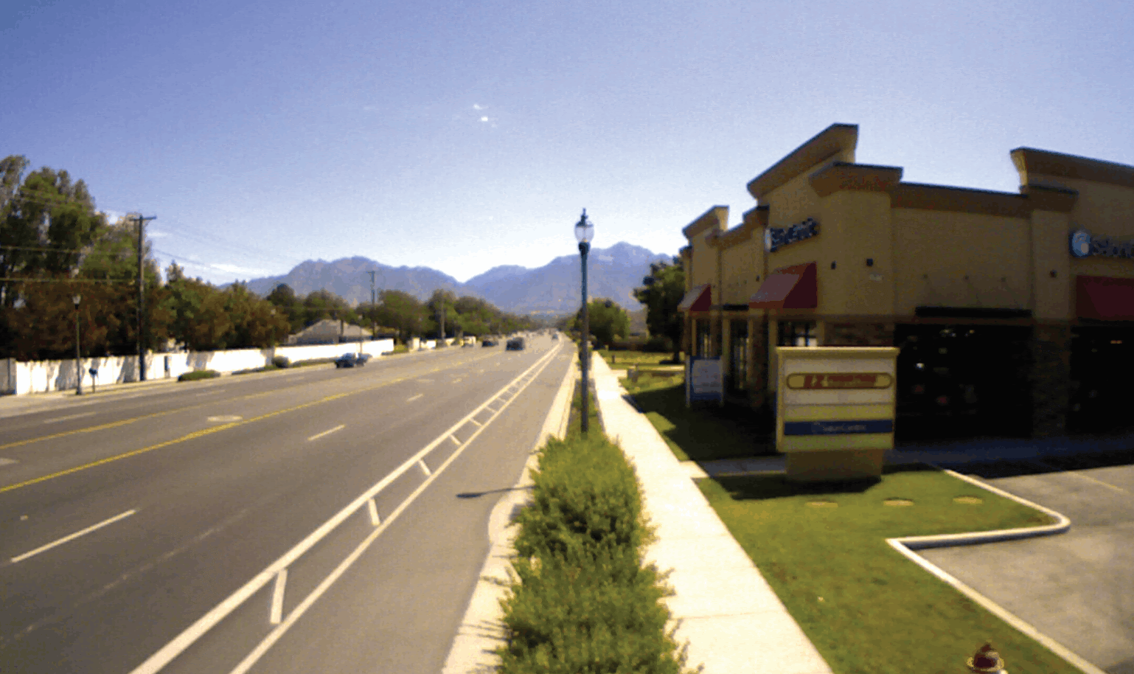
Buffered Bike Lane Use
Problem: City engineers suspected improper use
Tool used: Time-lapse camera
Outcome: City recommitted to continuing to build buffered bike lanes
Notes:
This first project I’m highlighting was an analysis done by Bike Utah. City engineers had the impression that buffered bike lanes were not being used appropriately. Specifically, they thought people were riding in the buffer between the bike lane and car lane instead of inside the bike lane. Bike Utah set up the time lapse camera at various locations and put together videos including this one showing virtually all users using the lanes appropriately. The outcome was the city recommitting to continuing to build buffered bike lanes.

Slide 20
In a lot of cases buffered bike lanes are like the “gateway drug” to physically protected bike lanes. So if we hadn't won this battle, it would’ve made future battles impossible—the ultimate goal impossible. So from that perspective, they’re pretty important. Pretty fundamental.
Notes:
Our contact at Bike Utah described the importance of buffered bike lanes, saying they’re like the gateway drug to more protective bike lanes and convincing the city engineers not to discontinue them was therefore extremely important for longer term goals of even safer facilities.

Slide 21
Assessing Perceived Safety
Problem: 8-lane road unsafe for bikes/scooters
Tools used: Strava Metro and StreetLight Data
Outcome: Case-making for road diet
Notes:
This next analysis by Bike Cleveland was part of a larger project, advocating for a road diet on a large arterial road. Current facilities are unsafe and to demonstrate that users feel unsafe in the bike lane, they used Strava Metro to look at the precise routes taken by cyclists on this road. They found that on a particular stretch of this road, heading into downtown, bikers were traveling on the sidewalk, which is technically illegal, instead of in the bike lane because they do not feel safe. The blue line is the most direct route and the red line is the most common route, so the jog over of the red line is where cyclists go up on the sidewalk. They used this among other evidence to make the case for a road diet, removing one of the eight car lanes and adding protected bike lanes. They also used traffic volume data from StreetLight Data to show that bike volumes were high and car volumes were not as high as might be expected to make the case that a road diet was desperately needed and wouldn’t adversely affect car traffic.

Slide 22
It's about making it safer for everybody, that's kind of the messaging we put up there... Going from a four lane road configuration to a three and adding a bike lane, can improve safety for bikes, obviously, but it also calms the traffic and slows it down for people driving, which makes it safer for them as well.
Notes:
Our contact at Bike Cleveland explained how it is important to frame these kinds of interventions as improving safety for all users.

Slide 23
Slow Streets Programs
Problem: Need for more walking and biking facilities during COVID
Tools used: EcoCounter and StreetLight Data
Outcome: City expanded and extended program in Denver
Notes:
Two awardee organizations, Walk Bike Nashville and Denver Streets Partnership, used data to support slow streets programs in their cities, sometimes also called shared streets. These have been implemented in many cities all over the world during the pandemic and involve closing off parts of a street to through traffic to make more safe dedicated space for active modes. Denver Streets Partnership used the EcoCounter, installing it at different slow streets locations throughout the city to document bike, scooter and pedestrian counts to compare to data from a prior year before the pandemic. This demonstrated that the intervention was supporting and encouraging active travel. WalkBike Nashville used StreetLight Data to analyze car volumes, speeds, and cut-through before and after slow streets installations.

Slide 24
Just getting very simple data on how many people walk down a street segment is incredibly valuable because there's such a dearth of that data. Being able to have this more objective data definitely changed the dynamic between us and the city – we became more of a partner working on the projects.
Notes:
Our Denver contact described how the city has a wealth of data on car traffic and road conditions that affect cars, like potholes, but does not have data on active modes, so even the very basic bikeped counts from the EcoCounter were extremely valuable, and the city relied on her organization to collect data to evaluate the slow streets program. This dynamic she said, was more collaborative and the city valued the data they had to offer.

Slide 25
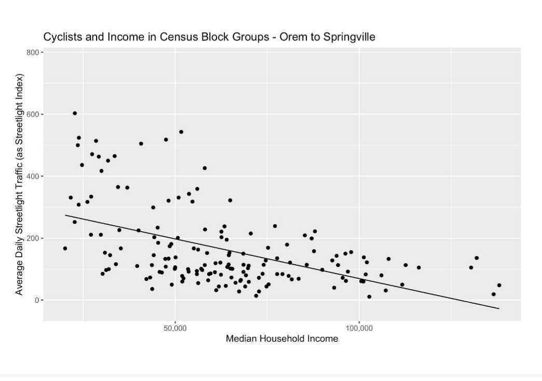
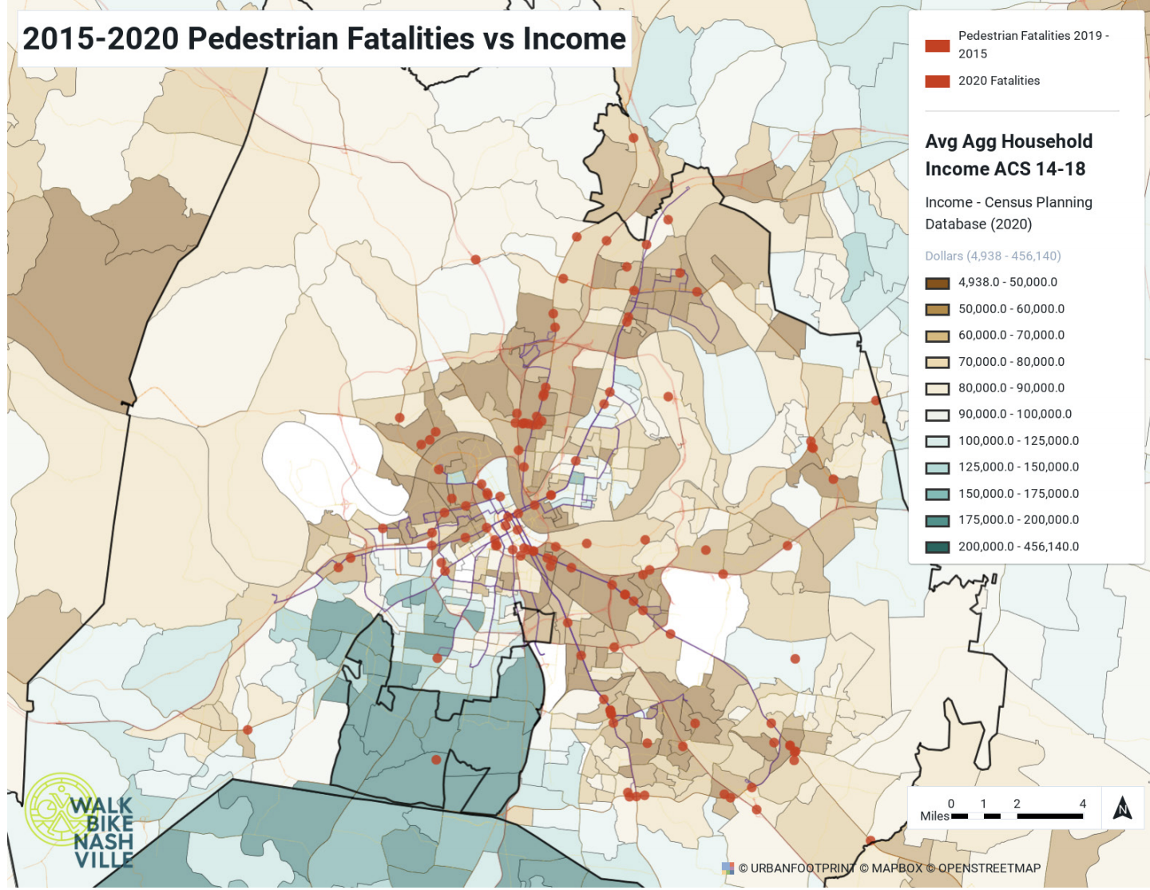
Supporting Underrepresented Communities
Problem: Low income communities use active transportation more but have less safe facilities
Tools used: StreetLight Data and Urban Footprint
Outcome: Case-making for equity not equality based funding for infrastructure
Notes:
For this last highlight, I’ll touch on several different projects all related to the theme of supporting underrepresented communities. Several different organizations were concerned with the fact that low income communities in their cities do not have sufficient safe facilities for active transportation even though those communities are more reliant on active modes. The graph on the left shows analysis of census data and bike volume data from StreetLight, in a city in Utah. Specifically it shows a strong negative correlation where bike volumes are higher in lower income neighborhoods. Bike Utah found a similar pattern in 7 other Utah County cities. The graph on the right was produced by Walk Bike Nashville in Urban Footprint. It shows a strong negative correlation where pedestrian fatalities are higher in lower income neighborhoods. Another awardee, Sustain Charlotte, started a coalition of neighborhoods in an underserved area of the city, and had community leaders work together, using Urban Footprint, to map out mobility gaps in their communities.

Slide 26
It’s been eye opening for officials and some advocates to realize that the types of people who advocate for bicycling are not the only people out there riding… Identifying those places where people are walking and biking, but don’t have residents coming to the planning meeting to put a pin on the map is really powerful.
Notes:
A majority of the awardees noted some faulty assumptions or weakness in the approaches of the city or their planning consultants that resulted in overlooking underrepresented communities, either because available data and/or the most vocal community members did not represent these groups. The data tools provided those missing data and helped highlight inequalities and the needs of low income communities. Another awardee remarked that with some of the data tools, there are no social-economic or geographic barriers.

Slide 27
SAFETY
SUPPORTING UNDERREPRESENTED COMMUNITIES
DATA AVAILABILITY
ADVOCACY
Notes:
For this last highlight, I’ll touch on several different projects all related to the theme of supporting underrepresented communities. Several different organizations were concerned with the fact that low income communities in their cities do not have sufficient safe facilities for active transportation even though those communities are more reliant on active modes. Another awardee, Sustain Charlotte, started a coalition of neighborhoods in an underserved area of the city, and had community leaders work together, using Urban Footprint, to map out mobility gaps in their communities.
A majority of the awardees noted some faulty assumptions or weakness in the approaches of the city or their planning consultants that resulted in overlooking underrepresented communities, either because available data and/or the most vocal community members did not represent these groups. The data tools provided those missing data and helped highlight inequalities and the needs of low income communities. Another awardee remarked that with some of the data tools, there are no social-economic or geographic barriers.

Slide 28
MAILING ADDRESS
UC Davis Institute of Transportation Studies
1605 Tilia Street, Davis CA, 95616
Contact Info
Ashley N. DePew
EMAIL ADDRESS
andepew@ucdavis.edu
Notes:
I’m happy to take questions if we have time, and also please feel free to contact me later. I’m very grateful for your time today and for Ford’s support on this project.

