Slide 1
The Demand for the Curb and Optimal Allocation: Data, Technology, Research and Experimentation
Alejandro Henao, PhD
Center for Integrated Mobility Systems
National Renewable Energy Laboratory
Conference on Sustainability and Emerging Transportation Technology
June 1, 2022

Slide 2

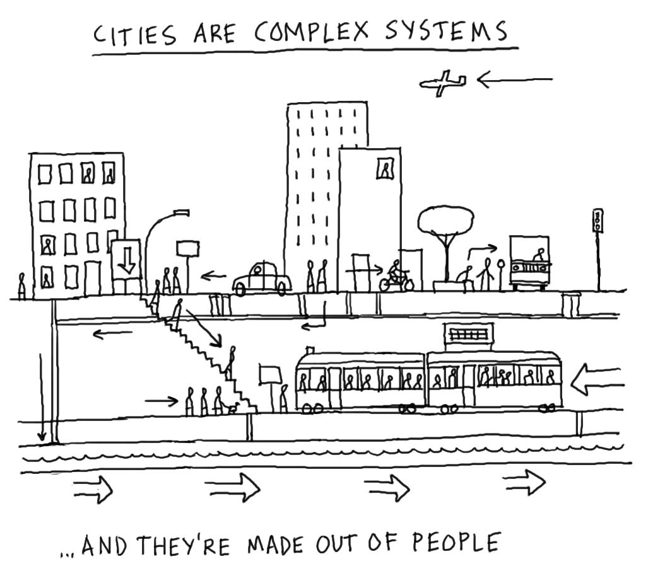



Source: Dave Gray (flickr)

Slide 3
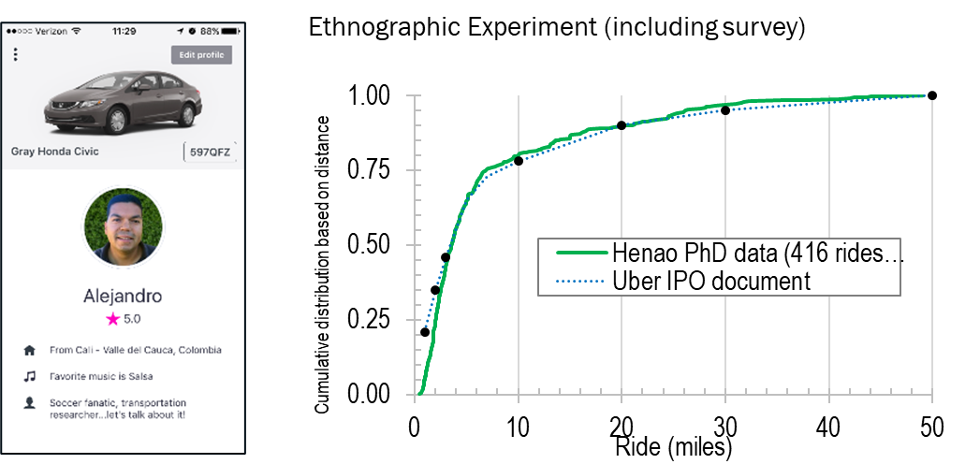
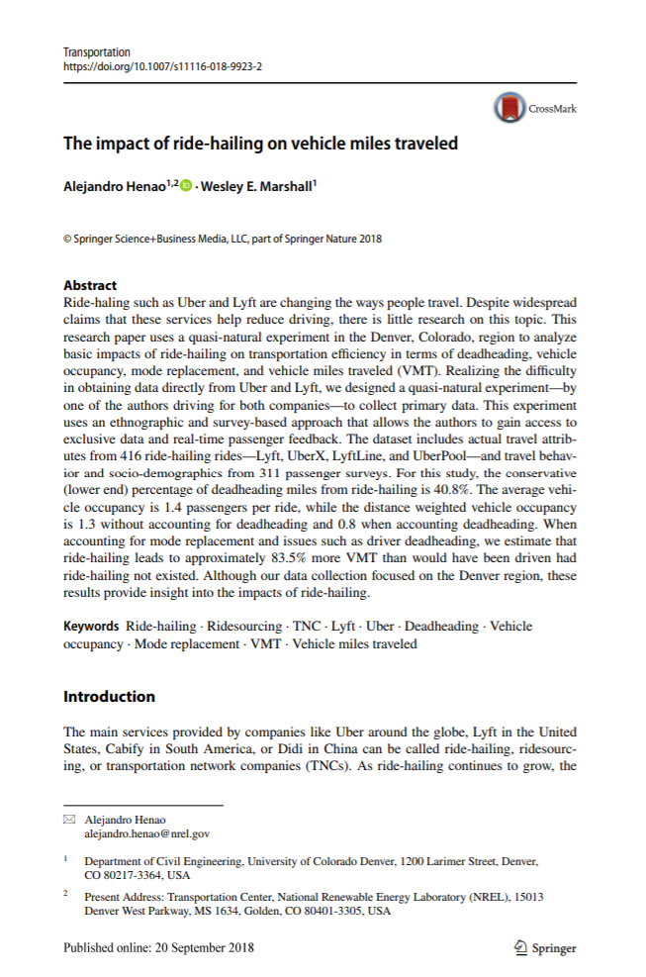
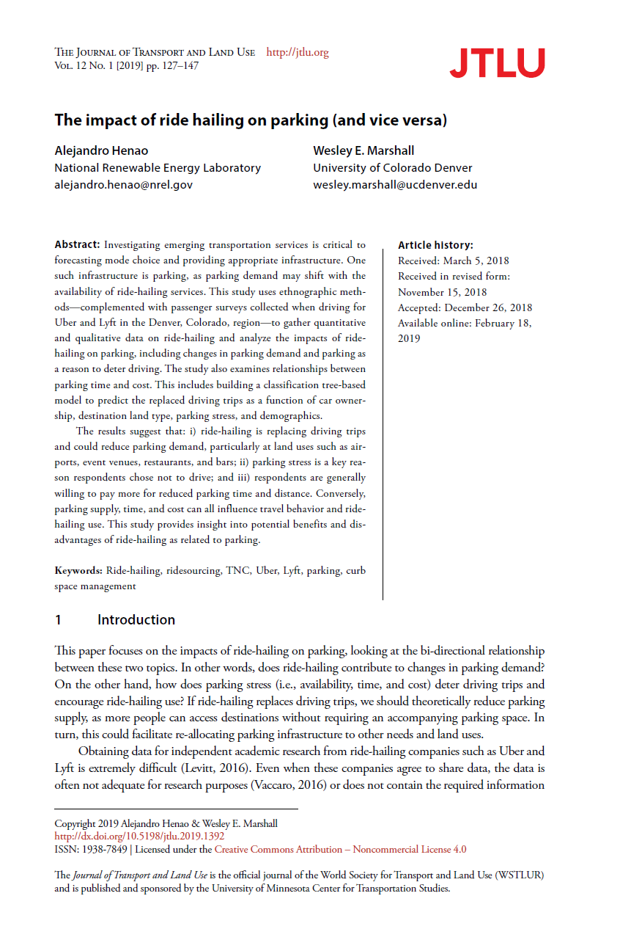
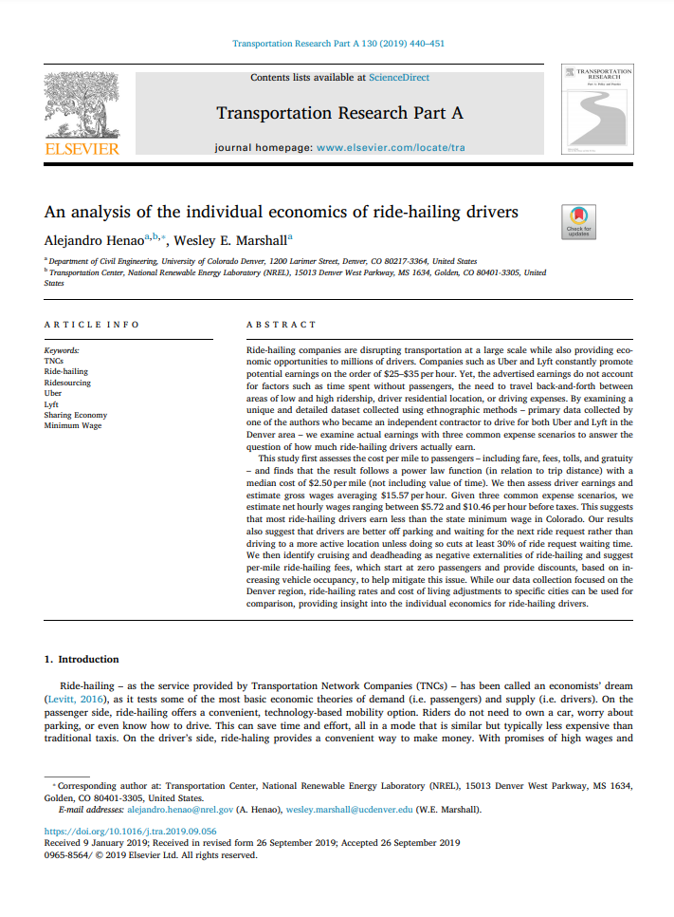
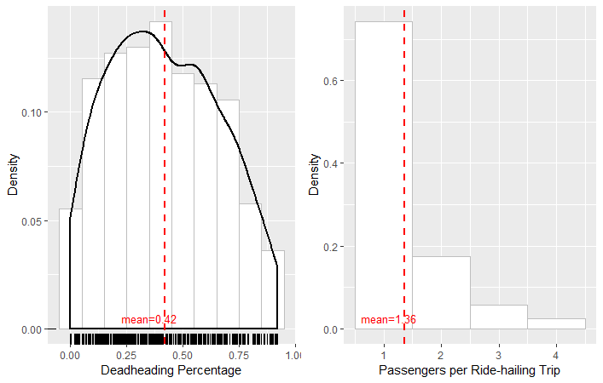
The Impacts of Ridehailing on VMT, Parking, Economics, etc…
Henao, A., & Marshall, W. E. (2018). The impact of ride-hailing on vehicle miles traveled. Transportation. https://doi.org/10.1007/s11116-018-9923-2
Henao, A., & Marshall, W. E. (2019). The impacts of ride-hailing on parking (and vice versa). Journal of Transportation and Land Use (JTLU) https://www.jtlu.org/index.php/jtlu/article/view/1392
Henao, A., & Marshall, W. E. (2019). An Analysis of the Economics of Ride-hailing Drivers. Transportation Research Part A. https://www.sciencedirect.com/science/article/pii/S0965856419300333

Slide 4

The Good, the Bad and the Unknown of Uber & Lyft
THE GOOD:
Increase stock of clean vehicles (including EVs)
Reduce Parking and Restructure Landscape
Full-filling a gap in our transport systems
Non-car market (such as micromobility)
THE BAD:
Not-so-Sharing
Deadheading & Congestion
Replacement of Sustainable Modes
Car-use
UNKNOWNS:
Safety
Equity
True Carpooling
Sharing Economy
Quantity and Quality of Travel
Business Model
https://medium.com/@alehenao1/the-good-the-bad-and-the-unknown-of-uber-and-lyft-eb36cc0338b1

Slide 5
From Parking

Slide 6
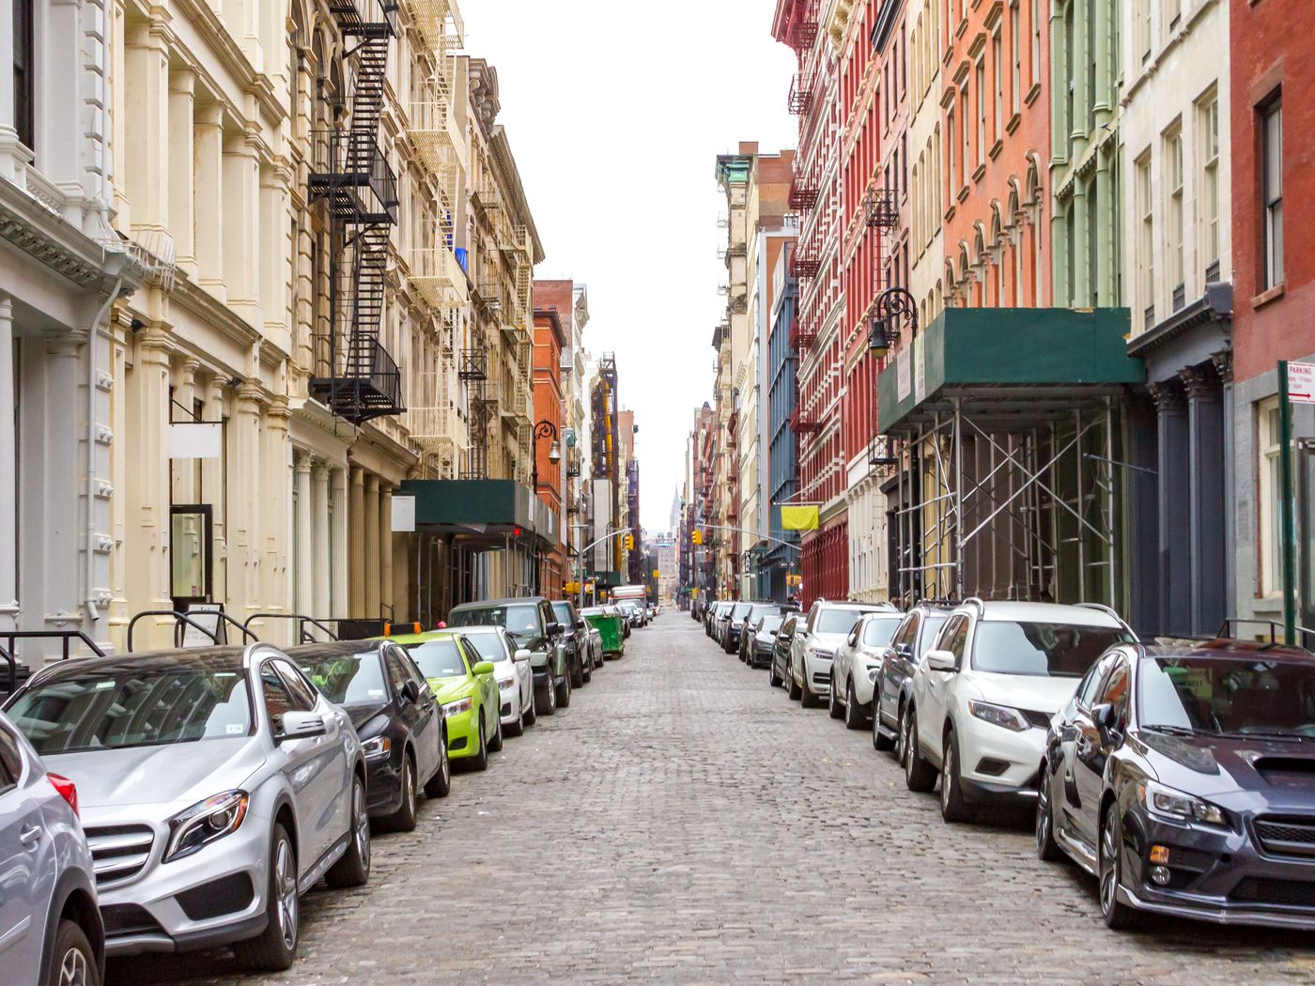
From Parking…
Source: Shutterstock

Slide 7
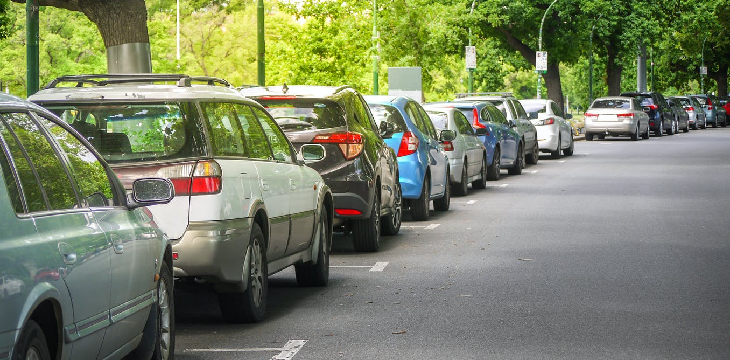
From Parking…
Source: zee5.com

Slide 8
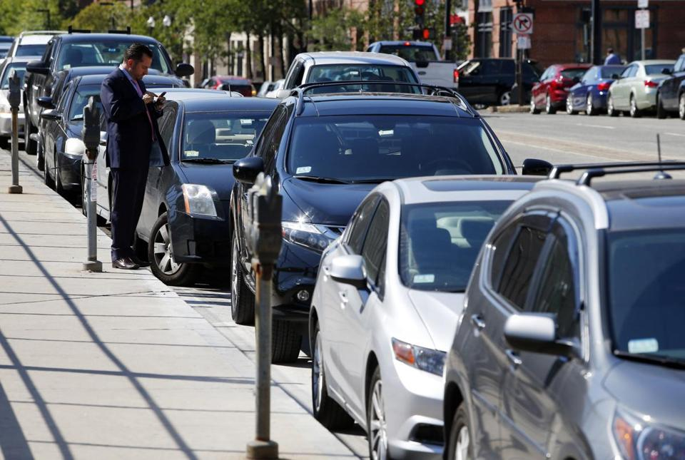
From Parking…
Source: spotangels.com

Slide 9
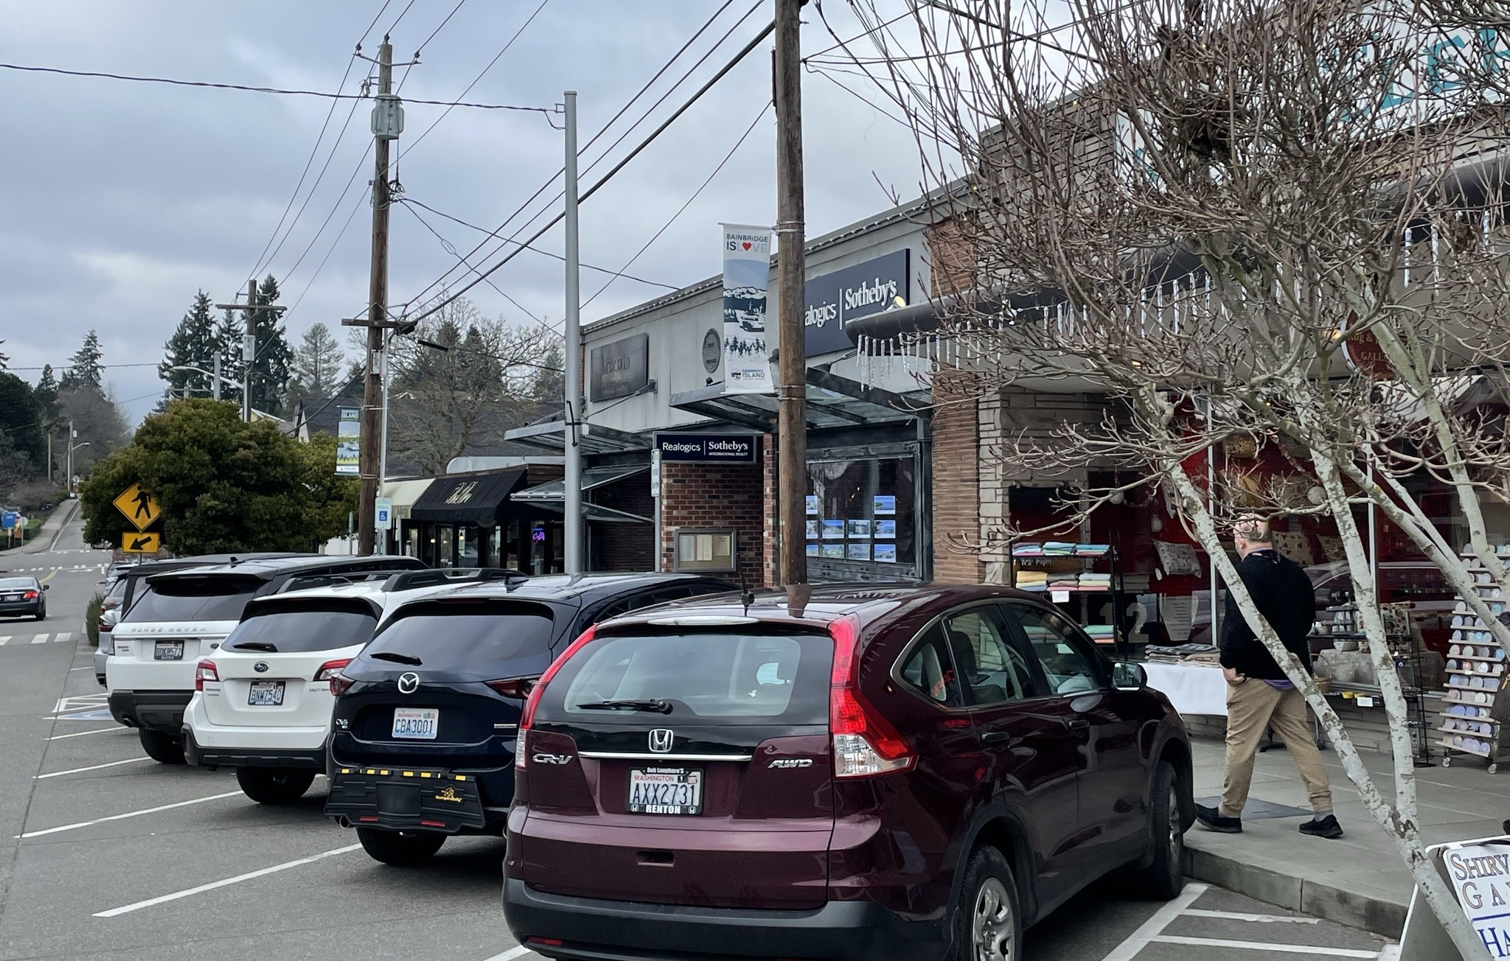
From Parking…
Source: Henao

Slide 10
To…

Slide 11
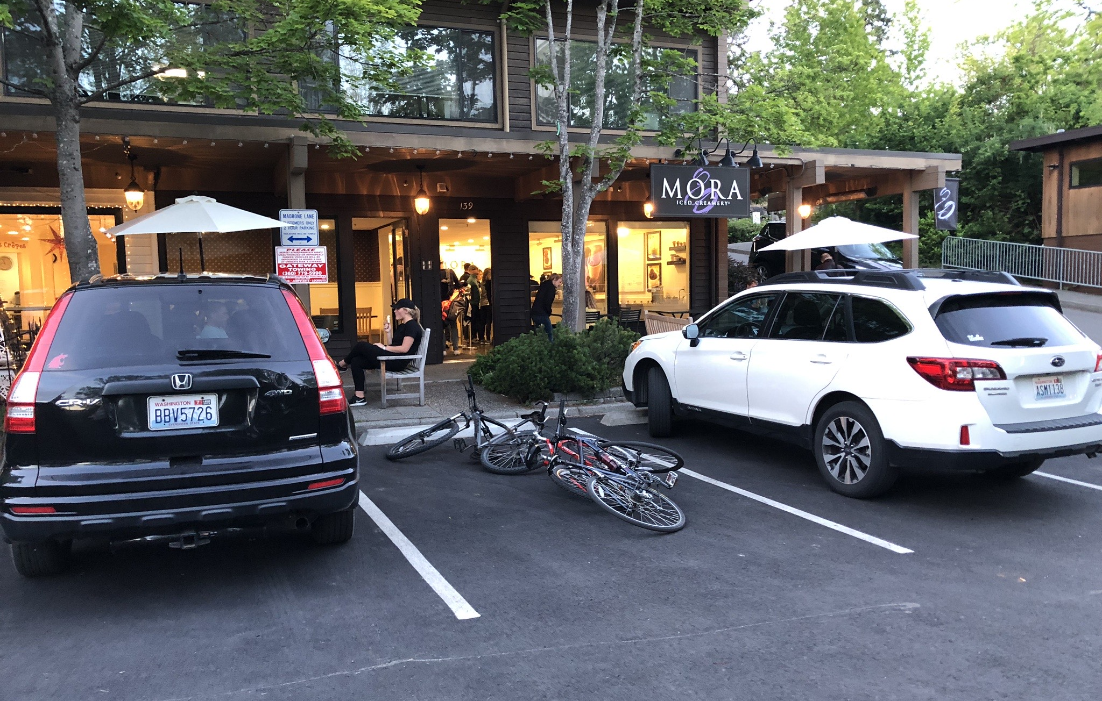
To…
Source: Henao

Slide 12
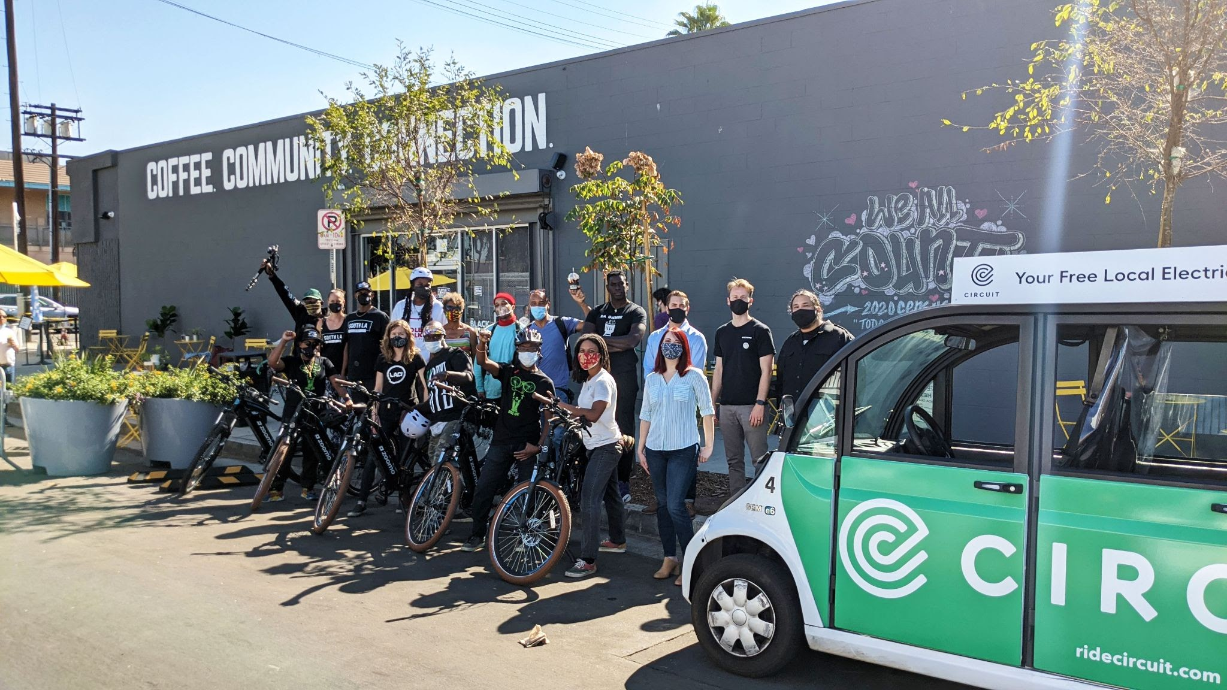
To…
Source: laci.org

Slide 13
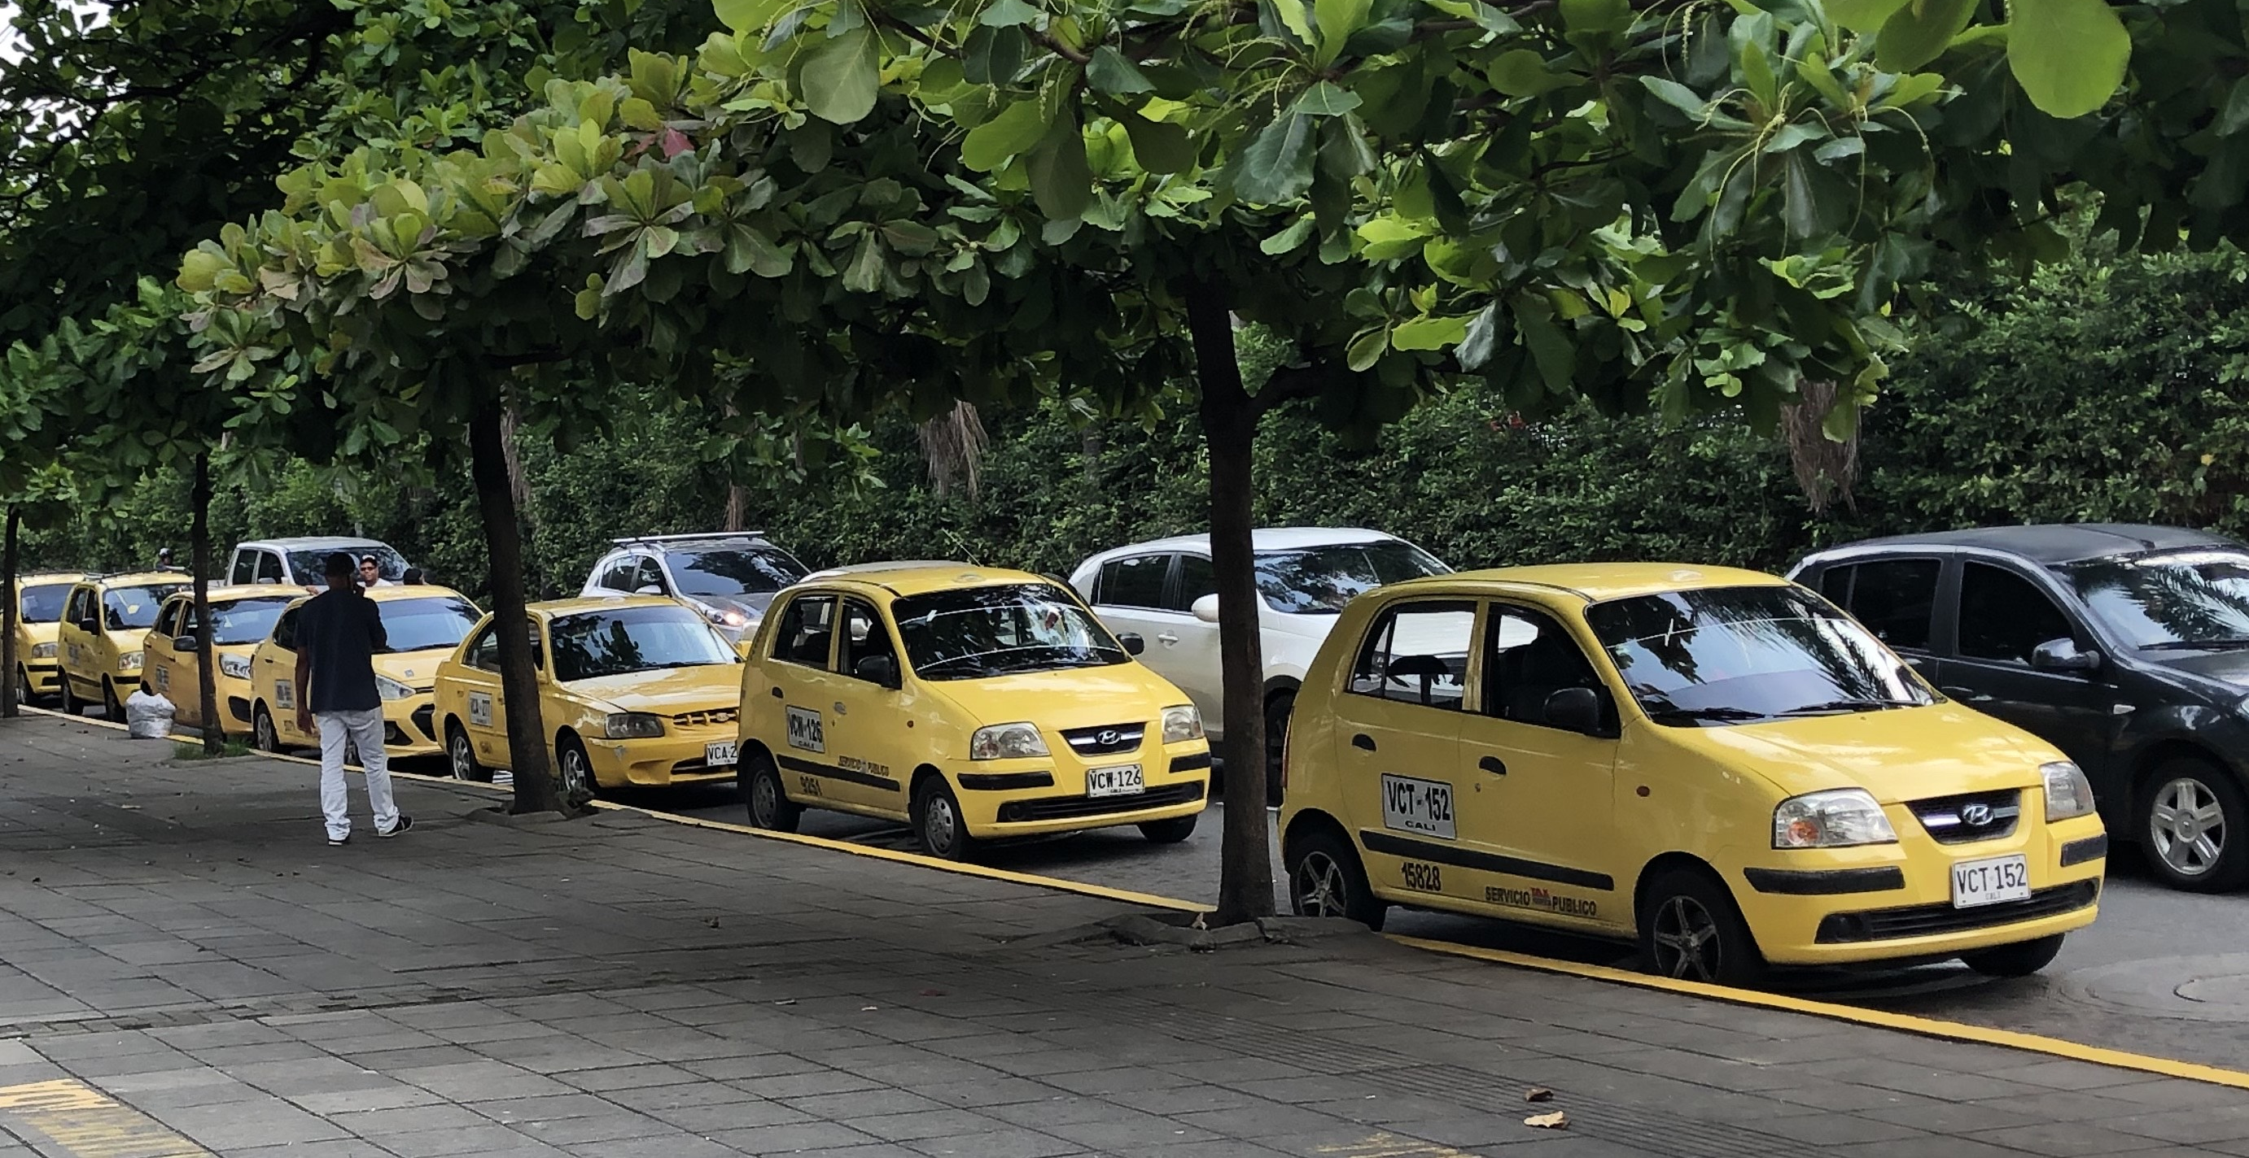
To…
Source: Henao

Slide 14
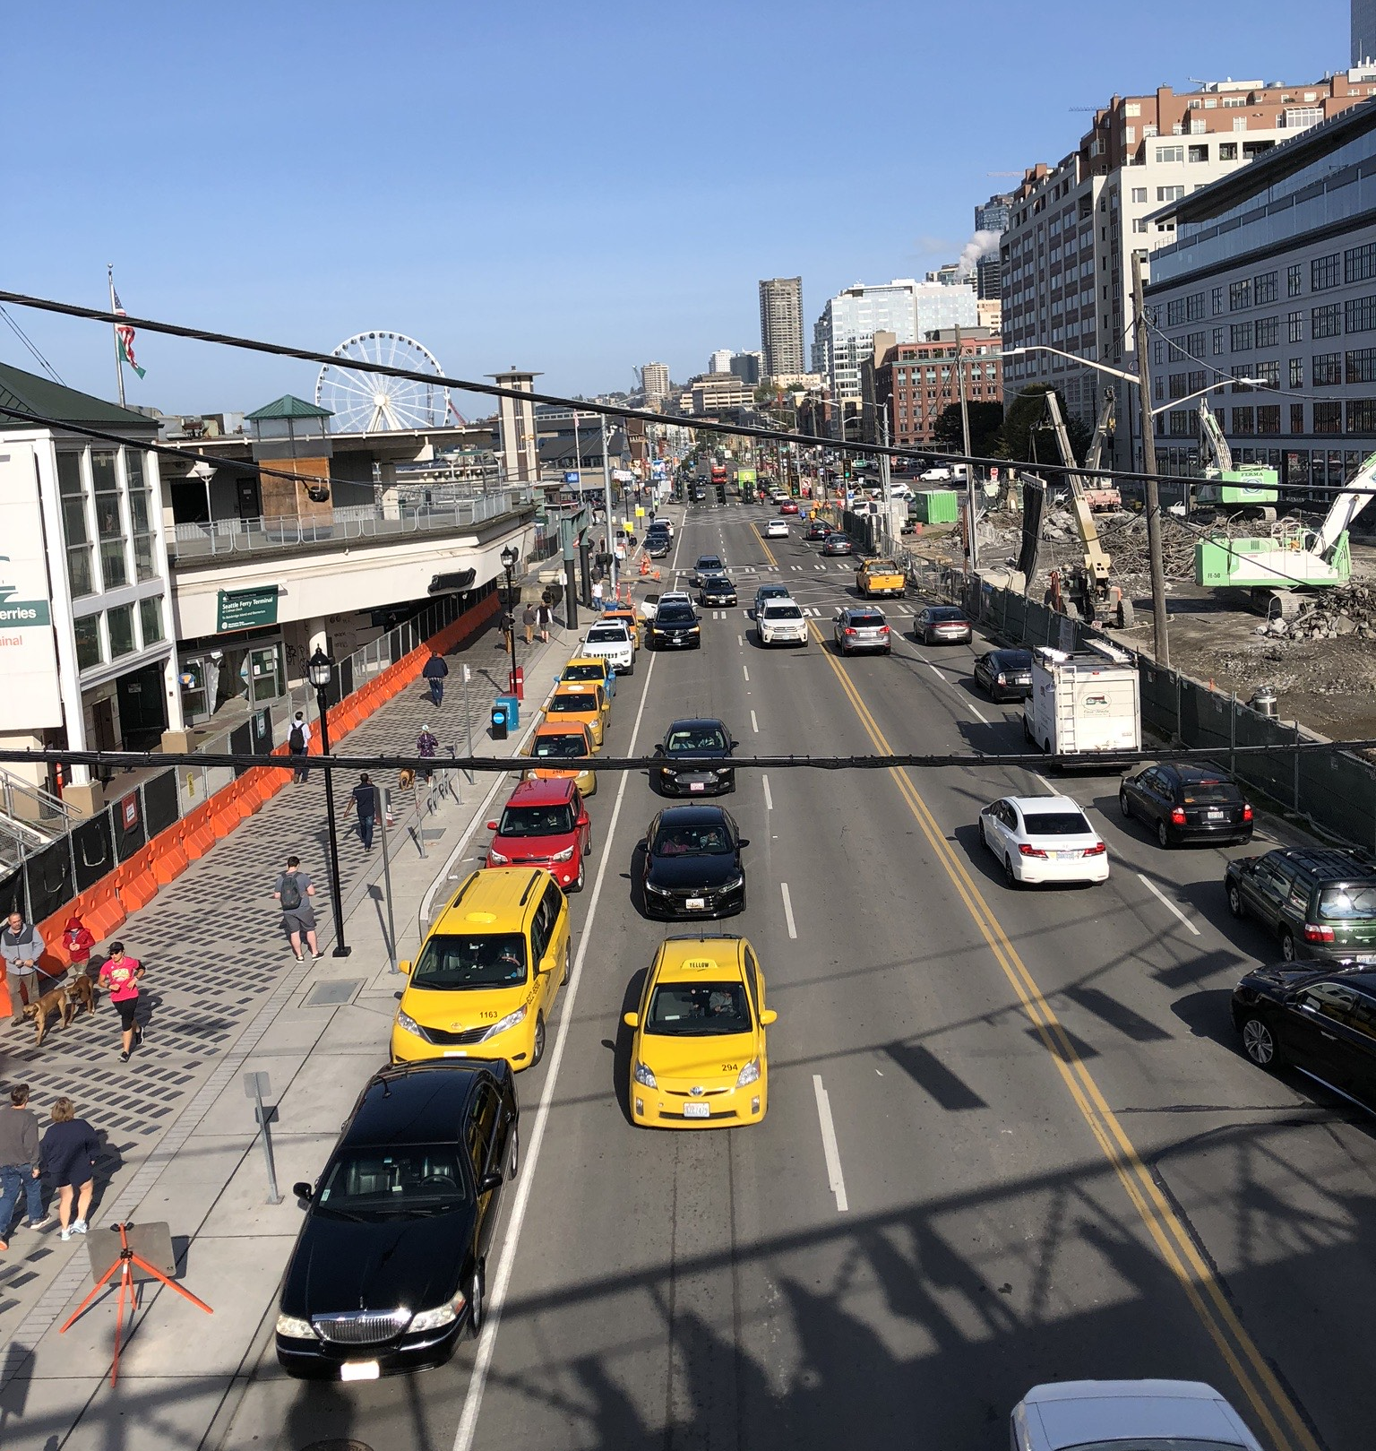
To…
Source: Henao

Slide 15

To…
Source: Henao

Slide 16
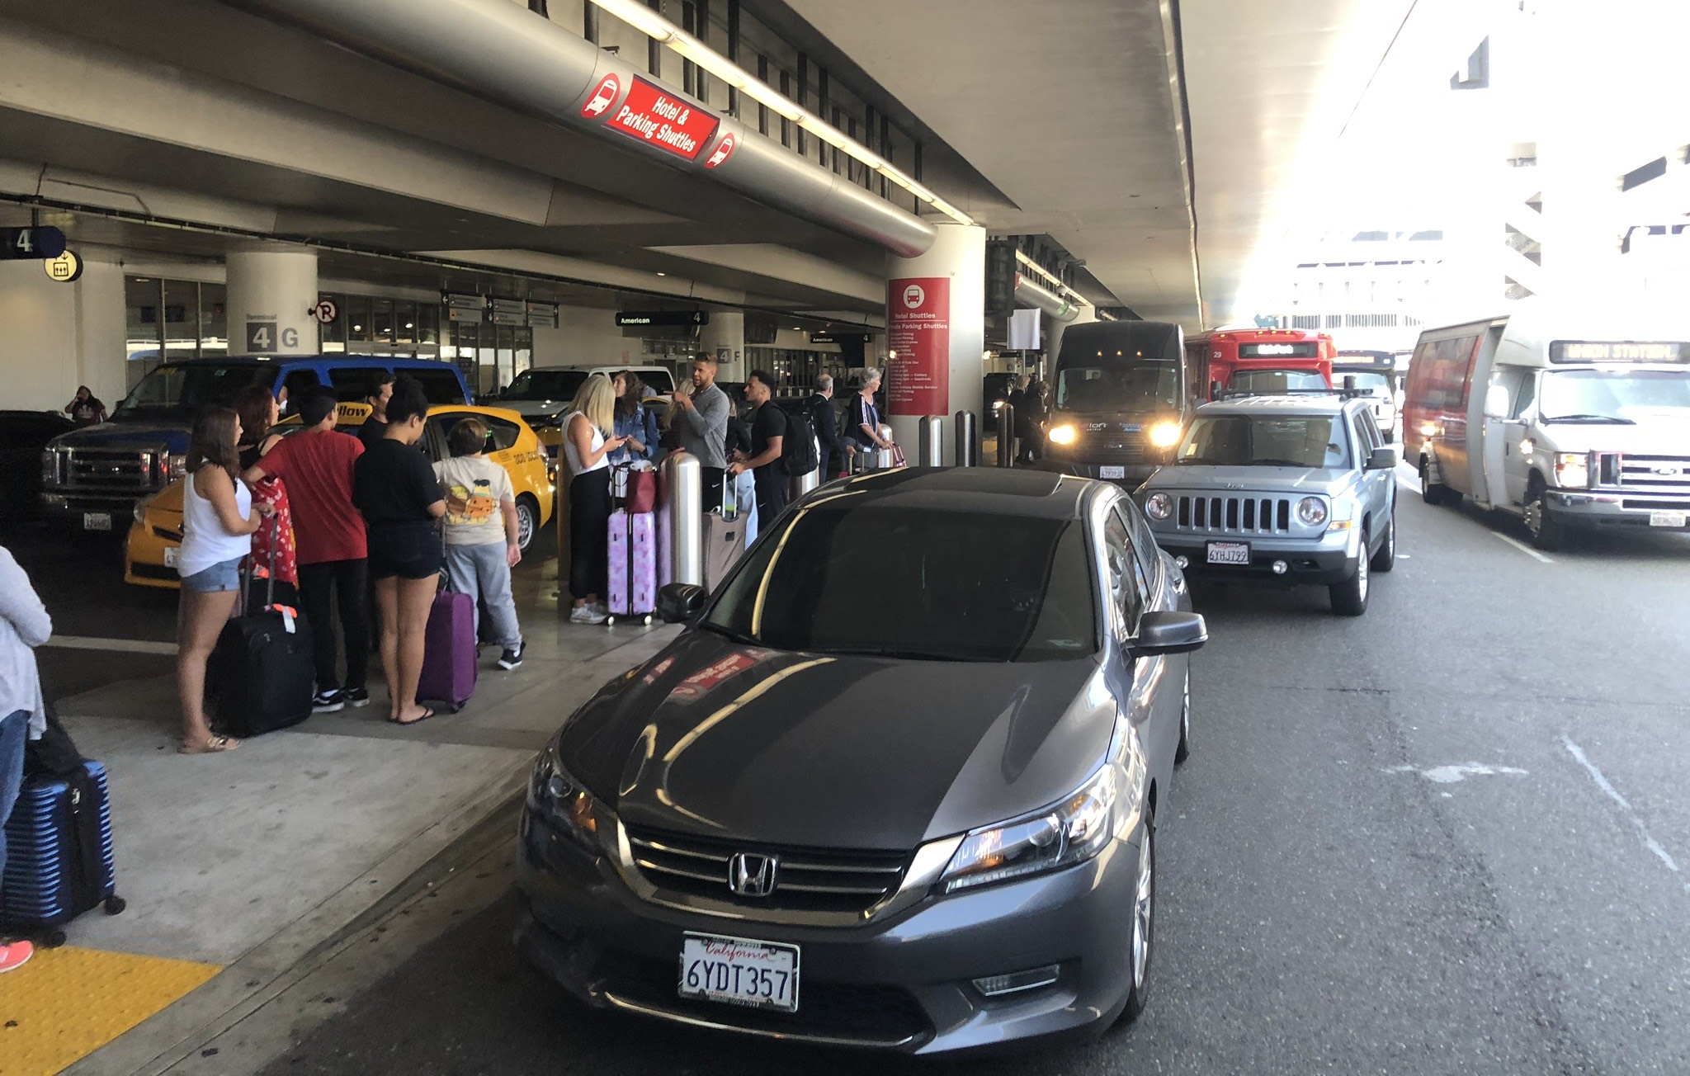
To…
Source: Henao

Slide 17
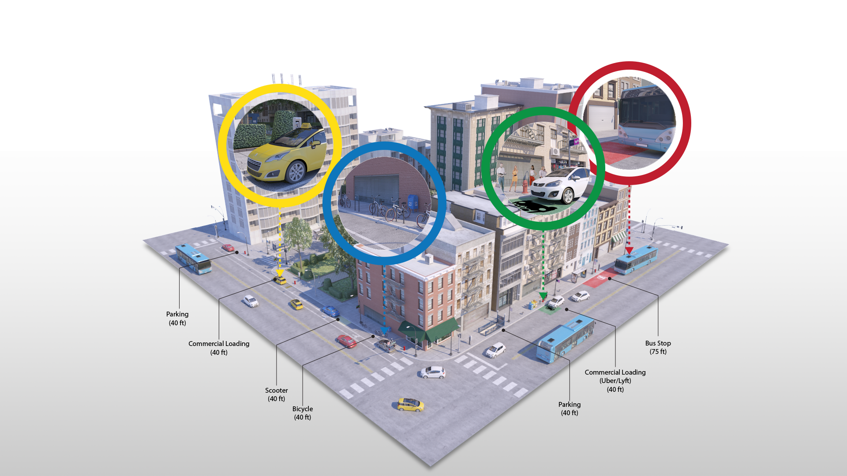
The Curb

Slide 18

What’s the issue?
The "fight for the curb" as the tragedy of the commons:
Increases in demand (e.g., freight, ridehailing, micromobility)
Free or low-cost curb use
Curb utilization from less efficient modes (single-passengers in car/ridehail/taxi)
Lack of prioritization for more efficient modes such as transit, high-occupancy vehicles, micromobility, electric vehicles.

Slide 19




Ground Transportation at Airports
Uber I.P.O. revealed that 15% of all rides are to/from airports
Travel to and from the airport represents more than 2% of all VMT by the case study regions.

Slide 20
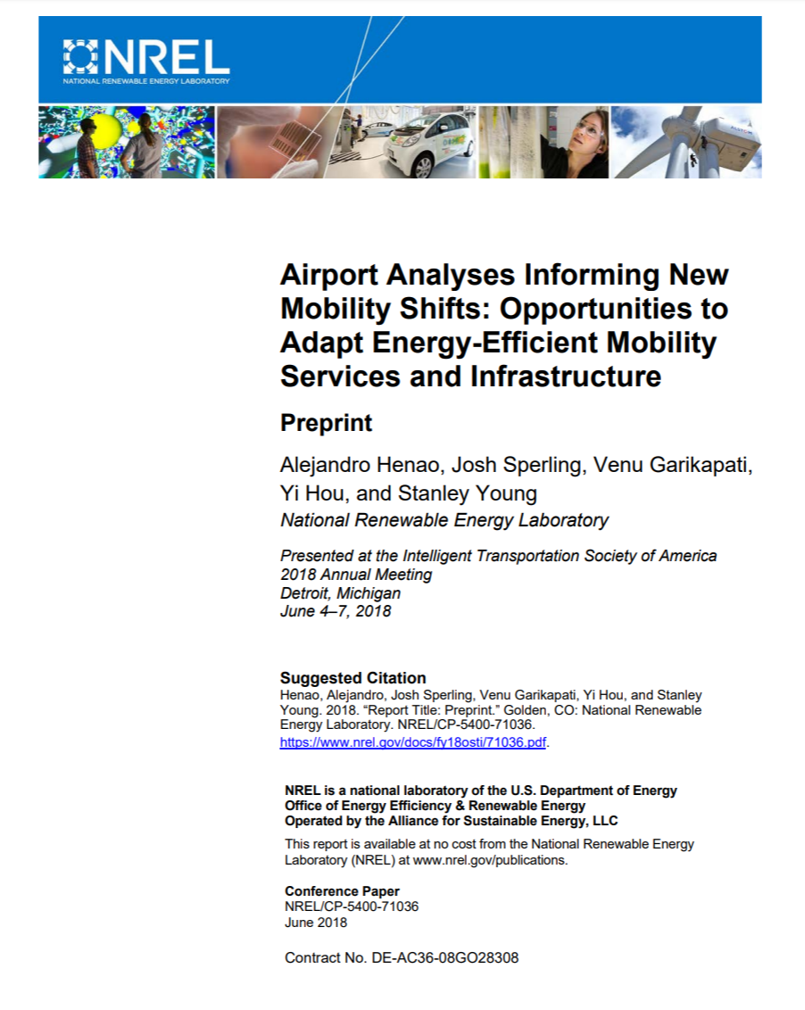
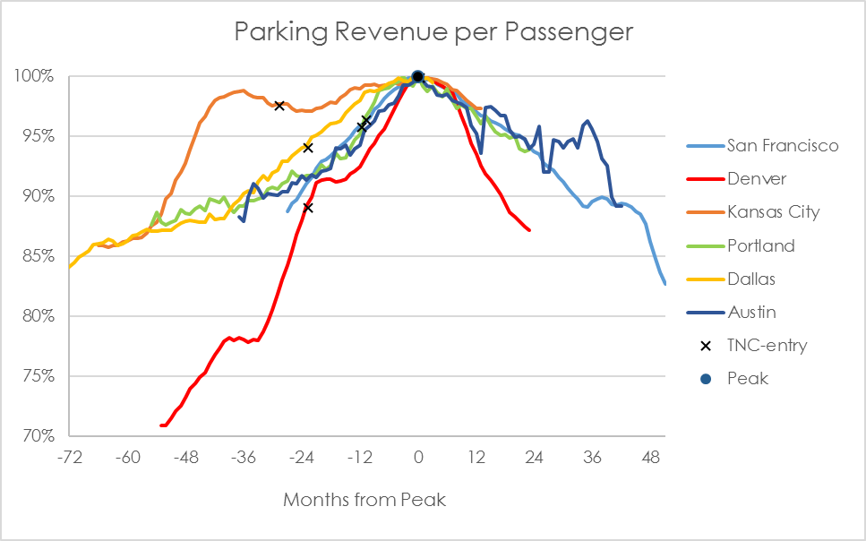
Ground Transportation at Airports
Henao, A., Sperling, J., Garikapati, V., Hou Y. & Young, S. (2018). “Airport Analyses Informing New Mobility Shifts: Opportunities to Adapt Energy-Efficient Mobility Services and Infrastructure” Golden, CO: National Renewable Energy Laboratory. NREL/CP-5400-71036. https://www.nrel.gov/docs/fy18osti/71036.pdf

Slide 21
Curb Management
METRICS
DATA
RESEARCH
REAL-WORLD

Slide 22
Curb Management
METRICS
DATA
RESEARCH
REAL-WORLD

Slide 23
METRICS
Performance metrics to evaluate and reach goals:
Prioritize between different aims. Weight between safety, emissions, energy efficiency, economics, equity, customer experience, etc.
Metrics focusing more on people and goods access (not just vehicles)
More societal benefits (each jurisdiction to decide what they value the most)
Dynamic
Notes:
The Curb as the link to Advance Mobility & Energy Productivity

Slide 24
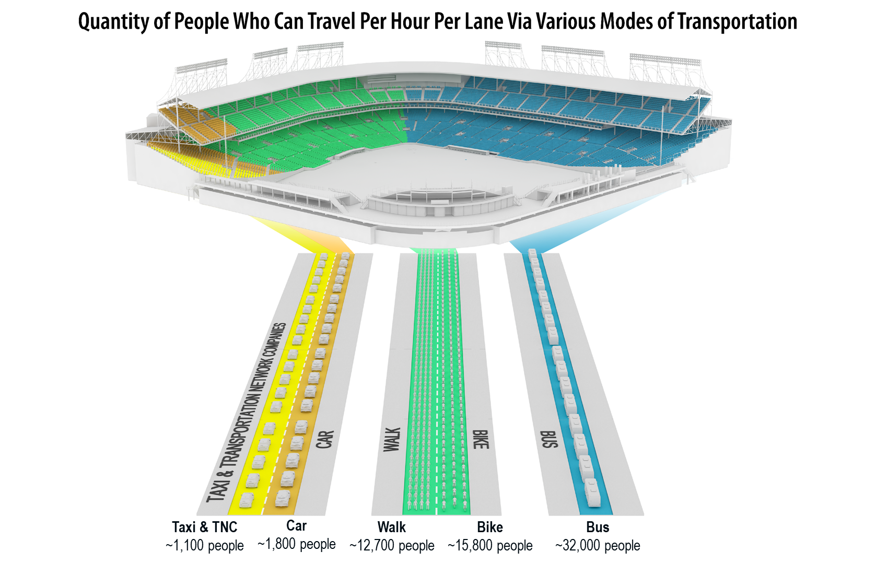
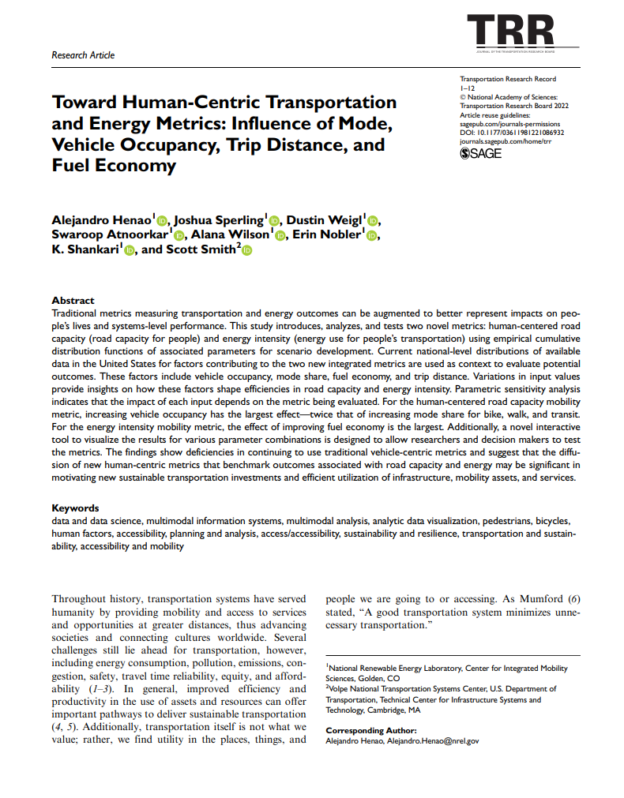
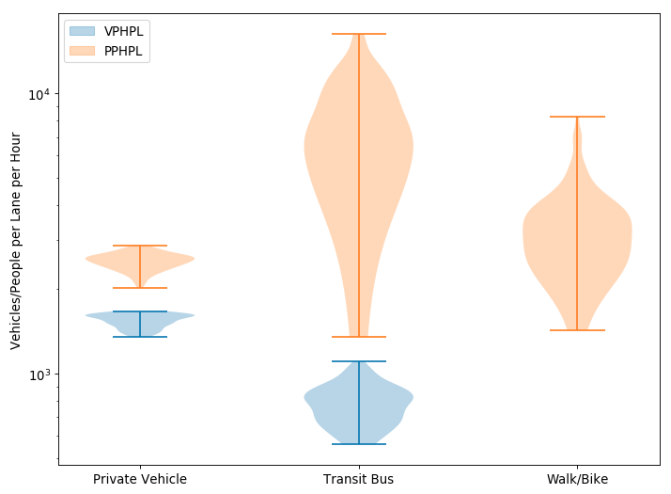
Human-Centered Mobility and Energy Metrics
Movement of people & goods (not just vehicles):
VEHICLE-ORIENTED:
In a day, an X-ft curb-space can serve 50 private cars to park, 80 TNCs, or 30 buses
HUMAN-ORIENTED
In a day, an X-ft curb-space can serve 60 drivers, 90 TNC-passengers, or 240 bus-passengers

Slide 25
Curb Management
METRICS
DATA
RESEARCH
REAL-WORLD

Slide 26
Curb Management
METRICS
DATA
RESEARCH
REAL-WORLD

Slide 27
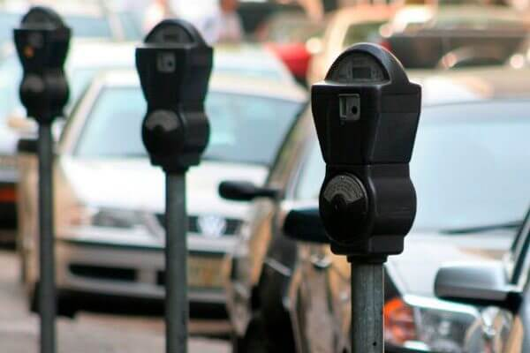
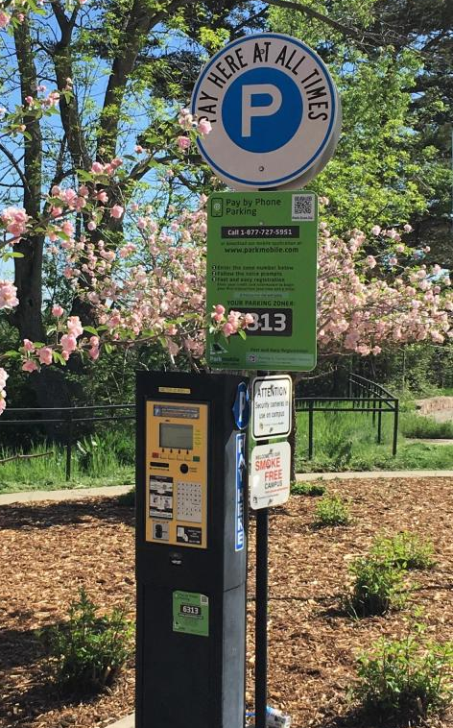
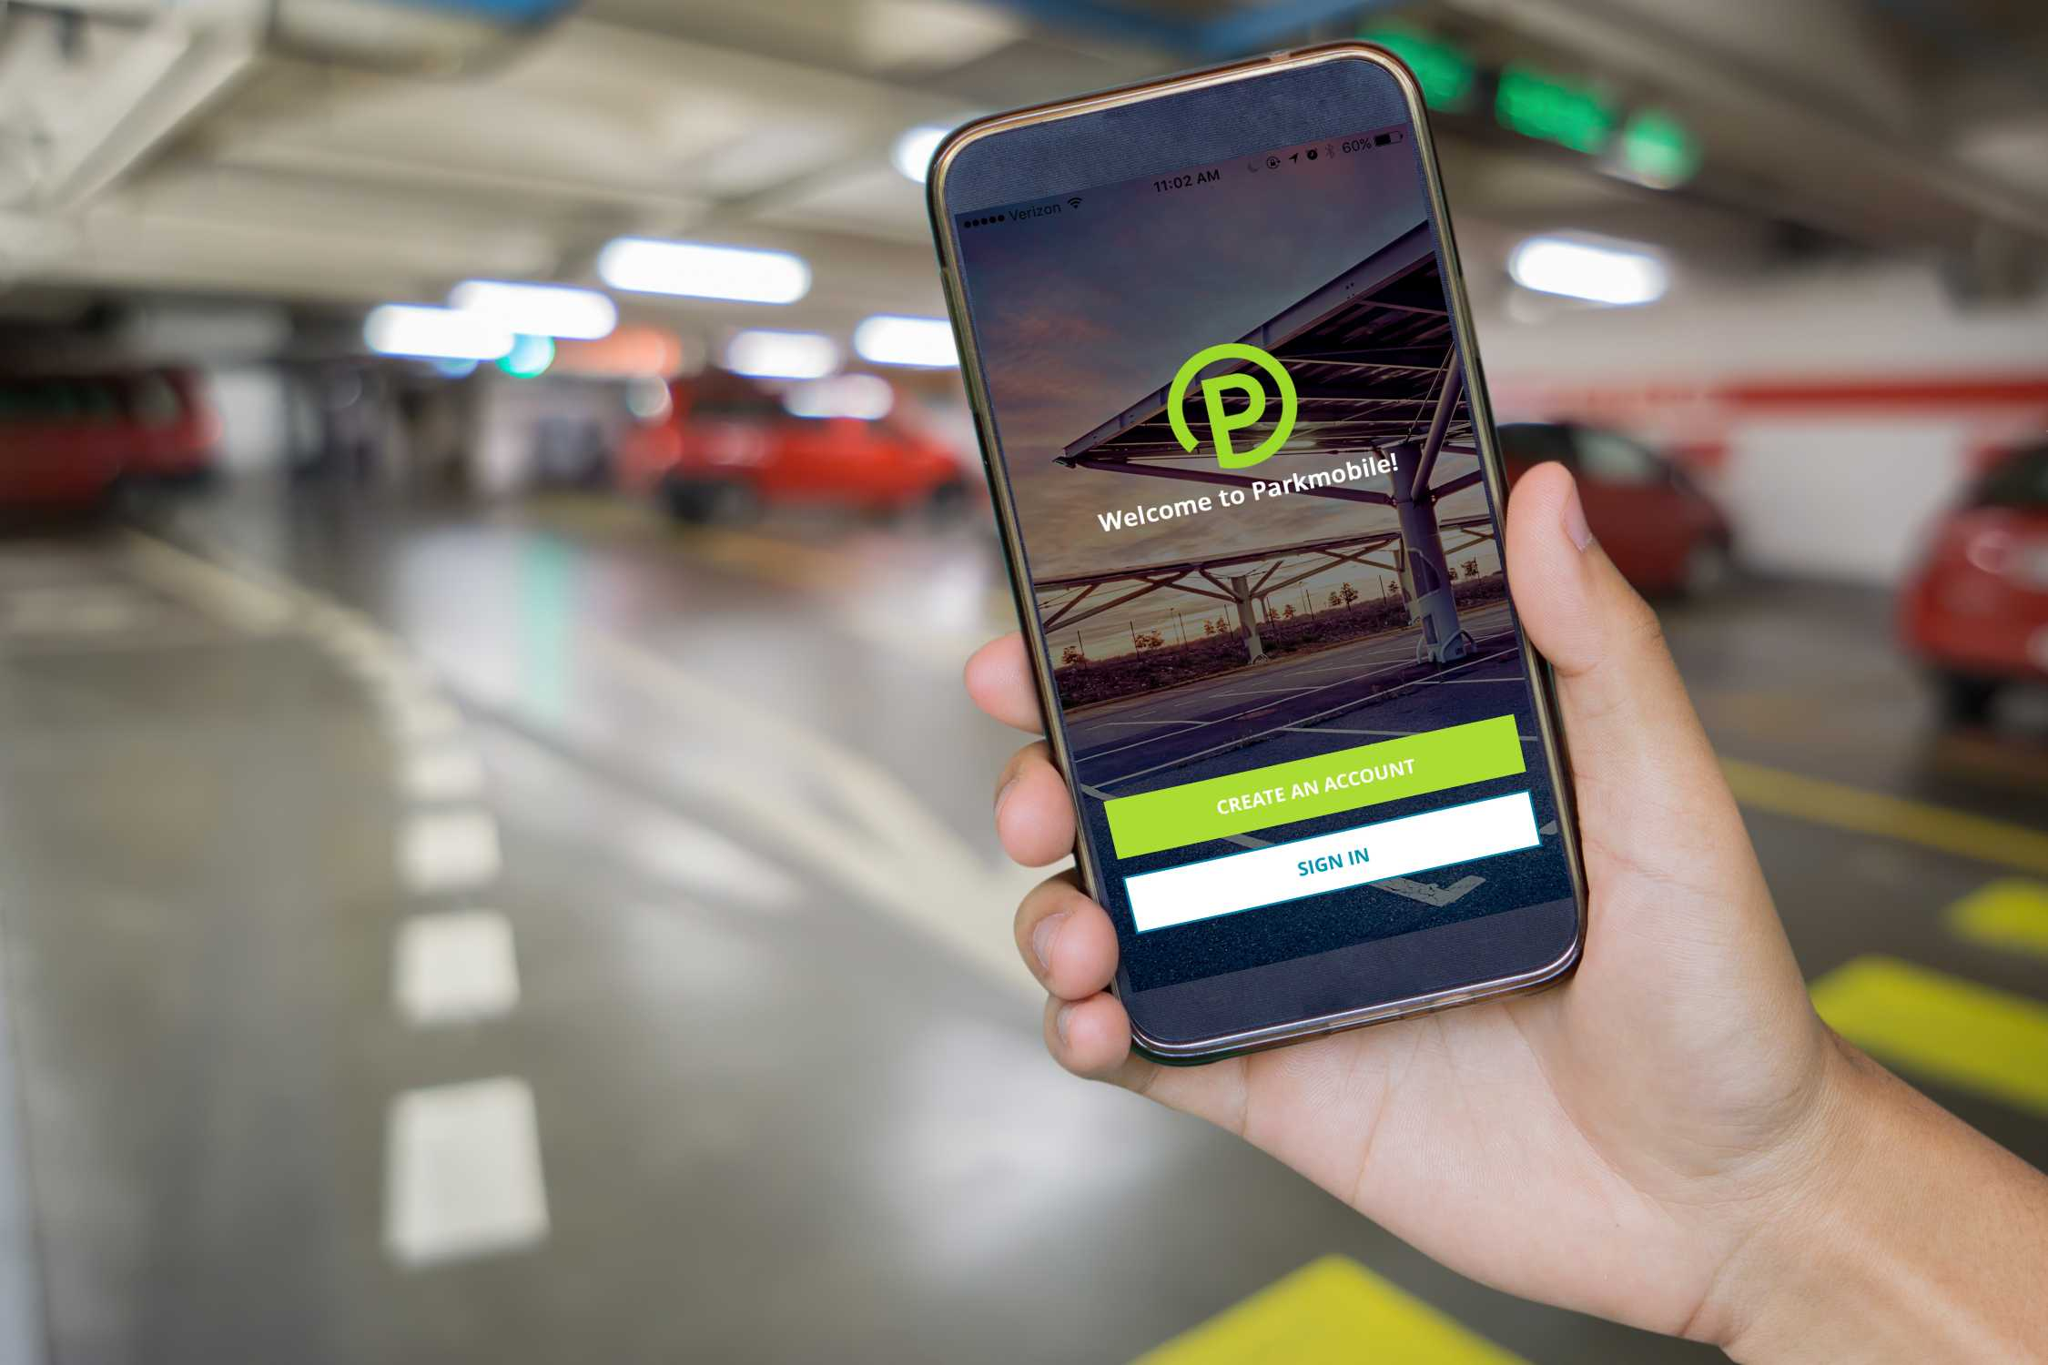
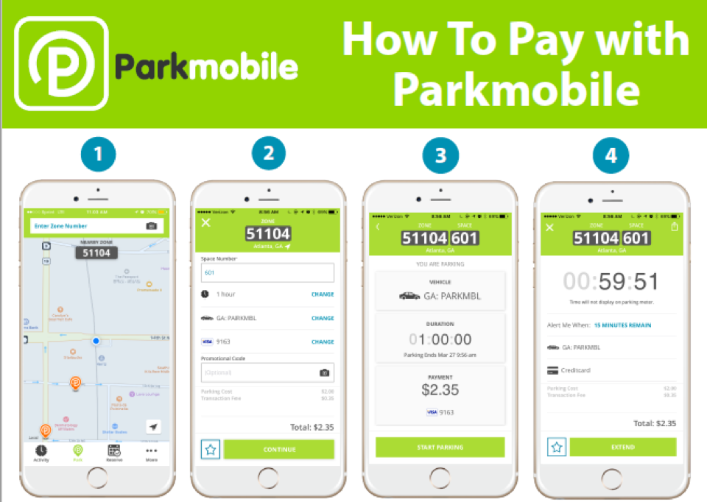
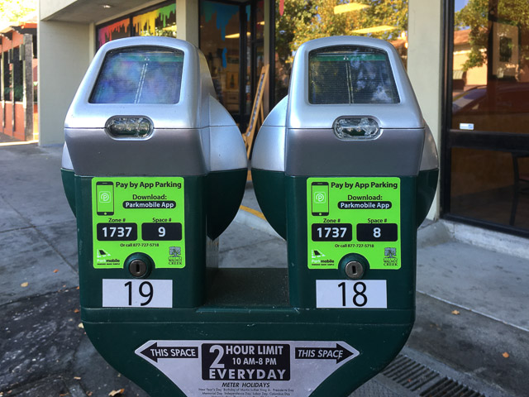
Data

Slide 28
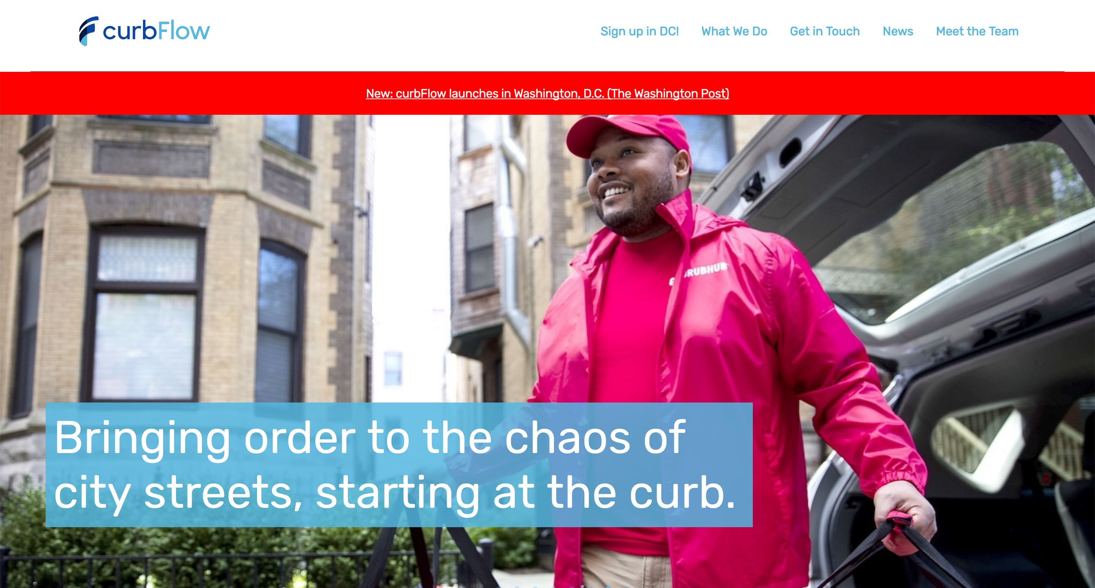
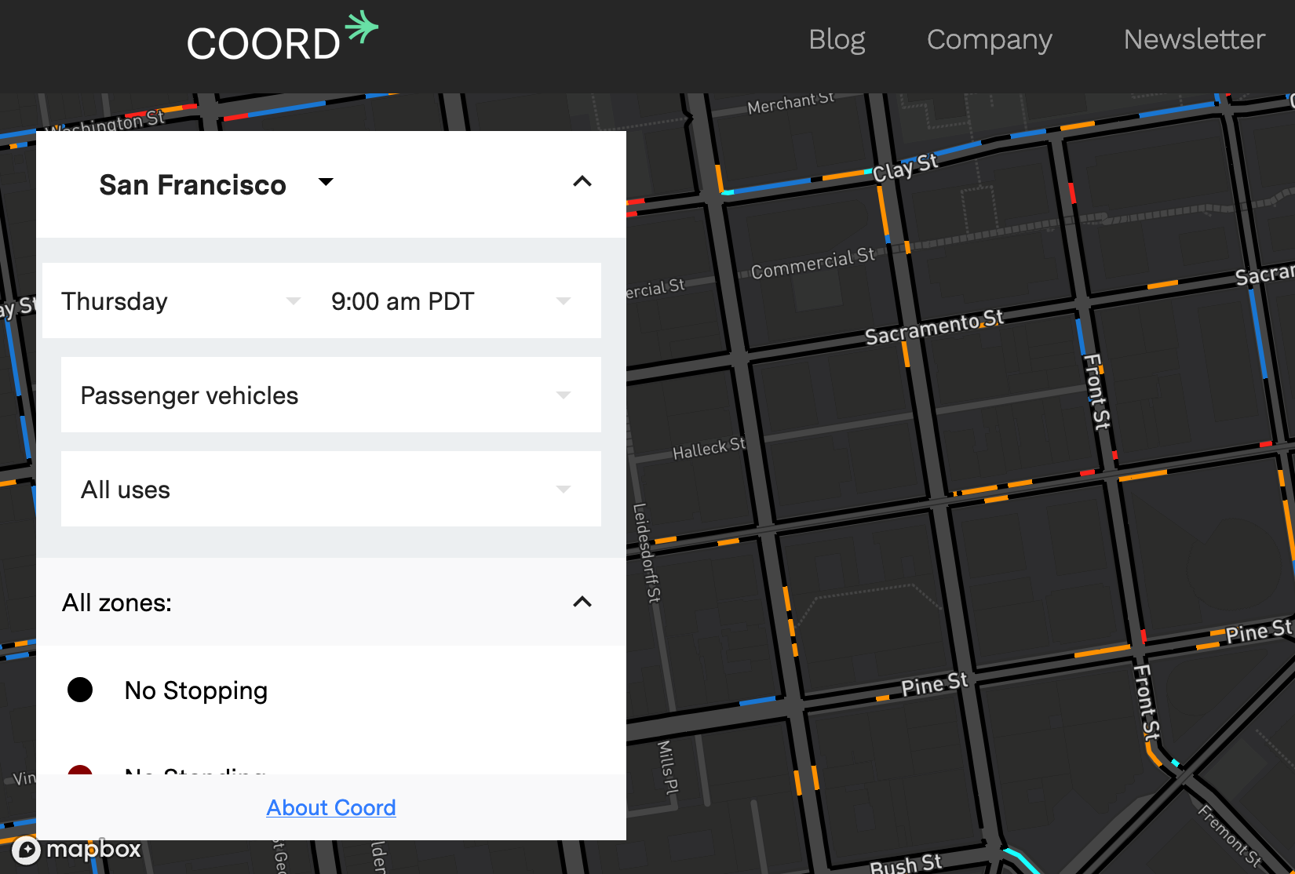
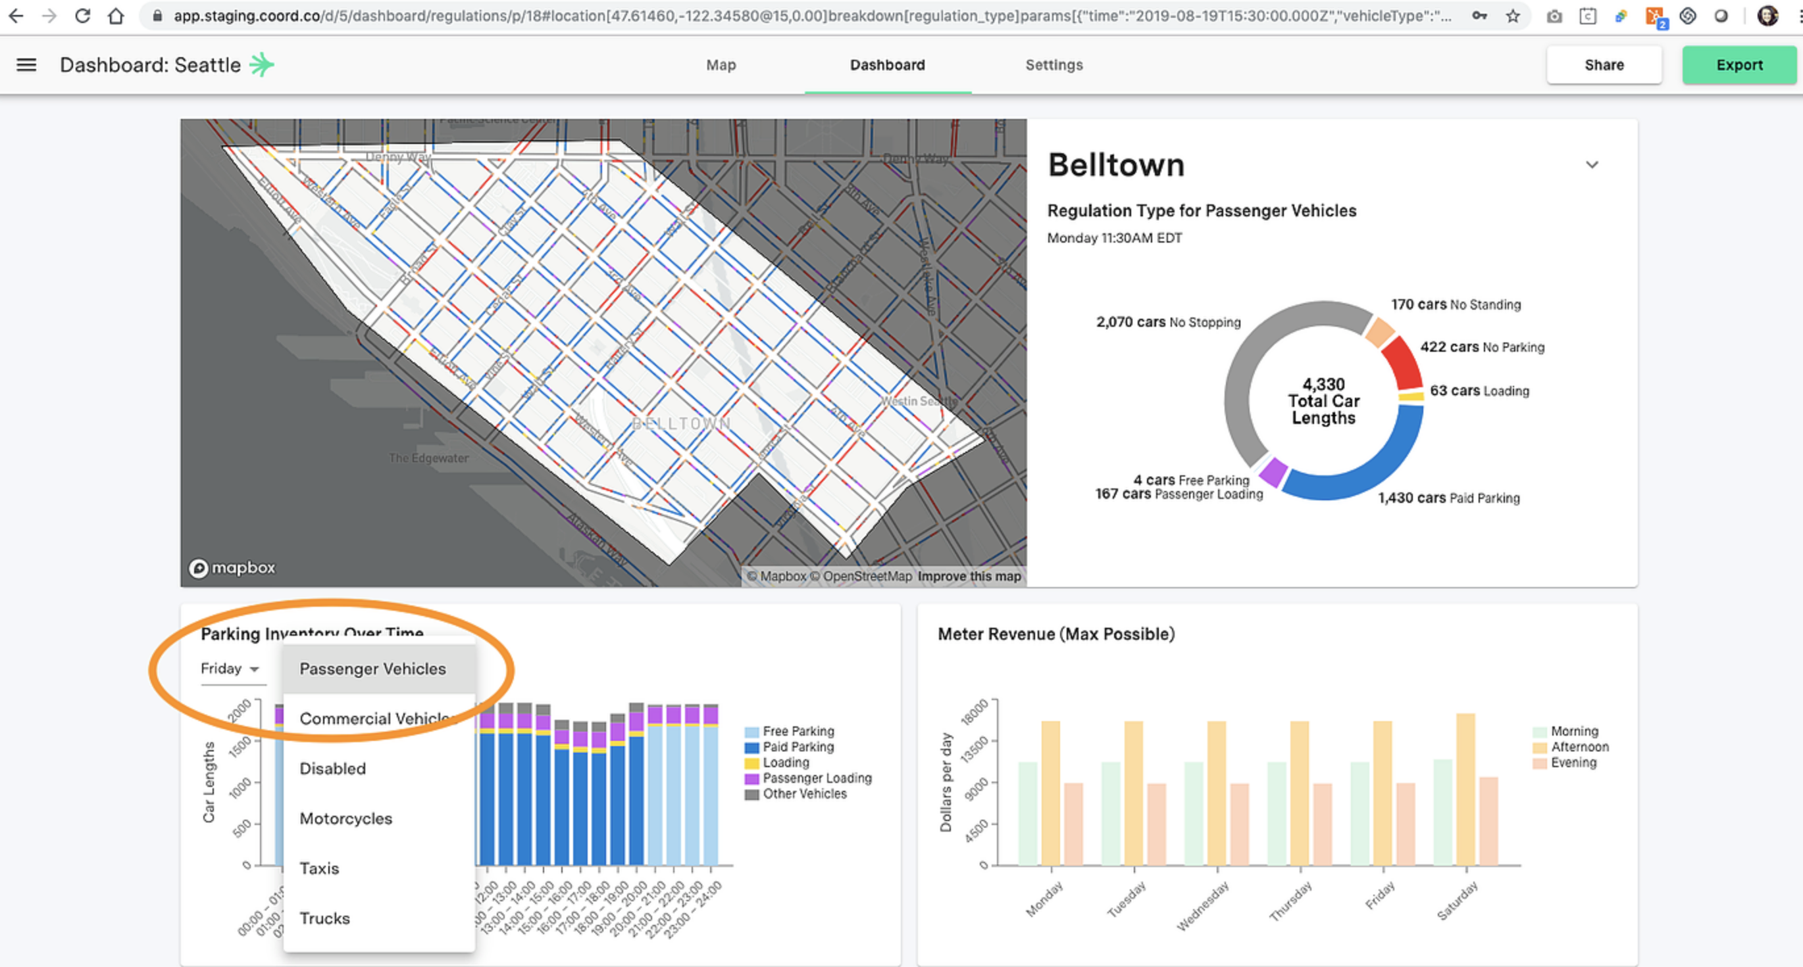
Data
Companies dealing with digitalization and data:
SharedStreets
CurbFlow
Coord
Populus
Remix
Lacuna

Slide 29
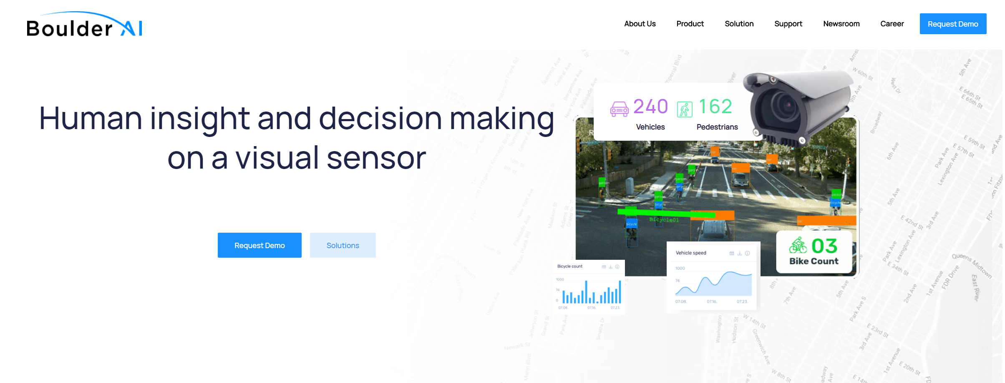
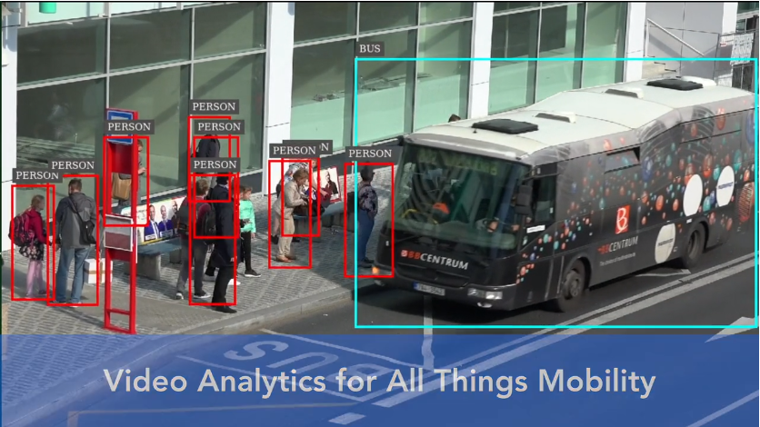
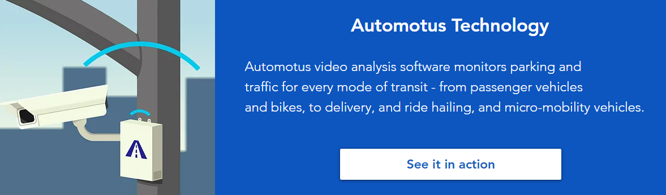
Data and Technology
Boulder AI
Automotus
Avrio Analytics

Slide 30
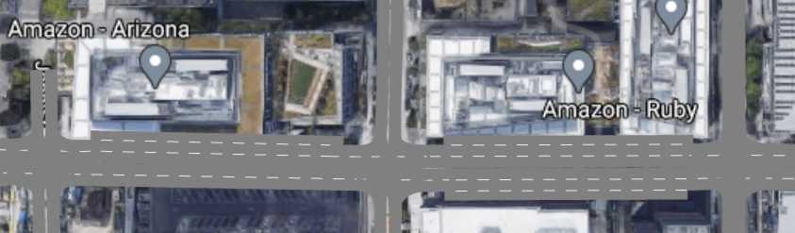
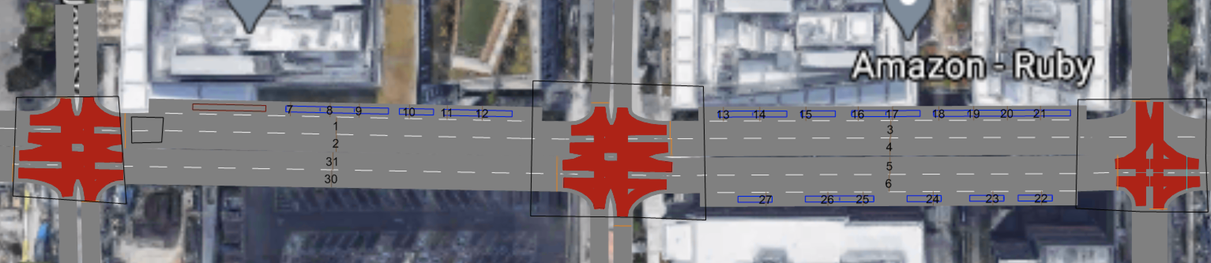
Data and Technology
Speed and Volume data:
in each direction on study blocks
Speed-flow fundamental diagrams
Curb Space data:
in each curb space
Space occupancy, turnover, throughput, etc.

Slide 31
Curb Management
METRICS
DATA
RESEARCH
REAL-WORLD

Slide 32
Curb Management
METRICS
DATA
RESEARCH
REAL-WORLD

Slide 33
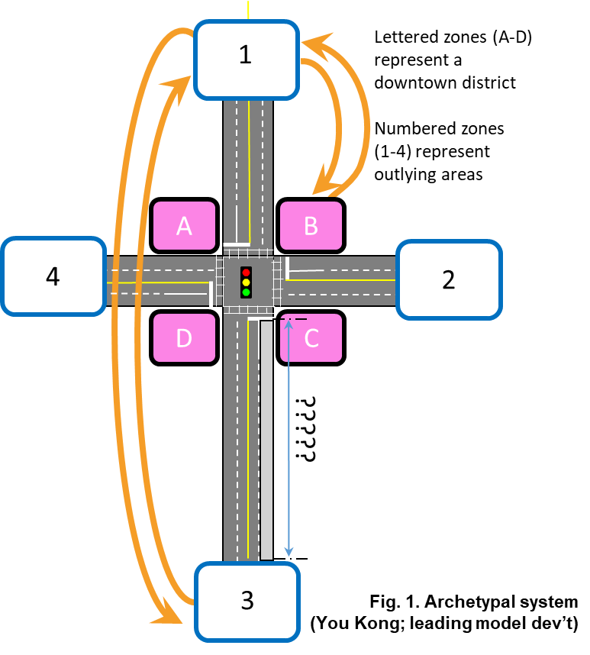
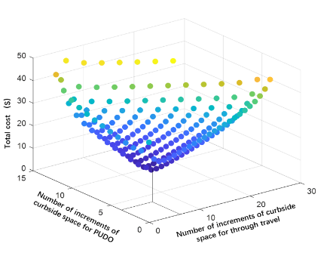
Research under SMART 1.0 curb
Publications in peer-reviewed journals
Butrina, P.; Le Vine, S.; Henao, A.; Sperling, J.; and Young, S. (2020). Municipal Adaptation to Changing Curbside Demands: Exploratory Findings from Semi-Structured Interviews with Ten U.S. Cities. Transportation Policy. https://doi.org/10.1016/j.tranpol.2020.03.005.
Kong, Y.; Le Vine, S.; Henao, A.; and Young, S. (2020). A Framework for Optimal Allocation of Curbside Space. International Journal of Sustainable Transportation.

Slide 34
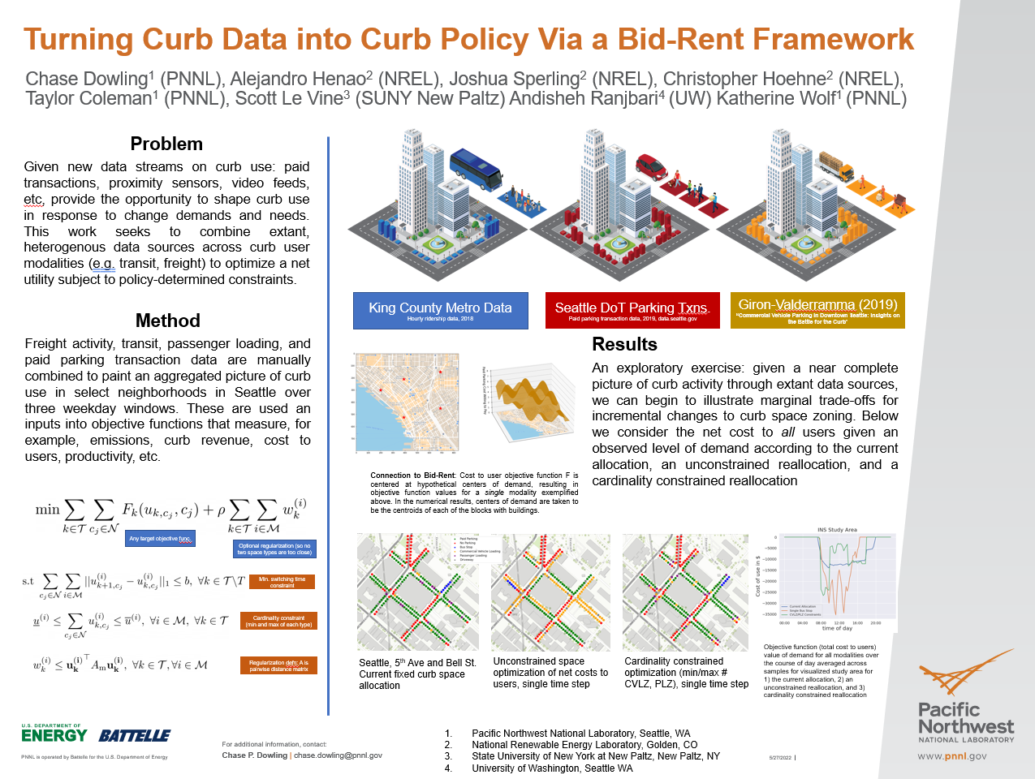
Research under SMART 2.0 curb

Slide 35
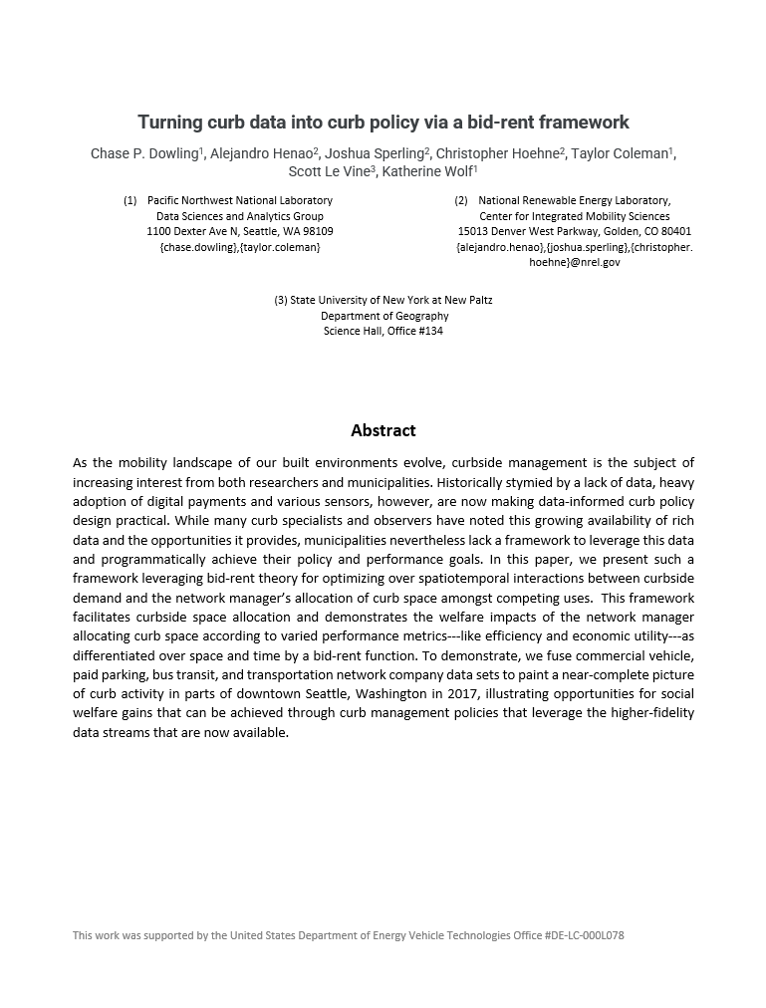
Research Paper: “Turning Curb Data into Curb Policy
Via a Bid-Rent Framework”
A framework leveraging bid-rent theory for optimizing spatiotemporal interactions between curbside demand and the network manager’s allocation of curb space
Demonstrates welfare impacts of new curb allocation according to varied performance metrics (e.g., economic utility)
To demonstrate, we fuse commercial vehicle, paid parking, bus transit, and ridehailing data sets to paint a near-complete picture of curb activity in parts of downtown Seattle, Washington in 2017.
Dowling, C. P., Henao, A., Sperling, J., Hoehne, C., Coleman, T., Le Vine, S., Ranjbari, A., & Wolf, K. (2021). Turning curb data into curb policy via a bid-rent framework. 100th Annual Meeting of the Transportation Research Board, Washington, D.C.

Slide 36
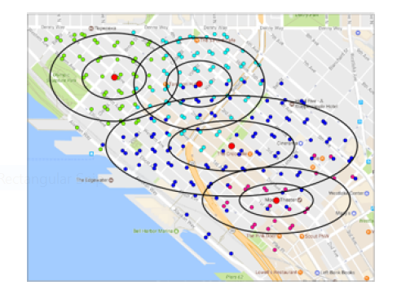
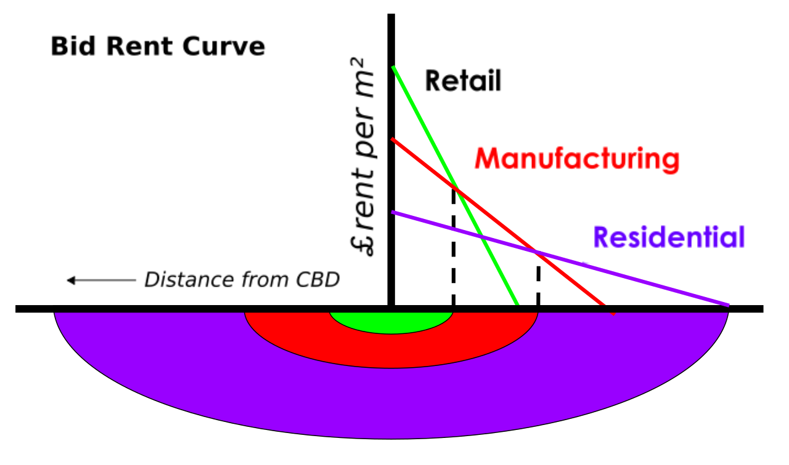
Bid-Rent Theory of Curb Space
Canonical bid-rent theory modeling the price of real-estate by land use
Centralized patterns of demand for private parking* in Belltown, Seattle
* Fiez et al. Gaussian Mixture Models for Parking Demand Data (2019) IEEE ITS

Slide 37
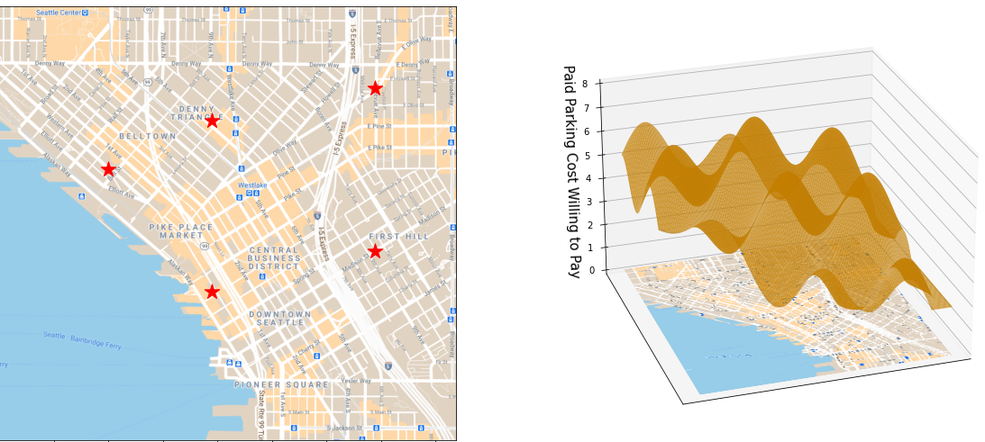
Bid-Rent Theory of Curb Space
A few hypothetical high demand centers (left) located as red stars in downtown Seattle. The surface on the right illustrates the corresponding cost willing to pay (e.g., search time, price) for a single modality (paid parking) for curb spaces around these high demand regions.

Slide 38
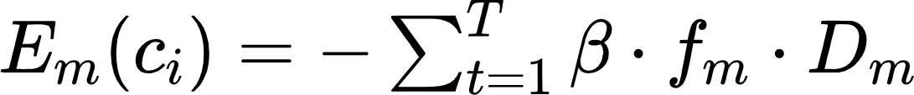
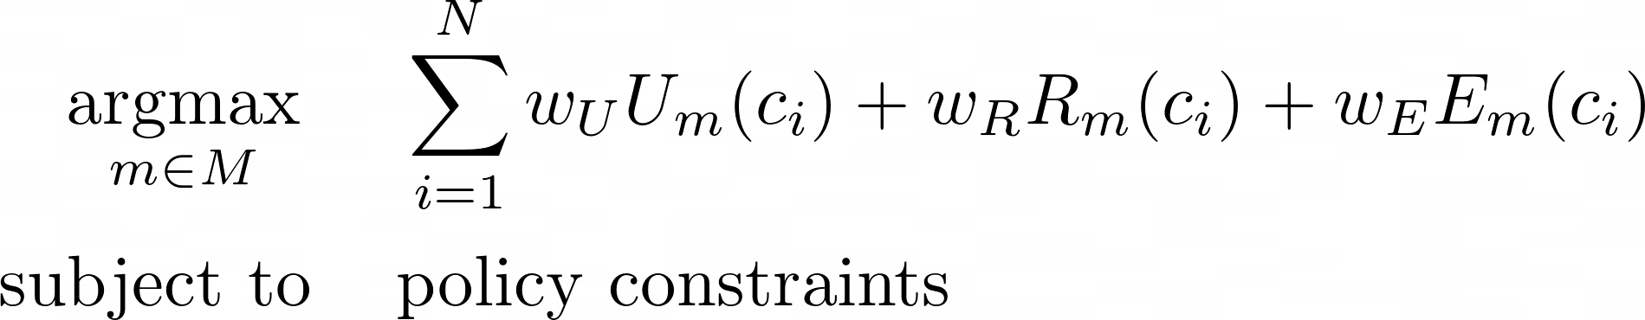
Variables, curb metrics and functions
To define an objective function, parameters (inputs, outputs, performance metrics) are essential (net utility, either from the user or system performance)
Economic welfare for mode m and curb space c with respect to center of demand j:
Revenue of mode m at curb space:
Emissions associated with curb space:

Slide 39
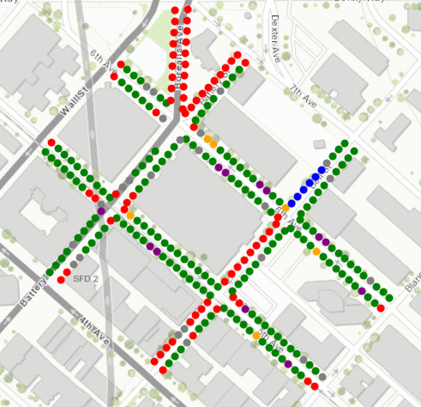
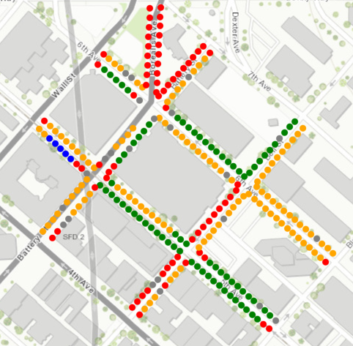
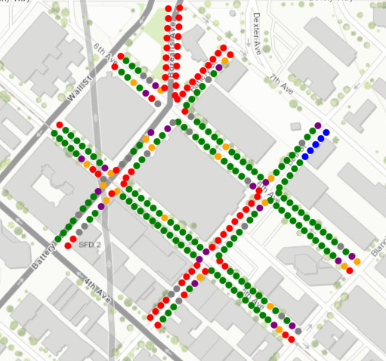
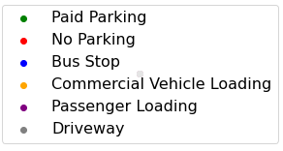
Example Results
Using carefully regressed objective functions and available data, we compute new optimal allocations with and without constraints
Current allocation
Unconstrained optimization
One single bus stop, one commercial (CVLZ) and one passenger (PLZ) per block-face, optimization

Slide 40
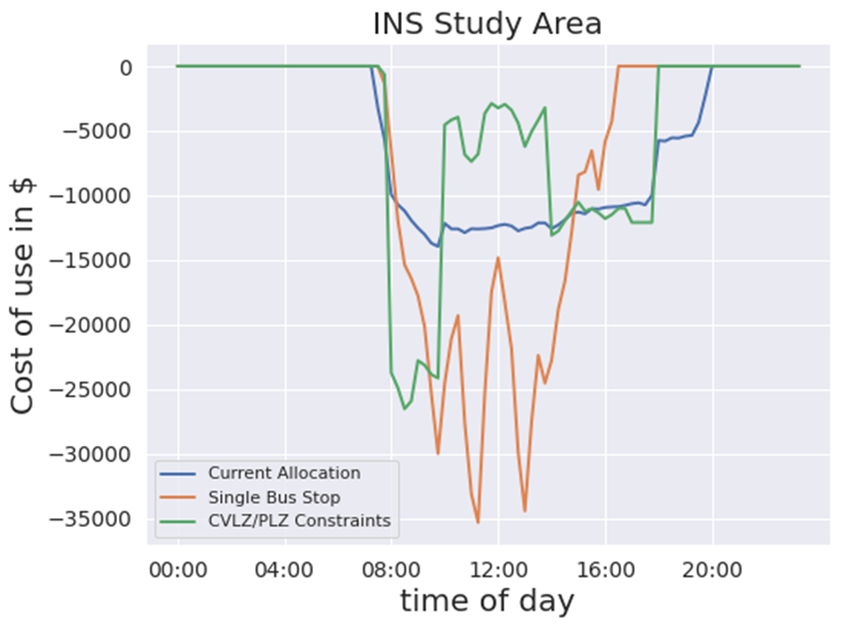
Estimated Net Utility Over Time

Slide 41
Curb Management
METRICS
DATA
RESEARCH
REAL-WORLD

Slide 42
Curb Management
METRICS
DATA
RESEARCH
REAL-WORLD

Slide 43


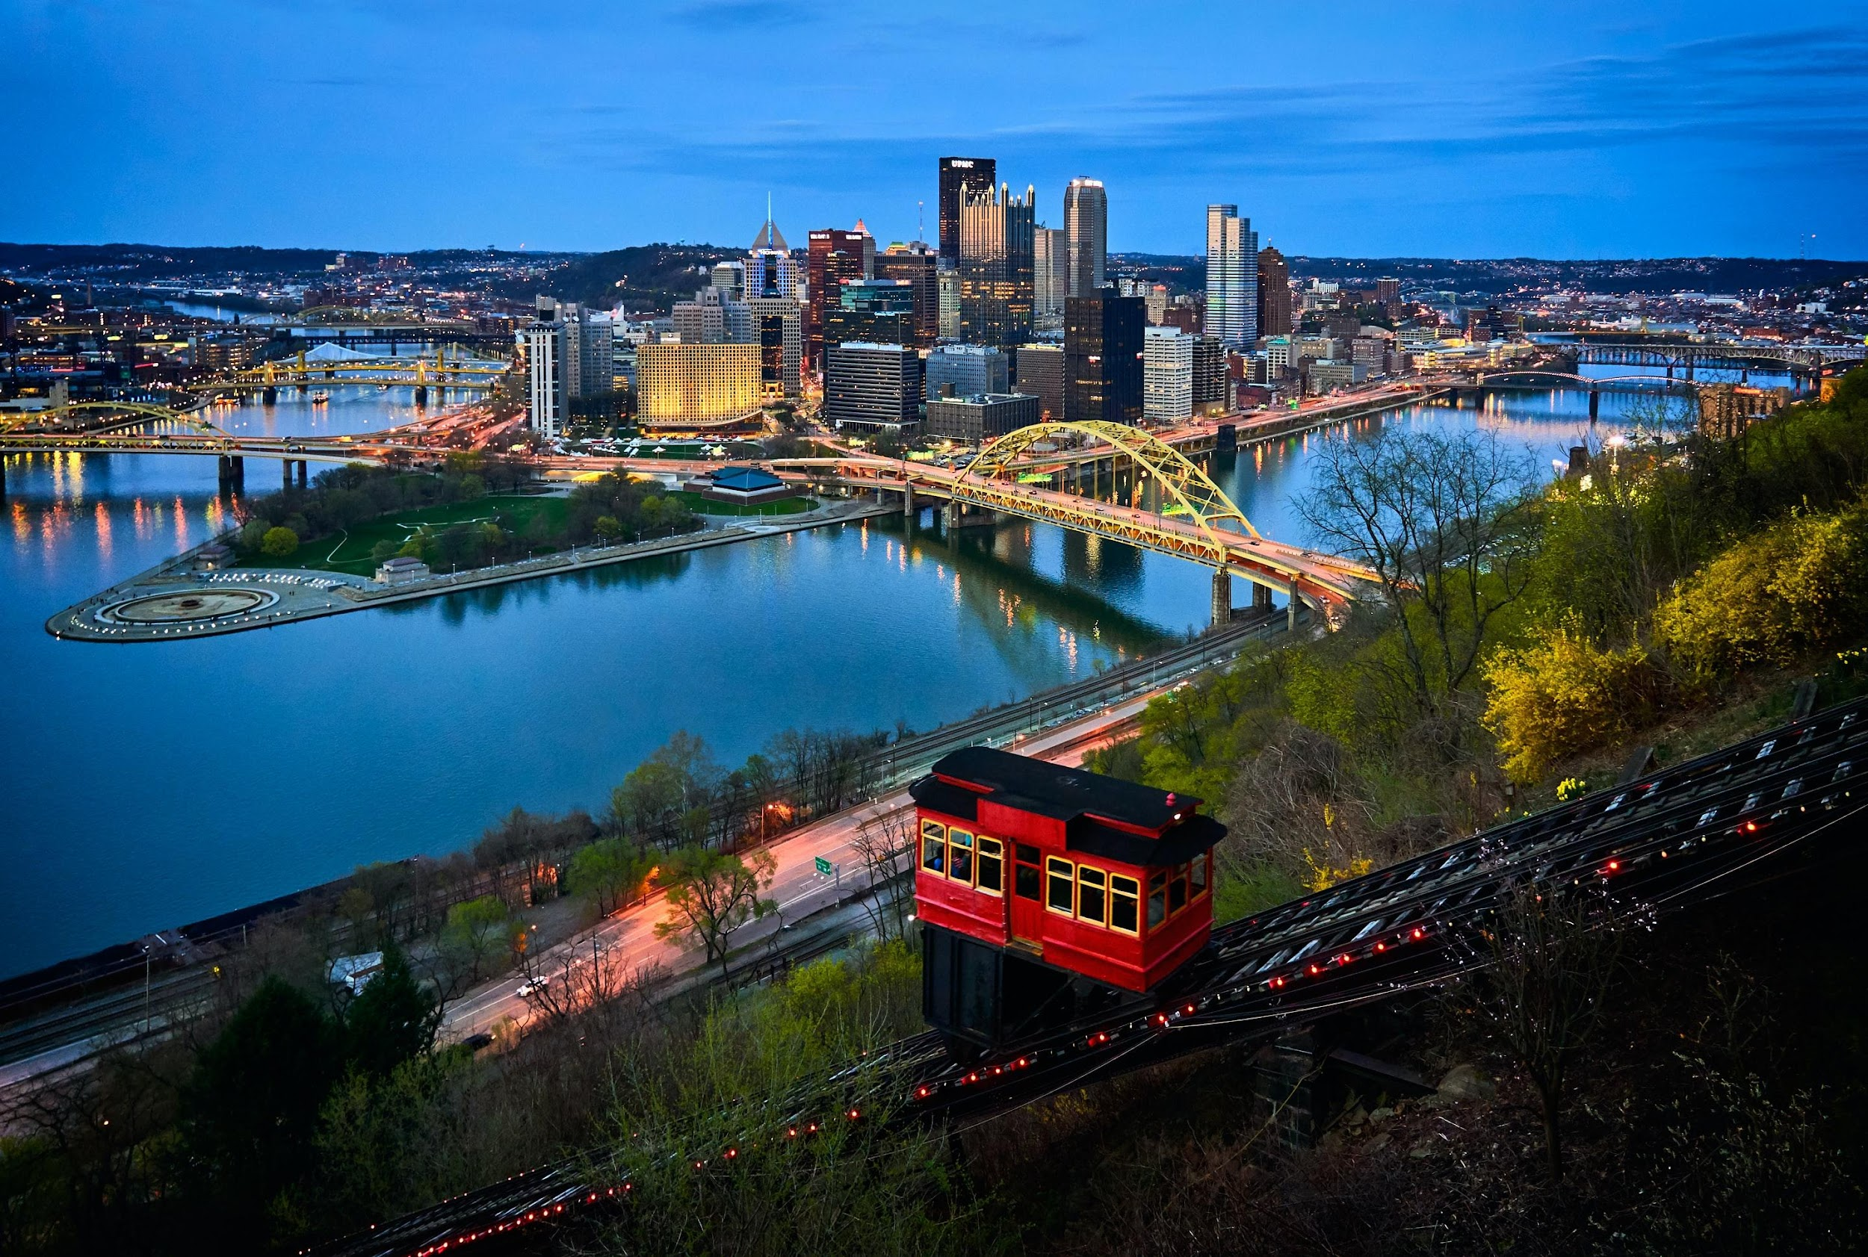







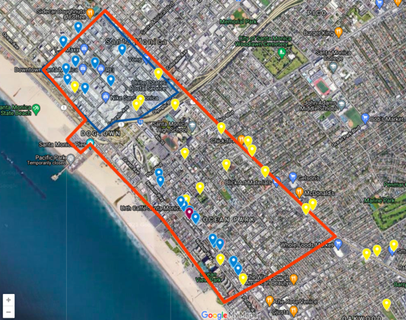



Real-World Experimentation
Project Title: Testing and Evaluation of Curb Management and Integrated Strategies to Catalyze Market Adoption of Electric Vehicles

Slide 44
The project will help municipalities and regions implement curb management strategies to increase EV adoption.
Project Vision: to accelerate adoption for zero emission transportation, provide health outcomes for communities, and provide more efficient transportation and energy systems as well as delivery operations at the curb.
Key Project Deliverables: blueprints and simulation models for cities and researchers on recommended technical, policy, behavioral incentive, and data-driven curb management strategies.
Key Project Outcomes:
Increased electric vehicle (EV) utilization of the curb
Increased Mobility Energy Productivity from curb use efficiency (number of people and goods per unit of consumption)
Reduced GHG emissions and air pollutants
Support socio-economic outcomes, including more equitable access to the curb and EVs and deployments in underserved communities.

Slide 45

Real-World Experimentation
Project Title: Testing and Evaluation of Curb Management and Integrated Strategies to Catalyze Market Adoption of Electric Vehicles

Slide 46
Final Thoughts

Slide 47
Opportunities
Movement of people & goods (not just vehicles):
Prioritization & Incentives (time & cost)
Why can’t curb managers get creative and test different interventions to increase curb efficiency (e.g., pricing, EVs, HOV)?
We can study/influence mobility behavior economic and do curb management optimization research. This is a big opportunity!

Slide 48
The Curb as the link to Advance Mobility & Energy Productivity
Prioritization & Incentives for using the curb:
Modes that allow more people and goods access (per time and per area used)
Higher vehicle occupancy
Lower energy consumption (including EVs)
More societal benefits (each jurisdiction to decide what they value the most) using optimization
Dynamic (allow to accommodate special circumstances such as COVID-19, time-of-day)
Notes:
The Curb as the link to Advance Mobility & Energy Productivity

Slide 49
Curb Management
METRICS
DATA
RESEARCH
REAL-WORLD

Slide 50

Testing Interventions: Be creative and innovative
MOVE ALONG
First 5 Min Free
Each extra Min: $3
We will send you
the bill
Notes:
The Curb as the link to Advance Mobility & Energy Productivity

Slide 51
Thank you
Alejandro Henao, Ph.D.
Alejandro.Henao@nrel.gov

