Slide 1
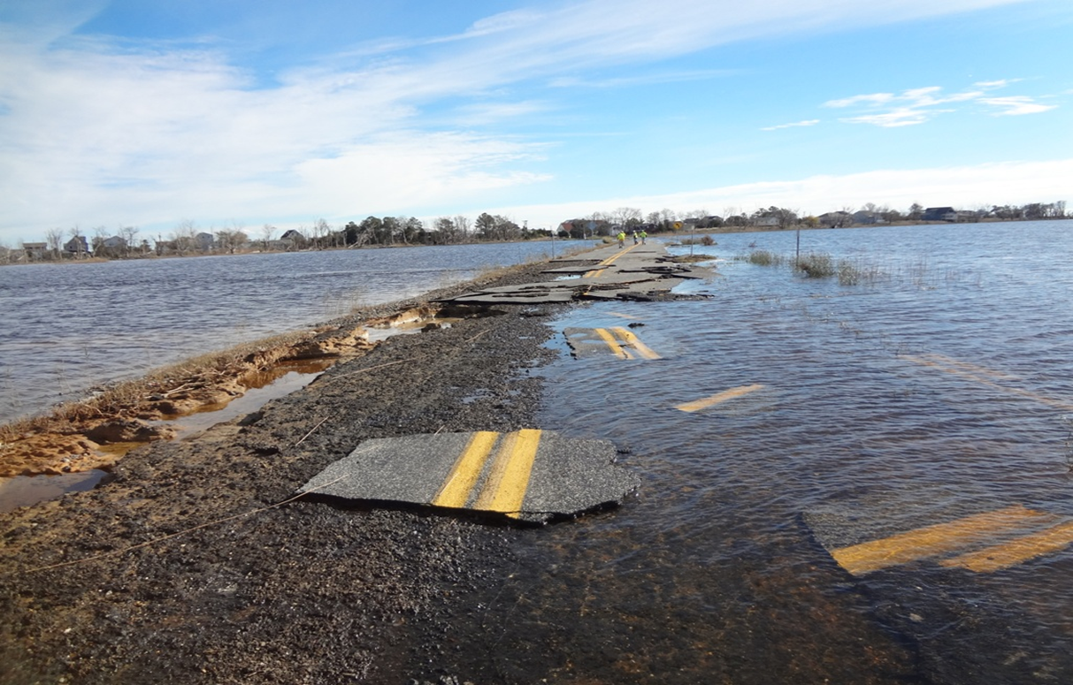
Sustainability and Emerging Transportation Technology June 1, 2022
Division of Transportation
Resiliency & Sustainability
Jim Pappas, P.E.
Director

Slide 2
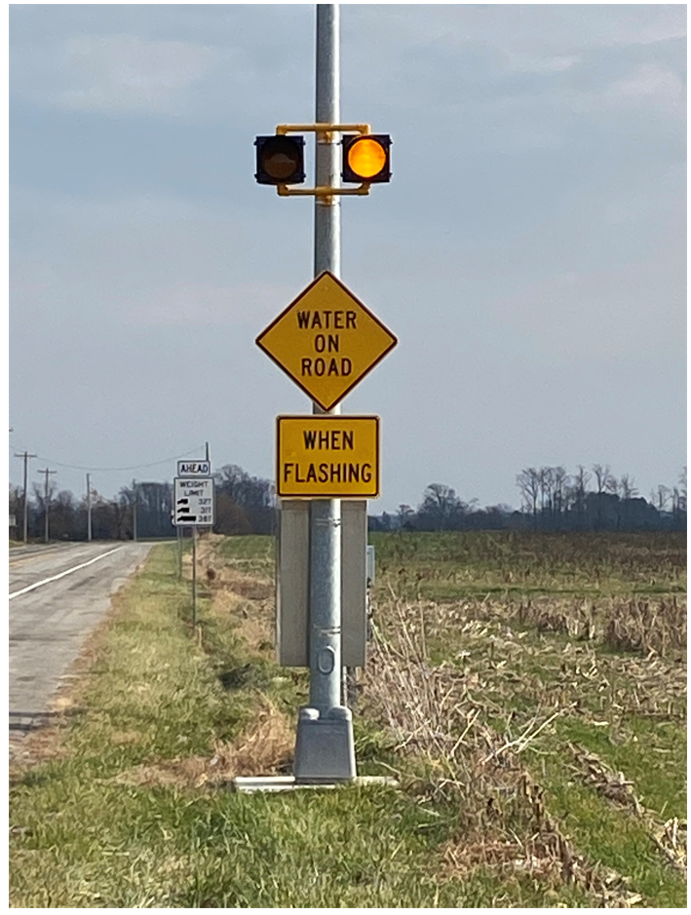
Decision-making for Mobility and Sustainable Transportation
Projects/Initiatives
Planning
State EV Infrastructure Implementation Plan
SR 1, Dewey Beach to Fenwick Island
SR 299, east of Odessa
Pilottown Road, Lewes
Port Mahon Road
Woodland Beach Road
Design
South Bowers Road
Water on Road warning signage

Slide 3
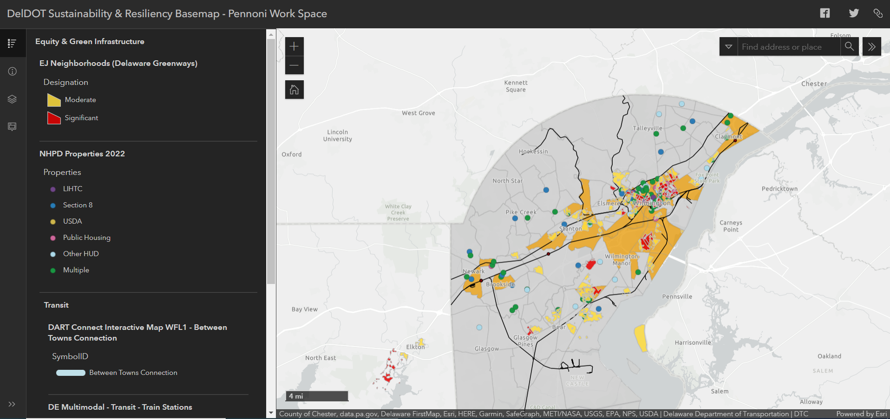

Slide 4
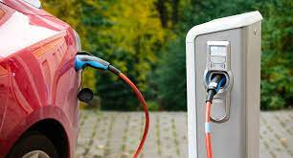
Electric Vehicle Infrastructure
Developing EV infrastructure implementation plan for the state
Partnership with Division of Natural Resources and Environmental Control (DNREC) and AECOM
Kicked off in January 2022
Stakeholder and community input to determine areas of need
Estimated IIJA/BIL funding of $3.5M/year for 5 years for initiative

Slide 5
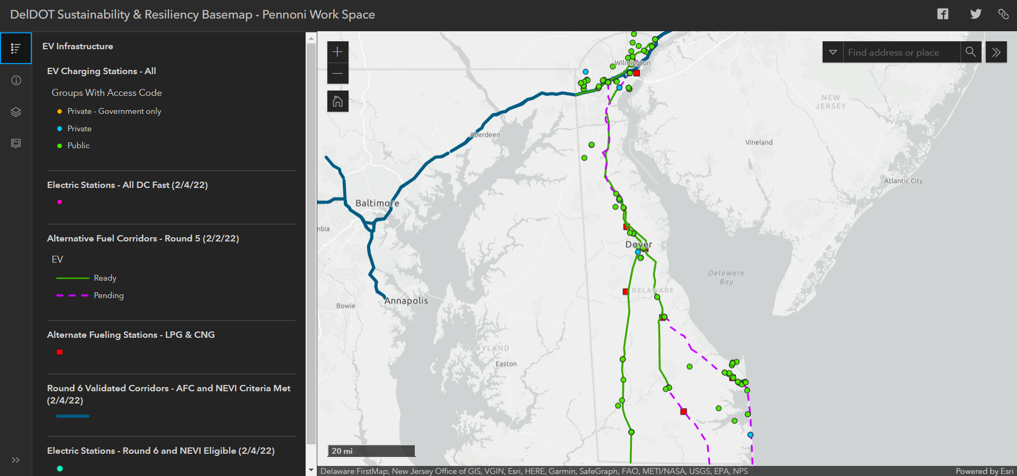

Slide 6
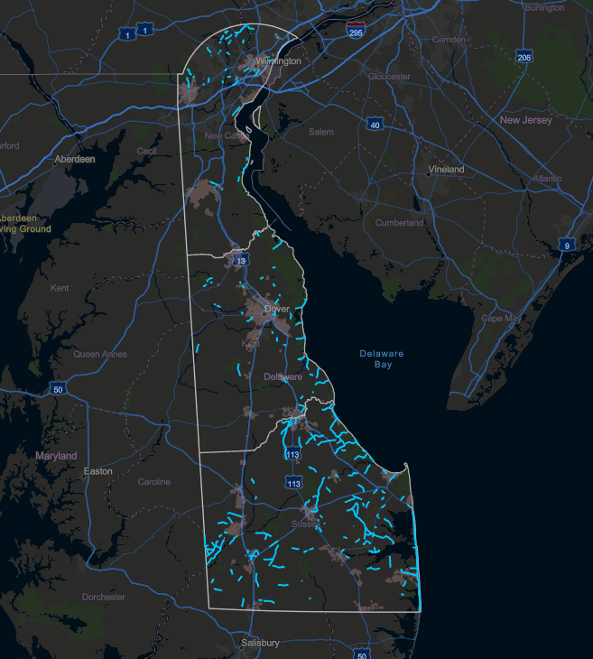
Roadway Flooding Challenges
Due to the low-lying topography of the state, creating resilient infrastructure in the face of roadway flooding becomes a challenge. We have been and continues to be challenged by the effects of sea level rise and frequently flooded roadways across the state.

Slide 7
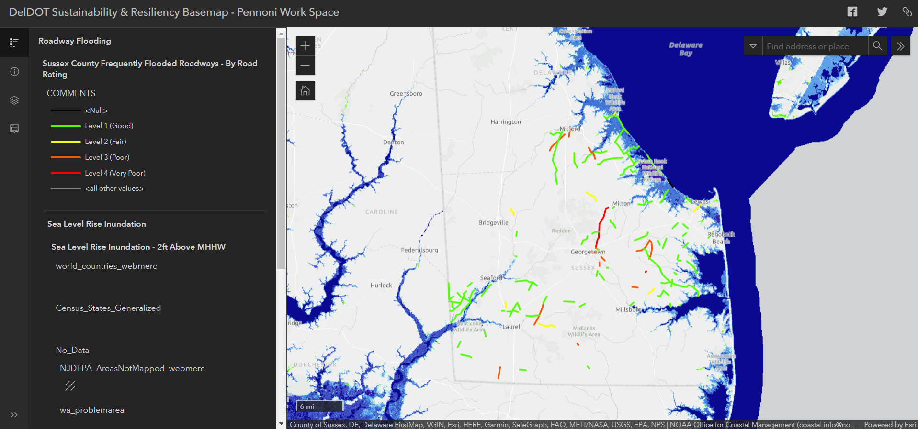

Slide 8
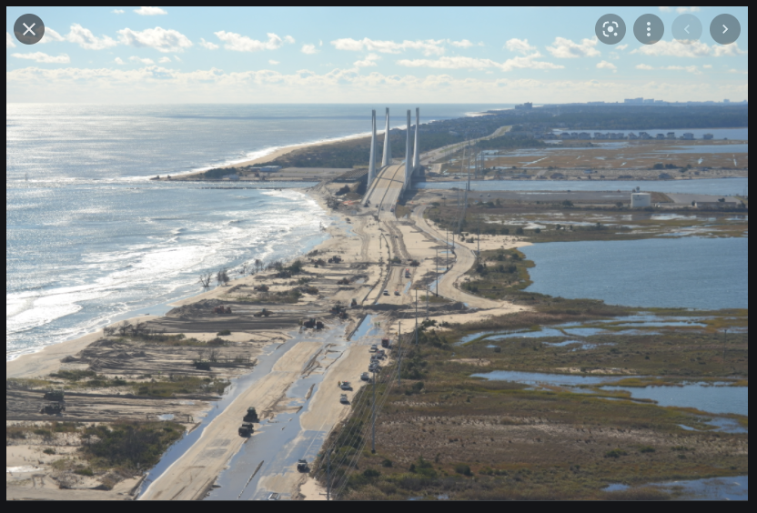
SR 1, Dewey Beach to Fenwick Island
Critical corridor for the state
FEMA Planning Study Grant
Engaged with AECOM for the study
Data gathering, model generation on going
Extensive public engagement planned – communities, businesses, legislators
Deliverable – resilient transportation options for corridor

Slide 9
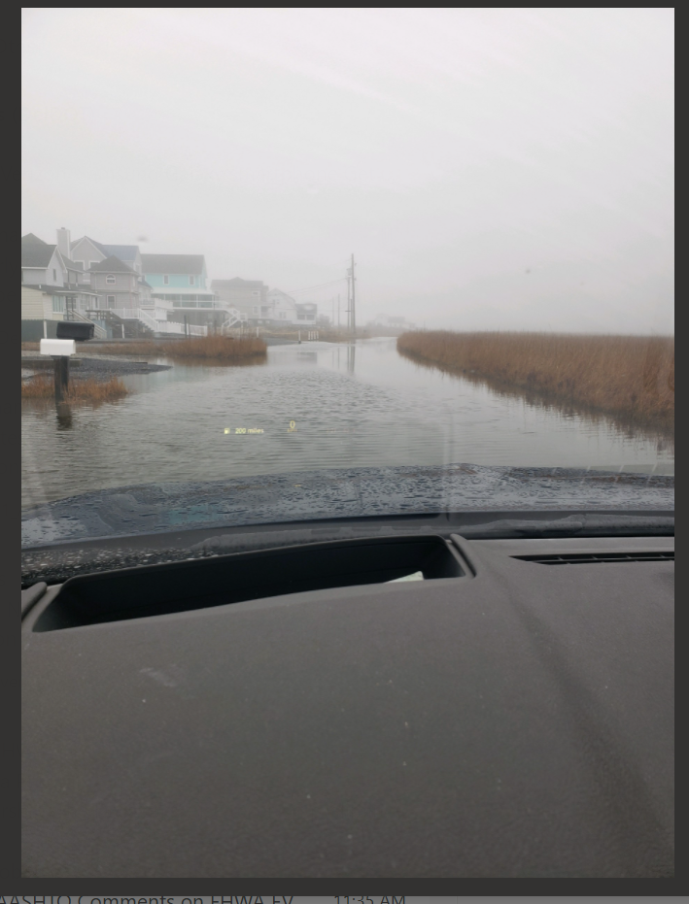
New/Innovative Roadway Elevation Options
South Bowers Road
Small, local, one-way-in, one-way out roadway to beach community
Significant roadway overtopping at times
Short-term solution is to elevate roadway … by how much?
Encroaching wetlands along roadway; limited construction area
Build on existing roadway footprint
Roadway settlement concerns with additional overlay
Notes:
This is a background slide of the location along with a picture of what it looks like during a storm event.

Slide 10
South Bowers Road - Pavement Section
Notes:
Pavement section showing pathway of water through the pavement with filter fabric intended to minimize debris in the pavement section.

Slide 11
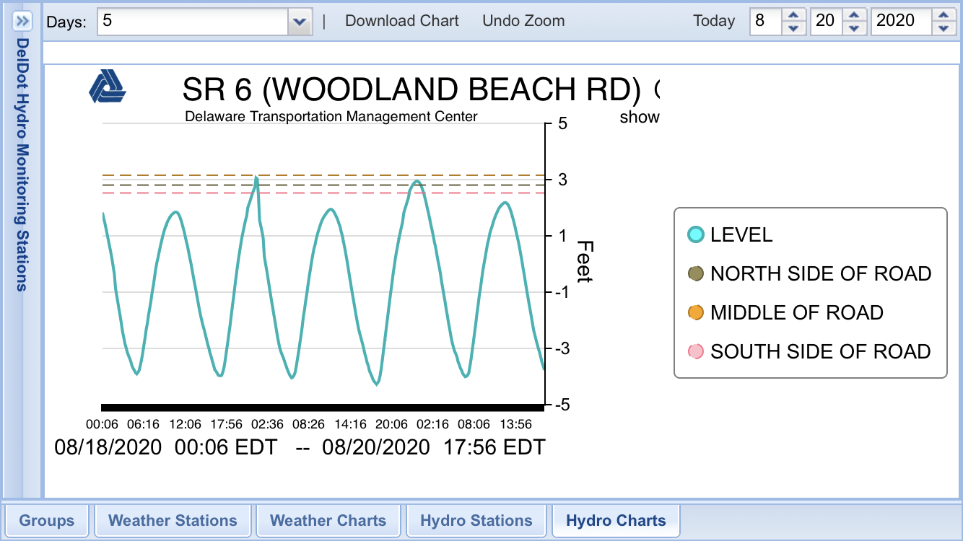
Warning Signage
Long-Term Maintenance
Pre-staged barricades/signs/gates
Monitoring of water elevations
Notification
Dynamic messages
Electronic messaging (texts, apps, Facebook, Twitter)
Virtual messages boards

Slide 12
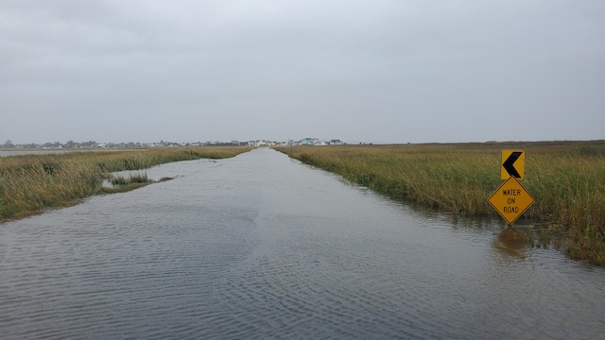
Possible Mitigation Options
Tolerate
Relocation/Realignment
Elevate
Harden
New, innovative solutions
Abandon
Buy-outs

Slide 13
Strategic Thinking
No “one size fits all” solution
Careful considerations – data, review, planning, operations, investment, etc.
More future strategies/future case studies – innovative solutions
Stakeholder input ensuring equity
Public
Other governmental agencies
Non-governmental organizations
Subject matter experts
University researchers

Slide 14
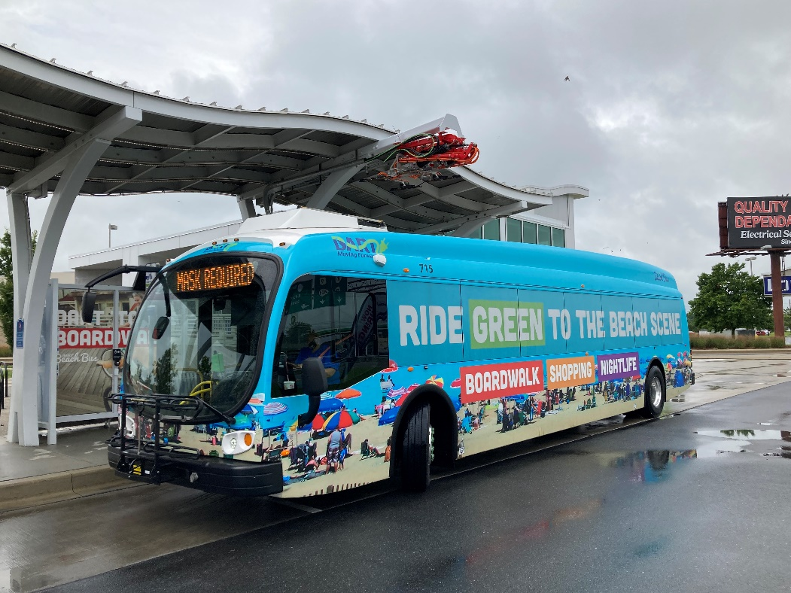
Transportation Resilience & Sustainability
Summary - Items of DelDOT interest:
Integrate and include social and transportation equity in all decision-making associated with planning transportation opportunities
Zero-emission transportation
Alternative energy (solar in the ROW)
Green infrastructure
Wetland sites
Pollinator sites
Living shorelines
Infrastructure flooding challenges
Prioritization process
Innovative pavement solutions

Slide 15
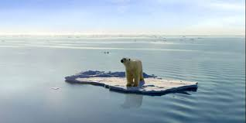
Thank you for your time and attention
Jim Pappas
james.pappas@delaware.gov

