Slide 1
Conference on Sustainability and Emerging Transportation Technology
May 31, 2022
Richard W. Corey, Executive Officer

Slide 2
2022 is a Transformative Year
2022 Scoping Plan and State SIP Strategy
Accelerating the Transition to ZEVs through Regulation
Historic Climate Budget
Promoting Sustainable Communities and Reducing VMT

Slide 3
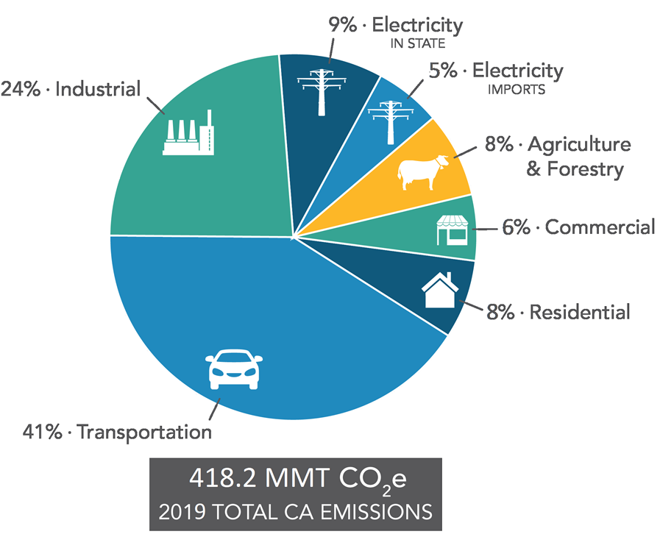
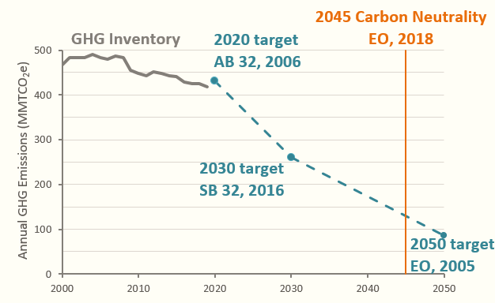
CA GHG Reduction Targets and Sources
CARB GHG Inventory, 2021

Slide 4
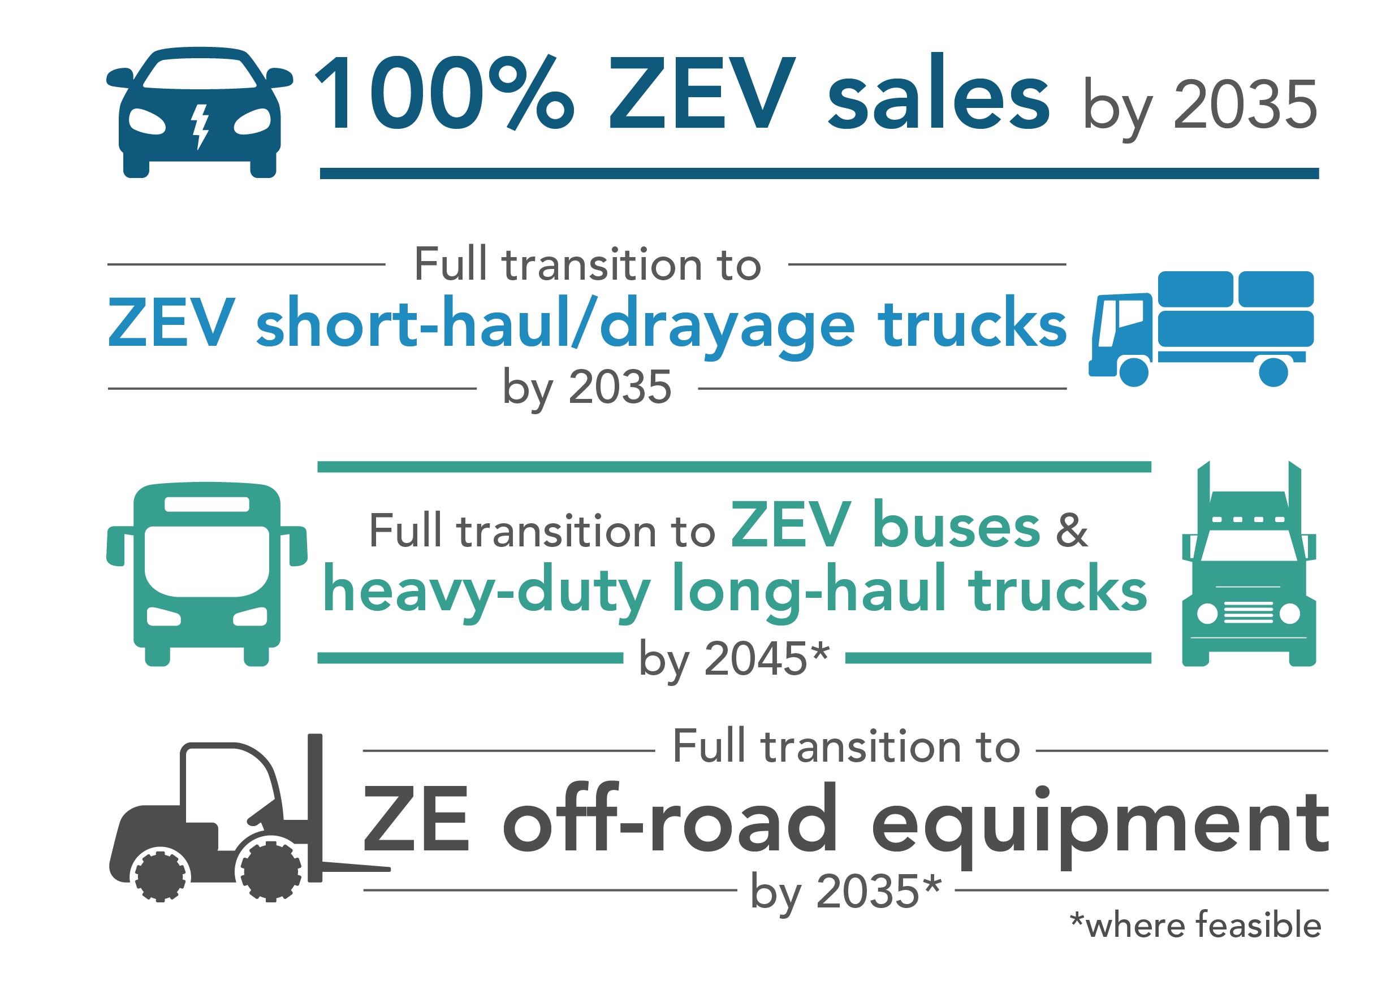
Governor’s Directives
Executive Order N-79-20:
Sets ZEV sales goals
Accelerates ZEV infrastructure
Supports multi-modal and clean transportation

Slide 5
Reducing Emissions from Transportation
100% of new LDV sales are ZEVs starting in 2035
100% of new MHDV sales are ZEVs starting in 2040
Aggressive transition to ZEV technology in off-road space
22% reduction in VMT by 2045
Low-carbon fuels in existing on-and-off-road vehicles
Long-term strategy for decarbonizing end uses that are more difficult to transition to ZEV technology

Slide 6
Advanced Clean Cars (ACC) II
Fully transform sales to electric vehicles by 2035
Continue to clean up gasoline cars in real-world driving conditions
ZEV requirements to assure consumers of value
Equity-focused actions

Slide 7
ACCII: ZEV Consumer Assurance Measures
Goal: Increase consumer confidence in ZEVs
ZEV warranty and durability requirements
Battery state of health monitor for driver
On-board data for service and resale
Common DC Fast Charge Port (CCS) for BEVs
Required “convenience cord” with all BEVs and PHEVs, Level 2 capable

Slide 8
ACCII: Environmental Justice ZEV Measures
EJ allowance for manufacturers who take action to help increase affordable access to ZEVs for our priority communities
Community Program
Discounts
Used ZEVs & PHEVs
Low-Priced ZEVs & PHEVs

Slide 9
Clean Miles Standard (CMS)
Climate
Zero
gCO₂/PMT
Electric Miles
90
% eVMT
Applicable to ride-hailing services by transportation network companies (TNCs)
Key goals:
Reduce GHG emissions
Increase electrification
Reduce VMT
2030 Targets:

Slide 10
Innovative Clean Transit (ICT) Regulation
Year | ZEB Percentage of Total New Bus Purchases
 | Large Transit Agency | Small Transit Agency
2023 | 25% | -
2024 | 25% | -
2025 | 25% | -
2026 | 50% | 25%
2027 | 50% | 25%
2028 | 50% | 25%
2029 & after | 100% | 100%
A beachhead technology driving regulations
The first heavy-duty zero emission vehicle regulation adopted in California and the U.S.
Statewide goal for public transit agencies to fully transition to zero-emission technologies by 2040.

Slide 11
Advanced Clean Trucks
Model Year (MY) | Class 2b-3 | Class 4-8 | Class 7-8 Tractors
2024 | 5% | 9% | 5%
2025 | 7% | 11% | 7%
2026 | 10% | 13% | 10%
2027 | 15% | 20% | 15%
2028 | 20% | 30% | 20%
2029 | 25% | 40% | 25%
2030 | 30% | 50% | 30%
2031 | 35% | 55% | 35%
2032 | 40% | 60% | 40%
2033 | 45% | 65% | 40%
2034 | 50% | 70% | 40%
2035+ | 55% | 75% | 40%
Goal: Foster and accelerate large-scale production of zero-emission trucks
Effective date: March 15, 2021
Manufacturer sales in California must be ZEVs
Partial credit for plug-in hybrids to 2035
Aligns with 100% ZE drayage goal by 2035
ACT Board Resolution set 100% ZEV targets
2035 – Last mile delivery, drayage, public fleets
2040 – Refuse, utilities, buses
2045 – All other trucks where feasible

Slide 12
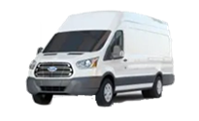
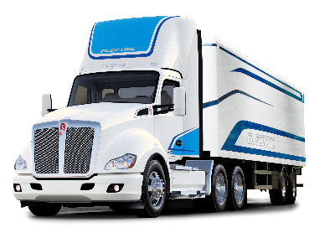
Proposed Advanced Clean Fleets Regulation
State and Local Government Fleets
50% of purchases from 2024-2026 and 100% of purchases starting 2027
Drayage Trucks
All Class 7 & 8 drayage trucks operating at intermodal seaports or railyards to be full ZE by 2035
High Priority & Federal Fleets
Purchase ZE trucks starting 2024 or meet ZEV milestones as a percent of the total fleet
Manufactures must sell 100% ZE trucks beginning 2040
Board consideration October 2022
Zero-Emission Fleet Percentage​ | 10%​ | 25%​ | 50%​ | 75%​ | 100%​
Box trucks, vans, two-axle buses, yard trucks​ | 2025​ | 2028​ | 2031​ | 2033​ | 2035​
Work trucks, day cab tractors, three-axle buses​ | 2027​ | 2030​ | 2033​ | 2036​ | 2039​
Sleeper cab tractors and specialty vehicles ​ | 2030​ | 2033​ | 2036​ | 2039​ | 2042​

Slide 13
Proposed $10B ZEV Budget
Clean Vehicle Rebate Project: $525M
Clean Cars 4 All & Other Equity Projects: $656M
ZEV Fueling Infrastructure Grants: $900M
Equitable At-home Charging: 300M
Passenger Vehicles
Drayage Trucks & Infrastructure: $945M
Drayage Trucks & Infrastructure Pilot Program: $65M
Transit Buses & Infrastructure: $750M
School Buses & Infrastructure: $1.95B
Clean Trucks, Buses and Off-Road Equipment: $1.8B
Near-Zero Heavy Duty Trucks: $45M
Ports: $400M
Big ZEVs
ZEV Consumer Awareness: $5M
ZEV Manufacturing Grants: $250M
Transportation Package ZEV: $790M
Community-Based Plans, Projects and Support/Sustainable Community Strategies: $419M
Emerging Opportunities: $200M
Additional Investments

Slide 14
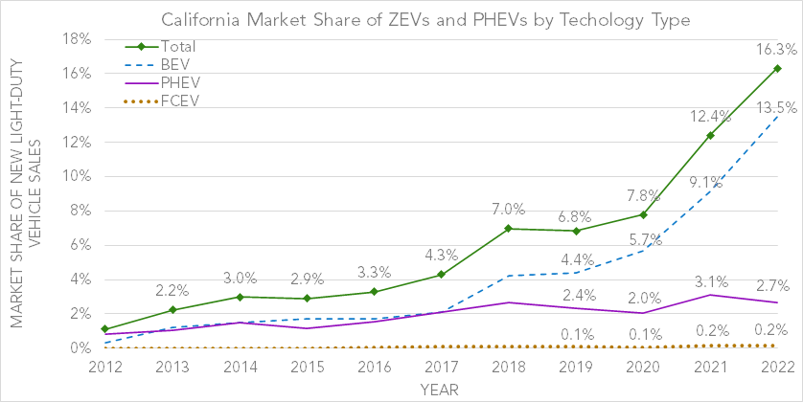
Transition has Already Begun: One million+ ZEVs and PHEVs in California
CEC ZEV Statistics
https://www.energy.ca.gov/zevstats

Slide 15
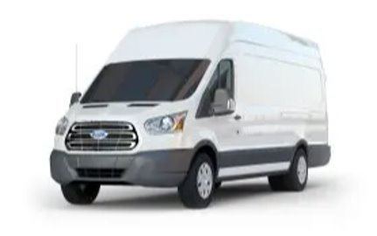
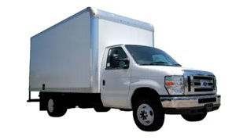
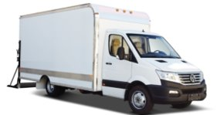
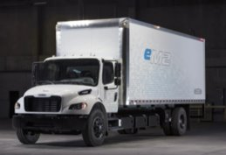
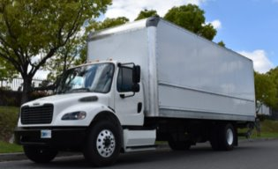
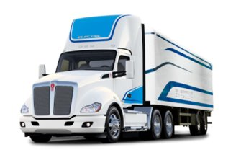
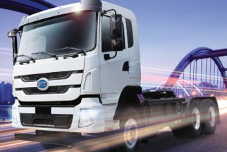
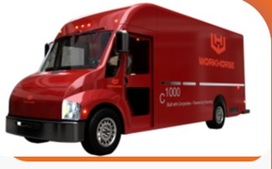
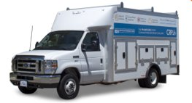
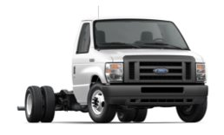
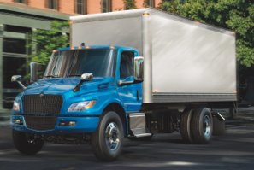
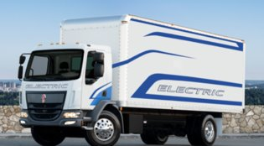
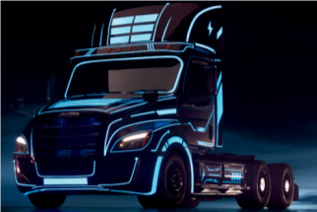
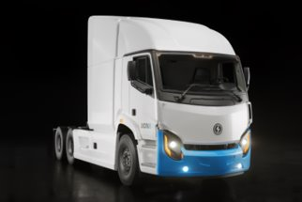
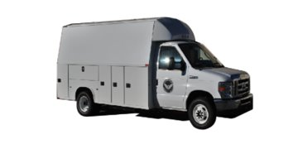
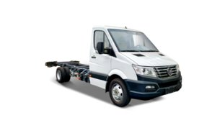
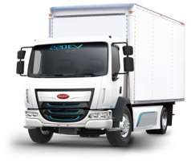
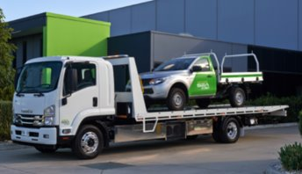
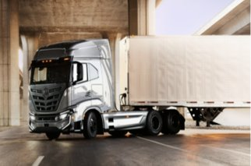
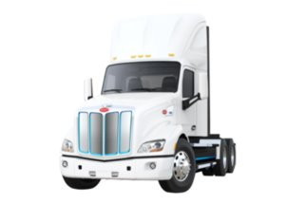
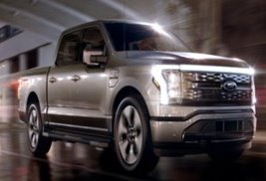
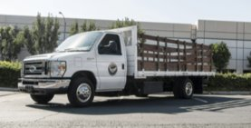
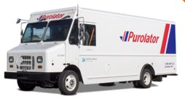
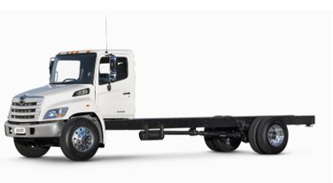
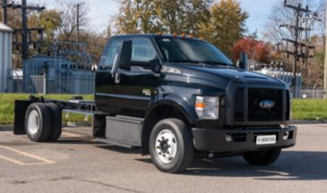
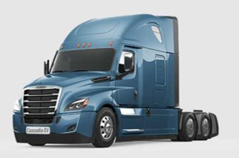
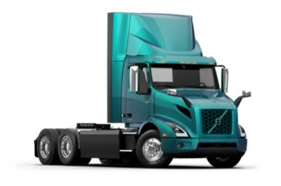
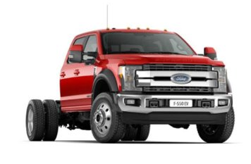
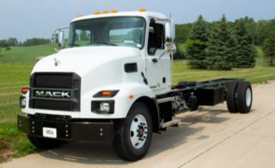
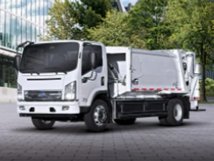
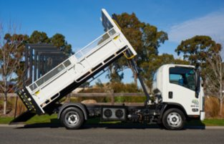
Commercially Available ZETs
 | 2B-3 (8,501 – 14,000 lbs.) | 4-5 (14,001-19,500 lbs.) | 6-7 (19,501 – 33,000 lbs.) | 8 (33,001 lbs. and over)
Commercial Vehicles Today

Slide 16
VMT Reductions and GHG Targets

Slide 17
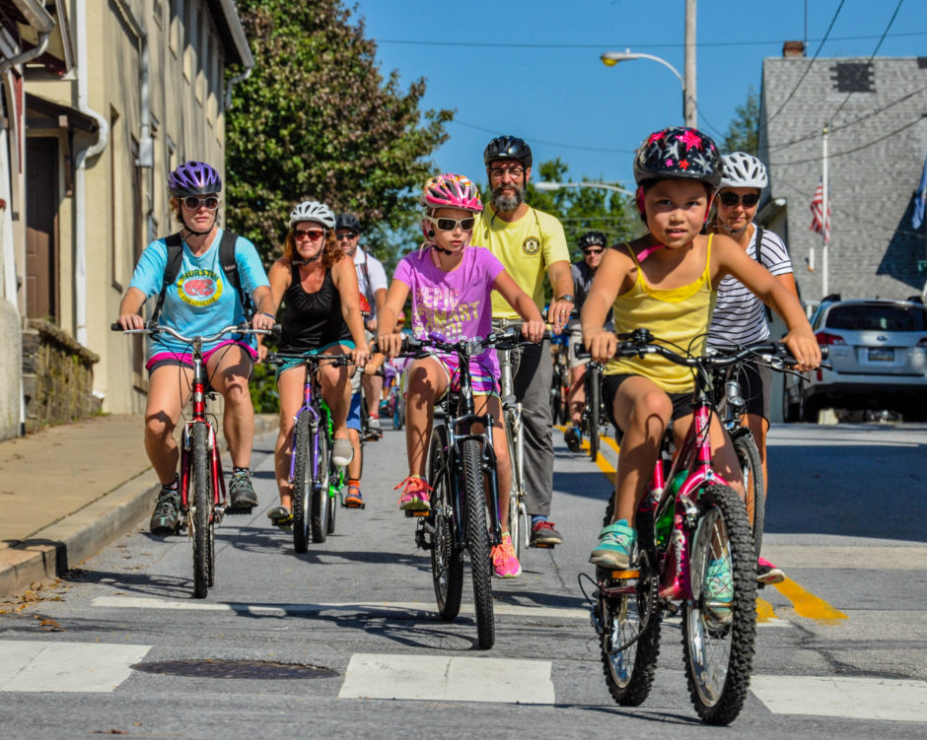
Beyond Transportation
Sustainable communities that reduce VMT also support GHG reductions from:
Construction and energy use in buildings
Infrastructure construction and maintenance
Carbon sequestration on natural and working lands
Reducing VMT also provides important community benefits:
Improved air quality
Better public health outcomes
More time with family and community
Lower household transportation costs

Slide 18
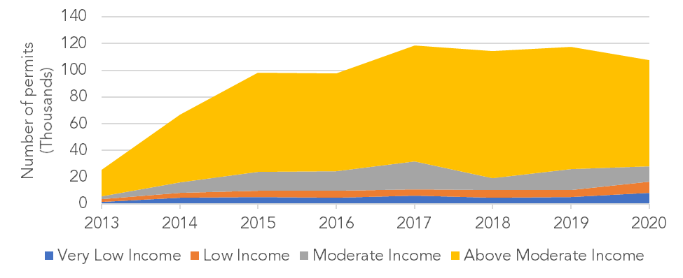
Housing, Equity, and Climate
Source: Housing Element Implementation and APR Data Dashboard, Page 6: https://www.hcd.ca.gov/apr-data-dashboard-and-downloads
18

Slide 19
State Actions to Reduce VMT
Housing as a Climate Strategy - $1.5 billion in investments on infill affordable housing
Regional Early Action Planning (REAP) grants - $600 million to support regional planning for housing affordability and VMT reduction
Implementation of SB 743 – streamlining environmental review of projects that reduce VMT
Climate Action Plan for Transportation Infrastructure – aligning transportation investments with climate and equity commitments
Promoting inter-agency collaboration – biannual joint meetings between CARB, the CTC, and HCD

Slide 20
Strategies to Reduce VMT
Roadways
Reimagine roadway projects that increase VMT in a way that meets community needs and reduces the need to drive.
Implement roadway pricing strategies and reallocate revenues to sustainable transportation choices.
Public Transit
Double local transit coverage and service frequencies by 2030.
Prioritize addressing key transit bottlenecks and other infrastructure investments to improve transit operational efficiency over investments that increase VMT.

Slide 21
Strategies to Reduce VMT (con’t)
New Mobility
Prevent an uninhibited growth of autonomous vehicle VMT, and particularly zero-passenger miles.
Channel new mobility services towards pooled use models, transit complementarity, and lower VMT outcomes
Land Use and Development
Accelerate infill development in existing transportation-efficient places.
Ensure alignment in land use, housing, transportation, and conservation planning in adopted regional plans (RTP/SCS and RHNA) and general plans (e.g., general plans, zoning, and local transportation plans).

Slide 22
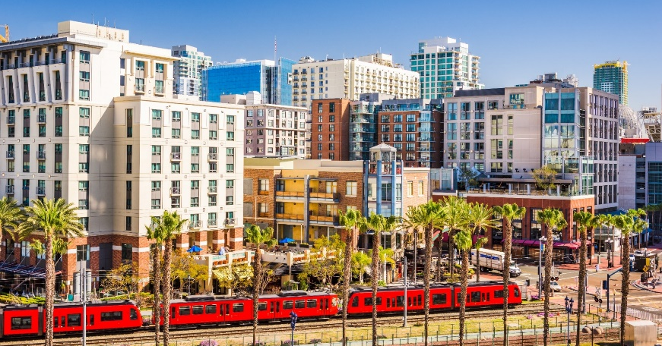
Strategies to Reduce VMT (con’t)

