Slide 1
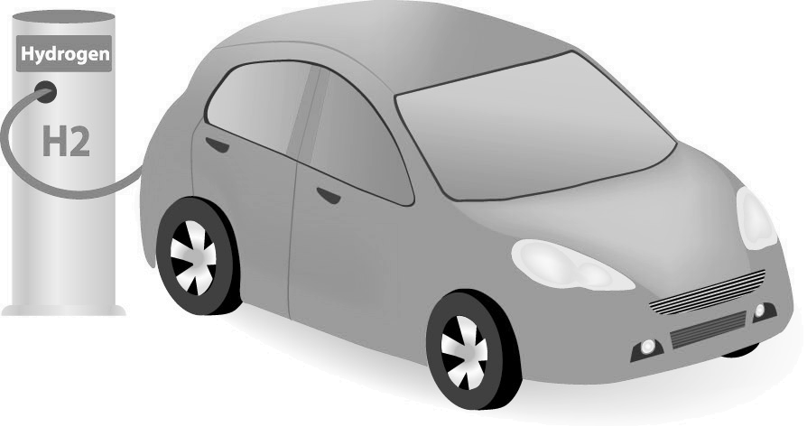
ICEV
Factors Associated with the Adoption of
Alternative Fuel Vehicles in California
June 1, 2022
Xiatian (Summer) Iogansen | Ph.D. student | xtwu@ucdavis.edu
Kailai Wang, Ph.D., David Bunch, Ph.D., Giovanni Circella, Ph.D., Grant Matson
3 Revolutions Future Mobility Program, University of California, Davis

Slide 2
Current Market of Alternative Fuel Vehicles (AFVs) in CA
CA State Regulations: Zero-Emission Vehicle (ZEV) Program
Goals of promoting ZEVs (PHEV+BEV+FCEV) in the state
1.5 million ZEVs by 2025, 5 million by 2030
0.25 million EV charging stations by 2025
ZEV Categories | State of California (end of 2021)
 | # of ZEVs | % of total ZEVs | % of total vehicles
Plug-in hybrid (PHEV) | 305,315 | 36.4% | 1.0%
Battery electric (BEV) | 522,445 | 62.4% | 1.8%
Fuel cell electric (FCEV) | 10,127 | 1.2% | 0.03%
Total | 837,887 | 100.0% | 2.9%
Source: https://tableau.cnra.ca.gov/t/CNRA_CEC/views/DMVDataPortal_15986380698710/STOCK_Dashboard?:showAppBanner=false&:display_count=n&:showVizHome=n&:origin=viz_share_link&:isGuestRedirectFromVizportal=y&:embed=y

Slide 3
Research question
What factors impact individuals’ current vehicle fuel type choice and interest in purchasing or leasing AFVs in the future?

Slide 4
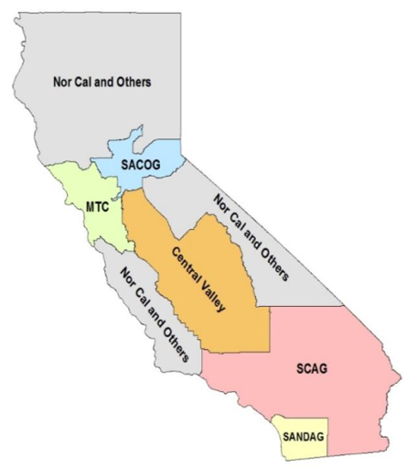
Dataset
2018 CA Panel Survey administered by UCD-ITS-3RFM research team
A mixed sampling method
paper survey, online opinion panel, recontact for longitudinal sample
Weighted sample (N=3,767)
Survey Questions
What type of fuel does your most frequently used vehicle run on?
Would you ever be interested in buying/leasing a vehicle that runs on any of alternative fuels?
https://escholarship.org/uc/item/35x894mg

Slide 5
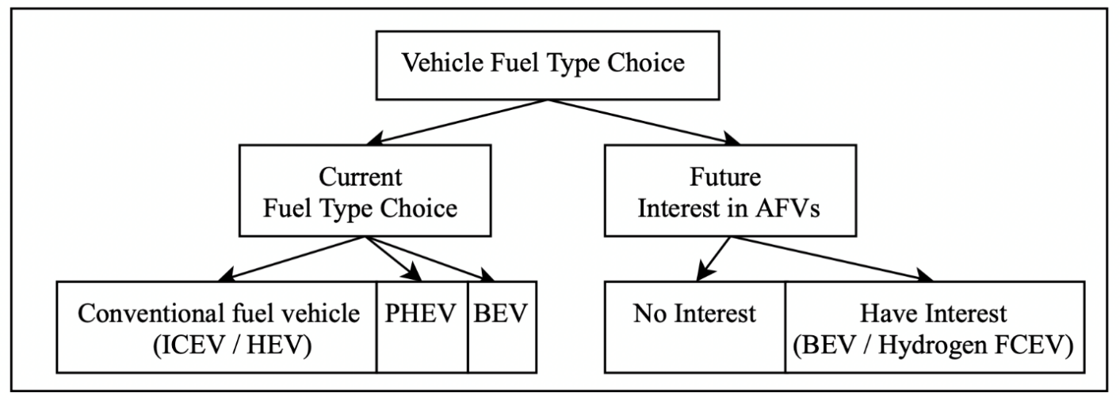
Research framework
Jointly model current choice and interest in the future.

Slide 6
Current choice & interest in the future
2% of respondents chose PHEVs/BEVs as the most frequently used vehicle currently. 40% of respondents indicate interest in buying/leasing AFVs in the future.
Current Vehicle Fuel Type | Weighted Distribution (column-wise 100%) | Interest in purchasing/leasing an AFV in the future (row-wise 100%)
 |  | No interest | Have interest
 |  |  | BEV only | Hydrogen only | BEV & Hydrogen
Conventional fuel vehicles (ICEV + HEV) | 98.1% | 61% | 22% | 3% | 15%
PHEV | 1.2% | 33% | 31% | 0% | 37%
BEV | 0.8% | 7% | 64% | 6% | 23%
% of total sample | -- | 60% | 22% | 3% | 15%
(N=3,251)
Notes:
Even though we have a small sample size of ZEV user in our sample, it is still a slightly over-estimate of the actual share by the end of the year 2018, which is around 1.5%.

Slide 7
Hypotheses
Research Question
What factors impact individuals’ current vehicle fuel type choice and interest in purchasing or leasing AFVs in the future?
Hypotheses:
Socio-demographic characteristics (e.g., age, gender, education, etc.)
Attitudes towards environment, new technology, car use and residential location preferences
Neighborhood effects
Neighborhood type and housing characteristics
Past exposure to EVs in residential location and worksite
Density & Accessibility of EV Supply Equipment (EVSE)

Slide 8
Past exposure to EVs at residential location and worksite
At the residential location
Measured by the stock of PHEVs and BEVs within a 1-mile radius of each block group centroid where respondents resided (based on vehicle registration data from DMV)
At worksite
Measured by the expected number of PHEVs and BEVs a regular commuter from each block group is exposed to at the worksite (based on LEHD Origin-Destination Employment Statistics database)
(Chakraborty, Bunch, Brownstone, Xu, & Tal, 2022)

Slide 9
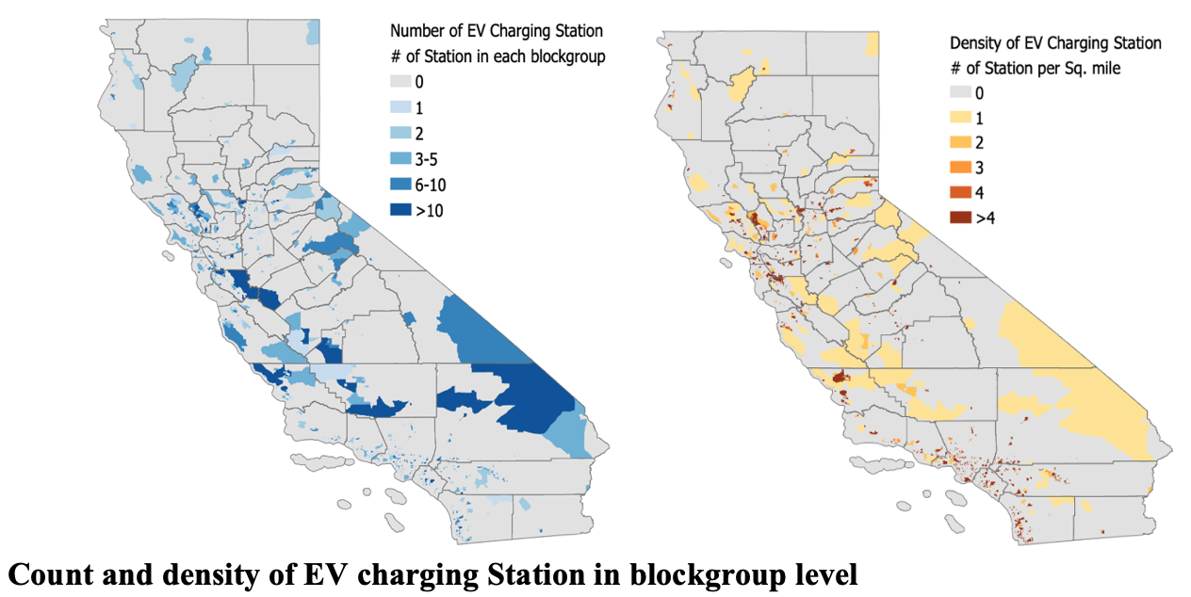
EVSE density & accessibility at residential location
Count and density of EVSE in blockgroup level
Euclidean distance (mile) from home to the nearest EVSE

Slide 10
Modeling Framework with ICLV Models
Integrated choice and latent variable (ICLV) model for current vehicle fuel type choice and interest in purchasing or leasing AFVs in the future.
Measurement equation:
$i_{n}=Dx_{n}^{∗}+η_{n}$ , $η_{n}\sim N(0,Ψ)$ (1)
Structural equation:
$x_{n}^{∗}=As_{n}+v_{n}$ ,$v_{n}\sim N(0,Φ)$ (2)
Utility specification:
$u_{mnj}=B_{mx}x_{nj}+B_{ms}s_{nj}+Γ_{m}x_{n}^{∗}+ϵ_{mnj}$ , $ϵ_{nj}\sim i.i.d. Gumbel$ (3)
Choice equation:
$y_{mnj}=\left\{\begin{aligned}1, if u_{mnj}≥u_{mnj^{′}}, ∀j^{′} \\ 0, otherwise\end{aligned}\right.$ (4)

Slide 11
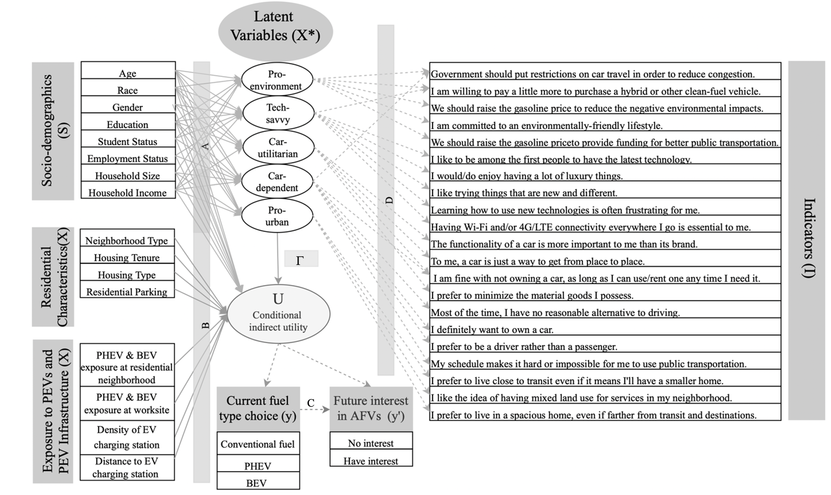
Integrated choice and latent variable (ICLV) model
Eq. (2)
Eq. (1)
Eq. (3)
Eq. (4)

Slide 12
What are the underlying latent attitudes?
Individuals’ attitude towards all types of governmental environmental regulations as well as personal environmentally friendly lifestyle.
Individuals' familiarity/proficiency with new technologies and their curiosity/openness to new experience.
Individuals' value on the pragmatic aspects of a vehicle, such as taking more seriously on its functionality instead of its brand.
Individuals' dependence on and attachment to their vehicle on daily life.
Individuals' preference on living in areas with more mixed land use, better neighborhood services and public transportation.

Slide 13
Who are more likely to have certain attitudes?
Individuals who are younger, with higher education, higher income, under student status and with small household size.
Individuals who are younger, with higher education, higher income, employed and with larger household size.
Individuals who are older, not male, with higher education, with lower income
Individuals who are older, not student, with lower education, with higher income and with large household size.
Individuals who are students, employees, individual with higher education, with lower income, with smaller household size.
Notes:
Impacts of the COVID-19 on lifestyles
Current travel patterns
Vehicle ownership
Personal attitudes and preferences

Slide 14
How factors impact current choice and interest in the future?
Variables | Current Fuel Type Choice |  |  | Future Interest in AFV
 | (base: Conventional fuel, n=3172) |  |  | (base: no interest, n=1765 )
Variables | PHEV (n=47) | BEV (n=41) |  | Has interest (n=1495)
Latent Factors
Pro-environment | +++ | +++ |  | +++
Tech-savvy | + | +++ |  | +++
Car-utilitarian |  |  |  | +
Pro-suburban |  | +
Direction of association:
+ : positive
- : negative
Level of significance
(p-value):
: > 0.05
+ : 0.01-0.05
++ : 0.001- 0.01
+++ : < 0.001
Notes:
The results suggest that individuals who are more pro-environment and tech-savvy are more likely to be currently using a PHEV or BEV, and that these attitudes will continue to play a role in developing an interest in purchasing an AFV in the future.
In particular, those exhibiting an attitude of car-utilitarianism had a higher likelihood of expressing an intent to purchase. This attitude is characterized by viewing cars primarily in terms of their practicality for delivering mobility, where functionality is more important than brand. This suggests that AFVs in California may have reached a stage where they are no longer viewed as “exotic” or “risky” technologies, but realistic, practical, and perhaps an inevitable part of California’s future.
Those who are more pro-suburban are more likely to have BEV currently.

Slide 15
How factors impact current choice and interest in the future?
Variables | Current Fuel Type Choice |  |  | Future Interest in AFV
 | (base: Conventional fuel, n=3172) |  |  | (base: no interest, n=1765 )
Variables | PHEV (n=47) | BEV (n=41) |  | Has interest (n=1495)
Socio-demographics
Middle-age (vs. younger-age) |  | +
White (vs. non-White) |  |  |  | +
Male (vs. female) |  |  |  | +++
Student (vs. non-student) |  |  |  | -
Bachelor (vs. below bachelor) |  | + |  | +++
Household size | +
Median-income (vs. low) |  |  |  | ++
High-income (vs. low-income) |  |  |  | ++
Direction of association:
+ : positive
- : negative
Level of significance
(p-value):
: > 0.05
+ : 0.01-0.05
++ : 0.001- 0.01
+++ : < 0.001

Slide 16
How factors impact current choice and interest in the future?
Variables | Current Fuel Type Choice |  |  | Future Interest in AFV
 | (base: Conventional fuel, n=3172) |  |  | (base: no interest, n=1765 )
Variables | PHEV (n=47) | BEV (n=41) |  | Has interest (n=1495)
Residential Characteristics
Stand-alone house (vs. apt.) | +
Private parking (vs. public) | +++
Exposure to BEVs
At neighborhood |  | +
At worksite |  | ++
Direction of association:
+ : positive
- : negative
Level of significance
(p-value):
: > 0.05
+ : 0.01-0.05
++ : 0.001- 0.01
+++ : < 0.001

Slide 17
How factors impact current choice and interest in the future?
Variables | Current Fuel Type Choice |  |  | Future Interest in AFV
 | (base: Conventional fuel, n=3172) |  |  | (base: no interest, n=1765 )
Variables | PHEV (n=47) | BEV (n=41) |  | Has interest (n=1495)
User experience
Current BEV user |  |  |  | ++
Current PHEV users |  |  |  | ++
Direction of association:
+ : positive
- : negative
Level of significance
(p-value):
: > 0.05
+ : 0.01-0.05
++ : 0.001- 0.01
+++ : < 0.001

Slide 18
Conclusions & policy implications
Individuals who are more pro-environment and tech-savvy are more likely to be currently using a PHEV or BEV, and these attitudes will continue to play a role in developing an interest in purchasing an AFV in the future.
AFVs are perceived as high-priced alternatives. Finding ways to lower the (perceived) purchase price of AFVs continues to be important.
There is need for dedicated, private space for home charger installation, or increased access to public chargers as a complement.
Exposure to BEVs at both residential and worksite locations increases the chances of a respondent being a current BEV user.
Increase awareness and user experience (e.g., test driving) promotes interests.
We project that 41.4% of the population (adults) may show interest in AFVs in the future, which can be viewed as a proxy for estimated maximum market penetration, with current high-income PEV users leading the way.

Slide 19
ICEV
Any questions? Please contact:
Xiatian Iogansen
Institute of Transportation Studies, University of California, Davis
xtwu@ucdavis.edu

