Slide 1
Sustainability & Emerging Transportation Technology conference (SETT-TRB)
Preparing the On-Demand Shared Autonomous Vehicle User Experience

Slide 2
Smart Mobility solutions since 2001

Slide 3
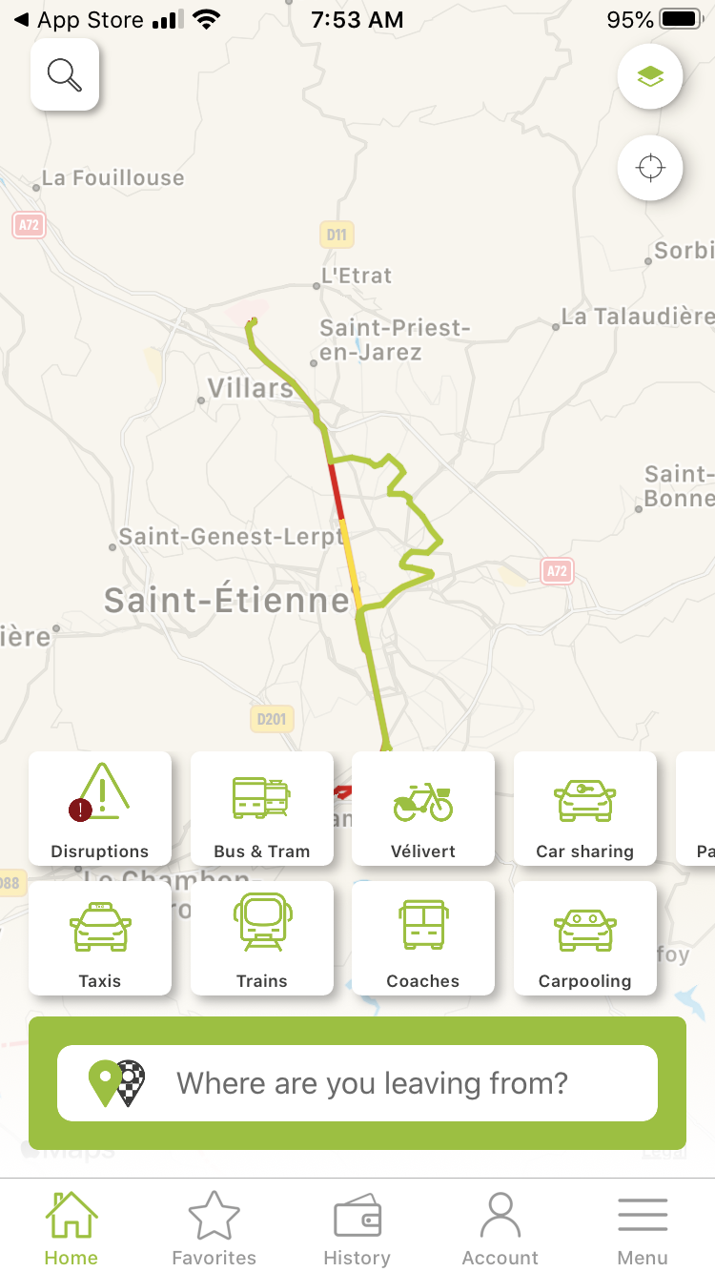
Smart Mobility Solutions since 2001
Mobility Data Integrator
Expertise in Industry Data Standards White labeled, open & scalable solutions
250 Tech & Mobility Experts
Europe, North America, Australia
Innovation division of
Leveraging Mobility Data
Help our clients build their Mobility Strategy Provide the best Traveler Experience
B2G – Transit Agencies & Governments
Over 150 collaborative projects
Rooted in transit

Slide 4
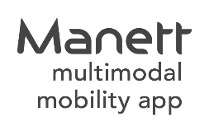
Proven Transit Tech & solutions
Data Management
Advanced Traveler Information Systems
Proven Microtransit Technology Platform

Slide 5
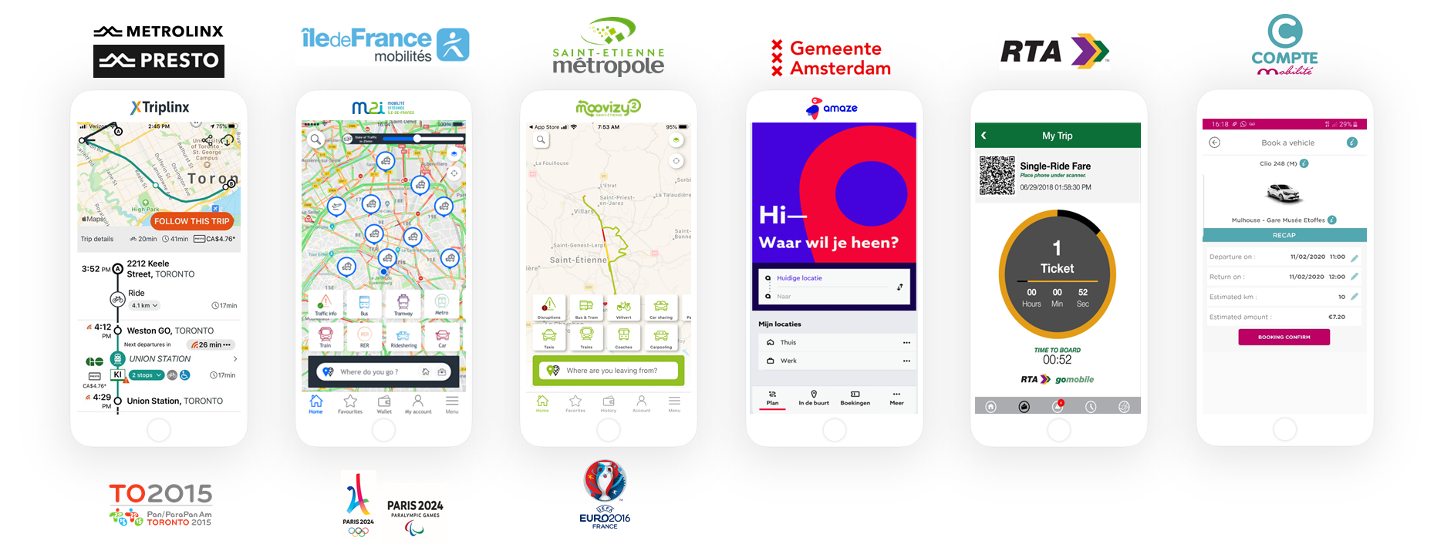
Intermodal Information Systems
Most innovative Integrated Mobility Platforms
New Orleans, LA

Slide 6
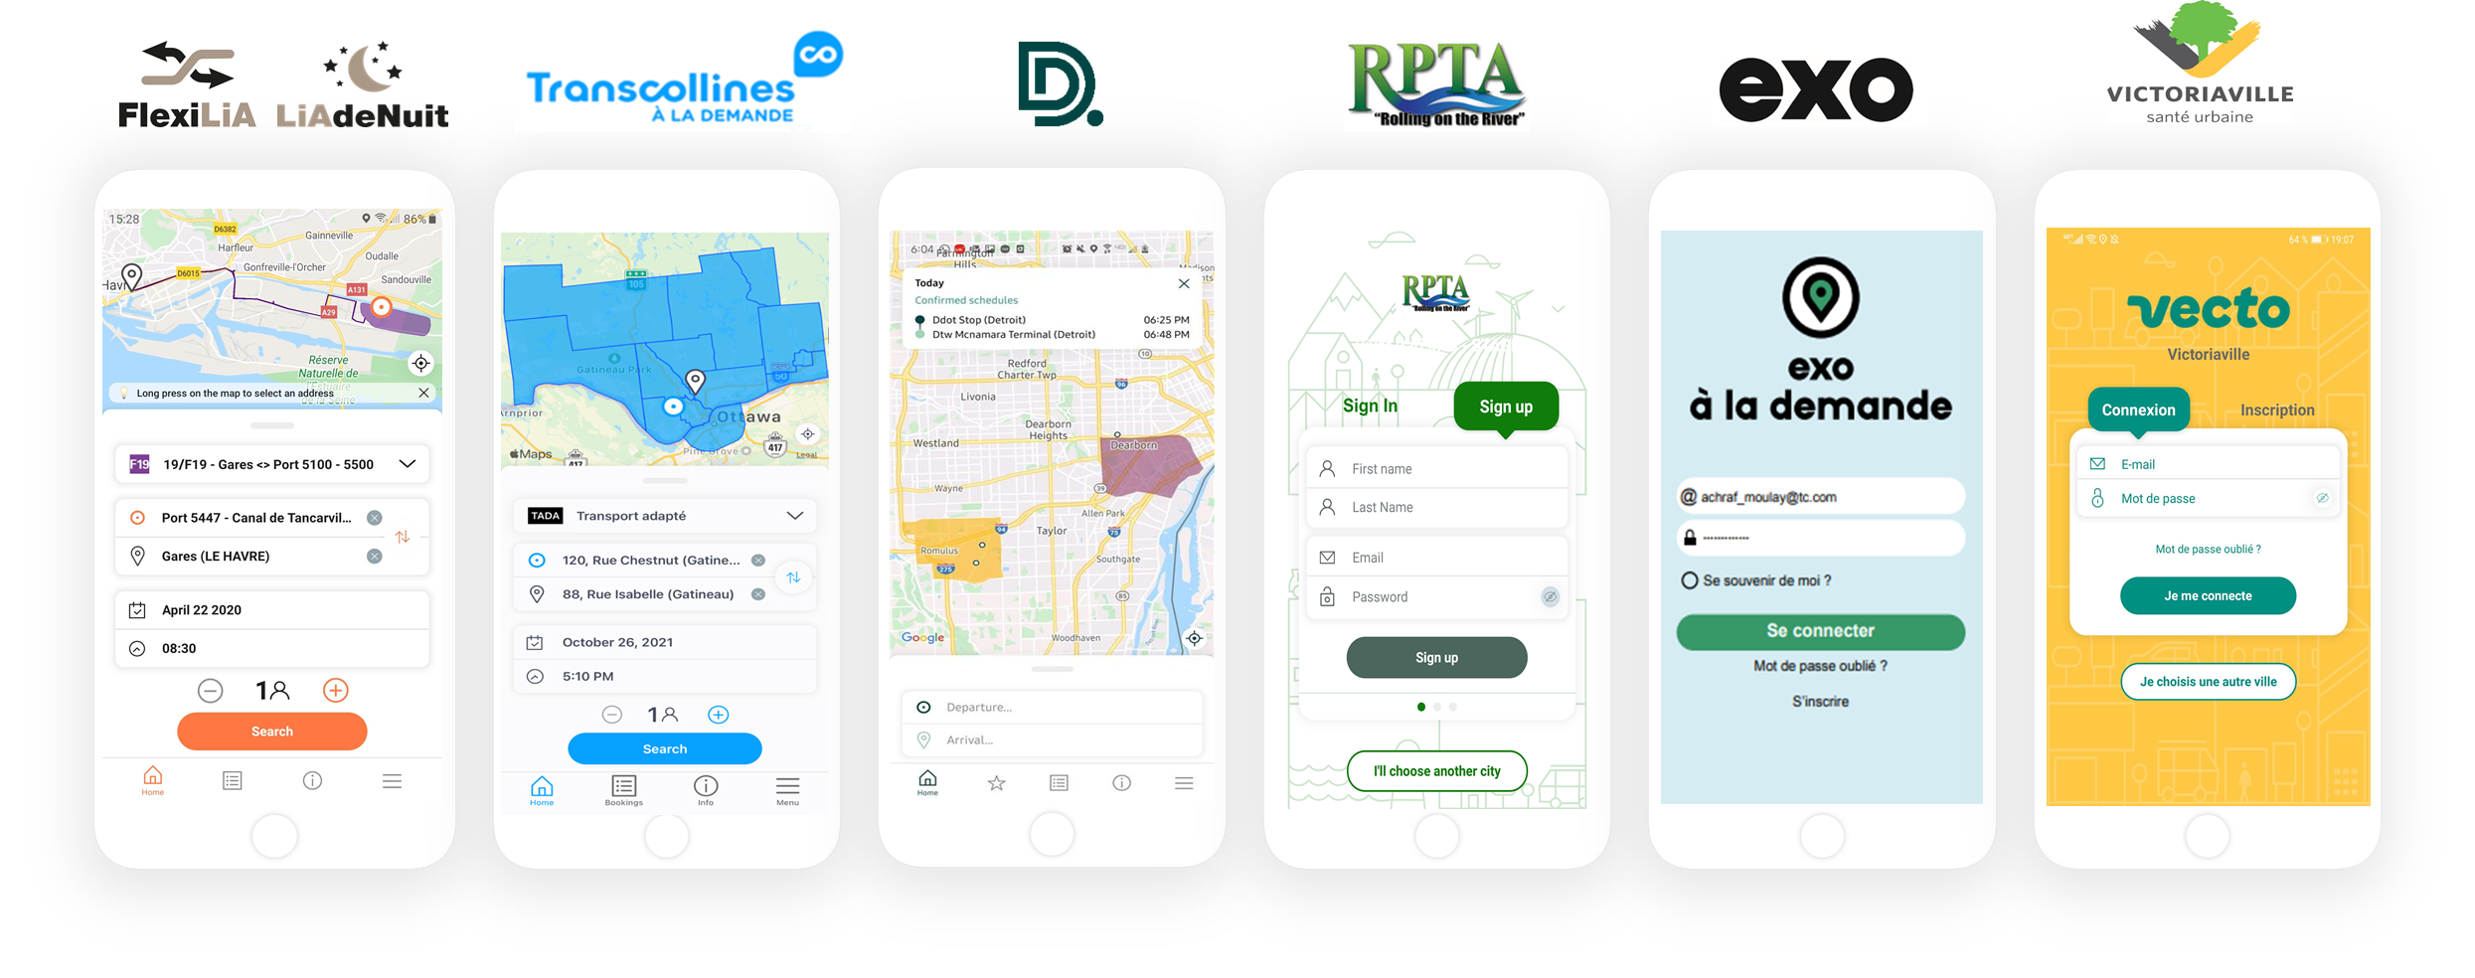
Microtransit Technology Platform
120 deployments – 1.3 m trips/y – 600 on-demand Zones/Routes
100 projects in France
TranscollinesQC, Canada
Detroit, MI USA
River Parish, LA USA
Greater Montreal, QC Canada
Victoriaville, QC Canada

Slide 7
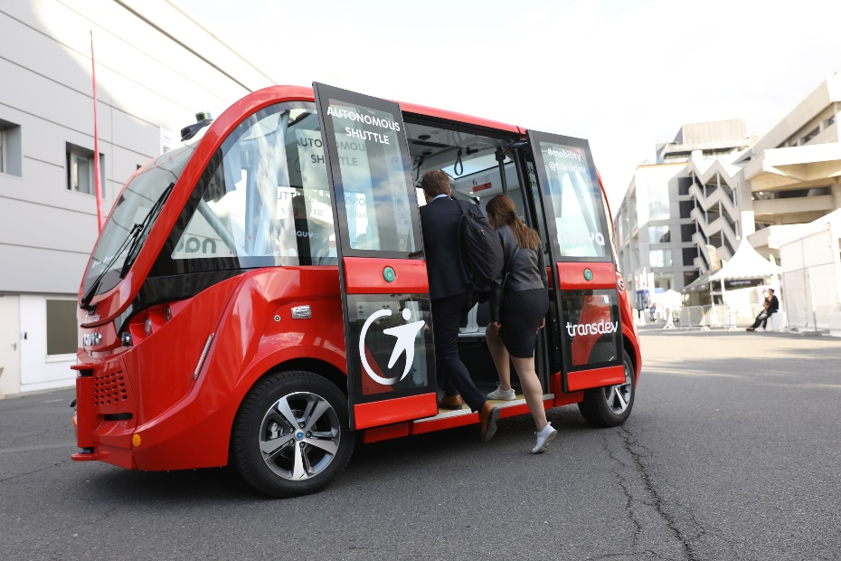
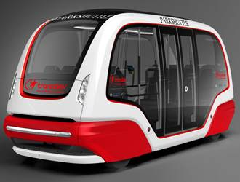
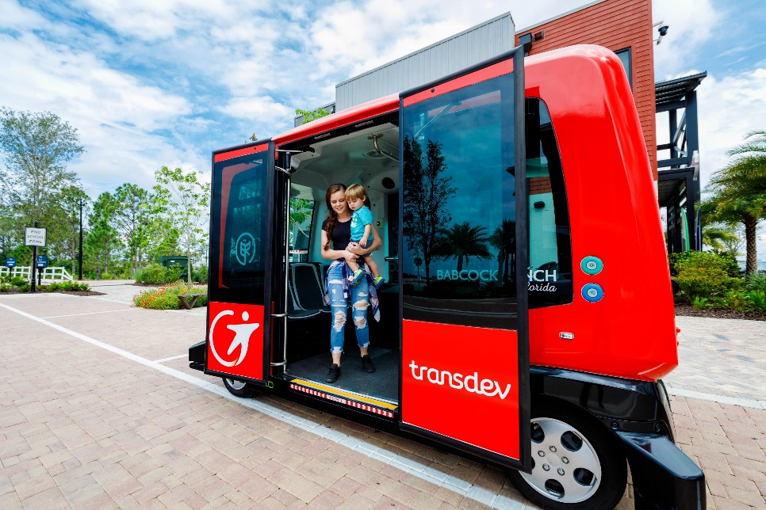
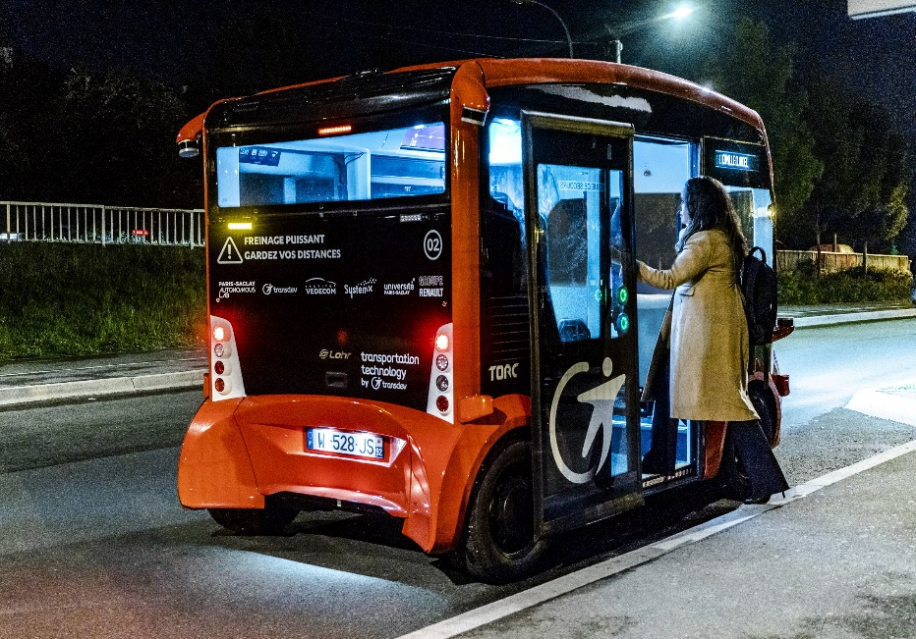
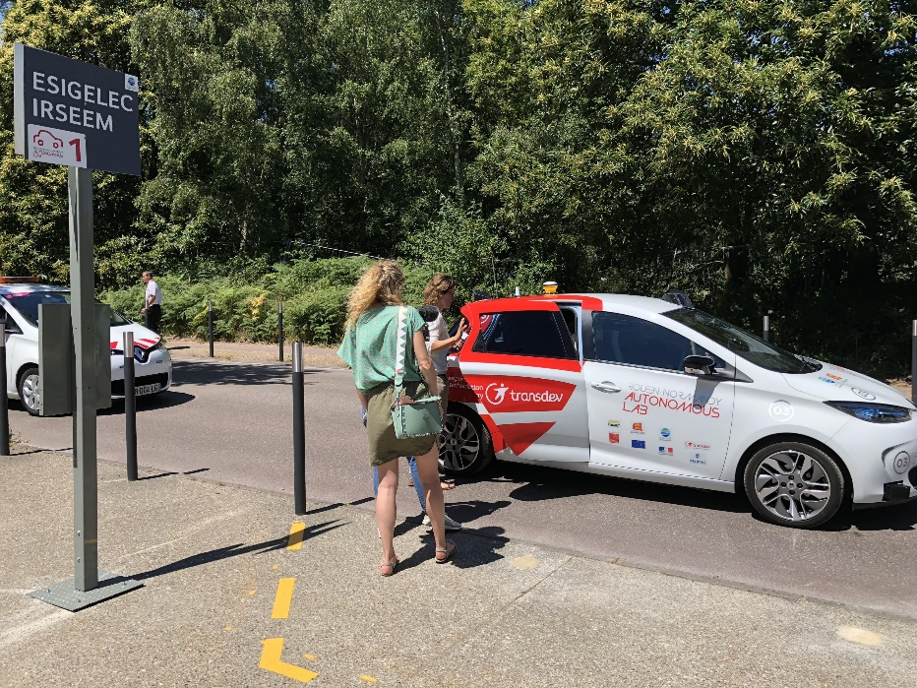
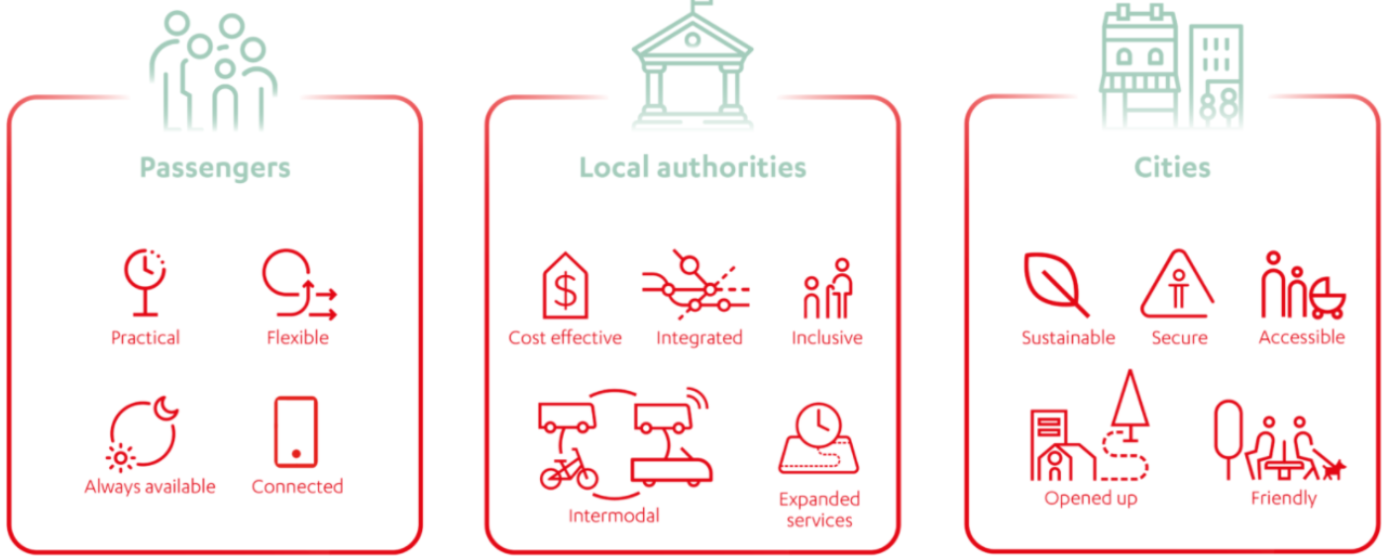
AVs Deployments

Slide 8
Shared AV vision since 2016

Slide 9
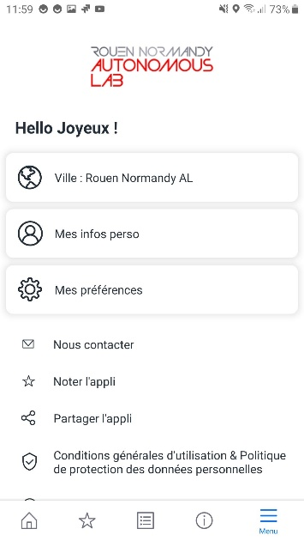
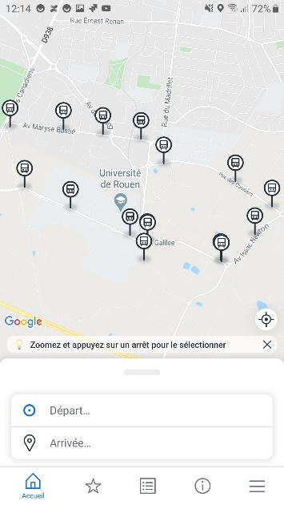
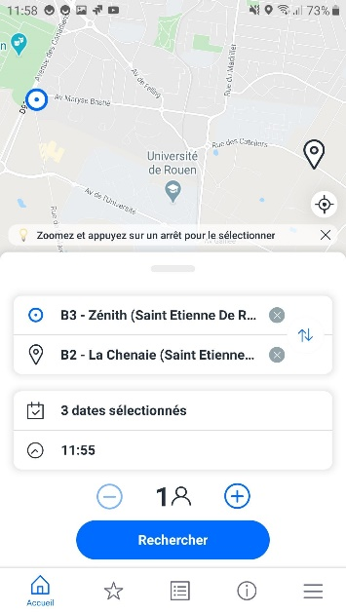
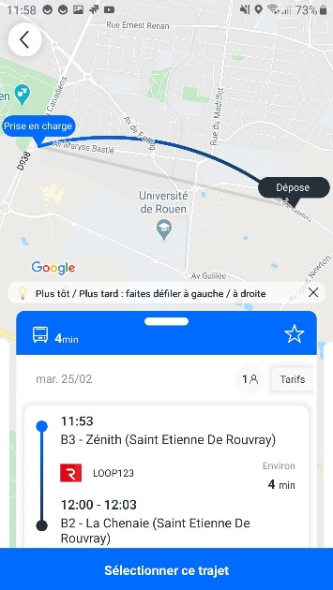
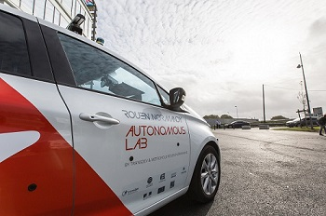
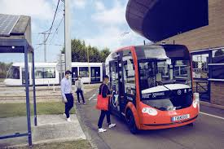
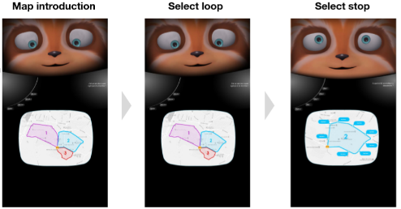
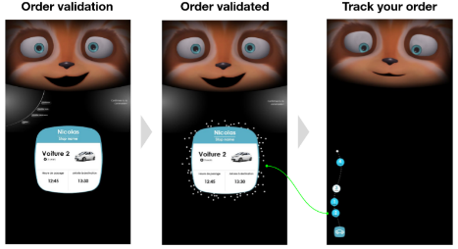
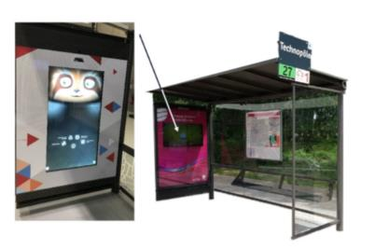
Shared AV vision since 2016
Microtransit App deployment
SAV booking application
SAV route visualization
Departure/Arrival stop selection
Real-time notifications before/during trip
Recurring bookings (commute trips)
API integration
Integration with SPOON, Smart Shelter intelligence provider for JC Decaux
Accessibility

Slide 10
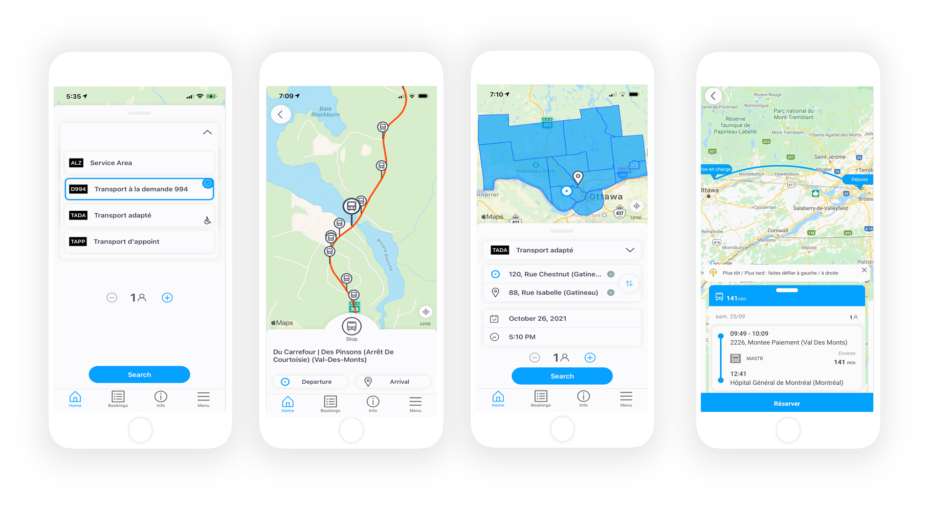
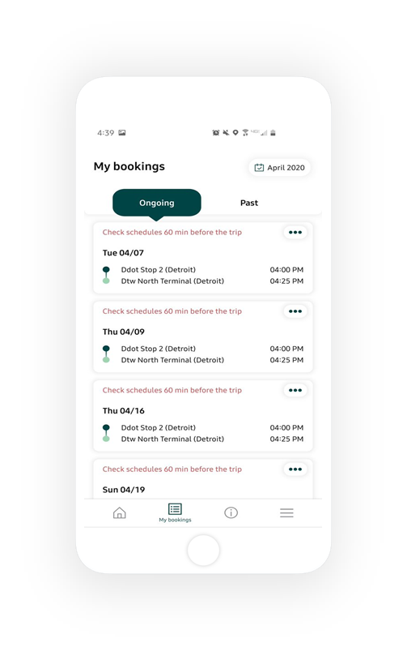
Shared AV vision since 2016
Commingled trips, regular/paratransit Mixed fleets
Mixing on-demand models, applying specific rules
Step by step real-time information & notifications
Real-time & recurring trips

Slide 11
Shared AV vision since 2016
From Microtransit to Shared On-Demand Autonomous Vehicles
Natural evolution of AV services
Ability to dispatch/route a vehicle On-Demand
Providing riders with a ride hailing App
Serving all populations: accessibility, equitability
Shared On-demand AVs & operational efficiency
With a driver it is Microtransit, without it is Shared On-Demand AV
Progressively target optimized and dynamically generated routes
Shared rides for vehicle/seats optimization
Increased service quality (more direct trips, less wait time)
Integrate SAVs in the Mobility Ecosystem as a real Transit On-Demand Mode
Microtransit Technology
+
AV Technology
+
MaaS Technology

Slide 12
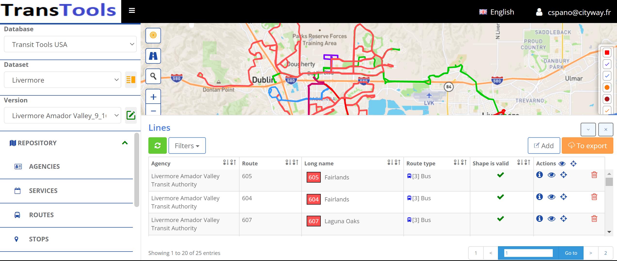
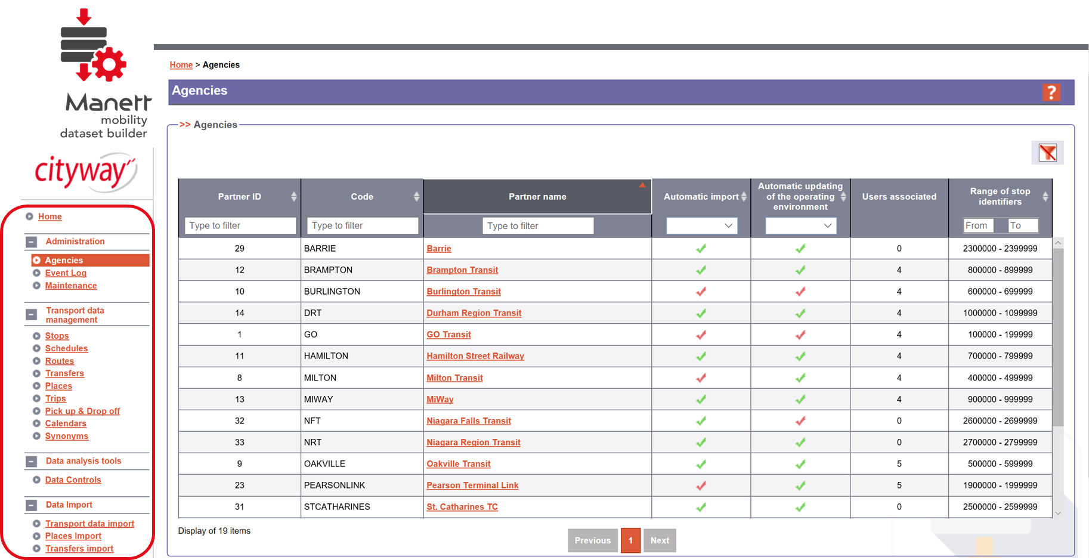
SAVs and the Mobility Ecosystem
Shared OD AVs integration as a real Transit Mode fully integrated
GTFS / GTFS-RT
Elevator Mode = Fixed Route / FR On-Demand
Transfers at drop-off (scheduled/Real-Time)
Accessibility of the Mobility Assets
GTFS-Flex / GTFS On-Demand
Visualization of the service area
Service Area/Business Rules/ Booking Service
Integration/Visualization in advanced Trip Plans
Advanced features
Non compete feature
Step by step navigation to the stop + voice over
Real-time vehicle status (load, fraud, seats, commingle trips)

Slide 13
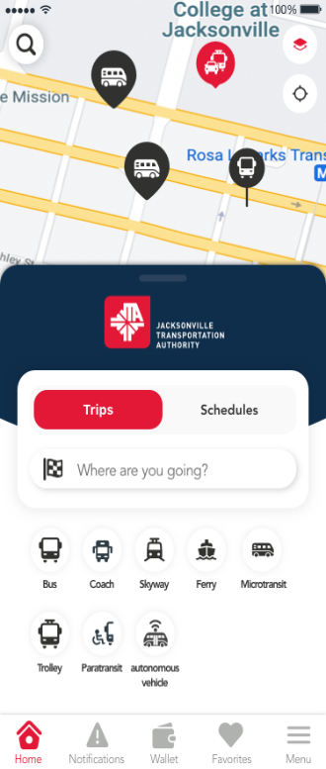
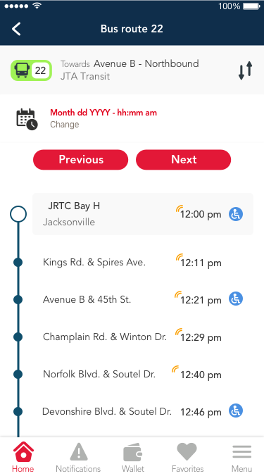
SAVs and the Mobility Ecosystem
Full integration of SAVs in the Transit Ecosystem

Slide 14
R&D
Working on full integration between systems
AV Technology
Microtransit Technology
+
=
Progressively remove the on-board operator
Bi-directional Real-Time communication to improve booking and safety processes’ autonomy

Slide 15
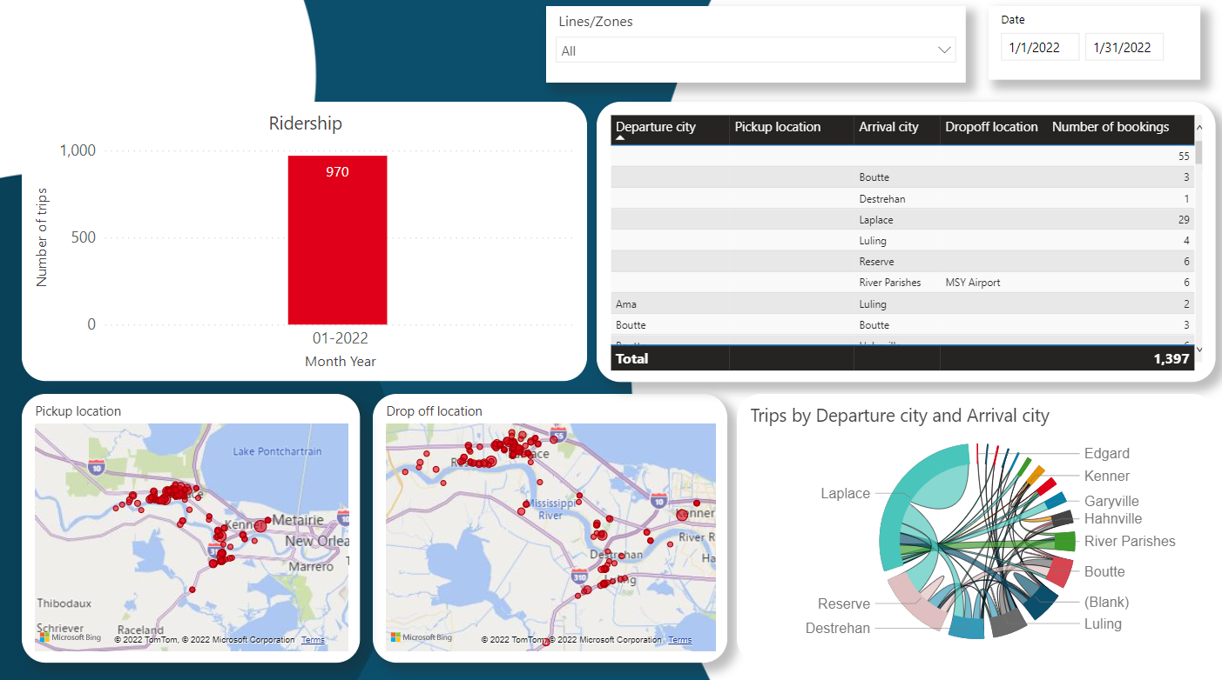
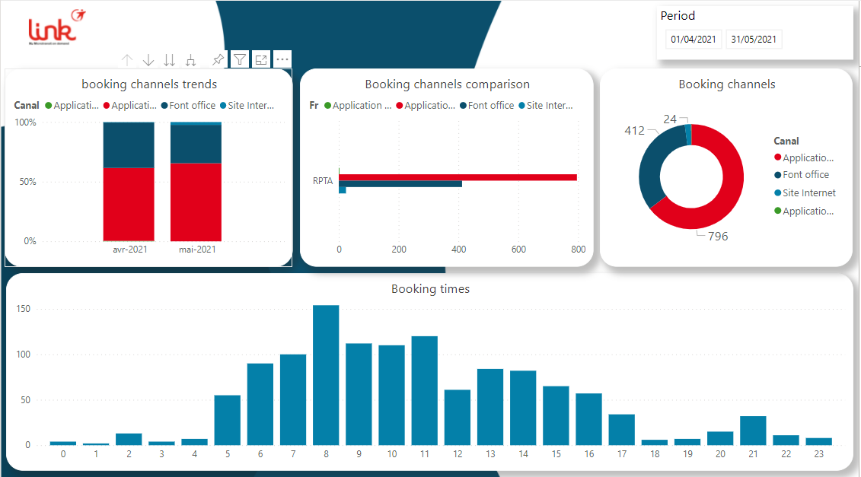
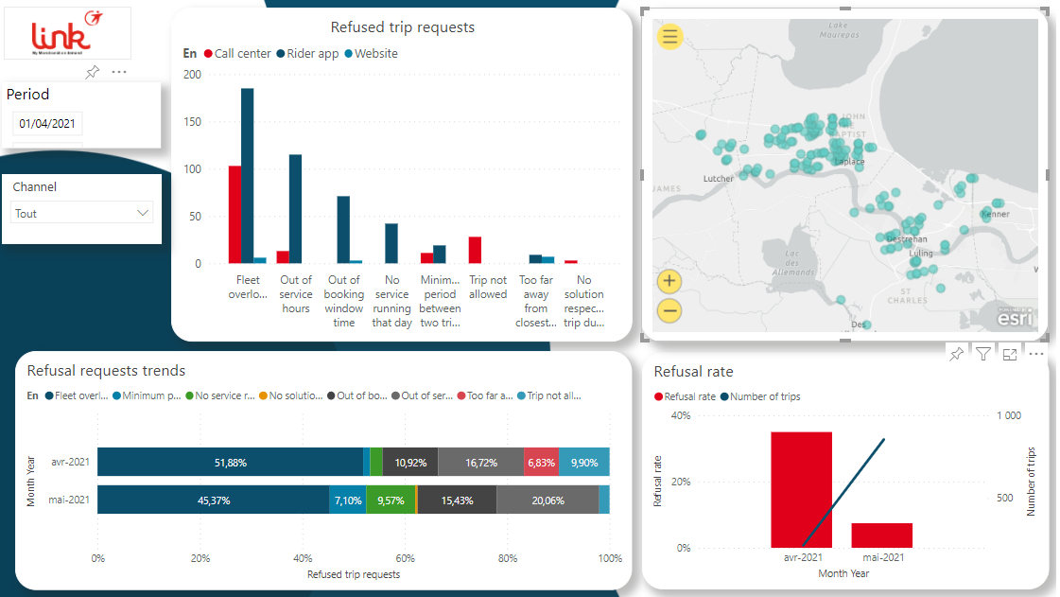
KPIs monitoring & reporting dashboard
Monitor, Analyze and adapt performance
KPIs monitoring on all aspect of the service
60+ reports
NTD ready exports
Operational efficiency
Close to real-time performance tracking
On Time Performance, Grouping Rate…

Slide 16
Thank you!
Chloe SPANO VP Business Development & Innovation T: 630 601 0665 @: cspano@cityway.io

