Slide 1
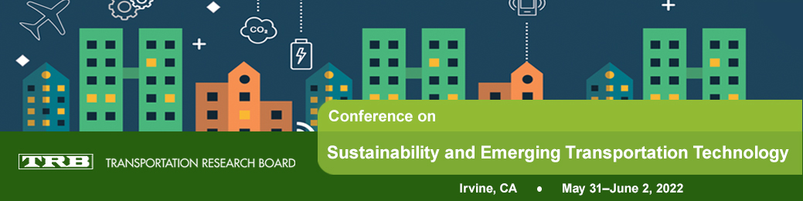
Increasing Vehicle Occupancy through Shared-Ride Mobility Services
Michael Hyland
Asst. Professor
University of California, Irvine
Civil & Environmental Engineering
Institute of Transportation Studies -- Irvine
TRB Conference on Sustainability and Emerging Transportation Technology
June 1, 2022

Slide 2
Agenda
Introduction
          Preliminary Information
          Conceptual Framework
          Motivation
          Study 1: Assessing the demand for demand-adaptive transit
Study 2: Operational benefits and challenges of shared-rides in (automated) mobility-on-demand services
Study 3: Smarter fleet vehicle paths to improve shared-ride services

Slide 3
Preliminaries
Mobility-on-demand (MOD) services without shared rides
  E.g. UberX, Conventional Lyft, Taxis
  Automated MOD → AMOD
Shared-ride MOD services
  E.g. Uber Pool, Lyft Line, Via, Chariot, Bridj
  Microtransit, Demand-responsive transit, Dial-a-ride Problem
Network Paths vs. Vehicle Routes
  Network Paths: the sequence of nodes/links a vehicle traverses in a road network
  Routes: the ordered sequence of user pick and drop locations for a vehicle

Slide 4
Motivation
So many great benefits of shared-ride MOD services!
  Individuals: Reduced travel costs
    Splitting operational – fuel and labor (~$0 for AVs) – costs
    Capture capital/depreciation cost reduction from…
  Mobility Service Providers (MSPs): Reduced ‘fleet’ size and operational costs
  Society: Reduce vehicle miles travelled (VMT), traffic congestion, fuel consumption, harmful emissions
Yet…

Slide 5
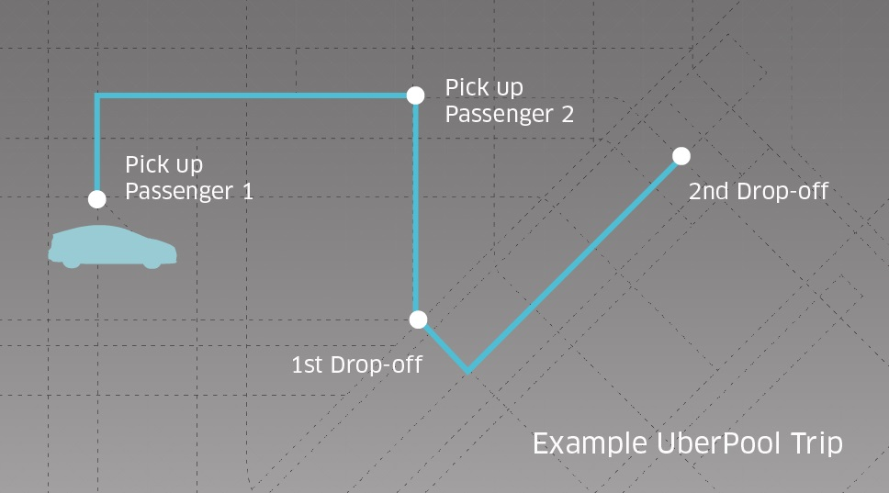
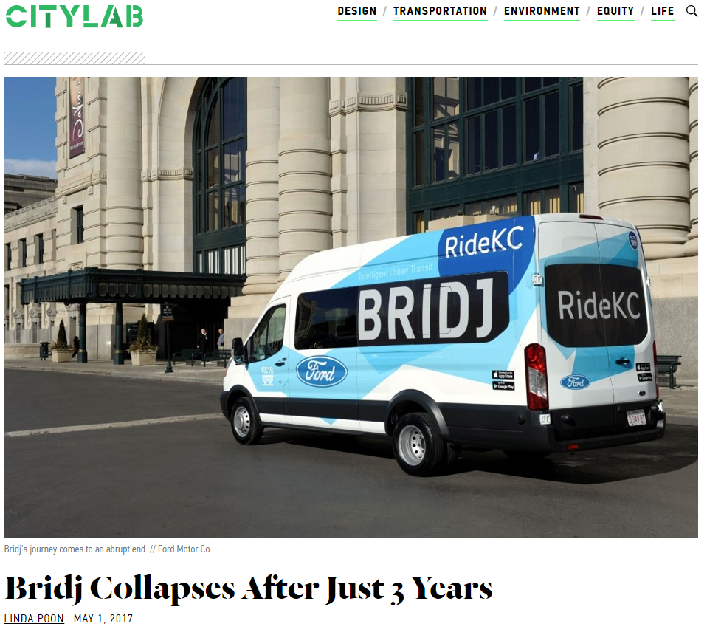
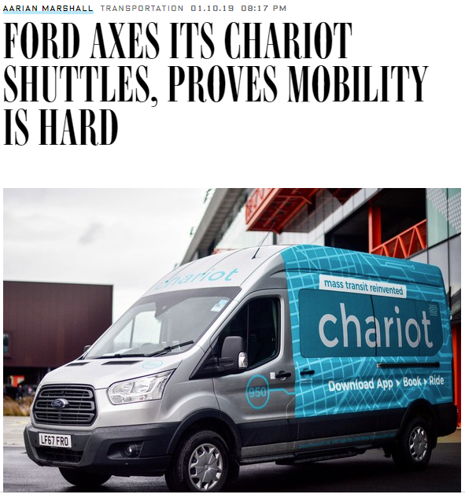
Motivation
But what about Uber Pool and Lyft Line?
Not a majority of TNC trips

Slide 6

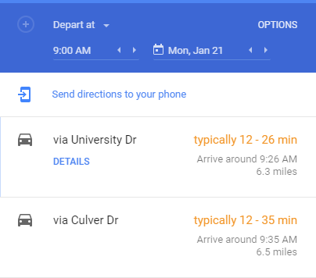
Motivation
Challenges/Problems
Travelers have an aversion to sharing rides
  A global pandemic did not improve the situation
Operating shared-ride vehicle fleets is challenging
  Trade-offs between sharing opportunities, detours, and price
  Uncertainties/Stochasticity everywhere
    New traveler requests
    Link travel times
    Pickup times (and to a lesser extent) drop-off times
What policy interventions would be helpful?

Slide 7
Conceptual Framework
Study 2b: Understanding the Impact of Stochastic Curbside Wait Times
Curbside Wait Time
Study 1: Behavioral model of demand for shared-ride services
Fleet Cost
-
Study 3: Improving Operational Efficiency to Reduce Fleet (and/or User) Costs
-
Service Quality
-
+
+
Demand for
Shared Rides
Operational Efficiency of Fleet
+
Fully-Automated Vehicles
+
Study 2a: Impact of More Sharing Opportunities / Demand on Operational Efficiency of Fleet
Shared-ride Opportunities
+

Slide 8
Acknowledgements
Study 1: Demand for demand-adaptive transit
  PhD Cohort Colleague, Dr. Charlotte Frei, dissertation
Study 2: Operational benefits and challenges of shared-ride mobility services
  My dissertation, with advisor Dr. Hani Mahmassani
  U.S. DOT Eisenhower Fellowship
Study 3: Smarter pathfinding for shared-ride fleet vehicles
  UCI PhD students Dr. Dingtong Yang and Navjyoth Sarma
  Caltrans, via USC/METRANS, via US DOT Pacific Southwest University Transportation Center
Ongoing Study: Corner-to-corner mobility-on-demand with walking legs
  UCI PhD students Navjyoth Sarma, Zifan Wang, Younghun Bahk
  Argonne National Laboratory: Krishna “Murthy” Gurumurthy, Felipe de Souza
New Study: Is Microtransit a Scalable Complement to Traditional Public Transit?
  UC Davis Colleagues: Dr. Susie Pike and Dr. Yan Xing
  The California Resilient and Innovative Mobility Initiative

Slide 9
Big Picture Research Questions
Will people ride shared-ride transit?
Do shared-ride services have operational benefits?
Can being anticipatory about assigning vehicles to network paths, improve efficiency?

Slide 10
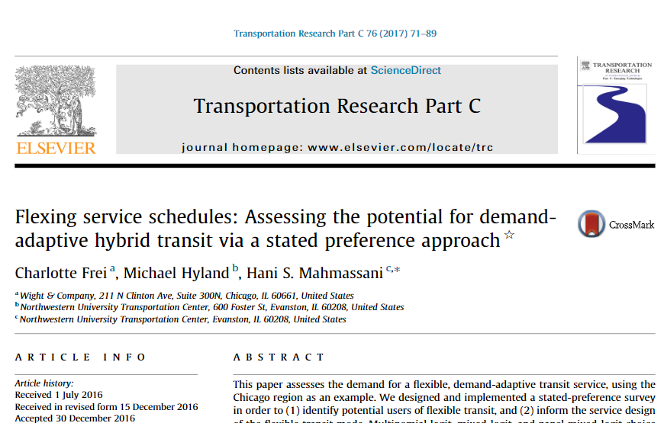
Study 1:

Slide 11
Survey Basics
Convenience Sampling of Chicago Commuters
  Chicago MPO newsletter
  Personal and Northwestern University Transportation Center Facebook & Twitter accounts
D-efficient Survey Design
  Segment commuters by commute distance
  Gathered information from actual commutes, using Google Maps API
    Pivoted from existing commute trips

Slide 12
Basic Survey Statistics
Variable/Factor | September 2014 Wave | February 2015 Wave | Pooled
Average monthly temperature (low – high) | 55 F – 75 F | 10 F – 25 F | -
Total Precipitation | 3 in | 26.4 in
Complete Responses | 119 | 62 | 181
Repeated Responses | - | 12 | 12
Choice Experiments Completed | 1294 | 716 | 1997

Slide 13
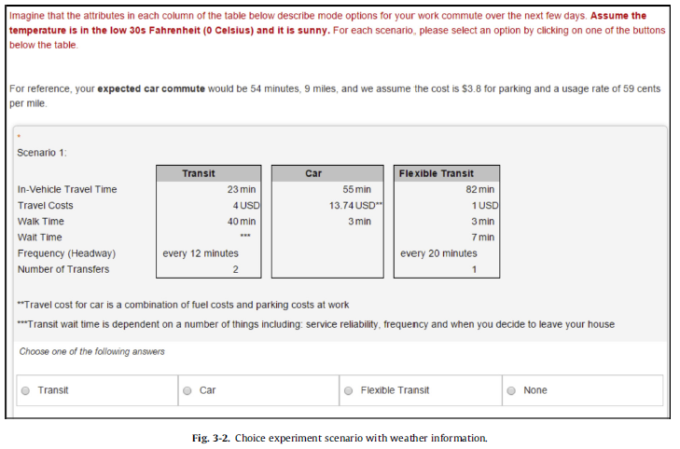
Example Choice Experiment

Slide 14
Google Maps API

Slide 15
Key Findings: Service Design
Mode | Value of Time ($/hr)
In-vehicle travel time
Car | 16.3
Flexible Transit | 21.1
Transit | 18.3
Walking Time
Car | Not significant
Flexible Transit | Not significant
Transit | 25.9
Wait Time
Flexible Transit | ***11.3***
Effective Cost Increase | Effective Cost Increase
Base: 5 min Headway
12-15 min | $0.9
20-25 min | $2.5
30 min | $3.9
60 min | $5.6
Base: 0 Transfers
1 Transfer | $0.9
2 Transfers | $2.0

Slide 16
Key Findings: Elasticity of Demand

Slide 17
Key Findings: Potential Users of Flexible Transit
Baby Boomers, followed by Millennials → most likely to use Flex Transit
Modal Inertia is Very Strong
  Current car commuters stick with car
  Current walk and bike commuters most likely to use/try Flex Transit
Respondents who bring ‘luggage’ to work, much prefer a private vehicle
Carsharing and ride-sharing users likely to use/try Flex Transit

Slide 18
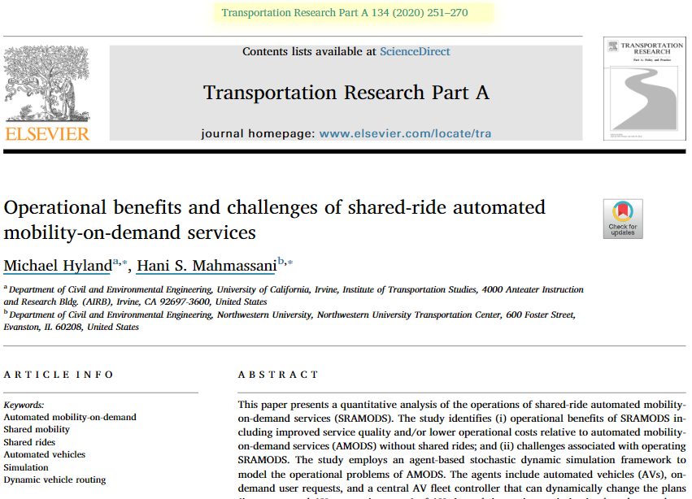
Study 2:

Slide 19
Research Questions
What are the operational efficiency benefits of shared-ride AMOD service (SRAMODS)
  over AMOD service without shared rides,
  from the perspective of the fleet operator/manager,
  As a function of the maximum traveler detour distance/time?
What are the operational challenges of SRAMODS associated with
  Stochastic AV curbside pickup times,
  In addition to stochastic demand request (time and locations)?

Slide 20
Concept of Operations
Basically UberPool, Lyft Line without scheduled rides and with automated vehicles
  Maximum two requests inside vehicle
  Fleet operator has central control over all vehicles
  Fixed fleet size

Slide 21
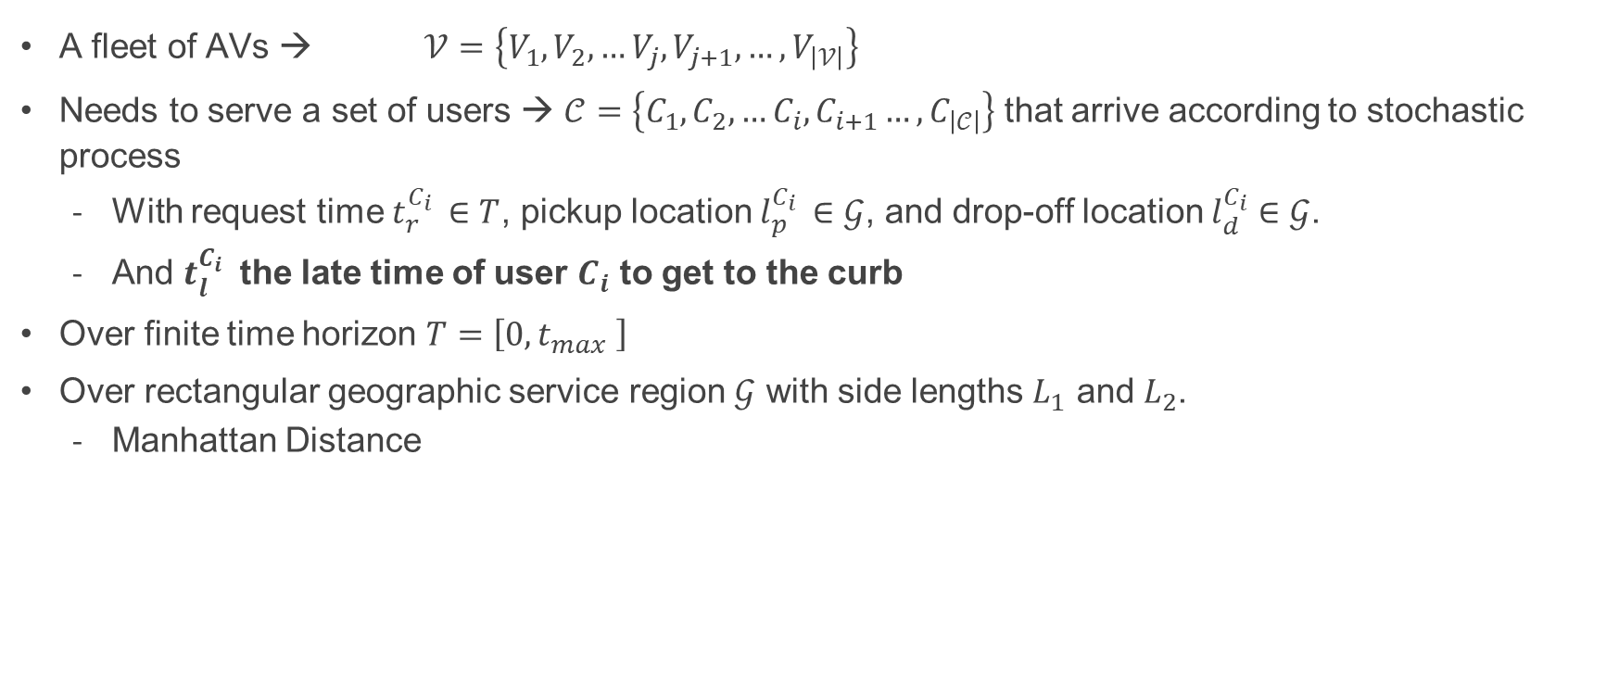
Problem Statement
A fleet of AVs → $𝒱=\left\{V_{1},V_{2},…V_{j},V_{j+1},…,V_{\left|𝒱\right|}\right\}$
Needs to serve a set of users → $𝒞=\left\{C_{1},C_{2},…C_{i},C_{i+1}…,C_{\left|𝒞\right|}\right\}$ that arrive according to stochastic process
  With request time $t_{r}^{C_{i} }∈T$, pickup location $l_{p}^{C_{i} }∈𝒢$, and drop-off location $l_{d}^{C_{i}}∈𝒢$.
  And $t_{l}^{C_{i} }$ the late time of user $C_{i}$ to get to the curb
Over finite time horizon $T=\left[0,t_{max} \right]$
Over rectangular geographic service region $𝒢$ with side lengths $L_{1}$ and $L_{2}$.
  Manhattan Distance

Slide 22
Problem Statement Continued
Objective is to minimize combination of user wait time, user in-vehicle travel time, and fleet distance
Decision/Control Variables include
  Assignment of AVs to user requests
  Routing of Vehicles (i.e., Sequencing pickups and drop-offs)
Constraints
  Maximum Vehicle Capacity is 2 user requests
  Maximum user detour distance

Slide 23
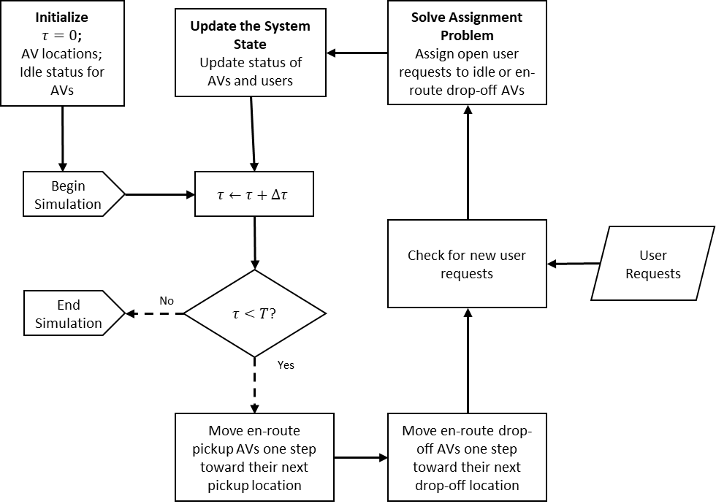
Simulation
Agent-based Simulation
  Travelers
  AVs
  Fleet Operator
Sequential Decision Problem
  Optimization-based control policy

Slide 24
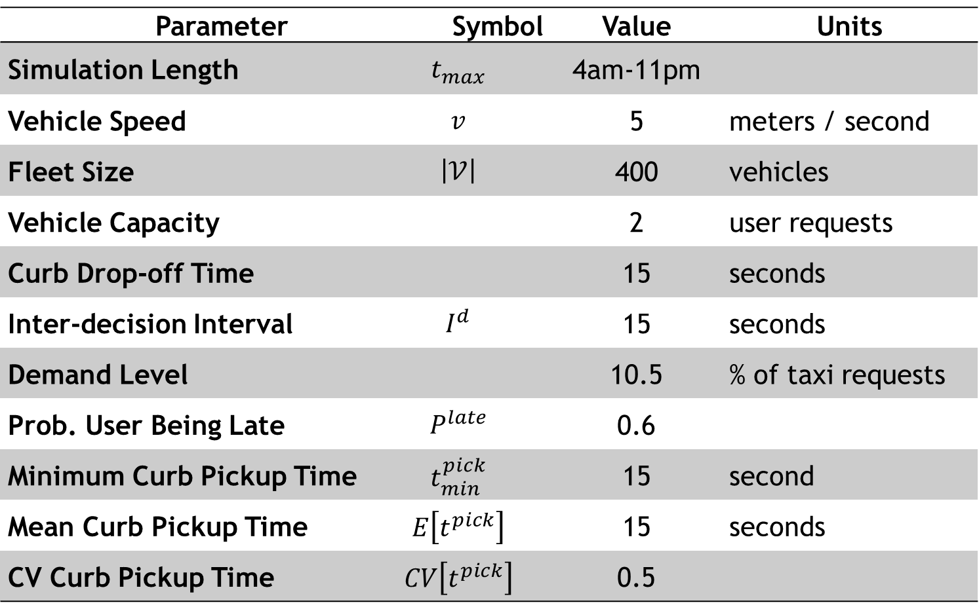
Study 2: Input Parameters
Parameter |  | Symbol | Value | Units
Simulation Length | $$t_{max}$$ |  | 4am-11pm
Vehicle Speed | $$v$$ |  | 5 | meters / second
Fleet Size | $$\left|𝒱\right|$$ |  | 400 | vehicles
Vehicle Capacity |  |  | 2 | user requests
Curb Drop-off Time |  |  | 15 | seconds
Inter-decision Interval | $$I^{d}$$ |  | 15 | seconds
Demand Level |  |  | 10.5 | % of taxi requests
Prob. User Being Late | $$P^{late}$$ |  | 0.6
Minimum Curb Pickup Time | $$t_{min}^{pick}$$ |  | 15 | second
Mean Curb Pickup Time | $$E\left[t^{pick}\right]$$ |  | 15 | seconds
CV Curb Pickup Time | $$CV\left[t^{pick}\right]$$ |  | 0.5

Slide 25
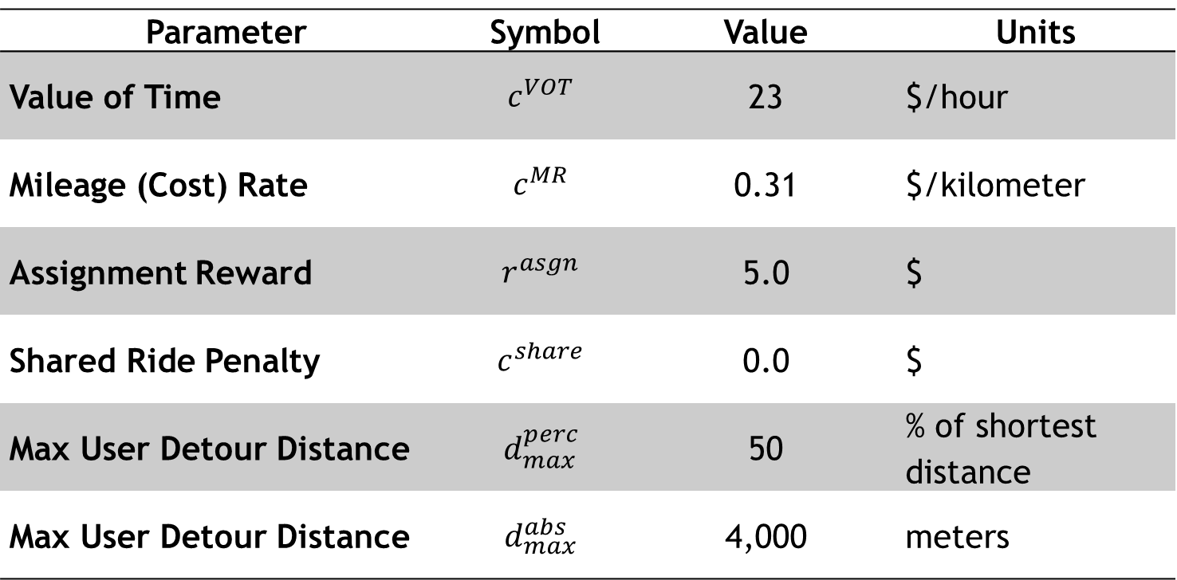
Study 2: Input Parameters
Parameter | Symbol | Value | Units
Value of Time | $$c^{VOT}$$ | 23 | $/hour
Mileage (Cost) Rate | $$c^{MR}$$ | 0.31 | $/kilometer
Assignment Reward | $$r^{asgn}$$ | 5.0 | $
Shared Ride Penalty | $$c^{share}$$ | 0.0 | $
Max User Detour Distance | $$d_{max}^{perc}$$ | 50 | % of shortest distance
Max User Detour Distance | $$d_{max}^{abs}$$ | 4,000 | meters

Slide 26
Scenarios/Sensitivity Analysis
2a. Examining Benefits of SRAMODS
  Demand level [% of Manhattan, NY taxi requests]:
    6%, 7.5%, 9%, 10.5%, and 12%
    Representing 3620, 4525, 5430, 6335, 7240 requests
  Max User Detour Distance [%increase over a user’s shortest OD distance]:
    0%, 5%, 15%, 30%, 50%, 80%

Slide 27
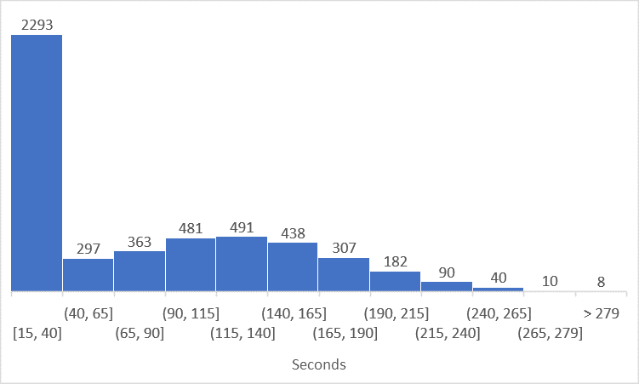
Scenarios/Sensitivity Analysis
2b. Analyzing Operational Challenges of SRAMODS
  Mean curbside wait pickup time [minutes]:
    0.5, 1.0, 2.0, 3.0, 4.0
  Curbside wait pickup time coefficient of variation (CV)
    0.5, 1.0, 1.5

Slide 28
Shared-ride Benefit Results
Sharing rides increases IVTT ← Impact is relatively minor
As demand increases, IVTT increases
As max detour increases, IVTT increases

Slide 29
Shared-ride Benefit Results
Wait time increases with demand
Rate is much faster for AMOD without shared rides
Even compared to SRAMODS with 5% max detour

Slide 30
Shared-ride Benefit Results
Fleet miles increase with demand
Rate is linear for AMOD without shared rides
Rate is sub-linear for SRAMODS
  Economies of Demand Density

Slide 31
Shared-ride Benefit Results
Network Effects and Economies of Demand Density
Due to sharing rate increasing with demand/demand density

Slide 32
Shared-ride Benefit Results
System Cost includes
  Fleet Miles * Mileage Rate
  Wait Time * Value of Time
  In-Vehicle Travel Time * Value of Time

Slide 33
Societal Implications
Significant benefits associated with SRAMODS
  Smaller fleet sizes to serve same demand
  Fewer fleet miles/VMT to serve same demand
    Potentially leading to reductions in congestion, energy use, emissions
Also, network effects and economies of demand density
  More shared-ride travelers → More shared ride opportunities → More Shared Rides
1 and 2 suggest, a role for government intervention
  Carrots: subsidy for SRAMODS
  Sticks: congestion pricing, higher gas tax, road user fees
    Exempt SRAMODS?

Slide 34
Shared-ride Operational Challenges Results
User in-vehicle travel time increases ‘linearly’ with increases curbside pickup times

Slide 35
Shared-ride Operational Challenges Results
User wait time increases, greater than linearly, with curbside pickup times

Slide 36
Shared-ride Operational Challenges Results
Fleet distances not significantly impacted by curbside wait pickup time

Slide 37
Shared-ride Operational Challenges Results
System cost increases, greater than linearly, with increases in curbside wait pickup times

Slide 38
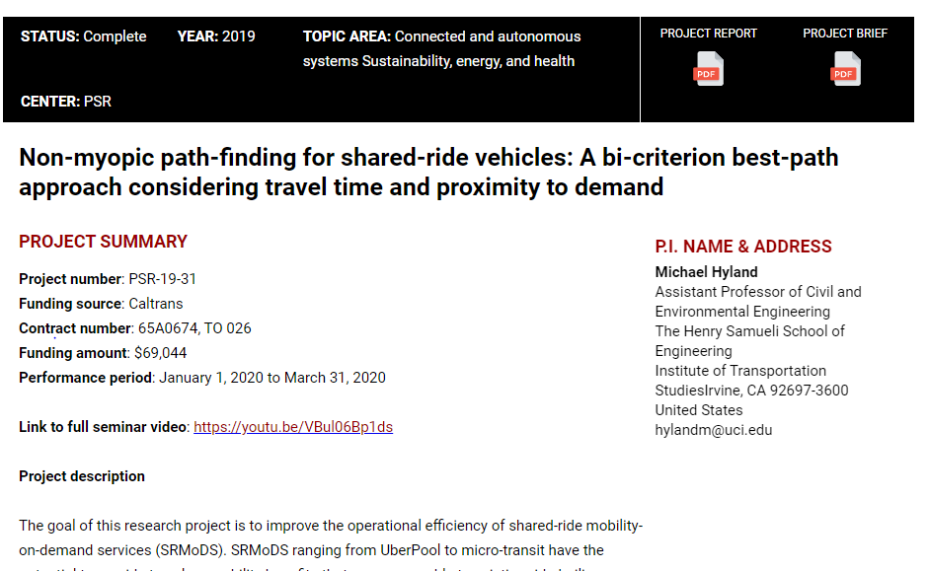
Study 3:

Slide 39
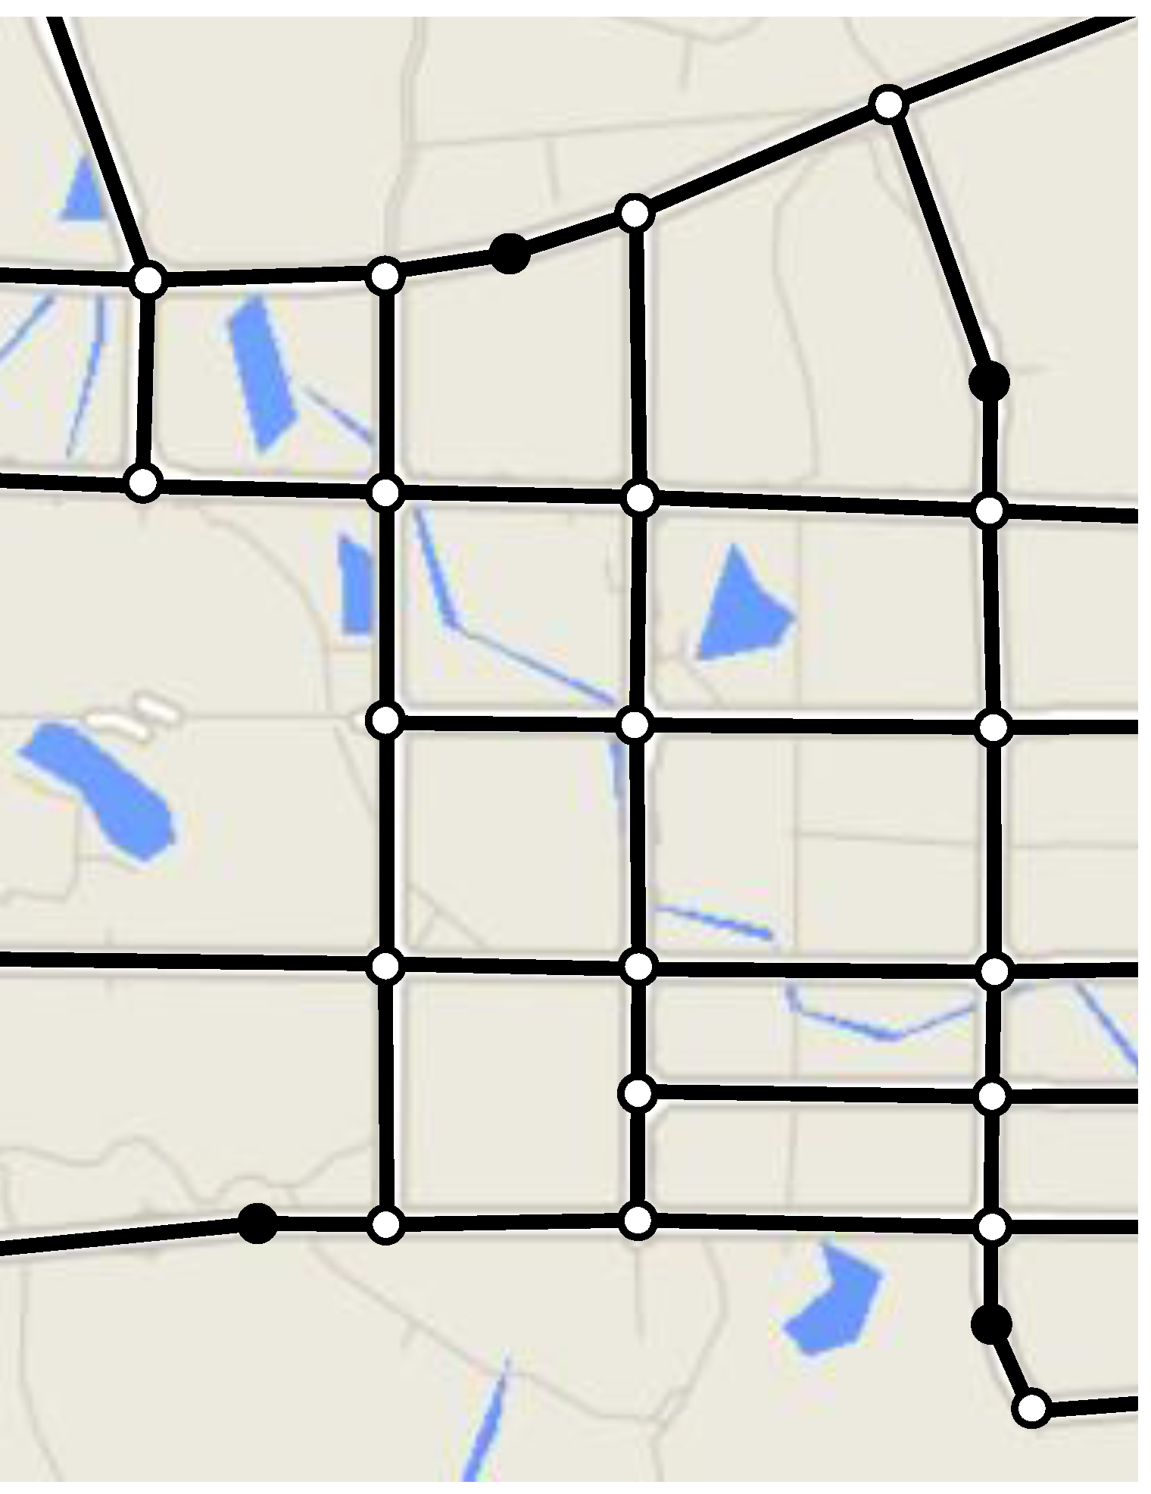





Background
$$V_{1}$$
The operational process for shared-ride MOD services usually includes two/three interconnected parts:
  Matching passengers with service vehicles
  Routing/Sequencing vehicles to pick-up/drop-off customers
  Repositioning empty vehicles
Pathfinding largely overlooked – “just assign vehicles to shortest network paths”
$${Pick}_{2}$$
$$V_{2}$$
$${Pick}_{1}$$
$${Drop}_{1}$$

Slide 40
Research Hypothesis
Assigning vehicles to shortest paths between pickup and drop-off locations may result in suboptimal fleet performance
  Vehicles may incur avoidable mileage when responding to new requests, since pathfinding process does NOT consider future demand

Slide 41
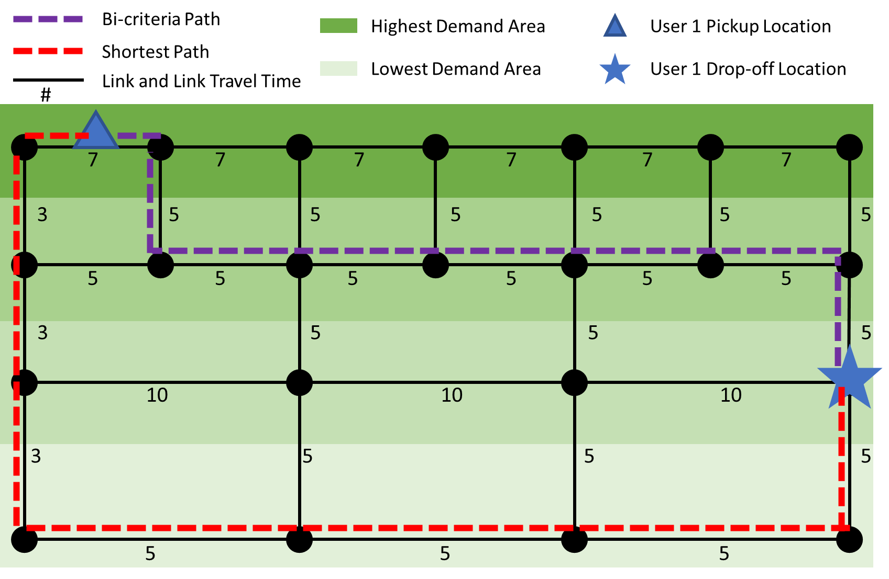
Key Idea: Bi-criteria Pathfinding

Slide 42
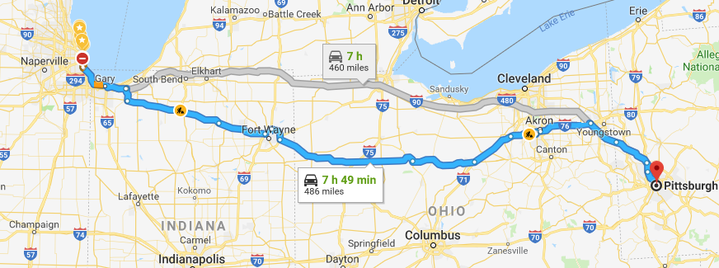
Key Idea: Bi-criteria Pathfinding

Slide 43
Goals and Research Questions
This research project aims to develop an efficient operational policy for shared-ride MOD services that efficiently:
  Matches new requests to vehicles
  Sequences traveler pickups and drop-offs for individual vehicles
  Repositions empty vehicles
  Assigns vehicles to paths through a network, considering both travel time and potential future demand
To answer the following questions
  Does bi-criteria pathfinding improve the operational efficiency of shared-ride MOD services?
  If yes, when should shared-ride MOD vehicles be assigned to bi-criteria paths?
  What are the major exogenous and endogenous factors that impact the effectiveness of bi-criteria pathfinding?

Slide 44
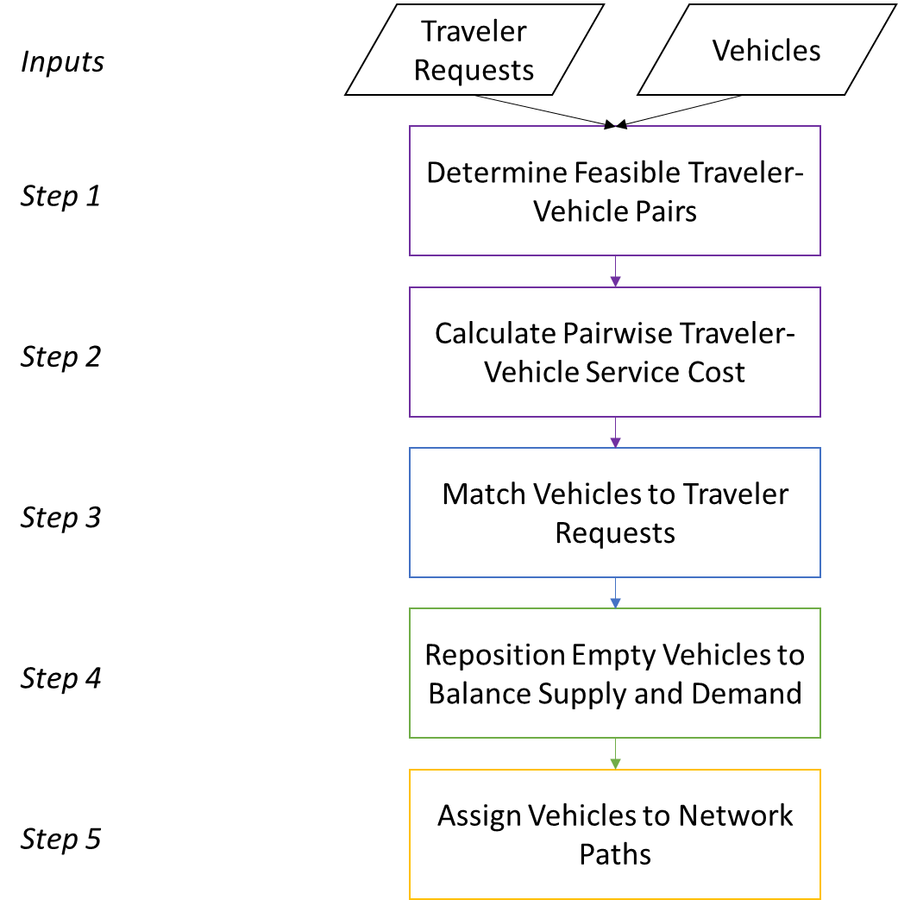
Methodology: Architecture Overview

Slide 45
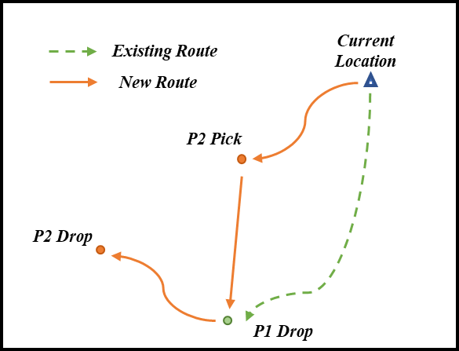
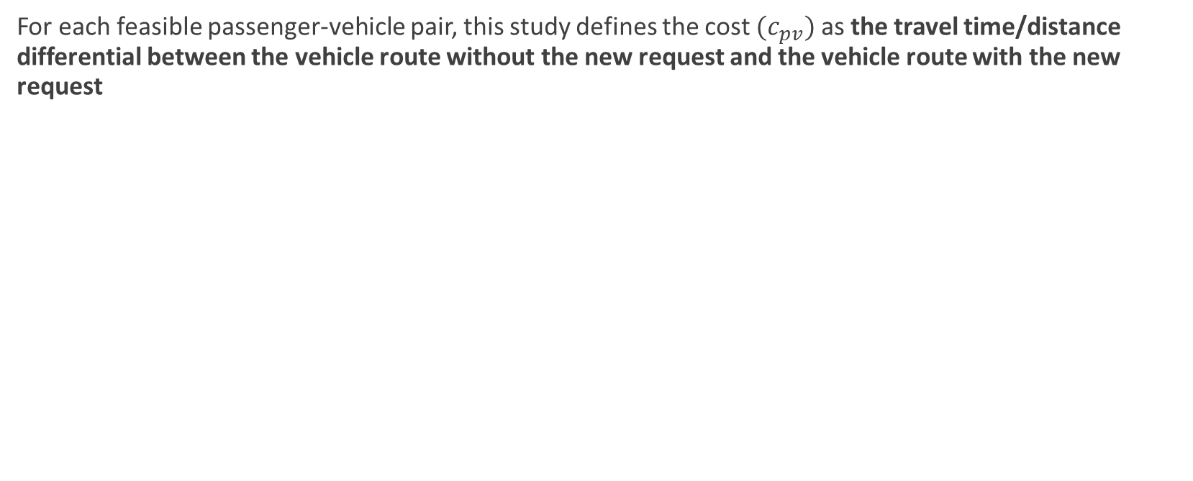
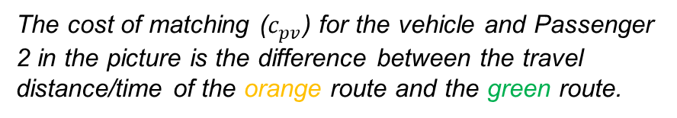
Methodology: Step 2 – Cost Measure
For each feasible passenger-vehicle pair, this study defines the cost $(c_{pv})$ as the travel time/distance differential between the vehicle route without the new request and the vehicle route with the new request
The cost of matching ($c_{pv}$) for the vehicle and Passenger 2 in the picture is the difference between the travel distance/time of the orange route and the green route.

Slide 46
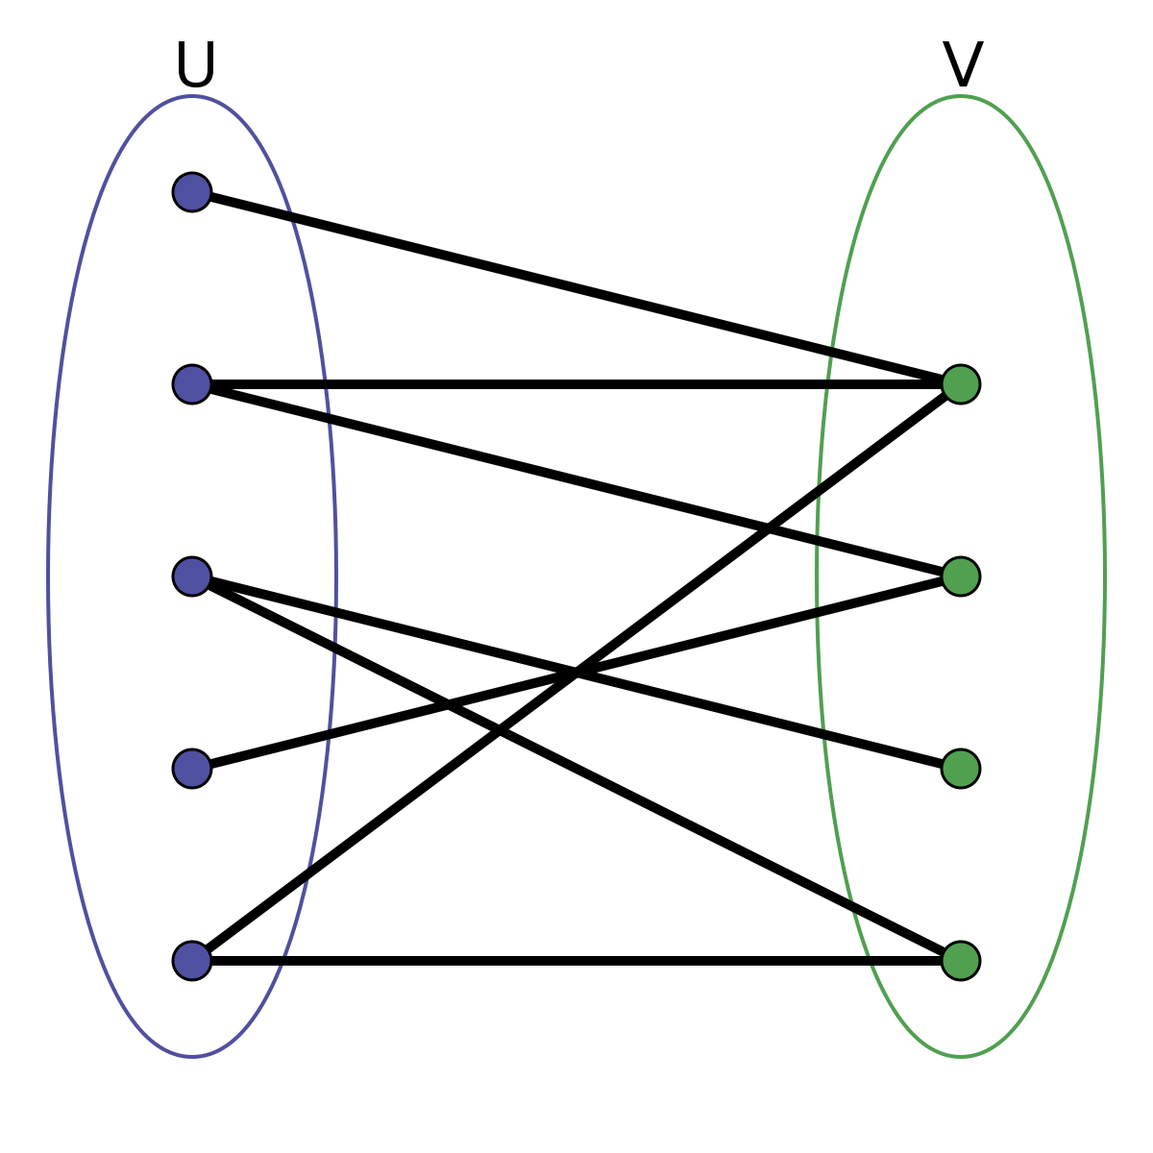

Methodology: Step 3 -- Matching
Passenger-vehicle assignment problem (bi-partite matching)
$$\underset{x_{pv}}{Max}{\sum_{v∈V}{\sum_{p∈P}{\left(r_{p}−c_{pv}\right)×x_{pv}}}}$$
subject to:
  $$\sum_{v}{x_{pv}}≤1, ∀p∈P$$
  $$\sum_{p}{x_{pv}}≤1, ∀v∈V$$
  $$x_{pv}∈\left[0, 1\right]$$
In the above formulation:
$x_{pv}:$ Binary decision variable, equal to 1 if traveler $p$ is served by vehicle $v$
$r_{p}:$ Reward for serving traveler $p$
$c_{pv}:$ Cost of serving traveler $p$ with vehicle $v$
P

Slide 47
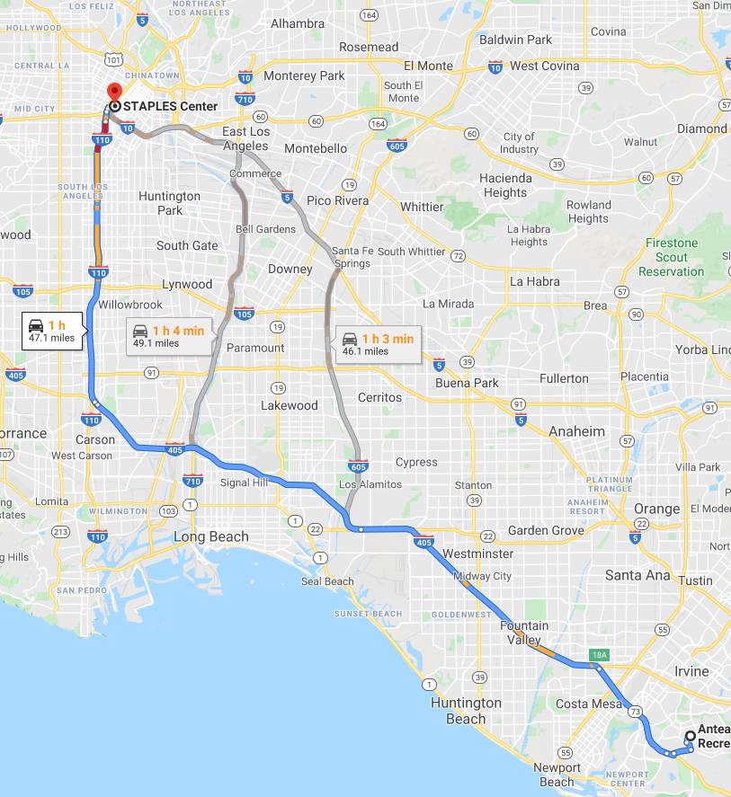
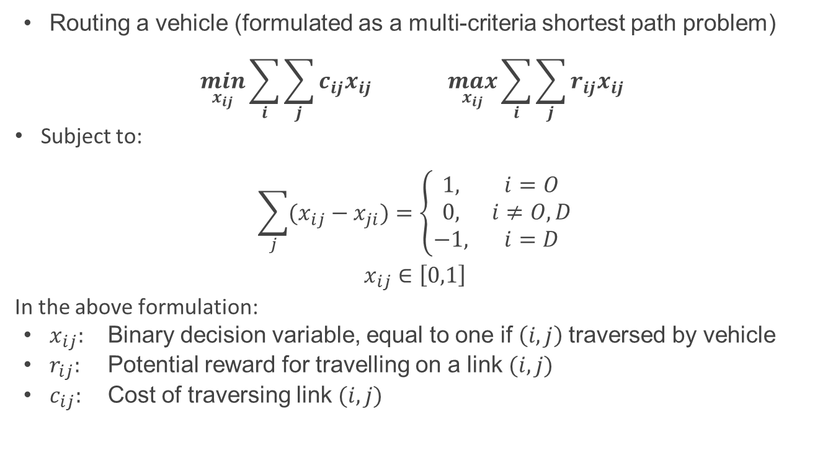
Methodology: Step 5 -- Path Assignment
Routing a vehicle (formulated as a multi-criteria shortest path problem)
$$\min_{x_{ij}}{\sum_{i}{\sum_{j}{c_{ij}x_{ij}}}} \max_{x_{ij}}{\sum_{i}{\sum_{j}{r_{ij}x_{ij}}}}$$
Subject to:
$$\sum_{j}{(x_{ij}−x_{ji})}=\left\{\begin{matrix}1, & i=O \\ 0, & i≠O, D \\ −1, & i=D\end{matrix}\right.$$
$$x_{ij}∈\left[0,1\right]$$
In the above formulation:
$x_{ij}:$ Binary decision variable, equal to one if $\left(i, j\right)$traversed by vehicle
$r_{ij}:$ Potential reward for travelling on a link$(i, j)$
$c_{ij}:$ Cost of traversing link$(i, j)$

Slide 48

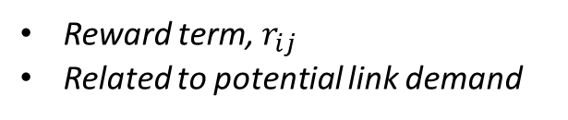
Methodology: Step 5 -- Path Assignment
Combine the two objective functions
$$\max_{x_{ij}}{\sum_{i}{\sum_{j}{(w_{r}r_{ij}−c_{ij})×x_{ij}}}}$$
$w_{r}=f\left(occupancy, time slack\right)$
Reward term, $r_{ij}$
Related to potential link demand
We test bi-criteria pathfinding under three conditions
  The vehicle has only one drop off task remaining
  The vehicle has two drop-off tasks and no pickup tasks remaining
  The vehicle has two drop-off tasks and no pickup tasks remaining OR the vehicle is empty and en-route to a pickup task

Slide 49
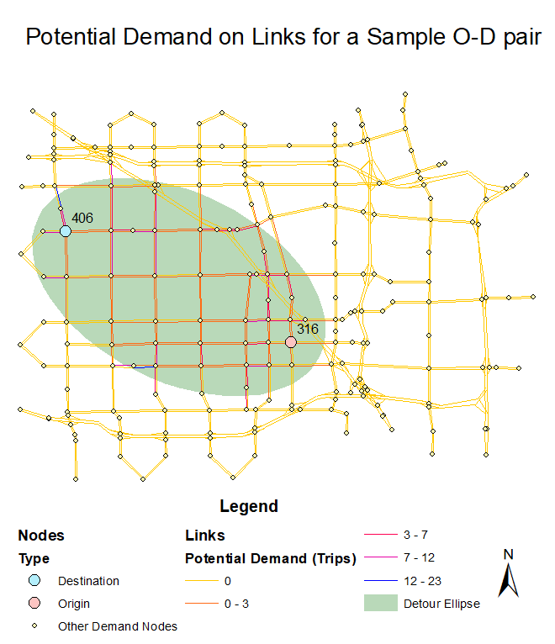
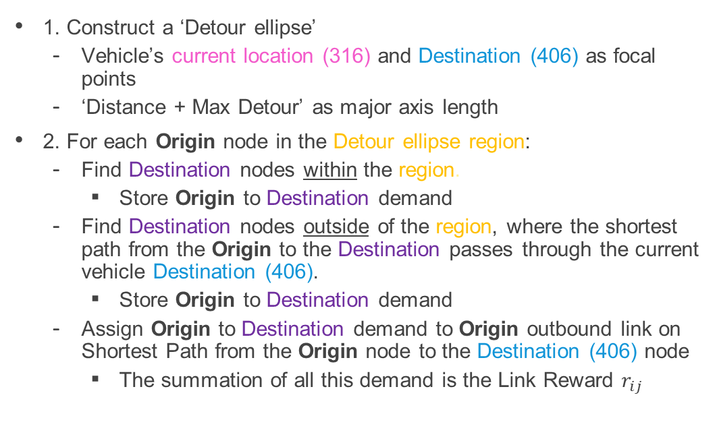
Methodology: Link reward calculation (Potential Demand on Links)
1. Construct a ‘Detour ellipse’
  Vehicle’s current location (316) and Destination (406) as focal points
  ‘Distance + Max Detour’ as major axis length
2. For each Origin node in the Detour ellipse region:
  Find Destination nodes within the region.
    Store Origin to Destination demand
  Find Destination nodes outside of the region, where the shortest path from the Origin to the Destination passes through the current vehicle Destination (406).
    Store Origin to Destination demand
  Assign Origin to Destination demand to Origin outbound link on Shortest Path from the Origin node to the Destination (406) node
    The summation of all this demand is the Link Reward $r_{ij}$

Slide 51
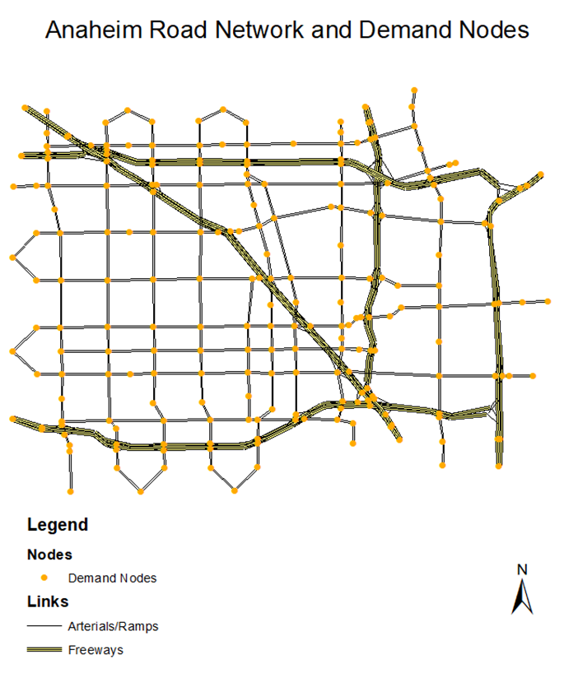
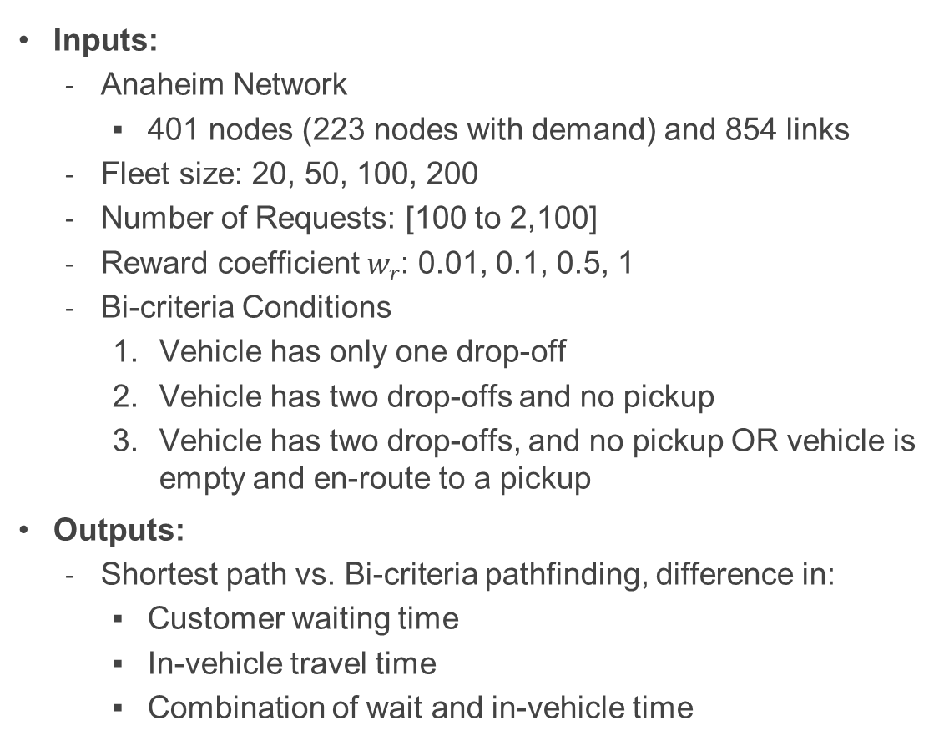
Case Study
Inputs:
  Anaheim Network
    401 nodes (223 nodes with demand) and 854 links
  Fleet size: 20, 50, 100, 200
  Number of Requests: [100 to 2,100]
  Reward coefficient $w_{r}$: 0.01, 0.1, 0.5, 1
  Bi-criteria Conditions
    Vehicle has only one drop-off
    Vehicle has two drop-offs and no pickup
    Vehicle has two drop-offs, and no pickup OR vehicle is empty and en-route to a pickup
Outputs:
  Shortest path vs. Bi-criteria pathfinding, difference in:
    Customer waiting time
    In-vehicle travel time
    Combination of wait and in-vehicle time
Notes:
A relocation scheme is also designed for vehicles in this study. If a vehicle has been idle for more than 5 minutes, the system will search the node with highest demand that is within 2.5 miles of the current location and direct the vehicle toward that node

Slide 52
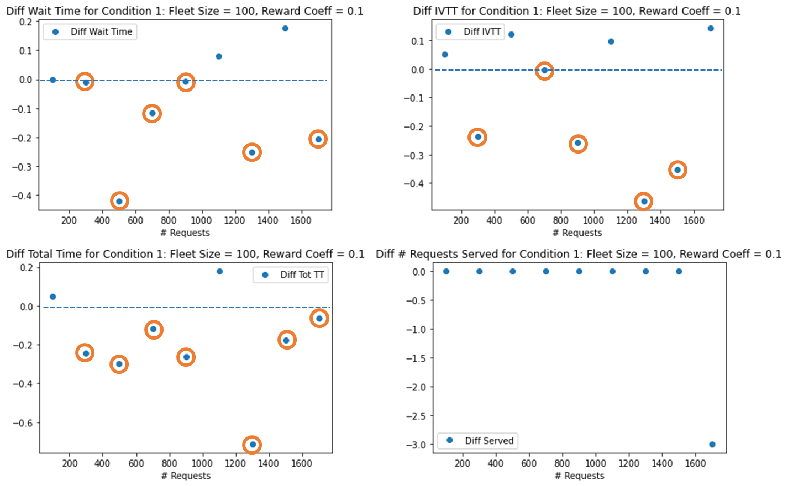
Base Case:
Condition 1, Fleet Size 100, Reward Coeff = 0.1
Bi-criteria pathfinding is reasonably effective when # Requests is between 300 and 1000
  This represents moderate oversupply to moderate undersupply
Bi-criteria pathfinding is ineffective in extreme undersupply and oversupply cases
Notes:
fleet size is relatively large,, a new passenger request could be surrounded by considerable number of available vehicles, which could also be empty (directly available). Under these cases, using bi-criteria pathfinding may cause the vehicles to travel unnecessary distance, and therefore increase the waiting time and in-vehicle travel time for passengers. However, when the supply ratio is within a proper range (0.55 to 2.78 for the 100 vehicle case), encouraging the usage of bi-criteria pathfinding would proactively sending vehicles to potential high demand locations, which would result in reduction in waiting and travel time.

Slide 53
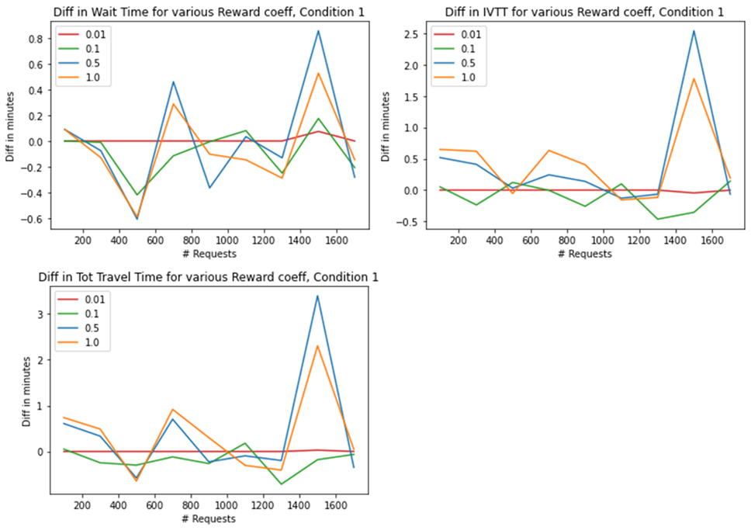
Impact of Reward Coefficient: $w_{r}$
High variance in the results
  Indicates an area of future research
  Need to be selective when using bi-criteria pathfinding
Using reward coefficient of 0.1 outperforms others
  It works especially well when request are between 300 to 1000.
Giving large weights to reward terms does not make bi-criteria path more effective.
Notes:
The result indicates that the choice of reward coefficient is related to the supply ratio of the network. Using relatively large reward coefficient would more likely to route the vehicles to path that is a non-shortest path. When the supply of vehicle is sufficient, it becomes less likely for vehicles to cover more requests along the non-shortest paths. In that way, a smaller reward coefficient is preferable.

Slide 54
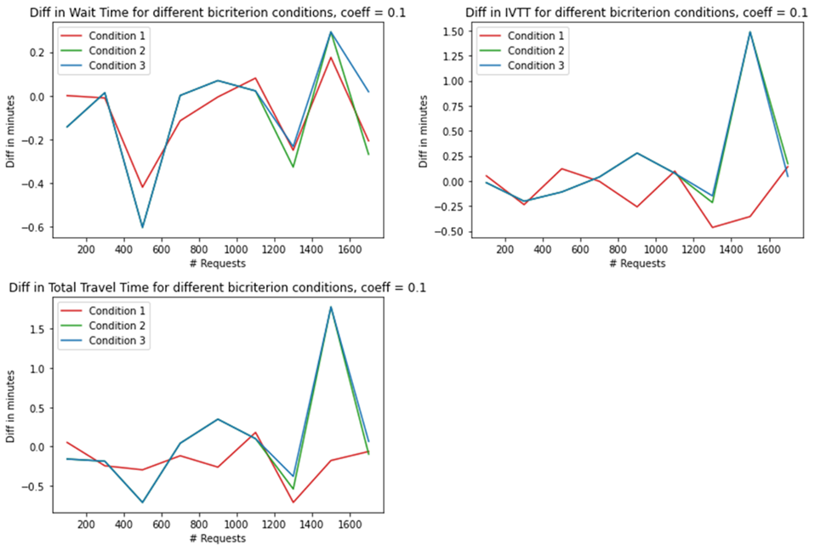
Testing Conditions for Bi-criteria Paths
Condition 1 outperforms 2 and 3
Simple policy is better than complex ones
Need to be selective about employing bi-criteria pathfinding
  If a vehicle has only one drop off task assigned.
  If a vehicle has two or less drop off tasks assigned.
  Condition 2 & if a vehicle is empty and en-route to a pickup task

Slide 55
Conclusions
Bi-criteria path usage is effective for reducing both customer waiting time and in-vehicle travel time
  The reduction of total time for passengers with with bi-criteria path is 3-5%
Bi-criteria pathfinding works best in cases where the supply of vehicles and request demand are relatively balanced
Link reward weights impact performance
Condition 1 outperforms Condition 2 and 3
  Only consider bi-criteria paths when vehicle is empty or has one remaining drop-off

Slide 56
Future Enhancements
Improve link reward estimation method to better estimate potential demand
Improve pickup/drop-off resequencing when the vehicle is on a bicriterion path
Incorporate remaining travel time buffer of in-vehicle passengers and current vehicle occupancy during bi-criteria path choice
Account for spatial and temporal availability of VEHICLES (in addition to demand) when assigning vehicles to paths
Optimal dispersion of vehicles through multiple bi-criterion paths, instead of assigning all vehicles on the same path
Make reward term in objective function, conditional on state of system
  Supply-demand imbalance, vehicle occupancy, etc.

Slide 57
Thank You!
Contact
  hylandm@uci.edu

