Slide 1
THE TRUE COST OF SHARING: A DETOUR PENALTY ANALYSIS BETWEEN UBERPOOL AND UBERX IN TORONTO
2022 Conference on Sustainability and Emerging Transportation Technology
Mischa Young
Steven Farber
Matthew Palm

Slide 2
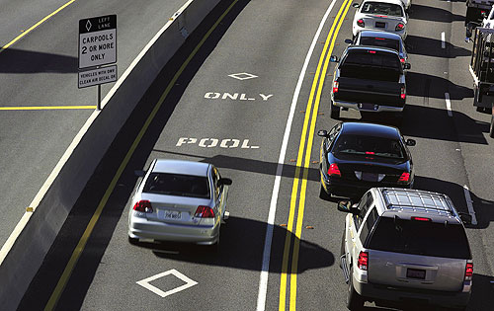
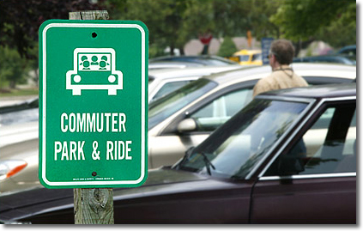
Background - Pooling
Policymakers have long understood the benefits of pooling
These have fallen short due to an insufficient pool of users... Until smartphones

Slide 3
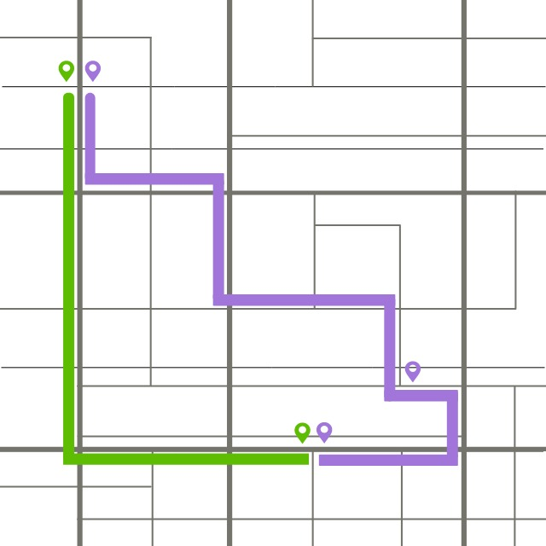


Background – Shared ridehailing
Enable passengers to share ride
Provide sizeable discounts in exchange for
uncertainty and longer travel times

Slide 4
Research objectives
Determine the proportion of shared ridehailing services that are successfully matched
Determine the factors that influence whether shared ridehailing trips will be matched
Estimate the detour time penalty associated with pooling

Slide 5
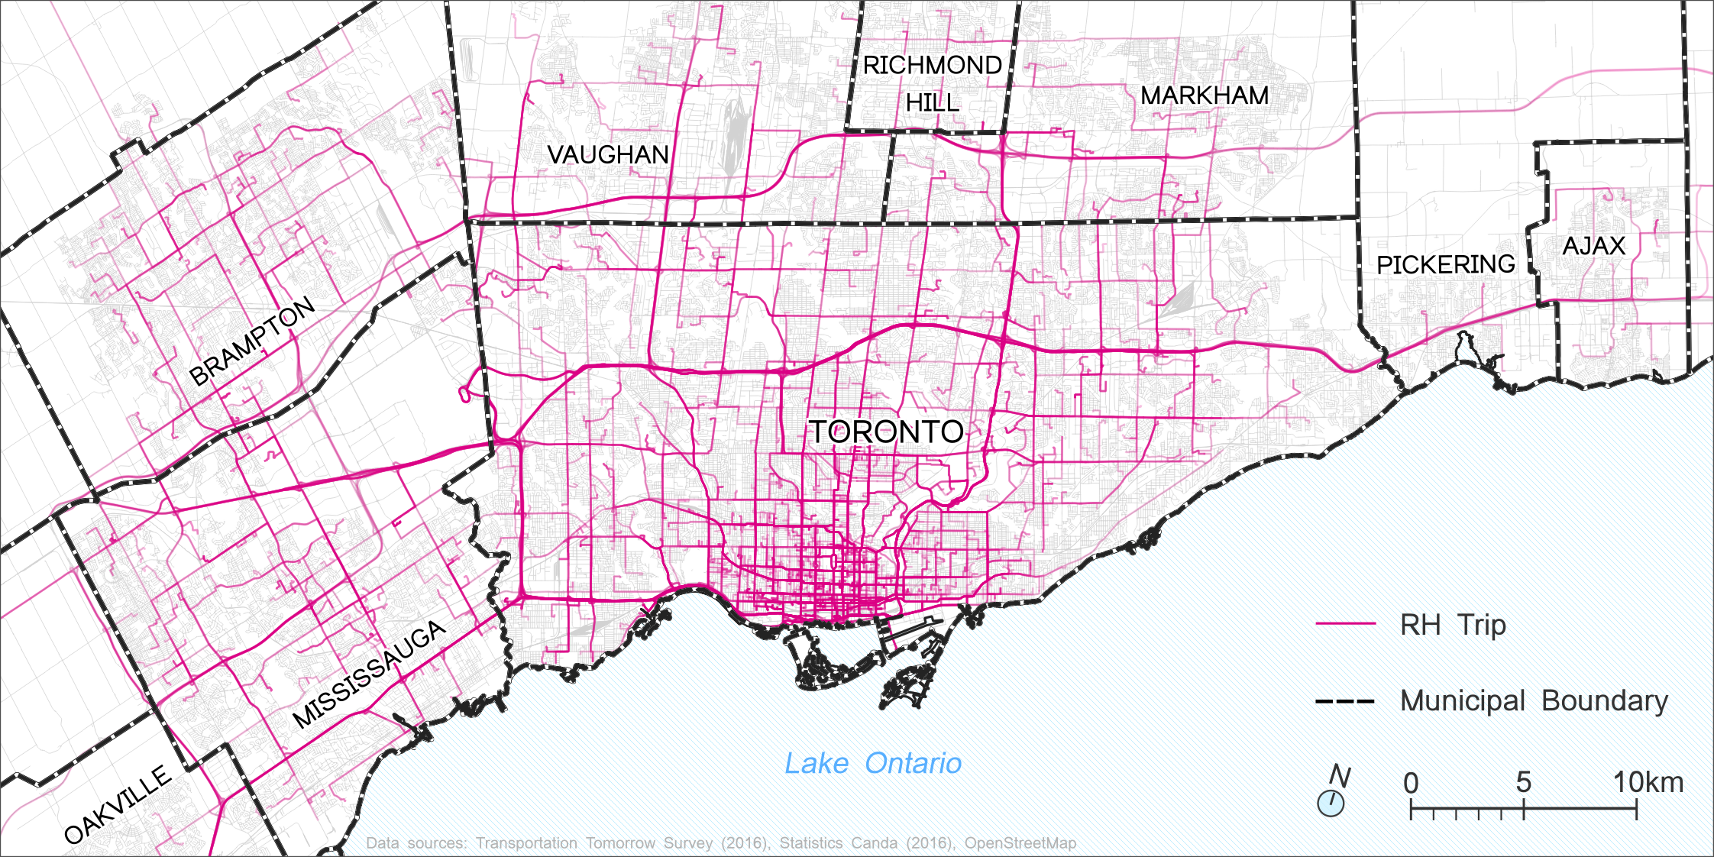
Study area and data
Data: 12-million record dataset of all ride-hailing trips in Toronto
Type of ridehailing trips
Start-time & end-time
Origin/Dest. Location
Trip was matched or not
Notes:
12-million record dataset of all ride-hailing trips in Toronto between September 7th,2016 and March 31st, 2017.
Type of RH trips (UberX, UberPool, etc.)
Start-time and end time of trips at the closest second)
Location (to the closest interestction of origin and destination)
Whether shared trips were successfully matched or not.

Slide 6
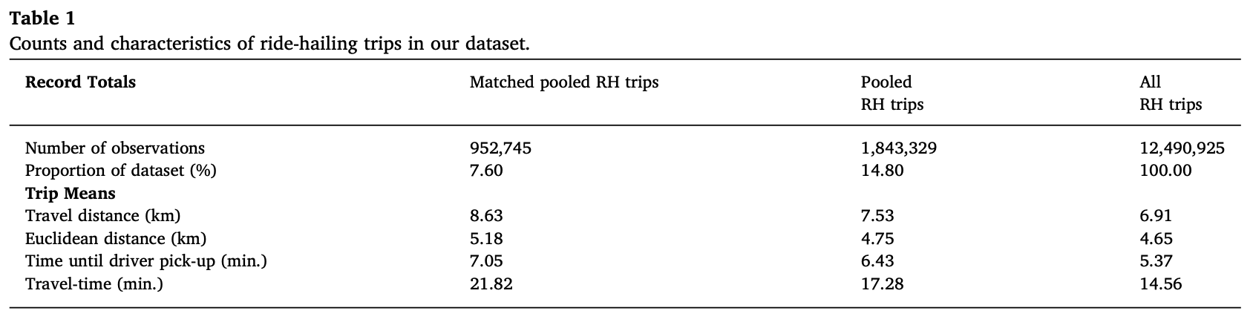
Study area and data

Slide 7
Study area and data
Notes:
What also stands out is the travel-time difference between successfully matched pooled trips (21-22 minutes) and the average travel time for all ridehailing modes combined (pooled and unpooled) less than 15 minutes, which means there is definitely a detour time penalty associated with pooling.
And that there must therefore be a fare discount to account for this increase in travel duration.

Slide 8
Study area and data
Notes:
Even within City of Toronto boundaries there are inner-suburban neighbourhoods that were not yet included in the coverage area of shared ridehailing services (like parts of Etobicoke and Scarborough)

Slide 9
Matching propensity
Factors that influence Shared ridehailing matching success:
Time of day
Time of year
Trip distance
Wait-time
Demand
Notes:
Descriptive analysis to uncover the characteristics of successfully matched SRH trips.
Time of day: successfully matched trips are least likely to occur during midday periods (10am-3pm)
Time of year: successfully matched SRH trips are less likely to occur during the later months of our sample
Trip distance (as trip distance increases, the number of successfully matched SRH trips increase)
Wait-time (as wait-time, the time between which the passenger places an UberPool order and the driver arrives to the pick up location increses, match rate increases) Probably because that give the matching algorithm more time to find a potential match
As demand increases, so does the likelihood that a shared RH trip will be matched.
Downtown (which is where we see the highest demand for SRH services) is also were match rates are highest (between 60-80%!)

Slide 10
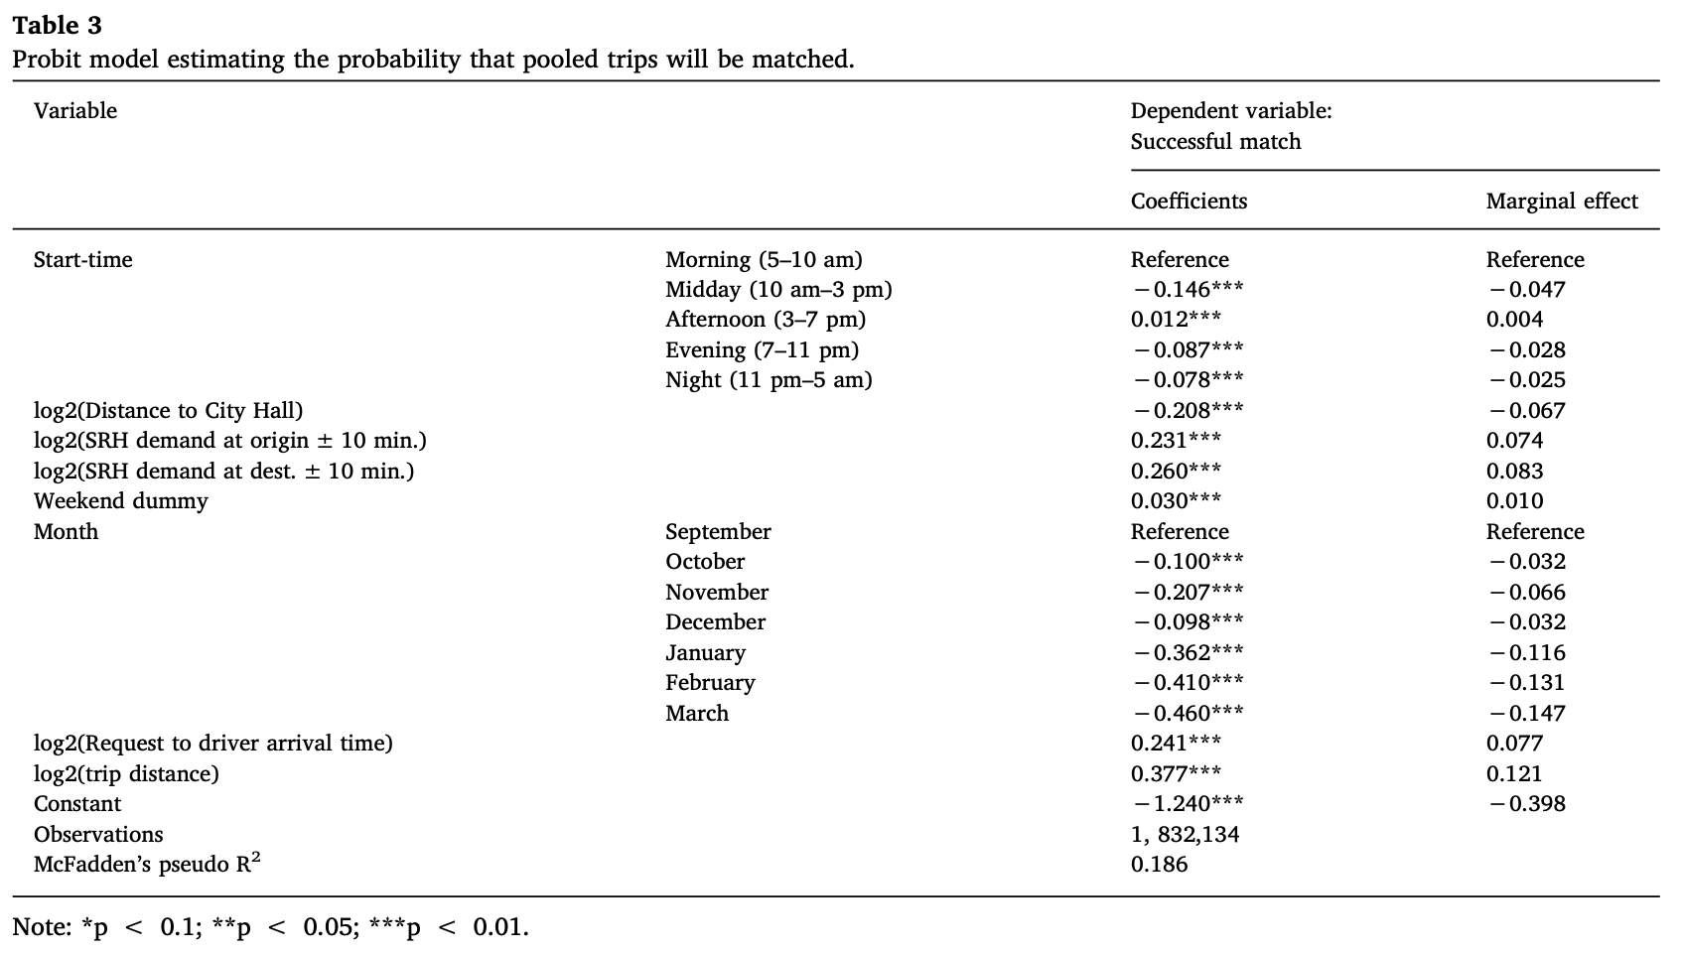
Matching propensity
Notes:
SRH demand – both at the origin and destination – increase the likelihood of a match occurring.
As demand for shared ridehailing doubles at the trip’s TAZ (traffic analysis zones) of origin the match rate increases by 7% percentage points, and this increases to 8% points when demand for SRH at the destination TAZ doubles

Slide 11
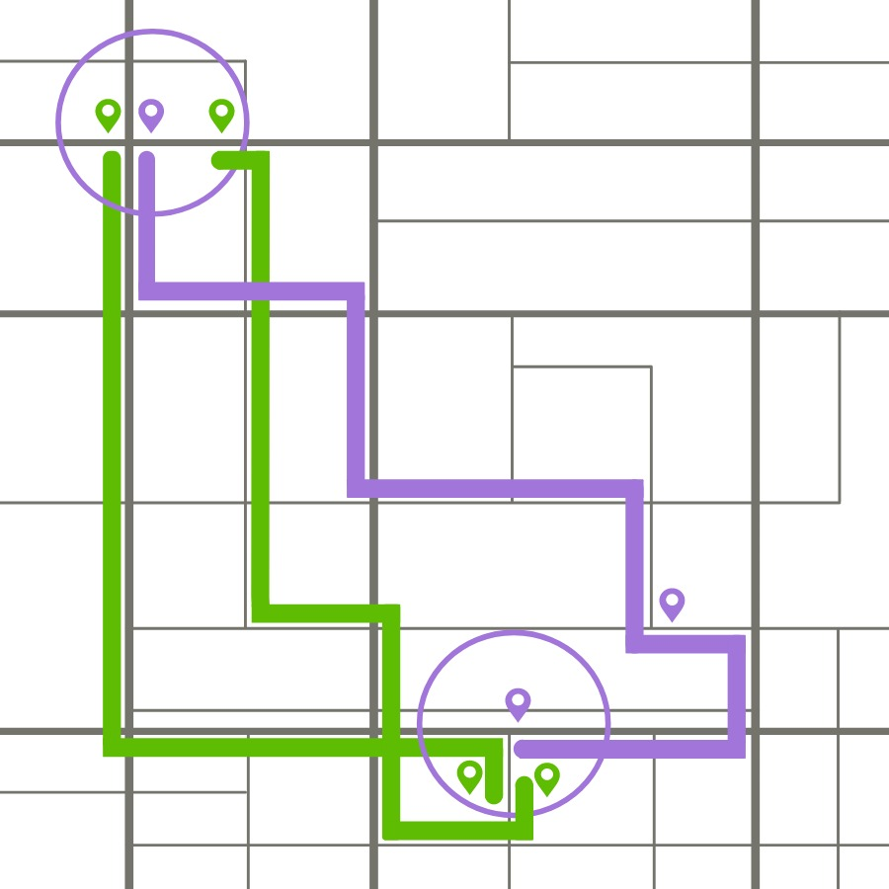
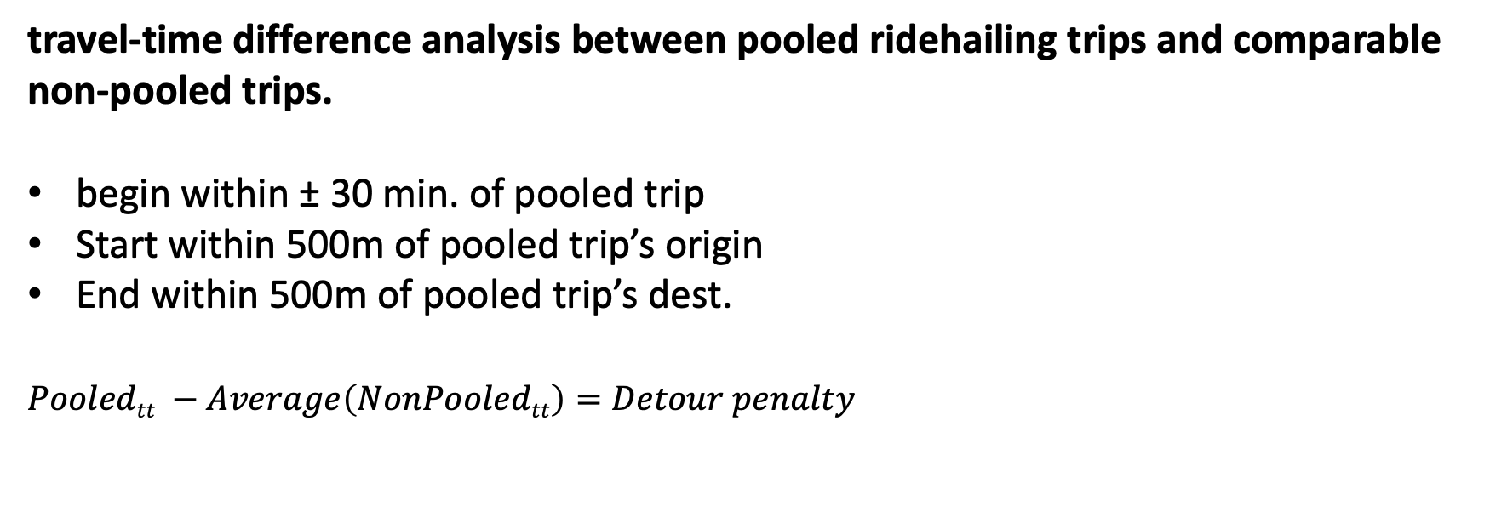
Detour time penalty
travel-time difference analysis between pooled ridehailing trips and comparable non-pooled trips.
begin within ± 30 min. of pooled trip
Start within 500m of pooled trip’s origin
End within 500m of pooled trip’s dest.
$Pooledtt −Average\left(NonPooledtt\right)=Detour penalty$
Notes:
To be deemed comparable, a non-shared RH trips must
begin within +/- 30 minutes of the successfully matched shared ridehailing trip
start within 500m of the successfully matched shared ridehailing trip’s origin
end within 500m of the successfully matched shared ridehailing trip’s destination
If all 3 criteria are met, then a non-pooled trip is deemed comparable and included in the analysis.
Detour penalty for each pooled trip = the travel time of that pooled trip (20 mins) – the average travel-time of all comparable non-pooled trips (10+12)/2. So travel time diff = 9mins!

Slide 12
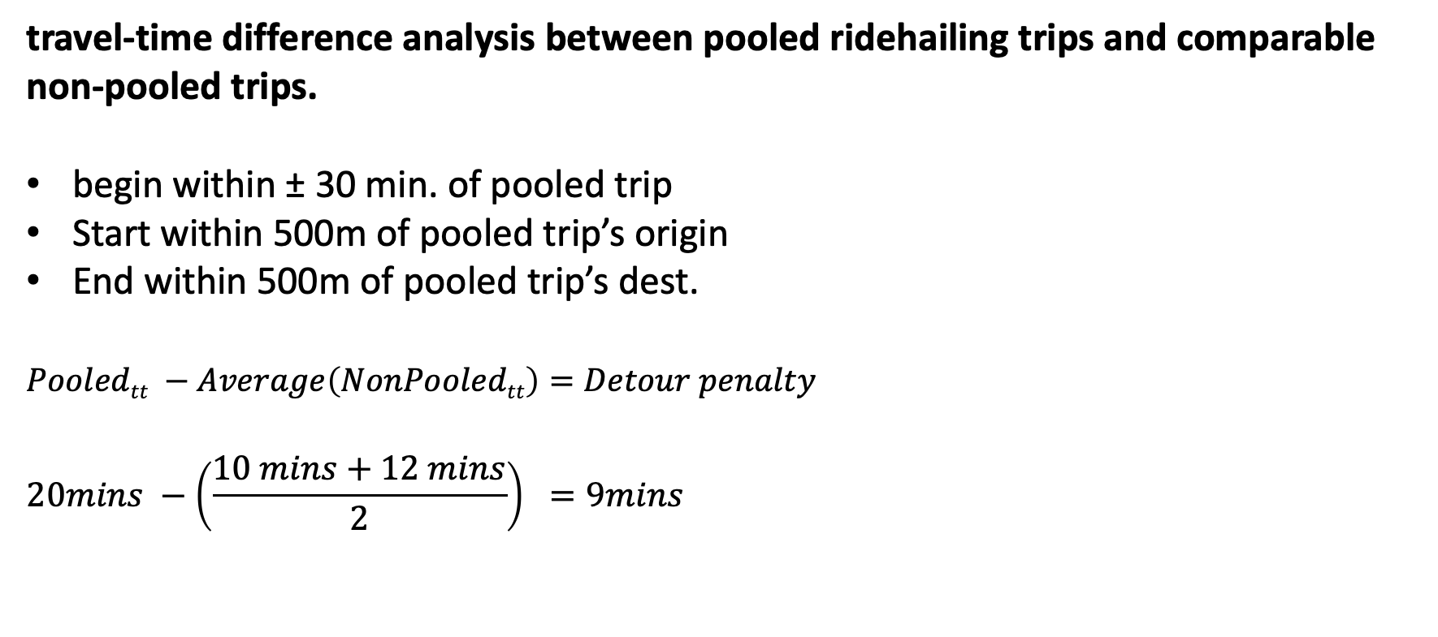
Detour time penalty
travel-time difference analysis between pooled ridehailing trips and comparable non-pooled trips.
begin within ± 30 min. of pooled trip
Start within 500m of pooled trip’s origin
End within 500m of pooled trip’s dest.
$Pooledtt −Average\left(NonPooledtt\right)=Detour penalty$
$$20mins −\left(\frac{10 mins+12 mins}{2}\right) =9mins$$
Notes:
To avoid unrepresentative matches biasing our results we only include successfully matched SRH trips that have at least 3 comparable non shared trips in our analysis. So the above example would not be include, you need at least 3 comparable non shared trips (green)
In total we retain 151,468 succesffully matched SRH trips that have at least 3 comparable non-shared trips.

Slide 13
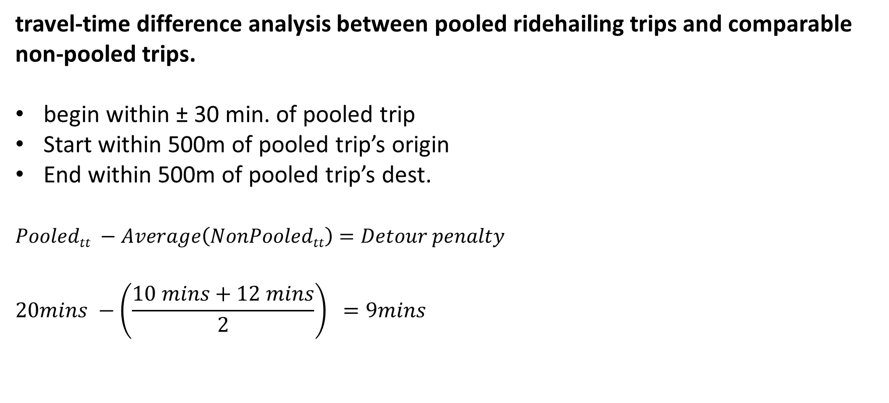
Detour time penalty
travel-time difference analysis between pooled ridehailing trips and comparable non-pooled trips.
begin within ± 30 min. of pooled trip
Start within 500m of pooled trip’s origin
End within 500m of pooled trip’s dest.
$Pooledtt −Average\left(NonPooledtt\right)=Detour penalty$
$$20mins −\left(\frac{10 mins+12 mins}{2}\right) =9mins$$
Notes:
To explore the shared RH penalty further, we conduct a two-step Heckman selection model to account for the selection bias introduced by restricting our sample to successfully matched SRH trips with at least 3 equivalent non-shared trips (UberX).
As Previously mentioned, we only include SRH trips with at least 3 equivalent non-shared trips to avoid unrepresentative matches biasing our results (e.g. to avoid bias in travel difference between a particularly fast UberPool and particularly slow UberX trip).
The Heckman two-step selection model treats the bias as an omitted variable.
In step 1 we conduct a probit model to uncover the selection process and the selection effect is introduced in the second model (linear regressions) as an explanatory variable.
Longer trips are more likely to have longer detour time penalties.

Slide 14
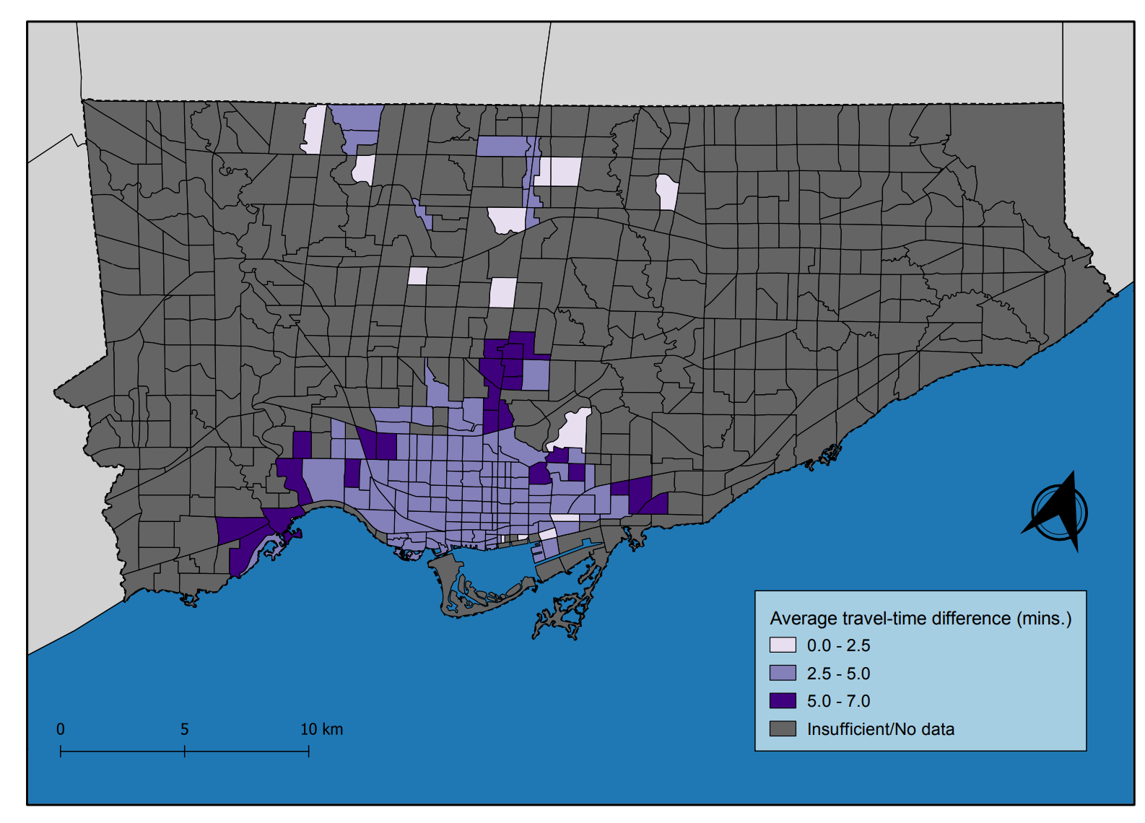
Detour time penalty

Slide 15
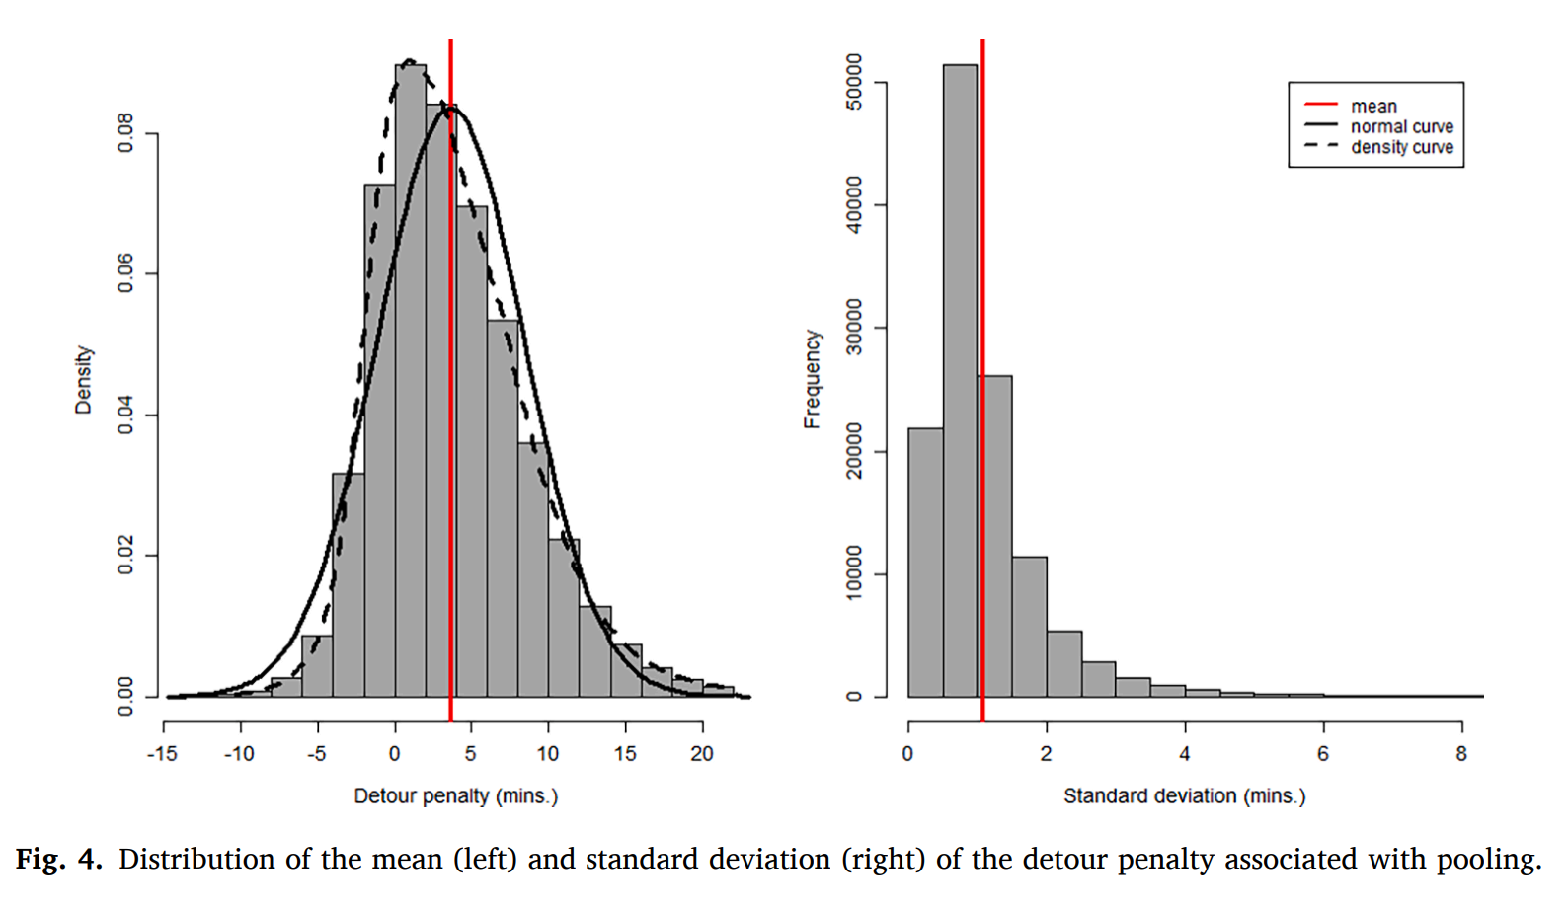
Detour time penalty
Average detour time penalty: 3.6 minutes
Notes:
Mean detour of 3.6 minutes

Slide 16
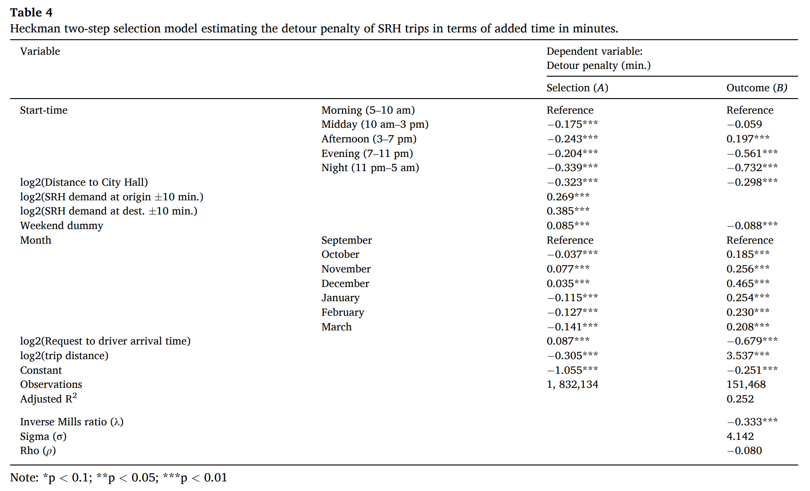
Heckman Selection Model Results

Slide 17
Heckman Selection Model Results

Slide 18
Heckman Selection Model Results
Notes:
As trip distance doubles,
30% decrease it matching propensity,
detour penalty increases by 3.5 minutes
overall duration increases by 17%.

Slide 19
Discussion
14% of ridehailing trips in our data were pooled
Only 52% of these are successfully matched
Cities intent on meeting their sustainable transport objective through pooling should pay close attention to the factors affecting shared ridehailing’s matching propensity.
As demand at trip’s origin doubles within ± 10 min. from start-time
7% increase in match rate
As demand at trip’s destination doubles within ±10 min. from end-time
8% increase in match rate

Slide 20
Discussion
Average time penalty for shared ridehailing was just 3.6 minutes (17% of total travel time)
Very small, compared to estimates for how long it takes to find parking
Many passengers experience no delay as they are picked up and dropped off within the context of another passenger’s trip
Uncertainty? Average standard deviation of delay was just 1 minute

Slide 21
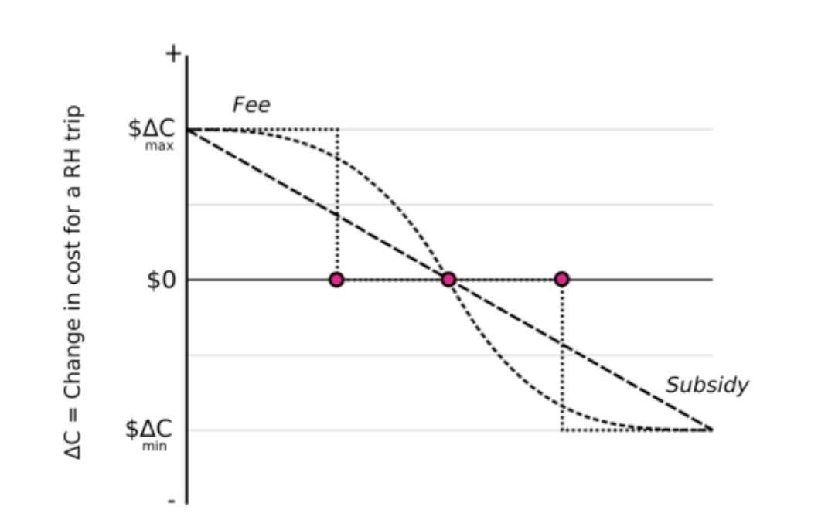
Policy recommendations
Reduce the cost of pooled trips (subsidize)
Increase the cost of non-pooled trips (Tax) to arrive at a feebate approach
Having pooling as the default option
Better advertising the small delays
Better promote cost savings

Slide 22
Limitations
Data provided to the City were incomplete
  Trips were “unlinked”
  No routes
  No fares
Underrepresenting long distance trips
Work at the University has helped inform the renewal of the ridehailing permitting policies at City, including sharing of more complete data

Slide 23
Reference
Young, M., Farber, S., & Palm, M. (2020). The true cost of sharing: A detour penalty analysis between UberPool and UberX trips in Toronto. Transportation Research Part D: Transport and Environment, 87, 102540.

