Slide 1
Vehicle Design Strategies to Reduce COVID-19 Transmission in Shared and Pooled Vehicles
SETT
Ashley N. DePew
Graduate Student Researcher
University of California, Davis
andepew@ucdavis.edu
Notes:
Hello everyone, my name is Ashley DePew, and I am a Graduate Student Researcher at University of California, Davis. I am finishing up my Master’s next week, and will be staying on for my Ph.D. Thank you for joining our session. Today I will be presenting on Vehicle Design Strategies to Support a Return to Ride-Pooling in the Wake of the Pandemic.

Slide 2
COVID-19
and Shared and Pooled
Transport
June 2020 - December 2020:
US public transit usage 65%
from pre-COVID patronage.
Notes:
It comes as no surprise that in the wake of the pandemic, shared and pooled ridership has drastically decreased, as we have been advised to social distance and shelter in place.
U.S. public transit usage was still down 65% in December of 2020, in comparison to patronage pre-COVID. Also, Transportation Network Companies like Uber and Lyft had suspended the pooled version of their services at this time.

Slide 3
2.8 million essential workers
use public transit to get to & from work in the U.S.
Notes:
However, not everyone can afford to stay home. In the United States, 2.8 million essential workers rely on public transit to get to and from work.
Additionally, the price of private passenger cars is one that not everyone can pay. Individuals of lower socioeconomic status disproportionately rely on shared and pooled modes of transportation, which thus unduly puts them at risk for contracting COVID-19. Furthermore, the operators of these transit vehicles themselves are at a profound risk every day, coming into contact with passengers.

Slide 4
Research Statement
To identify high-leverage design solutions that both objectively mitigate the risk of COVID-19 transmission and are acceptable and perceived as valuable to consumers of shared and pooled transportation.
These insights aim to serve as tools for policymakers at the federal, state, and local levels, as well as individual transit organization decision-makers, for mechanism implementation to keep all individuals safe.
Notes:
The present study set out to identify high-leverage design solutions that both objectively mitigate the risk of COVID-19 transmission, and are acceptable and perceived as valuable to consumers of shared and pooled transportation.
These insights aim to serve as tools for policymakers at the federal, state, and local levels, as well as individual transit organization decision-makers, for mechanism implementation to keep all individuals safe.

Slide 5
BUS
TROLLEY
SHUTTLE
RIDE-HAILING
CAR SHARING
TAXI
AIRPLANE
TRAIN / SUBWAY
FERRY
WATER TAXI
SHARED BIKES
SHARED SCOOTERS
Notes:
Vehicles considered in our analysis include buses, trolleys, shuttles, airplanes, ride-hailing, car sharing, taxis, trains and subways, ferries, water taxis, and shared micromobility in the form of bikes and scooters.

Slide 6
Methodology

Slide 7
Mitigation Strategy Identification
Literature Review
Academic Literature
Media
In-depth, targeted searches were conducted across various vehicles and identified strategies.
Peer-reviewed publications
Transit websites, news articles, organizational sites
Notes:
Our first aim was to inventory all the vehicle design strategies being implemented or proposed to mitigate the risk of COVID transmission in shared and pooled vehicles. We conducted a literature search, relying primarily on popular media since there is limited scholarly research on the topic. Our team performed targeted searches across the aforementioned vehicle types.

Slide 8
Search Terms
“COVID-19” OR “coronavirus” OR “covid”
AND [vehicle type]
AND “design” OR [strategy]
Examples:
“COVID-19 bus design”
“coronavirus airplane space conditioning”
Notes:
Our search terms included some form of the name for COVID-19, plus a specific vehicle type, plus the name of a general type of strategy (once identified), or, more broadly, “design”, as in vehicle design.
Examples of possible search term combinations are “COVID-19 bus design” or “coronavirus airplane space conditioning”

Slide 9
Coding & Analysis
Definition of Feature
Observable or Not Observable
Images
Mitigation Mechanism
(i.e. distance, physical separation, air exchange)
Vehicle * Service Type
Direct mitigation impact, or mediated by rider behavior
Built-in or Modification
Implemented or Conceptual
Number of Mentions
(Media vs. Academic sources)
Notes:
Our coding and analysis process started with defining a design strategy as observed in the academic or media source.
We coded each design strategy on a number of variables, including vehicle and service types referenced, if the feature was a possible retrofit modification or if a vehicle needed to be manufactured with the feature, and if the feature has been implemented somewhere across the world, or is in conceptual design phases.

Slide 10
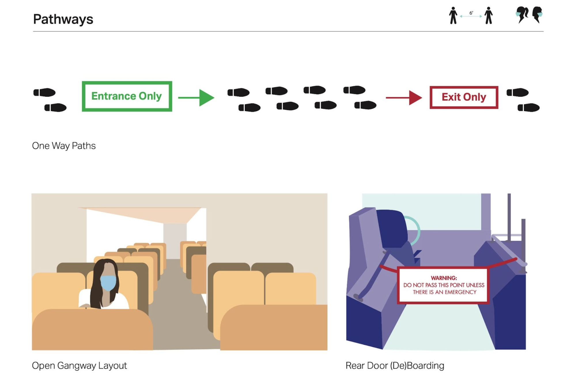
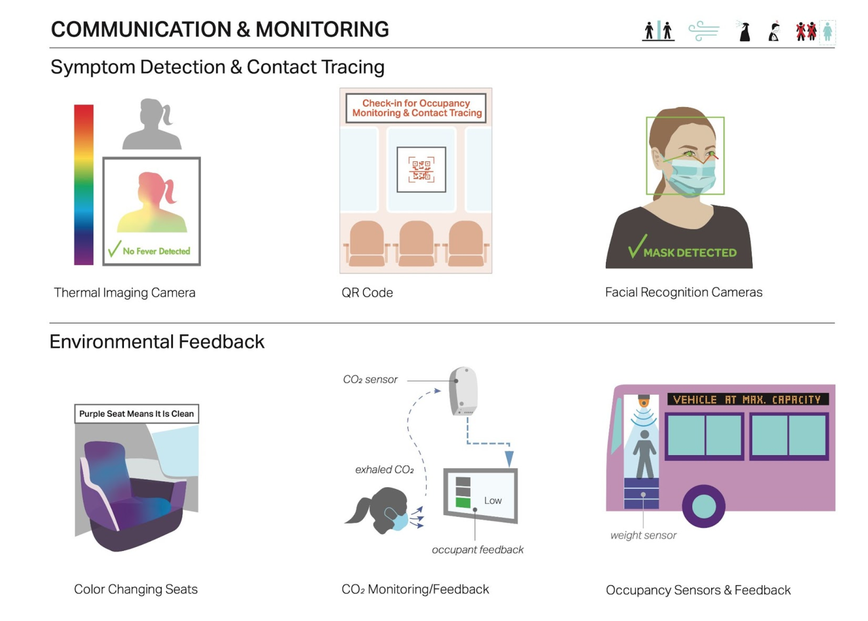
Interviews
User Perspectives
n = 20 UCD students
Expert Perspectives
n = 23 UCD faculty and staff
Infectious Disease Faculty and Clinical Staff
Air Quality Researchers/Engineering Faculty
HVAC Engineers/Researchers
Social Scientists researching COVID
Notes:
After we inventoried the design strategies, we conducted two series of interviews. All interviewees were affiliated in some capacity with University of California, Davis, also known as UC Davis. Interviews discussed the identified strategies, features, and mitigation mechanisms to gauge public perceptions of effectiveness and understand potential actual effectiveness from experts. Graphics of the identified features, such as those displayed on the right side of the screen, were shown to interviewees for a visual and explanatory experience.
To begin to gauge user perspectives on perceived effectiveness and preferences, we interviewed 20 UC Davis students, all regular users of some type of public transit or shared mobility prior to the pandemic. These interviews with a convenience sample are intended as initial explorations to identify key themes, and we hope to later conduct a large-scale survey of a more representative sample.
For more valid and objective assessment of potential effectiveness, we interviewed 23 UC Davis faculty, research, and administrative staff with expertise in fields related to COVID-19 and/or its transmission, including: 5 physicians and 3 administrative staff at the Division of Infectious Diseases, 1 respiratory toxicologist, 3 engineers whose foci include airborne pathogen exposures; 6 engineers who specialize in heating, ventilation, and cooling and/or related controls systems, 3 epidemiologists, 2 of which had expertise in air pollutant exposures and 1 in environmental justice, and 2 social scientists with public health and communication backgrounds, whom both have conducted research on COVID; they shed light on the potential influence of user behavior on strategy effectiveness. We hope to expand to experts beyond UC Davis in future work.
By triangulating insights from experts and consumers, we can identify design solutions that objectively mitigate the risk of COVID-19 transmission, and are acceptable and perceived as valuable to consumers of shared and pooled transportation.

Slide 11
Results

Slide 12
COVID-19 Risk-mitigating Vehicle Design (CRVD) Typology
Vehicle Design Strategy Type | Definition
Seating Configuration | Specifying where riders sit (or stand) in the vehicle, including location and orientation through signage or structural changes (temporary or permanent)
Pathways | Specifying how riders move about the cabin, e.g., boarding and deboarding
Barriers | Vertical partitions of various sizes and materials that separate the air space between passengers and between passengers and mobility workers
Space Conditioning | Equipment or setting that improves ventilation (brings outside air into the vehicle, moves inside air out), air circulation (movement of air inside the cabin), air filtration (trapping airborne particles), or air purification (cleaning the air that is circulating or introduced into the vehicle)
Onboard Surface Sanitization | Installed equipment and settings in vehicles that implement sanitization processes
Hygienic Materials | Surface materials and construction that keeps vehicles cleaner
Touchless Technology | Adaptations or new mechanisms, including automated technologies, that limit driver/rider physical contact and interaction with the vehicle
PPE Provisioning | Onboard provision of personal protective equipment and supplies
Communication & Monitoring | Features that collect and/or display information to passengers and/or service providers
Multimodal Support | Features that facilitate multimodal trips to limit time in more shared or pooled modes
Notes:
Through our literature review, we developed the Covid-19 Risk-mitigating Vehicle Design Typology, or CRVD Typology.
The ten vehicle design strategy types of the CRVD typology include seating configuration, pathways, barriers, space conditioning, onboard surface sanitization, hygienic materials, touchless technology, PPE provisioning, communication and monitoring, and multimodal support.

Slide 13
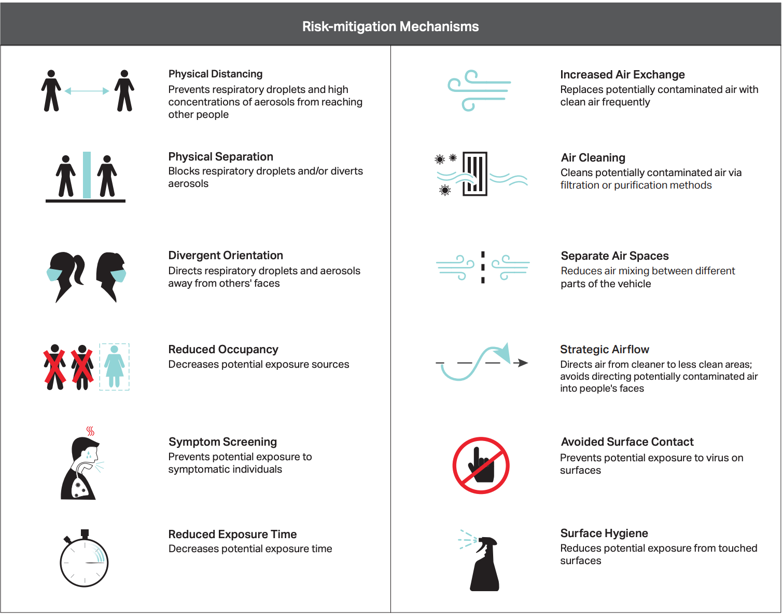
Notes:
Through our analysis, including interviews with experts, we also articulated 12 different mitigation mechanisms by which these strategies may reduce the risk of COVID transmission.

Slide 14
Strategies to Mitigate Fomite Transmission
Notes:
Most of the mechanisms can be divided into two general categories: those that mitigate the risk of fomite transmission (contacting the virus on surfaces) and those that mitigate the risk of airborne transmission through droplets and aerosols. I’m going to review several of the CRVD categories that mainly relate to each fomite and airborne transmission and then summarize some of the interview insights.

Slide 15
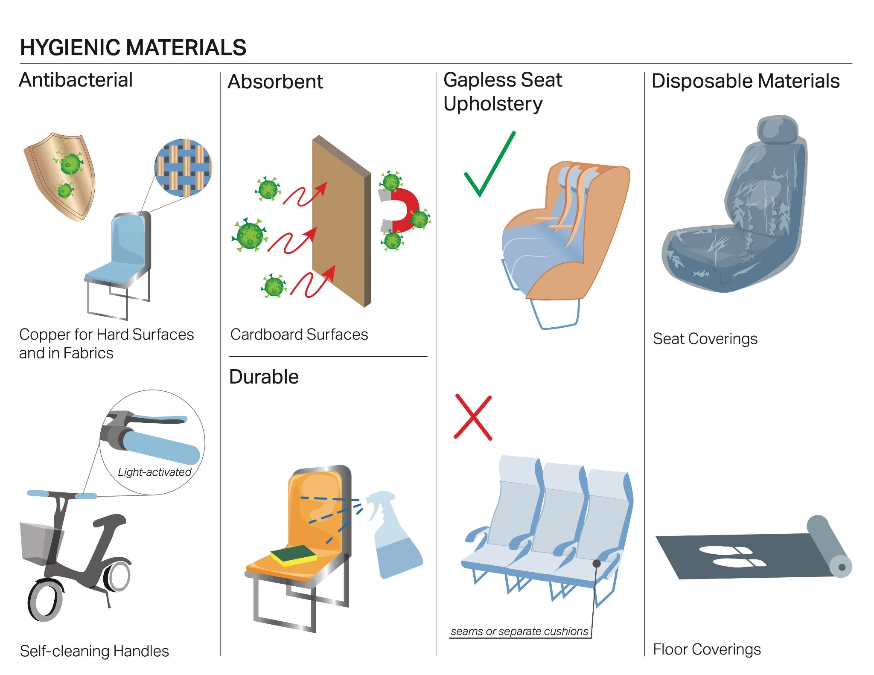
Notes:
One CRVD category related to fomite transmission is Hygienic Materials, which includes surface materials and construction styles that keep vehicles cleaner; for example, using antibacterial materials like copper, absorbent materials that soak in the virus such that it won’t easily transfer off the surface, and durable materials that hold up to frequent cleaning, as well as constructing seats to have fewer crevices that trap dirt and germs.

Slide 16
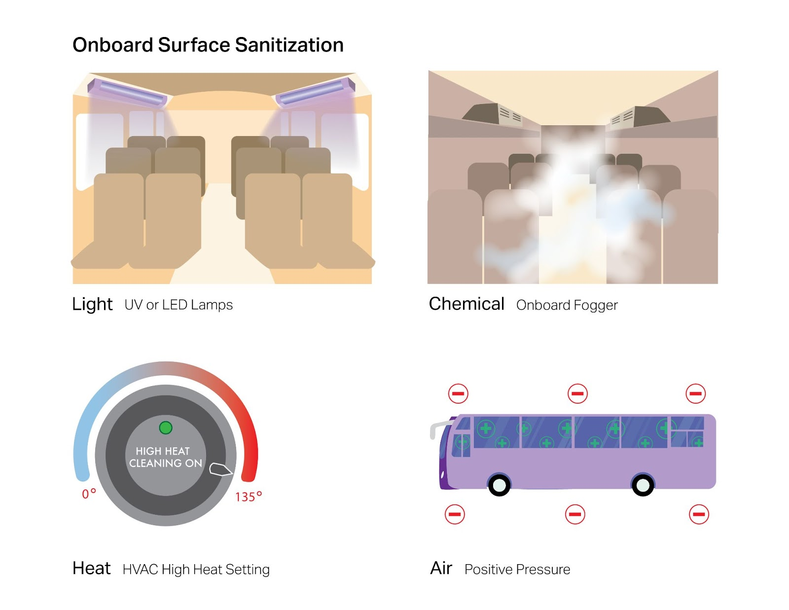
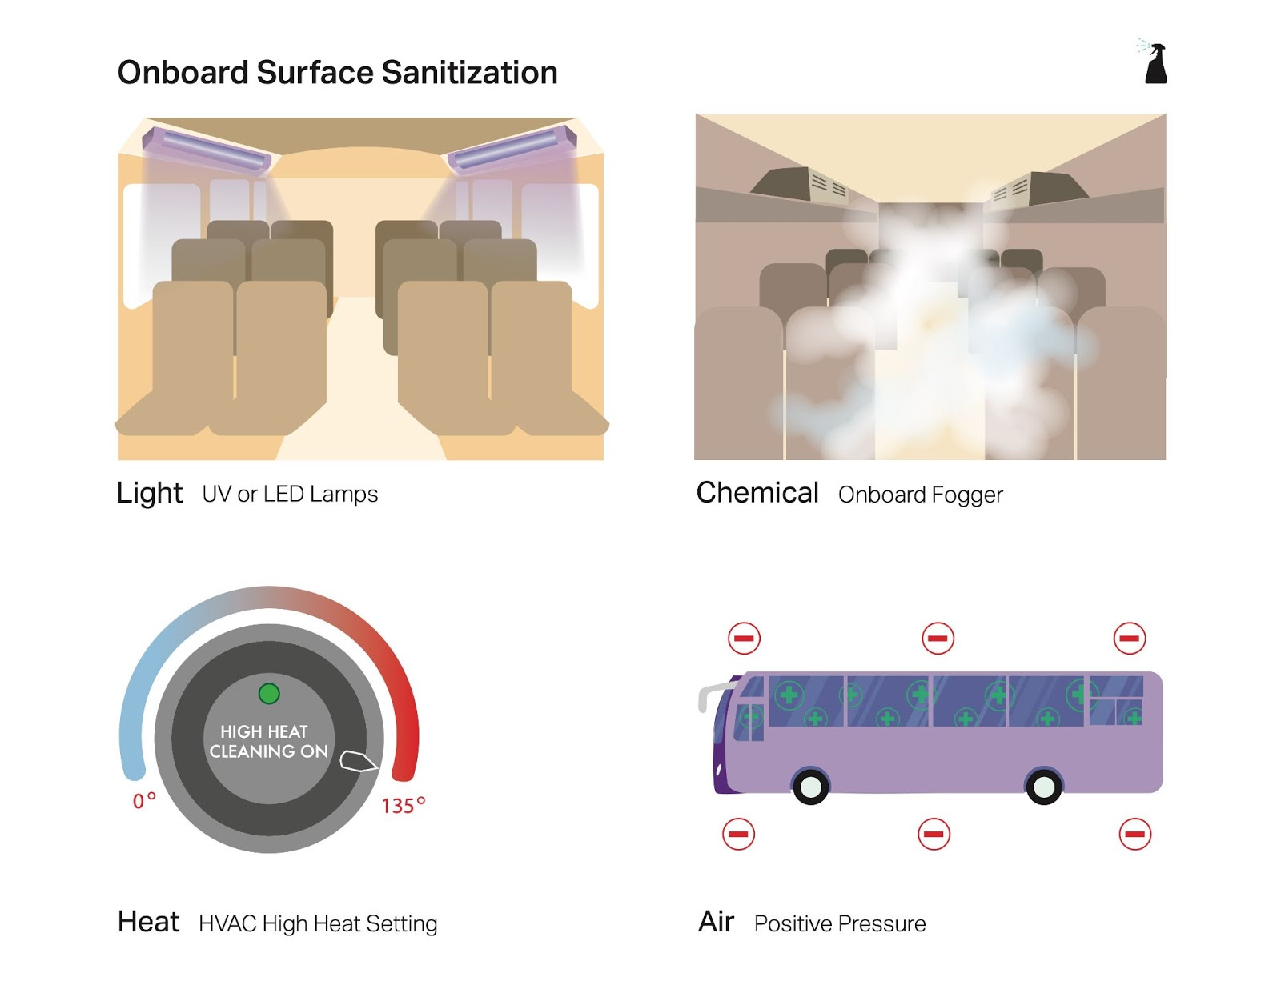
Notes:
Another related category is Onboard Surface Sanitization, which refers to equipment installed in vehicles that implements surface cleaning processes, often when the vehicle is unoccupied, but in some cases cleaning might occur during vehicle operation. There are several different general types of onboard sanitization processes, including cleaning with light, chemicals, heat, or air pressure.

Slide 17
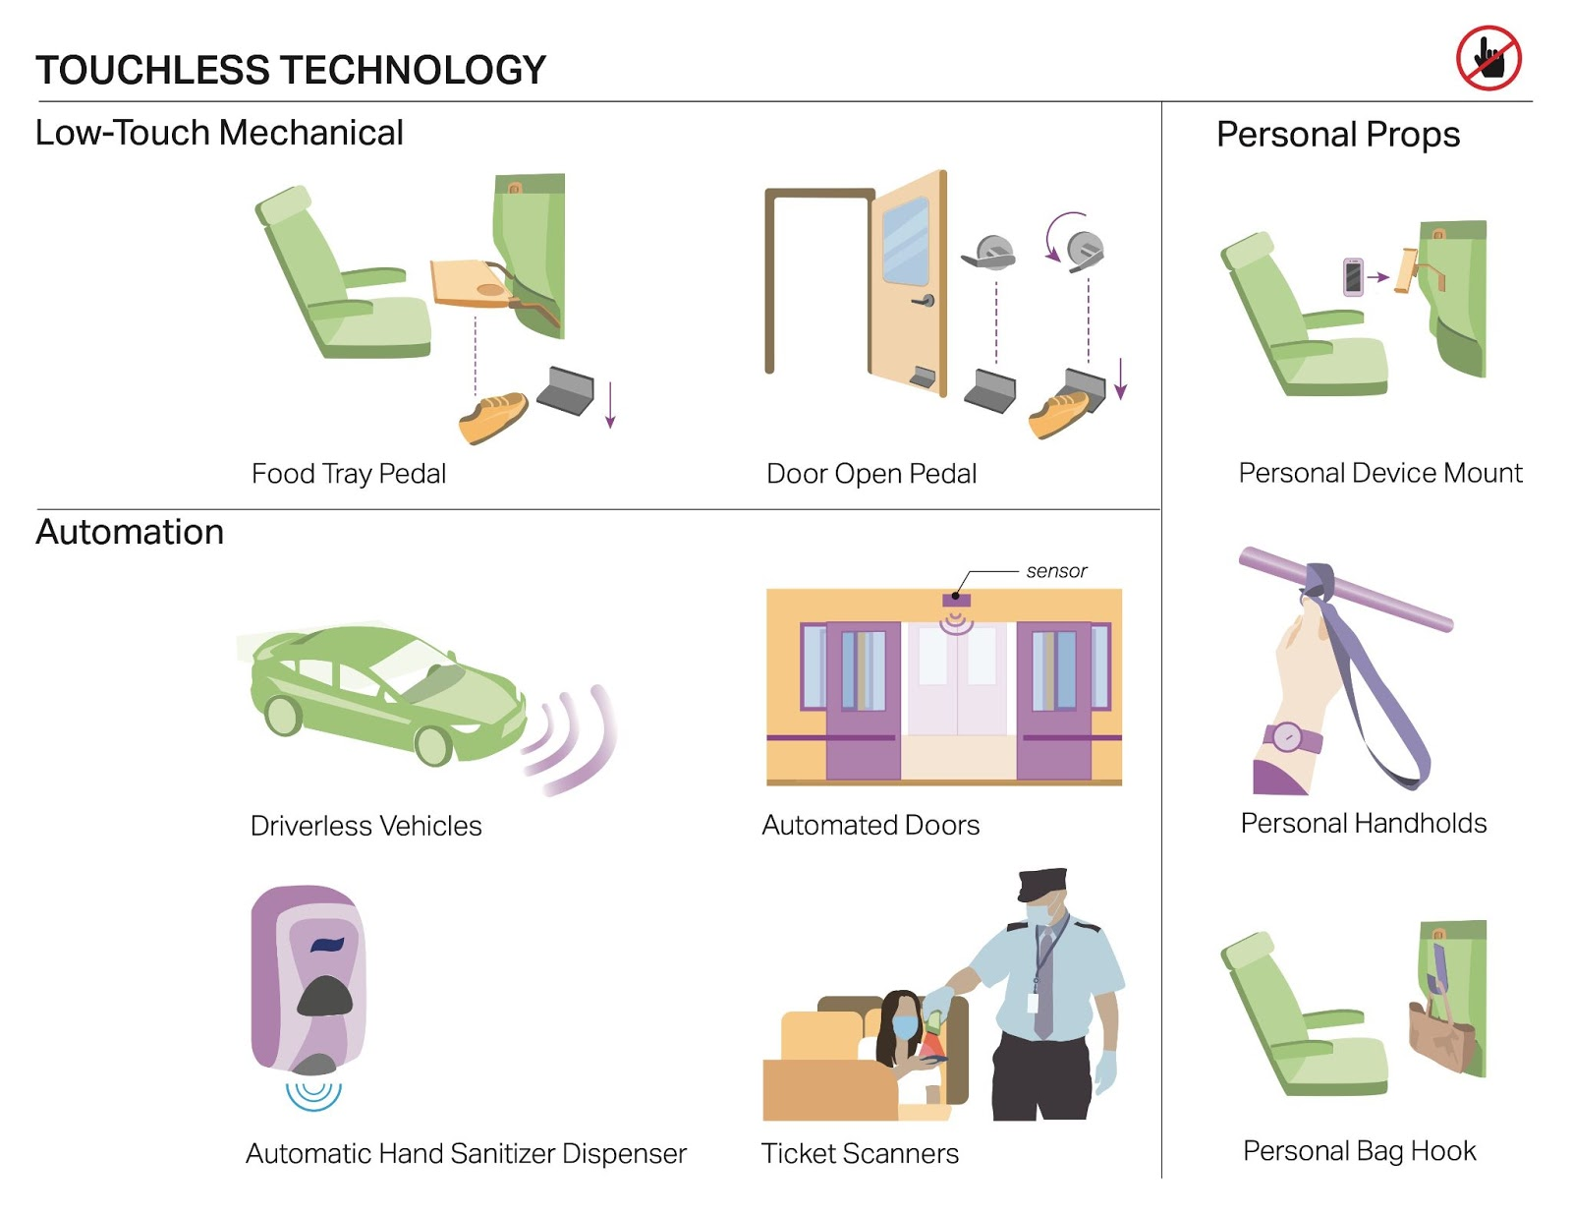
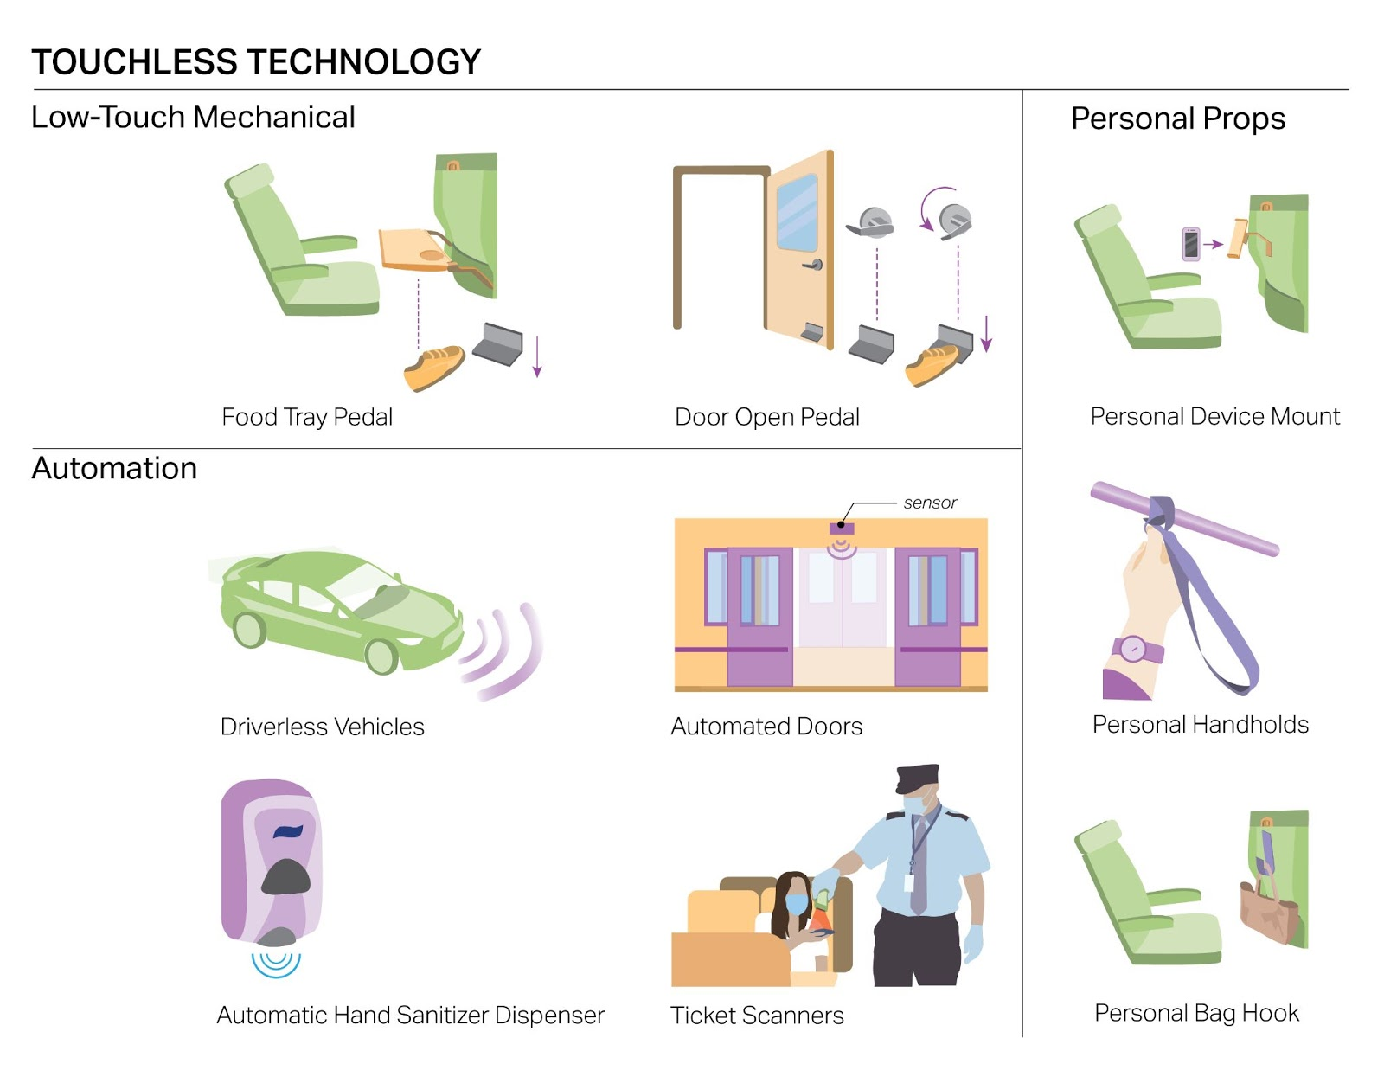
Notes:
Touchless Technology refers to adaptations or new mechanisms, including automation, that allow drivers and passengers to interact with the vehicle without touching it. Automation ranges from automated ticket scanners that replace employees physically collecting tickets, to fully automated driverless vehicles. Also included are personal props provided by service operators like a mount for your phone instead of a shared tablet, and a handhold strap that you can keep and bring with you whenever you ride.

Slide 18
Interview Insights
Perception of cleanliness
May not be accessible to all of the population
Airborne transmission trumps fomite concerns
Safety concerns regarding introduction of chemicals to habitable environment
Post-COVID implementation: yes
Notes:
Most student and expert interviewees felt that these strategies would be valuable to mitigate the risk of COVID spread, but only to a limited degree and thus should not be high priority in terms of resource allocation. Both experts and students mentioned that transmission from surfaces (fomite transmission) is not the main mode of COVID spread. In general, they liked the idea of strategies that make cleaning easier, strategies that kill the virus, and automation, and felt these would be useful to retain beyond COVID to protect health and hygiene. Some said these strategies might give people “peace of mind”/make them “feel safer”, but warned not to “solely rely on them”, because fomite transmission is not as important as airborne transmission. Interviewees felt that these strategies would be more important for high-traffic vehicles where there is little opportunity for cleaning in between uses (e.g., trains, buses). Experts and students both pointed out potential accessibility issues with some touchless technologies, like foot pedals to operate doors and tray tables. There was also some uncertainty and skepticism, particularly among students, about potential hazards of chemical cleaning processes and the effectiveness of less familiar and less visible strategies, like self-cleaning handles and absorbent materials. Our social scientist-interviewees noted the importance of including an educational component to any strategy that is unfamiliar or invisible in order to promote understanding, and thereby perceived safety, as well as compliance in some cases.

Slide 19
Strategies to mitigate Airborne Transmission
Notes:
Moving on to Airborne Transmission...

Slide 20
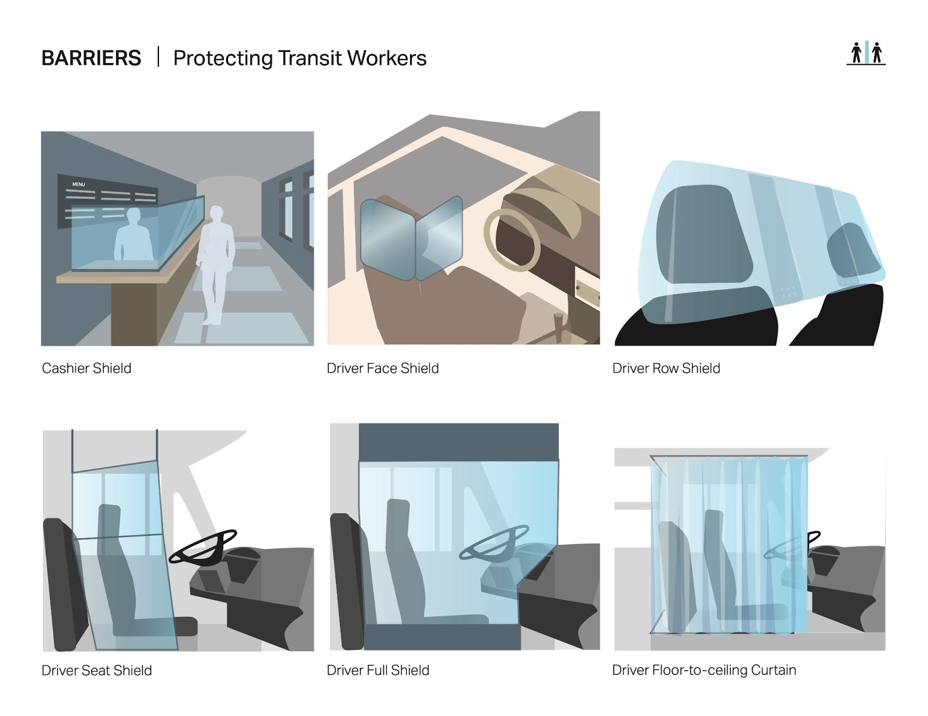
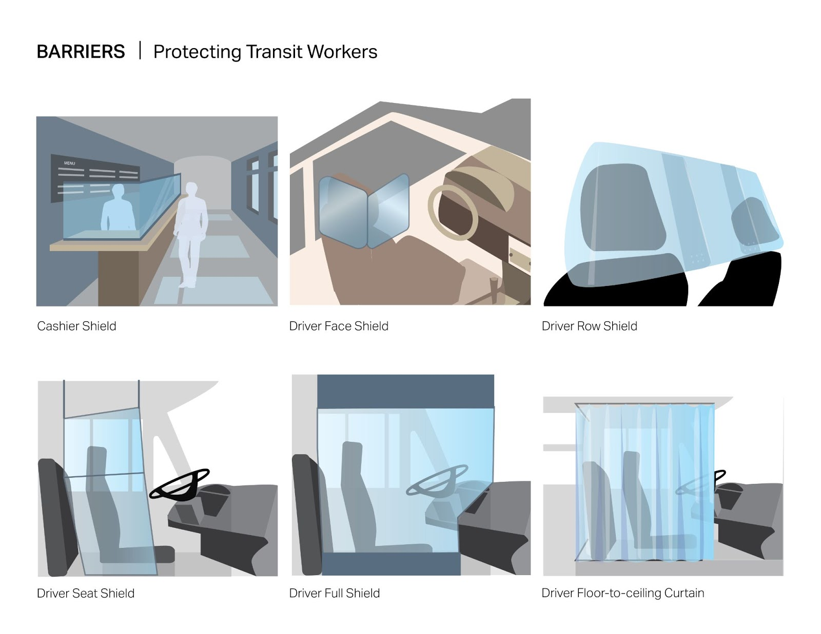
Notes:
Barriers are being implemented in many contexts including vehicles. These are vertical partitions of various sizes, usually transparent hard plastic screens but sometimes also soft plastic curtain-like material. We found these different types of barriers that specifically aim to separate transit workers from passengers…

Slide 21
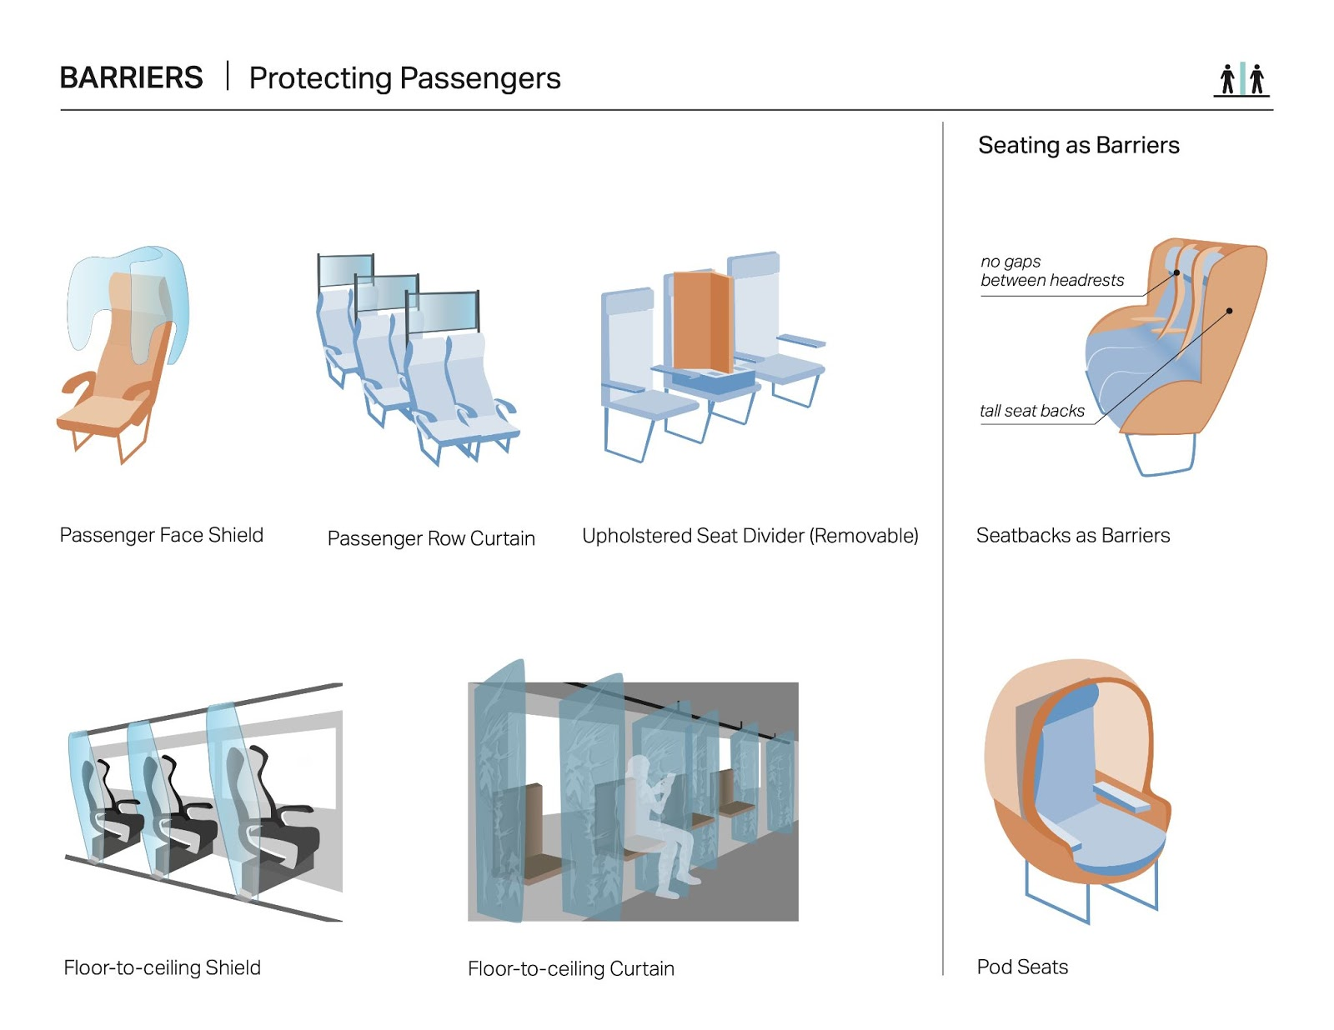
Notes:
And a variety of others aimed at separating passengers from each other… including added barriers as well as some ideas to use seating as barriers, like pod seating or having high seatbacks.

Slide 22
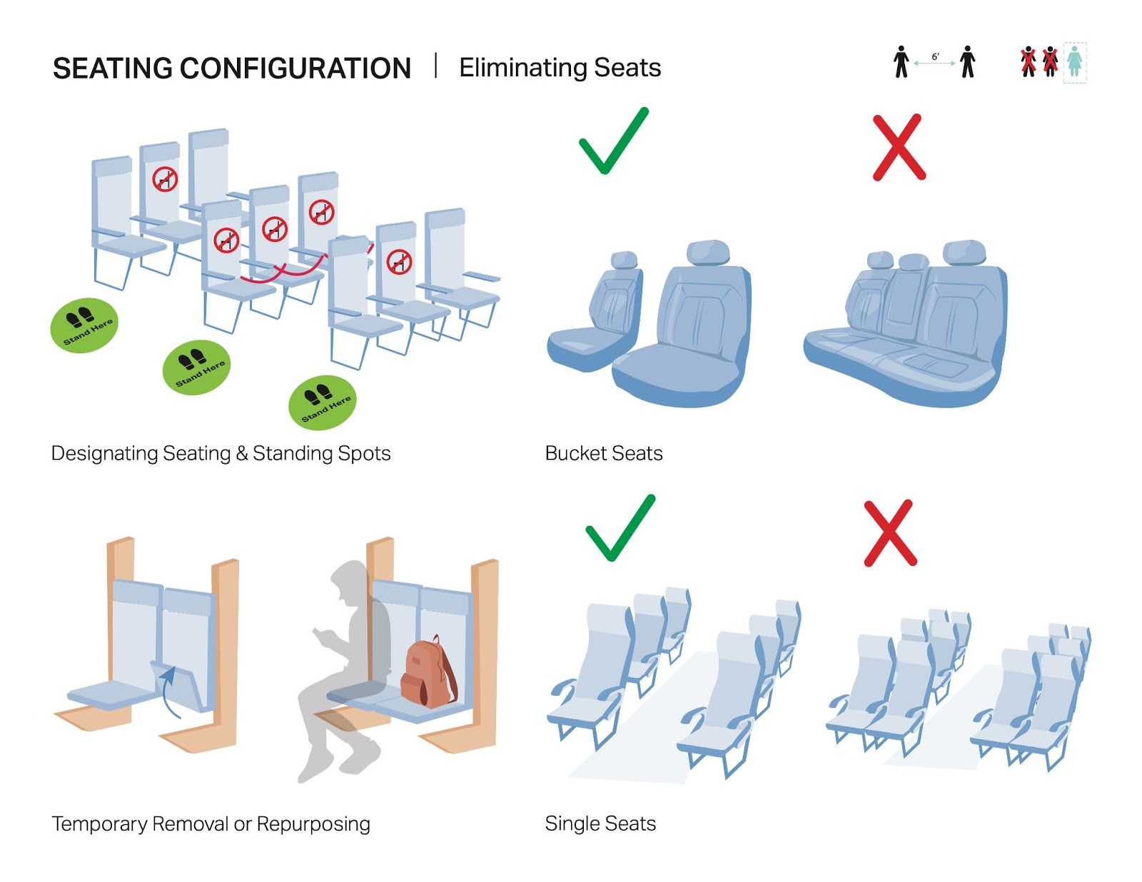
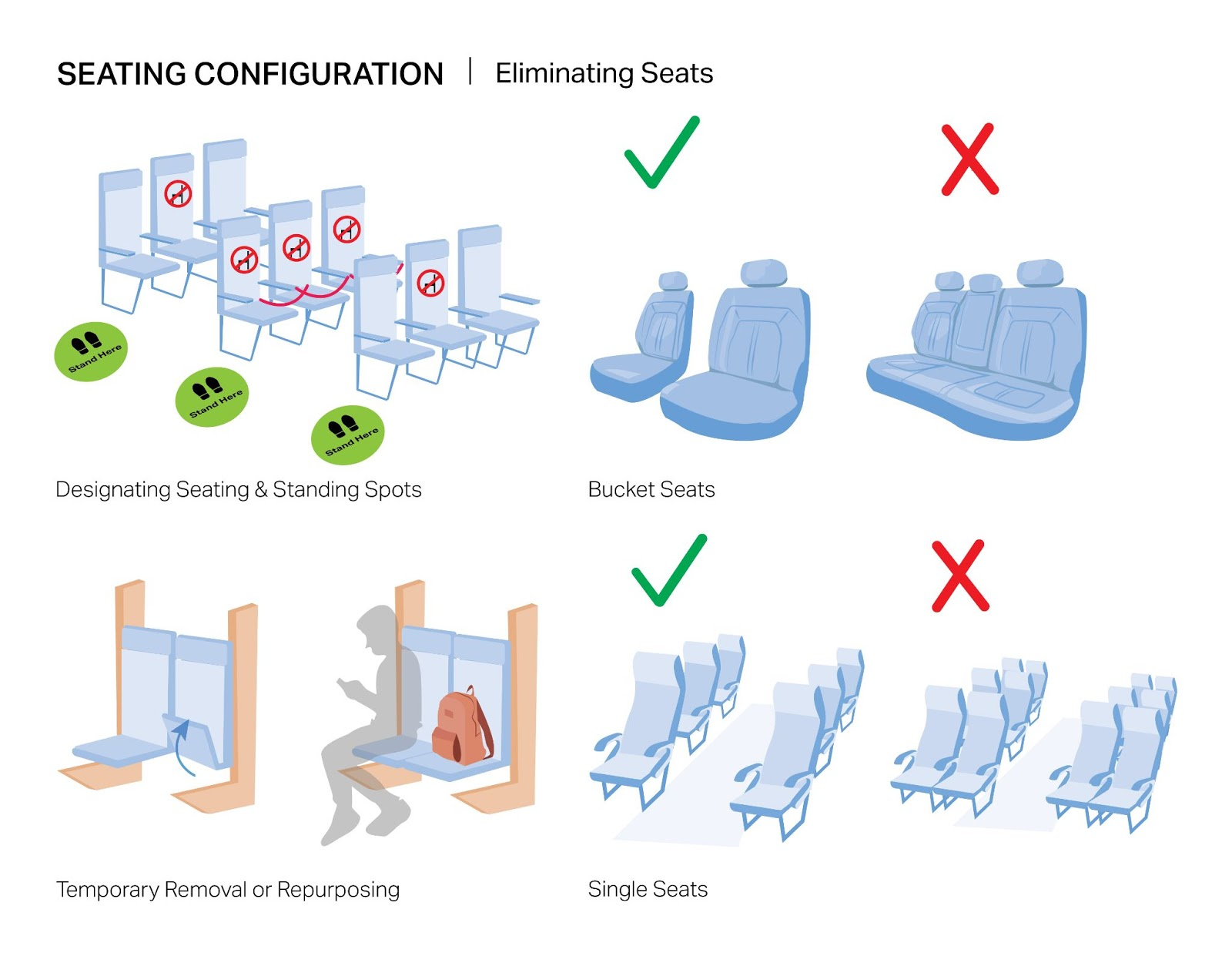
Notes:
Seating strategies include eliminating seats, either by roping them off or adding signage, or policies that allow passengers to use the seat next to them for storage. There are also more involved redesigns like replacing bench seating with fewer bucket seats, or new layouts with no directly adjacent seats.

Slide 23
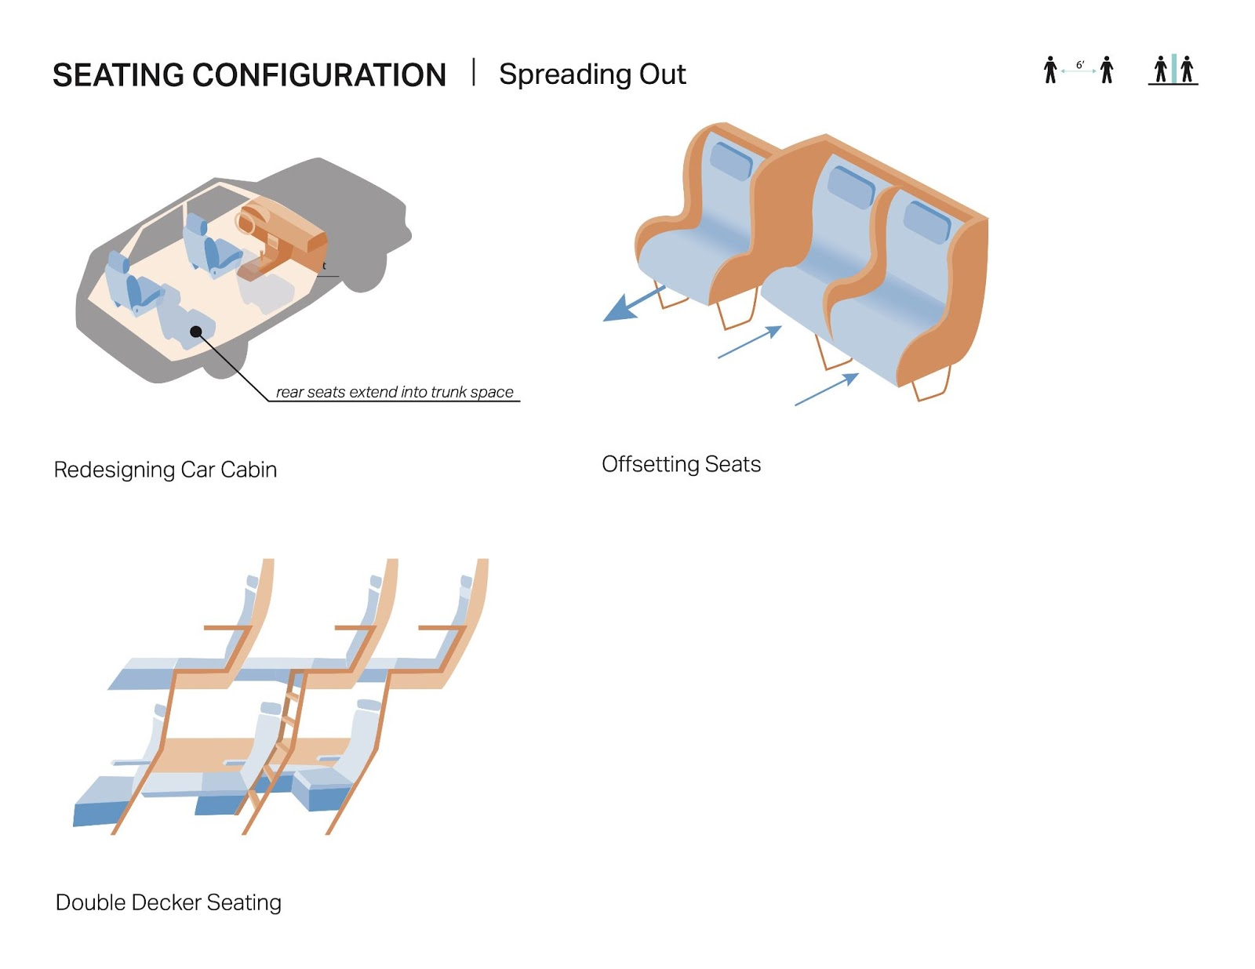
Notes:
Another seating-related tactic is to spread seats or passengers out more without necessarily eliminating any. For example, new car layouts eliminate the traditional trunk space to make more room for each passenger, double-decker seating, and offsetting seats within a row so you are not quite as close to someone next to you.

Slide 24
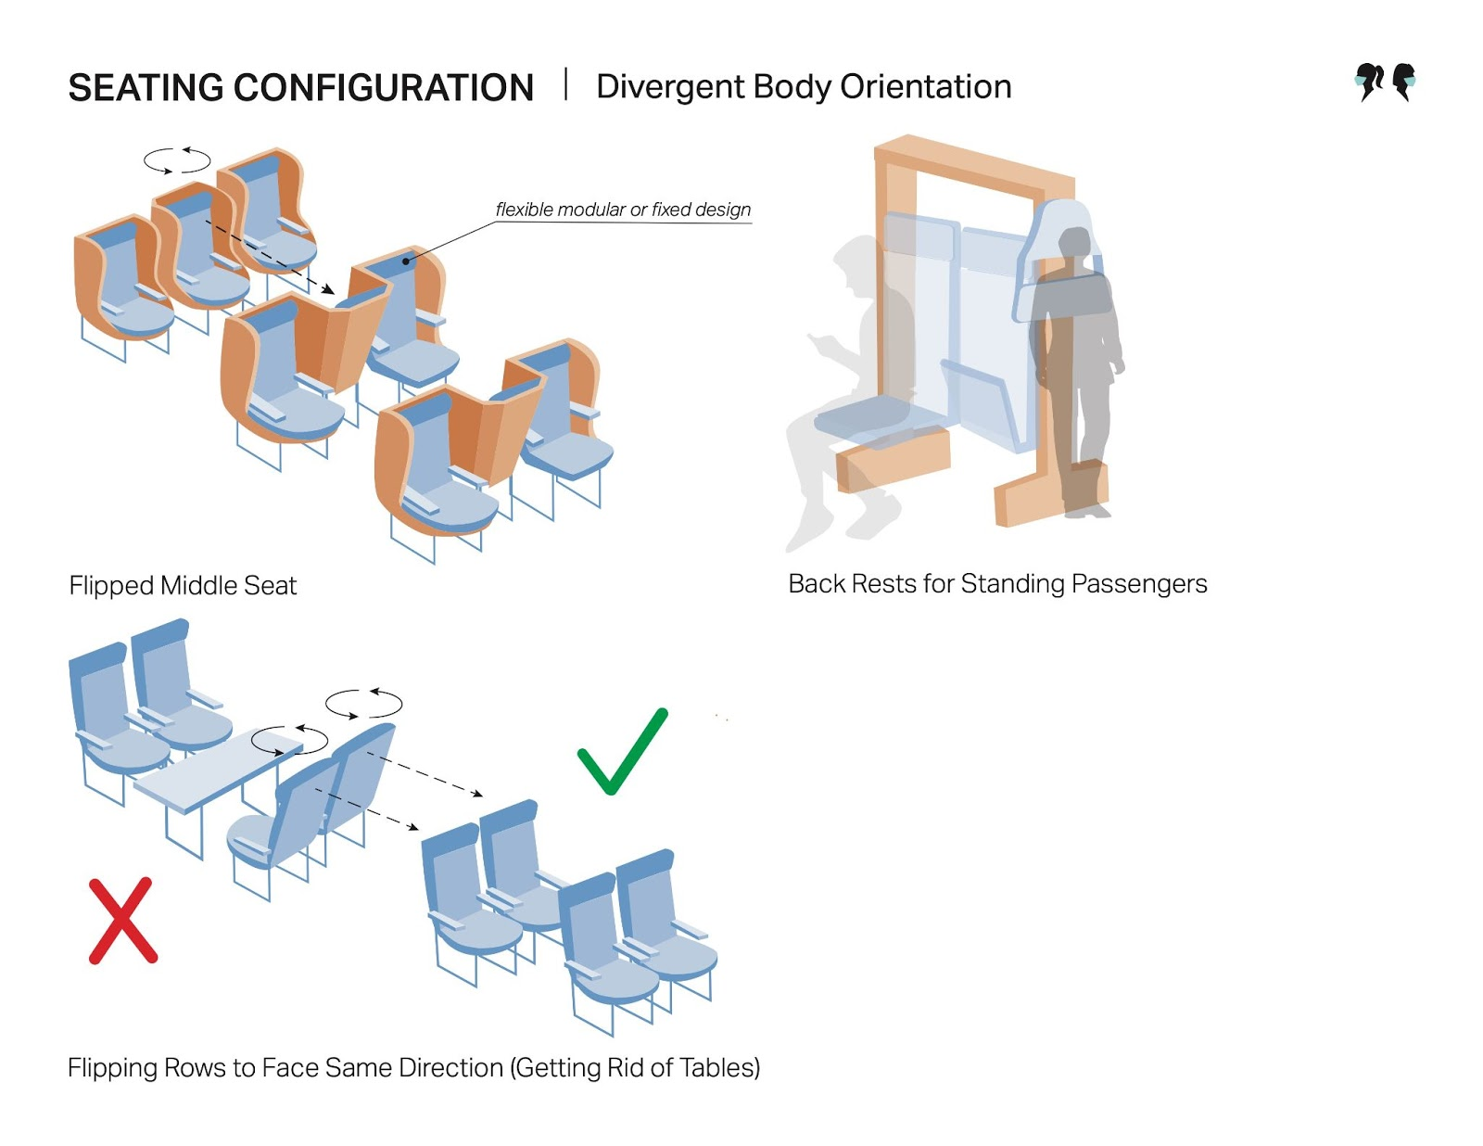
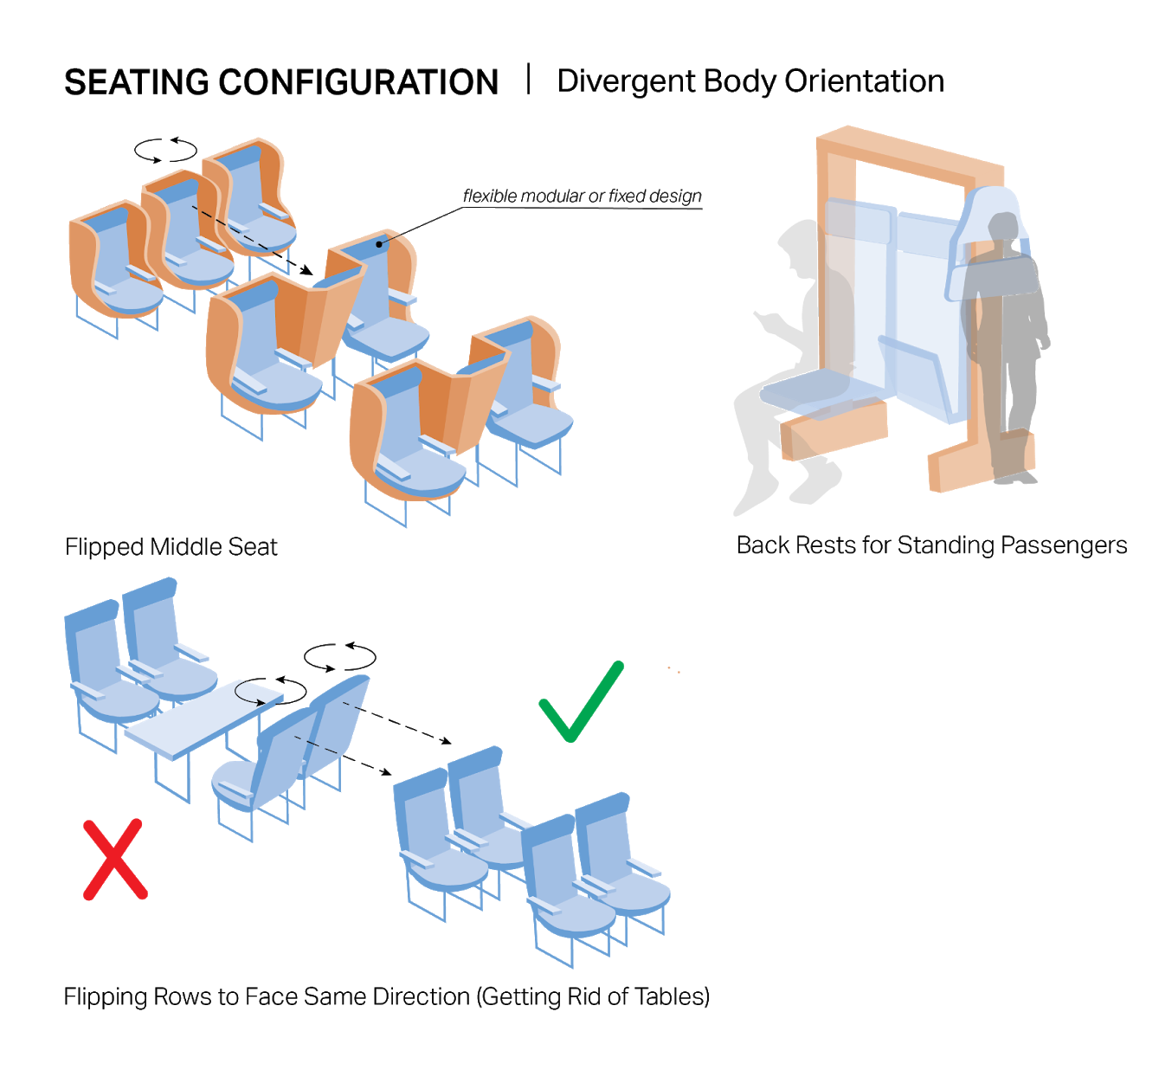
Notes:
The last category of seating strategies is about reorienting passengers' bodies to face different directions. These include flipping the middle seat, removing tables in trains and flipping whole rows of seats to face the same direction, and adding back rests to specify where standing passengers should ride and which direction they face.

Slide 25
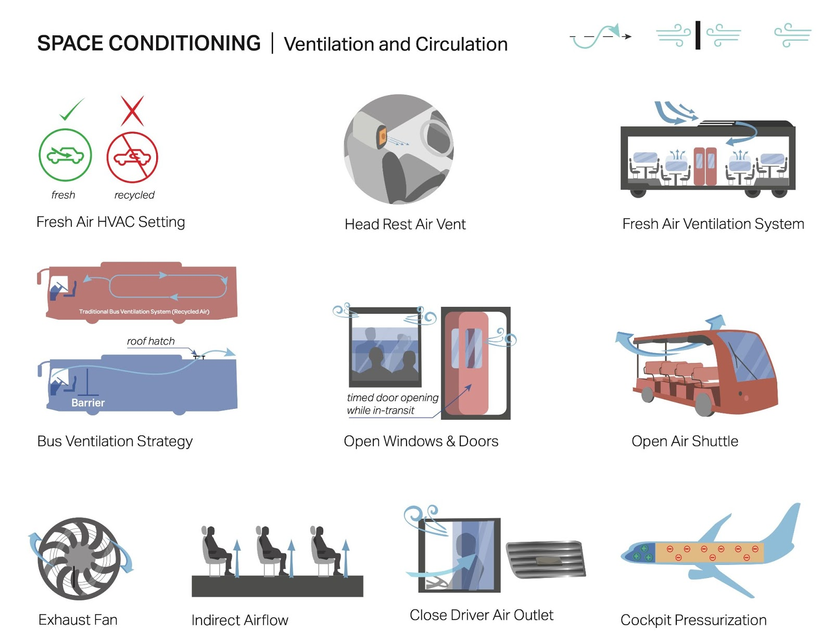
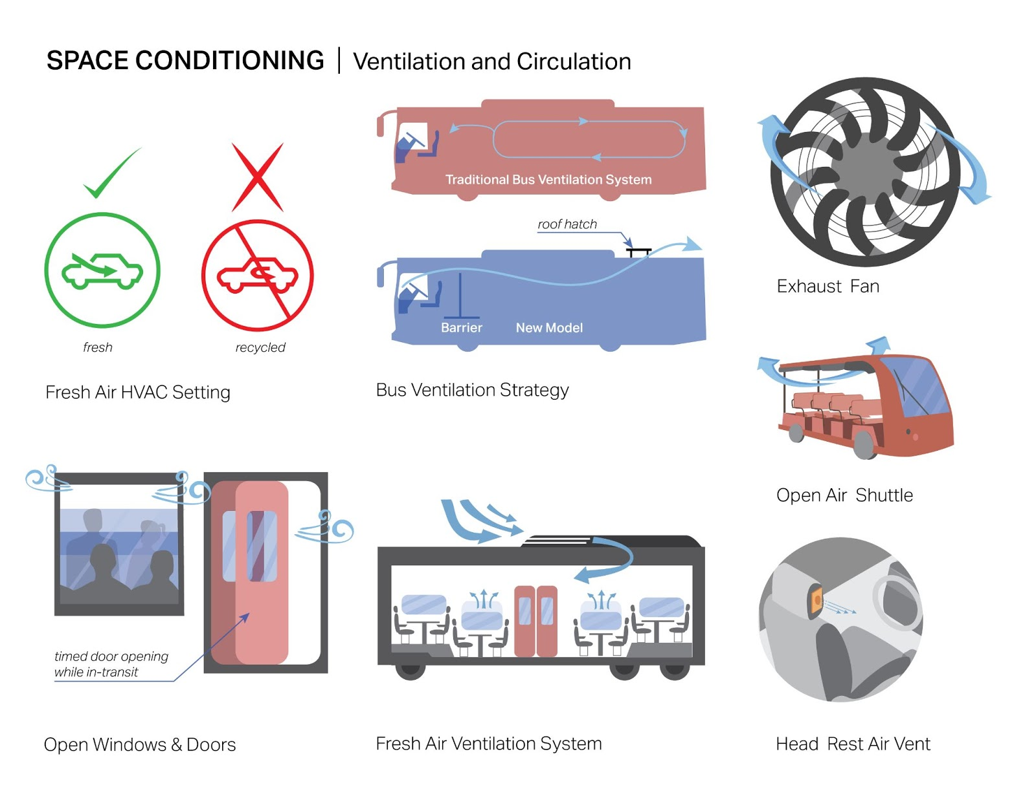
Notes:
Space Conditioning includes strategies to increase Ventilation and Air Circulation, such as using the fresh air setting on the HVAC system instead of recycled air, opening windows and doors, using exhaust fans to move air out, and strategically controlling the airflow through venting or pressurization to reduce air mixing among passengers.

Slide 26
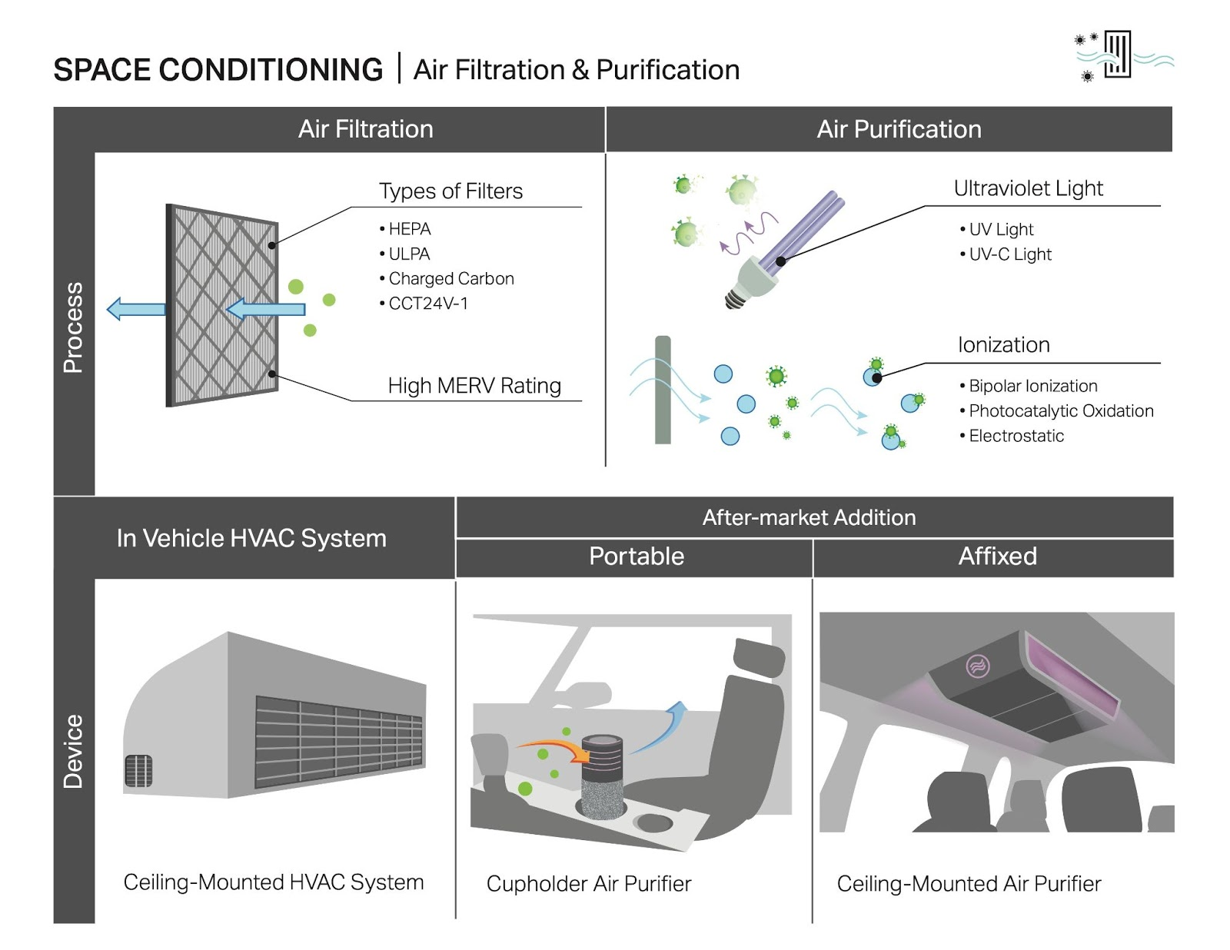
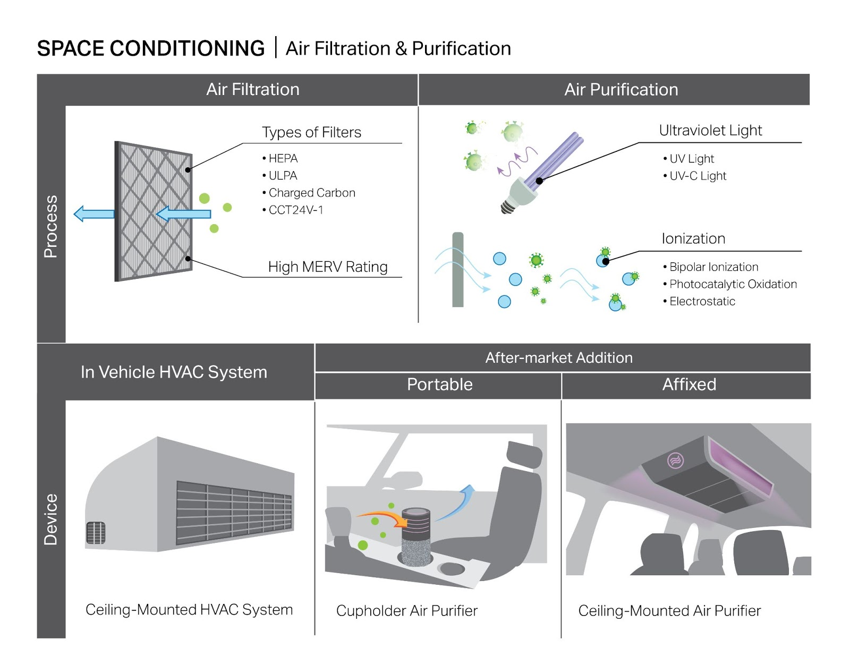
Notes:
Other Space Conditioning strategies involve Air Filtration and Purification, using mechanical air filters, UV light, and/or ionization processes. These processes can be implemented inside a vehicle's HVAC system or in add-on devices like portable or mounted air purifiers.

Slide 27
Interview Insights
Seating
Barriers
Space Conditioning
Layperson: Likes fresh air; comfort concerns; unfamiliar but impressed with purification
Expert: can impact air exchange negatively
Both: reduced occupancy more important
Layperson: liked distance; temporary solutions
Layperson: bigger is better
Expert: air exchange and flow = key; filtration = important; purification = it depends!
Expert: behavior is key; talking expels magnitudes more particles than breathing
Both: particularly important for workers
Notes:
The students we interviewed had knowledge of the latest information about the relatively greater risk of airborne, including aerosol, transmission. When we asked them to rank the design categories from most to least important, collectively they ranked Space Conditioning strategies as most important and Barriers as third most important. Onboard PPE Provision was ranked second.
For barriers, students preferred hard plastic shields to soft plastic curtains and mentioned they would be easier to clean. They also felt that the bigger the barrier the better. They liked the idea of additional privacy afforded by the barriers, but worried about them interfering with communication and generally didn’t think they should be retained post-COVID, with the exception of barriers to protect workers, which they thought should be retained since workers have so much contact and could be better protected from other illnesses as well as potential violence from passengers. Experts saw barriers between passengers as less important if masks are worn since, like masks, barriers are better at blocking droplets than aerosols, with one expert noting that barriers may actually do harm by creating stagnant air pockets that could increase aerosol transmission.
For seating, most people liked the idea of more space, particularly in planes, but had doubts about corporations or transit operators being willing or able to sacrifice higher ridership and did not want to incur higher costs to ride as a result. Many thought blocking off, temporarily removing or repurposing seats was more practical than eliminating or reconfiguring seats permanently, and some strategies might make it harder for groups to travel together. Although they also noted that passengers might not comply with simply marking seats as off-limits.
Space conditioning is the most important and unfortunately most complicated category. Air exchange is crucial to replace potentially contaminated air with clean air. Airflow is also important. Systems should move air from clean to less clean areas, avoid blowing potentially contaminated air into people’s faces, and they should push air toward the exhaust outlet. Our experts noted that the virus particles are relatively large. A MERV-rated 12 or 13 would catch them (for reference, the highest MERV rating is 20), and they also confirmed that HEPA filters are good, although not every HVAC system can use them because they require a higher level of power. They noted that there could be some potential benefit to adding UV purification, but that this also introduces more room for error because it can be done wrong and adds more equipment to be maintained in order to function properly. One expert pointed out that ionization methods can actually be harmful, as they could introduce other pollutants, namely ozone, into the indoor environment.

Slide 28
“[It] comes down to occupant density.”
“You can’t ventilate your way out of [crowding].”
- expert insight
- expert insight
Notes:
A powerful quote from one expert was, “you can’t ventilate your way out of crowding”.

Slide 29
Conclusions
White paper on CRDV typology
Future Research
Full research report, including interview data
Notes:
That was a brief overview of some of our identified CRVD categories and interview insights. We have a white paper that presents the CRVD typology, and a pending publication on the full study.

Slide 30
Future Research
Expand Inventory
Include station and service app features
Expert Input
Interview experts outside of UC Davis affiliates
Layperson Input
Interview a large, representative sample of public transportation users
Notes:
We are hoping to continue this research program by expanding our inventory of design strategies to transit service stations including bus stops, train stations and platforms, and airports, as well as to transit and mobility service app and website features. We also want to interview experts outside UC Davis, and conduct a large sample survey of essential workers who use public transportation and shared mobility services.

Slide 31
Our Team
PI: Angela Sanguinetti, PhD
Research Environmental Scientist
Institute of Transportation Studies
University of California, Davis
Ashley N. DePew
Graduate Research Fellow
Energy Graduate Group
University of California, Davis
Notes:
I’d like to thank my research team, and acknowledge that our funding came from California Senate Bill 1.

Slide 32
Our Team
Co-PI: Beth Ferguson
Assistant Professor
Department of Design
University of California, Davis
Ethan Louis Khoe
Undergraduate Researcher
University of California, Davis
Cindy Ross
Undergraduate Researcher
University of California, Davis
Kate Hirschfelt
Undergraduate Researcher
University of California, Davis

Slide 33
THANK YOU!
Do you have any questions?
Ashley N. DePew
andepew@ucdavis.edu
www.linkedin.com/in/ashley-depew-a6088517a
PI: Angela Sanguinetti, PhD
asanguinetti@ucdavis.edu
https://www.researchgate.net/profile/Angela-Sanguinetti
CREDITS: This presentation template was created by Slidesgo, including icons by Flaticon, and infographics & images by Freepik.
Please, keep this slide for attribution.
Notes:
If you would like to be notified when our publications come out please contact me or project Principal Investigator Angela Sanguinetti. Thank you so much for your time and I look forward to your questions.

