Slide 1
Evaluating Equitable Mobility Impacts with the Mobility Energy Productivity (MEP) Metric
Ambarish Nag, Chris Hoehne, Rob Fitzgerald, Stan Young, Venu Garikapati (PI)
SETT Conference, June 2, 2022

Slide 2
MEP Background

Slide 3







WHY DO WE WANT TO QUANTIFY
THE
QUALITY OF MOBILITY?
The ability to quantify the quality of mobility at a given location is the first step toward answering important questions, such as:
How do you evaluate competing infrastructure options for the dollar, which will also provide the greatest mobility for travelers?
Would businesses make different decisions about their location if they could assess the quality of mobility?
Would people change their choice of housing if they had a holistic mobility score before they purchased?
How does mobility impact a person’s quality of life?
How does an infrastructure investment impact the mobility of a place or a region?
In what way does new and emerging mobility technology enhance (or degrade) a communities’ overall mobility?
Notes:
In the transportation domain, access is defined as the ability of a network or system to connect people to goods, services, and employment that enable a high quality of life. We define mobility as the efficiency in providing access and we want to quantify this efficiency along energy, cost and time dimensions. Why in the first place are we interested in quantifying the quality of mobility ?

Slide 4
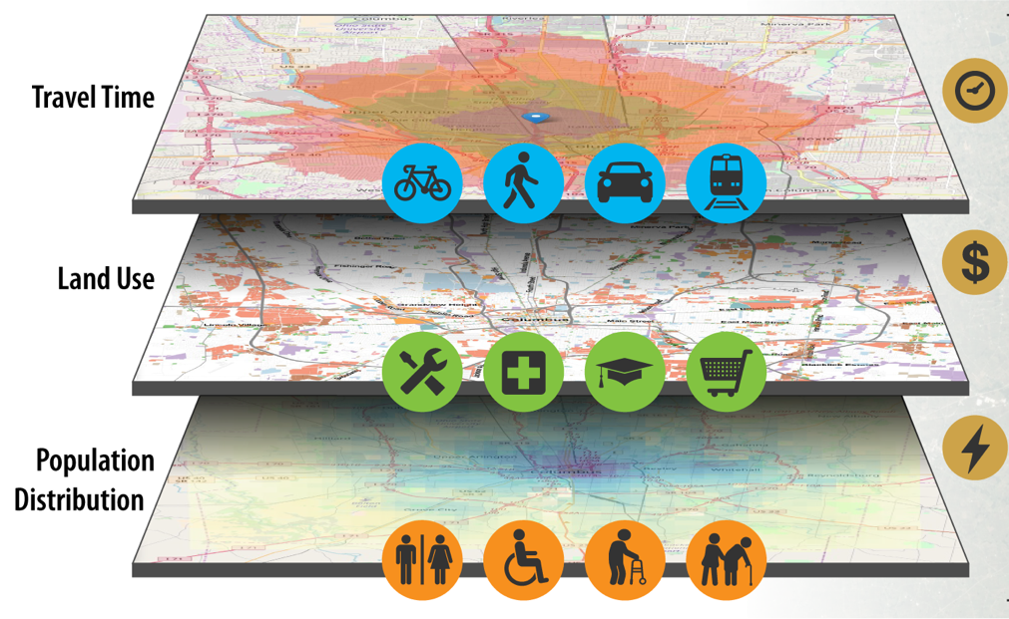
Introduction to MEP
Many ‘siloed’ metrics such as walk score, bike score, transit score, and average travel time index (by auto) are available to understand the mobility of a neighborhood
Effectively combine different modes into a holistic metric
Incorporate the energy & cost component as well as land-use and population information into the metric
Included weighting by modal preference factor depending on socio-demographics
Mobility Energy Productivity Metric = F (mobility weighted by [energy, cost, trip purpose, modal preference])
Notes:
Multiple mobility scores e.g. walk score, bike score, transit score already exist, but these are siloed in the sense that they are specific to individual transportation modes. We wanted to develop a more holistic measure of mobility that encompasses multiple modes of transportation. As a result of this endeavor, our team came up with the MEP metric. Mobility Energy Productivity (MEP) quantifies the mobility potential of a location to connect people to goods, services, and employment using a variety of modes, while accounting for time, energy, and affordability.

Slide 5
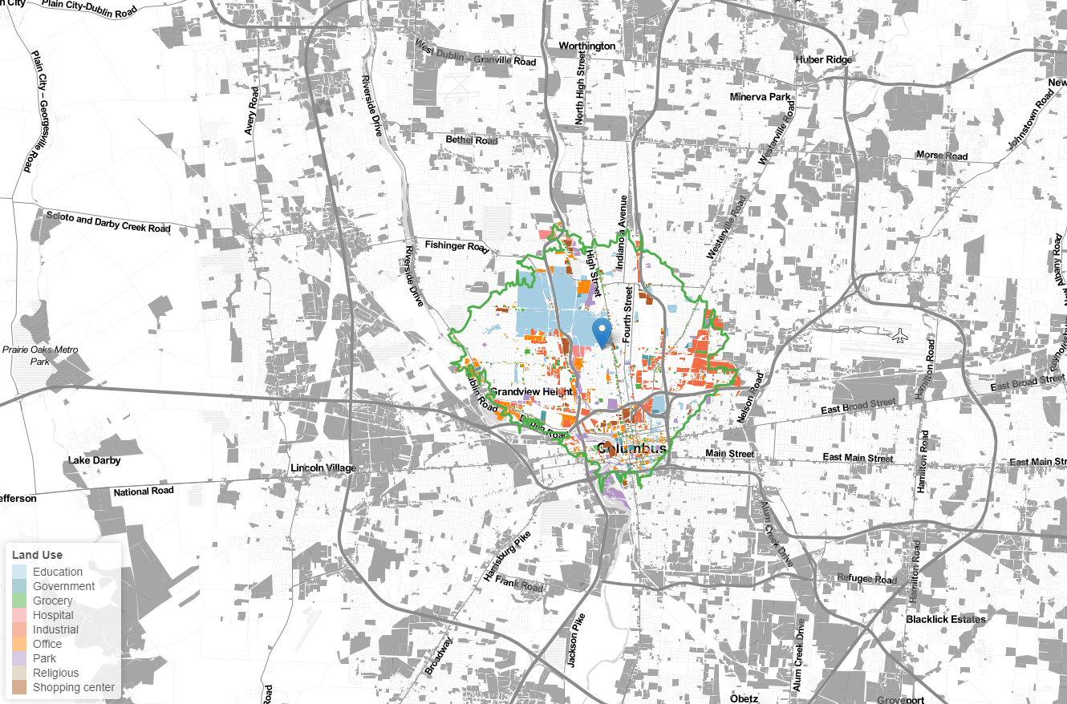
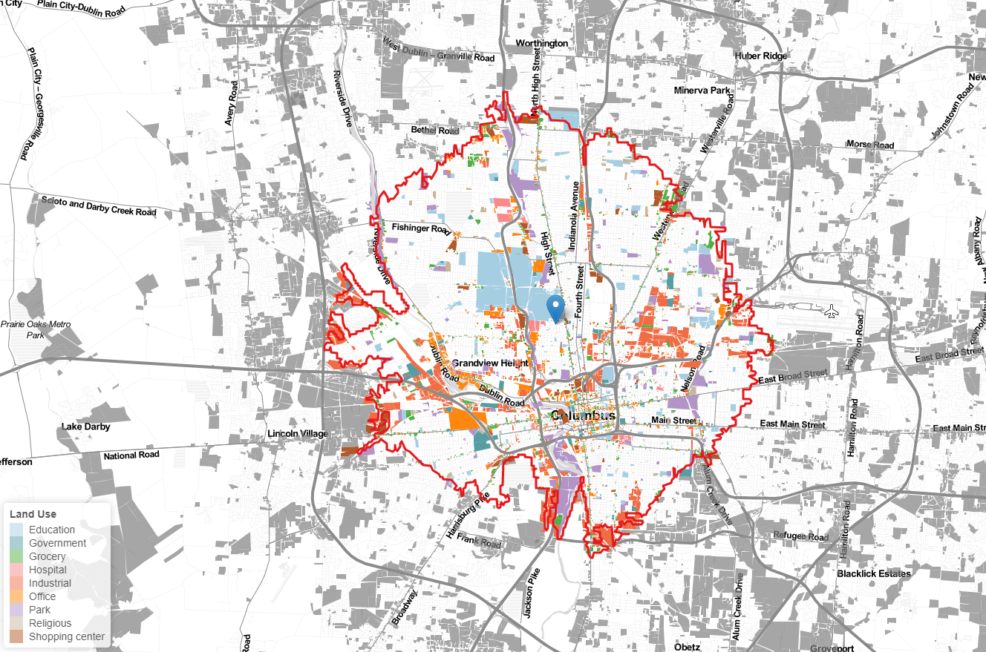
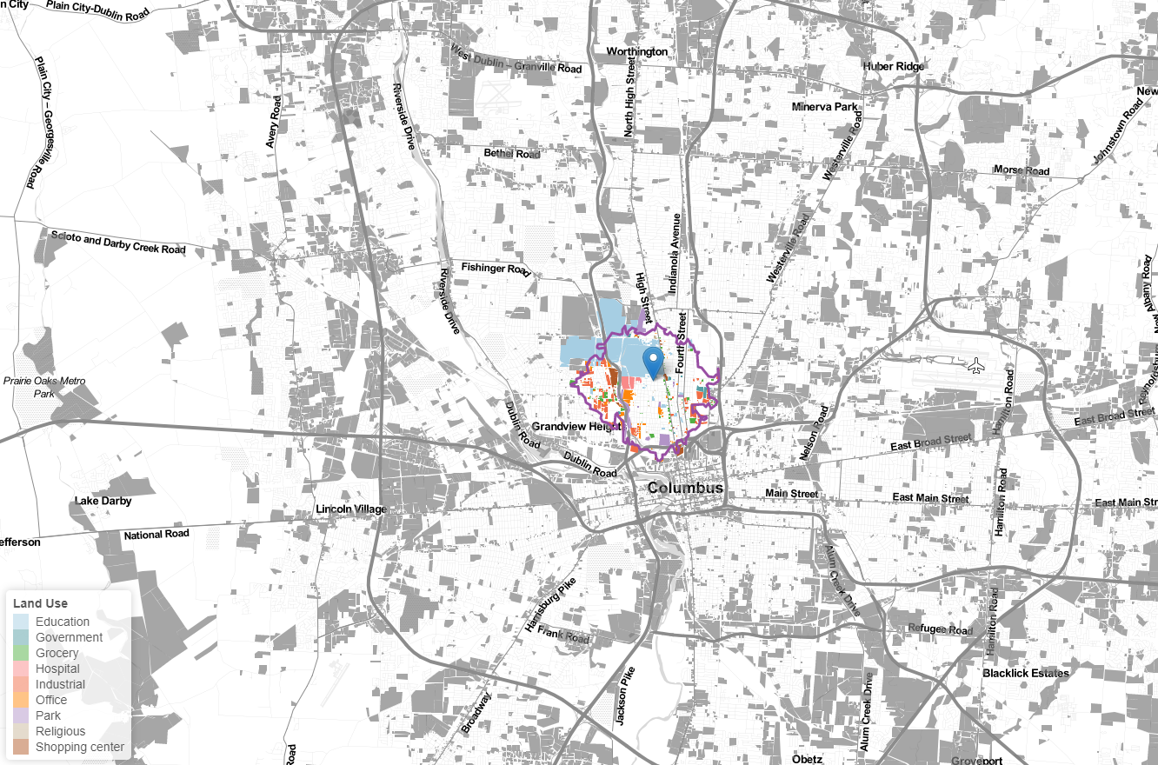
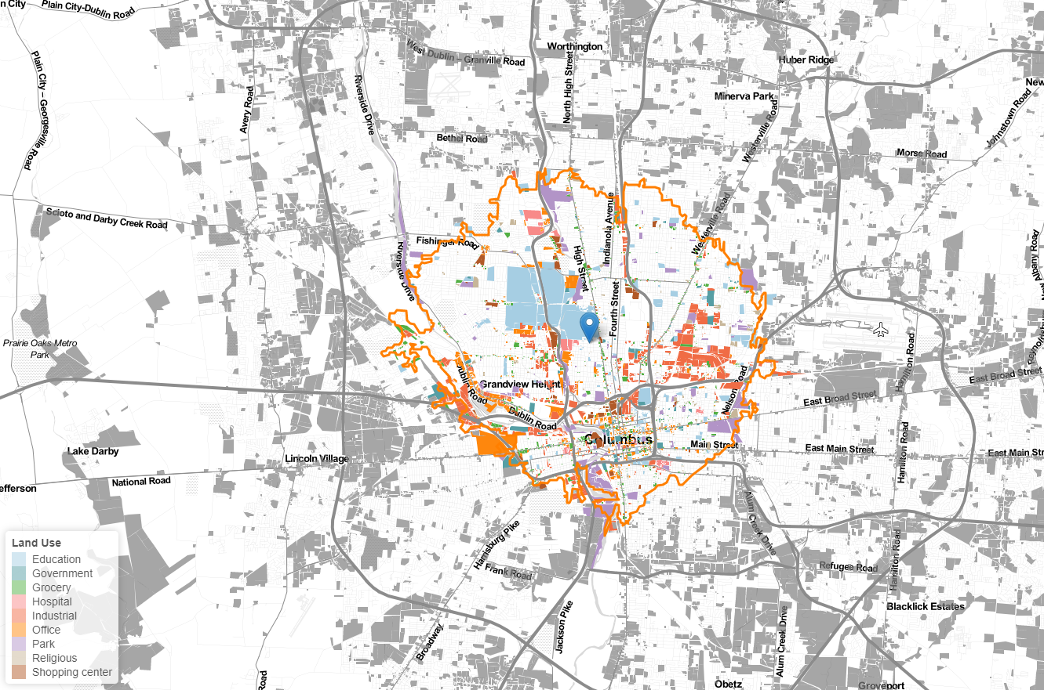
Isochrone
An isochrone is defined as “a line drawn on a map connecting points at which something occurs or arrives at the same time”
An example of opportunities accessible by biking
Notes:
To measure the number of opportunities that are reachable from a specific location in a given amount of time by a specific mode we use the concept of travel time isochrones. An isochrone is defined as …
More specifically, a travel time isochrone is a line on a map that connects all points reachable from a specific location in a specified time by a given mode. Let us consider a specific location in Columbus, OH denoted by the blue pin icon. The opportunities that can be reached from this specific location by biking within 10 minutes are bounded by the 10-minute biking isochrone shown in purple.
Next, the 20-minute biking isochrone shown in green encloses all opportunities that are reachable from the specified location in 20 minutes by biking. Similarly, the 30-min biking isochrone is shown in orange and the 40-min isochrone in red.

Slide 6


Basic Data Elements of the MEP metric
Quantify the number of opportunities that people can reach within a certain travel time threshold via different transportation modes
The opportunities measure is weighted by the time, energy, and cost-efficiency metrics of different transportation modes, as well as frequency of engaging in different types of activities and mode choice to generate a single measure called the MEP metric for a given location (grid-cell)
For city-level aggregation of MEP, average of grid-cell MEP values, weighted by fraction of total population in that grid cell
Notes:
The MEP metric quantifies the number of opportunities that people can reach within a certain travel time threshold using different transportation modes. The number of opportunities is weighted by the time, energy and cost-efficiency metrics of different transportation modes, as well as the frequency of engaging in diff types of activities and mode choice. The end result is a single measure, called the MEP metric, for a given location or grid cell.

Slide 7
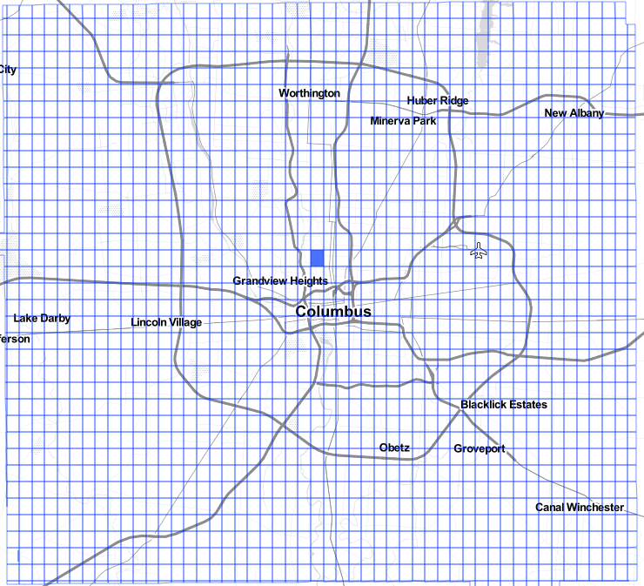

MEP: Population Density Weighted Summation for City-Level Aggregation
Zone 1 | Zone 2
Zone 3 | Zone 4
$$\sum_{k=0}^{n}{}$$
# of People: 875
= 10= 10* [50/875]* [50/875]
= 10 * [50/875]
10 | 25
123 | 32
50 | 150
650 | 25
0.571 | 4.286
91.371 | 0.914
190.0
97.14
10 | 25
123 | 32
25 | 650
150 | 50
0.286 | 18.571
21.086 | 1.829
190.0
41.77
Notes:
Let us consider a toy example. Let’s say a small town comprises of 4 grid cells and the total population of the town is 875. If the effect of the population distribution of the 4 zones is not taken into account, then the aggregated MEP is just the sum of the grid-wise MEP values. On the other hand, if for the city-level aggregation, we consider the weighted mean of the cell-wise MEP values, with the weights being the population fraction, then the overall MEP value depends on the population distribution. If the population distribution changes, so does the aggregated MEP value.

Slide 8
Adding A Socio-Demographic Layer to MEP

Slide 9

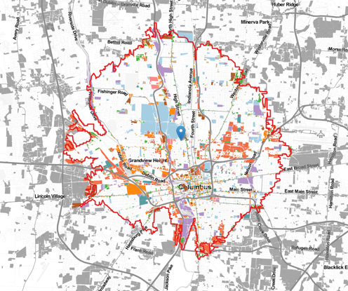


Incorporating Socio-Demographic Aspects in MEP calculations
An average MEP score for a location (encompassing all modes, activities, and travel times) might not resonate with specific socio-demographic cohorts
  Individuals who are car-constrained (age < 16, or income < 25K) might have different travel, and activity preferences compared to the average traveler
Enhancements have been made to make MEP scores reflective of travel characteristics of specific socio-demographic cohorts. Variation is introduced in the form of
Trip Frequencies
Travel Time Tolerances
Modal Preferences
Population Distribution

Slide 10
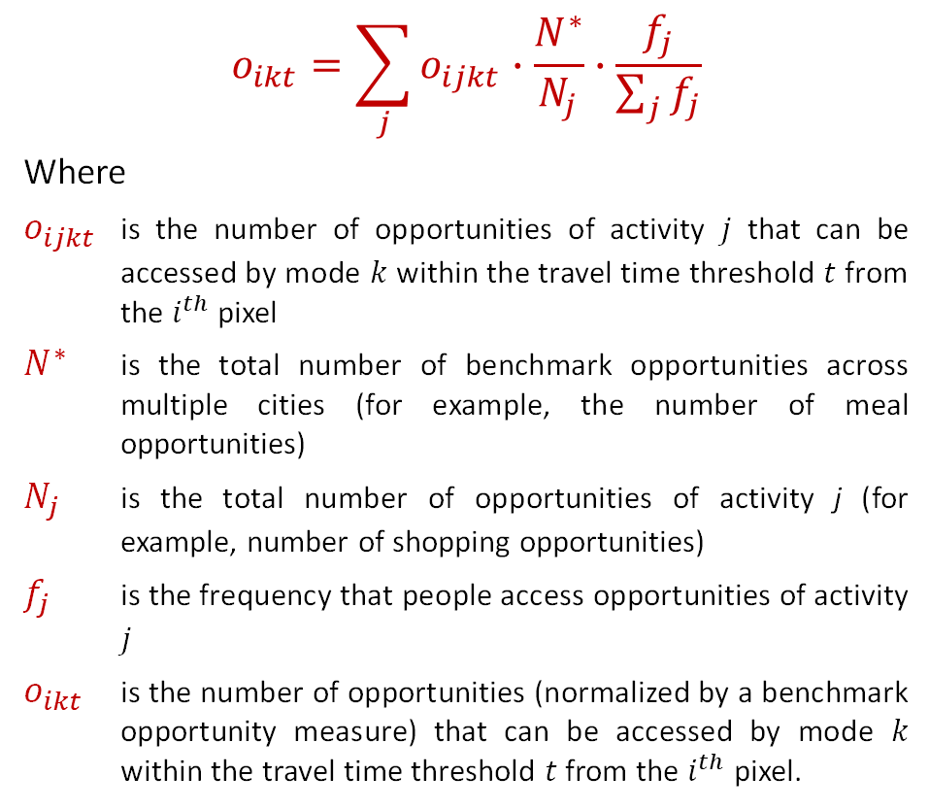
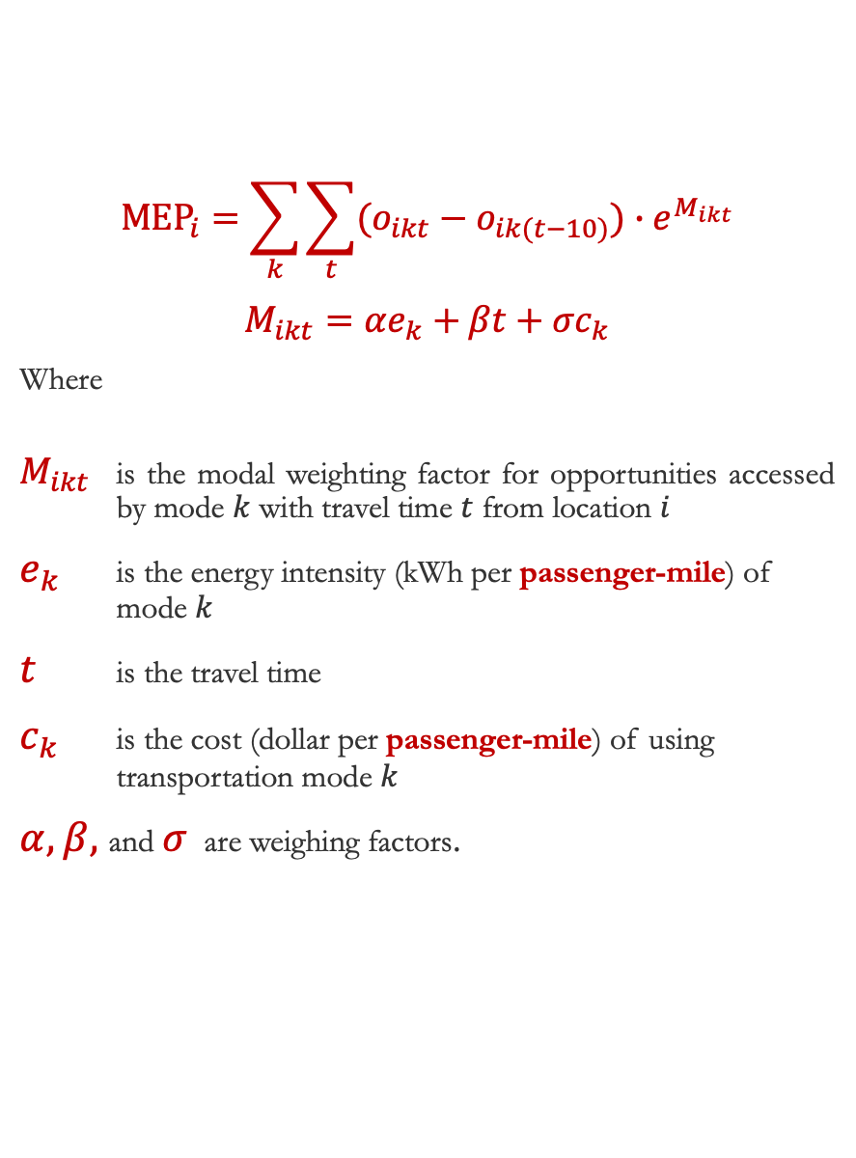
MEP Equation
$$o_{ikt}=\sum_{j}{o_{ijkt}∙\frac{N^{∗}}{N_{j}}∙\frac{f_{j}}{\sum_{j}{f_{j}}}}$$
Where
$o_{ijkt}$ is the number of opportunities of activity $j$ that can be accessed by mode $k$ within the travel time threshold $t$ from the $i^{th}$ pixel
$N^{∗}$ is the total number of benchmark opportunities across multiple cities (for example, the number of meal opportunities)
$N_{j}$ is the total number of opportunities of activity j (for example, number of shopping opportunities)
$f_{j}$ is the frequency that people access opportunities of activity $j$
$o_{ikt}$ is the number of opportunities (normalized by a benchmark opportunity measure) that can be accessed by mode $k$ within the travel time threshold $t$ from the $i^{th}$ pixel.
$${MEP}_{i}=\sum_{k}{\sum_{t}{(o_{ikt}−o_{ik(t−10)})∙e^{M_{ikt}}}}$$
$$M_{ikt}=αe_{k}+βt+σc_{k}$$
Where
$M_{ikt}$ is the modal weighting factor for opportunities accessed by mode $k$ with travel time $t$ from location $i$
$e_{k}$ is the energy intensity (kWh per passenger-mile) of mode $k$
$t$ is the travel time
$c_{k}$ is the cost (dollar per passenger-mile) of using transportation mode $k$
$α, β,$and $σ$ are weighing factors.
Notes:
This is the mathematical formulation of MEP before we add a socio-demographic layer.

Slide 11
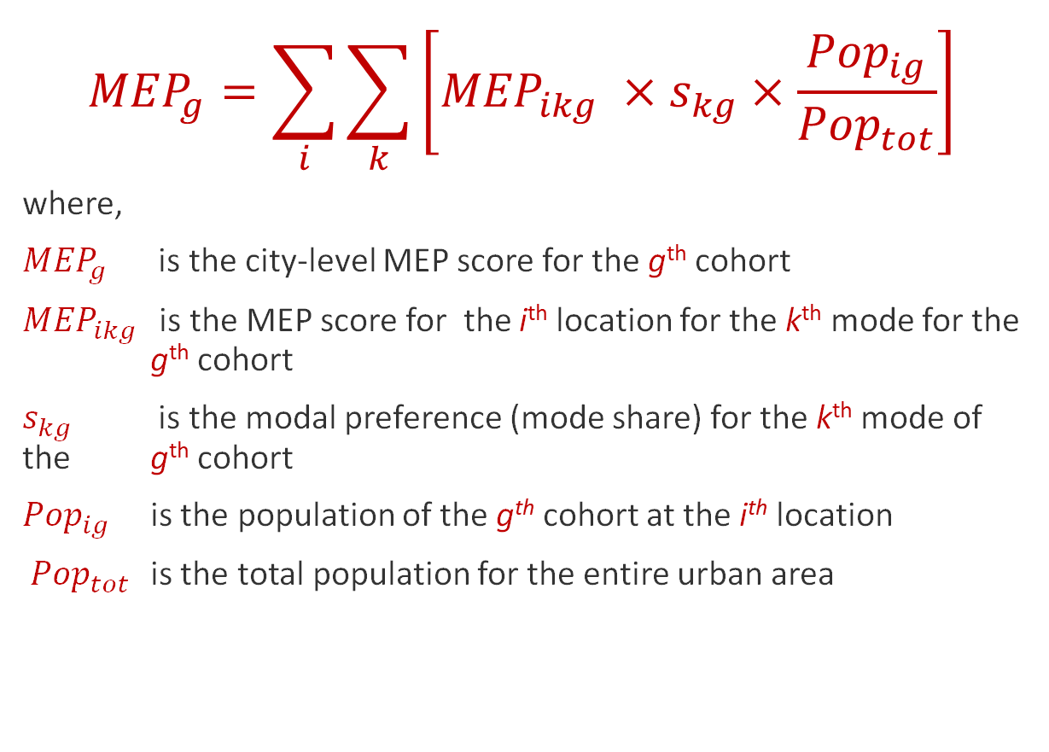
Mode share-based weighting of MEP Scores
$${MEP}_{g}=\sum_{i}{\sum_{k}{\left[{MEP}_{ikg} ×s_{kg}×\frac{{Pop}_{ig}}{{Pop}_{tot}}\right]}}$$
where,
${MEP}_{g}$ is the city-level MEP score for the g^{th} cohort
${MEP}_{ikg}$ is the MEP score for the i^{th} location for the k^{th} mode for the g^{th} cohort
$s_{kg}$ is the modal preference (mode share) for the k^{th} mode of the g^{th} cohort
${Pop}_{ig}$ is the population of the g^{th} cohort at the i^{th} location
${Pop}_{tot}$ is the total population for the entire urban area
Mode | Score | Share (%)
Walk | 10 | 3
Bike | 30 | 8
Transit | 15 | 5
Drive | 120 | 84
Before: 175
After: 104.25
Notes:
To make the MEP scores more reflective of the travel characteristics of SD cohorts, the MEP value at the ith location for the kth mode and the gth cohort cohort is weighted by the preference of the gth cohort for the kth mode. This weighting can significantly alter the aggregated MEP value. Let me give you an example…. As mentioned earlier, the MEP at each location (grid-cell) is weighted by the population frac where the denominator is the total population of the urban area and the numerator is the population of the cohort population at the location under consideration.

Slide 12
Workflow for Socio-demographic incorporated MEP analysis
Carry out a clustering analysis to identify ‘unique’ cohorts*
Obtain activity frequencies, mode shares, and travel time thresholds of the identified cohorts
Compute city-level MEP scores for each cohort
Compute pixel-level MEP scores for the chosen cohorts
Generate population proportion distributions (at the pixel-level) for each cohort of interest
Identify Socio-demographic dimension(s) of interest
* For multiple Socio-demographic dimensions. This step can be skipped when only one socio-demographic dimension is being analyzed.
Notes:
The workflow for socio-demographic incorporated MEP analysis involves a few steps. First, we identify the socio-demo dimensions of interest. Then we carry out a clustering analysis to … It should be noted that this step is necessary only if we consider multiple SD factors. This step can be skipped when only 1 SD dimension is being analyzed. Next, we estimate the activity frequency, mode shares and mode-wise travel time thresholds for the identified cohorts. The activity and mode share frequencies estimated from from NHTS 2017. We use travel time isochrones for Chicago in 2019, obtained from TomTom, for each of the different modes. As mentioned earlier, the population distributions are taken from I year ACS for 2019 from the US census bureau. Next, we compute the pixel-level MEP scores for the chosen cohorts. Then, we generate the population proportion

Slide 13
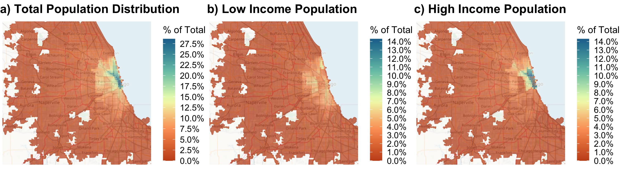
Variation in Population Distributions of Various Cohorts
Notes:
On this slide we shown an example of how the population of different income-based cohorts are distributed. How does the population distribution affect the aggregated MEP value ?

Slide 14
Variation in Population Distributions of Various Cohorts
Notes:
Let us pick a location where population % belonging to the low-income cohort is higher that that for the high-income cohort. Assuming the MEP values to be similar at this location, the contribution of the MEP at this location to the overall city-level aggregated MEP will be higher for the low-income cohort compared to the high-income cohort.

Slide 15
Results
Notes:
Now that I have given you enough context about SD incorporated MEP, I am about to present our results

Slide 16
Single Socio-Demographic Factor Based Cohorts
Notes:
First, we consider the analyses where only single SD factors to define the cohorts

Slide 17
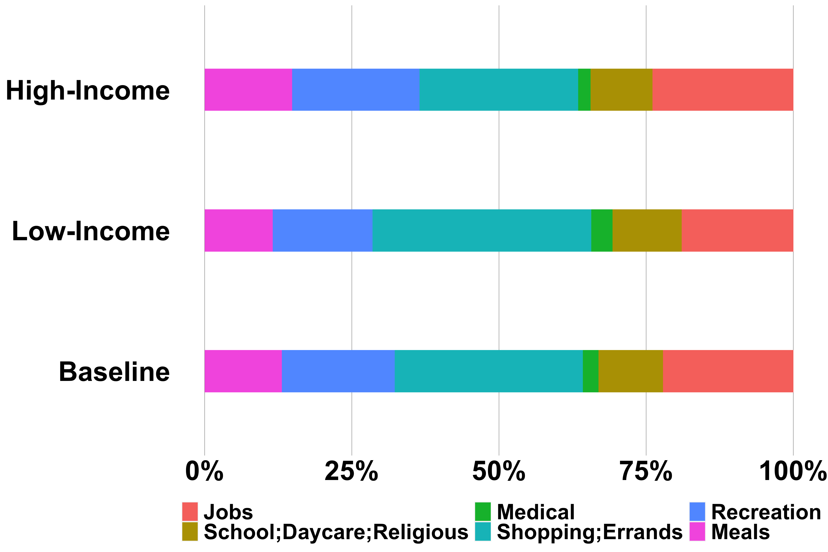
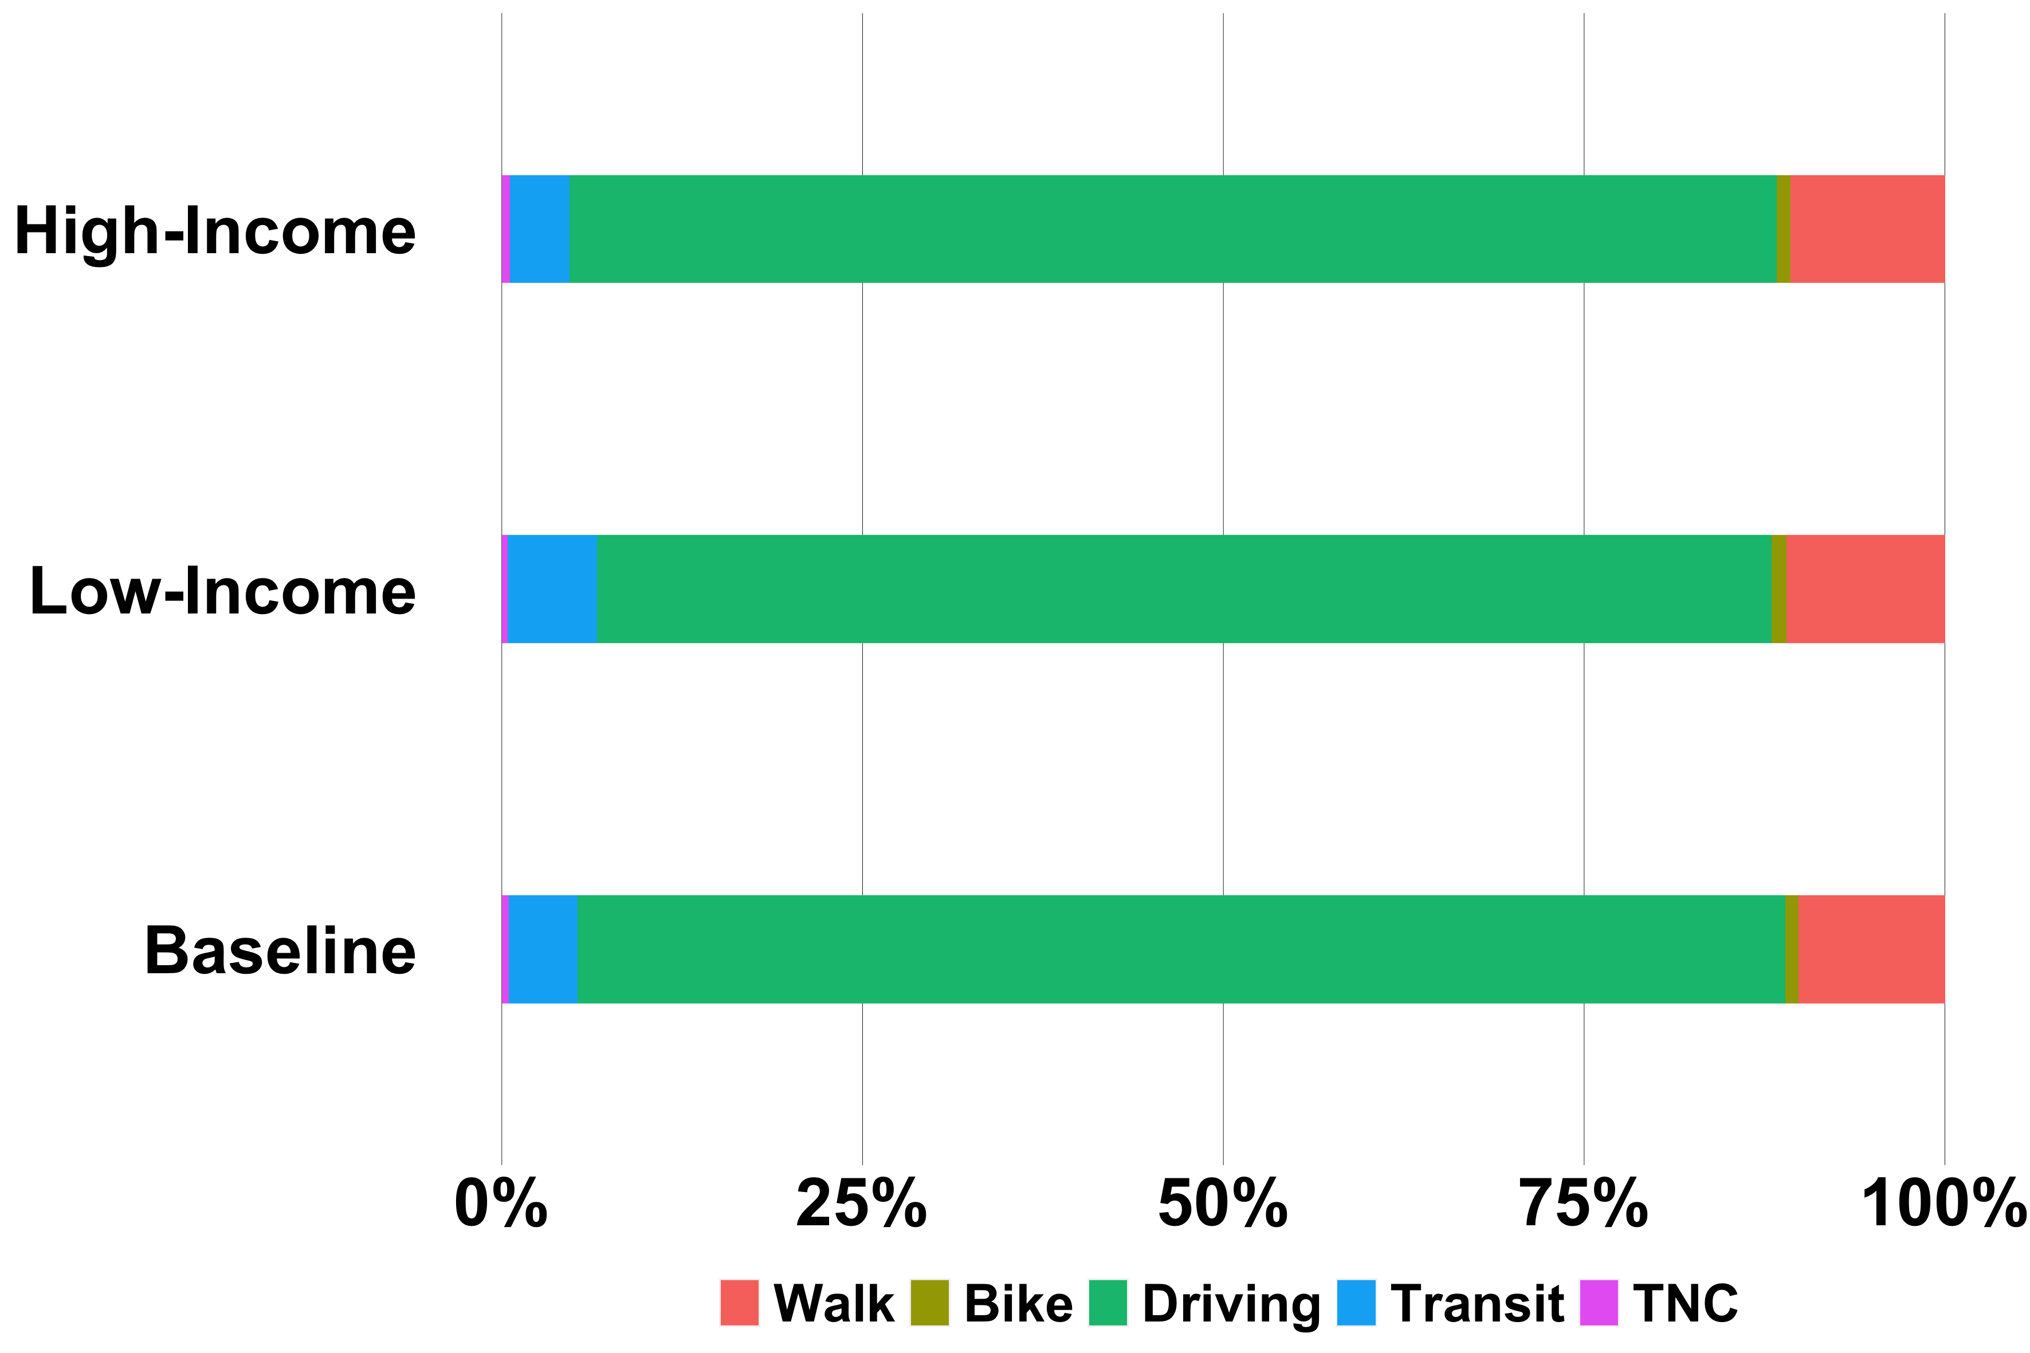
Variation in Travel Patterns
Across Income-based Cohorts
Low-Income cohort accesses shopping/errands opportunities more and job opportunities less than the high-income cohort
High-Income: Household Annual Income > $100K
Low-Income: Household Annual Income < $50K
Notes:
On this slide, we show the variation in travel patters across income-based cohorts. An individual is considered to belong to the low-income cohort if the household annual income is < $50K and considered high income if the HAI is > $100K. On the left panel we show the variation in activity frequency for baseline, low-income and high-come cohorts. The different categories of activity that we consider are … . On the left panel, we show the variation in mode-share frequencies across the same set of cohorts.

Slide 18
Mode-wise Maximum Travel time Isochrones for Income-based Cohorts
Travel time isochrones up to 40 mins (in increments of 10 min) were considered for each mode depending on 85th percentile of travel time by each mode
85th Percentile of Travel Time (in mins) by Mode
Maximum Travel Time (in mins) Isochrone by Mode
Mode | Baseline | Low-Income | High-Income
Walk | 20 | 25 | 20
Bike | 35 | 30 | 38
Driving | 30 | 30 | 31
Transit | 70 | 70 | 71
TNC | 30 | 32 | 30
Mode | Baseline | Low-Income | High-Income
Walk | 20 | 30 | 20
Bike | 40 | 30 | 40
Driving | 30 | 30 | 30
Transit | 40 | 40 | 40
TNC | 30 | 30 | 30
Notes:
We had mentioned earlier that in addition to the activity and mode-share frequencies we need the mode-wise travel time isochrones as inputs. The 2 tables on this slide shows the mapping between the 85th pc of travel time by each mode and the corresponding maximum travel time isochrone. Let me give you an example …
We do not use the 85th pc travel times directly in the MEP calculation, rather we use the travel time isochrones in the table on the right. So far as the TT isochrones are considered, the main diff between the low-income and high-income cohorts are the following:
we consider walk isochrones up to 30 mins for LI cohort, whereas we consider up to 20 minutes walk isochrone for the HI cohort.
we consider bike isochrones up to 30 mins for LI cohort, whereas we consider up to 40 minutes bike isochrone for the HI cohort.

Slide 19
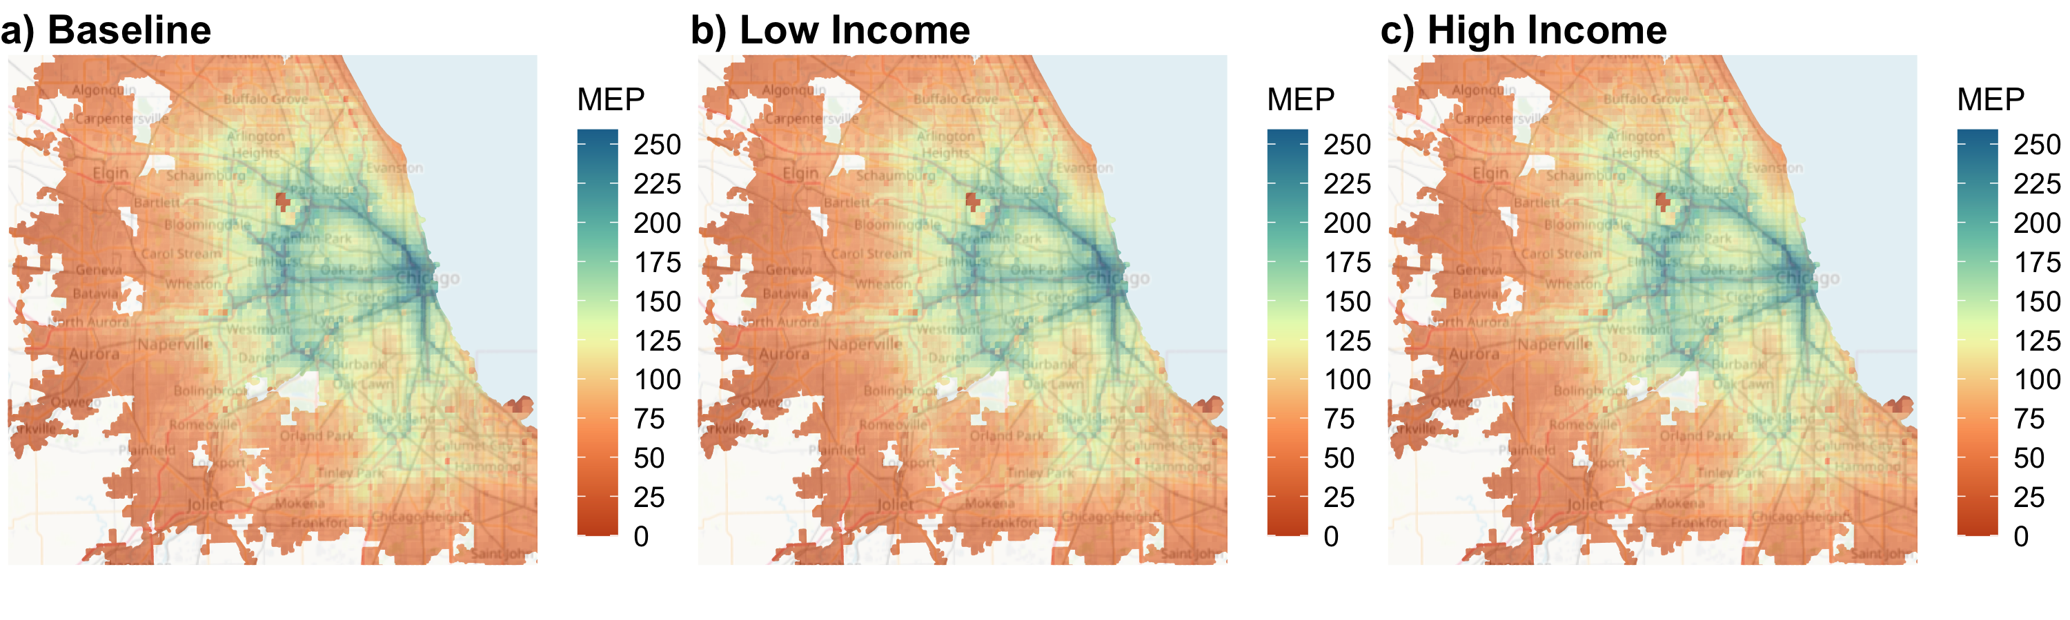
Comparison of MEP estimation for
Income-based Cohorts
We have compared the MEP scores for the baseline cohort (total population) of Chicago in 2019 with the corresponding income-based cohorts
Overall MEP: 119
Overall MEP: 33
Overall MEP: 51
No significant difference in grid-wise MEP values between low-income and high-income cohorts
Overall MEP higher by ~ 55% for high-income cohort compared to low-income cohort
Notes:
Low-Income cohort population: 2103081
High-Income cohort population: 3373786
Total population for high-income cohort higher by ~ 60%

Slide 20
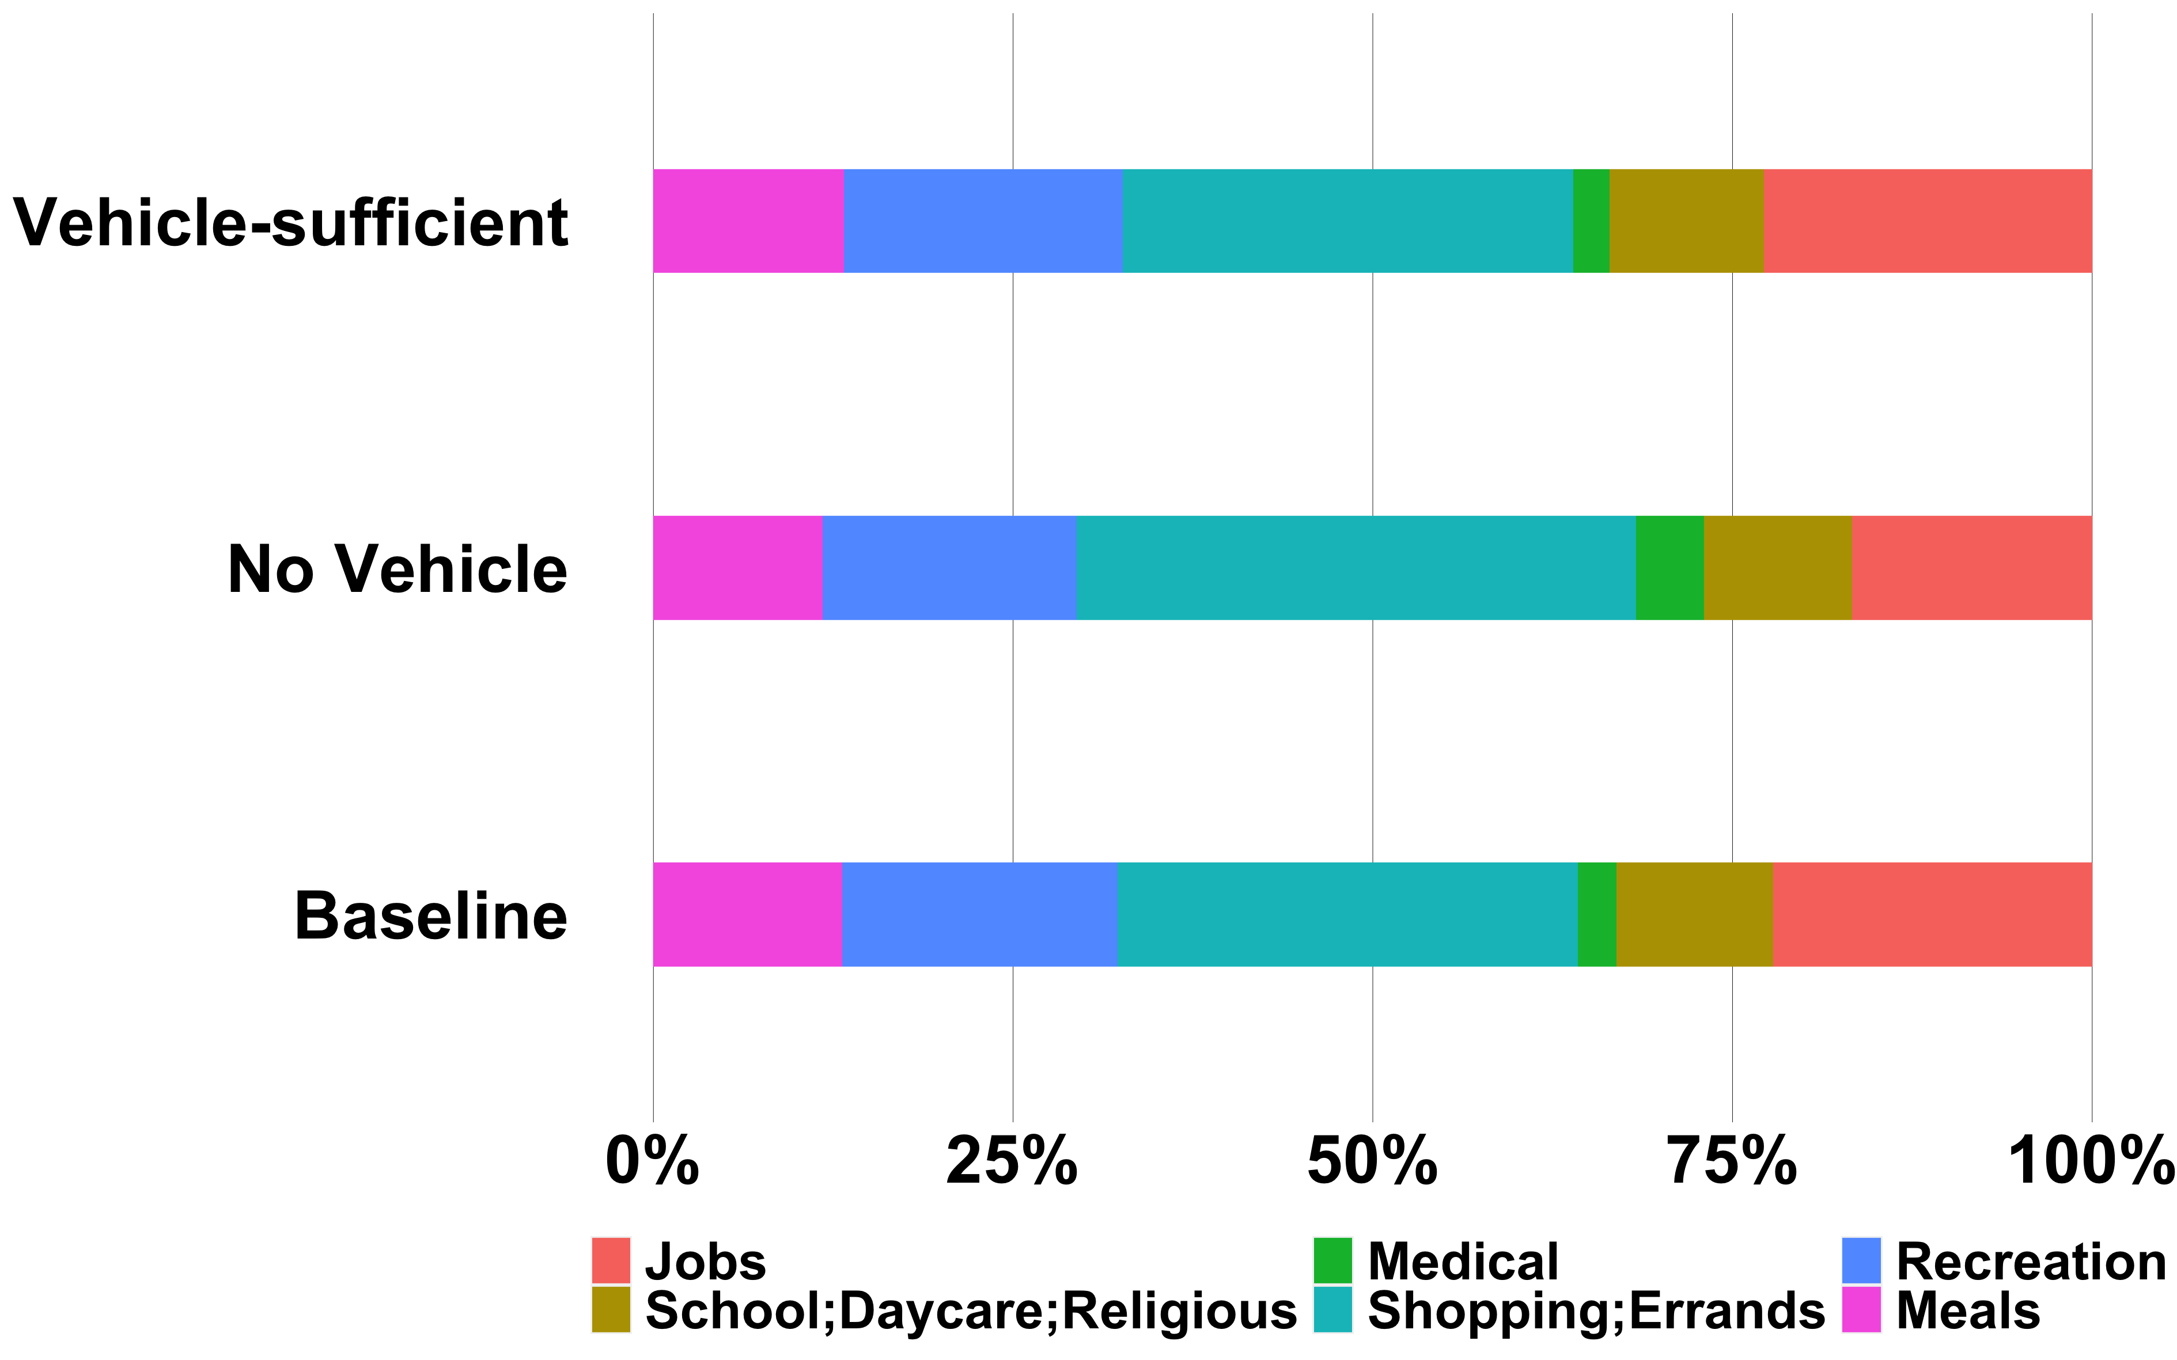
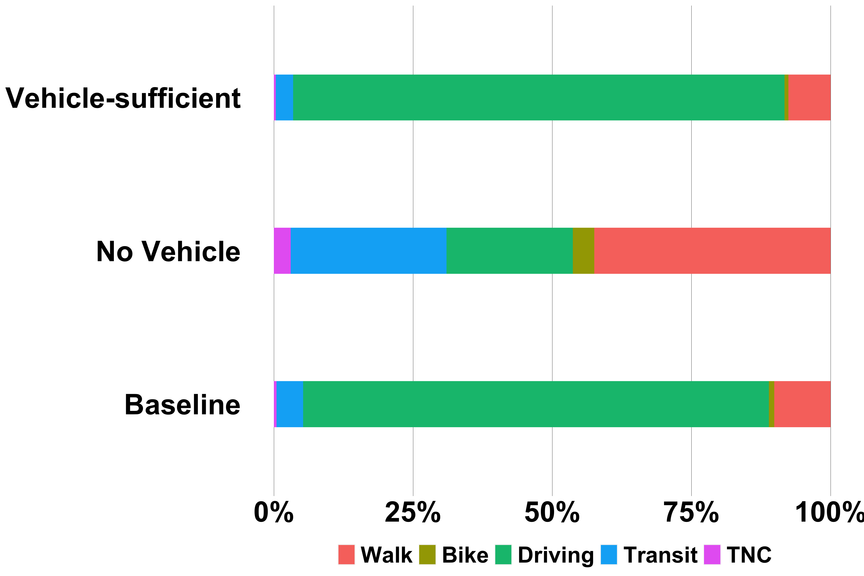
Variation in Travel Patterns
Across Vehicle ownership-based Cohorts
No Vehicle: No vehicle in household
Vehicle-Sufficient: Number of drivers ( age > 16 yrs old) >= Number of vehicles in household
Vehicle-sufficient cohort drives more than no-vehicle cohort, which in turn avails all other modes to a greater extent
Notes:
On this slide, we show the variation in travel patterns across vh-ownership cohorts. Unlike, the income-based cohorts there is much greater variation in mode share frequencies than in activity frequencies.

Slide 21
Mode-wise Maximum Travel time Isochrones for Vehicle ownership-based Cohorts
Travel time isochrones up to 40 mins (in increments of 10 min) were considered for each mode depending on 85th percentile of travel time by each mode
85th Percentile of Travel Time (in mins) by Mode
Maximum Travel Time (in mins) Isochrone by Mode
Mode | Baseline | No-Vehicle | Vehicle-Sufficient
Walk | 20 | 25 | 20
Bike | 35 | 30 | 39
Driving | 30 | 30 | 30
Transit | 70 | 73 | 66
TNC | 30 | 30 | 35
Mode | Baseline | No-Vehicle | Vehicle-Sufficient
Walk | 20 | 30 | 20
Bike | 40 | 30 | 40
Driving | 30 | 30 | 30
Transit | 40 | 40 | 40
TNC | 30 | 30 | 40
Notes:
Though the number of driving isochrones considered for the no-vehicle and vehicle-sufficient cohorts are the same, the much lower mode share frequency for driving for the no-vehicle cohort negates the result of this equality.

Slide 22
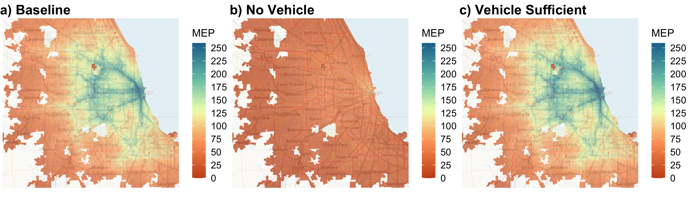
Comparison of MEP estimation for
Vehicle ownership-based Cohorts
We have compared the MEP scores for the baseline cohort (total population) of Chicago in 2019 with the corresponding vehicle-ownership based cohorts
Overall MEP: 119
Overall MEP: 4
Overall MEP: 61
Significant difference in grid-wise MEP values between no-vehicle and vehicle-sufficient cohorts
Overall MEP higher by factor of ~15 for vehicle-sufficient cohort compared to no-vehicle cohort
Notes:
No-vehicle cohort population: 692890
Vehicle-sufficient cohort population: 4111363
Vehicle-sufficient cohort population ~6 times higher than that of no vehicle cohort.

Slide 23
Multiple Socio-Demographic Factors Based Cohorts

Slide 24
Identifying Unique Cohorts based on multiple
Socio-Demographic factors
Considering multiple socio-demographic factors (even as low as two distinct factors) can lead to an exhaustive set of cohorts for whom MEP scores need to be computed.
However, not all cohorts will have travel patterns that are distinct from one another. Cluster analysis can be used to group cohorts that have common travel attributes
  In the example presented here, mode-share frequency is used as the cluster identification factor
The following clustering algorithms were used to determine the optimal number of clusters
  Within Sum of Squares (Elbow Method)
  Silhouette Method
Income-based cluster
Low-Income
Medium-Income
High-Income
Vehicle ownership-based cluster
No-vehicle
Vehicle-deficient
Vehicle-sufficient
9 cohorts based on household income and vehicle ownership
Notes:
Till now we have been using only one SD factor at a time to define cohorts. What if we use multiple SD factors to define cohorts ? Considering as low as two SD factors can lead to a large number of cohorts. However, not all of these cohorts will have travel patterns that are distinct from one another. Cluster analysis can be used to group cohorts with common travel attributes.

Slide 25
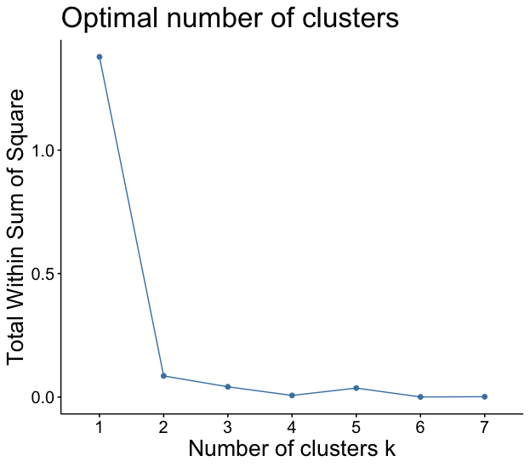
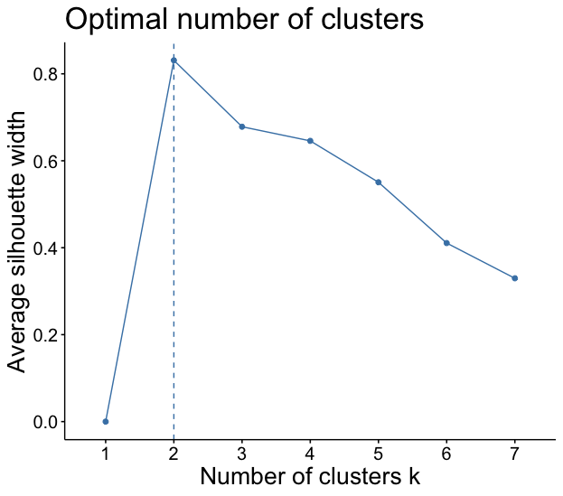
Clustering Analysis of Cohorts based on household income and vehicle-ownership
Optimal Number of Clusters: 2

Slide 26
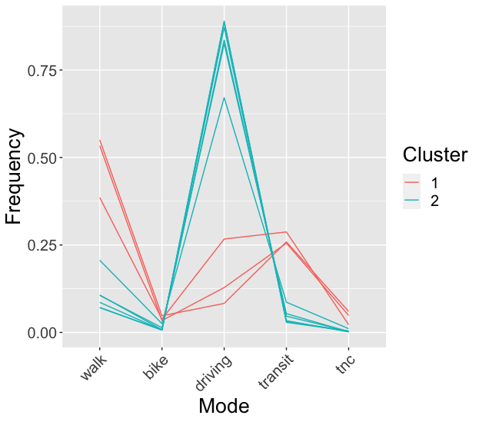
Clustering of Cohorts based on household income and vehicle-ownership
Cluster | Cohorts
1 | No-Vehicle (All Income Ranges)
2 | Vehicle Owners (All Income Ranges)
Notes:
What are these two clusters ? One cluster is the no-vehicle cluster which contains three of the 9 cohorts, These are the three no vehicle cohorts corresponding to the three income ranges. The second cluster is the vehicle-owning cluster which contains the remaining 6 of the 9 cohorts these are the vehicle-deficient and vehicle-sufficient cohorts corresponding to each of the three income ranges. The figure on this slide shows a parallel coordinate plot for the mode share frequencies for the 9 cohorts. It is clearly evident that 3 of the 9 cohorts form one cluster (red color lines), whereas 6 others form another cluster (colored in blue)

Slide 27
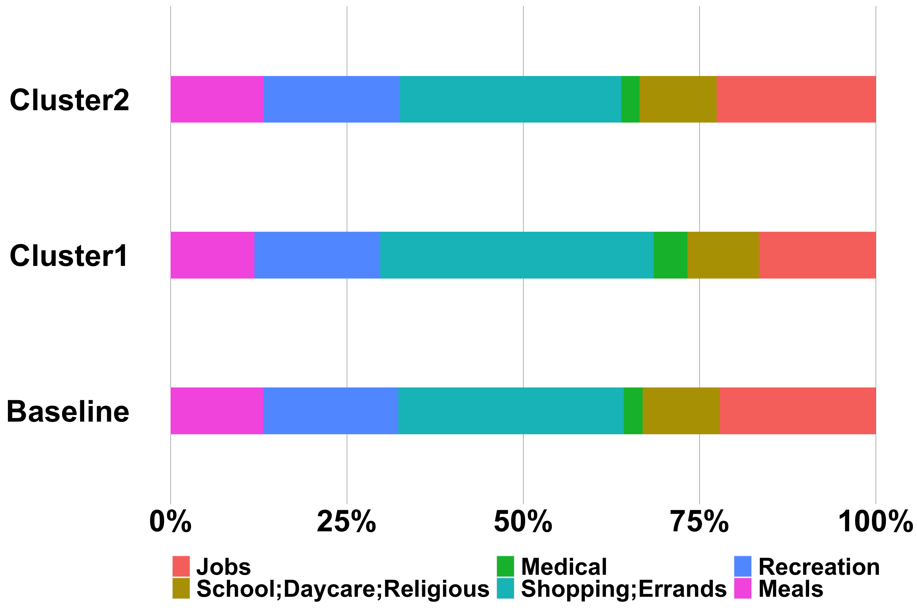
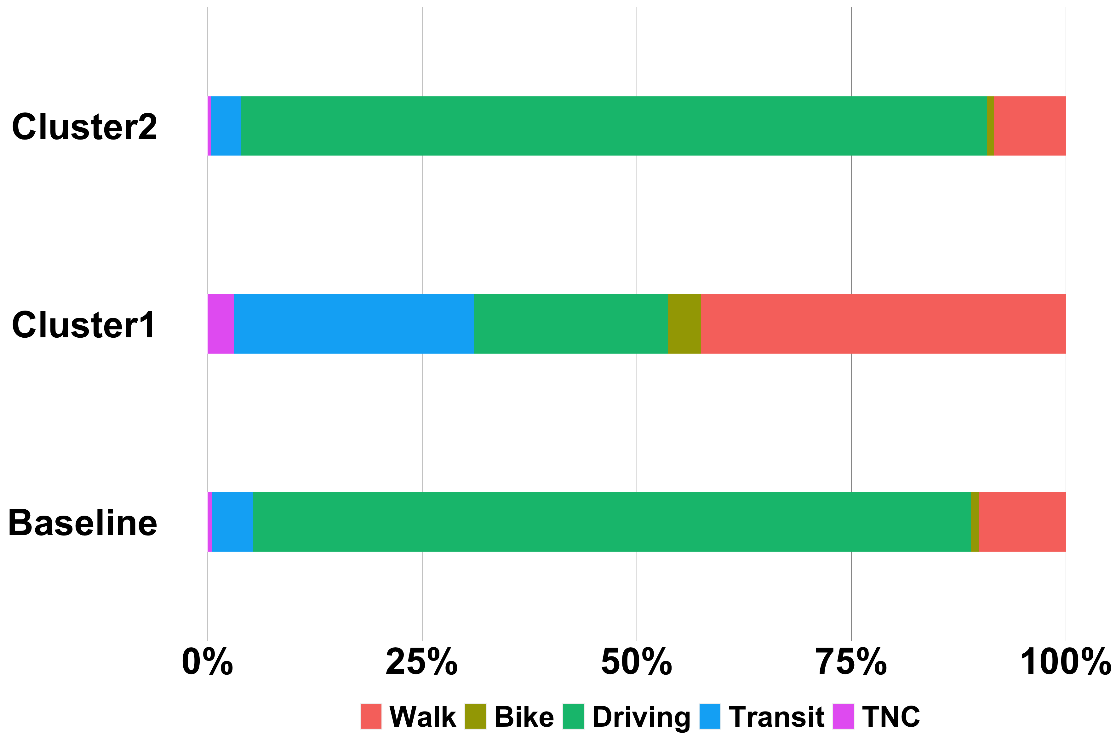
Variation in Mode Share and Activity Engagement in two Cohort Clusters
There is a significant difference between Cluster 1 and Cluster 2 in availing different modes. Cluster 2 drives more than Cluster 1, whereas Cluster 1 avails all other transportation modes considerably more than Cluster 2. However, the difference between the two clusters in the frequencies for engaging in different types of activities is much less pronounced.

Slide 28
Mode-wise Maximum Travel time Isochrones for two Cohort Clusters
Travel time isochrones up to 40 mins (in increments of 10 min) were considered for each mode depending on 85th percentile of travel time by each mode
85th Percentile of Travel Time (in mins) by Mode
Maximum Travel Time (in mins) Isochrone by Mode
Mode | Baseline | Cluster 1 | Cluster 2
Walk | 20 | 25 | 20
Bike | 35 | 30 | 35
Driving | 30 | 31 | 30
Transit | 70 | 74 | 70
TNC | 30 | 30 | 35
Mode | Baseline | Cluster 1 | Cluster 2
Walk | 20 | 30 | 20
Bike | 40 | 30 | 40
Driving | 30 | 30 | 30
Transit | 40 | 40 | 40
TNC | 30 | 30 | 40

Slide 29
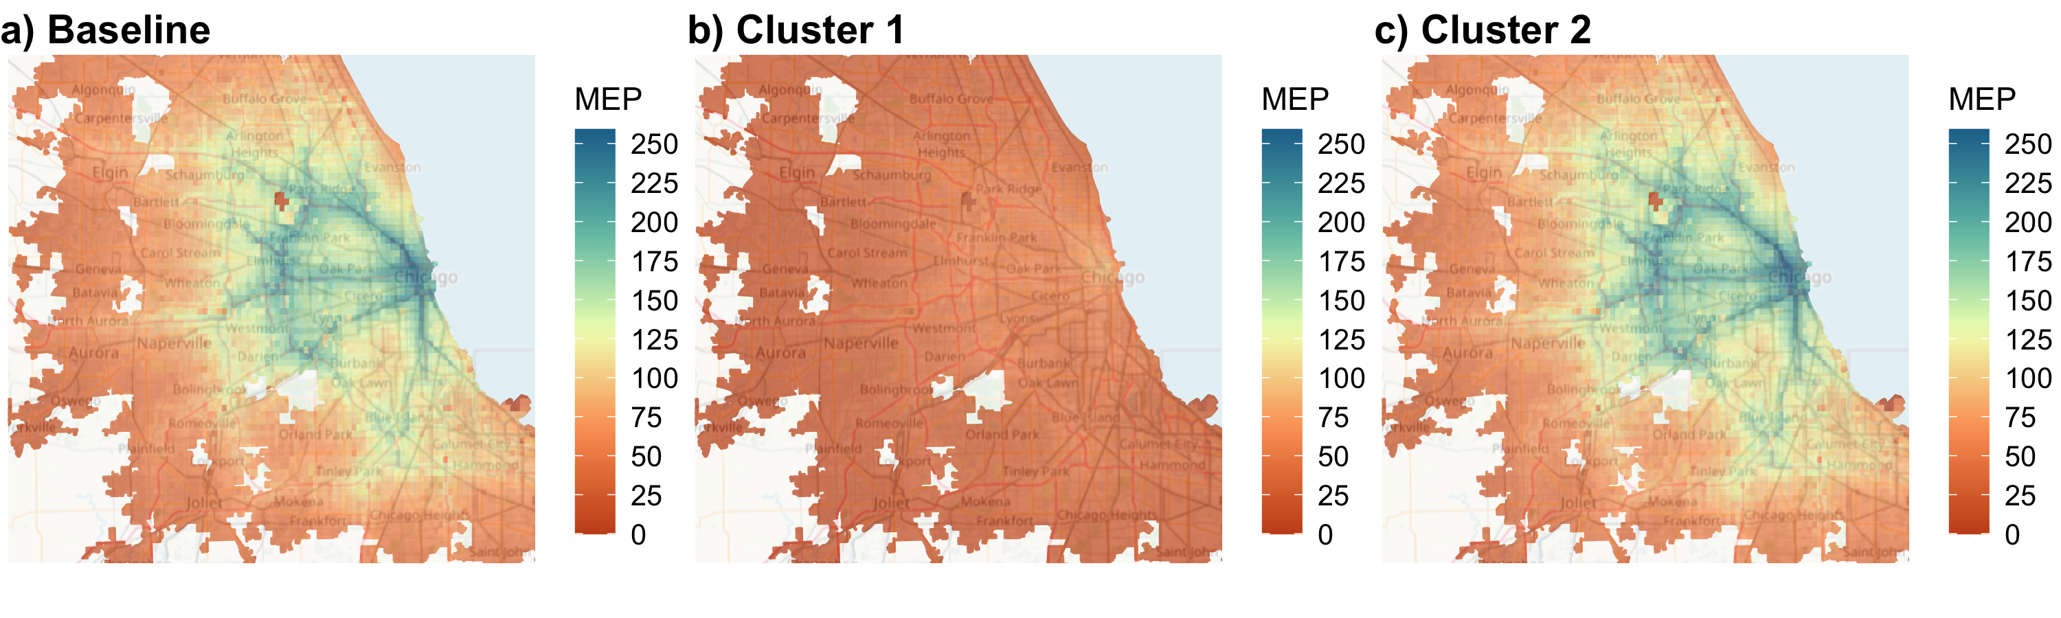
Comparison of MEP estimation for two Cohort Clusters
We have compared the MEP scores for the baseline cohort (total population) of Chicago in 2019 with Cluster 1 and Cluster 2 cohorts
Overall MEP: 119
Overall MEP: 4
Overall MEP: 108
Significant difference in grid-wise MEP values between Cluster 1 and Cluster 2 cohorts
Overall MEP higher by factor of 27 for vehicle-owning cohort compared to no-vehicle cohort
Notes:
Cluster1 cohort population: 692890
Cluster2 cohort population: 6891892
Cluster2 cohort population ~10 times higher than that of Cluster1 cohort
This indicates that, when we use both vehicle-ownership and household annual income for defining socio-demographic groups, vehicle-ownership emerges as the dominant factor for the identification for similar travel patterns.

Slide 30
Summary and Future Work
MEP scores are modified when socio-demographic factors, e. g. household annual income and vehicle-ownership, are taken into account.
Vehicle-ownership has a greater effect on MEP compared to household annual income.
Clustering of cohorts defined using multiple socio-demographic factors can indicate which factor is dominant
This workflow can be used to predict MEP for different socio-demographic groups for future scenarios where future travel behavior and population can be simulated using models, e. g., simulated travel behavior from transportation and land use simulations.
Notes:
It emerges from the clustering of cohorts defined using multiple socio-demographic factors that which factor is dominant

Slide 31
Acknowledgement
This work was authored by the National Renewable Energy Laboratory (NREL), operated by Alliance for Sustainable Energy, LLC, for the U.S. Department of Energy (DOE) under Contract No. DE-AC36-08GO28308. Funding was provided by the U.S. Department of Energy Vehicle Technologies Office (VTO). The views expressed in the article do not necessarily represent the views of the DOE or the U.S. Government. The U.S. Government retains and the publisher, by accepting the article for publication, acknowledges that the U.S. Government retains a nonexclusive, paid-up, irrevocable, worldwide license to publish or reproduce the published form of this work, or allow others to do so, for U.S. Government purposes. The authors acknowledge the support of DOE VTO for program management.

Slide 32
Back-up Slides

Slide 33
Population Distributions
Low-Income cohort population: 2103081
High-Income cohort population: 3373786
Total population for high-income cohort higher by ~ 60%
City-level MEP for high-income cohort higher by ~ 55%
No-vehicle cohort population: 692890
Vehicle-sufficient cohort population: 4111363
Vehicle-sufficient cohort population ~6 times higher than that of no vehicle cohort.
City-level MEP for vehicle-sufficient cohort ~15 times the value for no-vehicle cohort
Cluster1 cohort population: 692890
Cluster2 cohort population: 6891892
Cluster2 cohort population ~10 times higher than that of Cluster1 cohort
City-level MEP for Cluster 2 cohort 27 times than that of Cluster 1 cohort

Slide 34
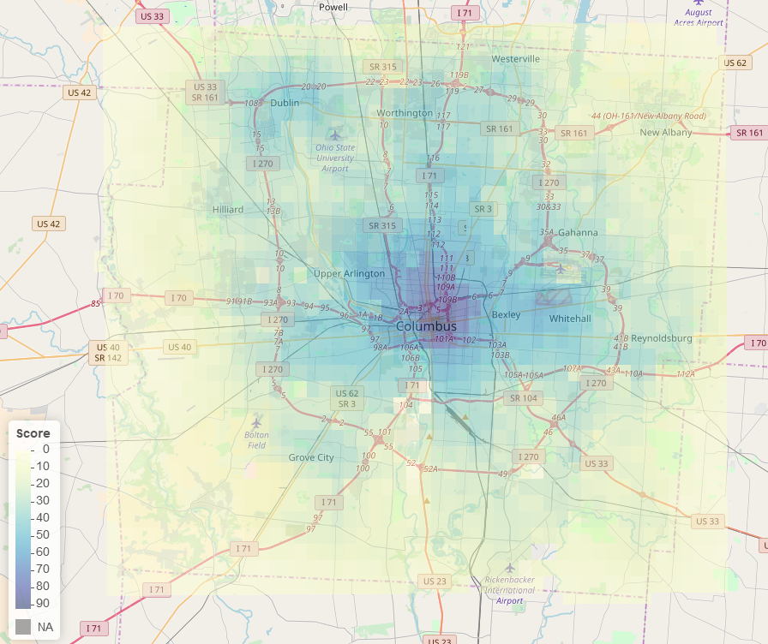
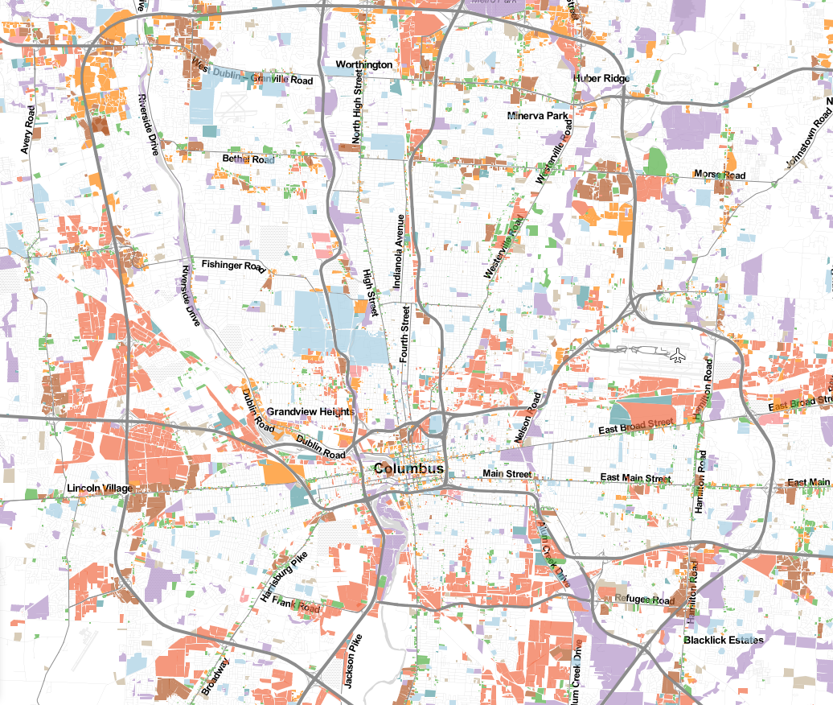

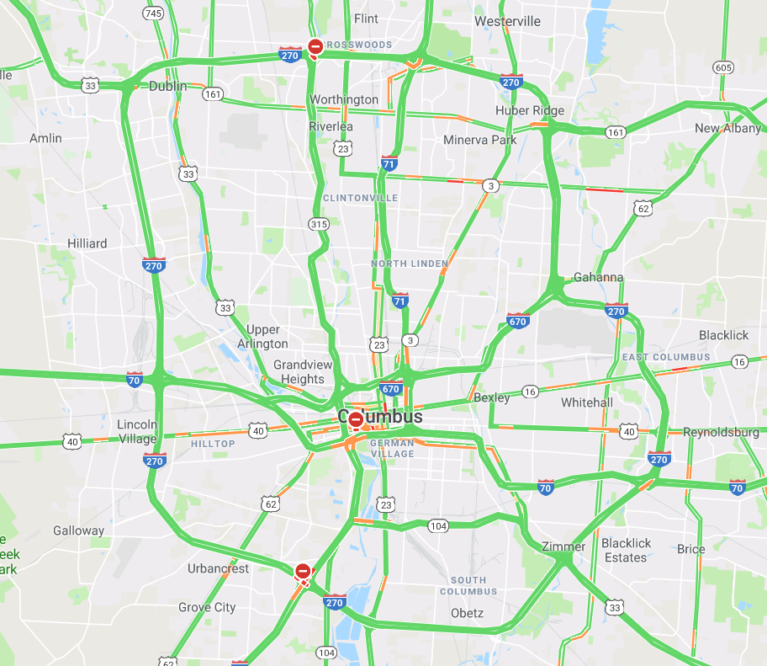
Data Spectrum Driving MEP
Energy Efficiency Measures
Travel Demand Data
Transportation Energy Data Book
Other energy intensity studies
National Household Travel Survey (NHTS)
Cost Measures
Capital costs, operational costs
Value of time
Travel Time and Isochrone
Third-party isochrone APIs (e.g., HERE)
GPS trajectory data (TomTom, INRIX)
Travel Demand Models
Land-Use Data
Metropolitan Planning Organizations
Mobility Energy Productivity
Land use
Travel time

Slide 35




MEP Computation: Illustrative
Time
Mode
Activity
Proportioned by activity engagement frequency
Weighted by time
Weighted by modal energy intensity , cost and personal preference for transportation mode
 | WORK | SHOP | GROCERY
DRIVING | 804,681 | 433 | 1,952
TRANSIT | 24,628 | 8 | 109
BIKING | 120,292 | 40 | 676
 | CUMULATIVE OPPURTUNITIES
DRIVING | 10,000
TRANSIT | 680
BIKING | 450
MEP
68

Slide 36
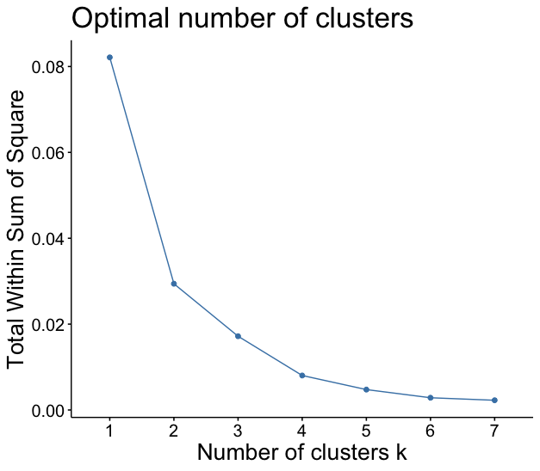
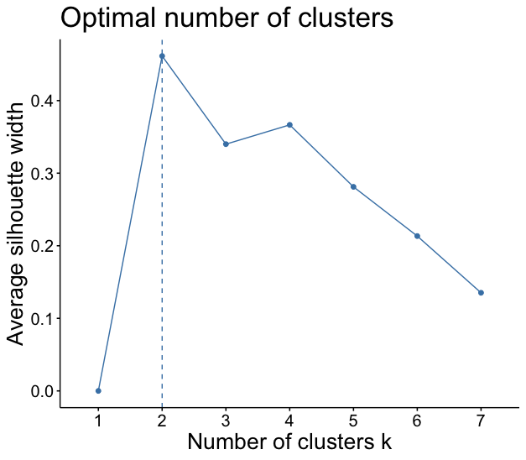
Activity frequency-based Clustering Analysis of Cohorts based on household income and vehicle-ownership
Optimal Number of Clusters: 2

Slide 37
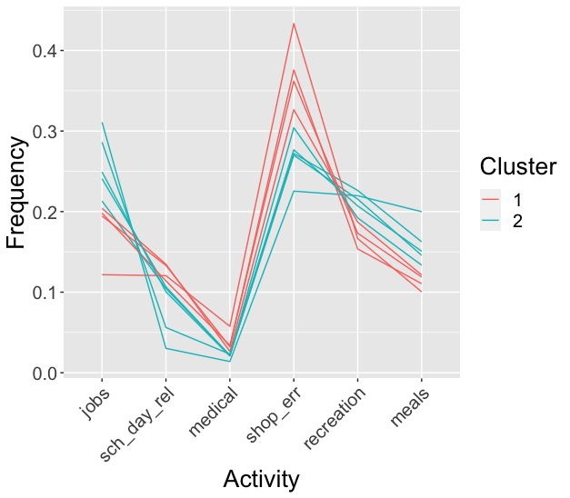
Clustering of Cohorts based on household income and vehicle-ownership
Cluster | Cohorts
1 | Low-Income, Medium-Income & Vehicle-deficient
2 | High-Income, Medium-Income & No Vehicle, Medium-Income & Vehicle-sufficient

Slide 38

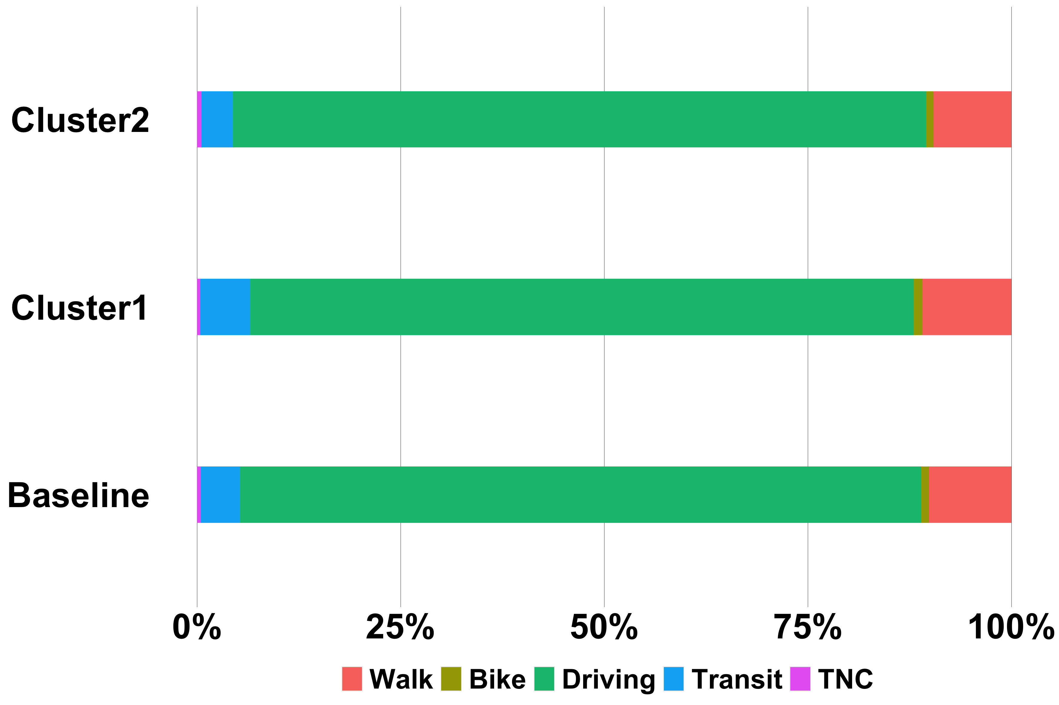
Variation in Mode Share and Activity Engagement in two Cohort Clusters
Cluster1 cohort accesses shopping/errands opportunities more and job opportunities less than Cluster2 cohort; similar to comparison of mode share & activity engagement between low-income and high-income cohorts; household annual income predominates over vehicle-ownership in the clustering

Slide 39
Mode-wise Maximum Travel time Isochrones for two Cohort Clusters
Travel time isochrones up to 40 mins (in increments of 10 min) were considered for each mode depending on 85th percentile of travel time by each mode
85th Percentile of Travel Time (in mins) by Mode
Maximum Travel Time (in mins) Isochrone by Mode
Mode | Baseline | Cluster 1 | Cluster 2
Walk | 20 | 25 | 20
Bike | 35 | 30 | 38
Driving | 30 | 30 | 30
Transit | 70 | 70 | 70
TNC | 30 | 30 | 30
Mode | Baseline | Cluster 1 | Cluster 2
Walk | 20 | 30 | 20
Bike | 40 | 30 | 40
Driving | 30 | 30 | 30
Transit | 40 | 40 | 40
TNC | 30 | 30 | 30

Slide 40
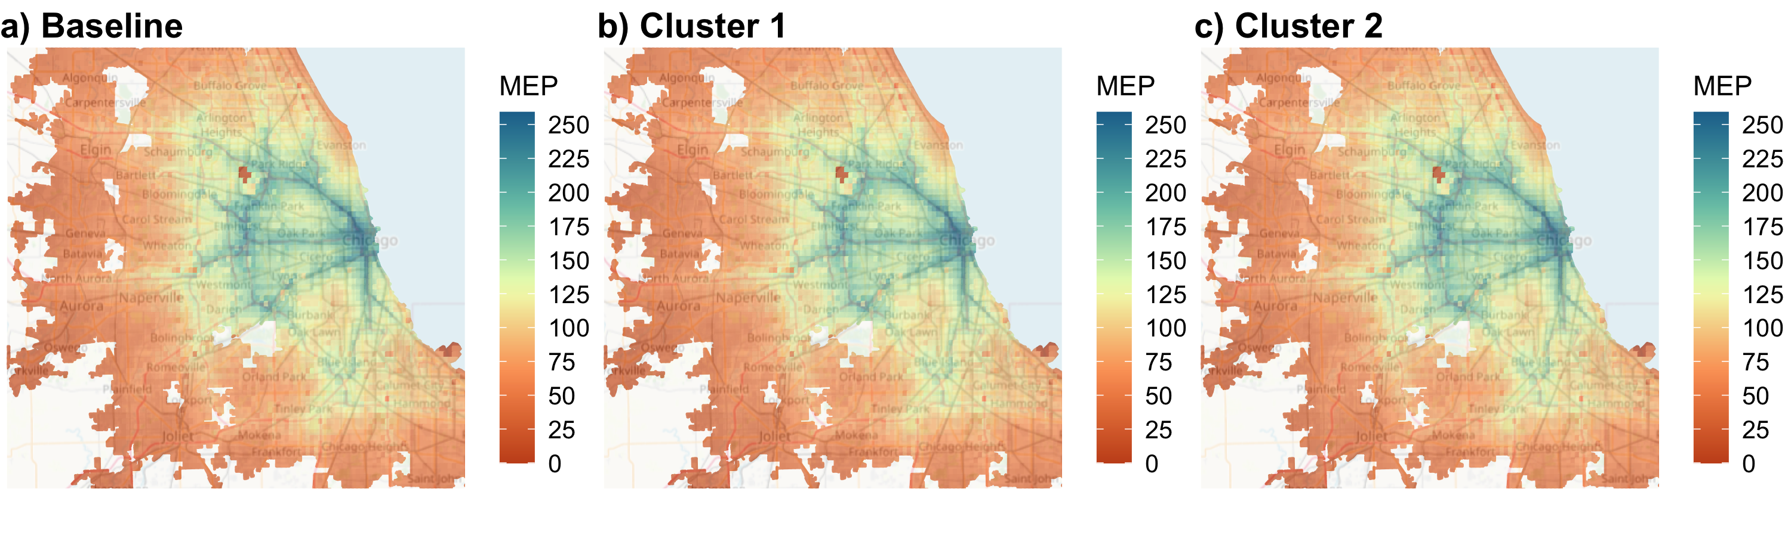
Comparison of MEP estimation for two Cohort Clusters
We have compared the MEP scores for the baseline cohort (total population) of Chicago in 2019 model with Cluster 1 and Cluster 2 cohorts
Overall MEP: 119
Overall MEP: 47
Overall MEP: 71
No significant difference in grid-wise MEP values between Cluster 1 and Cluster 2 cohorts
Overall MEP for Cluster 2 ~ 1.5 times the value for Cluster 1 cohort
Notes:
Cluster1 cohort population: 2943901
Cluster2 cohort population: 4640713
Cluster2 population ~ 1.6 times that of Cluster1 population

