Slide 1
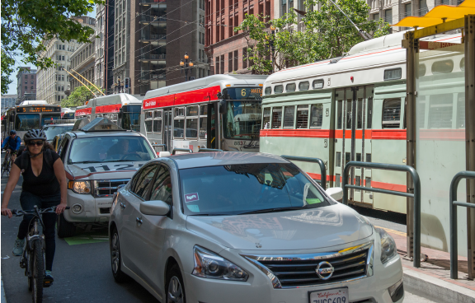
Do transportation network companies increase or decrease transit ridership? Empirical evidence from San Francisco
TRB Conference on Sustainability and Emerging Transportation Technology (SETT)
Irvine, California
Presented by:
Greg Erhardt, University of Kentucky
With contributions from:
Alex Mucci, Drew Cooper, Bhargava Sana, Mei Chen and Joe Castiglione
Image from: TNCs and Congestion, SFCTA
Working Draft Material
June 2022

Slide 2
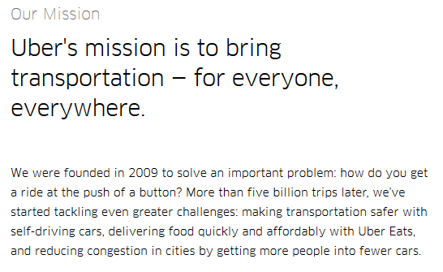
TNCs will support transit and revolutionize cities!
J. Zimmer, The Third Transportation Revolution. John Zimmer (2016), (available at https://medium.com/@johnzimmer/the-third-transportation-revolution-27860f05fa91).
Uber, Uber Newsroom, (available at https://www.uber.com/newsroom/company-info/).

Slide 3
Competing Arguments
TNCs Increase Ridership
TNCs Decrease Ridership
Serve first- and last-mile role
Occur in evenings & weekends when transit service is sparse
Enable a car-free lifestyle
Concentrated in densest part of city where transit service is best
Temporal profile similar to other trips
No observed changes in auto ownership rates
Feigon and Murphy 2016, 2018
Rayle et al 2016,
Alemi and Rodier 2017
Hall et al 2018
Clewlow and Mishra 2017
Henao 2017
Gehrke et al 2018
Babar and Burtch 2020
Li 2019

Slide 4
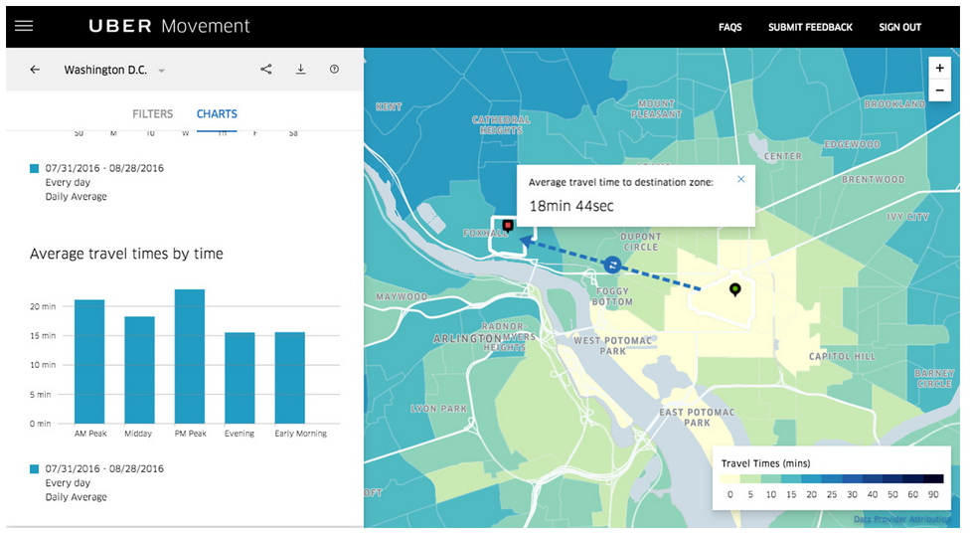
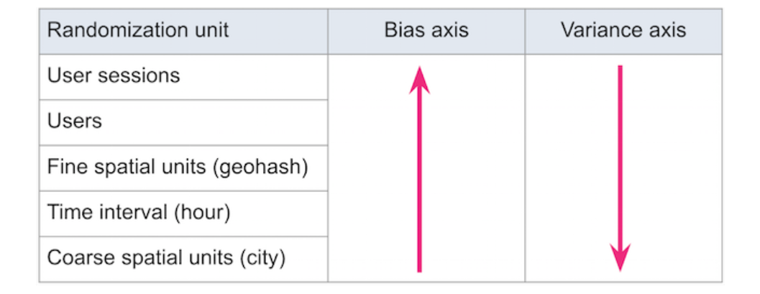
TNCs: Data, data everywhere, but not a drop for us
“There has been little or no objective data available on TNCs…”
Cooper, Drew, Joe Castiglione, Alan Mislove, and Christo Wilson. “Profiling TNC Activity Using Big Data.” In TRB Annual Meeting, 2018.
https://eng.lyft.com/experimentation-in-a-ridesharing-marketplace-b39db027a66e

Slide 5
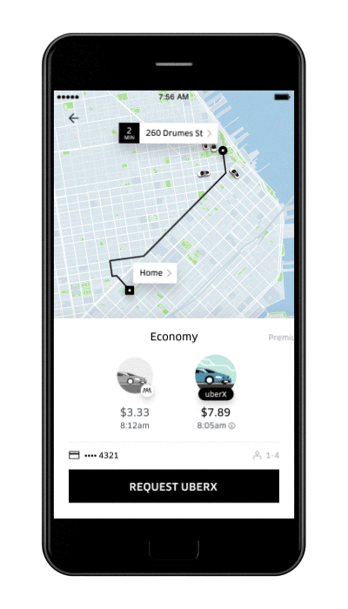
Data collection
API Pickup Location
Jiang, Shan, Le Chen, Alan Mislove, and Christo Wilson. “On Ridesharing Competition and Accessibility: Evidence from Uber, Lyft, and Taxi,” 863–72. ACM Press, 2018.
Cooper, Drew, Joe Castiglione, Alan Mislove, and Christo Wilson. “Profiling TNC Activity Using Big Data.” In TRB Annual Meeting, 2018.

Slide 6
Data collection
API and True Drop Off Location
Jiang, Shan, Le Chen, Alan Mislove, and Christo Wilson. “On Ridesharing Competition and Accessibility: Evidence from Uber, Lyft, and Taxi,” 863–72. ACM Press, 2018.
Cooper, Drew, Joe Castiglione, Alan Mislove, and Christo Wilson. “Profiling TNC Activity Using Big Data.” In TRB Annual Meeting, 2018.

Slide 7
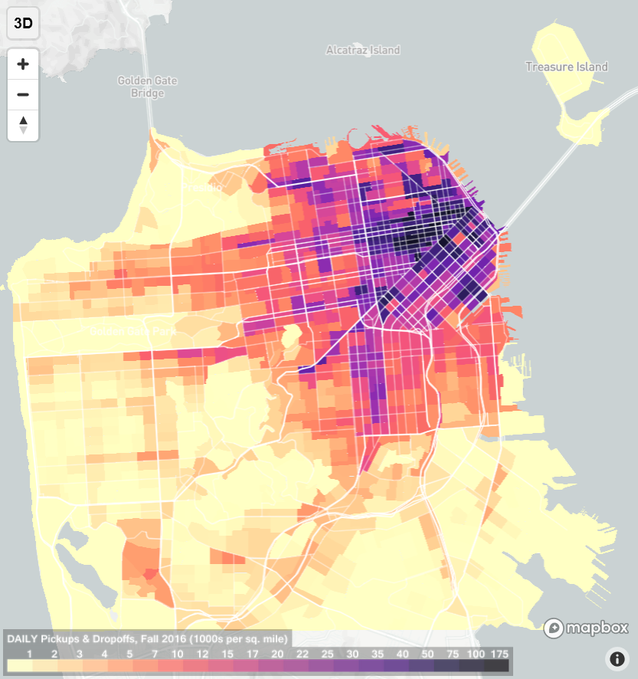
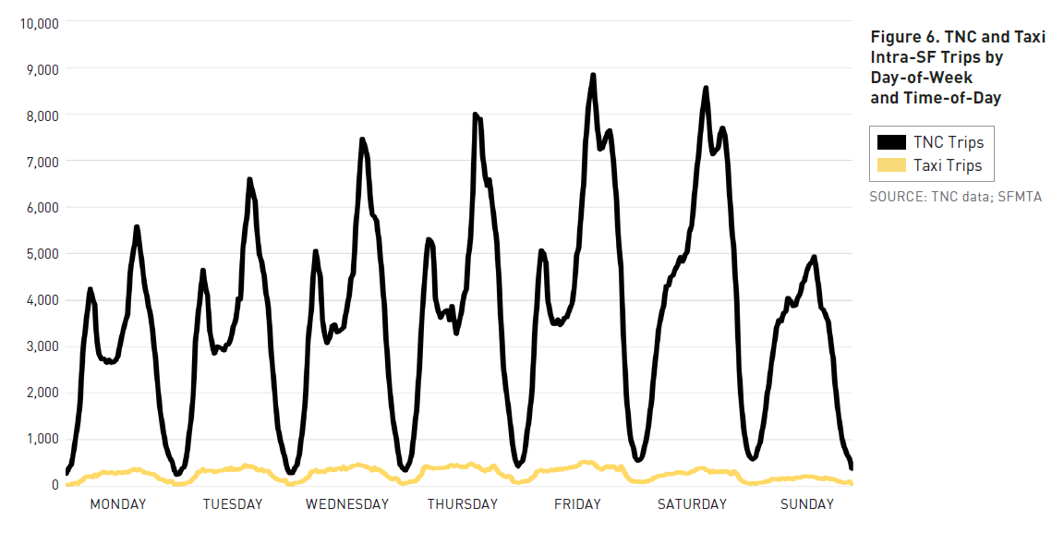
TNC Data – Fall 2016
170,000 average weekday TNC trips w/i SF
Concentrated downtown
2.6 mile average length
Bi-modal time-of-day distribution
20% deadhead VMT
70% of drivers from outside SF
Tncstoday.sfcta.org

Slide 8
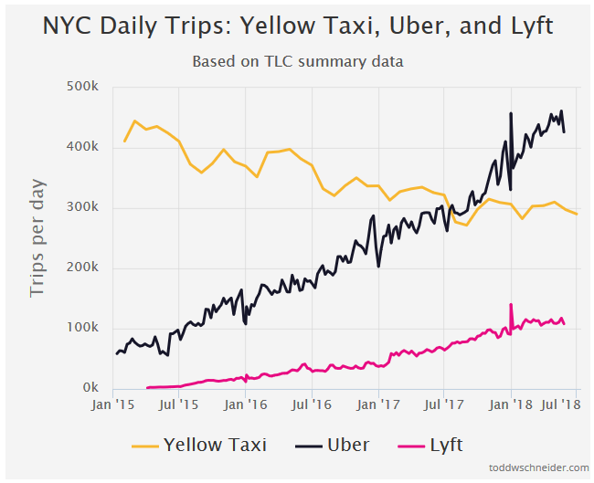
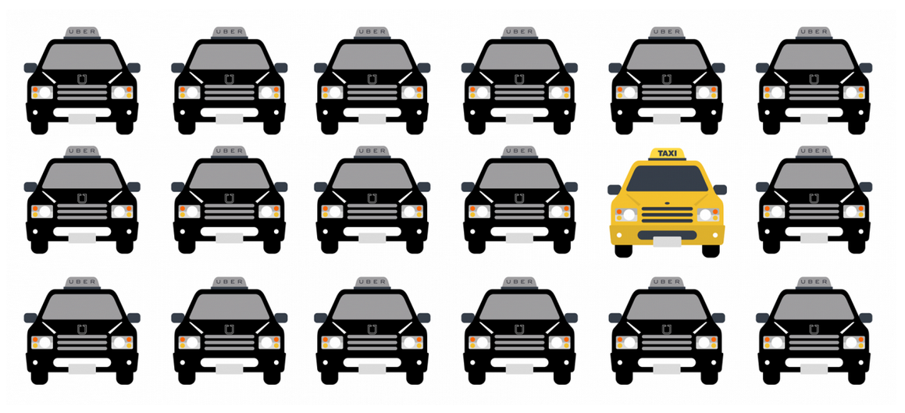
TNCs are big in the same places as transit, and often among the same travelers
San Francisco
15% of intra-SF vehicle trips
12 times the number of taxis
New York
Exceeded taxis in 2016
60,000 to almost 600,000 from 2015 to 2018
Schaller 2018; Feigon and Murphy 2016, 2018; Gehrke et al. 2018; Fehr and Peers 2019; Zhang and Zhang 2018

Slide 9
But, these relationships do not establish the effect on transit ridership in either direction.
To discern the two, we can consider the change in transit ridership.

Slide 10
Research design & hypotheses
Before & After: Compare ridership by stop and time-of-day in 2010 when TNCs were negligible to 2015/2016 when we have data, controlling for changes in service level, population, employment, etc.
If TNCs increase transit ridership, ridership will be higher than otherwise predicted.
If TNCs decrease transit ridership, ridership will be lower than otherwise predicted. That gap will be larger for stops proximate to high levels of TNC pick-ups and drop-offs.

Slide 11
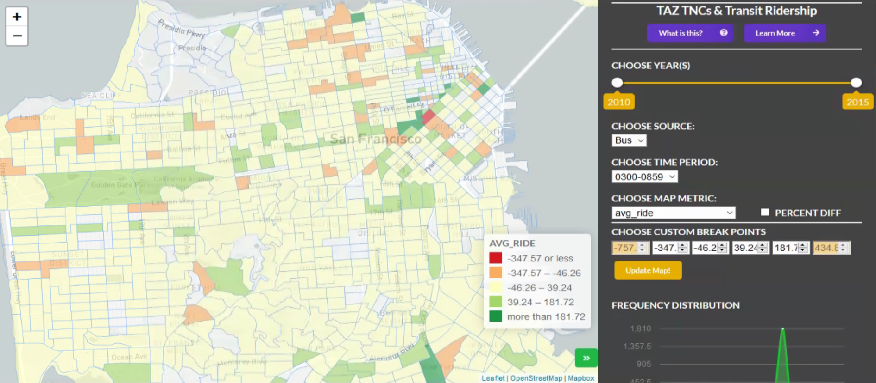
Data
Automated passenger counters (APCs)
GTFS (transit schedules)
Population & Employment
American Community Survey
TNC pick-up and drop-off locations

Slide 12
Method
Transit “direct-demand” model -- fixed-effects panel model of transit boardings/alightings in each TAZ.
Confirm result with a time-series model using monthly ridership.

Slide 13
Panel Model of Muni Bus & Rail Ridership

Slide 14
Time-Series Model of Muni Bus Ridership

Slide 15
Contributions to Change in MUNI Ridership

Slide 16
Contributions to Change in MUNI Bus Ridership over Time

Slide 17
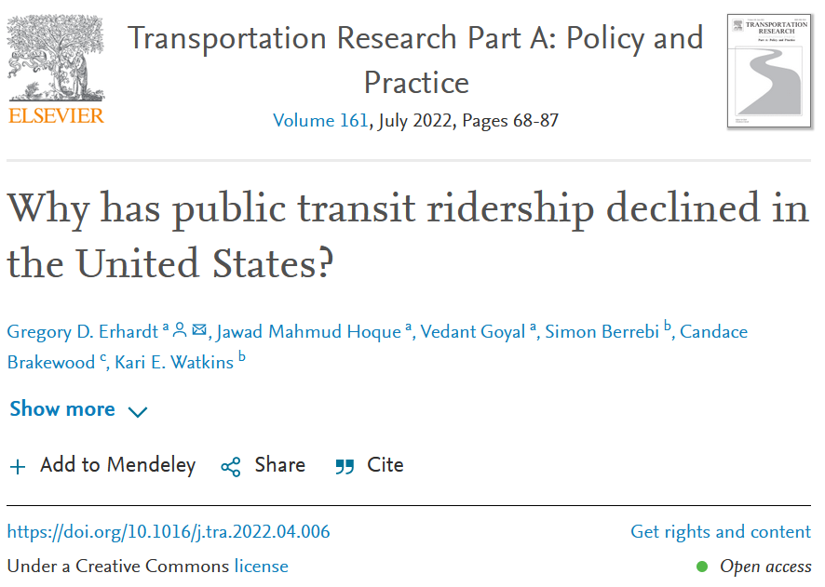
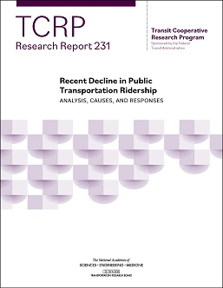
Do we see similar effects elsewhere?
In other research, we consider the change in bus and rail ridership in each of 215 MSAs annually from 2012-2018. We relate this to the introduction of ride-hailing and to changes in gas price, service, land use and other control factors.

Slide 18
Change in transit ridership attributable to new competing modes
Large MSAs
Mid-Sized MSAs
Small MSAs
Effect on bus ridership
“Ride-hailing is the biggest contributor to transit ridership decline over this period, reducing bus ridership by 10%. Ride-hailing’s effect on rail varies by metropolitan area size: it has little effect on rail ridership in the largest metropolitan areas but decreases rail ridership 10% in mid-sized metropolitan areas.”
Effect on rail ridership
Watkins et al 2021 “Recent Decline in Public Transportation Ridership: Analysis, Causes, Responses”, TCRP Report 230

Slide 19
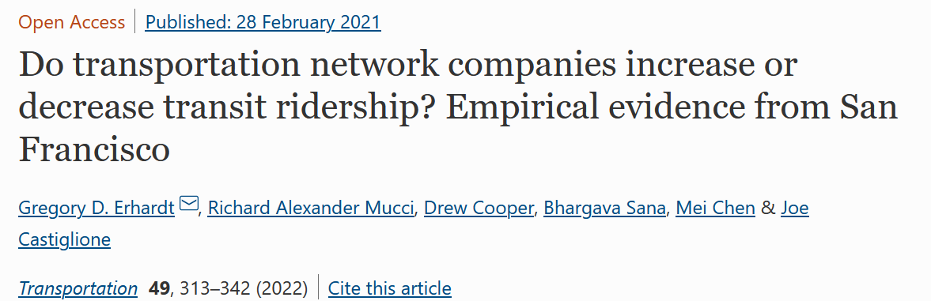
Acknowledgments and Questions
Image from: TNCs and Congestion, SFCTA
Notes:
Move beyond defining the problem
Develop the solution
Articulate markets transit can best serve in competitive environment
Equip with tools

