Slide 1
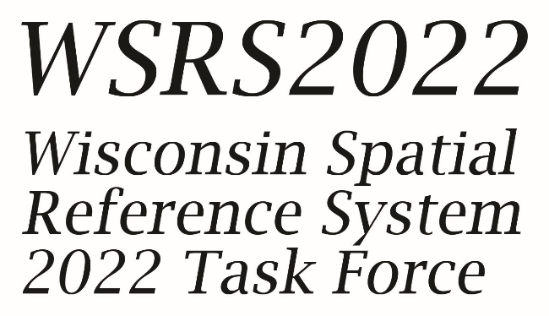
Preparing for the 2022 Datums:
A Statewide Task Force and DOT Perspective
2020 Summer Virtual Meeting
Transportation Research Board
AKD70 – Standing Committee on Geospatial Data Acquisition Technologies
2020 Summer Virtual Meeting
August 5, 2020
Richard Kleinmann, PLS
Ayres Associates

Slide 2

Richard Kleinmann, PLS
Project Manager – Geospatial Division
Ayres Associates
Dick has 40 years of surveying experience in both the private and public sectors obtaining his Wisconsin Land Surveyor License in 1985.
He currently serves as a Project Manager in Aerial Mapping Group/Geospatial Division of Ayres Associates.
Dick is active in the geospatial profession serving at the local, state and national level:
Chair of the WSLS Geospatial Committee
Co-Chair of the Wisconsin Spatial Reference System 2022 Task Force (WSRS 2022)
National Society of Professional Surveyors (NSPS) Wisconsin Director
Transportation Research Board (TRB) AKD70 Geospatial Data Acquisition Technologies Committee.
Introduction

Slide 3
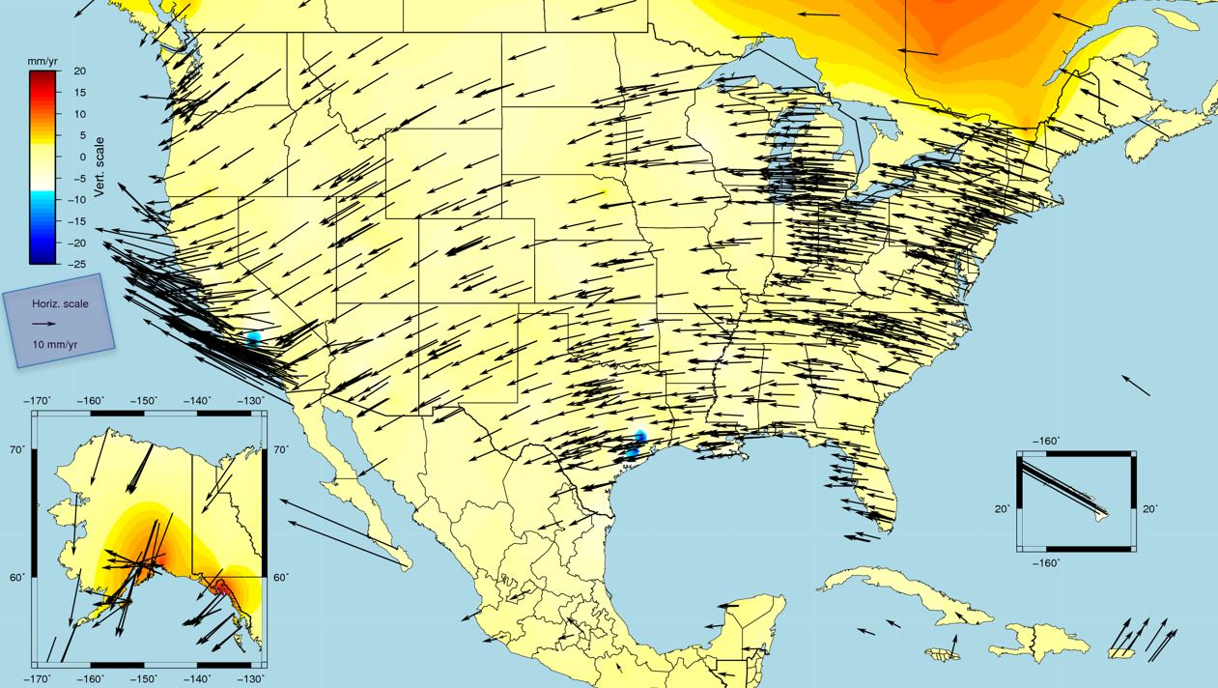
Not about technical details
Is about ramifications and implementation issues
Data stewards & acquisition professionals will need to address and accommodate these issues
Setting the Stage
Background image from NGS Feb 19-21 2020 Dave Zenk presentation to MN Society of Professional Surveyors
Notes:
`

Slide 4
Share one state’s 2022 task force perspective
Encourage data stewards & acquisition professionals to act now!
Get feedback from other states and other DOT’s
Goals
Background image from NGS Feb 19-21 2020 Dave Zenk presentation to MN Society of Professional Surveyors
Notes:
`

Slide 5
What is changing.
How much it is changing.
Coord System ramifications
Task Force response
DOT issues
What you can do to prepare.
Gather Feedback
Overview
Background image from NGS Feb 19-21 2020 Dave Zenk presentation to MN Society of Professional Surveyors
Notes:
`

Slide 6
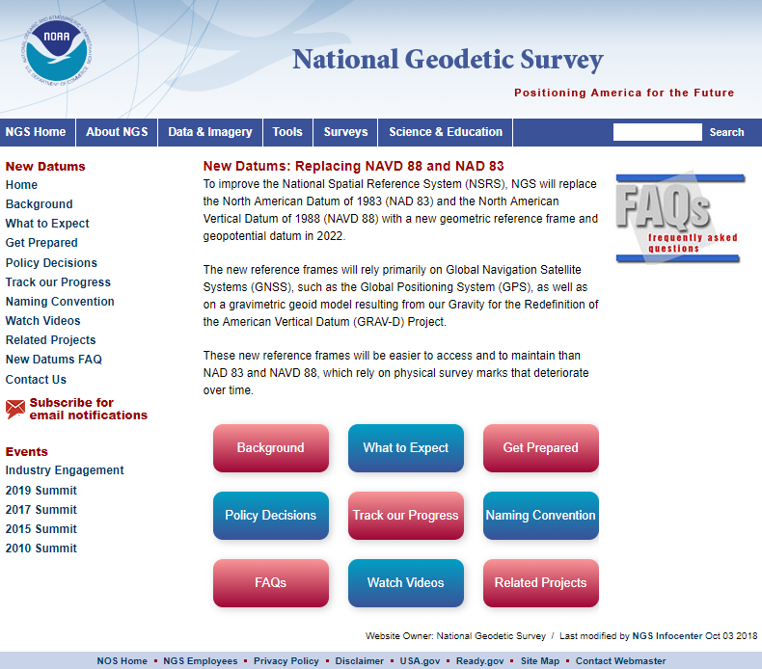

What is Changing?
In case you hadn’t heard,
NEW “DATUMS” ARE COMING!

Slide 7
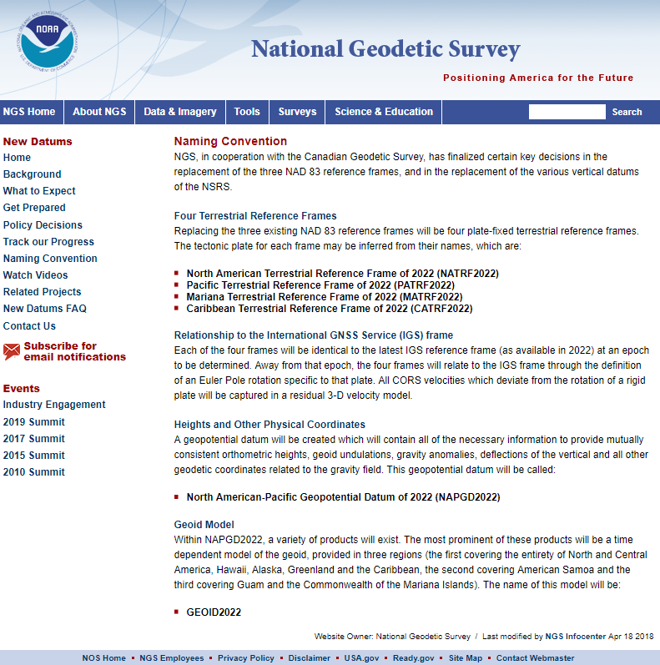
New horizontal reference frame
and new vertical datum & a new geoid.
What is Changing?

Slide 8

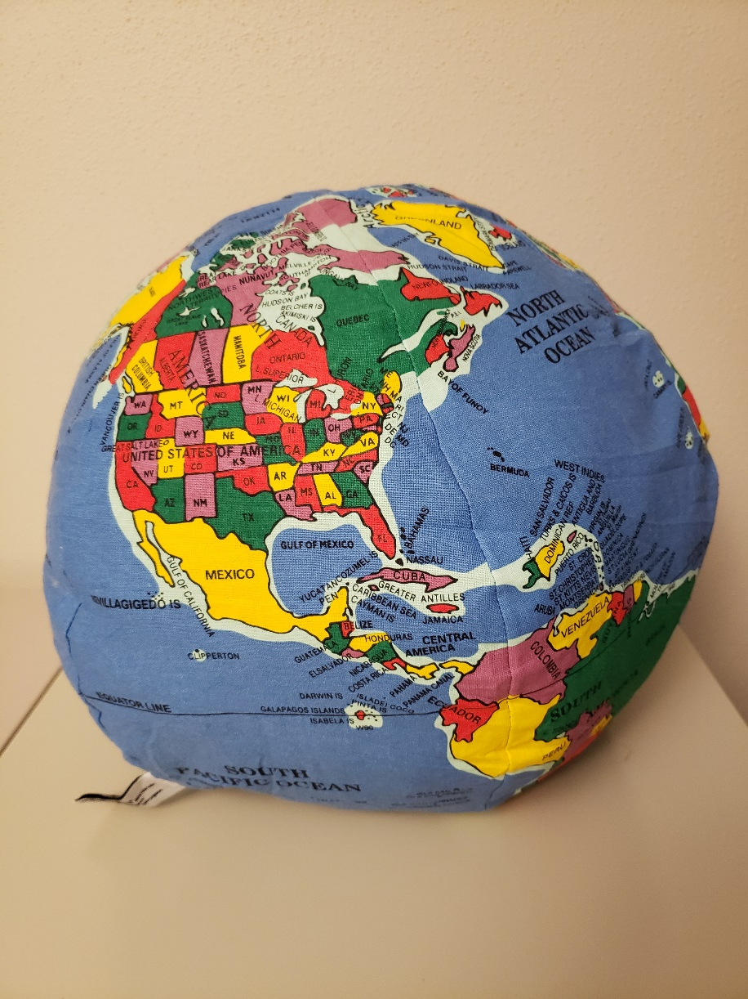
LESS LIKE THIS GLOBE.
Think of the world ….
MORE LIKE THIS PILLOW.
https://morguefile.com/photos/morguefile/2/globe/pop
Notes:
The globe could be thought of as the mathematical surface like the ellipse
The pillow as the actual earths crust always moving horizontally and vertically.
This should give you some appreciation for the math involved in keeping track of locations on the pillow!

Slide 9
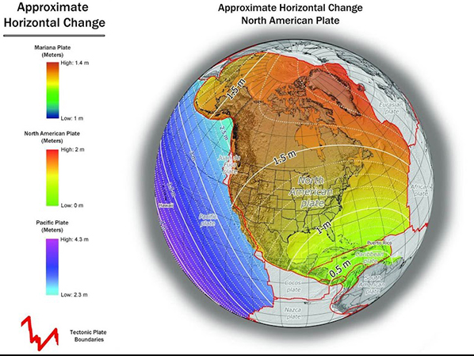
Permission obtained to use NGS images 6-11-2019
How Much?
>1.25 m shift horizontal
(Ellipsoid center shift)

Slide 10
How Much?
Approximate Change in Elevation from NAVD 88 to NAPGD2022
From https://www.ngs.noaa.gov/datums/newdatums/images/Orthometricheights.jpg
Permission obtained to use NGS images 6-11-2019

Slide 11
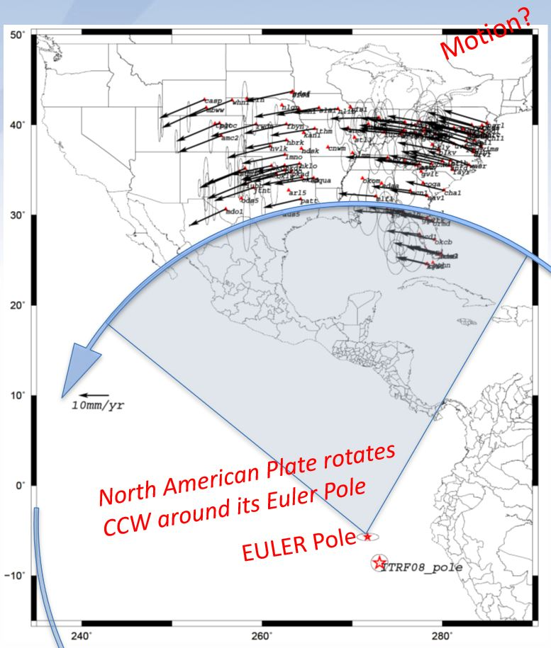
How Plate Motion will be Handled
Coordinates will be time-dependent (epochs) due to movement of crustal plates
Euler-pole model of plate rotation (~3 cm/yr counter-clockwise for Wisconsin)
Intra-Frame Velocity Model (IFVM) to estimate non-rotational movement as well as vertical change
The 4th Dimension:
Time!
Background image from NGS Feb 19-21 2020 Dave Zenk presentation to MN Society of Professional Surveyors permission granted 6-16-2020

Slide 12
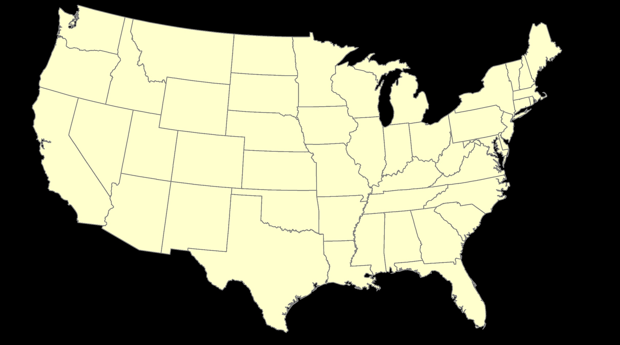
ITRF – constant frame, rotating plate
Slide courtesy of Jeff Jalbrzikowski, NGS Regional Advisor in Ohio via Dave Zenk 6-16-2020

Slide 13
NATRF – rotating frame, constant with plate
Slide courtesy of Jeff Jalbrzikowski, NGS Regional Advisor in Ohio. via Dave Zenk 6-16-2020

Slide 14
ITRF or NATRF – your choice, just use EPP
If we align the Grids at say 2020.00, then allow time to pass, we can see changing coordinates in ITRF, but also convert to/from NATRF at a date of interest!
Slide courtesy of Jeff Jalbrzikowski, NGS Regional Advisor in Ohio.

Slide 15
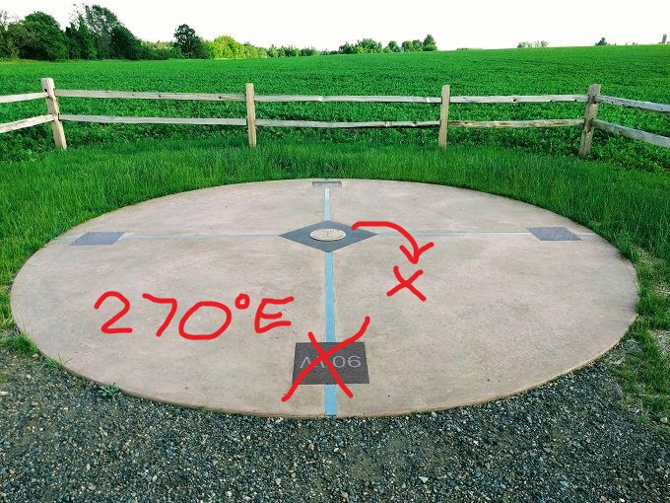
45°N x 90°W Geographic Marker
45°N x 270°E Geographic Marker
The New Normal?
Horizontal
NO MORE NEGATIVE LONGITUDES. ALL POSITIVE EAST.
Marathon County - near Poniatowski, WI

Slide 16
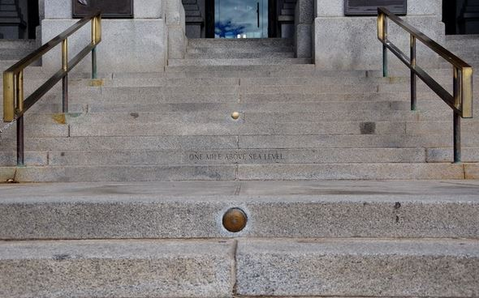
The Mile High Marker Quandary
1969
The New Normal?
Vertical
1909
2003
Years provided by 5280.com
Colorado State Capitol Steps Denver, CO

Slide 17
A Tale of Two Feet
NOAA, NIST prepare to drop U.S. survey foot and adopt the international survey foot in a move towards more precise positioning.
The New Normal?
Units

Slide 18
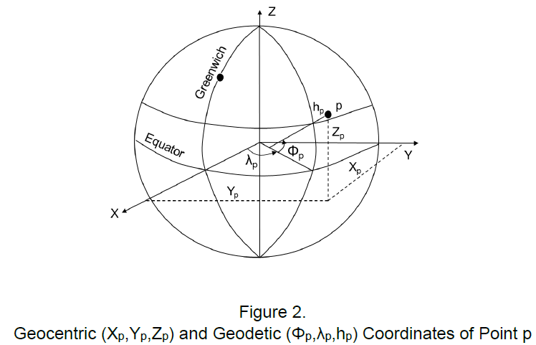
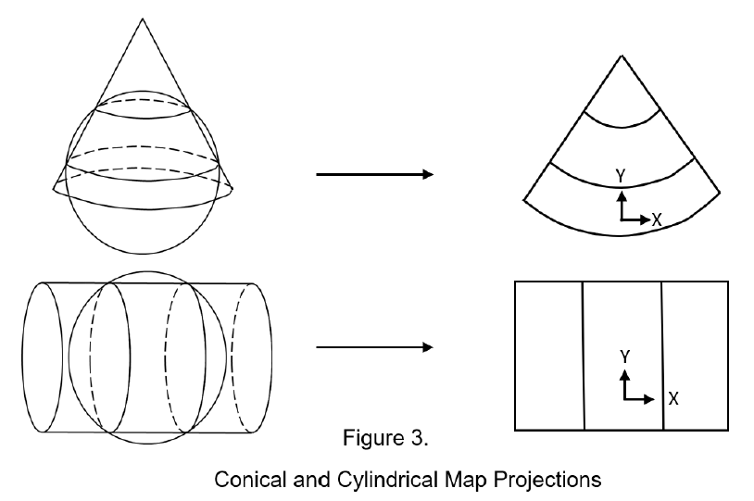
DATUMS
Mathematical defined model of the size and shape of the earth.
PROJECTIONS (Lambert Conformal Conic & Transverse Mercator)
Different Issues
RECTANGULAR COORDINATE
SYSTEMS
Graphics from: The New 2022 Datums: A Brief Book Dr. Alan Vonderohe 2019

Slide 19
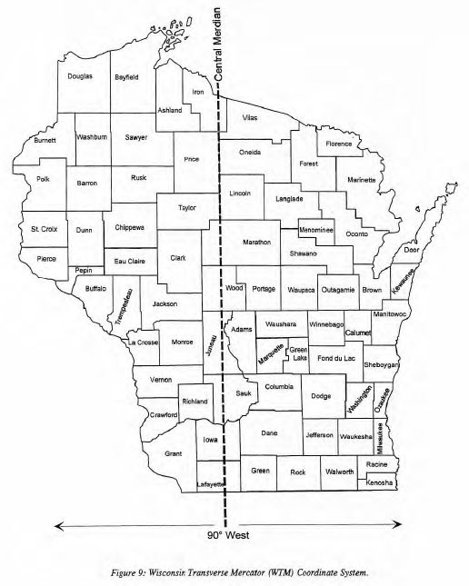
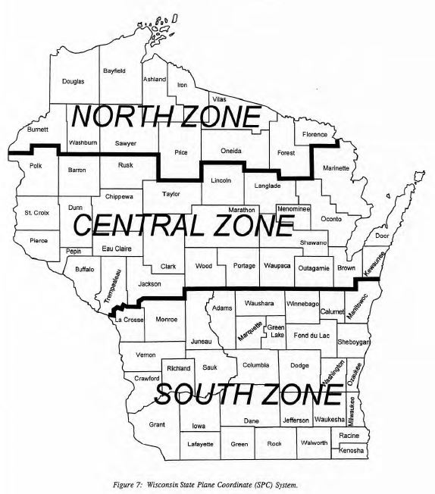
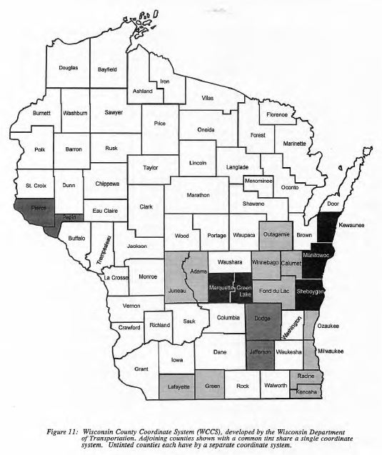
Since coordinate systems are referenced to datums
the coordinate systems will also change along with
intentional shifts to reduce confusion with old systems.
Coordinate Systems

Slide 20
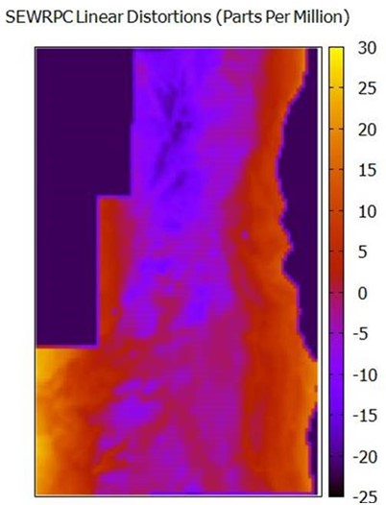
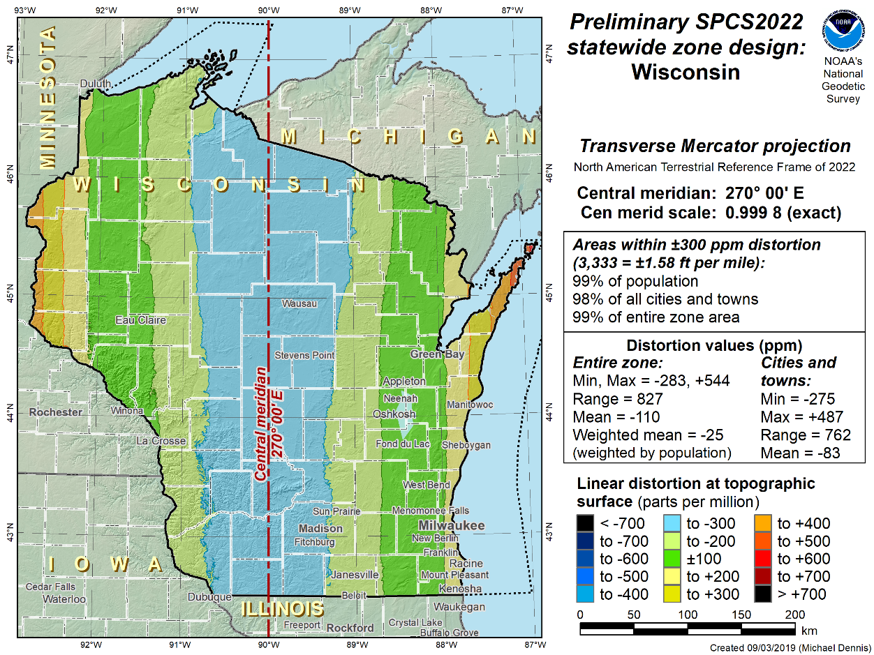
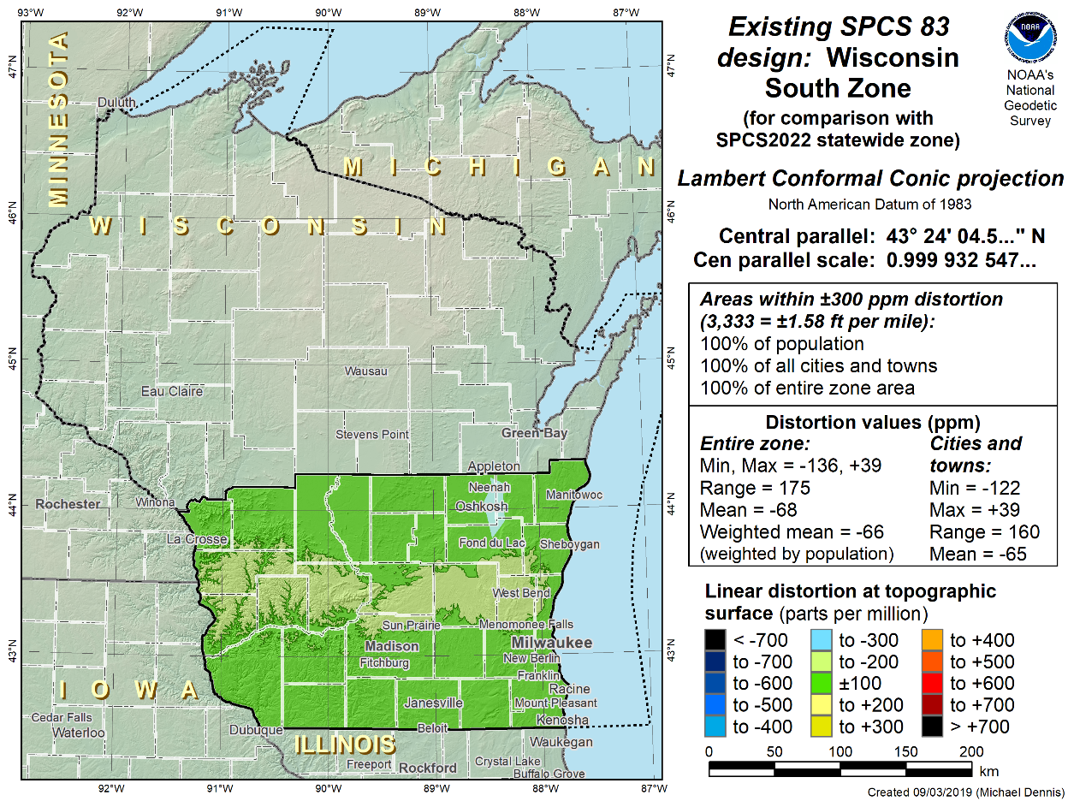
Example Issues:
Coord Sys Design
Balancing User Linear Distortion Level Wish List with NGS SPCS Policies Allowing Only Two Statewide Layers

Slide 21
The Wisconsin geospatial community has decided to
move forward with just two coordinate system
layers.
Example Issues:
Coordinate System Layers

Slide 22
The Wisconsin geospatial community has decided to
move forward with just two coordinate system
layers.
The classic 3 zone State Plane Coordinate System will not be included in the NGS eco-system.
Example Issues:
Coordinate System Layers

Slide 23
How Wisconsin is Getting Ready
In 2018 WSLS Board voted to create Task Force to explore implications of new reference frame
Organized under WSLS’s Geospatial Committee
Members represent cross-section of Wisconsin geospatial community including public & private sector, Surveying & GIS professionals, software, hardware, RPC’s and utility companies
Goal is to ensure Wisconsin is prepared for the new reference frame
Howard Veregin, State Cartographer,
Task Force Chair
Richard Kleinmann, chair of WSLS
Geospatial Committee, is Co-Chair
WSRS 2022

Slide 24
WSRS 2022 Organizational Structure
Technical Focus Group
Legislative Focus Group
Education and Outreach Focus Group
Software/Hardware Focus Group
Implementation and Adoption Focus Group
Funding Focus Group
WSRS 2022

Slide 25
WSRS 2022 won’t fix everyone’s
specific problems, but it
IS here to:
Facilitate
Coordinate
Educate
WSRS 2022

Slide 26
Technical Focus Group Goals:
Ensure decisions are technically sound and based on geodetic principles.
Response to NGS request for input on the State Plane Coordinate System redesign.
Design of 2022 version of Wisconsin Coordinate Reference System WISCRS.
Identify gaps in existing conversion software available
Identify impacts of elimination of US Survey Foot
Identify impacts of new vertical datum.
Provide guidance to education and outreach efforts.
Practical Issues: Technical

Slide 27
Legislative Focus Group Goals:
Find all statutory references to datums.
Identify impacts on state and local legislation and ordinances.
Develop resources to educate local and regional government organizations.
Develop example language for statutes and codes
Develop a timeline to fit legislative calendars. This is critical because of long lead times to enact legislation.
Practical Issues: Legislative

Slide 28
Education and Outreach Focus Group Goals:
“Spread the word” and educate the geospatial community
Act as our PR group
Educate software vendors, developers, surveyors, utilities, GIS practitioners, educators, and students.
Group is made up of both educators and users/practitioners to bring both sides of the education equation together.
Practical Issues: Education & Outreach

Slide 29
Software/Hardware Focus Group Goals:
Ensure Wisconsin’s version of the new reference system is incorporated into hardware and software
Register new/modified Wisconsin coordinate systems with EPSG.
Work with NGS to include Wisconsin’s new systems are incorporated into publications and transformation software
Monitor and coordinate with NGS national effort to assist software and hardware vendors.
Practical Issues:
Software & Hardware

Slide 30
Implementation and Adoption Focus Group Goals:
Identify implementation and adoption issues
Identify workflows and procedures that will be prone to errors during migration.
Encourage organizations to populate missing metadata for existing data sets.
Develop best practices for transforming current data.
Work with WisDOT regarding WISCORS VRS system migration.
Coordinate with NGS regarding their plan for CORS migration.
Identify timing of federal agencies (USGS, FEMA) migration
Practical Issues:
Implementation & Adoption

Slide 31
Funding Focus Group Goals:
Investigate funding options/sources for local/county/regional/state data conversion.
Develop level of effort for different kinds of data to identify the magnitude of funding required.
Practical Issues:
Funding

Slide 32
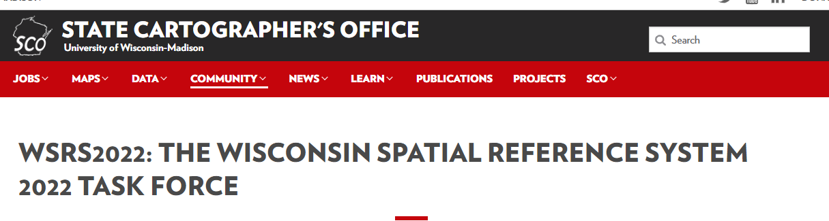
WSRS 2022 Web Site
WSRS 2022
https://www.sco.wisc.edu/community/wsrs2022/

Slide 33
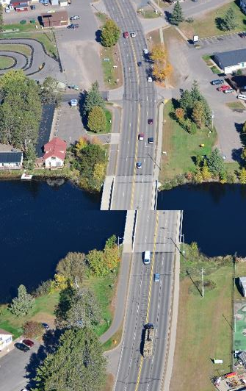
Everyone thinks about this kind of image when they think about bad data or bad surveying.
But what is more likely to happen is you design budget will be busted by early assumptions about available base data or existing survey data from previous projects.
After the budget is set and the design work begins you find out that each data source is based on a different datum and or coordinate system.
This will result in extra effort and busted budgets!
Transportation Issues:
Busted Project Budgets

Slide 34
Several States and private entities run GNSS Virtual Reference Systems that simplify GNSS surveying effort.
These systems broadcast GNSS corrections/positions in specific datums and adjustments.
If a VRS changes mid project “stuff” happens!
When are you going to adopt the new datums?
Can Your VRS broadcast in two datums?
Transportation Issues:
Virtual Reference Systems

Slide 35
DOT’s are large complex organizations.
3 levels of data, Planning, Project Design & Statewide Asset Management/GIS
Each is its own animal with its own issues
Adoption and conversion will need to be coordinated
Transportation Issues:
Planning, Design, Asset Management/GIS

Slide 36
Manuals will need to be revised
Standard specification will be affected
Workflow will need to be developed for conversions
Transportation Issues:
Manuals, Standards and Work Flows

Slide 37
Project Life Cycles tend to be very long.
Available external base data may need conversion
Early internal legacy data may need converting
Historic data may not be useable
These differences are much larger than previous “adjustments” that may have been ignored in the past
Transportation Issues:
Long Project Life Cycles

Slide 38
Different Implementation Schedules:
Federal
State
County
Metropolitan & Regional Planning Organizations
Cities
Tollway Authorities
Transportation Issues:
Inter government/agency

Slide 39
The future of autonomous navigation will depend on your past data acquisition efforts!
Onboard sensors provide close proximity awareness, but we don’t want to waste onboard CPU resources resolving three-foot data alignment errors!
Transportation Issues:
The Future

Slide 40
You Can Start Now!
How can you prepare?

Slide 41
Metadata! ----------Data about Data-----------
Much of the digital data out there lacks current or correct metadata.
NOW would be a good time to take inventory of your data and fix metadata issues.
Ensure all current contracts require metadata reports as a deliverable NOW.
Ensure all current contract specifications NOW cite full and complete references to H & V datum, AND adjustment/realization year NAD83(2011), Geoid year, Coordinate System, Coordinate System Zone, Consider listing the EPSG code, unit of measure (meter, US Survey Foot, Intl Foot etc).
Never accept a coordinate list without the above metadata.
Ensure the metadata is always transmitted with the data.
How can you prepare?

Slide 42
Survey practices to help existing projects convert in the future:
Include and pay for quality project control based on NGS monuments.
Have physical control monuments set throughout the projects including points outside of the anticipated construction zone to ensure they will survive the project.
This control can be used as a physical tie between the old and new project datums and as a check on any automated data conversion.
Collect and record and save raw data observations not just final coordinates.
Consider having the project surveyor deliver the project control in geographic lat/longs and project coordinates or even state plane coordinates if you project uses county coordinates. The idea being have the person most familiar with the data do the conversion now.
Have the surveyor establish benchmarks on vertically stable features to eliminate questions about settling control in poor soils etc.
How can you prepare?

Slide 43
General data: (as budgets allow):
Consider dual deliverables, project coordinates and any other system that may make a future conversion easier. Sometimes it is more efficient to have dual deliverables done now instead of later.
Sometimes it makes sense to move part way from old datums to new datums that will be supported in data conversion software.
Consider that not all data has to be converted to the same degree of digital usefulness. Maybe some hard copy data just gets scanned or some digital raster data just gets moved with a simple shift to get it “close” and not fully transformed and rotated.
How can you prepare?

Slide 44

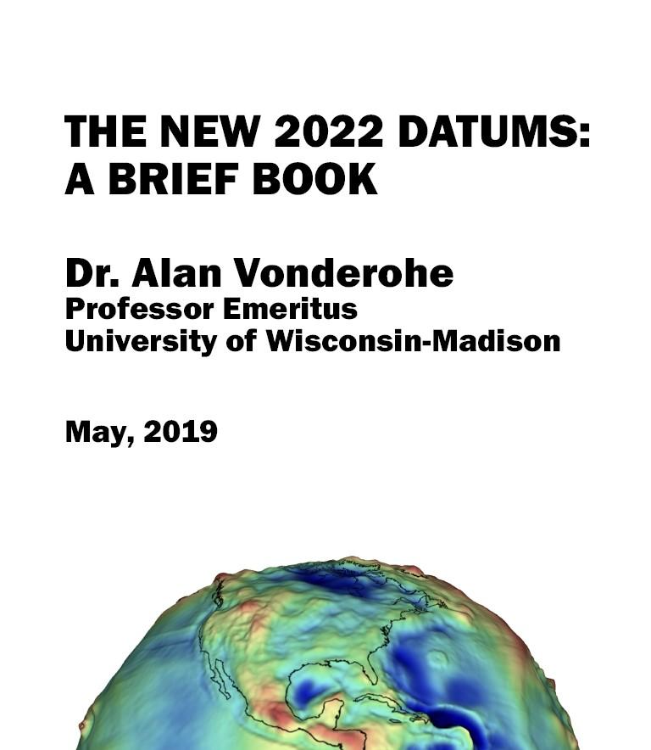
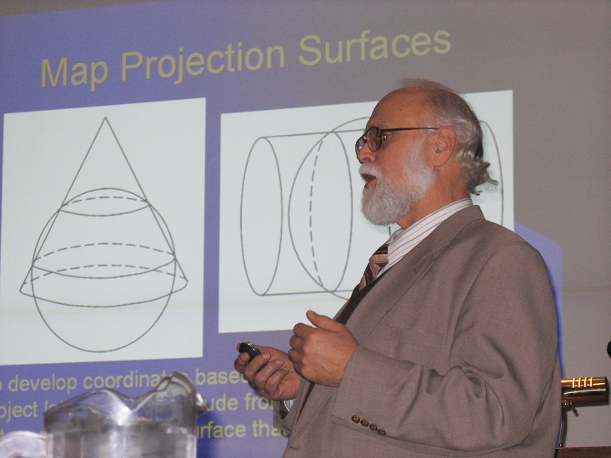
https://www.sco.wisc.edu/pubs/the-new-2022-datums-a-brief-book/
Technical Resources:
Dr. Vonderohe is the person who lead the redesign of the Wisconsin County Coordinate Systems in 2006.

Slide 45
All the people & organizations volunteering to the WSRS 2022 Task Force effort.
Thank You!

Slide 46
As Co-Chair of the WSRS 2022 Task Force I would appreciate your feedback and for you to share your experiences.
Q & A

Slide 47
Contact Information:
Richard Kleinmann
Ayres Associates
N17 W24222 Riverwood Drive, Suite 310
Waukesha, WI 53188-1132
KleinmannR@AyresAssociates.com
262-305-4619
Dick’s Contact Info

